Slide 1

Linux Kernel space

Slide 2
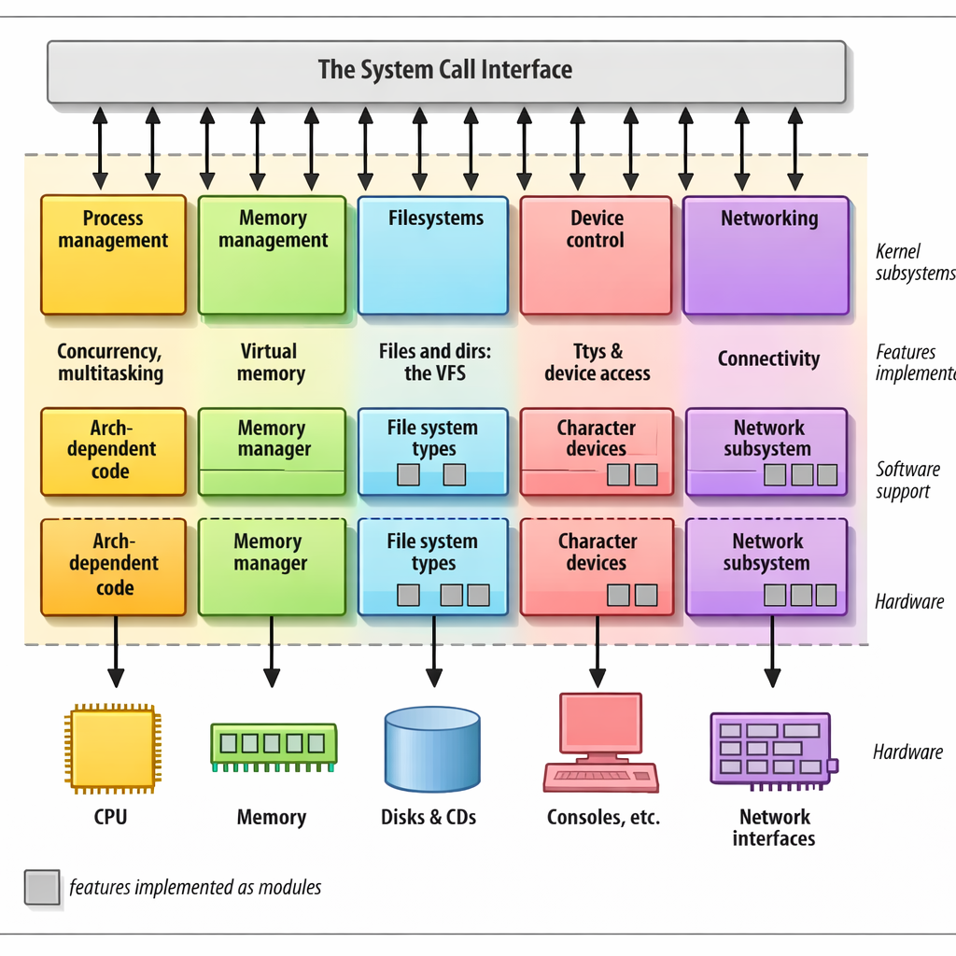
Components of the Kernel

Slide 3
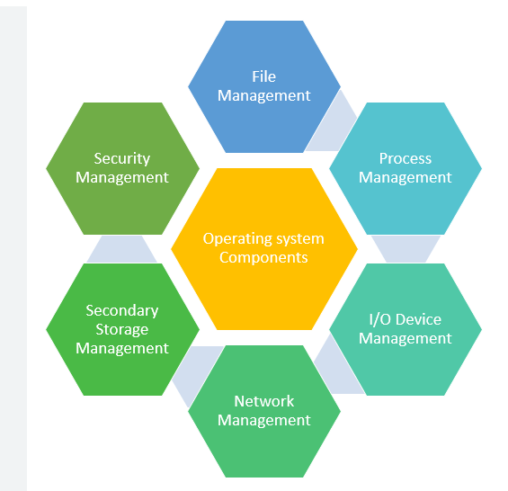
Components of OS

Slide 4
Components of OS
In a Linux system, several concurrent processes attend to different tasks. Each process asks for system resources, be it computing power, memory, network connectivity, or some other resource. The kernel is the big chunk of executable code in charge of handling all such requests. Although the distinction between the different kernel tasks isn’t always clearly marked, the kernel’s role can be split (as shown in Figure) into the following parts:
Process management:
The kernel is in charge of creating and destroying processes and handling their connection to the outside world (input and output). Communication among different processes (through signals, pipes, or inter process communication primitives) is basic to the overall system functionality and is also handled by the kernel. In addition, the scheduler, which controls how processes share the CPU, is part of process management.
Memory management:
The computer’s memory is a major resource, and the policy used to deal with it is a critical one for system performance. The kernel builds up a virtual addressing space for any and all processes on top of the limited available resources. The different parts of the kernel interact with the memory-management subsystem through a set of function calls, ranging from the simple malloc/free pair to much more complex functionalities

Slide 5
File systems:
Linux is heavily based on the file system concept; almost everything in Linux canbe treated as a file. The kernel builds a structured file system on top of unstructured hardware, and the resulting file abstraction is heavily used throughout the whole system. In addition, Linux supports multiple file system types, that is, different ways of organizing data on the physical medium. For example, disks may be formatted with the Linux-standard ext3 file system, the commonly used FAT File system or several others.
Device control:
Almost every system operation eventually maps to a physical device. With the exception of the processor, memory, and a very few other entities, any and all device control operations are performed by code that is specific to the device being addressed. That code is called a device driver. The kernel must have embedded in it a device driver for every peripheral present on a system, from the hard drive to the keyboard and the tape drive.
Networking:
Networking must be managed by the operating system, because most network operations are not specific to a process: incoming packets are asynchronous events. The packets must be collected, identified, and dispatched before a process takes care of them. The system is in charge of delivering data packets across program and network interfaces, and it must control the execution of programs according to their network activity. Additionally, all the routing and address resolution issues are implemented with in the kernel.

Slide 6
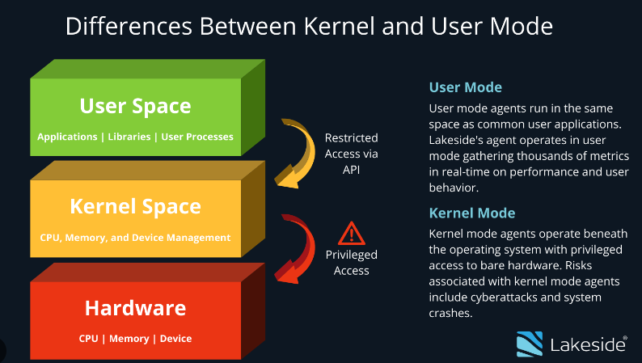
User Mode vs Kernel Space

Slide 7
User space and Kernel space
Some operating systems, such as MS-DOS, always execute in a single CPU mode, but UNIX-like operating systems use dual modes to effectively implement time-sharing. On a Linux machine, the CPU is either in a trusted kernel mode or in a restricted user mode.
All user processes execute in user mode, whereas the kernel itself executes in kernel mode. Kernel mode code has unrestricted access to the entire processor instruction set and to the full memory and I/O space. If a user mode process needs these privileges, it has to channel requests through device drivers or other kernel mode code via system calls.
User mode code is allowed to page fault, however, whereas kernel mode code isn't.
A module runs in kernel space, whereas applications run in user space. This concept is at the base of operating systems theory.

Slide 8
We usually refer to the execution modes as kernel space and user space. These terms encompass not only the different privilege levels inherent in the two modes, but also the fact that each mode can have its own memory mapping — its own address space — as well.
Linux transfers execution from user space to kernel space whenever an application issues a system call or is suspended by a hardware interrupt. Kernel code executing a system call is working in the context of a process—it operates on behalf of the calling process and is able to access data in the process’s address space. Code that handles interrupts, on the other hand, is asynchronous with respect to processes and is not related to any particular process.

Slide 9
Types of Devices
The Linux way of looking at devices distinguishes between three fundamental device types. Each module usually implements one of these types, and thus is classifiable as a char module, a block module, or a network module.
Character devices:
A character (char) device is one that can be accessed as a stream of bytes (like a file); a char driver is in charge of implementing this behaviour. Such a driver usually implements at least the open, close, read, and write system calls.
The text console (/dev/console) and the serial ports (/dev/ttyS0 and friends) are examples of char devices, as they are well represented by the stream abstraction.
Char devices are accessed by means of file system nodes, such as /dev/tty1 and /dev/lp0.
The only relevant difference between a char device and a regular file is that you can always move back and forth in the regular file, whereas most char devices are just data channels, which you can only access sequentially

Slide 10
Block devices:
Like char devices, block devices are accessed by file system nodes in the /dev directory.
A block device is a device (e.g., a disk) that can host a file system. In most Unix systems, a block device can only handle I/O operations that transfer one or more whole blocks, which are usually 512 bytes (or a larger power of two) bytes in length.
Linux, instead, allows the application to read and write a block device like a char device—it permits the transfer of any number of bytes at a time. As a result, block and char devices differ only in the way data is managed internally by the kernel, and thus in the kernel/driver software interface.

Slide 11
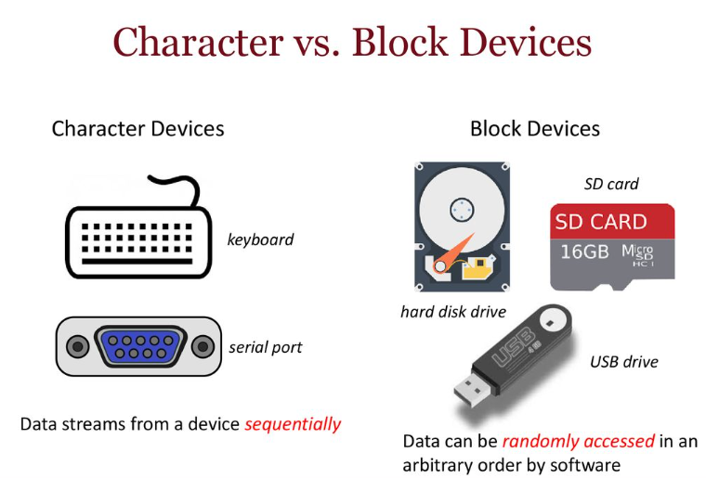

Slide 12
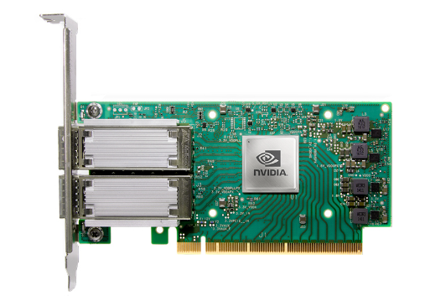
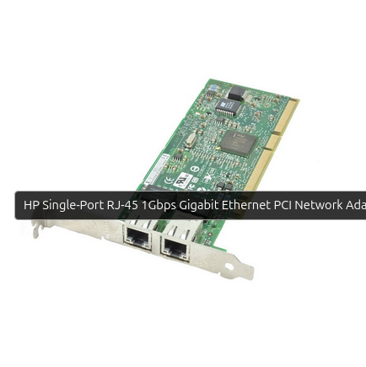
Network interfaces:
Any network transaction is made through an interface, that is, a device that is able to exchange data with other hosts. Usually, an interface is a hardware device, but it might also be a pure software device, like the loopback interface. A network interface is in charge of sending and receiving data packets, driven by the network subsystem of the kernel, without knowing how individual transactions map to the actual packets being transmitted..
A network driver knows nothing about individual connections; it only handles packets. Not being a stream-oriented device, a network interface isn’t easily mapped to a node in the filesystem, as /dev/tty1 is. The Unix way to provide access to interfaces is still by assigning a unique name to them (such as eth0), but that name doesn’t have a corresponding entry in the filesystem.
Communication between the kernel and a network device driver is completely different from that used with char and block drivers. Instead of read and write, the kernel calls functions related to packet transmission.

Slide 13
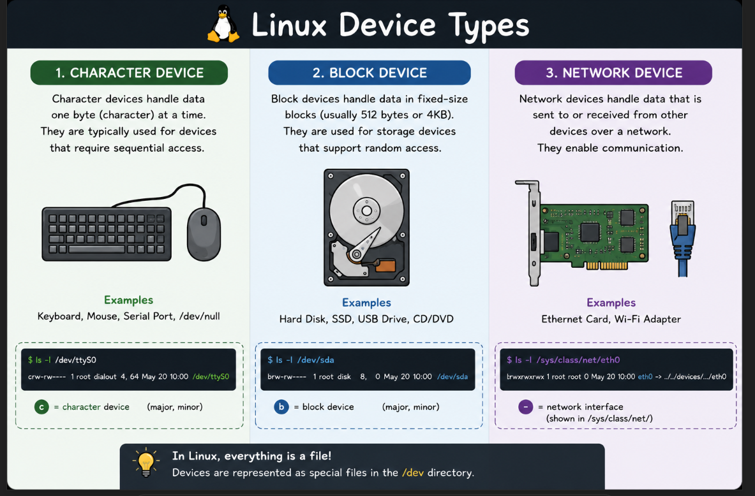

Slide 14
There are other ways of classifying driver modules that are orthogonal to the above
device types. In general, some types of drivers work with additional layers of kernel
support functions for a given type of device. For example, one can talk of universal
serial bus (USB) modules, serial modules, SCSI modules, and so on. Every USB device is driven by a USB module that works with the USB subsystem, but the device itself shows up in the system as a char device (a USB serial port, say), a block device (a USB memory card reader), or a network device (a USB Ethernet interface).

