Slide 1
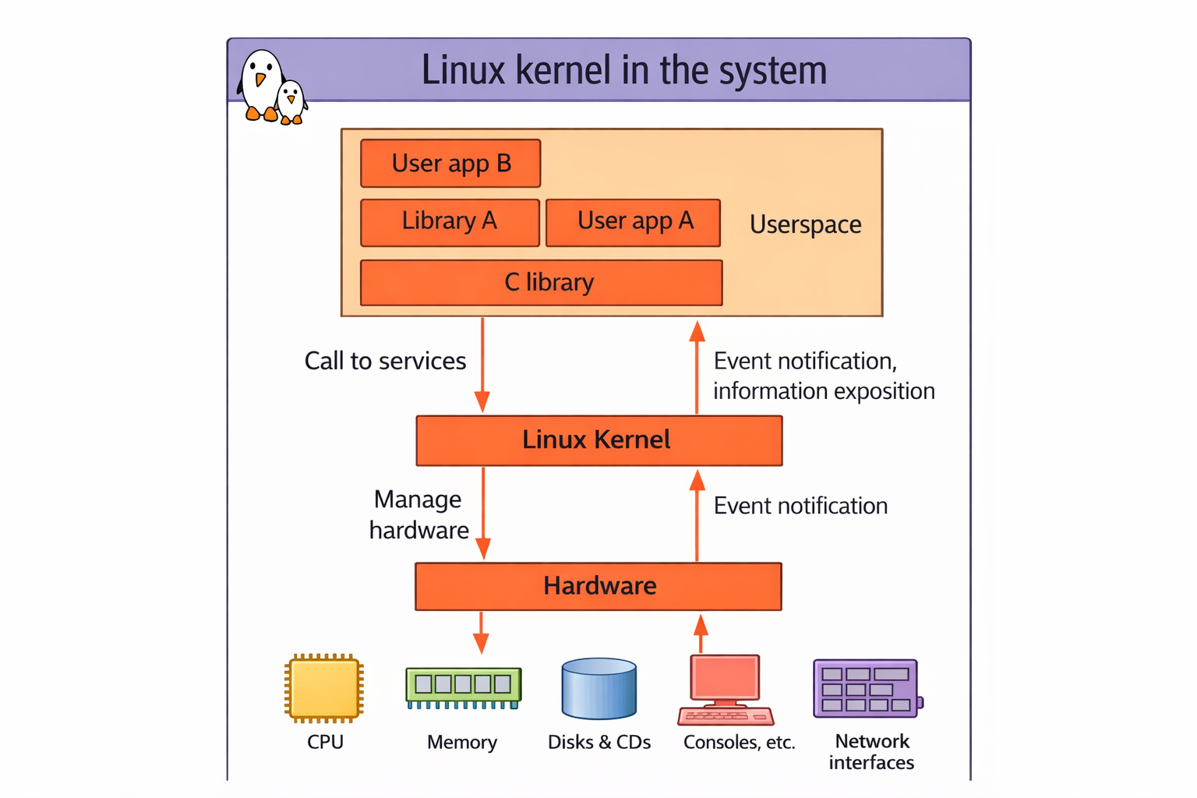

Slide 2

Kernel Development on x86 platform
The Linux kernel development requires following steps:
•Selecting kernel
•Configuring kernel
•Compiling kernel
•Installing the kernel

Slide 3
vector@vector:~$ curl -L https://www.kernel.org/finger_banner
The latest stable version of the Linux kernel is: 6.18.2
The latest mainline version of the Linux kernel is: 6.19-rc2
The latest stable 6.18 version of the Linux kernel is: 6.18.2
The latest stable 6.17 version of the Linux kernel is: 6.17.13 (EOL)
The latest longterm 6.12 version of the Linux kernel is: 6.12.63
The latest longterm 6.6 version of the Linux kernel is: 6.6.119
The latest longterm 6.1 version of the Linux kernel is: 6.1.159
The latest longterm 5.15 version of the Linux kernel is: 5.15.197
The latest longterm 5.10 version of the Linux kernel is: 5.10.247
The latest longterm 5.4 version of the Linux kernel is: 5.4.302 (EOL)
The latest linux-next version of the Linux kernel is: next-20251219

Slide 4
wget --https-only -O ~/Downloads/linux-6.4.2.tar.xz
https://mirrors.edge.kernel.org/pub/linux/kernel/v6.x/linux-6.4.2.tar.xz
sudo apt-get install git fakeroot build-essential ncurses-dev xz-utils libssl-dev bc flex libelf-dev bison
Linux Source version control system git:
You can use Git to obtain a copy of the latest “pushed” version of Linus’s tree:
$ git clone --depth=3
https://git.kernel.org/pub/scm/linux/kernel/git/torvalds/linux.git
When checked out, you can update your tree to Linus’s latest:
$ git pull
rama@rama-Inspiron-3501:~$ uname -r
5.14.0-1056-oem
Major # (or w): 5
Minor # (or x): 14
[patchlevel] (or y): 0
[-EXTRAVERSION] (or -z): -1056-oem
tar xf ~/Downloads/linux-5.4.tar.xz
Use cregit-Linux to view kernel source code

Slide 5
▶The Linux kernel is licensed under the GNU General Public License version 2
• This license gives you the right to use, study, modify and share the software freely
▶However, when the software is redistributed, either modified or unmodified, the
GPL requires that you redistribute the software under the same license, with the
source code
• If modifications are made to the Linux kernel (for example to adapt it to your
hardware), it is a derivative work of the kernel, and therefore must be released under
GPLv2.
User space device drivers:
The kernel provides some mechanisms to access hardware from userspace:
• USB devices with libusb, https://libusb.info/
• SPI devices with spidev, spi/spidev
• I2C devices with i2cdev, i2c/dev-interface
• GPIOs with libgpiod, https://libgpiod.readthedocs.io
• Memory-mapped devices with UIO, including interrupt handling,
driver-api/uio-howto
Lab activity:
▶ Explore kernel sources manually
▶ Use automated tools to explore the source code

Slide 6
The Kernel Source
1. arch - This sub directory contains all of the architecture specific code
for each supported architecture (MIPS, ARM, 386 and so on), there
is sub directory under "arch". Each supported architecture sub directory
has four major sub directories:
kernel - which contains the architecture specific kernel cod
mm - which contains the architecture specific memory mgmt code.
lib - which contains architecture specific library code (vsprintf…)
target platform directory - which contains platform specific code
Note: Linux ports to processors without memory management units
(MMU) are also available. The kernel has access to neither the
C libray nor the standards C Headers.
Core kernel subsystem: the code here deals with process/thread life cycle, CPU scheduling, locking, cgroups, timers, interrupts, signaling, modules, tracing, and more.

Slide 7
block:This primarily contains the implementation of I/O scheduling algorithms
for block storage devices. The underlying (to the VFS/FS) block I/O code path.
It includes the code implementing the page cache, a generic block IO
layer, IO schedulers, and so on.
crypto:This directory implements cipher operations and the cryptographic API,
used, for example, by some WiFi device drivers for implementing encryption
Algorithms. Kernel level implementation of ciphers kernel API to serve consumers
that require cryptography services.
Documentation:This directory has brief descriptions of various kernel
subsystems. This can be your first stop to dig for answers to kernel-related
queries.
drivers - Device drivers for numerous device classes and peripheral controllers
reside in this directory. The device classes include character, serial,
Inter-Integrated Circuit(I2C), Personal Computer Memory Card International
Association(PCMCIA), Peripheral Component Interconnect (PCI), Universal
Serial Bus (USB), video, audio, block, Integrated Drive Electronics (IDE), Small
Computer System Interface (SCSI), CD-ROM, network adapters, Asynchronous
Transfer Mode (ATM), Bluetooth, and Memory Technology Devices (MTD).
Each of these classes live in a separate sub directory under drivers/. You will, for
instance, find PCMCIA driver sources inside the drivers/pcmcia/ directory and
MTD drivers inside the drivers/mtd/ directory.

Slide 8
fs: This directory contains the implementation of file systems such as EXT3,
EXT4, reiserfs, FAT, VFAT, sysfs, procfs, isofs, JFFS2, XFS, NTFS,
include. Kernel header files live here. Sub directories prefixed with asm cont
headers specific to the particular architecture. So the directory include/asm-x
contains header files pertaining to the x86 architecture, whereas include/asm
holds headers for he ARM architecture.
Init: This directory contains high-level initialization and startup code.
Ipc:This contains support for Inter-Process Communication (IPC) mechanis
such as message queues, semaphores, and shared memory kernel. The archit
Independent portions of the base kernel can be found here.
lib. Library routines such as generic kernel object (kobject) handlers and
Cyclic Redundancy Code (CRC) computation functions stay here.
mm. The memory management implementation lives here.
net. Networking protocols reside under this directory. Protocols implemente
Internet Protocol version 4 (IPv4), IPv6, Internetwork Protocol eXchange (IP
ATM, Infrared, Link Access Procedure Balanced (LAPB), and Logical Link
Scripts: Scripts used during kernel build reside here.
Security: This directory contains the framework for security.
Sound: The Linux audio subsystem is based in this directory.
Usr:This currently contains the initramfs implementation.

Slide 9
IPC The Inter-Process Communication (IPC) subsystem code; covers IPC mechanisms such as (both SysV and POSIX) message queues, shared memory, semaphores, and so on.
Sound The audio subsystem code, also known as Advanced Linux
Sound Architecture (ALSA).
Virt The virtualization (hypervisor) code; the popular and powerful Kernel Virtual Machine (KVM) is implemented here.
Linux Kernl build procedure on X86:
1. https://kernel.org/ -> Download 6.12 kernel
2. tar -xvf linux-6.12.tar.xz -> Un tar file
#Install dependency packages on Ubuntu setup
3. $sudo apt update
$sudo apt install build-essential libncurses-dev bison flex libssl-dev bc

Slide 10
Kernel Configuration
The Linux kernel configuration is usually found in the kernel source
in the file: /xxx/src/linux/.config .
The kernel can be configured using text mode or graphical mode
make config - starts a character based questions and answer session
make menuconfig - starts a terminal-oriented configuration tool (using
ncurses)
make defconfig - This command creates a configuration based on the defaults for your architecture options
make oldconfig: After making changes to your configuration file, or when using an existing configuration file on a new kernel tree, you can validate and update the configuration
$ zcat /proc/config.gz > .config
$ make oldconfig
make olddefconfig
•

Slide 11
Kernel Configuration…
When the kernel configuration runs, it reads the main kernel
configuration file, located in arch/i386/Kconfig.
This configuration file also includes other configuration files as
needed.
For example arch/i386/Kconfig file includes
source “sound/core/Kconfig”
Which includes
source “sound/core/Kconfig”
source “sound/drivers/Kconfig”

Slide 12
Debug Kernel Configurations
CONFIG_DEBUG_INFO
CONFIG_DEBUG_FS (the debugfs pseudo filesystem)
CONFIG_MAGIC_SYSRQ (the Magic SysRq hotkeys feature)
CONFIG_DEBUG_KERNEL
CONFIG_DEBUG_MISC
Memory debugging:
CONFIG_SLUB_DEBUG .
CONFIG_DEBUG_MEMORY_INIT
CONFIG_KASAN : this is the Kernel Address Sanitizer port; however, as of the time of writing, it only works on 64-bit systems
CONFIG_DEBUG_SHIRQ - Shared IRQ
CONFIG_SCHED_STACK_END_CHECK Detect stack corruption on calls to schedule()
Lock debugging:
CONFIG_PROVE_LOCKING : the very powerful lockdep feature to catch locking bugs! This turns on several other lock debug configs as well. Prove locking correctness
CONFIG_LOCK_STAT Lock usage statistics
CONFIG_DEBUG_ATOMIC_SLEEP - Sleep inside atomic section checkin
CONFIG_STACKTRACE - Stack backtrace support
CONFIG_DEBUG_BUGVERBOSE – printk and dmesg options
CONFIG_FTRACE ( ftrace : within its sub-menu, turn on at least a couple of "tracers")
enable/disable function tracing dynamically
CONFIG_BUG_ON_DATA_CORRUPTION - Trigger a BUG when data corruption is detected
CONFIG_KGDB (kernel GDB; optional)
CONFIG_UBSAN - Undefined behaviour sanity checker
CONFIG_EARLY_PRINTK
CONFIG_DEBUG_BOOT_PARAMS
CONFIG_UNWINDER_FRAME_POINTER (selects FRAME_POINTER and CONFIG_STACK_VALIDATION )
CONFIG_FRAME_WARN – High kernel stack usage

Slide 13
Building Kernel
The "make" command (with no arguments) now automatically
(and silently) generates dependency information, compiles the kernel, and compiles any drivers that you have selected for installation as modules.
make:
arch/<arch>/boot/*Image, the final, usually compressed,
kernel image that can be booted. X86 arch bzimage
If bzImage is the actual kernel that we use to boot and initialize the system, then what's vmlinux for? Notice that vmlinux is the uncompressed kernel image. It can be large (even very large, in the presence of kernel symbols generated during a debug build).
make olddefconfig
make -jn , make modules, make modules_install, make install
To recompile faster (7x according to some benchmarks),
use the ccache compiler cache:
export CROSS_COMPILE="ccache arm-linux-"

Slide 14
make modules_install:
Install all modules in /lib/modules/<version>/
make Install:
Installs /boot/vmlinuz-<version>
kernel/
Module .ko (Kernel Object) files, in the same directory structure as in
the sources.
Compressed kernel image. Same as the one in arch/<arch>/boot
/boot/System.map-<version> Stores kernel symbol addresses
/boot/config-<version> Kernel configuration for this version
modules.alias
Module aliases for module loading utilities.
Example line:
alias sound-service-?-0 snd_mixer_oss
modules.symbols Tells which module a given symbol belongs to
modules.dep Module dependencies

Slide 15
modules.builtin List of built-in modules of the kernel.
Make builds the kernel image and any kernel modules
(and, on an embedded system, possibly a Device Tree Blob (DTB) binary) will get built.
vmlinux actually matches the name of the uncompressed kernel image.
make -jn or time make -jn
File | Purpose
.c | Kernel source code
.o | Compiled object file
.mod | Build metadata for a module
.mod.c | Auto-generated C file with module info
.ko | Final loadable kernel module
Module.symvers | Symbol versioning

Slide 16

The Linux Boot Process
Power-up/Reset
System startup
BIOS/BootMonitor
Stage1 bootloader
Master Boot Record
Stage2 bootloader
LILO, GRUB etc
Kernel
Linux
Init
User Space
Operation

Slide 17
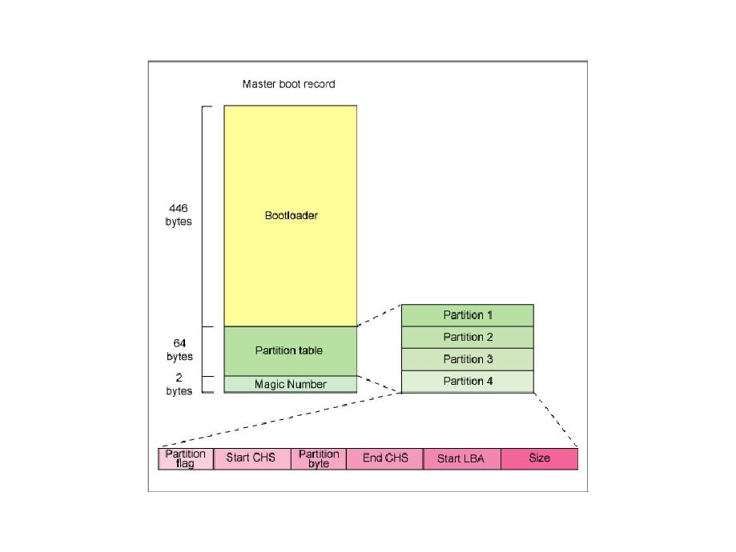
Legacy BIOS booting
x86 platforms shipped before 2005-2006 include a firmware called BIOS
• BIOS = Basic Input Output System
• Part of the hardware platform, closed-source, rarely modifiable
• Implements the booting process
• Provides runtime services that can be invoked - not commonly used
• Stored in some flash memory, outside of regular user-accessible storage devices
▶ To be bootable, the first sector of a storage device is “special”
• MBR = Master Boot Record
• Contains the partition table
• Contains up to 446 bytes of boot loader code, loaded into RAM and executed
• The BIOS is responsible for the RAM initialization

Slide 18
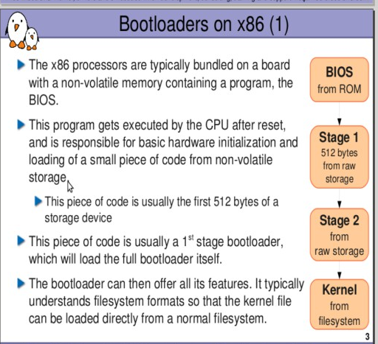
Due to the limitation in size of the boot loader, boot loaders are split into two stages
• Stage 1, which fits within the 446 bytes constraint
• Stage 2, which is loaded by stage 1, and can therefore be bigger
▶ Stage 2 is typically stored outside of any file system, at a fixed offset → simpler to
load by stage 1
▶ Stage 2 generally has file system support, so it can load the kernel image from a
File system

Slide 19
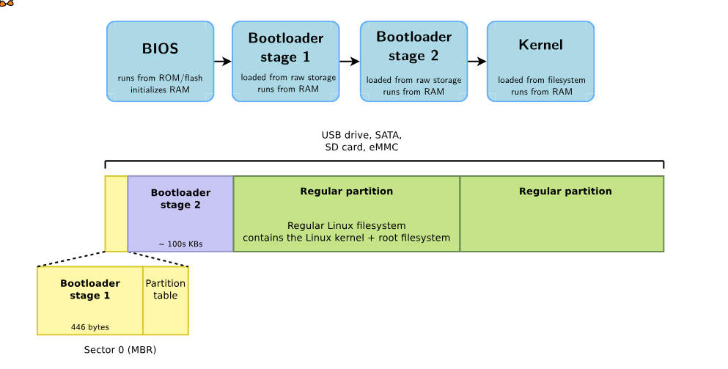
Legacy BIOS booting: sequence and storage

Slide 20
UEFI booting
Starting from 2005-2006, UEFI is the new firmware interface on x86 platforms
• Unified Extensible Firmware Interface
• Describes the interface between the operating system and the firmware
• Firmware in charge of booting
• Firmware also provides runtime services to the operating system
• Stored in some flash memory, outside of regular user-accessible storage devices
▶ Loads EFI binaries from the EFI System Partition
• Generally a boot loader
• Can also be directly the Linux kernel, with an EFI Boot Stub
EFI System Partition (ESP)
▶ Special partition, formatted with the FAT filesystem
• MBR: identified by type 0xEF
• GPT: identified with a specific globally unique identifier
GPT (GUID Partition Table) is a modern disk partitioning scheme that replaces MBR.
/EFI/ubuntu/grubx64.efi

Slide 21
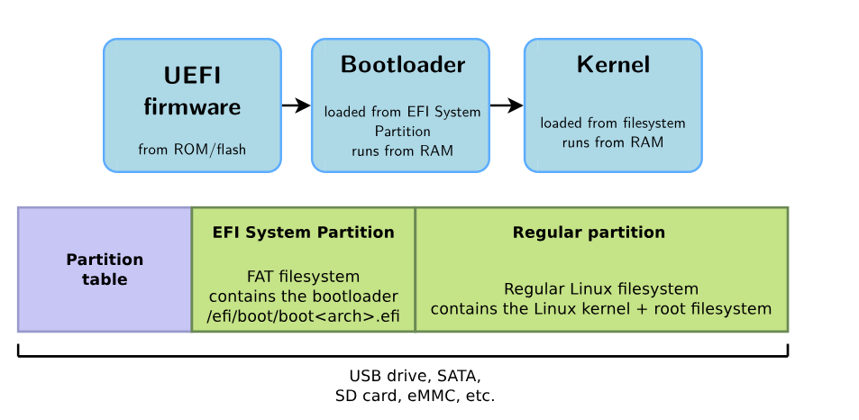
UEFI booting: sequence and storage

Slide 22
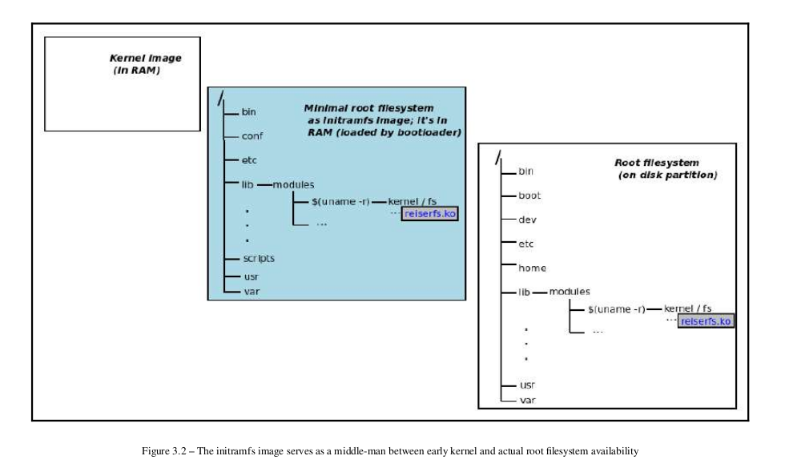

Slide 23
The initramfs framework is essentially a kind of middle-man between the early
kernel boot and usermode. It allows us to run user space applications (or scripts) before the actual root filesystem has been mounted. This is useful in many
circumstances, a couple of which are detailed in the following list. The key point is
that initramfs allows us to run user mode apps that the kernel cannot normally run
during boot time.
Practically speaking, among various uses, this framework allows us to do things
including the following:
Set up a console font.
Customize keyboard layout settings.
Print a custom welcome message on the console device.
Accept a password (for encrypted disks).
Load up kernel modules as required.
Spawn a "rescue" shell if something fails.
And many more!
CONFIG_BLK_DEV_INITRD -> initramfs

Slide 24
Understanding the basics of the boot process on the x86
In the following list, we provide a brief overview of the typical boot process on an
x86[_64] desktop (or laptop), workstation, or server:
1. Early boot, POST, BIOS initialization – the BIOS (short for Basic Input Output System; essentially, the firmware on the x86) loads up the first sector of the first bootable disk into RAM and jumps to its entry point. This forms what is often referred to as the stage one bootloader, whose main job is to load the stage two (larger) bootloader code into memory and jump to it.
2. Now the stage two bootloader code takes control. Its main job is to load the actual (stage three) GRUB bootloader into memory and jump to its entry point (GRUB is typically the bootloader employed on x86[-64] systems)
3. The (GRUB) bootloader will be passed both the compressed kernel image file
(/boot/vmlinuz-<kernel-ver> ) as well as the compressed initramfs image file
.
The bootloader will (simplistically) do the following:
Perform low-level hardware initialization.
Load these images into RAM, uncompressing the kernel image to a certain extent.
It will jump to the kernel entry point.
4. The Linux kernel, now having control of the machine, will initialize the hardware and software environment. It makes no assumptions regarding the earlier work performed by the bootloader.

Slide 25
5. Upon completing the majority of hardware and software initialization, it notices that the initramfs feature is turned on ( CONFIG_BLK_DEV_INITRD=y ). It will thus locate (and if required, uncompress) the initramfs ( initrd ) image in RAM (see earlier slide).
6. It will then mount it as a temporary root filesystem in RAM itself, within a RAMdisk.
7. We now have a base, minimal root filesystem set up in memory. Thus, the
initrd startup scripts now run, performing, among other tasks, the loading of the required kernel modules into RAM (in effect, loading the root filesystem drivers)
8.The kernel then performs a pivot-root, un-mounting the temporary initrd root filesystem, freeing its memory, and mounting the real root filesystem; it's now possible because the kernel module providing that filesystem support is indeed available
9. Once the (actual) root filesystem is successfully mounted, system initialization can proceed. The kernel continues, ultimately invoking the first user space process, typically /sbin/init PID 1 .
Remember, the kernel itself hasn't yet completed initialization; how can user space
apps run? Again, the initramfs framework solves this issue by indeed setting up a
temporary user space runtime environment complete with the required root
filesystem containing libraries, the loader, kernel modules, and so on, in memory.
lsinitramfs /boot/initrd.img-***

Slide 26
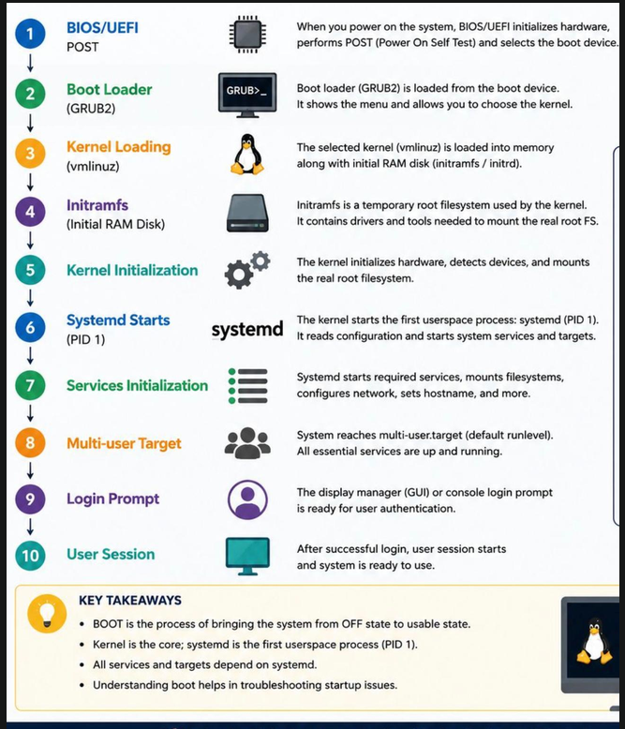
X86 Boot Process

Slide 27
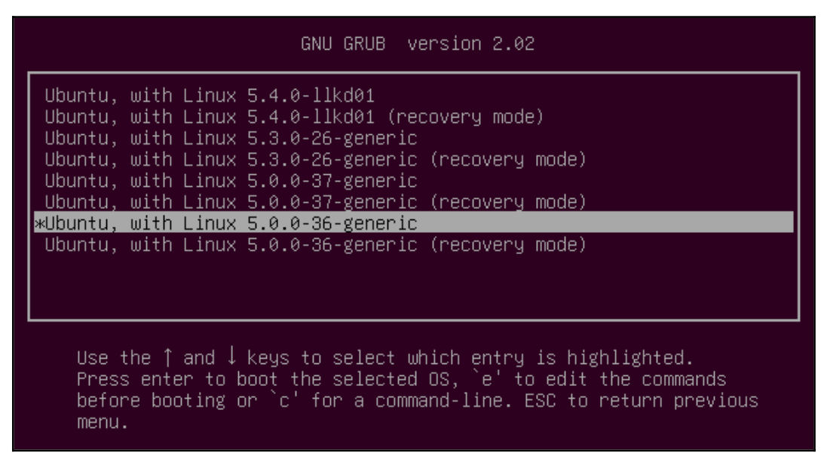
GRUB
Grand Unified Bootloader, from the GNU project
▶ De-facto standard in most Linux distributions for x86 platforms
▶ Supports x86 legacy and UEFI systems
▶ Can read many filesystem formats to load the kernel image, modules and configuration
▶ Provides a menu and powerful shell with various commands
▶ Can load kernel images over the network
▶ Also supports ARM, ARM64, RISC-V, PowerPC, but less popular than other
bootloaders on those platforms
▶ https://www.gnu.org/software/grub/

Slide 28
Initialization Overview
When the operating system starts, the kernel runs /sbin/init. This can
be either a script or a program, but typically it is a program that
processes the statements in /etc/initab.
The default inittab file tells init to run the commands in the file
/etc/rc.d/rcS. In addition, init spawns programs to present login
prompts on two virtual terminals.
In Ubuntu: systemd is in use, but /etc/rc0.d still exists for
compatibility reasons.

Slide 29
Systemd-boot : Simple UEFI boot manager
▶ Useful alternative to GRUB for UEFI systems: simpler than GRUB
▶ Configured using files stored in the EFI System Partition
▶ Part of the systemd project, even though obviously distinct from systemd itself
▶ systemd-boot is a UEFI boot manager which executes configured EFI images.
▶ systemd-boot operates on the EFI System Partition (ESP) only. Configuration file fragments, kernels, initrds, other EFI images need to reside on the ESP. Linux kernels need to be built with CONFIG_EFI_STUB to be able to be directly executed as an EFI image.
https://www.freedesktop.org/wiki/Software/systemd/systemd-boot/

Slide 30
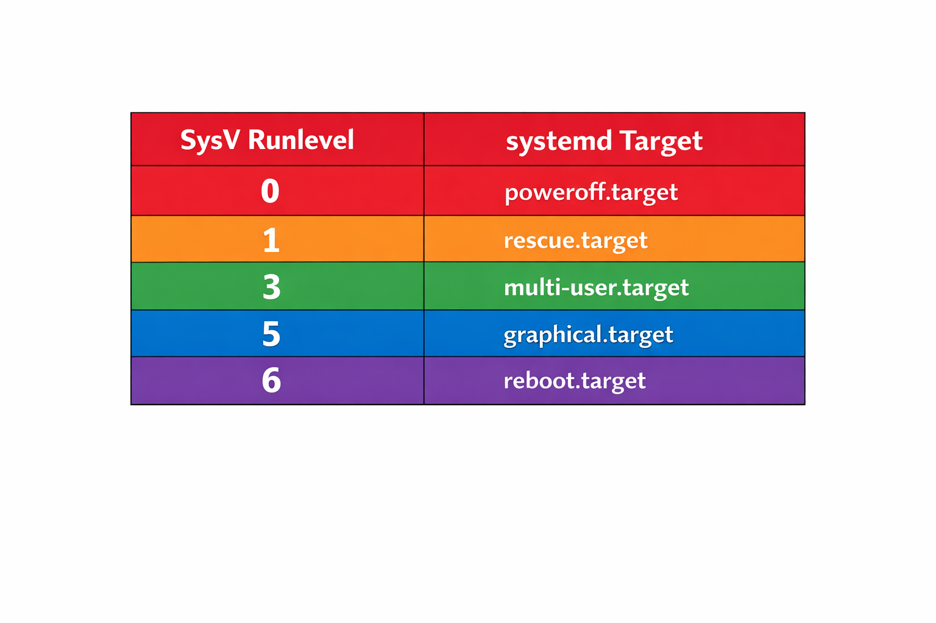
Init Runlevels: /etc/rc0.d (SysVinit)
The idea behind operating different services at
different run levels essentially revolves around the fact that
different systems can be used in a different ways. The following
runlevels are defined in Red Hat Linux :

