Slide 1
Secure Boot process

Slide 2
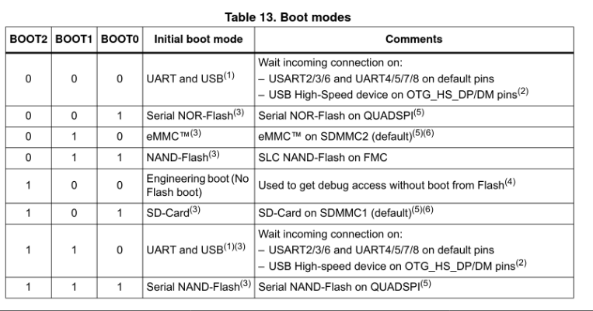
Booting on embedded platforms: ROM code
Most embedded processors include a ROM code that implements the initial step of the boot process
▶ The ROM code is written by the processor vendor and directly built into the processor
• Cannot be changed or updated
• Its behavior is described in the processor data sheet
▶ Responsible for finding a suitable boot loader, loading it and running it
• From NAND/NOR flash, from USB, from SD card, from eMMC, etc.
• Well defined location/format
▶ Generally runs with the external RAM not initialized, so it can only load the bootloader into an internal SRAM
• Limited size of the boot loader, due to the size of the SRAM
• Forces the boot process to be split in two steps: first stage boot loader (small, runs from SRAM, initializes external DRAM), second stage bootloader (larger, runs from external DRAM)

Slide 3
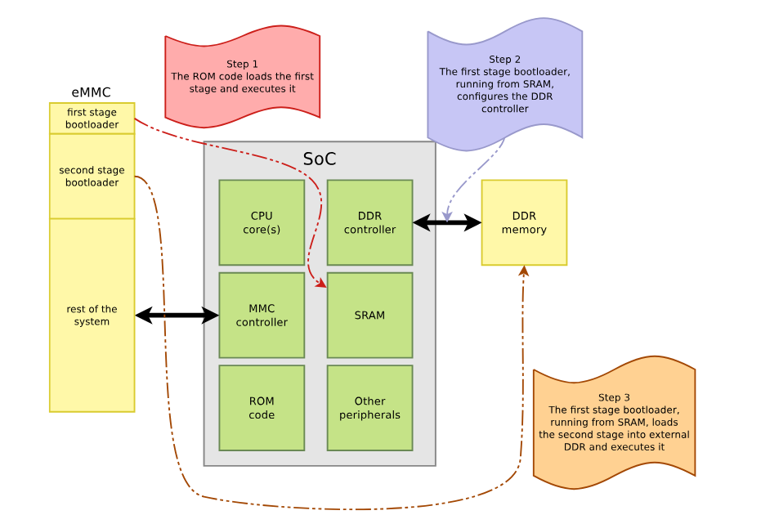
Two stage booting sequence

Slide 4
Boot loaders and firmware Trusted firmware
▶ Traditionally, bootloaders are only used during the booting process
Bootloader loads operating system, jumps to it, and is discarded
▶ Modern SoCs have advanced security mechanisms that require running some sort of trusted firmware
▶ This firmware is loaded by the bootloader, or part of the boot chain itself
▶ This trusted firmware stays resident after control has been passed to the OS
• It is stored in a dedicated portion of the DDR, or some specific SRAM, inaccessible from the OS
• It provides services to the OS, which the OS cannot perform directly
• Can also be responsible for running a secure OS alongside the regular OS (Linux in our case)
Modern ARMv7 and ARMv8 processors have
• 4 privilege levels (Exception Levels)
EL3, the most privileged, runs secure firmware
EL2, typically used by hypervisors, for virtualization
EL1, used to run the Linux kernel
EL0, used to run Linux user-space applications
• 2 worlds
Normal world, used to run a general purpose OS, like Linux
Secure world, to run a separate, isolated, secure operating system and applications.
Also called TrustZone by ARM.
▶ EL3 only exists in the secure world
▶ EL2 exists in both secure and normal worlds since ARMv8.4, before that EL2 was
only in the normal world
▶ EL1 and EL0 exist in both secure and normal worlds. EL3 is the highest implemented exception level in the Arm A-profile security model and is normally used for secure monitor/runtime firmware.

Slide 5
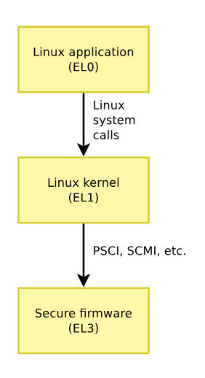
Interfaces with secure firmware
▶ Standardized by ARM
▶ Services
• implemented by the secure firmware
• called by the operating system
▶ Prevents the operating system running in normal world from directly accessing critical hardware resources
▶ PSCI, Power State Coordination Interface
• Power management related: turn CPUs on/off, CPU idle state, platform shutdown/reset
▶ SCMI, System Control and Management Interface
• Power domain, clocks, sensor, performance
▶ Secure firmware implementing these interfaces is
• Mandatory to run Linux on ARMv8
• Mandatory to run Linux on some ARMv7 platforms, but not all
TF-A
▶ Trusted Firmware-A (TF-A) provides a reference implementation of secure world software for Armv7-A and Armv8-A, including a Secure Monitor executing at Exception Level 3 (EL3)
▶ Formerly known as ATF, for ARM Trusted Firmware
▶ Implements the various standard interfaces that operating systems need from the secure firmware
▶ Has drivers for the hardware blocks that are not accessed directly by Linux
▶ Needs to be ported for each SoC
▶ Depending on the platform, may also need to be ported per board: DDR initialization
▶ Used on the vast majority of ARMv8 platforms, and on a few recent ARMv7 platform
CPU_ON ├── CPU_OFF ├── CPU_SUSPEND ├── SYSTEM_OFF └── SYSTEM_RESET

Slide 6
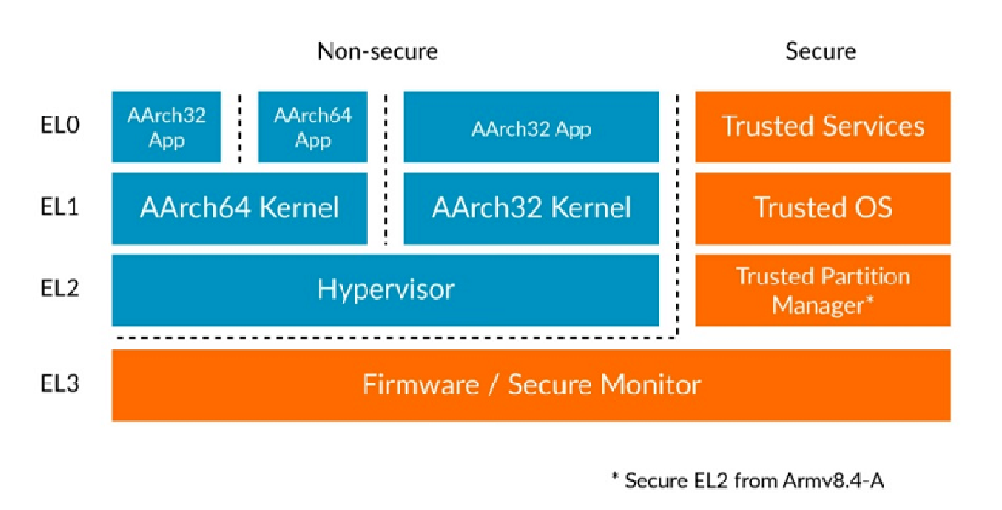
ARM exception levels and worlds

Slide 7
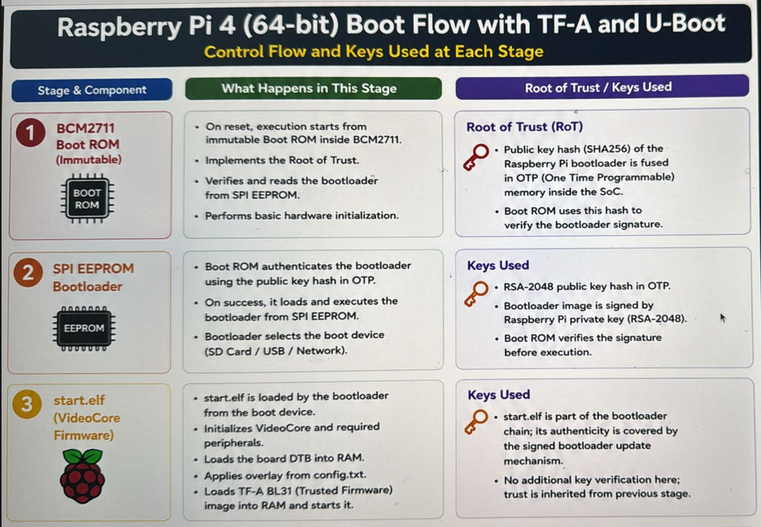

Slide 8
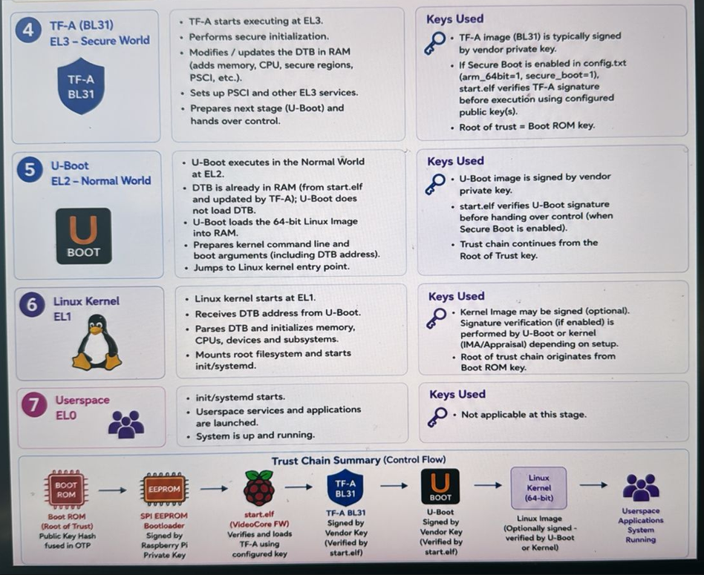

Slide 9
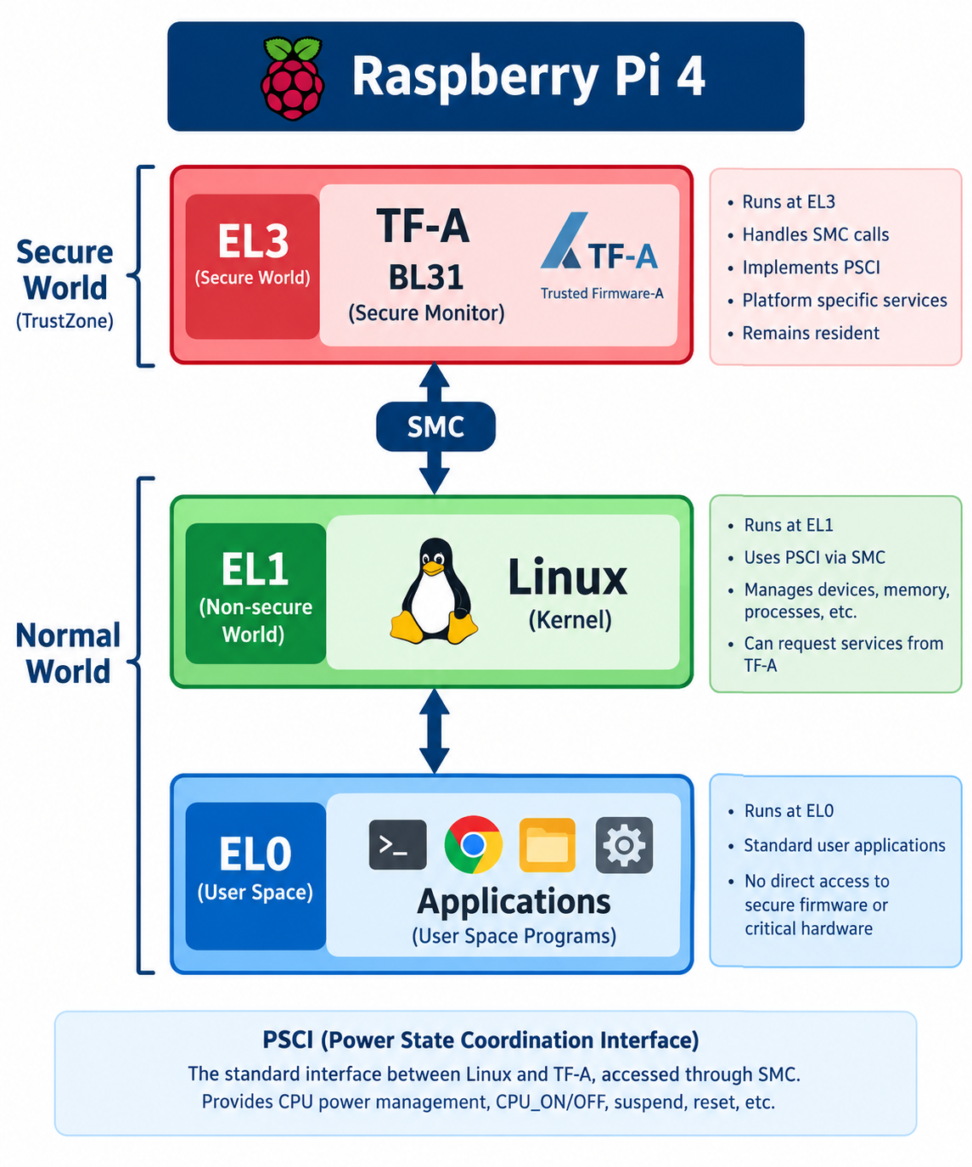

Slide 10
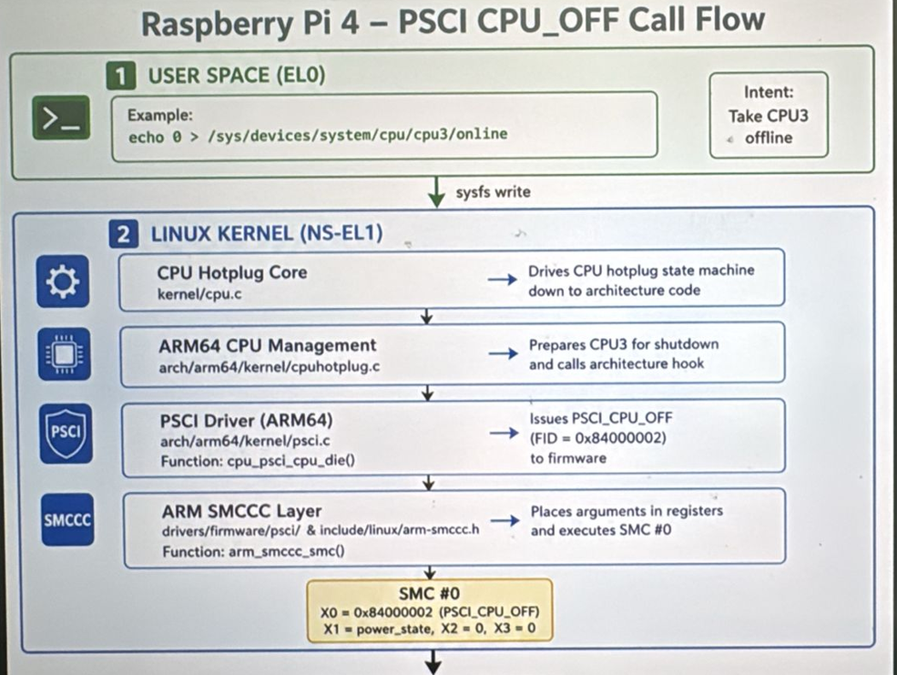

Slide 11
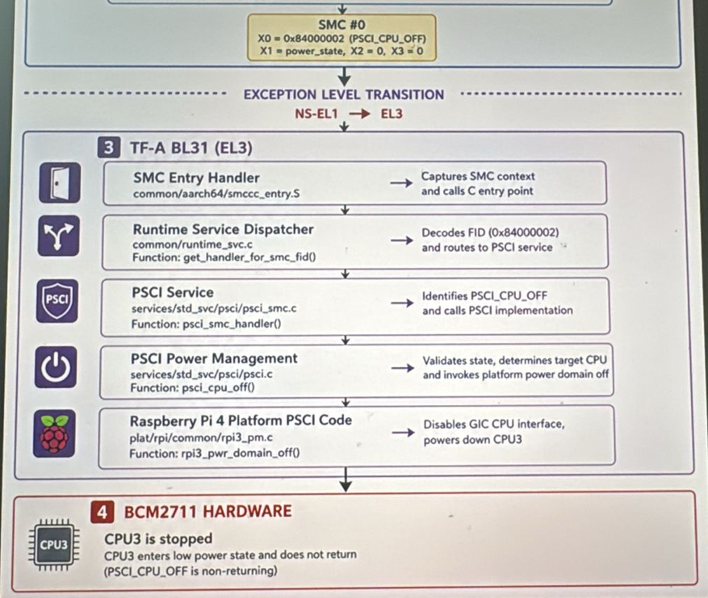

Slide 12
BeagleBone Linux Boot Process with Trusted Firmware-A Secure Boot
This document describes the Linux boot process on BeagleBone-class boards using Trusted Firmware-A (TF-A) with Secure Boot enabled. This applies to newer TI K3-based SoCs such as AM62x, AM64x, and AM65x.
1. Power-On and ROM Code (BL0)
When power is applied, the CPU begins execution from immutable on-chip ROM code. This ROM code forms the
Root of Trust.
• Boot mode selection via boot pins
• Minimal hardware initialization
• Authentication of the first boot image using keys stored in eFuses
• Loading of TF-A BL2 into internal SRAM
2. TF-A BL2 (Secure Boot Loader)
BL2 runs in Secure EL3 and is responsible for initializing DDR memory and maintaining the secure chain of trust.
• Initialize clocks, DDR, and security firewalls
• Authenticate and load BL31 (TF-A runtime)
• Authenticate and load BL32 (OP-TEE, optional)
• Authenticate and load BL33 (U-Boot)
• DTB(FDT blob)
DTB is used across all stages.

Slide 13
3. TF-A BL31 (Secure Monitor TF-A)
BL31 provides the secure monitor runtime and remains resident for the entire system lifetime.
• Runs in EL3
• Handles Secure Monitor Calls (SMCs)
• Provides PSCI services
• Transitions execution to the non-secure world
→ Does not modify DTB
Acts as dispatcher:
→ Passes DTB pointer to
BL32(OP_TEE)
BL33(U-boot)
4. BL32 (OP-TEE OS – Optional)
OP-TEE runs in Secure EL1 and provides trusted execution services.
• Trusted Applications execution
• Secure storage and cryptographic services
• Communication via SMC through BL31
→ OP-TEE Receives DTB pointer from TF-A
Uses DTB for
→ secure memory layout
→ reserved memory regions
→ Device configuration (secure peripherals)

Slide 14
5. BL33 (U-Boot – Non-Secure)
U-Boot runs in the non-secure world but is cryptographically verified before execution.
• Board-level initialization
• Loading Linux kernel, device tree, and initramfs
• Optional verification of kernel and device tree
• Jumping to the Linux kernel
6. Linux Kernel Boot
The Linux kernel executes in the non-secure world and completes system initialization.
• Kernel initialization and device probing
• Root filesystem mount
• User space startup (systemd/init)
7. Secure Boot Chain of Trust
The secure boot process enforces a strict chain of trust from ROM to Linux.
ROM → BL2 → BL31 → (OP-TEE) → U-Boot → Linux Kernel

