Slide 1
Linux Introduction with Embedded systems

Slide 2
Rama Krishna.K
With an M.Tech (Master of Technology) degree and 20 years of experience in training, design, development, and debugging of embedded software, networking, and storage systems, primarily on the Linux operating system.Assosiated with Cisco, Juniper, Xilinx (AMD) and Honeywell.
Trainer Experience: Delivered corporate training for
1.Hewlett Packard Enterprise, Bangalore
(Linux Application development & Device drivers)
2. Seimens, Mumbai (Embedded C++)
3. FPT, Vietnam (C++, QT Programming)
3. Medha servo systems, Hyderabad. (Linux Device drivers)
4. Tata Elxsi systems, Bangalore. (Embedded Linux)
5. Embitel (Volkswagen), Bangalore (Linux, C++)
6. BORQS Software solutions, Bangalore (Embedded Linux)
→ Working as Guest faculty in Vector Embedded Training institute INIDA for C, C++, Linux internals, Embedded Linux and Device drivers.
→ Industry experience includes working with leading technology companies such as Juniper, Xilinx (now AMD), Cisco, and Honeywell.

Slide 3
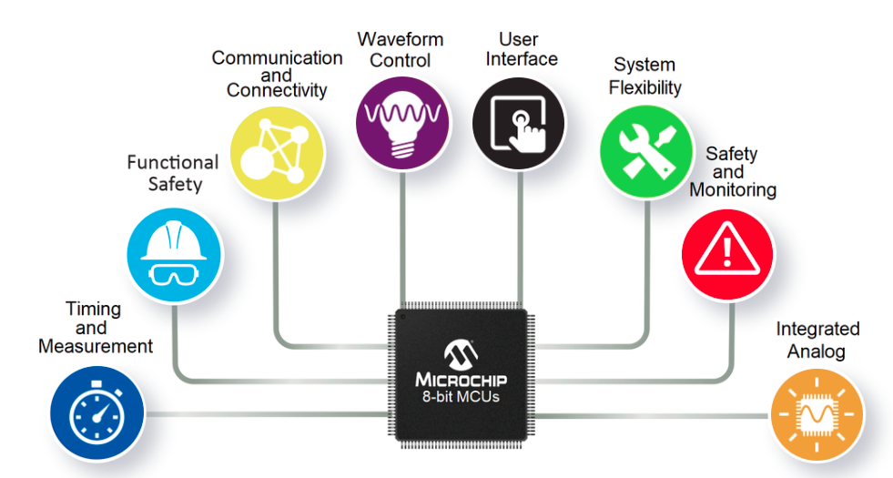

Embedded systems overview
Computing systems are everywhere
Most of us think of “desktop” computers
PC’s
Laptops
Mainframes
Servers
But there’s another type of computing system
Far more common...
What may be surprising is that billions of computing systems are built every year for a very different purpose: they are embedded within larger electronic devices, repeatedly carrying out a particular function, often going completely unrecognized by the device’s user. Creating a precise definition of such embedded computing systems, or simply embedded systems
<number>

Slide 4

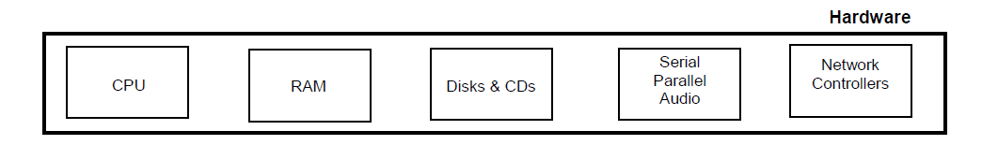
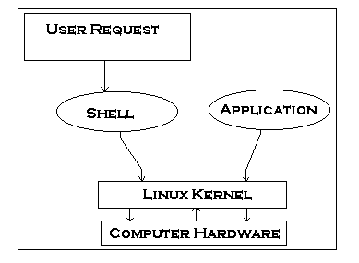
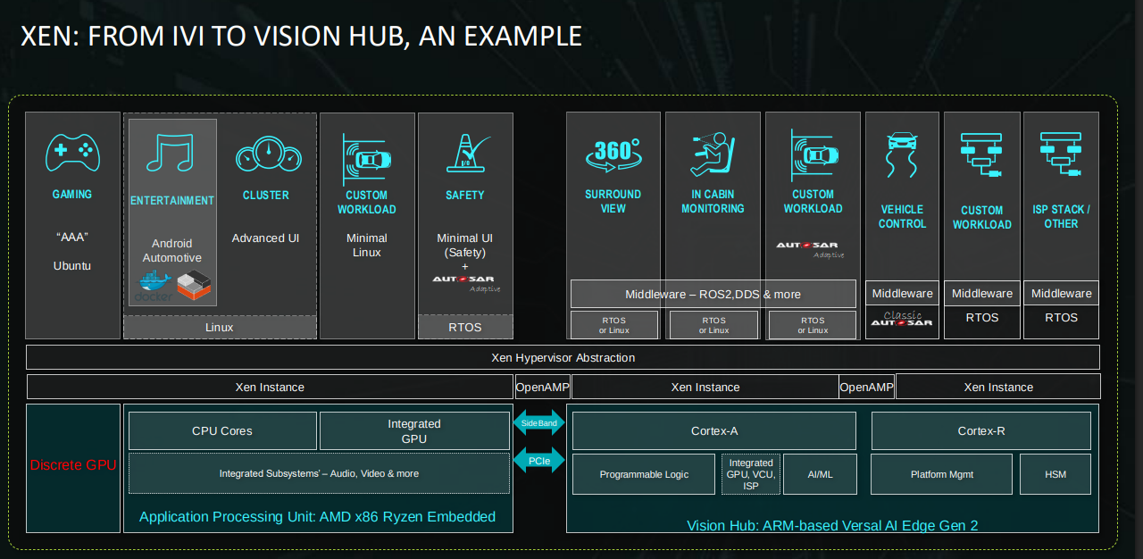
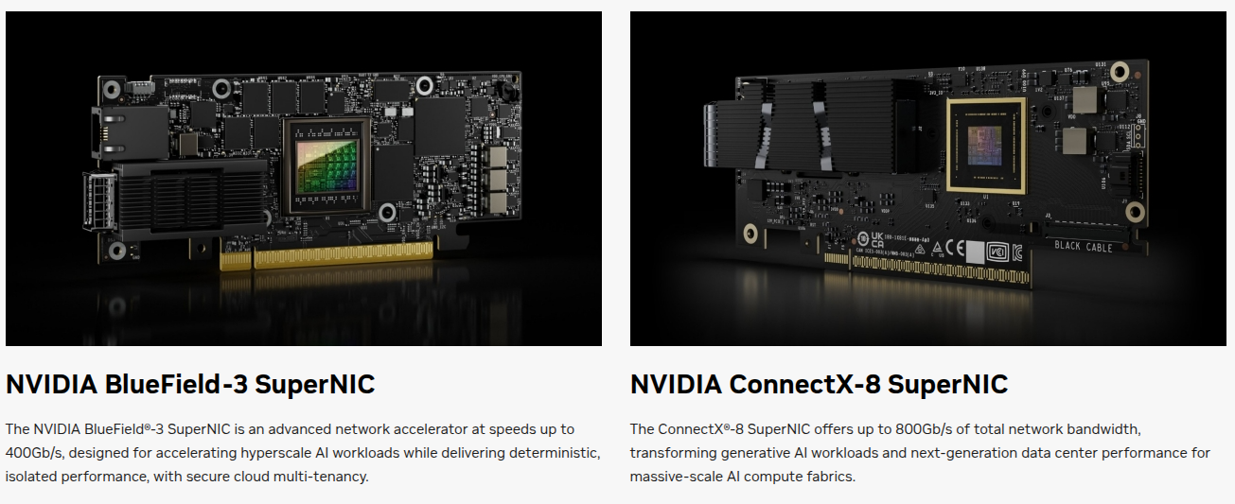
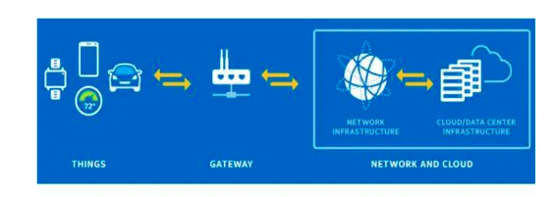
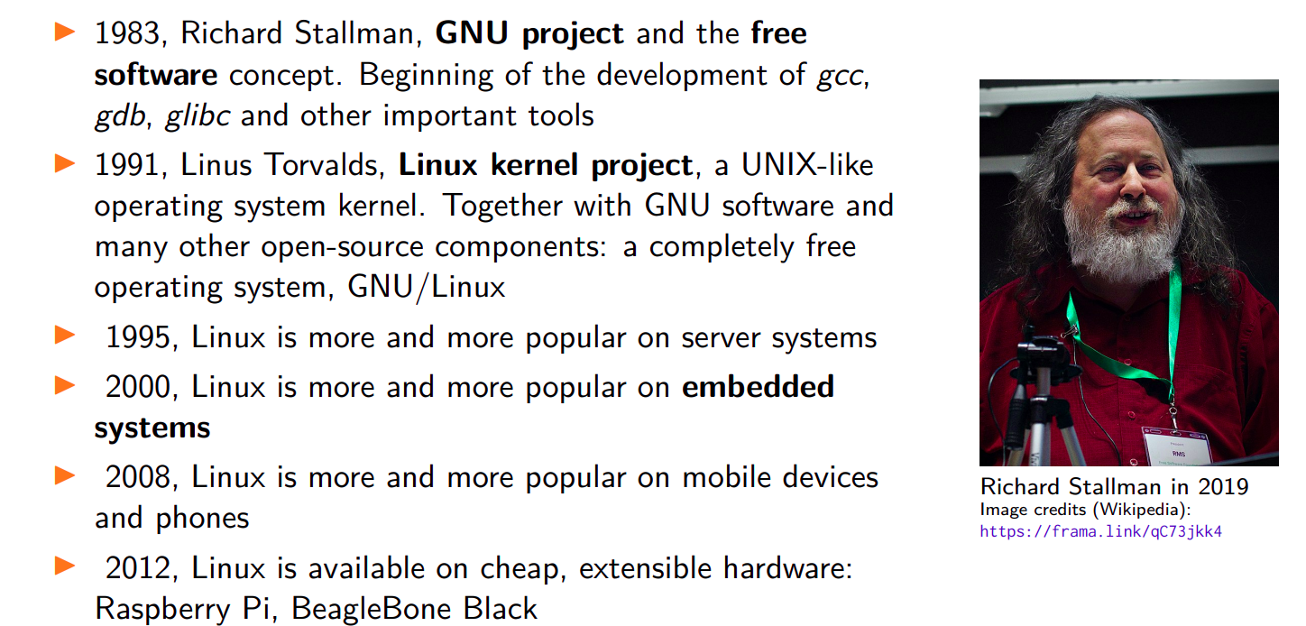
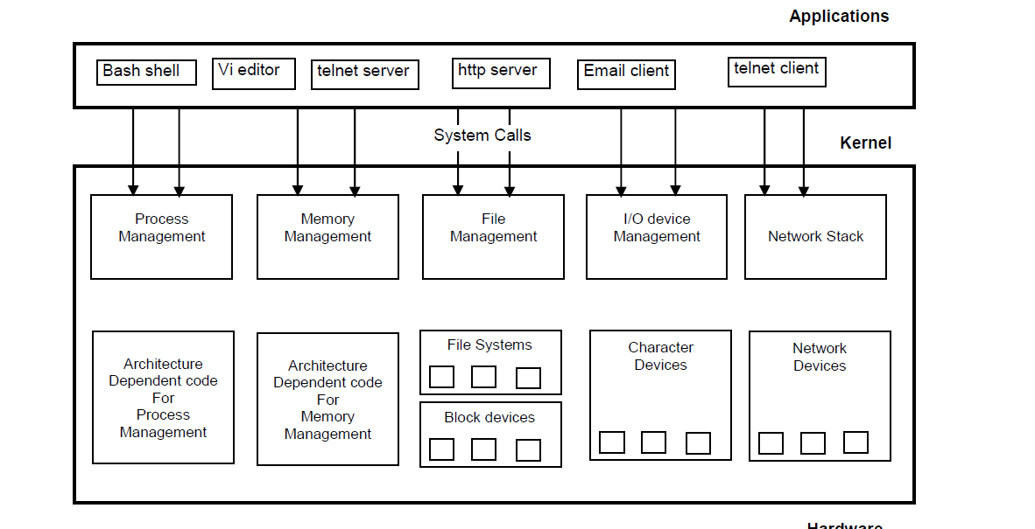
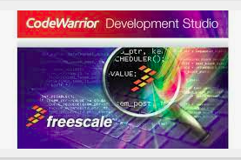




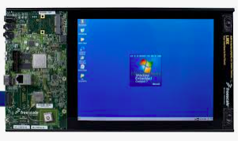
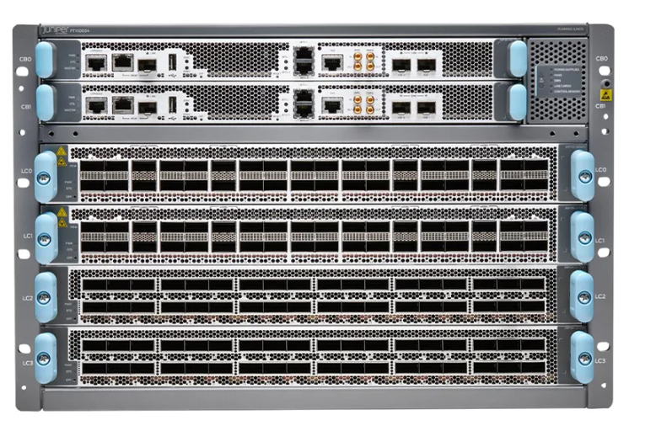
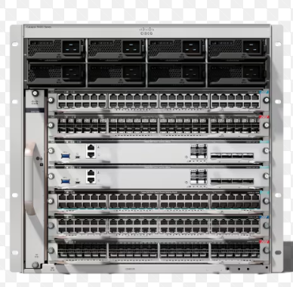
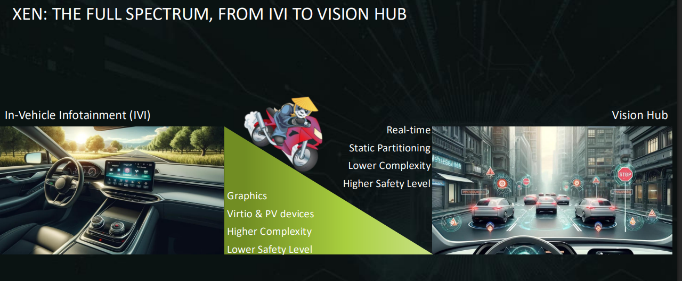
Embedded systems overview
Embedded computing systems
Computing systems embedded within electronic devices
Hard to define. Nearly any computing system other than a desktop computer
Billions of units produced yearly, versus millions of desktop units
Perhaps 50 per household and per automobile
Embedded systems are found in a variety of common electronic devices, such as:
(a) consumer electronics -- cell phones, pagers, digital cameras, camcorders, videocassette recorders, portable video games, calculators, and personal digital assistants;
(b) home appliances -- microwave ovens, answering machines, thermostat, home security, washing machines, and lighting systems; (c) office automation -- fax machines, copiers, printers, and scanners; (d) business equipment -- cash registers, curbside check-in, alarm systems, card readers, product scanners, and automated teller machines;
(e) automobiles -- transmission control, cruise control, fuel injection, anti-lock brakes, and active suspension.
Computers are in here...
and here...
and even here...
Lots more of these, though they cost a lot less each.
<number>

Slide 5
A “short list” of embedded systems
Anti-lock brakes
Auto-focus cameras
Automatic teller machines
Automatic toll systems
Automatic transmission
Avionic systems
Battery chargers
Camcorders
Cell phones
Cell-phone base stations
Cordless phones
Cruise control
Curbside check-in systems
Digital cameras
Disk drives
Electronic card readers
Electronic instruments
Electronic toys/games
Factory control
Fax machines
Fingerprint identifiers
Home security systems
Life-support systems
Medical testing systems
Modems
MPEG decoders
Network cards
Network switches/routers
On-board navigation
Pagers
Photocopiers
Point-of-sale systems
Portable video games
Printers
Satellite phones
Scanners
Smart ovens/dishwashers
Speech recognizers
Stereo systems
Teleconferencing systems
Televisions
Temperature controllers
Theft tracking systems
TV set-top boxes
VCR’s, DVD players
Video game consoles
Video phones
Washers and dryers
And the list goes on and on
<number>

Slide 6
Types of Embedded Systems
They can also be categorized by performance requirements:
Small-scale embedded systems.
These systems typically use up to an 8-bit microcontroller.
Medium-scale embedded systems.
These systems use a 16-bit or 32-bit microcontroller. They can use one or multiple units depending on the complexity of the system.
Sophisticated-scale embedded systems.
These systems may use complex software and hardware components.

Slide 7
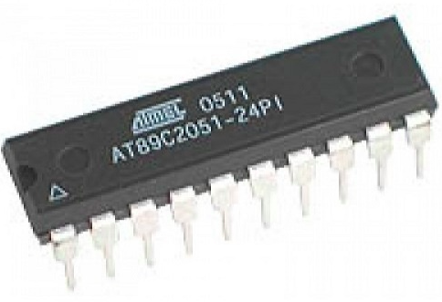
Classifications of Embedded systems
Small Scale embedded system
– Use single 8 bit or 16 bit micro controller
– Little hardware and software complexity
– Embedded software IDE is specific to processor
– Software has to fit in given memory
– Power consumption is limited
Programming tools:
Editor, Assembler, Cross compiler
Commonly used Micro controllers used:
8051, PIC16F8X Family
https://en.wikipedia.org/wiki/Intel_8051#
<number>

Slide 8
Medium scale embedded system
– Single or few 16 bit, 32 bit microprocessor
– DSP or ARM is used
– Both hardware and software complexities
– C,C++, Visual C++, Java is popular for programming, RTOS, and Source code , engineering tool, Simulator, Debugger and Integrated Development Environment (IDE).
- Software tools provide the solutions to the hardware complexities.
<number>

Slide 9
Large Scale Embedded System 32-bit/64-bit Micro controller
Enormous hardware and software complexities
– Several processors/controllers are used
– FPGA, DSP, DSC, IP core on VLSI chip, ASIC is used
– Hardware software co-design is required
– Some critical functions are implemented in the hardware (instead of software) to achieve speed
– Development tools available are costly
– Needs team work for development
Telecommunication Routers and Switches
Juniper router- PTX10K-LC1201-36CD—a 36-port multiple-speed line card that can be configured as 400GbE, 200GbE, 100GbE, 50GbE, 25GbE, or 10GbE Ethernet ports.
Cisco Catalyst 9400 switch
<number>

Slide 10
Automotive Infotainment and ADAS Systems

Slide 12
Data Center Smart NICs and DPUs

Slide 13
latest trends in Embedded systems.
Embedded systems will be of high importance not only for mobile devices and networks but also for real-time applications. The present and future industries that are aggressively growing include aerospace, healthcare, military, and consumer electronics applications, etc.
Artificial intelligence The new trend in the embedded systems industry is the increase in the usage of Artificial Intelligence and Machine Learning. AI is used almost in any segment such as e-commerce, manufacturing, supply chain, industrial control, and many more. AI takes the data and learns to make better decisions, while IoT and embedded systems which are physical devices help to generate data to achieve functionality.
Embedded artificial intelligence (AI) is the application of machine and deep learning in software at the device level. Software can be programmed to provide both predictive and reactive intelligence, based on the data that is collected and analyzed.
Traditionally, complex AI computations, such as producing search engine results, were performed at a data center in the cloud. With the implementation of AI models on
graphics processing units (GPUs), session border controllers (SBCs), and systems on chips (SoCs), there is less of a dependence on the cloud for AI data processing.
With embedded AI, devices have the ability to run AI models at the device level and then directly use the results to perform an appropriate task or action.
The cloud is still helpful from a data storage perspective, as data can be stored temporarily at the device level and eventually sent to a cloud server for safekeeping.

Slide 15
Linux history and open source
- 1960-80
Focus on academic computer science at places like Berkeley, MIT, CMU, as well as corporate research facilities like Bell Labs and Xerox’s Palo Alto Research Center
Unix, C (Bell Labs)
Simultaneous development of networks
Usenet and later Arpanet
1980-90
In the early ‘80’s, AT&T began to treat Unix as proprietary, at which point different “flavors” of the OS emerged (Berkeley’s BSD Unix, HPUX, Sun)
Emergence of formal rules in response to AT&T’s threats of litigation to govern open source development
Free Software Foundation (R. Stallman, MIT)
GNU software and the General Public License (GPL)
Notes:
<number>
<number>

Slide 16
History and open source - Timeline
1969 : UNIX, Thompson & Ritchie (AT&T Bell Labs)
1978 :BSD, Berkeley Software Distribution
Commercial vendors:Sun,HP,IBM,SGI,DEC
1984 :GNU, Richard Stallm an (FSF)
1986 : POSIX (Portable Operating System Interface)
1987 :Minix, Andy Tanenbaum
1989 :SVR4,AT&T and Sun
1991 : birth of Linux
IIn 1991, while attending the University of Helsink Torvalds became curious about operating systems^{[26]} and frustrated by the licensing of MINIX, which limited it to educational use only. He began to work on his own operating system which eventually became the Linux kernel
Notes:
<number>
<number>

Slide 17
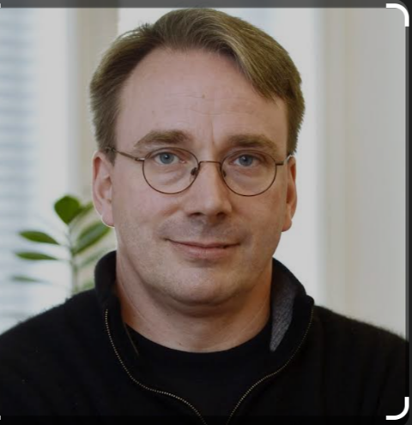
Birth of Free Software
https://www.youtube.com/watch?v=HmBp_QazaVI

Slide 18
Linux Features
UNIX-like operating system
Preemptive multi-tasking
Virtual memory (protected memory, paging)
Shared libraries
Demand loading, dynamic kernel modules
TCP/IP networking
SMP support , Multi processor, Multi thread
Open Source!
Support Various architectures (X86/ARM/MIPS/…)
Notes:
<number>
<number>

Slide 19
Kernel Functionality
Provides following facilities:
- Basic kernel services
- System start up and shutdown
- Memory management
- Process control
- File system
- I/O System (Device Drivers)
- IPC facilities
- Networking service
Notes:
<number>
<number>

Slide 20
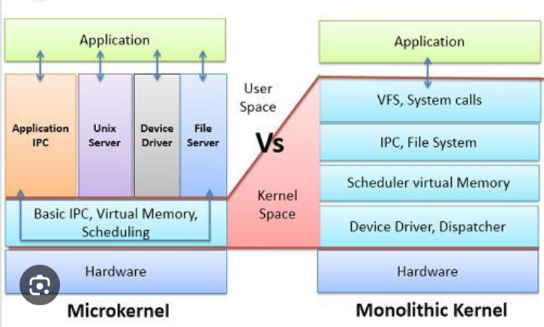
Monolithic Kernel Vs Micro Kernel
Monolithic Kernel: Includes all essential operating system services (device drivers, file system, memory management..) in a single large block of code running in kernel space
Ex: Linux, Unix and BSD
High performance
Lower stability – A bug in any part can crash the entire system
Micro Kernel: includes only the minimal required functionality in kernel space—typically just IPC, basic scheduling, and memory management. Other services (drivers, file systems, etc.) run in user space as separate processes. Lower performance (due to IPC) More stable – failures in user space services don’t crash the whole OS.

Slide 22
Basic commands
Date Print or set the system date and time
cal Prints calendar
Who Print who is currently logged in
Whoami Print the current user id and name
Uname Print system information, print information about the machine and operating system it is run on.
Passwd Modify a user password.
Echo Display message on screen
Pwd Present working directory
Notes:
<number>
<number>

Slide 23
Mkdir –Creates directory
Rmdir – Remove directory
Ls List information about FILEs
Cat Display the contents of a file
Cp Copy one or more files to another loc
Rm Remove files (delete/unlink)
More Display output one screen at a time
Wc Print byte, word, and line counts
Cmp Compare two files, and if they differ,
Diff Display the differences between two files
Chmod Change access permissions
Grep Search file(s) for specific text.
Ps Process status, information about processes running in memory
Notes:
<number>
<number>

Slide 24
fdisk -l
find
egrep --color "vmx|svm" /proc/cpuinfo
sudo systemctl start sshd
sudo /usr/bin/update-manager
lsb_release -a
tldr ps
blkid, /etc/fstab
Lab activities:
1. Format the Linux USB disk and create partitions with fdisk command
2. how to auto mount usb device
3. Prepare Raspberry Pi with USB boot way.
Gcc compilers vs Other compilers
h
Notes:
<number>
<number>

Slide 25
Gcc compiler options
Flag | Description
-o | Output file name for executable $gcc main.c -o main
-Wall | Enable all warnings $gcc -Wall main.c -o main
-E | Preprocessor stage $gcc -E main.c > main.i
-S | Produce assembly code $gcc -S main.c > main.s
-c | Produce only compiled code, no linker invocation $gcc -C main.c
-save-temps | Produce all above stage files $gcc -save-temps main.c
-l | Link shared libraries $gcc -Wall main.c -o main -lpthread
-fPIC | To create shared library generate position indepndent code $ gcc -c -Wall -Werror -fPIC Cfile.c ,$ gcc -shared -o libCfile.so Cfile.o
-v | Provide verbose information, gcc -Wall -v main.c -o main
-D | Enable macro during compile time $ gcc -Wall -DMY_MACRO main.c -o main
-Werror | Treate warning as error
-fstack-usage | Analyzing stack usage of individual function
-g | Produce debug information
-On | Optimization levels

Slide 26
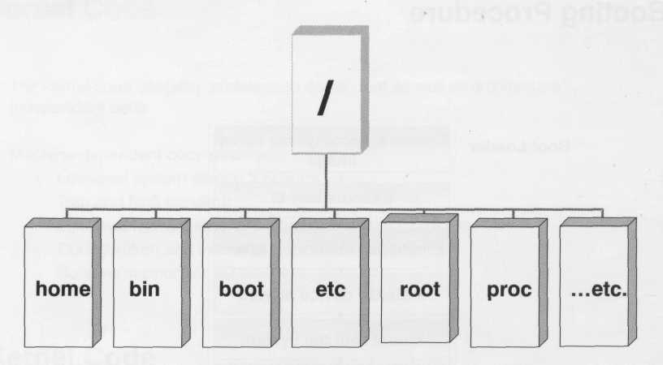
File Tree Structure
Inverted tree structure
Notes:
<number>
<number>

Slide 27
File system description
/ root directory
/bin Essential low level system utilities
/usr/bin High level system utilities
/sbin Super user system utilities
/lib program libraries
/usr/lib program libraries for high level
/tmp Temporary file storage system
/home User home directories
/etc Unix system configuration and information
/dev Hardware devices
/proc Pseudo file system which used as interface to kernel
Notes:
<number>
<number>

Slide 28
Shell Scripting:
Shell is user program or it’s environment provided for user interface. Shell is common language interpreter that executes commands read from standard input device (keyboard) or from a file. Shells available in linux
Shell Name | Developed by | Where | Remark
BASH ( Bourne-Again SHell ) | Brian Fox and Chet Ramey | Free Software Foundation | Most common shell in Linux. It's Freeware shell.
CSH (C SHell) | Bill Joy | University of California (For BSD) | The C shell's syntax and usage are very similar to the C programming language.
KSH (Korn SHell) | David Korn | AT & T Bell Labs | --
TCSH | See the man page. Type $ man tcsh | -- | TCSH is an enhanced but completely compatible version of the Berkeley UNIX C shell (CSH).

Slide 29
To find available shells in your system
$ cat /etc/shells
To find current shell
$echo $0
$echo $SHELL
Shell script:
Shell script is series of commands written in plain text file.

Slide 30
How to write shell script
Following steps are required to write shell script:
(1) Use any editor like vi or mcedit to write shell script.
(2) After writing shell script set execute permission for your script as follows syntax: chmod permission your-script-name
Examples: $ chmod +x your-script-name $ chmod 755 your-script-name
Note: This will set read write execute(7) permission for owner, for group and other permission is read and execute only(5).
(3) Execute your script as syntax: bash your-script-name sh your-script-name ./your-script-name
Examples: $ bash bar $ sh bar $ ./bar
In Liunx shell there are 2 types of variables
System Variables
User defined Variables

Slide 31
You can see system variables by using $ set command
System Variable | Meaning
BASH=/bin/bash | Our shell name
BASH_VERSION=1.14.7(1) | Our shell version name
COLUMNS=80 | No. of columns for our screen
HOME=/home/vivek | Our home directory
LINES=25 | No. of columns for our screen
LOGNAME=students | students Our logging name
OSTYPE=Linux | Our Os type
PATH=/usr/bin:/sbin:/bin:/usr/sbin | Our path settings
PS1=[\u@\h \W]\$ | Our prompt settings
PWD=/home/students/Common | Our current working directory
SHELL=/bin/bash | Our shell name
USERNAME=vivek | User name who is currently login to this PC

Slide 32
$ vi variscript # # # Script to test MY knowledge about variables! # myname=Vivek myos = TroubleOS myno=5 echo "My name is $myname" echo "My os is $myos" echo "My number is myno, can you see this number"

Slide 33
Lab activities:
Format USB disk with mkfs
Write bash script to delete temp folder each day at 6:30 pm with crontab –e
30 18 * * * rm /home/someuser/tmp/*
Mount USB disk with command and copy directory to and from USB
4. Install Ubuntu on USB as mount device
https://itsfoss.com/intsall-ubuntu-on-usb/

Slide 34
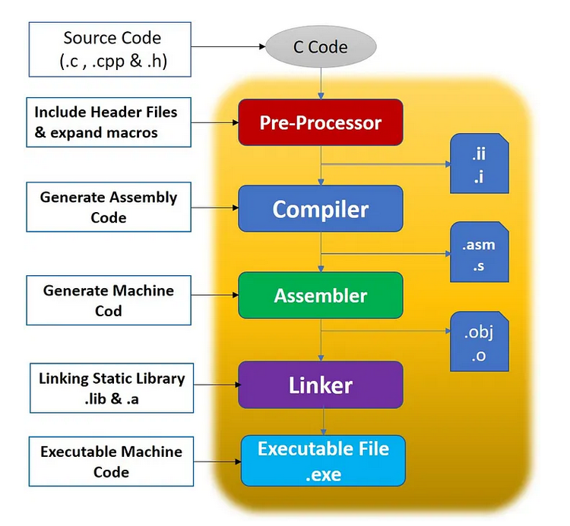
C Program Compilation steps with gcc

Slide 35
Gcc compiler options
Flag | Description
-o | Output file name for executable $gcc main.c -o main
-Wall | Enable all warnings $gcc -Wall main.c -o main
-E | Preprocessor stage $gcc -E main.c > main.i
-S | Produce assembly code $gcc -S main.c > main.s
-c | Produce only compiled code, no linker invocation $gcc -C main.c
-save-temps | Produce all above stage files $gcc -save-temps main.c
-l | Link shared libraries $gcc -Wall main.c -o main -lpthread
-fPIC | To create shared library generate position indepndent code $ gcc -c -Wall -Werror -fPIC Cfile.c ,$ gcc -shared -o libCfile.so Cfile.o
-v | Provide verbose information, gcc -Wall -v main.c -o main
-D | Enable macro during compile time $ gcc -Wall -DMY_MACRO main.c -o main
-Werror | Treate warning as error
-fstack-usage | Analyzing stack usage of individual function
-g | Produce debug information
-On | Optimization levels

Slide 36
GCC - The GNU Compiler Collection, supports C, C++, Fortran, and more. It's mature, widely used, and very stable.
Clang - Frontend Compiler - A modern compiler frontend for C/C++/Objective-C that uses LLVM as its backend. Parses the source code and generates LLVM IR (Intermediate Representation), which is then passed to LLVM for further processing.
LLVM - Compiler Infrastructure - A set of reusable compiler tools/libraries used by compilers like Clang (and others). LLVM takes the IR of Clang→ performs optimizations → generates machine code or other targets.
Feature | Gcc | Clang | LLVM
Role | Full compiler suite | Frontend compiler | Backend + optimizer infrastructure
Maintained by | GNU Project | LLVM Project (mostly Apple, Meta, etc.) | LLVM Project
Language support | C, C++, Fortran, Go, Ada, more | C, C++, Objective-C/C++ | Language-agnostic
Compilation speed | Slightly slowe | Faster | N/A
Output formats | Native machine code | LLVM IR → optimized/native code | LLVM IR → optimized/native code
License | GPL (v3) | BSD-like | BSD-like
Toolchain compatibility | Standard in Linux | Compatible with GCC tools | Modular; used in many tools
Cross-compilation | Supported (more mature) | Supported | Backend-dependent
Maturity | Very mature | Newer, but widely used | Widely adopted, industry standard
Use in industry | Linux distros, embedded, HPC | macOS/iOS, Chrome, Android, Rust | Used by many compilers (e.g., Rust, Julia, Swift)

