Slide 1
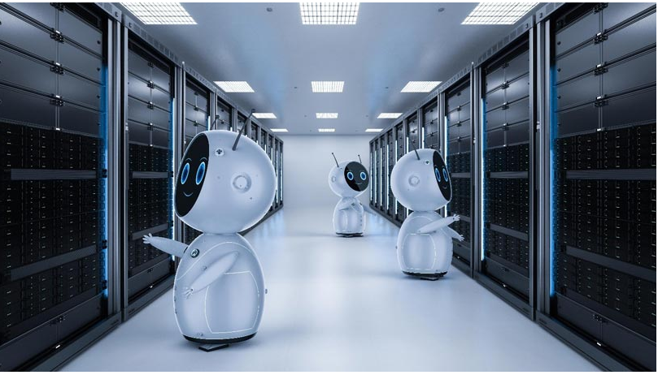
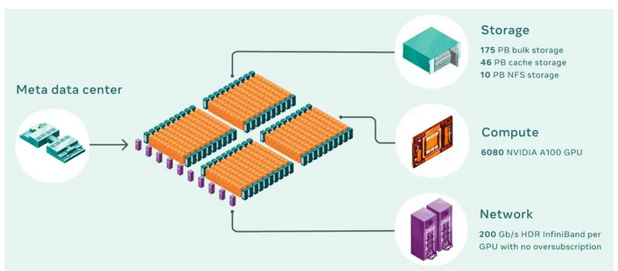
The Hidden Hardware of AI From Embedded Systems to Data center networking and storage

Slide 2
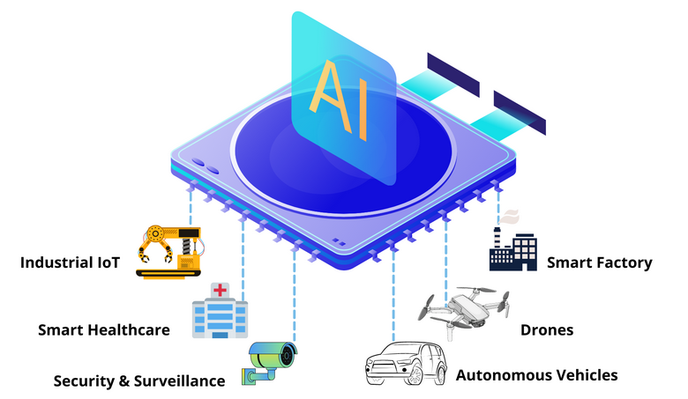
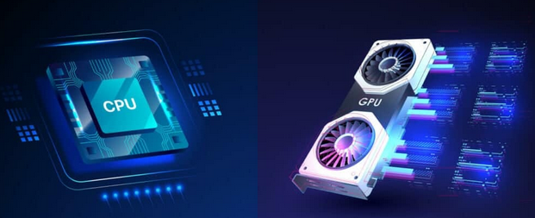
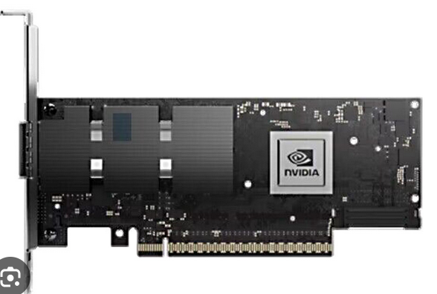
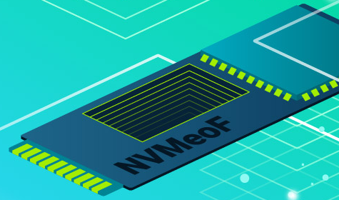

The Hidden Hardware of AI : From Embedded Systems to Data center networking and storage Understanding Hardware backbone of Modern AI
Agenda
AI Innovation Stack
Embedded Systems and Edge AI
Computer & Accelerators (CPU & GPU)
Networking & RDMA
Storage (NVMe, NVMeOF)
Career Opportunities & Learning Road map

Slide 3
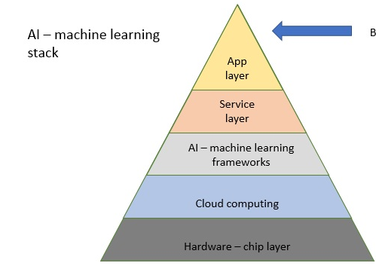
The Shift in AI Innovation
AI powered applications: Computer vision (Object detection, Facial Recognisation, Medical Imaging, Autonomous vehicle,
Industrial inspection, NLP (chatbots/Virtual Assistants, Machine translation), Speech recognition.
AI – machine learning frameworks (Algorithm):
These provide the tools and libraries necessary for developing, training
and deploying AI models.
Machine leaning algorithms (Regression/Classification)
Deep learning framework (Tensor Flow, PyTorch and Scikit)
Cloud computing (Data storage & Management System) The software and services that manage the underlying hardware,orchestrate workflows Cloud platforms (AWS, Azure, Google Cloud), container orchestration (Kubernetes, Docker), MLOps tools (MLflow, Kubeflow),
Networking Capabilities: In large-scale AI model training, data and model parameters are distributed across many computing nodes. The CCL Collective Communications Library (CCL) efficiently manages
the synchronization and sharing of gradients and model updates between these nodes.
Hardware: High performance computing resources are essential for training and running AI models. This includes GPU (Graphics Processing Units) (NVIDIA A100, H100), TPUs (Google's Tensor Processing Units), and custom ASICs. Also includes high-speed memory and storage solutions.

Slide 4
AI innovation is now hardware-driven, not just algorithmic
Performance gains depend on hardware efficiency.
Hardware = compute + network + storage synergy
Edge AI is the combination of edge computing and edge intelligence to run machine learning tasks directly on end devices. It generally consists of an in-built microprocessor and sensors, while the data processing task is completed locally and stored at the edge node end. The implementation of machine learning models in edge AI will decrease the latency rate and improve the network bandwidth.

Slide 5
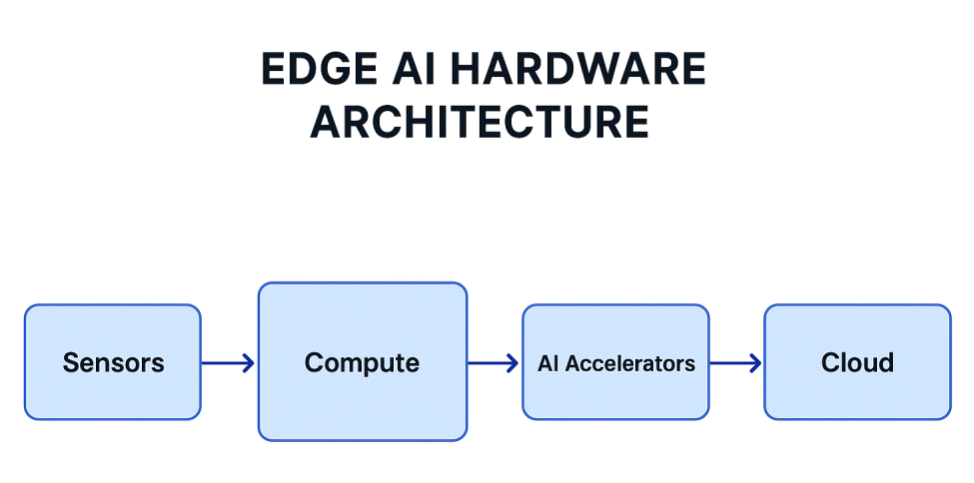
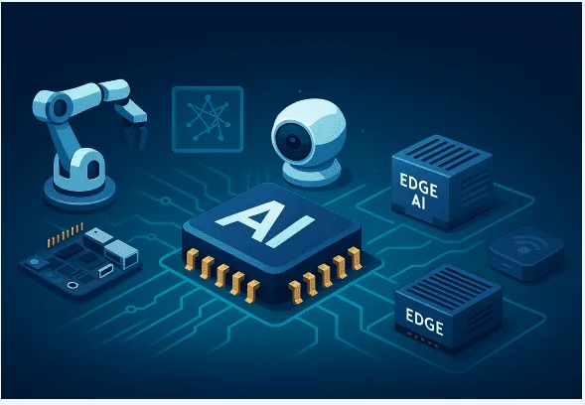
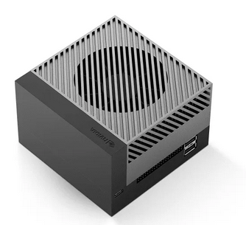
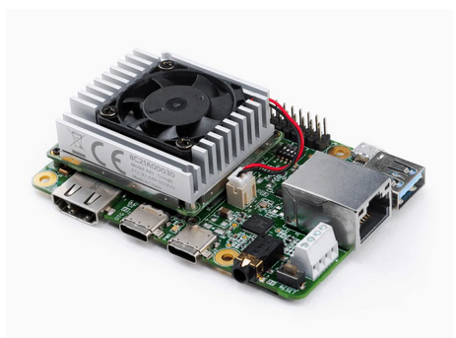
Edge AI
1. NVIDIA Jetson AGX Orin – High-End Edge AI Module for Robotics
NVIDIA’s Jetson AGX Orin is a flagship edge AI computer delivering up to 275 TOPS (trillions of operations per second) of AI performance. It packs a 12-core Arm Cortex-A78AE CPU alongside a 2048-core NVIDIA Ampere GPU with 64 Tensor Cores and up to 64 GB of LPDDR5 memory. The Jetson AGX Orin is built for demanding edge applications like autonomous robots, drones, and advanced computer vision systems.
2. Google Coral Dev Board – Low-Power AI Accelerator with Edge TPU
The Google Coral Dev Board features Google’s custom Edge TPU ASIC as a co-processor for on-device ML inferencing. The Edge TPU delivers 4 TOPS (tera-operations per second) of int8 performance at about 2 Watts (2 TOPS/W efficiency). This enables the Coral to execute state-of-the-art vision models like MobileNet V2 at nearly 400 frames per second in real time. The Dev Board’s system-on-module also includes an NXP i.MX 8M SoC (quad Cortex-A53 CPU, 1 GB or 4 GB RAM) to run a full Linux OS (Mendel Debian) for general control and networking tasks. . It’s popular for vision-based IoT applications such as smart security cameras, image recognition sensors, and portable ML devices. For example, the Coral can perform object detection or image classification locally on a camera feed with minimal latency,

Slide 6
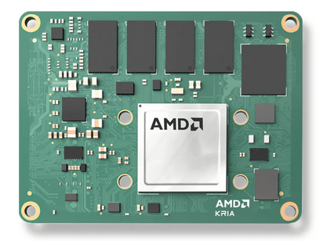
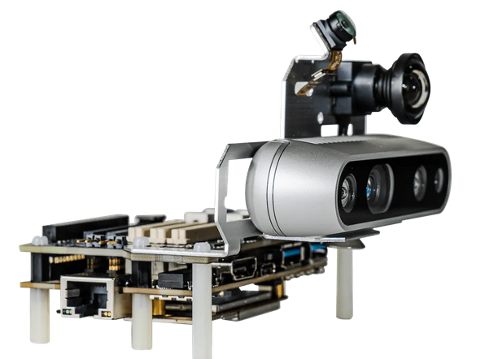
AMD Xilinx Kria K26 SOM – Adaptive Edge AI Module for Vision (KV260 Kit)
The Kria K26 is a system-on-module (SOM) by Xilinx (now part of AMD) targeting vision AI and robotics. It is built around a Xilinx Zynq UltraScale+ MPSoC which combines a quad-core Arm Cortex-A53 CPU with programmable FPGA logic and AI engines. The Kria K26 is optimized for computer vision at the edge, especially in industrial and smart city contexts. Typical applications include smart security cameras, automated optical inspection systems, vision-guided robots, and other embedded AI systems that need flexibility and low latency.
Qualcomm Robotics RB5 Platform – 5G-Enabled SoC for Edge AI Robots
Qualcomm’s Robotics RB5 is a cutting-edge platform combining high-performance AI computing with advanced connectivity. At its heart is the Qualcomm QRB5165 SoC (derived from the Snapdragon series), featuring an octa-core Kryo 585 CPU, an Adreno 650 GPU, and Qualcomm’s 5th-generation AI Engine. The AI Engine – which includes the Hexagon Tensor Accelerator (HTA) – delivers 15 TOPS of on-device AI performance for deep learning and computer vision tasks. Notably, the RB5’s image signal processor (Spectra 480 ISP) supports up to 7 concurrent cameras, enabling multi-camera setups for 360° sensing or stereo vision. The platform also supports 5G connectivity (via a companion modem module), allowing low-latency communication and teleoperation for robots. The RB5 is purpose-built for next-gen robots, drones, and autonomous machines. Its powerful heterogeneous computing (CPU, GPU, DSPs, ISP) and dedicated AI cores make it ideal for mobile robots performing sensor fusion, real-time object detection, SLAM (simultaneous localization and mapping), and path planning on-device.
Benefits of Using Machine Learning at Edge
Higher Scalability
Data Protection & Security
Low Operational Risks
Reduced Latency Rate
Cost-Effectiveness
Question: Will edge computing replace cloud computing ?

Slide 7
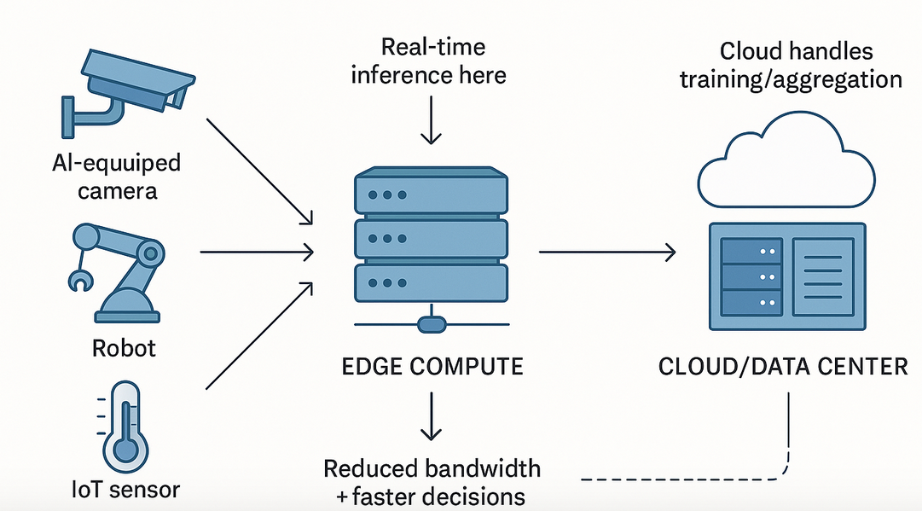
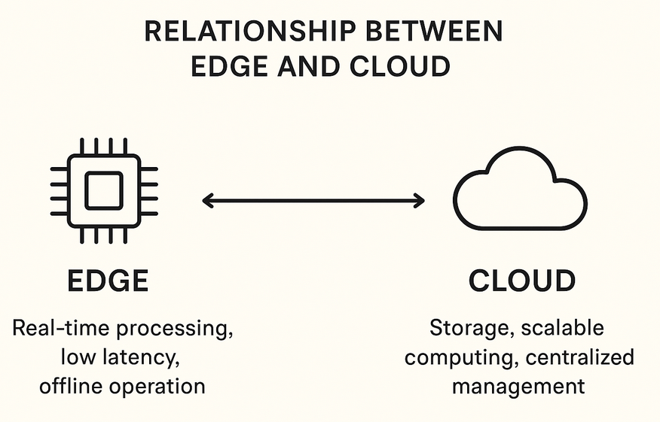
Edge vs Cloud
1. They solve different problems
Edge computing handles real-time, low-latency, privacy-sensitive tasks close to where data is produced. Examples: autonomous cars, industrial robots, smart cameras.
Cloud computing handles large-scale computation, long-term storage, training big AI models, analytics, backups. Examples: training GPT models, global databases, business applications.
2. Data growth is so large that cloud becomes more necessary
3. Edge computing depends on the cloud
4. Industry is moving to “cloud on the edge” , AWS Greengrass, Azure IoT Edge, Google Distributed Cloud Edge

Slide 8
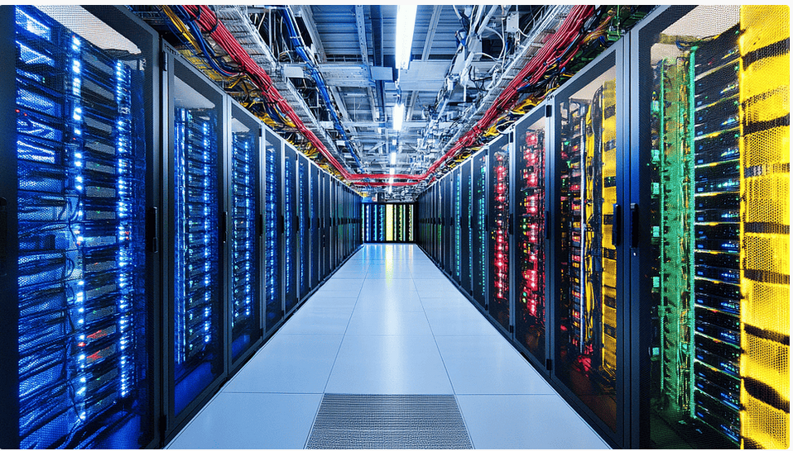
Data center – AI accelerators
Cloud: Computing resources (servers, storage, databases, networking) delivered over the internet and owned and managed by providers like AWS, Google Cloud (GCP), and Microsoft Azure. Data center: A physical facility with servers, storage, networking, cooling, and security that is usually owned and managed on-premises by a company itself.
AI data centers are specialized facilities designed to run artificial intelligence workloads, equipped with high-performance hardware (GPUs, TPUs, AI accelerators), massive storage systems, and advanced cooling and power infrastructure to train, deploy, and scale large AI models efficiently.
Computer accelerators, or hardware accelerators, are specialized components designed to efficiently offload and speed up specific, computationally intensive tasks from the general-purpose Central Processing Unit (CPU). GPU (Graphics Processing Unit) – Originally designed for graphics but well suited for parallel nature of AI computation.
TPU (Tensor Processing Unit) – Developed by Google for machine learning workloads.
ASIC (Application specific Integrated Circuits): Custom designed chips for a specific task, offering high performance and efficiency for AI tasks,
Field Programmable Gate Arrays (FPGAs): Programmable chips that can be reconfigured to act as a specialized AI accelerator.
Neural Processing Units (NPUs): A term often used for chips specifically designed to accelerate neural networks.

Slide 9
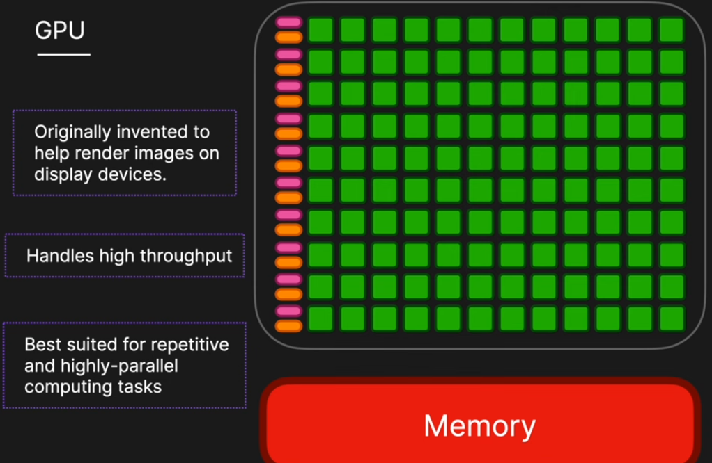
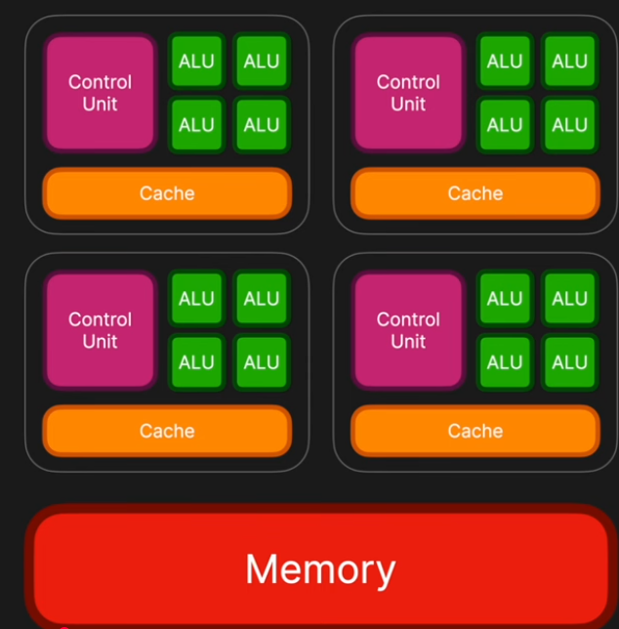
CPU vs GPU
Multi – Core CPU
Core: Self-contained, independent, processing unit

Slide 10
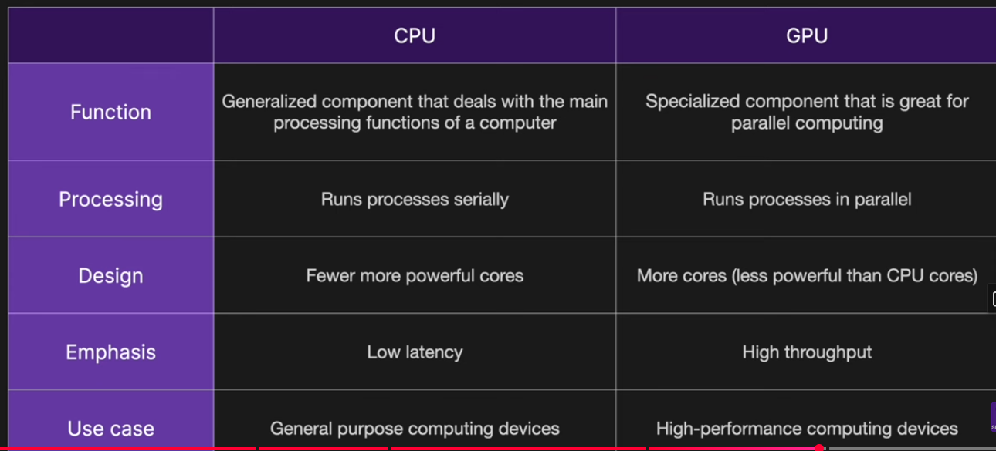
CPU vs GPU

Slide 11
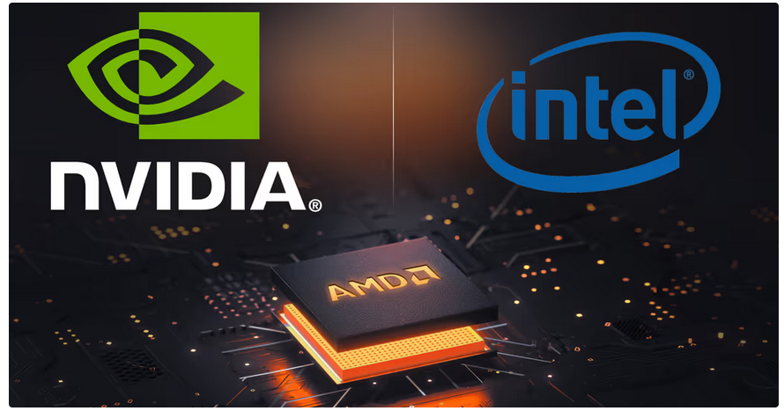
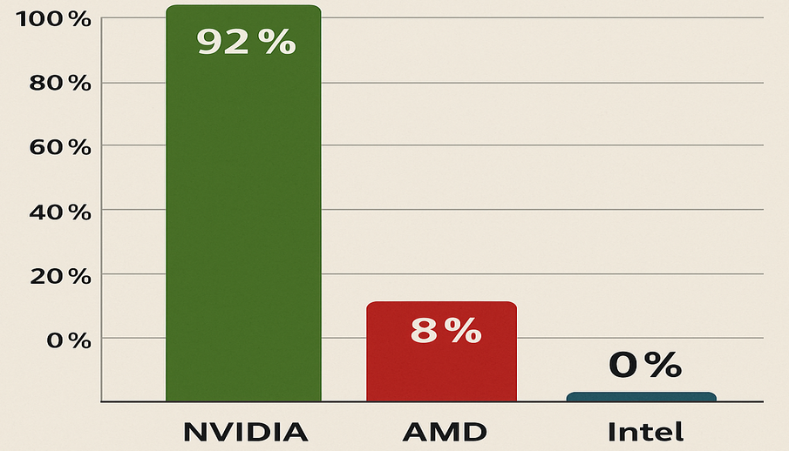
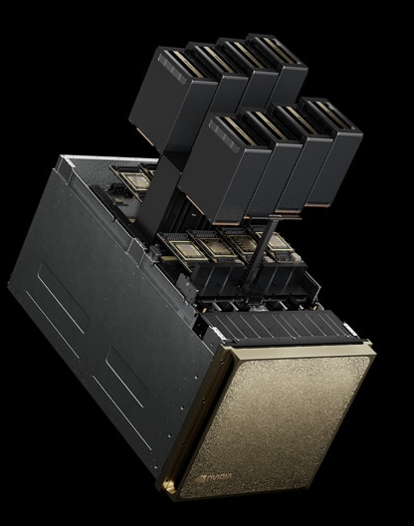
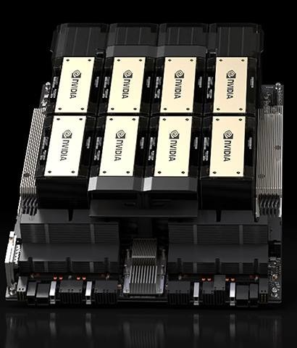
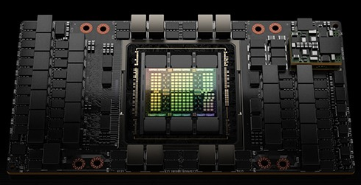
Graphics Processing Unit (GPU)
In 2025, the competitive landscape has changed notably. NVIDIA leads with nearly 92% of the discrete GPU market for dedicated cards, dominating in data centers as well as AI and gaming
Everyone wants to find gold, but the real value lies in creating the tools to mine it; in the same way, while the world chases AI, NVIDIA builds the hardware that drives it forward.
The best GPUs for AI and machine learning
1. NVIDIA B200 Tensor Core GPU
2. NVIDIA H200 Tensor Core GPU
3. NVIDIA H100 Tensor Core GPU

Slide 12
AI data center networking
AI data center networking refers to the high-speed, low-latency network infrastructure designed specifically to connect thousands of GPUs/TPUs and storage systems so they can train and run large AI models efficiently. AI workloads move massive amounts of data between GPUs.
Major manufacturers like NVIDIA, Intel, AMD, and Broadcom offer a range of AI-optimized NICs
Manufacturer | Product Example | Speed | Key Features
NVIDIA | ConnectX-7 VPI | 400GbE, 400Gb IB NDR | Ultra-low latency, RoCE support, hardware offloads
Intel | Ethernet Network Adapter | 100GbE | Based on Intel E810-CAM2 chipset, designed for cloud/data center applications
AMD | Pensando™ Pollara 400 AI NIC | 100/200/400Gbps | Fully hardware programmable (P4 engine), optimized for AI/ML workloads
Broadcom | Thor Ultra | 800GbE (emerging) | PCIe 6.0, advanced RoCE support, inline encryption

Slide 13
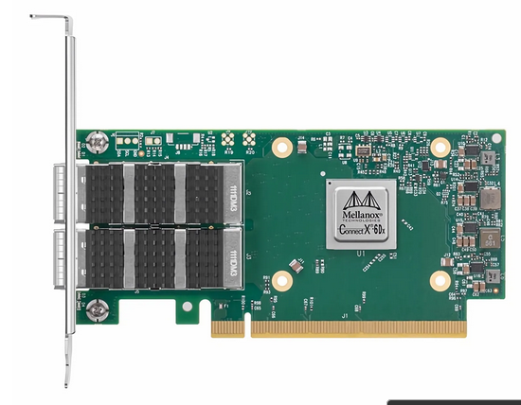
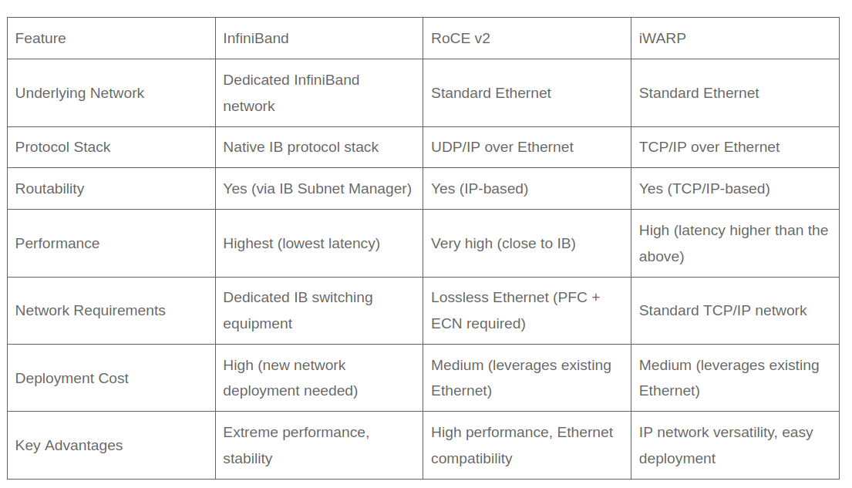
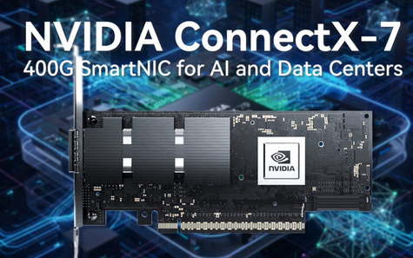
RDMA
RDMA (Remote Direct Memory Access) is a high-performance networking technology. It enables direct memory read/write between hosts without CPU involvement. It’s ideal for scenarios needing fast transfer speeds and low latency—like AI training, where compute nodes exchange large training datasets frequently. RDMA delivers low-latency, high-bandwidth transfer to speed up model training. RDMA relies on three core protocols: InfiniBand (IB), RDMA over Converged Ethernet (RoCE), and Internet Wide Area RDMA Protocol (iWARP).

Slide 14
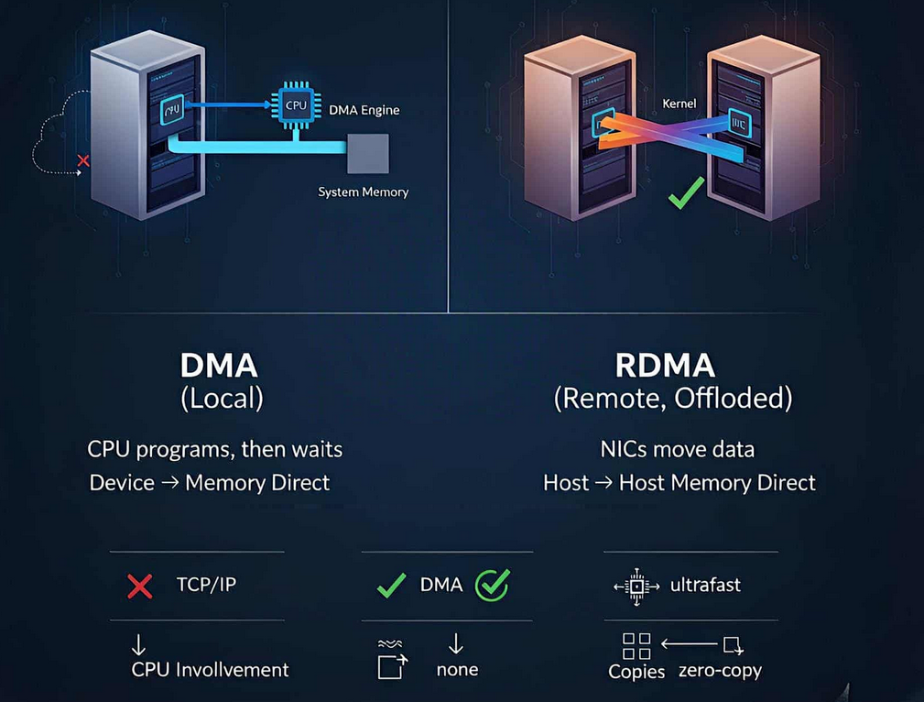
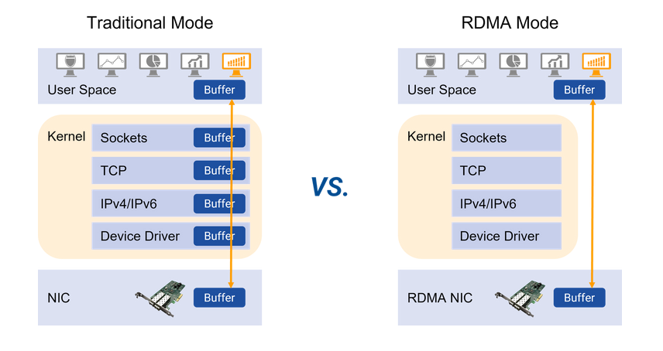
Direct Memory Access (DMA) lets a device move data to/from system memory without the CPU doing byte-by-byte copies. The CPU programs the DMA engine, then gets out of the way until an interrupt signals completion. Remote Direct Memory Access (RDMA) extends the DMA idea across machines. User-space applications register memory regions once, post “work requests” to NIC-managed queues, and the NICs move data between hosts directly with minimal kernel involvement and no extra copies along the hot path.

Slide 15
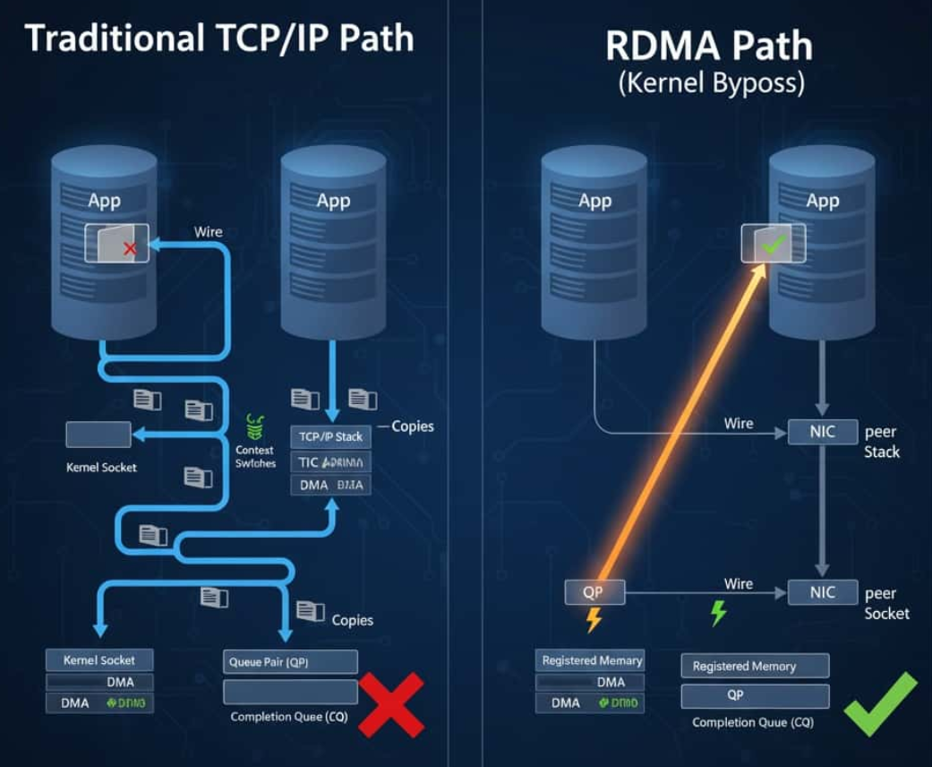
TCP/IP vs RDMA
When comparing RDMA and TCPIP, the fundamental difference lies in their data paths:
Traditional path (simplified):
App writes() → kernel socket → protocol stack (TCP/IP) → NIC DMA → wire → peer NIC → peer stack → peer socket → read() → app.
Multiple copies and context switches along the way.
RDMA path (simplified):
App registers memory, creates queue pairs and completion queues.
App posts RDMA WRITE/READ or SEND/RECV to the Send Queue.
NIC moves the payload directly from local memory to remote registered memory.
Completion shows up in the CQ. No per-message syscalls.

Slide 16
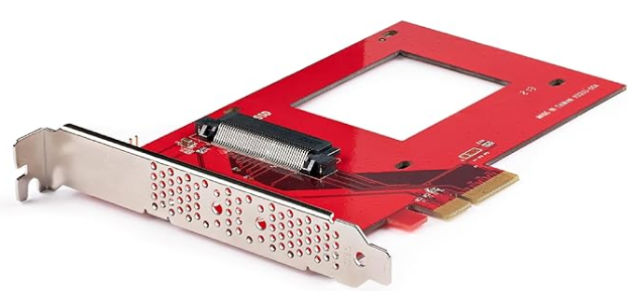
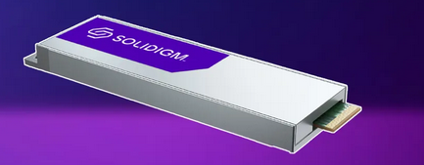
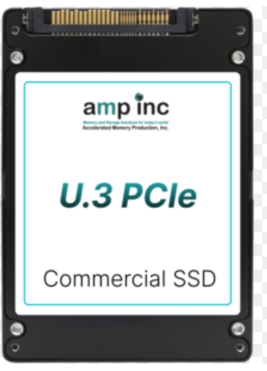
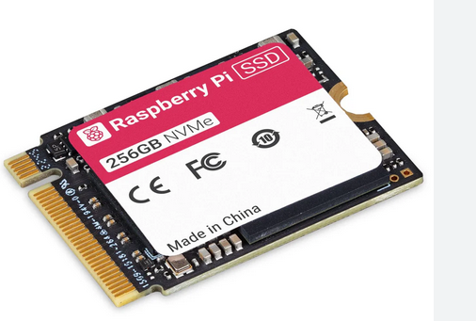
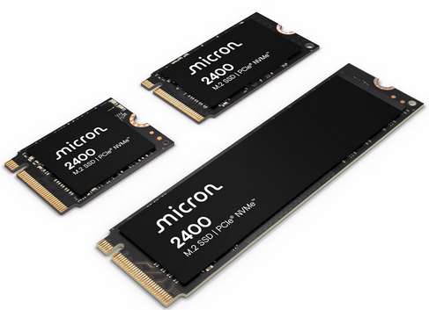
AI Data Center Storage
AI data centers use a specialized, high-performance storage architecture, primarily combining high-speed NVMe solid-state drives (SSDs) and high-capacity hard disk drives (HDDs) to manage the massive, data-intensive workloads of AI training and inference.
NVMe SSDs provide the high-speed, low-latency performance needed to quickly feed GPUs and other accelerators with data during AI model training.
Solidigm’s liquid-cooled D7-PS1010 eliminates the need for fans traditionally used in data center storage devices
U.3 to PCIe Adapter Card - PCIe 4.0 x4 Adapter For 2.5" U.3 NVMe SSDs
M.2 form

Slide 17
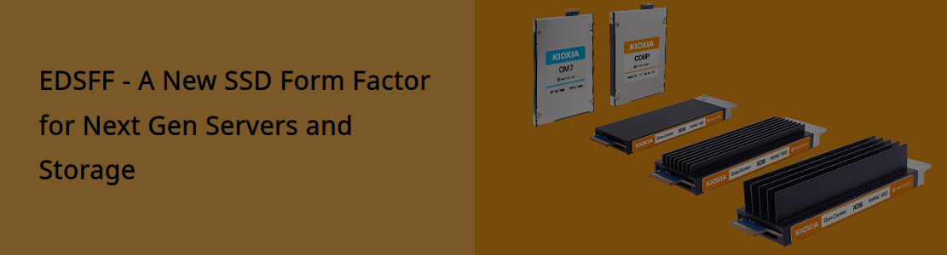
SSD
EDSFF (Enterprise and Data Center SSD Form Factor): This is a newer standard developed specifically for data center optimization, offering improvements in airflow, power, and density.

Slide 18
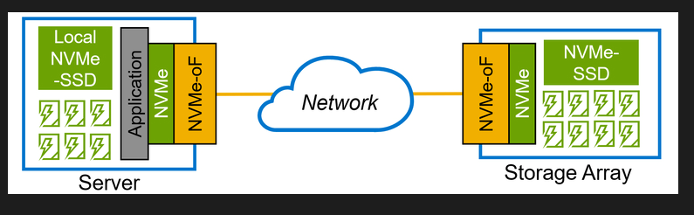
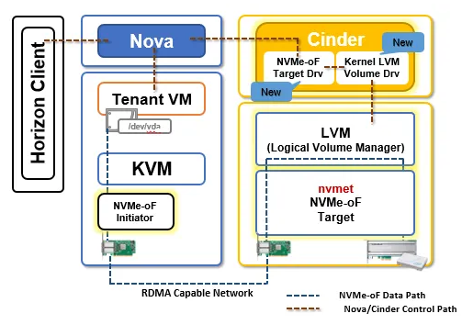
NVMeoF
NVMe-over-Fabrics (NVMe-oF) is a storage networking protocol that is an enabling technology for AI and machine learning (ML) workloads. It accelerates AI by providing high-speed, low-latency access to shared storage pools, which is crucial for data-intensive applications like big data analytics and AI training.

Slide 19
Learning Road map
1. Start with Core Foundations Learn C/C++, Data Structures, and Computer Architecture. Understand CPU pipelines, memory hierarchy, and OS fundamentals. 2. Embedded Systems & Firmware Study microcontrollers (ARM Cortex, RISC-V) and RTOS concepts (FreeRTOS, Zephyr). Practice with board bring-up, device trees, and driver development (I²C, SPI, PCIe). 3.Linux Kernel & Device Drivers Learn Linux internals: interrupts, memory management, and kernel modules. Implement simple drivers for GPIO, UART, or block devices. 4.Networking Fundamentals Understand TCP/IP stack, sockets, and NIC architecture. Explore RDMA, RoCE, and InfiniBand through simulation tools and open-source drivers. 5. Storage Technologies Study SATA, NVMe, and NVMeOF protocols. Experiment with SPDK (Storage Performance Development Kit) and fio benchmarking. | 6.Compute Acceleration (AI Hardware) Learn GPU programming (CUDA / OpenCL) and parallel computing concepts. Study AI frameworks (TensorFlow, PyTorch) from the hardware acceleration perspective. 7. Datacenter and Cloud Integration Explore PCIe Gen5/Gen6, CXL, DPUs, and virtualization (SR-IOV). Understand how embedded and datacenter hardware converge in AI inference and training clusters.

Slide 20
Career Opportunities
Skill Area | Industries That Hire | Companies Recruiting | Typical Roles
Core Foundations (C/C++, OS, Computer Architecture) | Semiconductors, Embedded, Cloud Infra | Intel, AMD, NVIDIA, Qualcomm, Broadcom, Apple, Google | Systems Software Engineer, Firmware Engineer
Embedded Systems & Firmware | IoT, Automotive, Robotics, Aerospace, Medical Devices | Bosch, Siemens, Honeywell, Philips, Renesas, STMicroelectronics, Tesla, DJI | Embedded Engineer, Firmware Developer, RTOS Engineer
Linux Kernel & Device Drivers | OS Vendors, Telecom, HPC, Cloud, Networking | Red Hat, Canonical, Collabora, Wind River, Cisco, Juniper, Arista | Kernel Engineer, Device Driver Developer
Networking Fundamentals (TCP/IP, NICs, RDMA) | Datacenter, Telecom, Cloud, HPC | Cisco, Juniper, Arista, Broadcom, Mellanox/NVIDIA, HPE, Dell | Network Systems Engineer, DPU Engineer, NIC Driver Developer
Storage Technologies (NVMe, NVMe-oF, SPDK) | Storage Vendors, Datacenters, Cloud Infrastructure | Samsung SSD, Western Digital, Seagate, Pure Storage, NetApp, Dell EMC | Storage Firmware Engineer, NVMe Stack Developer
Compute Acceleration (CUDA, GPUs, AI Hardware) | AI/ML, Autonomous Vehicles, HPC, Cloud | NVIDIA, Google TPU Team, Apple Neural Engine, Hailo, Graphcore, Tenstorrent, Cerebras | AI Accelerator Engineer, GPU Programmer
Datacenter & Cloud Integration (PCIe, CXL, DPUs, SR-IOV) | Cloud Providers, Hyperscalers, HPC | AWS, Google Cloud, Microsoft Azure, Meta, Oracle, Alibaba Cloud | Cloud Infrastructure Engineer, Systems/Platform Engineer
Board Bring-up & Low-level Hardware Integration | Semiconductors, Embedded, Automotive | NXP, TI, Qualcomm, Broadcom, Tesla, Rivian | Board Bring-up Engineer, HW-SW Co-design Engineer
Virtualization & High-performance I/O | Cloud, Telecom, Enterprise Datacenters | VMware, Nutanix, Red Hat, Intel, NVIDIA | Virtualization Engineer, High-performance I/O Engineer

Slide 21
