Slide 1
Linux Introduction

Slide 2
Profile
Rama Krishna.K
With an M.Tech (Master of Technology) degree and 20 years of experience in training, design, development, and debugging of embedded software, networking, and storage systems, primarily on the Linux operating system.Assosiated with Cisco, Juniper, Xilinx (AMD) and Honeywell.
Trainer Experience: Delivered corporate training for
1.Hewlett Packard Enterprise, Bangalore
(Linux Application development & Device drivers)
2. Seimens, Mumbai (Embedded C++)
3. FPT, Vietnam (C++, QT Programming)
3. Medha servo systems, Hyderabad. (Linux Device drivers)
4. Tata Elxsi systems, Bangalore. (Embedded Linux)
5. Embitel (Volkswagen), Bangalore (Linux, C++)
6. BORQS Software solutions, Bangalore (Embedded Linux)
→ Working as Guest faculty in Vector Embedded Training institute INIDA for C, C++, Linux internals, Embedded Linux and Device drivers.
→ Industry experience includes working with leading technology companies such as Juniper, Xilinx (now AMD), Cisco, and Honeywell.

Slide 3
History and open source - Timeline
1969 : UNIX, Thompson & Ritchie (AT&T Bell Labs)
1978 :BSD, Berkeley Software Distribution
Commercial vendors:Sun,HP,IBM,SGI,DEC
1984 :GNU, Richard Stallm an (FSF)
1986 : POSIX (Portable Operating System Interface)
1987 :Minix, Andy Tanenbaum
1989 :SVR4,AT&T and Sun
1991 : birth of Linux
IIn 1991, while attending the University of Helsink Torvalds became curious about operating systems^{[26]} and frustrated by the licensing of MINIX, which limited it to educational use only. He began to work on his own operating system which eventually became the Linux kernel
Notes:
<number>
<number>

Slide 4
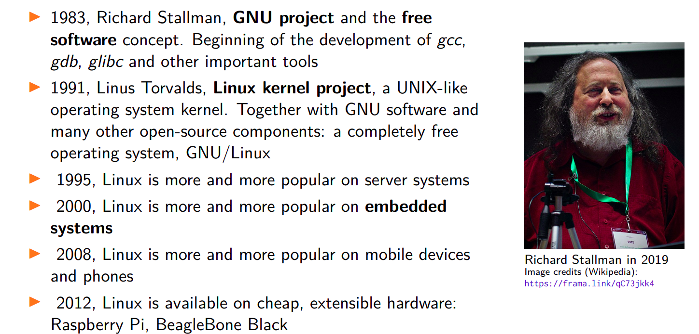
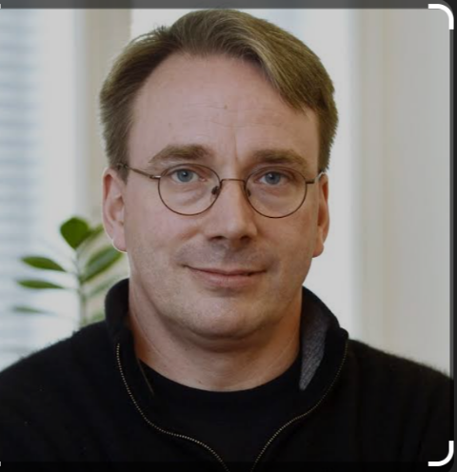
Birth of Free Software
https://www.youtube.com/watch?v=HmBp_QazaVI

Slide 5
Linux Features
UNIX-like operating system
Preemptive multi-tasking
Virtual memory (protected memory, paging)
Shared libraries
Demand loading, dynamic kernel modules
TCP/IP networking
SMP support , Multi processor, Multi thread
Open Source!
Support Various architectures (X86/ARM/MIPS/…)
Notes:
<number>
<number>

Slide 6
Kernel Functionality
Provides following facilities:
- Basic kernel services
- System start up and shutdown
- Memory management
- Process control
- File system
- I/O System (Device Drivers)
- IPC facilities
- Networking service
Notes:
<number>
<number>

Slide 7
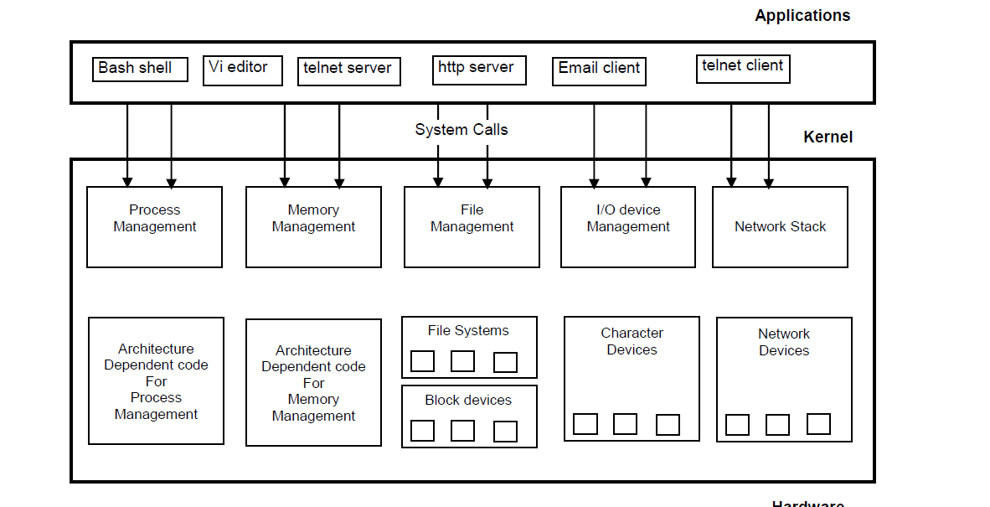
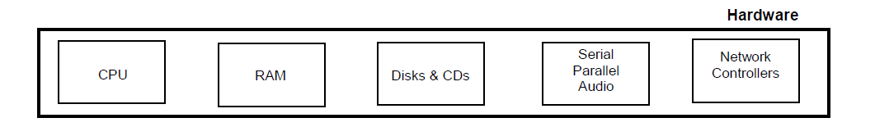

Slide 8
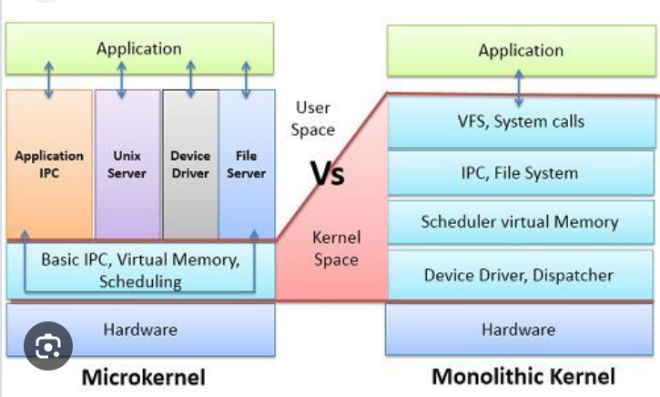
Monolithic Kernel Vs Micro Kernel
Monolithic Kernel: Includes all essential operating system services (device drivers, file system, memory management..) in a single large block of code running in kernel space
Ex: Linux, Unix and BSD
High performance
Lower stability – A bug in any part can crash the entire system
Micro Kernel: includes only the minimal required functionality in kernel space—typically just IPC, basic scheduling, and memory management. Other services (drivers, file systems, etc.) run in user space as separate processes. Lower performance (due to IPC) More stable – failures in user space services don’t crash the whole OS.

Slide 9
Basic commands
Date Print or set the system date and time
cal Prints calendar
Who Print who is currently logged in
Whoami Print the current user id and name
Uname Print system information, print information about the machine and operating system it is run on.
Passwd Modify a user password.
Echo Display message on screen
Pwd Present working directory
Notes:
<number>
<number>

Slide 10
Mkdir –Creates directory
Rmdir – Remove directory
Ls List information about FILEs
Cat Display the contents of a file
Cp Copy one or more files to another loc
Rm Remove files (delete/unlink)
More Display output one screen at a time
Wc Print byte, word, and line counts
Cmp Compare two files, and if they differ,
Diff Display the differences between two files
Chmod Change access permissions
Grep Search file(s) for specific text.
Ps Process status, information about processes running in memory
Notes:
<number>
<number>

Slide 11
fdisk -l
find,mkfs,top,htop,blkid,lsblk,lsusb,lspci objdump,readelf,nm
egrep --color "vmx|svm" /proc/cpuinfo
sudo /usr/bin/update-manager
lsb_release -a
tldr ps
blkid, /etc/fstab ,sudo apt update, (/etc/apt/sources.lst) Lab activities:
1. Format the Linux USB disk and create partitions with fdisk command
2. Prepare Raspberry Pi with USB boot way.
3. Install arm-linux 32 bit compiler explore the toolchain utilities.
Gcc compilers vs Other compilers
https://alibabatech.medium.com/gcc-vs-clang-llvm-an-in-depth-comparison-of-c-c-compilers-899ede2be378
Notes:
<number>
<number>

Slide 12
GCC - The GNU Compiler Collection, supports C, C++, Fortran, and more. It's mature, widely used, and very stable.
Clang - Frontend Compiler - A modern compiler frontend for C/C++/Objective-C that uses LLVM as its backend. Parses the source code and generates LLVM IR (Intermediate Representation), which is then passed to LLVM for further processing.
LLVM - Compiler Infrastructure - A set of reusable compiler tools/libraries used by compilers like Clang (and others). LLVM takes the IR of Clang→ performs optimizations → generates machine code or other targets.
Feature | Gcc | Clang | LLVM
Role | Full compiler suite | Frontend compiler | Backend + optimizer infrastructure
Maintained by | GNU Project | LLVM Project (mostly Apple, Meta, etc.) | LLVM Project
Language support | C, C++, Fortran, Go, Ada, more | C, C++, Objective-C/C++ | Language-agnostic
Compilation speed | Slightly slowe | Faster | N/A
Output formats | Native machine code | LLVM IR → optimized/native code | LLVM IR → optimized/native code
License | GPL (v3) | BSD-like | BSD-like
Toolchain compatibility | Standard in Linux | Compatible with GCC tools | Modular; used in many tools
Cross-compilation | Supported (more mature) | Supported | Backend-dependent
Maturity | Very mature | Newer, but widely used | Widely adopted, industry standard
Use in industry | Linux distros, embedded, HPC | macOS/iOS, Chrome, Android, Rust | Used by many compilers (e.g., Rust, Julia, Swift)

Slide 13
Gcc compiler options
Flag | Description
-o | Output file name for executable $gcc main.c -o main
-Wall | Enable all warnings $gcc -Wall main.c -o main
-E | Preprocessor stage $gcc -E main.c > main.i
-S | Produce assembly code $gcc -S main.c > main.s
-c | Produce only compiled code, no linker invocation $gcc -C main.c
-save-temps | Produce all above stage files $gcc -save-temps main.c
-l | Link shared libraries $gcc -Wall main.c -o main -lpthread
-fPIC | To create shared library generate position indepndent code $ gcc -c -Wall -Werror -fPIC Cfile.c ,$ gcc -shared -o libCfile.so Cfile.o
-v | Provide verbose information, gcc -Wall -v main.c -o main
-D | Enable macro during compile time $ gcc -Wall -DMY_MACRO main.c -o main
-Werror | Treate warning as error
-fstack-usage | Analyzing stack usage of individual function
-g | Produce debug information
-On | Optimization levels

Slide 14
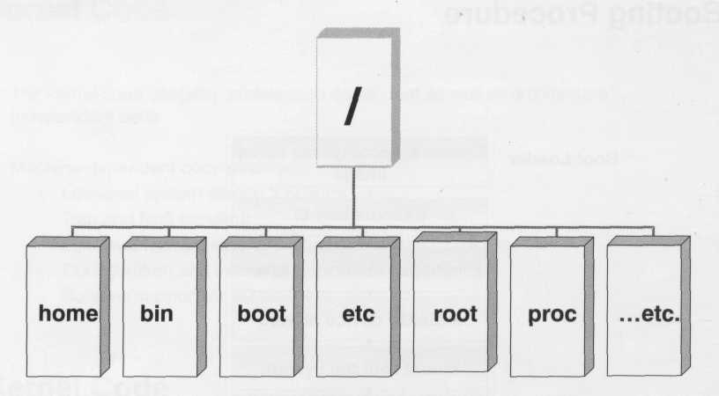
File Tree Structure
Inverted tree structure
Notes:
<number>
<number>

Slide 15
File system description
/ root directory
/bin Essential low level system utilities
/usr/bin High level system utilities
/sbin Super user system utilities
/lib program libraries
/usr/lib program libraries for high level
/tmp Temporary file storage system
/home User home directories
/etc Unix system configuration and information
/dev Hardware devices
/proc Pseudo file system which used as interface to kernel
Notes:
<number>
<number>

Slide 16
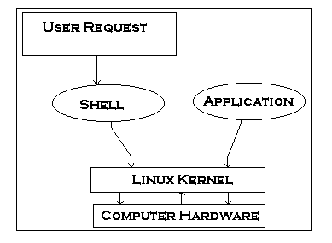
Shell Scripting:
Shell is user program or it’s environment provided for user interface. Shell is common language interpreter that executes commands read from standard input device (keyboard) or from a file. Shells available in linux
Shell Name | Developed by | Where | Remark
BASH ( Bourne-Again SHell ) | Brian Fox and Chet Ramey | Free Software Foundation | Most common shell in Linux. It's Freeware shell.
CSH (C SHell) | Bill Joy | University of California (For BSD) | The C shell's syntax and usage are very similar to the C programming language.
KSH (Korn SHell) | David Korn | AT & T Bell Labs | --
TCSH | See the man page. Type $ man tcsh | -- | TCSH is an enhanced but completely compatible version of the Berkeley UNIX C shell (CSH).

Slide 17
To find available shells in your system
$ cat /etc/shells
To find current shell
$echo $0
$echo $SHELL
Shell script:
Shell script is series of commands written in plain text file.

Slide 18
How to write shell script
Following steps are required to write shell script:
(1) Use any editor like vi or mcedit to write shell script.
(2) After writing shell script set execute permission for your script as follows syntax: chmod permission your-script-name
Examples: $ chmod +x your-script-name $ chmod 755 your-script-name
Note: This will set read write execute(7) permission for owner, for group and other permission is read and execute only(5).
(3) Execute your script as syntax: bash your-script-name sh your-script-name ./your-script-name
Examples: $ bash bar $ sh bar $ ./bar
In Liunx shell there are 2 types of variables
System Variables
User defined Variables

Slide 19
You can see system variables by using $ set command
System Variable | Meaning
BASH=/bin/bash | Our shell name
BASH_VERSION=1.14.7(1) | Our shell version name
COLUMNS=80 | No. of columns for our screen
HOME=/home/vivek | Our home directory
LINES=25 | No. of columns for our screen
LOGNAME=students | students Our logging name
OSTYPE=Linux | Our Os type
PATH=/usr/bin:/sbin:/bin:/usr/sbin | Our path settings
PS1=[\u@\h \W]\$ | Our prompt settings
PWD=/home/students/Common | Our current working directory
SHELL=/bin/bash | Our shell name
USERNAME=vivek | User name who is currently login to this PC

Slide 20
$ vi variscript # # # Script to test MY knowledge about variables! # myname=Vivek myos = TroubleOS myno=5 echo "My name is $myname" echo "My os is $myos" echo "My number is myno, can you see this number"

Slide 21
Lab activities:
Mount USB disk with command and copy directory to and from USB
Format USB disk with mkfs
Write bash script to delete temp folder each day at 6:30 pm with crontab –e
30 18 * * * rm /home/someuser/tmp/*
4. Install Ubuntu on USB as mount device
https://itsfoss.com/intsall-ubuntu-on-usb/

