Slide 1
Static library vs Dynamic library

Slide 2
Static library
Static libraries, also known as archives, were the first type of library to be pro-
vided on UNIX systems. They provide the following benefits:
-> We can place a set of commonly used object files into a single library file that can then be used to build multiple executables, without needing to recompile the original source files when building each application.
-> Link commands become simpler. Instead of listing a long series of object files on the link command line, we specify just the name of the static library. The linker knows how to search the static library and extract the objects required by the executable.

Slide 3
Static library
Static library disadvantages:
-> Disk space is wasted storing multiple copies of the same object modules. Such wastage can be considerable.
-> If several different programs using the same modules are running at the same time, then each holds separate copies of the object modules in virtual memory, thus increasing the overall virtual memory demands on the system.
-> If a change is required (perhaps a security or bug fix) to an object module in a static library, then all executables using that module must be relinked in order to incorporate the change. This disadvantage is further compounded by the fact that the system administrator needs to be aware of which applications were linked against the library.

Slide 4
Dynamic library
shared library is that a single copy of the object modules is shared by all programs requiring the modules.
-> The object modules are not copied into the linked executable; instead, a single copy of the library is loaded into memory at run time, when the first program requiring modules from the shared library is started. When other programs using the same shared library are later executed, they use the copy of the library that is already loaded into memory. The use of shared libraries means that executable programs require less space on disk and (when running) in virtual memory.
-> Global or static variables in a shared library are placed in the data section, which is not shared between processes. Each process gets its own copy of writable data (via Copy-On-Write if initially the same).
-> The cc –fPIC option specifies that the compiler should generate position-independent
code. This changes the way that the compiler generates code for operations such as accessing global, static, and external variables; accessing string constants; and taking the addresses of functions. These changes allow the code to be located at any
virtual address at run time. This is necessary for shared libraries, since there is no
way of knowing at link time where the shared library code will be located in memory.

Slide 5
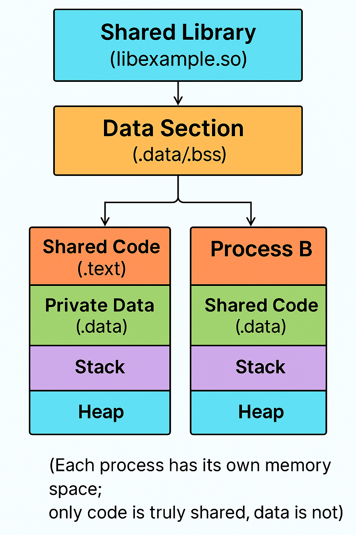
Dynamic linking, which is the task of resolving the embedded library name at run time. This task is performed by the dynamic linker (also called the dynamic linking loader or the run-time linker). The dynamic linker is itself a shared library, named /lib/ld-linux.so.2, which is employed by every ELF executable that uses shared libraries.

Slide 6
rama@rama-Inspiron-3501:~/Downloads/Corporate_trainings/siemen/Linux_userspace/3-Make/string$ ldd ./a.out
linux-vdso.so.1 (0x00007ffefedd8000)
libctest.so (0x00007fc8acc5c000)
libc.so.6 => /lib/x86_64-linux-gnu/libc.so.6 (0x00007fc8aca00000)
/lib64/ld-linux-x86-64.so.2 (0x00007fc8acc68000)
-> cat /proc/$PID/maps -- Check inode for static and dynamic library
-> objdump – Analyse the output for static and dynamic library

