Slide 1
mmap

Slide 2
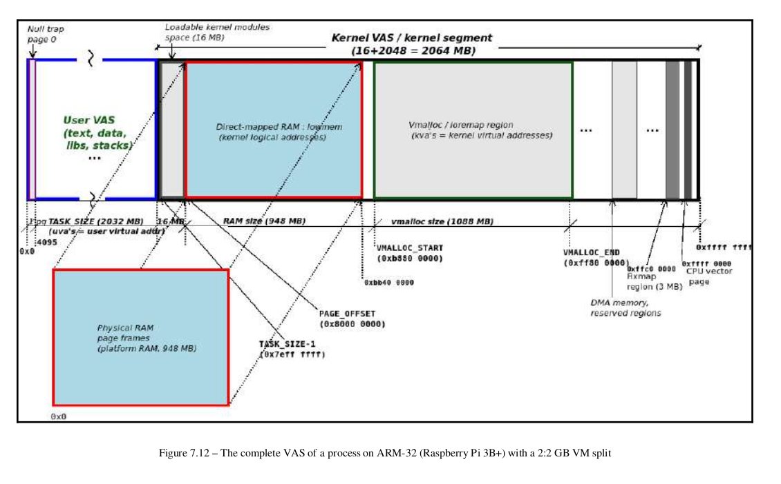

Slide 3
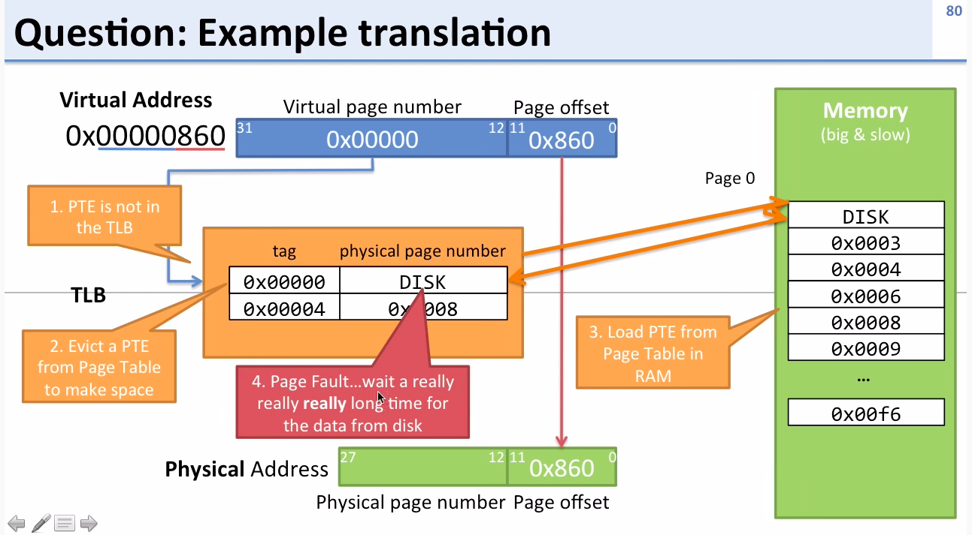
https://www.youtube.com/watch?v=95QpHJX55bM

Slide 4
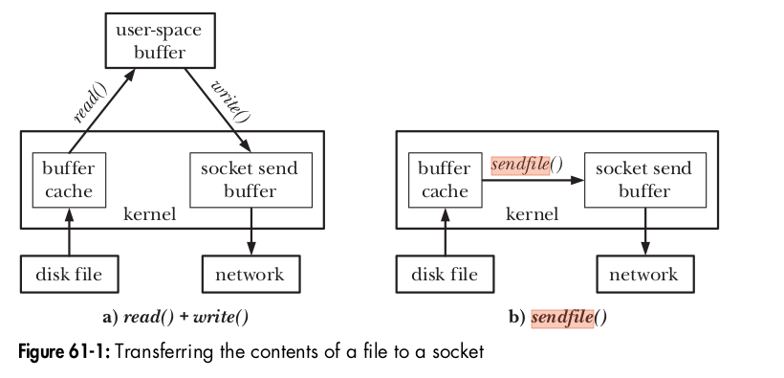
sendfile
Applications such as web servers and file servers frequently need to transfer the unaltered contents of a disk file through a (connected) socket. One way to do this would be a loop of the following form:
while ((n = read(diskfilefd, buf, BUZ_SIZE)) > 0)
write(sockfd, buf, n);
For many applications, such a loop is perfectly acceptable. However, if we frequently transfer large files via a socket, this technique is inefficient
The sendfile() system call is designed to eliminate this inefficiency. When an application calls sendfile(), the file contents are transferred directly to the socket, without passing through user space, as shown on the right side of Figure
ssize_t sendfile(int out_fd , int in_fd , off_t * offset , size_t count );
Returns number of bytes transferred, or –1 on error

Slide 5
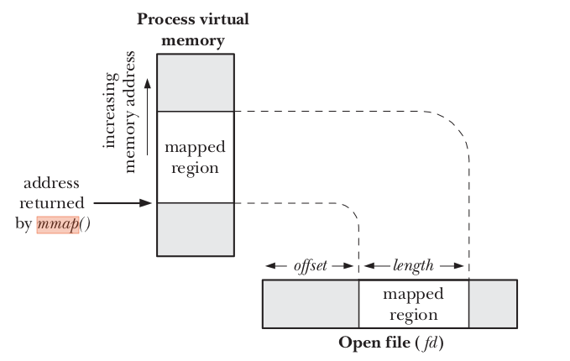
There are sound advantages to using mmap when it’s feasible to do so. X server, which transfers a lot of data to and from
video memory; mapping the graphic display to user space dramatically improves the throughput, as opposed to an lseek/write implementation. Another typical example is a program controlling a PCI device. Most PCI peripherals map their control registers to a memory address, and a high-performance application might prefer to have direct access to the registers instead of repeatedly having to call ioctl to get its work done.
#include <sys/mman.h>
void *mmap(void * addr , size_t length , int prot , int flags , int fd , off_t offset );
Returns starting address of mapping on success, or MAP_FAILED on error
#include <sys/mman.h>
int munmap(void * addr , size_t length );
Returns 0 on success, or –1 on error

Slide 6
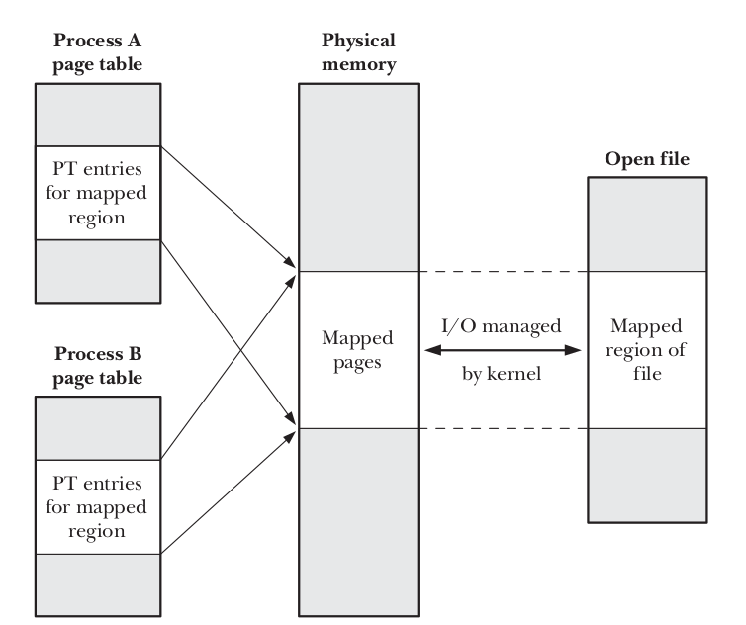
MAP_PRIVATE
Create a private mapping. Modifications to the contents of the region are not visible to other processes employing the same mapping, and, in the case of a file mapping, are not carried through to the underlying file.
MAP_SHARED
Create a shared mapping. Modifications to the contents of the region are visible to other processes mapping the same region with the MAP_SHARED attribute and, in the case of a file mapping, are carried through to the underlying file. Updates to the file are not guaranteed to be immediate;

Slide 7
Memory-mapped I/O has two potential advantages:
-> By replacing read() and write() system calls with memory accesses, it can simplify the logic of some applications.It can, in some circumstances, provide better performance than file I/O carried out using the conventional I/O system calls.
The kernel automatically carries modifications of the contents of a MAP_SHARED map-
ping through to the underlying file, but, by default, provides no guarantees about
when such synchronization will occur.
The msync() system call gives an application explicit control over when a shared mapping is synchronized with the mapped file. Synchronizing a mapping with the underlying file is useful in various scenarios. For example, to ensure data integrity, a database application may call msync() to force data to be written to the disk. Calling msync() also allows an application to ensure that updates to a writable mapping are visible to some other process that performs a read() on the file.
#include <sys/mman.h>
int msync(void * addr , size_t length , int flags );
Returns 0 on success, or –1 on error
MS_SYNC
Perform a synchronous file write. The call blocks until all modified pages of the memory region have been written to the disk.
MS_ASYNC
Perform an asynchronous file write. The modified pages of the memory region are written to the disk at some later point and are immediately made visible to other processes performing a read() on the corresponding file region.

Slide 8
In some applications, it is useful to lock part or all of a process’s virtual memory so that it is guaranteed to always be in physical memory. One reason for doing this is to improve performance. Accesses to locked pages are guaranteed never to be delayed by a page fault. This is useful for applications that must ensure rapid response times.
Another reason for locking memory is security. If a virtual memory page containing sensitive data is never swapped out, then no copy of the page is ever written to the disk. If the page was written to the disk, it could, in theory, be read directly from the disk device at some later time.
#include <sys/mman.h>
int mlock(void * addr , size_t length );
int munlock(void * addr , size_t length );
Both return 0 on success, or –1 on error

