Slide 1
Memory Management
in Linux

Slide 2
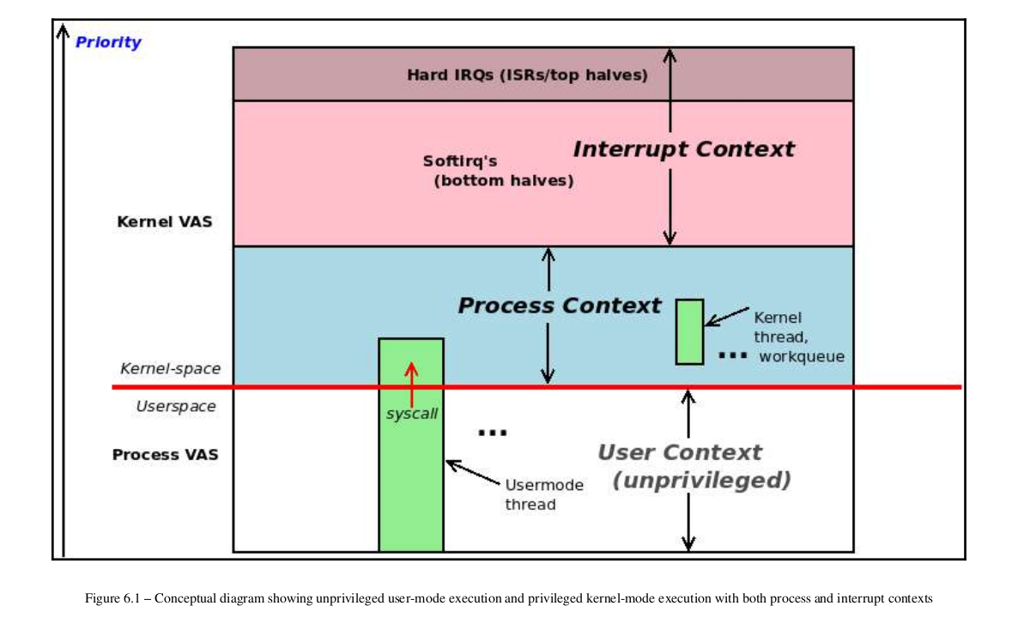
Process context: The kernel is entered from a system call or processor exception (such as a page fault) and kernel code is executed,kernel data worked upon; it's synchronous (top down).
Interrupt context: The is kernel entered from a peripheral chip's hardware interrupt and kernel code is executed, kernel data worked upon; it's asynchronous (bottom up).

Slide 3
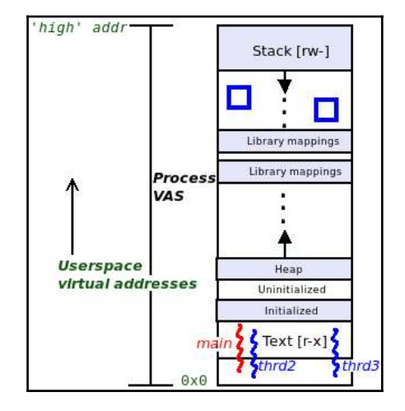

Slide 4
The user VAS is divided into homogeneous memory regions called segments or, more technically, mappings. Every Linux process has at least these mappings (or segments):
Text segment: This is where the machine code is stored; static (mode: r-x ).
Data segment(s): This is where the global and static data variables are stored (mode: rw- ). It is internally divided into three distinct segments:
Initialized data segment: Pre-initialized variables are stored here; static.
Uninitialized data segment: Uninitialized variables are stored here (they are auto-initialized to 0 at runtime; thisregion is sometimes called the bss); static.
Heap segment: The library APIs for memory allocation and freeing (the familiar malloc(3) family of routines) get memory from here.
Libraries (text, data): All shared libraries that a process dynamically links into are mapped (at runtime, via the loader) into the process VAS (mode:r-x / rw- ).
Stack: A region of memory that uses the Last In, First Out (LIFO) semantics; the stack is used for the purpose of implementing a high-level language's function-calling mechanism. It includes parameter passing, local variable instantiation (and destruction), and return value propagation. It is a dynamic segment. On all modern processors (including the x86 and ARM families), the stack 'grows' toward lower addresses (called a fully descending stack)
CONFIG_VMSPLIT_2G=y
# CONFIG_VMSPLIT_1G is not set
CONFIG_PAGE_OFFSET=0x80000000
=> Execute the program symbols.c

Slide 5
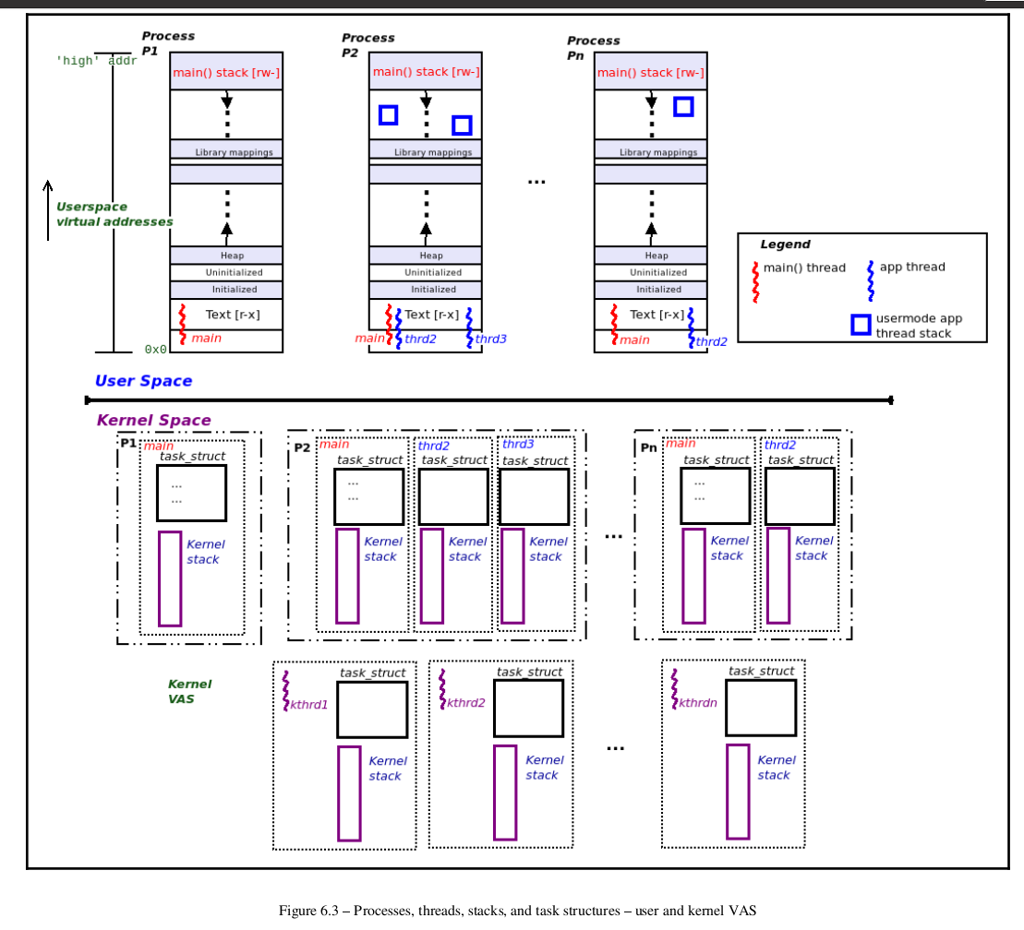
Stacks:
Every user space thread has two stacks:
A user mode stack (is in play when the thread executes user-mode code paths)
A kernel mode stack (is in play when the thread executes kernel-mode code paths) A pure kernel thread has only one stack - a kernel mode stack

Slide 6
we require one stack per thread per privilege level supported by the CPU. On modern OSes such as Linux, we support two privilege levels
– the unprivileged user mode (or user space) and the privileged kernel mode (or kernel space).
Thus, on Linux, every user space thread alive has two stacks:
A user space stack: This stack is in play when the thread executes user-mode code paths.
A kernel space stack: This stack is in play when the thread switches to kernel mode (via a system call or processor exception) and executes kernel code paths (in process context).
A kernel-mode stack is similar in most respects to its user-mode counterpart – every
time a function is called, a stack frame is set up. and the stack "grows"
toward lower virtual addresses. But, unlike the dynamic user-mode stack, the kernel-
mode stack is fixed in size and small. Kernel-mode stacks are fixed in size (static) and are quite small. Practically speaking, their size is 2 pages on 32-bit and 4 pages on 64-bit
OSes (with a page typically being 4 KB in size). They are allocated at thread creation time (usually boils down to _do_fork() ).
While discussing user and kernel-mode stacks, we should also briefly mention this point: many architectures (including x86 and ARM64) support a separate per-CPU stack for interrupt handling. When an external hardware interrupt occurs, the CPU's control unit immediately re-vectors control to, ultimately, the interrupt handling code /proc/<pid>/stack . Ex. sudo cat /proc/3085/stack

Slide 7
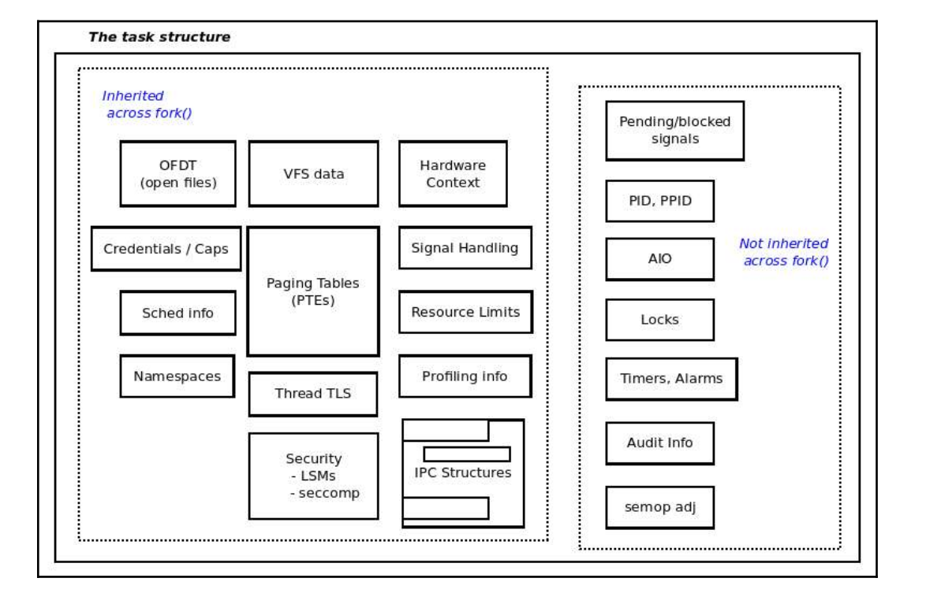
=> Execute program to display running process and threads

Slide 8
Single address space:
-Simple systems have single address space
- Memory and peripherals share
- Memory is mapped to one part
- Peripherals are mapped to another part
- All processes and OS share the same memory space
- No memory protection
Virtual memory:
Virtual memory introduces a layer of indirection that allows a number of nice things. With virtual memory, programs running on the system can allocate far more memory than is physically available;
indeed, even a single process can have a virtual address space larger than the system’s physical memory.
Virtual memory also allows the program to play a number of tricks with the process’s address space, including mapping the program’s memory to device memory.
Maps the virtual address to Physical RAM
Maps the virtual address to Hardware devices
PCI devices, GPU RAM..
Advantages of Virtual memory
1. Each process can have different memory mapping
- One process’s RAM inaccessible to other process
- Kerneal RAM invisible to user space process
2. Memory can be moved out and swapped to disk
MMU (memory management unit) is the hardware responsible for implementing virtual memory
- Sits between CPU core and memory
-Most often part of physical CPU itself, On ARM it is licence based core
Transpalently handles all memory access from load/store instructions
- Maps memory access using virtual address to system RAM
- Maps access using virtual address to memory mapped peripheral devices
- Handles permission
- Generates an exception (page fault) on an invalid address
- Unmapped address or insufficient permission

Slide 9
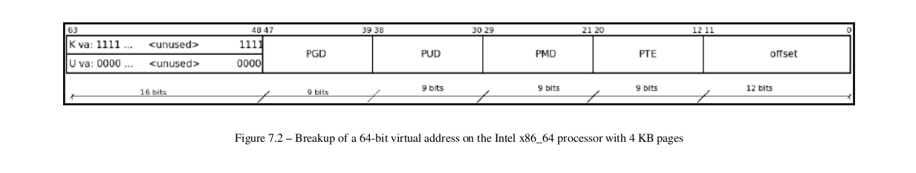
On a Linux OS running on a 32-bit processor (or compiled for 32-bit), the highest virtual address will be 2 32 = 4 GB.
On a Linux OS running on (and compiled for) a 64-bit processor, the highest virtual address will be 2 64 = 16 EB. (EB is short for exabyte. Believe me, it's an enormous quantity. 16 EB is equivalent to the number 16 18x 10 .)
on a 64-bit system, even with 48-bit addressing, there will be more fields within the virtual address bitmask.

Slide 10
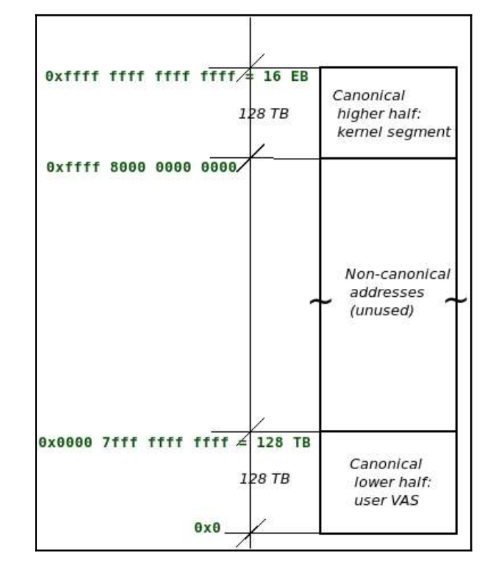
Interestingly, with the 48-bit addressing scheme, the vast majority of the VAS is left unused. This is why we term the VAS as being very sparse.

Slide 11
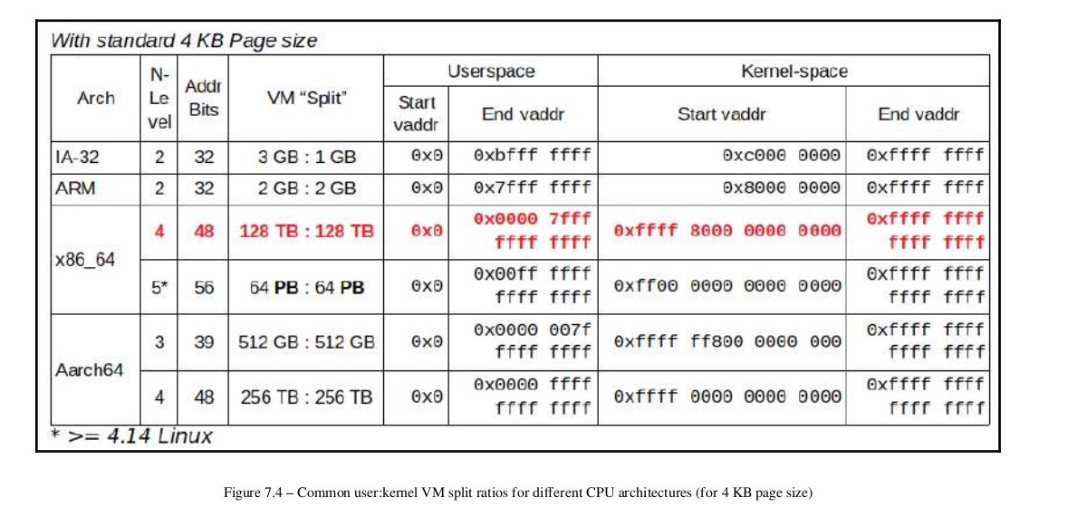

Slide 12
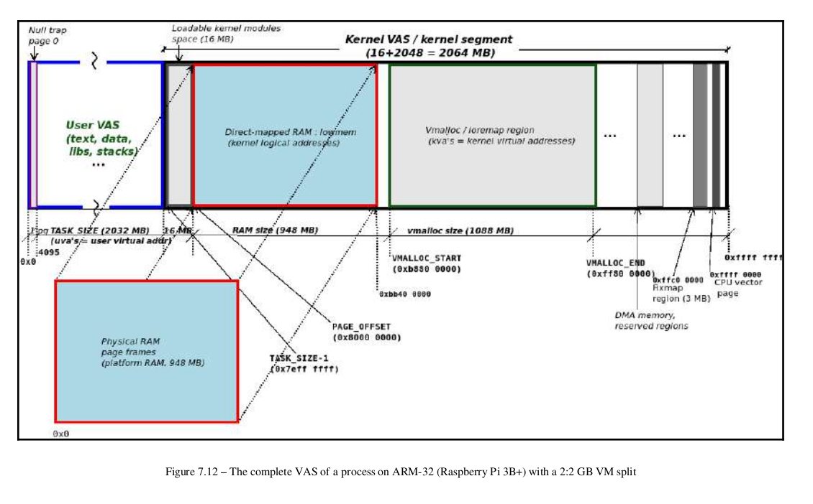

Slide 13
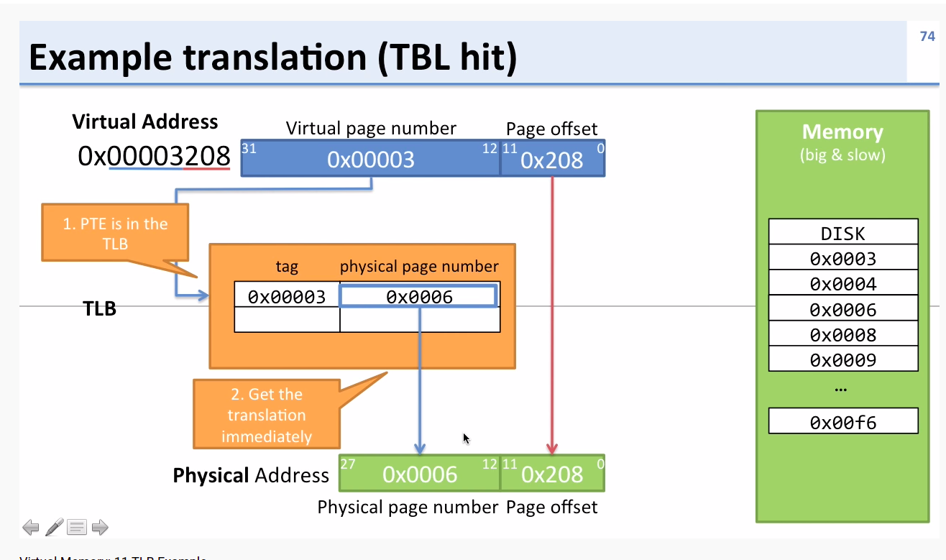
Translation look aside buffer
- TLB is list of mappings from vitual to physical space in hardware, also holds permission bits
- There are fixed number of entries in the TLB, which vaies by CPU
- The TLB is part of MMU systems
TLB is consulted by MMU when the CPU access virtual address
- if the virtual address is in TLB the MMU can look up the physical resource (RAM or hardware)
- if the virtual address is not in the TLB, the MMU will generate page fault exception and interrupt the CPU
- if the address is in TLB, but the permission are in sufficient, the MMU will generate page fault
Page fault:
- A page fault is CPU exception, generated when software attepmpts to use an invalid vartiual address. There are 3 cases
1. The virtual address is not mapped for process requesting for it
2. The process has insufficient permission for the address
3. The virtual address is valid, but swapped out

Slide 14
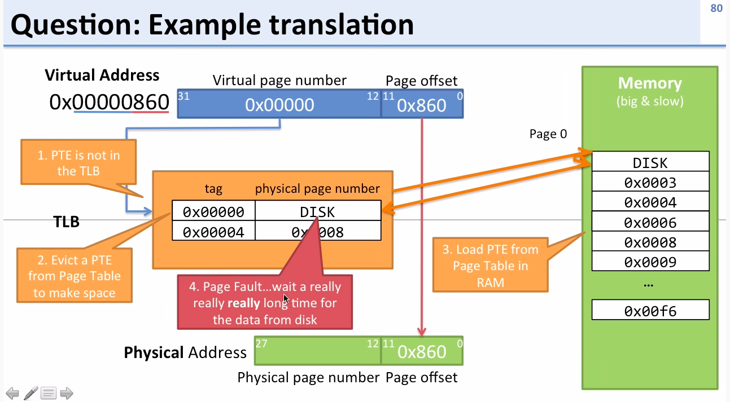
https://www.youtube.com/watch?v=95QpHJX55bM

Slide 15
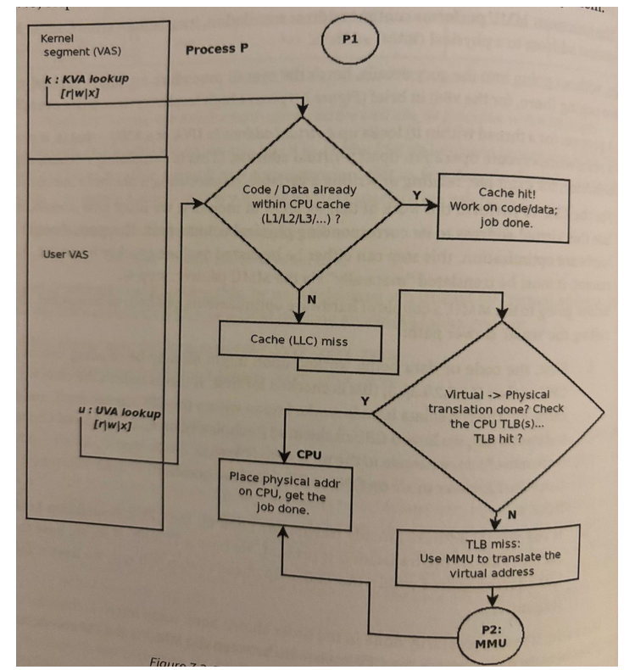

Slide 16
CR3 is a control register in Intel/AMD x86 processors that holds the physical address of the top-level page table used for virtual-to-physical address translation.
ARM (Translation Table Base Registers (TTBRs).
TTBR0_EL1 = base address of user page table
TTBR1_EL1 = base address of kernel page table
TTBR0_EL2 / TTBR0_EL3 Page-table base for hypervisor / firmware
Essentially, with 48-bit addressing, we use bits 0 to 47 (the LSB 48 bits) and ignore the Most Significant Bit (MSB) 16 bits, treating it much as a sign extension. Not so fast though; the value of the unused sign-extended MSB 16 bits varies with the address space you are in:
Kernel VAS: MSB 16 bits are always set to 1.
User VAS: MSB 16 bits are always set to 0.

Slide 17
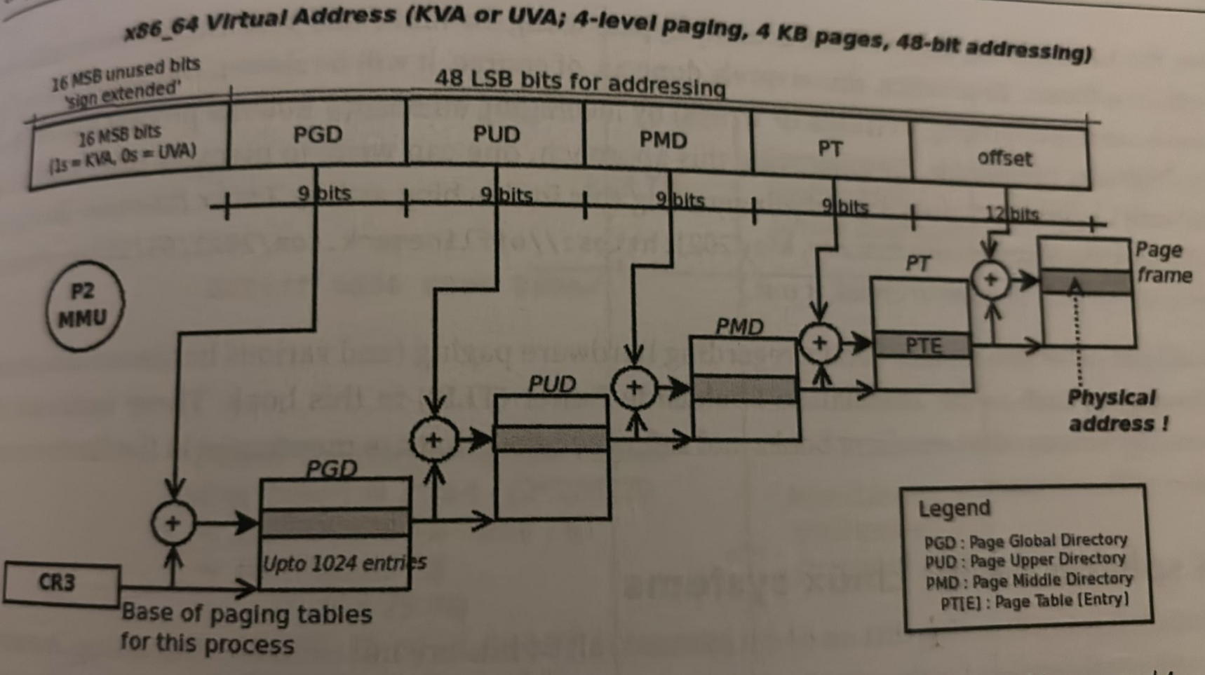

Slide 18
The vsyscall page
The very last line cat /proc/self/maps
the so-called vsyscall entry – maps a kernel page (by now, you know how
we can tell: the MSB 16 bits of its start and end virtual addresses are set). Here, we
just mention the fact that this is an (old) optimization for performing system calls. It
works by alleviating the need to actually switch to kernel mode for a small subset of
syscalls that don't really need to.
Currently, on the x86, these include the gettimeofday(2) , time(2) , and
getcpu(2) system calls. Indeed, the vvar and vdso (aka vDSO) mappings above it
are (slightly) modern variations on the same theme.
journalctl -b -k
KASAN: The modern kernel (4.0 onward for x86_64, 4.4 for ARM64)
employs a powerful mechanism to detect and report memory issues. It's
based on the user space Address SANitizer (ASAN) code base and is thus
called Kernel Address SANitizer (KASAN). Its power lies in ably (via
compile-time instrumentation) detecting memory issues such as Use After
Free (UAF) and Out Of Bounds (OOB) access

Slide 19
Virtual memory:
Virtual memory introduces a layer of indirection that allows a number of nice things. With virtual memory, programs running on the system can allocate far more memory than is physically available;
indeed, even a single process can have a virtual address space larger than the system’s physical memory.
Virtual memory also allows the program to play a number of tricks with the process’s address space, including mapping the program’s memory to device memory.
Address Types:
User virtual addresses
These are the regular addresses seen by user-space programs. User addresses are either 32 or 64 bits in length, depending on the underlying hardware architecture, and each process has its own virtual address space.
Physical addresses
The addresses used between the processor and the system’s memory. Physical addresses are 32- or 64-bit quantities; even 32-bit systems can use larger physical addresses in some situations.
Bus addresses
The addresses used between peripheral buses and memory. Often, they are the same as the physical addresses used by the processor, but that is not necessarily the case. Some architectures can provide an I/O memory management unit (IOMMU) that
remaps addresses between a bus and main memory. An IOMMU can make life easier in a number of ways
Kernel logical addresses
These make up the normal address space of the kernel. These addresses map some portion (perhaps all) of main memory and are often treated as if they were physical addresses. On most architectures, logical addresses and their associated physical addresses differ only by a constant offset. Logical addresses use the hardware’s native pointer size and, therefore, may be unable to address all of physical memory on heavily equipped 32-bit systems. Logical addresses are usually stored in variables of type unsigned long or
void *. Memory returned from kmalloc has a kernel logical address.
Kernel virtual addresses
Kernel virtual addresses are similar to logical addresses in that they are a mapping from a kernel-space address to a physical address. Kernel virtual addresses do not necessarily have the linear, one-to-one mapping to physical addresses that characterize the logical address space, however. All logical addresses are kernel virtual addresses, but many kernel virtual addresses are not logical addresses.
For example, memory allocated by vmalloc has a virtual address (but no direct physical mapping). The kmap function
also returns virtual addresses. Virtual addresses are usually stored in pointer variables
if you have a logical address, the macro __pa( ) (defined in <asm/page.h>) returns its
associated physical address. Physical addresses can be mapped back to logical addresses with __va( ), but only for low-memory pages

Slide 20
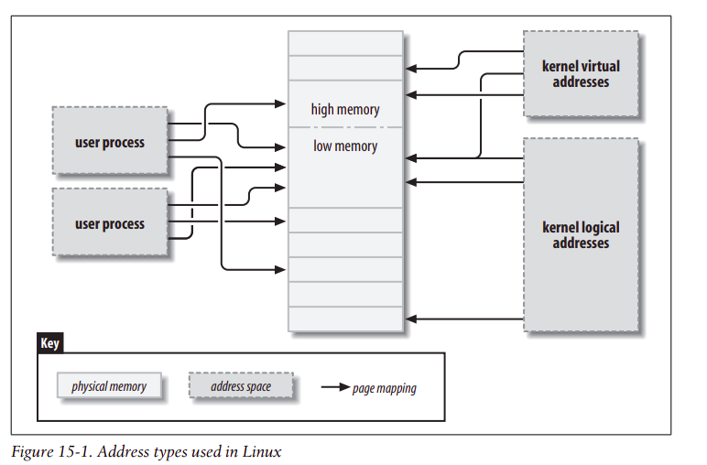
Physical memory is divided into discrete units called pages. Much of the system’s internal handling of memory is done on a per-page basis.
If you look at a memory address—virtual or physical—it is divisible into a page number and an offset within the page. If 4096-byte pages are being used,
for example, the 12 least-significant bits are the offset, and the remaining, higher bits indicate the page number. If you discard the offset and shift the rest of
an offset to the right, the result is called a page frame number (PFN).

Slide 21
High and Low Memory
Low memory Memory for which logical addresses exist in kernel space. On almost every system you will likely encounter,
all memory is low memory. The lowmem region: This is where platform (system) RAM direct-maps into the kernel.
where platform RAM is mapped is specified by a kernel macro called PAGE_OFFSET . The precise value of this macro is very arch-dependent; we will leave this discussion to a later section. For now, we ask you to just take it on faith that on the IA-32 with
a 3:1 (GB) VM split, the value of PAGE_OFFSET is 0xc000 0000
The virtual addresses that make up this region are termed kernel logical addresses as they are at a fixed offset from their
physical counterparts. The core kernel and device drivers can allocate (physically contiguous!) memory from this region via various APIs
The kernel static text (code), data, and BSS (uninitialized data) memory also resides within this lowmem region.
High memory Memory for which logical addresses do not exist, because it is beyond the address range set aside for kernel virtual addresses.
Before accessing a specific high-memory page, the kernel must set up an explicit virtual mapping to make that page available in the kernel’s address space.
Thus many kernel data structures must be placed in low memory; high memory tends to be reserved for user-space process pages.
Memory above the physical address of 896MB are temporarily mapped into kernel virtual memory whenever the kernel needs to access that memory.
This is a region of the kernel VAS that is completely virtual. Core kernel and/or device driver code can allocate virtually contiguous memory from this region using the vmalloc() Data which the kernel frequently needs to access is allocated in the lower 896MB of memory (ZONE_NORMAL) and can be immediately accessed by the Kernel . Data which the kernel only needs to access occasionally, including page cache, process memory and page tables, are preferentially allocated from ZONE_HIGHMEM. The system can have additional physical memory zones to deal with devices that can only perform DMA to a limited amount of physical memory, ZONE_DMA and ZONE_DMA32.
The Memory map and struct page
Historically, the kernel has used logical addresses to refer to pages of physical memory. The addition of high-memory support, however, has exposed an obvious problem with that approach—logical addresses are not available for high memory. Therefore, kernel functions that deal with memory are increasingly using pointers to struct page (defined in <linux/mm.h>) instead. This data structure is used to keep track of just about everything the kernel needs to know about physical memory; there is one struct page for each physical page on the system. Some of the fields of this structure include the following:
atomic_t count; -> The number of references there are to this page. When the count drops to 0, the page is returned to the free list.
void *virtual; -> The kernel virtual address of the page, if it is mapped; NULL, otherwise. Lowmemory pages are always mapped; high-memory pages usually are not.
unsigned long flags; -> A set of bit flags describing the status of the page. These include PG_locked, which indicates that the page has been locked in memory, and PG_reserved, which prevents the memory management system from working with the page at all.

Slide 22
Some functions and macros are defined for translating between struct page pointers and virtual addresses:
struct page *virt_to_page(void *kaddr); This macro, defined in , takes a kernel logical address and returns its associated struct page pointer. Since it requires a logical address, it does not work with memory from vmalloc or high memory.
struct page *pfn_to_page(int pfn); Returns the struct page pointer for the given page frame number. If necessary, it checks a page frame number for validity with pfn_valid before passing it to pfn_to_page.
void *page_address(struct page *page); - Returns the kernel virtual address of this page, if such an address exists. For high memory, that address exists only if the page has been mapped. This function is defined in <linux/mm.h> In most situations, you want to use a version of kmap rather than page_address.
The Linux kernel permanently maps 896 MB of its address space to the lower 896 MB of the physical memory (low memory). On a 4 GB system, there is only 128 MB left to the kernel to map the remaining 3.2 GB of physical memory (high memory). Low memory is directly addressable by the kernel because of the permanent and one-to-one mapping. When it comes to high memory (memory above 896 MB), the kernel has to map the requested region of high memory into its address space, and the 128 MB mentioned before is especially reserved for this. The function used to perform this trick, kmap(). kmap() , is used to map a given page into the kernel address space:
#include <linux/highmem.h> void *kmap(struct page *page); void kunmap(struct page *page);
kmap returns a kernel virtual address for any page in the system. For low-memory pages, it just returns the logical address of the page;
for high-memory pages, kmap creates a special mapping in a dedicated part of the kernel address space. Mappings created with kmap should always be freed with kunmap; a limited number of such mappings is available, so it is better not to hold on to them for too long. kmap calls maintain a counter, so if two or more functions both call kmap on the same page, the right thing happens. Note also that kmap can sleep if no mappings are available.
Page Tables On any modern system, the processor must have a mechanism for translating virtual addresses into its corresponding physical addresses. This mechanism is called a page table; it is essentially a multilevel tree-structured array containing virtual-to-physical mappings and a few associated flags

Slide 23
Virtual Memory Areas The virtual memory area (VMA) is the kernel data structure used to manage distinct regions of a process’s address space.
A VMA represents a homogeneous region in the virtual memory of a process: a contiguous range of virtual addresses that have the same permission flags and are backed up by the same object (a file, say, or swap space).
The memory areas of a process can be seen by looking in /proc/<pid/maps> (in which pid, of course, is replaced by a process ID). /proc/self is a special case of /proc/pid, because it always refers to the current process. As an example, here are a couple of memory maps (to which we have added short comments in italics):
# cat /proc/1/maps look at init
08048000-0804e000 r-xp 00000000 03:01 64652 /sbin/init text
0804e000-0804f000 rw-p 00006000 03:01 64652 /sbin/init data
0804f000-08053000 rwxp 00000000 00:00 0 zero-mapped BSS
40000000-40015000 r-xp 00000000 03:01 96278 /lib/ld-2.3.2.so text
40015000-40016000 rw-p 00014000 03:01 96278 /lib/ld-2.3.2.so data
The fields in each line are: start-end perm offset major:minor inode image. Each field in /proc/*/maps (except the image name) corresponds to a field in struct
vm_area_struct: start end The beginning and ending virtual addresses for this memory area. Perm A bit mask with the memory area’s read, write, and execute permissions. This field describes what the process is allowed to do with pages belonging to the area. The last character in the field is either p for “private” or s for “shared.” Offset Where the memory area begins in the file that it is mapped to. An offset of 0 means that the beginning of the memory area corresponds to the beginning of the file. Major minor The major and minor numbers of the device holding the file that has been mapped. Confusingly, for device mappings, the major and minor numbers refer to the disk partition holding the device special file that was opened by the user, and not the device itself. Inode The inode number of the mapped file. Image The name of the file (usually an executable image) that has been mapped.
VMAs are as follows (note the similarity between these fields and the /proc output we
just saw):
unsigned long vm_start;
unsigned long vm_end;
The virtual address range covered by this VMA. These fields are the first two fields shown in /proc/*/maps.
struct file *vm_file;
A pointer to the struct file structure associated with this area (if any).
unsigned long vm_pgoff;
The offset of the area in the file, in pages. When a file or device is mapped, this is the file position of the first page mapped in this area.

Slide 24
unsigned long vm_pgoff;
The offset of the area in the file, in pages. When a file or device is mapped, this is
the file position of the first page mapped in this area.
unsigned long vm_flags;
A set of flags describing this area. The flags of the most interest to device driver writers are VM_IO and VM_RESERVED. VM_IO marks a VMA as being a memorymapped I/O region. Among other things, the VM_IO flag prevents the region from
being included in process core dumps. VM_RESERVED tells the memory management system not to attempt to swap out this VMA; it should be set in most device mappings.
struct vm_operations_struct *vm_ops;
A set of functions that the kernel may invoke to operate on this memory area. Its presence indicates that the memory area is a kernel “object,”
void *vm_private_data;
A field that may be used by the driver to store its own information.
Like struct vm_area_struct, the vm_operations_struct is defined in <linux/mm.h>;
void (*open)(struct vm_area_struct *vma);
The open method is called by the kernel to allow the subsystem implementing the VMA to initialize the area. This method is invoked any time a new reference to the VMA is made (when a process forks, for example). The one exception
happens when the VMA is first created by mmap; in this case, the driver’s mmap method is called instead.
void (*close)(struct vm_area_struct *vma);
When an area is destroyed, the kernel calls its close operation. Note that there’s no usage count associated with VMAs; the area is opened and closed exactly once by each process that uses it.
struct page *(*nopage)(struct vm_area_struct *vma, unsigned long address, int *type);
When a process tries to access a page that belongs to a valid VMA, but that is currently not in memory, the nopage method is called (if it is defined) for the related area. The method returns the struct page pointer for the physical page after, perhaps, having read it in from secondary storage. If the nopage method isn’t defined for the area, an empty page is allocated by the kernel.Mapping a device means associating a range of user-space addresses to device memory.
Whenever the program reads or writes in the assigned address range, it is actually accessing the device. In the X server example, using mmap allows quick and easy access to the video card’s memory. For a performance-critical application like this, direct access makes a large difference.The limitation of mmap is that mapping is PAGE_SIZE grained. The kernel can manage virtual addresses only at the level of page tables; therefore, the mapped area must be a multiple of PAGE_SIZE and must live in physical memory starting at an address that is a multiple of PAGE_SIZE. The kernel forces size granularity by making a region slightly bigger if its size isn’t a multiple of the page size.

Slide 25
There are sound advantages to using mmap when it’s feasible to do so. X server, which transfers a lot of data to and from
video memory; mapping the graphic display to user space dramatically improves the throughput, as opposed to an lseek/write implementation. Another typical example is a program controlling a PCI device. Most PCI peripherals map their control registers to a memory address, and a high-performance application might prefer to have direct access to the registers instead of repeatedly having to call ioctl to get its work done.
The mmap method is part of the file_operations structure and is invoked when the mmap system call is issued. The system call is declared as follows (as described in the mmap(2) manual page):
mmap (caddr_t addr, size_t len, int prot, int flags, int fd, off_t offset)
On the other hand, the file operation is declared as:
int (*mmap) (struct file *filp, struct vm_area_struct *vma);
vma contains the information about the virtual address range that is used to access the device. Therefore, much of the work has been done by the kernel; to implement mmap, the driver only has to build suitable page tables for the address range and, if necessary, replace vma->vm_ops with a new set of operations.
There are two ways of building the page tables: doing it all at once with a function called remap_pfn_range or doing it a page at a time via the nopage VMA method.
Using remap_pfn_range
The job of building new page tables to map a range of physical addresses is handled by remap_pfn_range and io_remap_page_range, which have the following prototypes:
int remap_pfn_range(struct vm_area_struct *vma, unsigned long virt_addr, unsigned long pfn,
unsigned long size, pgprot_t prot);
int io_remap_page_range(struct vm_area_struct *vma, unsigned long virt_addr, unsigned long phys_addr,
unsigned long size, pgprot_t prot);
Vma The virtual memory area into which the page range is being mapped.
virt_addr The user virtual address where remapping should begin. The function builds page tables for the virtual address range between virt_addr and virt_addr+size.
Pfn The page frame number corresponding to the physical address to which the virtual address should be mapped. The page frame number is simply the physical address right-shifted by PAGE_SHIFT bits.
Size The dimension, in bytes, of the area being remapped
The first (remap_pfn_range) is intended for situations where pfn refers to actual system RAM, while io_remap_
page_range should be used when phys_addr points to I/O memory.

Slide 26
A simple implementation
If your driver needs to do a simple, linear mapping of device memory into a user address space, remap_pfn_range is almost all you really need to do the job.
static int simple_remap_mmap(struct file *filp, struct vm_area_struct *vma)
{
if (remap_pfn_range(vma, vma->vm_start, vm->vm_pgoff,
vma->vm_end - vma->vm_start,
vma->vm_page_prot))
return -EAGAIN;
vma->vm_ops = &simple_remap_vm_ops;
simple_vma_open(vma);
return 0;
}
As you can see, remapping memory just a matter of calling remap_pfn_range to create the necessary page tables.
The nopage method, therefore, must be implemented if you want to support the mremap system call. Here, we show a simple implementation of nopage for the simple device. The nopage method, remember, has the following prototype:
struct page *(*nopage)(struct vm_area_struct *vma, unsigned long address, int *type);
Adding VMA operations
As we have seen, the vm_area_struct structure contains a set of operations that may be applied to the VMA. In particular, we provide open and close operations for our VMA. These operations are called whenever a process opens or closes the VMA; in particular, the open method is invoked anytime a process forks and creates a new reference to the VMA.
The open and close VMA methods are called in addition to the processing performed by the kernel, so they need not reimplement any of the work done there. They exist as a way for drivers to do any additional processing that they may require.

Slide 27
https:/​ / ​ github.​ com/​ kaiwan/​ procmap :
tldr ps
nproc
lscpu
KASAN shadow memory region (only [Optional] (only on 64-bit and only if CONFIG_KASAN 64-bit) is defined; see more as follows)
KASAN_SHADOW_START Start KVA of the KASAN region
KASAN_SHADOW_END End KVA of the KASAN region; size
is KASAN_SHADOW_END - KASAN_SHADOW_START
The vmalloc region For memory allocated via vmalloc() and friends
VMALLOC_START Start KVA of the vmalloc region
End VMALLOC_END
KVA of the vmalloc region; size is VMALLOC_END - VMALLOC_START
Lowmem region Direct-mapped memory region PAGE_OFFSET Start KVA of the lowmem region; also represents the start of the kernel segment on some architectures and is (often) the VM split value on 32-bit.
End KVA of the lowmem region, upper bound of direct-mapped memory; in
effect, this value minus PAGE_OFFSET is the amount of (platform) RAM on the
high_memory system (careful, this is not necessarily the case on all arches though); not to be confused with ZONE_HIGHMEM .
Executre program on kernel_seg.c
/proc/buddyinfo

Slide 28
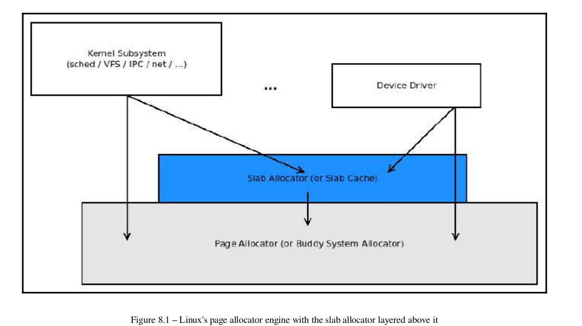

Slide 29
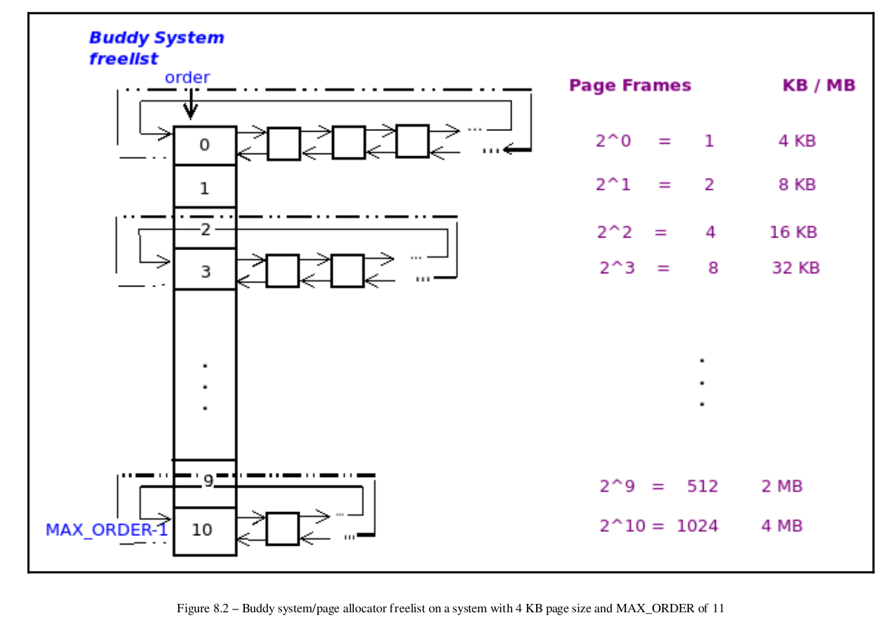

Slide 30
1. The algorithm expresses the amount to be allocated (128 KB here) in pages.
Thus, here, it's (assuming a page size of 4 KB) 128/4 = 32 pages.
2. Next, it determines to what power 2 must be raised to get 32. That's log 2 32,
which is 5 (as 2 5 is 32).
3. Now, it checks the list on order 5 of the appropriate node:zone page allocator
freelist. If a memory chunk is available (it will be of size 2 5 pages = 128 KB),
dequeue it from the list, update the list, and allocate it to the requester. Job
done! Return to caller.
4. If no memory chunk is available on the order 5 list (that is, if it's null), then
it checks the list on the next order; that is, the order 6-linked list (if it's not
empty, it will have 2 6 pages = 256 KB memory chunks enqueued on it, each
chunk being double the size of what we want).
5. If the order 6 list is non-null, then it will take (dequeue) a chunk of memory
from it (which will be 256 KB in size, double of what's required), and do the
following:
Update the list to reflect the fact that one chunk is now removed.
Cut the chunk in half, thus obtaining two 128 KB halves or
buddies! (Please see the following information box.)
Migrate (enqueue) one half (of size 128 KB) to the order 5 list.
Allocate the other half (of size 128 KB) to the requester.
Job done! Return to caller.
6. If the order 6 list is also empty, then it repeats the preceding process with
the order 7 list, and so on, until it succeeds.
7. If all the remaining higher-order lists are empty (null), it will fail the
request.

Slide 31
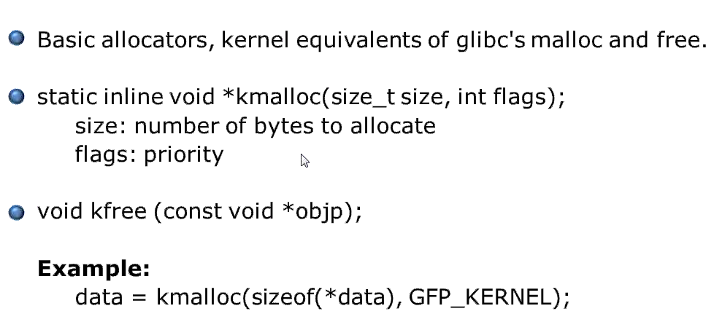

Slide 32
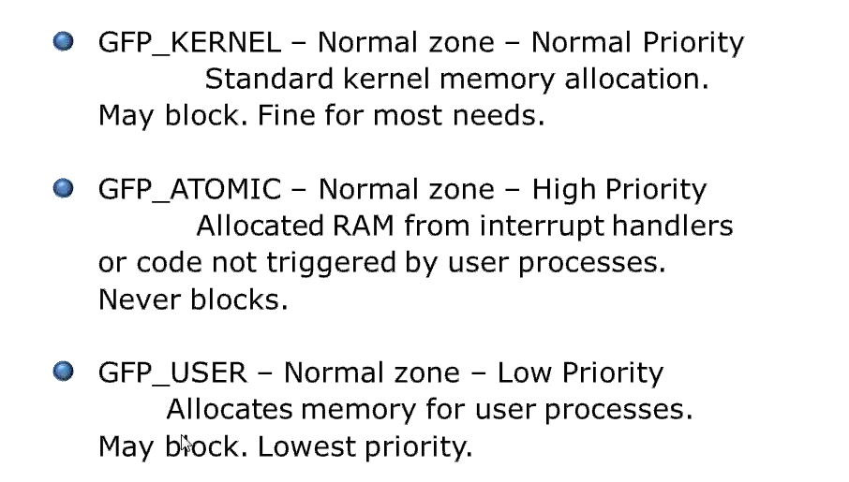

Slide 33
sudo vmstat -m | grep --color=auto "^kmalloc"

