Slide 1


Git
Pankaj Jha

Slide 2
Contents
What is Git
Difference between Git and CVS
Installations / Setup
Commands

Slide 3

Version Control System
Version control is a system that
records changes to a file or set of files over time so that
you can recall specific versions later

Slide 4
Types of Version Control System
Central Version Control
Distributed Version Control

Slide 5
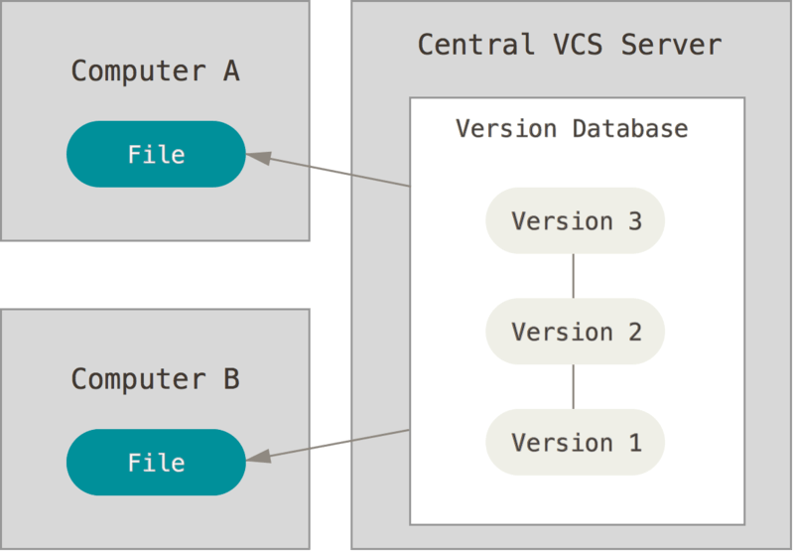
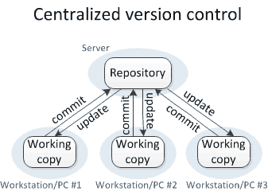
Central VCS

Slide 6
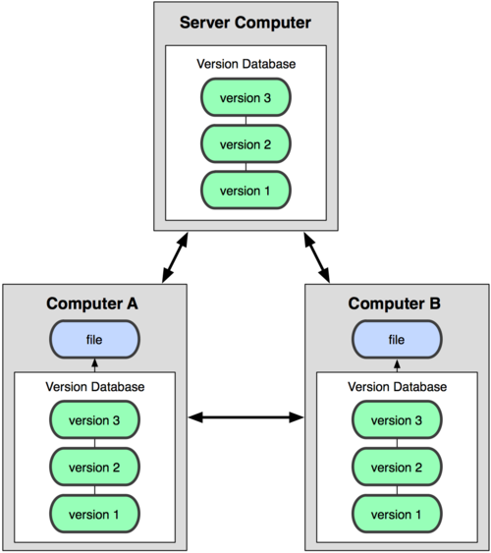
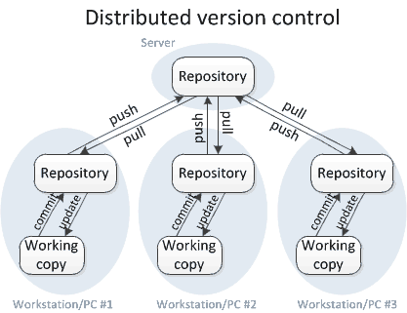
Distributed

Slide 7
Git
Version Control system
  Distributed
Free and Open source
Handle Projects of any size
Speed and Efficient
Branching and Merging

Slide 8
Install
Windows
  https://git-scm.com/download/win
Mac
    https://git-scm.com/download/mac
Linux
  https://git-scm.com/download/linux

Slide 9
Run Git
Windows
  #1:
    Command prompt – Win +R
    Cmd
  #2
    Git bash
Mac
  Open Terminal

Slide 10
GUI Clients
SourceTree
TortoiseGit
TortoiseGit
GitUp - mac

Slide 11
GitHub
Create GitHub acccount
https://gitlab.com/

Slide 12
First-Time Git Setup
  $ git config
$ git config --global user.name "John Doe”
$ git config --global user.email johndoe@example.com
$ git config --list
Only once on any given computer
Change them at any time
  Your Identity
  Your Editor (Optional)

Slide 13
Set Editor
On Windows
  $ git config --global core.editor "'C:/Program Files/Notepad++/notepad++.exe' -multiInst -nosession"
On Mac
  $ git config --global core.editor emacs

Slide 14
help
$ git help <verb>
$ git <verb> --help
$ man git-<verb>

Slide 15
Git Commands
$ git init
Cloning an Existing Repository
  $ git clone https://github.com/libgit2/libgit2
  Sample Git link
  https://gitlab.com/gchkumar/gitdemo.git

Slide 16
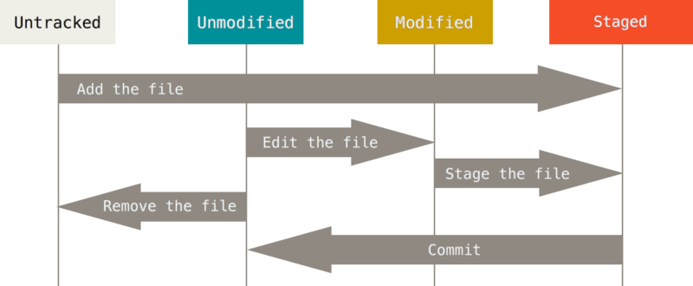
Record changes

Slide 17
Add, Commit
$git add .
$git commit –m “Comments”

Slide 18
Day 2

Slide 19
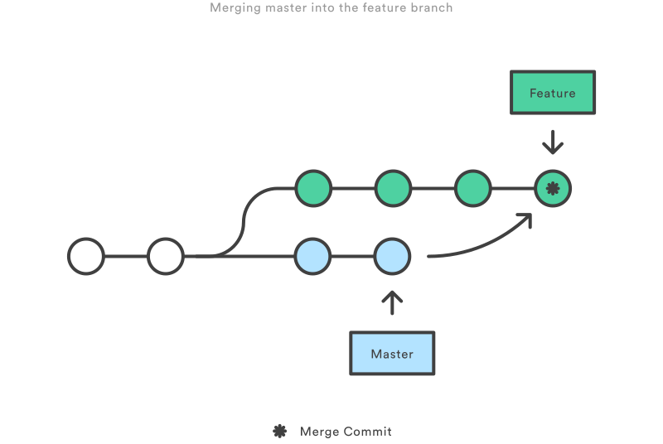
Branch and Merge

Slide 20
Branches
$git branches
$git branch ‘feature’
$git checkout feature
After the changes commit

Slide 21
Merge
$ git merge feature

