Slide 1
DELIVERY PIPELINE
Pankaj Jha

Slide 2
Contents
What is Delivery Pipeline
Why is Pipeline
How to configure in Jenkins

Slide 3
What is Delivery Pipeline
Visualisation of Continuous Delivery pipelines. Renders pipelines based on upstream/downstream jobs or Jenkins pipelines
When using Jenkins as a build server it is with the Delivery Pipeline plugin possible to visualise one or more delivery pipelines in the same view, even in full screen.

Slide 4
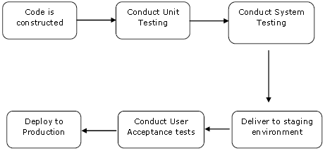
When we will use this

Slide 5
Scenarios
1. Dev-Deployment
2. Dev-Testing
3. UAT-Deployment
4. UAT-Testing
5. Prod-Deployment
6. Prod-Testing

Slide 6
Scenarios
Backend-Test
Backend-Build
Backend-Deploy
Frontend-Test
Frontend-Build
Frontend-Deploy

Slide 7

Configure
Download Delivery Pipeline Plugin

Slide 8
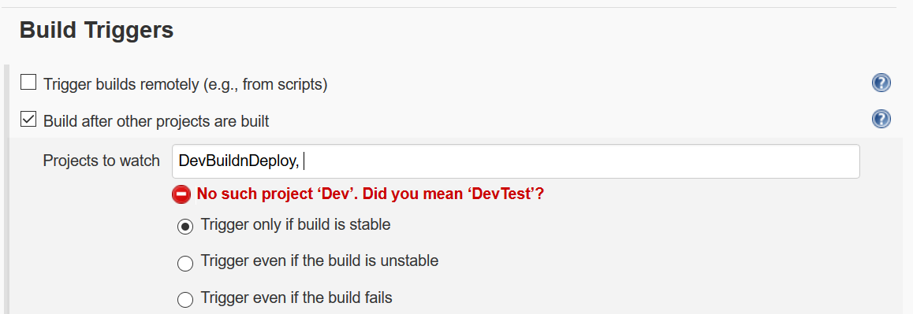
Setup Downstream and Upstream

Slide 9
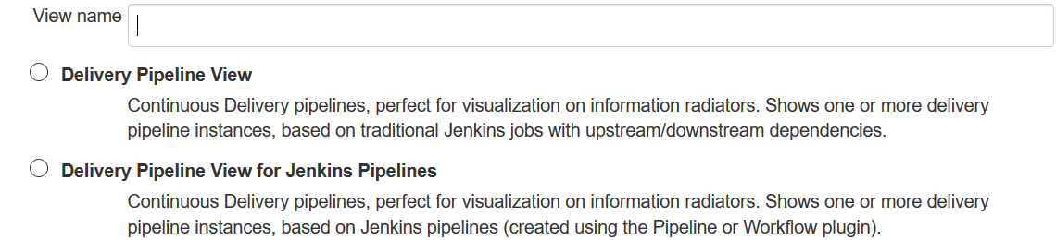
Delivery Pipeline

Slide 10
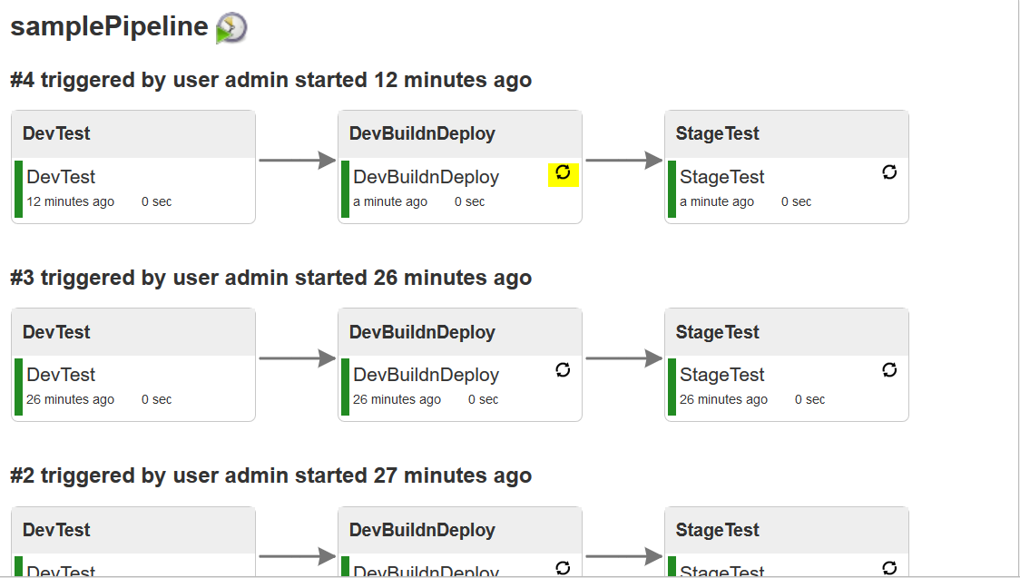
Pipeline view

Slide 11
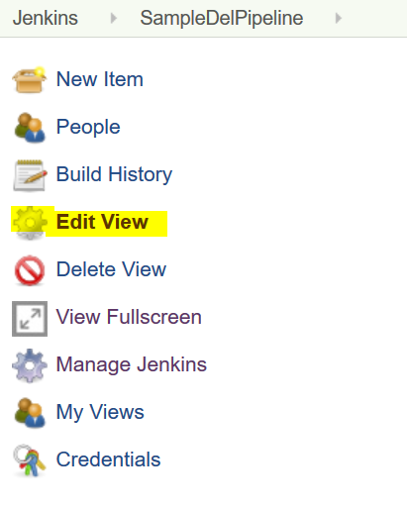
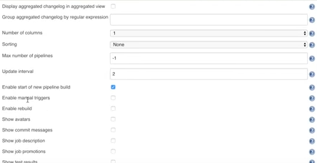
Edit View

Slide 12
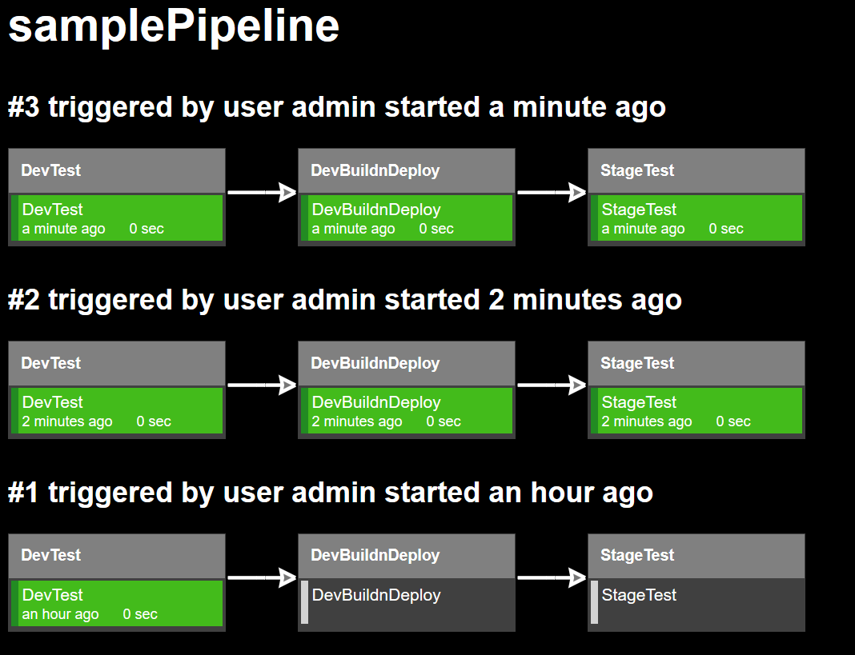
Full Screen

Slide 13
Build now

