Slide 1
Unit testing
Pankaj Jha

Slide 2
Contents
What is Unit Testing
Why Unit Testing
TDD
How to Configure in Jenkins

Slide 3
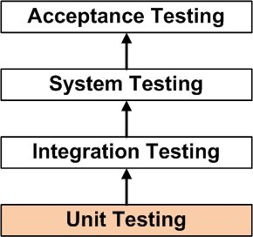
What is Unit Testing
Unit Testing is a level of software testing where individual units/ components of a software are tested.
Unit Testing is the first level of testing and is performed prior to Integration Testing.
A unit test focuses on a single “unit of code” – usually a function in an object or module.

Slide 4
Why
To check if the units in a program have been found to be working in the most efficient and error-free manner possible
The earlier a problem is identified
The fewer compound errors occur

Slide 5
Who
Unit Testing is normally performed by software developers themselves or their peers

Slide 6
Test Driven Development
Test-Driven Development is a process that relies on the repetition of very short development cycle.
Add a test
Run all tests and see if the new one fails
Write some code
Run tests
Refactor code
Repeat

Slide 7
TDD
First the developer writes an (initially failing) automated test case
that defines a desired improvement or new function,
then produces the minimum amount of code to pass that test, and
finally refactors the new code to acceptable standards

Slide 8
Frameworks
TestNG,
jUnit for Java
Jasmine for Javascript
The Grinder
Arquillian
Jtest
Jwalk
Mockito
Powermock

Slide 9
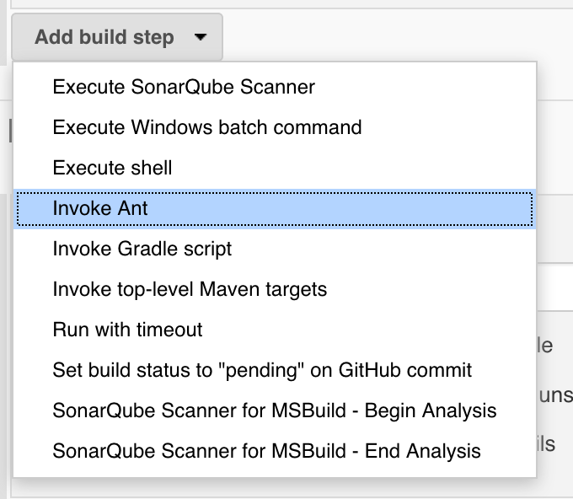
Configure

Slide 10
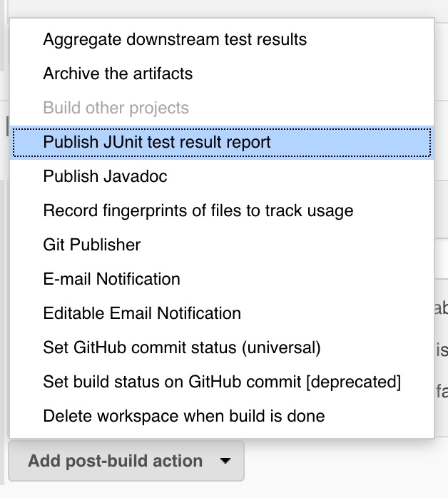
Post the results

Slide 11
Build now

