Slide 1
Jenkins
Pankaj Jha

Slide 2
Contents
What is Jenkins
Continuous Integration
Installations
Scheduling a Job
Build a Java Ant / Maven Project – Local / Git
Upload the project from Git
Commit changes and check the build
Pipeline

Slide 3
What is Jenkins
Jenkins is a Continuous Integration server
self-contained , Open source automation server
automate all sorts of tasks such as building, testing, and deploying software

Slide 4
Continuous Integration
Continuous Integration (CI) is a development practice that requires developers to integrate code into a shared repository several times a day. Each check-in is then verified by an automated build, allowing teams to detect problems early.

Slide 5
Continuous Integration
Integrating regularly
Detect errors quickly
Locate them more easily

Slide 6
The practices
Maintain a single source repository
Automate the build
Make your build self-testing
Every commit should build on an integration machine
Keep the build fast
Make it easy for anyone to get the latest executable version
Everyone can see what’s happening
Automate deployment

Slide 7
Team responsibilities
Check in frequently
Don’t check in broken code
Don’t check in untested code
Don’t check in when the build is broken
Don’t go home after checking in until the system builds

Slide 8
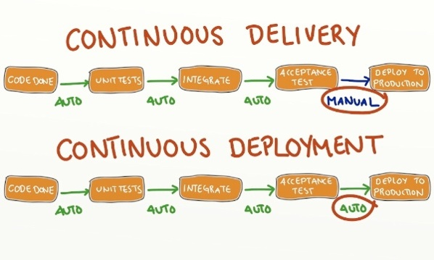
Continuous Delivery / Deployment

Slide 9
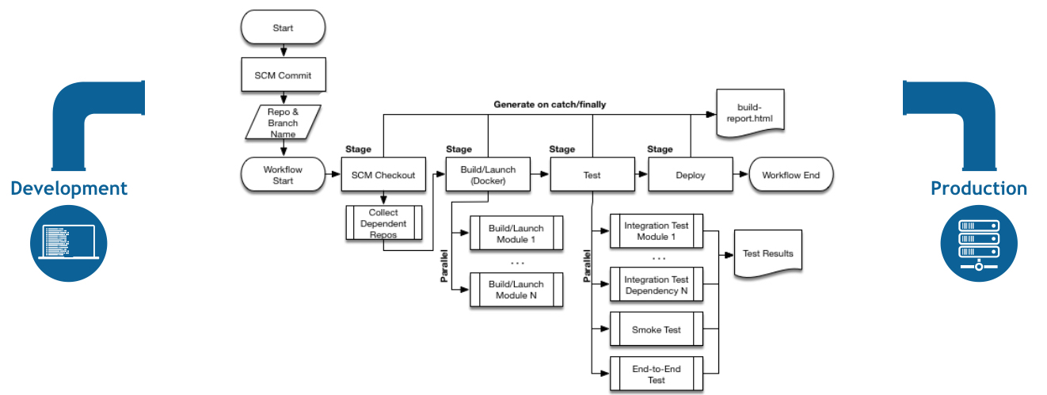
Ideal Continuous delivery scenario

Slide 10
Installations
Stand alone
Download jenkins.jar – Jetty / Winstone
Install it on Tomcat
Install on a Web Server

Slide 11
Standalone

Slide 12
Installations for Mac
Goto Jenkins.io / https://jenkins.io/download/
Download jenkins.war
Place jenkins.war to any folder
Run the command
Java –jar jenkins.war
It gives a password , Copy it
To login while you run jenkins for the first time
Go to localhost:8080
If jenkins to run on specific port –httpPort 9099

Slide 13
Installation on Windows
After install go to .jenkins and secrets folder
Copy the password from Secrets folder

Slide 14
Install Jenkins on EC2
wget -q -O - https://pkg.jenkins.io/debian/jenkins-ci.org.key | sudo apt-key add -
sudo sh -c 'echo deb http://pkg.jenkins.io/debian-stable binary/ > /etc/apt/sources.list.d/jenkins.list'
sudo apt-get update
sudo apt-get install jenkins
https://wiki.jenkins.io/display/JENKINS/Installing+Jenkins+on+Ubuntu

Slide 15
Tomcat
Download Tomcat
https://tomcat.apache.org/download-80.cgi
Download the zip
Unzip
Go to webapps
Copy jenkins.jar
Go to bin
Run startup file (.bat)
Run startup.sh on Mac

Slide 16
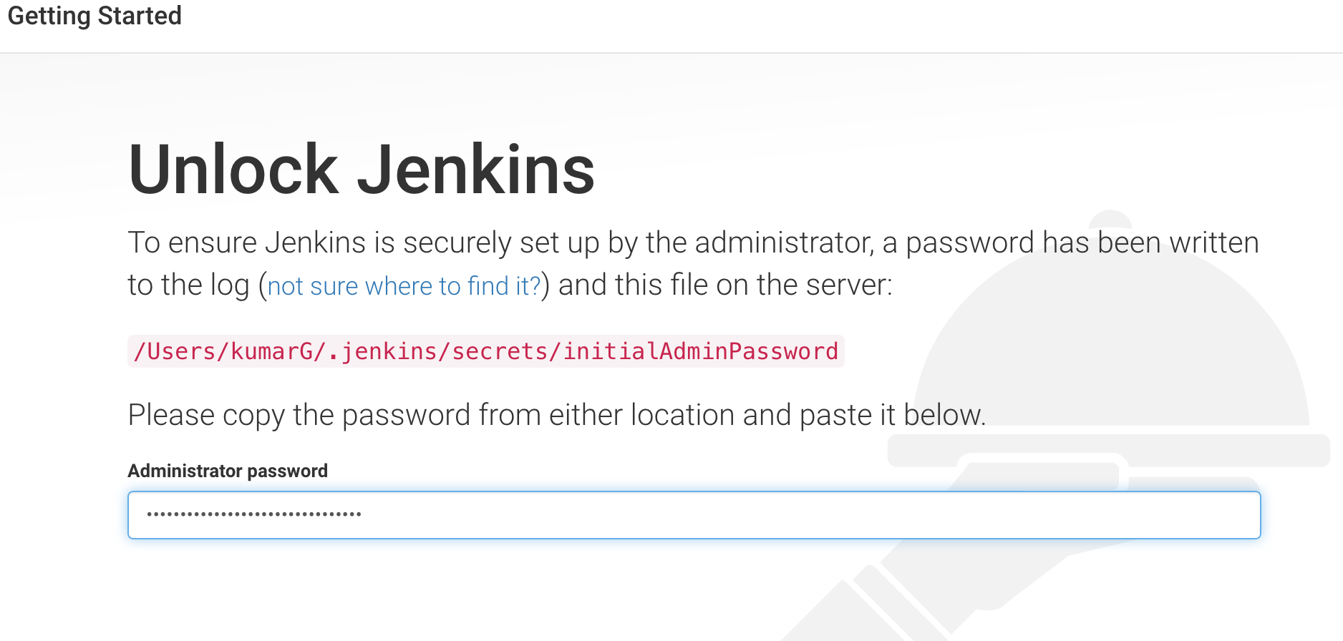
Enter the admin password

Slide 17
After launch
Install Suggested Plugins
Select Plugins to Install
Explore types of Plugins
Create First Admin User
Continue as admin
Create a user

Slide 18
Goto Home and explore
.jenkins folder at home

Slide 19
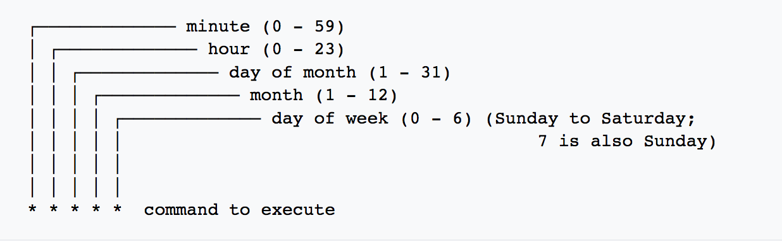
Cron
The software utility Cron is a time-based job scheduler
Use cron to schedule jobs (commands or shell scripts) to run periodically at fixed times, dates, or intervals

Slide 20
Cron examples
5 0 * * *
at fives minutes past midnight (00:05) every day
45 23 * * 6
at 23:45 (11:45 PM) every Saturday
0 0 * * 5
Every Friday 00.00 midnight
0 0 * * *
Run once a day at midnight

Slide 21
Pipeline
Jenkins Pipeline is a suite of plugins which supports implementing and integrating continuous delivery pipelines into Jenkins.
this "Pipeline as Code" would be written to a Jenkinsfile and checked into a project’s source control repository,
Ex:

Slide 22
Create a Job
SCM
Git Plugin
Build
Ant
Deploy P
Deploy plugin
Email Notification
Email the build status

Slide 23
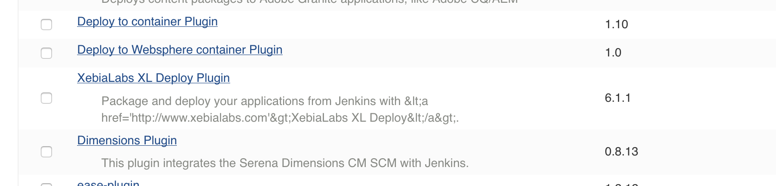
Deploy
Manage Plugin
Plugins can be downloaded as .hpi or from Manage Plugins
Search for Deploy

Slide 24
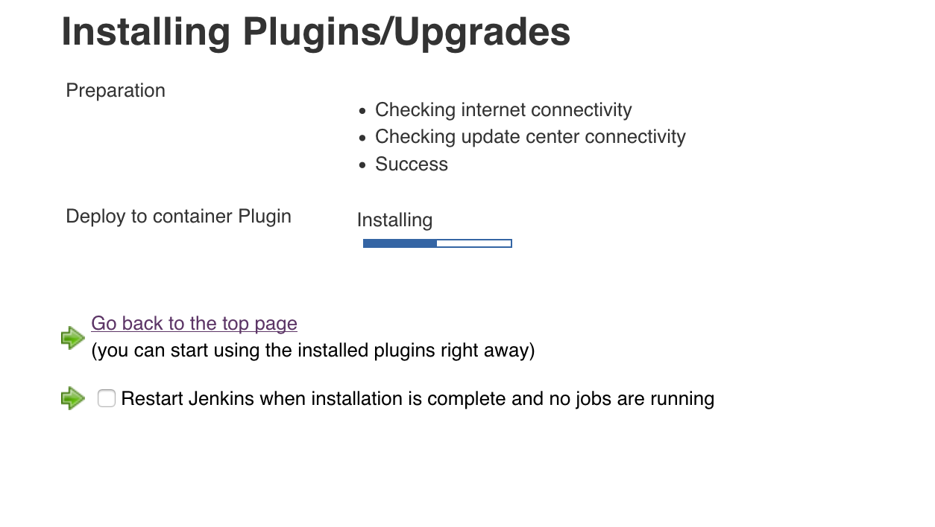
Plugin Installation Status

Slide 25
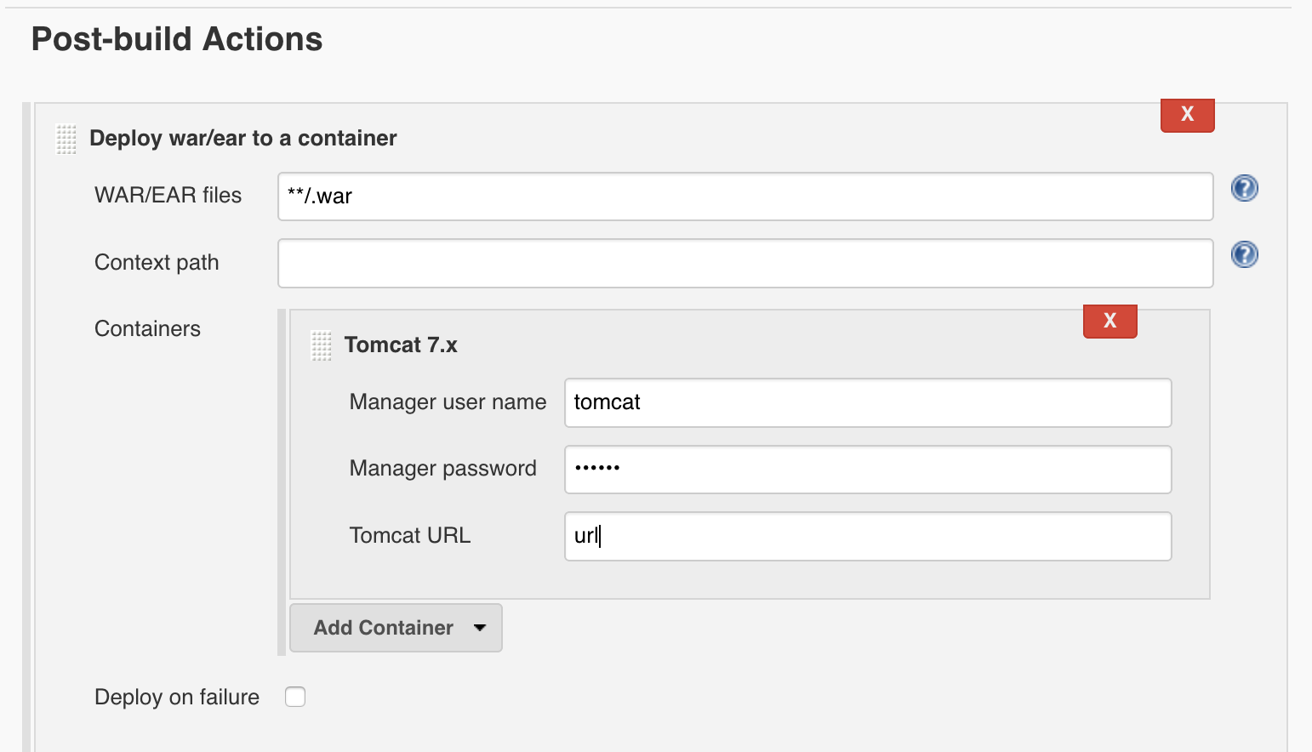
Deploy Config

Slide 26
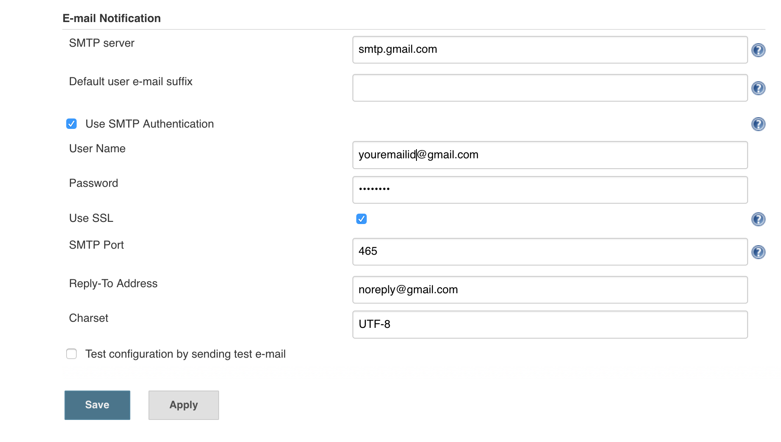
Email Notification
Manage Jenkins
Configure Systems

Slide 27
Day-2

Slide 28
User
Create User
Manage Jenkins -> Manage Users
List of Users
Create User
Configure User
Login with Users

Slide 29
Roles Strategy Plugin
Download plugin from Manage Plugin
Role based Strategy
Configure Global Security
Enable Security – Checked
Authorization
Role-Based Strategy

Slide 30
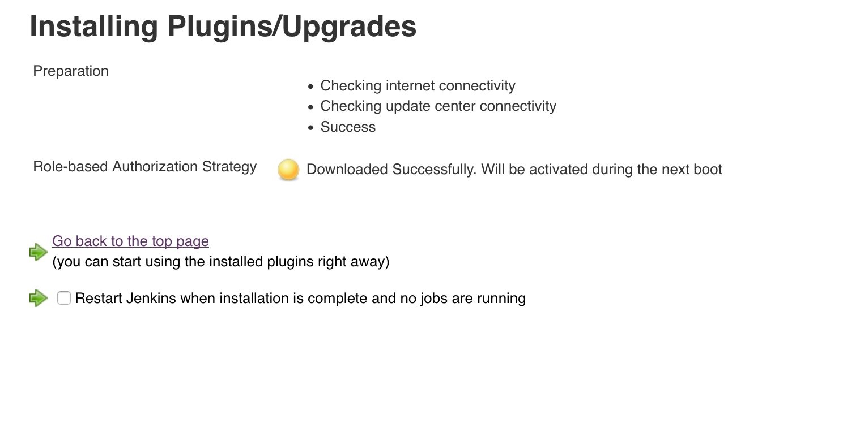
Role-based Authorization Install status

Slide 31
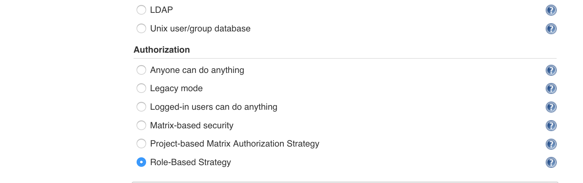
Enable Role Based Strategy
Manage Jenkins -> Configure Global Security

Slide 32
Enable Role based authentication
Manage and Assign Roles
Manage Roles
Assign Roles
Role Strategy Macros
Manage Roles
Admin role
Global roles – provide auth and access at global level
Project roles – Specific to the project

Slide 33
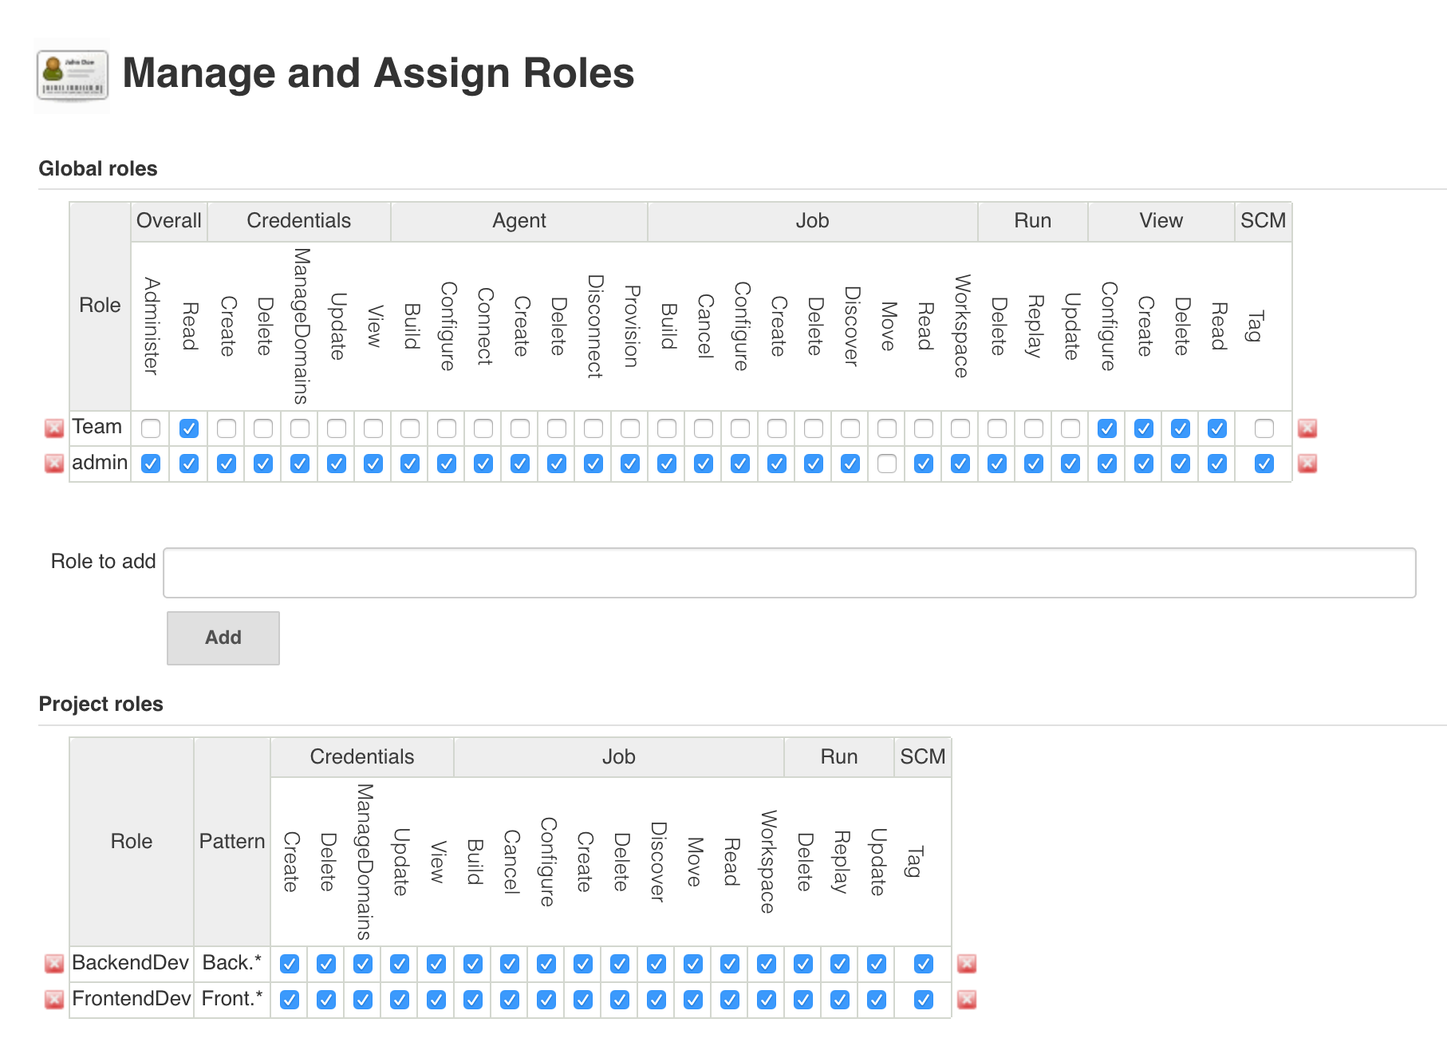
Manage and assign Roles

Slide 34
Global and Project
Add Global roles and set the permissions
Add Project roles and set project patterns
Front.*

Slide 35
Assign Roles
Add User and assign roles
Global
Item roles

Slide 36
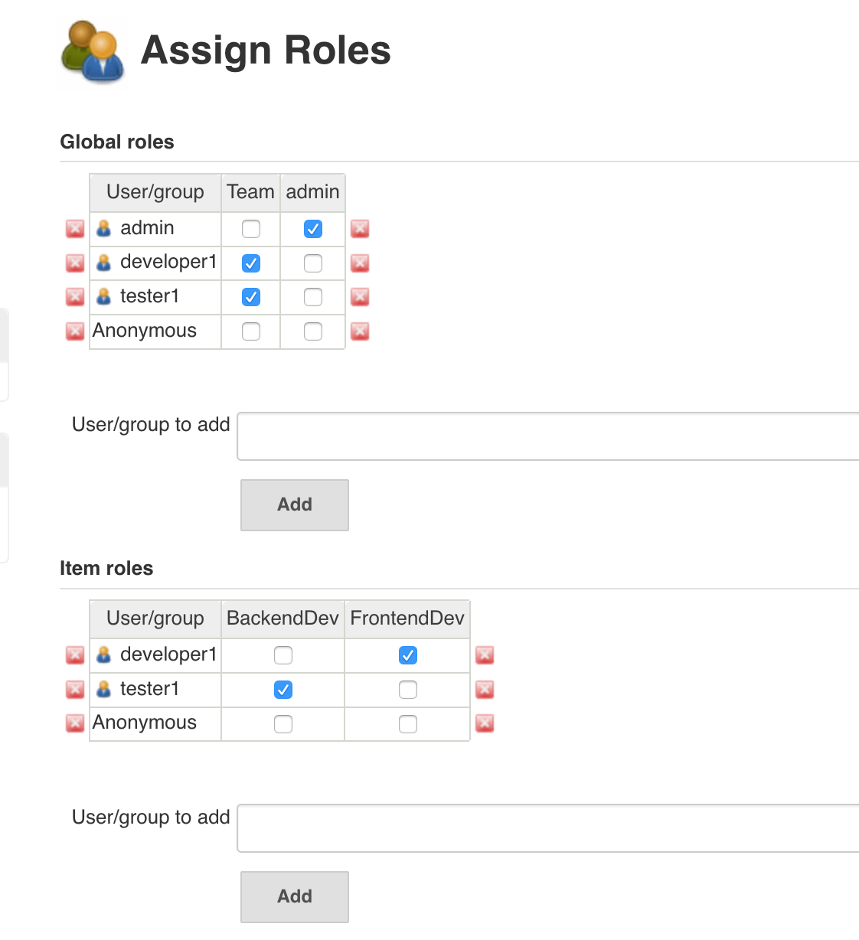
Assign Roles

Slide 37
Master Slave Nodes

