Slide 1

Secure Enterprise Linux File Server with Automated Backup
Department Shares, Samba Access Control, Automated Tar Backup & Cron Scheduling on Ubuntu
Team Members / Student Details
1. Tekumudi Rama Krishna – Register No: [2411021061402]
2. Nevin Tony – Register No: 2411021061276
3. Shaik Muheeb Ahamad Basha – Register No: [2411021061091]
4. Gaali Vamsi Krishna – Register No: 2411021061062
Name of the Mentor
MRS. KUSUMA J
Assistant Professor
Linux Microproject | Course: E1ITA 307 - Linux System Administration | CO3, CO4 | Academic Year 2026-27
1

Slide 2
Agenda & Project Overview
A hardened departmental Linux file server deployed on Ubuntu in Oracle VirtualBox. It establishes strict department-based storage isolation, Samba network shares, automated tar/gzip backups, root cron scheduling, UFW firewall security, and an interactive Bash administration interface.
1
Introduction & Problem Statement
7
Samba Share Configuration (smb.conf)
2
Objectives of the Project
8
Network File-Sharing Demonstration
3
Tools & System Requirements
9
Automated Backup System Design
4
System Architecture
10
Manual Backup Execution & Verification
5
Directory Hierarchy & Storage Layout
11
Backup Integrity & Restore Testing
6
Linux Users, Groups & Setgid Permissions
12
Cron Automation, Security & Bash Menu
2

Slide 3
Introduction and Problem Statement
Enterprise teams require centralized file storage to collaborate efficiently without exposing confidential data across department boundaries. Unmanaged workstations and manual backups lead to data spillage, ransomware vulnerabilities, and catastrophic data loss.
Problem: How can enterprise departmental files be securely shared, isolated from cross-department access, backed up automatically, and centrally managed on Linux?
Problem Faced in Legacy Storage | Our Enterprise Linux Solution
Scattered departmental files across individual unmanaged workstations | Centralized, structured repository under /srv/enterprise-fileserver/
Cross-department data exposure and unauthorized folder snooping | Strict Linux group permissions (dev, hr, finance) + Setgid (2770) + Samba ACLs
Manual, irregular, and forgotten backup procedures risking data loss | Automated Bash backup script (backup.sh) with gzip compression and 30-day retention
Silent archive corruption and unverified disaster recovery plans | Automated archive integrity verification (tar -tzf) + audit logging in backup.log
3

Slide 4
Objectives of the Project
Centralized Storage Hierarchy
Deploy /srv/enterprise-fileserver/ with isolated department subdirectories for Dev, HR, and Finance.
Automated Tar Backup Engine
Develop a robust Bash script (backup.sh) creating timestamped, compressed .tar.gz archives in /backups/.
1
5
User & Group Access Control
Configure Linux user accounts (devuser, hruser, financeuser) mapped to respective primary groups.
Archive Readability & Retention
Enforce non-destructive archive verification (tar -tzf) and automated purging of archives older than 30 days.
2
6
Setgid Permission Enforcement
Apply chmod 2770 so newly created files automatically inherit parent department group ownership.
Cron Job Task Automation
Configure root crontab (0 23 * * *) for automated daily 11:00 PM backups without operator intervention.
3
7
Samba SMB File Sharing
Deploy Samba daemon (smbd) with authenticated shares ([Development], [HR], [Finance]) and valid users.
Server Hardening & Menu Interface
Enforce UFW default-deny firewall policies, verify SSH, and create a 9-option interactive Bash administration tool.
4
8
4

Slide 5
Tools and System Requirements
Tool / Technology | Operational Role & Purpose
Ubuntu Linux | Base server Operating System (64-bit LTS)
Oracle VirtualBox | Type-2 hypervisor virtualization platform
Samba (smbd) | SMB/CIFS network protocol for file sharing
GNU Bash | Shell scripting for backup automation & admin menu
GNU tar & gzip | Compressed archive generation and integrity verification
Cron Daemon | Scheduled non-interactive daily backup automation
UFW Firewall | Host packet filtering and ingress port protection
OpenSSH Server | Encrypted remote terminal administration channel
Hardware Requirements
• Host System: PC/Laptop with VT-x / AMD-V virtualization enabled
• VM Compute: 4 GB Virtual RAM, 2 vCPU cores assigned
• Storage: 25 GB Virtual Hard Disk (VDI/VMDK)
• Networking: Host-Only / Bridged Adapter for SMB & SSH access
Software Environment
• Operating System: Ubuntu Linux (64-bit Server/Desktop)
• Hypervisor: Oracle VM VirtualBox 7.x
• Packages Installed: samba, smbclient, ufw, openssh-server, cron, tar
• Shell & Tools: GNU Bash 5.x, systemctl, testparm, tree, nano
5

Slide 6
System Architecture
STORAGE & ACCESS PIPELINE
Department Users
devuser, hruser, financeuser
Samba Daemon
smbd listening on port 445
Authentication & ACLs
valid users = @group
Setgid Folders
chmod 2770 inheritance
Isolated Shares
Dev | HR | Finance
→
→
→
→
PROTECTION, AUTOMATION & SECURITY LAYERS
Automated Backup Engine
backup.sh script compresses /shared/ into timestamped .tar.gz archives in /backups/.
Validates archive readability (tar -tzf), logs status to /logs/backup.log, and enforces a 30-day retention pruning policy.
Cron Automation Daemon
Root cron job scheduled at 0 23 * * * executes backup.sh daily at 11:00 PM.
Runs unattended without human intervention; requires the Ubuntu virtual machine to be powered on and active at schedule time.
Perimeter & Access Security
UFW firewall enforces default-deny incoming; explicitly permits Samba ports (137-139, 445) and SSH (port 22).
SSH service daemon supervision; Setgid ensures newly created files inherit the group ownership automatically.
6

Slide 7
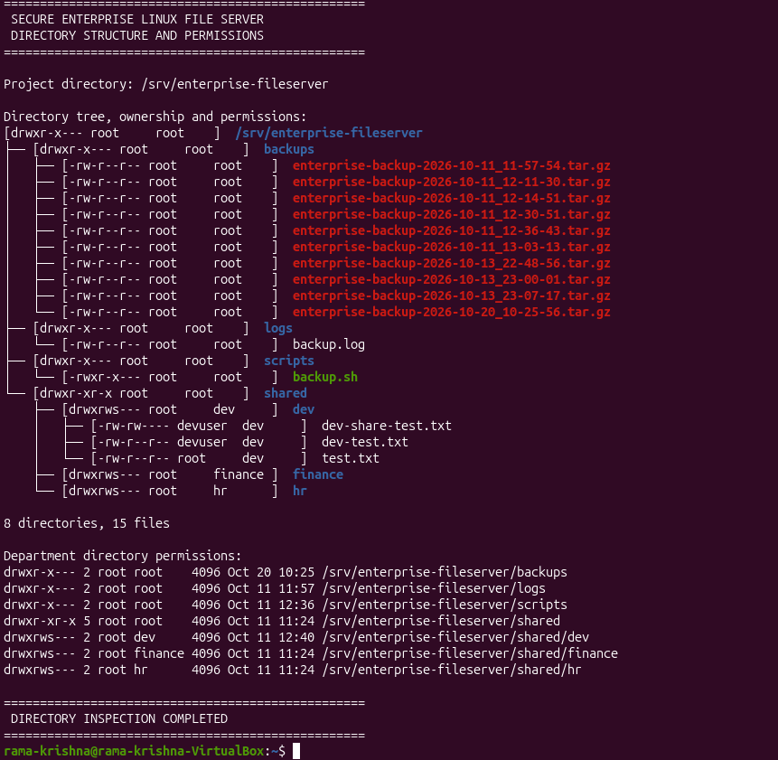
Implementation: Directory Structure
Hierarchical Storage Design
• Dedicated Root Hierarchy: All project assets are centralized under /srv/enterprise-fileserver/ to segregate enterprise data from OS system files.
• Departmental Shares: /shared/dev/, /shared/hr/, and /shared/finance/ provide dedicated storage for each business unit.
• Automated Backup Directory: /backups/ stores timestamped .tar.gz archives generated by the automated backup routine.
• Operational Logging: /logs/backup.log preserves persistent execution history, archive sizes, and integrity results.
• Script Repository: /scripts/backup.sh holds production maintenance utilities and scripts.
PASTE YOUR REAL UBUNTU SCREENSHOT HERE
Target File: [screenshot_01_tree_structure.png]
Command: $ sudo tree -pug /srv/enterprise-fileserver
(Replace this box with your actual terminal screenshot)
Directory Creation & Inspection Commands:
sudo mkdir -p /srv/enterprise-fileserver/{shared/{dev,hr,finance},backups,logs,scripts}
sudo tree -pug /srv/enterprise-fileserver
Figure 7.1: Directory hierarchy, ownership, and permission tree in terminal
7

Slide 8
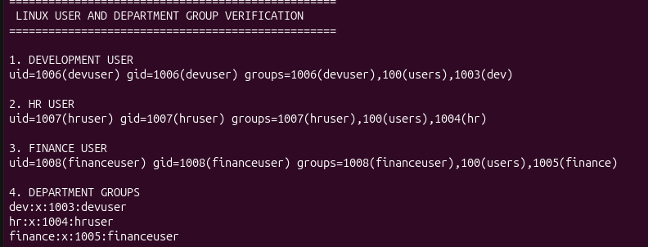
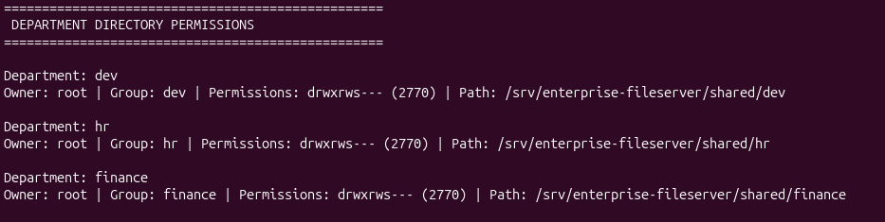
Implementation: Users, Groups & Permissions
POSIX Group Security & Setgid
• Department Mapping: devuser belongs to dev; hruser belongs to hr; financeuser belongs to finance.
• Setgid Bit (chmod 2770): Enforces automatic group ownership inheritance. When users create new files, they inherit the department group (dev, hr, finance) rather than the user's primary group.
• Strict Privacy Boundary: Permissions 2770 (rwxrws---) provide full read/write/traverse rights to group members while denying all access (---) to other users.
• Preventing Data Spillage: Guarantees zero cross-department data exposure at the Linux filesystem layer.
PASTE YOUR REAL UBUNTU SCREENSHOT HERE
Target File: [screenshot_02_user_groups.png]
Command: $ id devuser && id hruser && id financeuser
(Replace this box with your actual terminal screenshot)
Figure 8.1: Linux user accounts and primary group membership verification
PASTE YOUR REAL UBUNTU SCREENSHOT HERE
Target File: [screenshot_03_directory_permissions.png]
Command: $ ls -ld /srv/enterprise-fileserver/shared/*
(Replace this box with your actual terminal screenshot)
User Creation & Permission Commands:
sudo groupadd dev && sudo useradd -m -g dev -s /bin/bash devuser
sudo chown -R root:dev /srv/enterprise-fileserver/shared/dev
sudo chmod 2770 /srv/enterprise-fileserver/shared/dev
Figure 8.2: Setgid bit (rwxrws---) and group ownership on department directories
8

Slide 9
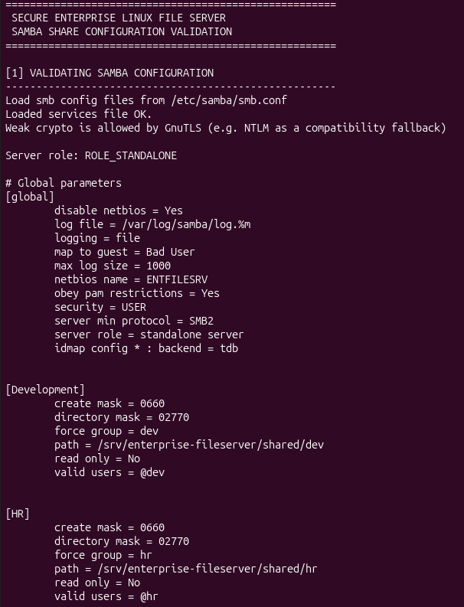
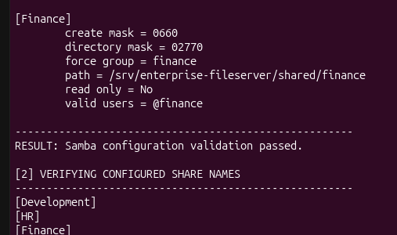
Implementation: Samba Share Configuration
Samba Network Architecture
• SMB/CIFS Protocol: Samba enables cross-platform network file sharing for Windows, macOS, and Linux clients.
• Dual Security Enforcement: Network requests must satisfy both Samba share access controls and Linux POSIX file permissions.
• Configured Shares: Three shares configured: [Development], [HR], and [Finance] mapped to their respective paths.
• Valid Users Directive: valid users = @dev explicitly restricts share access to members of the dev group.
• Permission Masks: create mask = 0660 and directory mask = 0770 ensure newly written network files remain strictly accessible only to department peers.
PASTE YOUR REAL UBUNTU SCREENSHOT HERE
Target File: [screenshot_04_testparm.png]
Command: $ sudo testparm -s
(Replace this box with your actual terminal screenshot)
Samba Configuration Excerpt (/etc/samba/smb.conf):
[Development]
path = /srv/enterprise-fileserver/shared/dev
valid users = @dev
read only = no
browseable = yes
create mask = 0660
directory mask = 0770
Figure 9.1: Validating Samba smb.conf syntax using testparm command
9

Slide 10
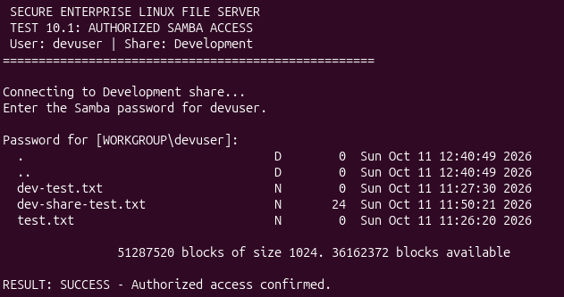
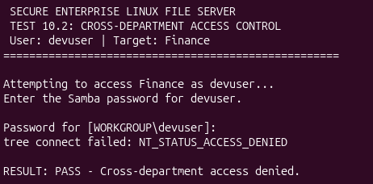
Demonstration: Network File Sharing & Access Control
Authorized Access Demonstration
When devuser authenticates to //localhost/Development using smbclient, the Samba service verifies credentials against the local Samba TDB database. Because devuser belongs to group dev, access is granted with full read/write privileges.
Unauthorized Cross-Department Access Blocked
When devuser attempts to connect to //localhost/Finance, Samba evaluates the valid users = @finance directive. Because devuser does not belong to group finance, Samba immediately rejects the connection with NT_STATUS_ACCESS_DENIED.
PASTE YOUR REAL UBUNTU SCREENSHOT HERE
Target File: [screenshot_05_smb_authorized.png]
Command: $ smbclient //localhost/Development -U devuser
(Replace this box with your actual terminal screenshot)
PASTE YOUR REAL UBUNTU SCREENSHOT HERE
Target File: [screenshot_06_smb_denied.png]
Command: $ smbclient //localhost/Finance -U devuser
(Replace this box with your actual terminal screenshot)
Figure 10.1: Successful authenticated Samba session for authorized devuser
Figure 10.2: Samba denies connection: NT_STATUS_ACCESS_DENIED enforced
10

Slide 11
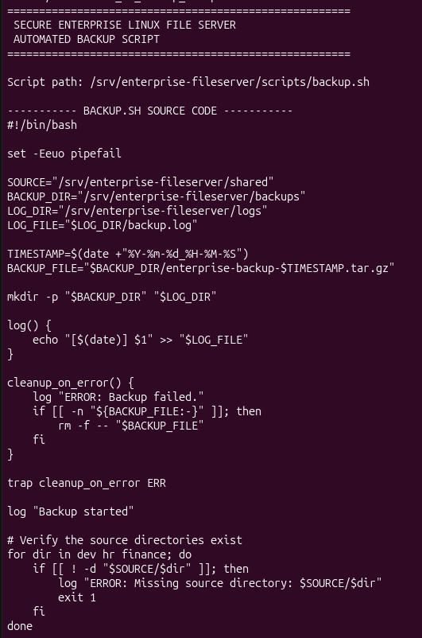
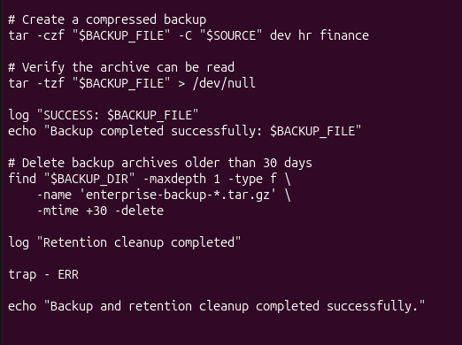
Automated Backup System Design
1. Source Audit & Archive Creation
The script verifies the existence of /shared/{dev,hr,finance}.
Executes tar -czf to bundle all departmental files into a single gzip-compressed archive named backup_YYYYMMDD_HHMMSS.tar.gz in /backups/.
PASTE YOUR REAL UBUNTU SCREENSHOT HERE
Target File: [screenshot_07_backup_script.png]
Command: $ sudo cat /srv/enterprise-fileserver/scripts/backup.sh
(Replace this box with your actual terminal screenshot)
2. Archive Readability & Integrity Check
Executes tar -tzf on the newly generated archive to test readability of headers and blocks.
If the archive is corrupted or unreadable, the script flags a fatal failure rather than reporting false success.
3. Audit Logging & 30-Day Retention
Records timestamp, byte size, archive name, and exit status into /logs/backup.log.
Executes find to automatically prune backup archives older than 30 days, preventing disk exhaustion.
Figure 11.1: Complete Bash automated backup script (backup.sh)
11

Slide 12
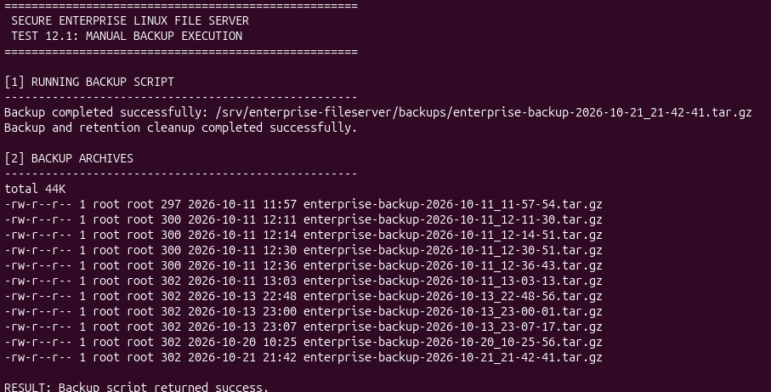
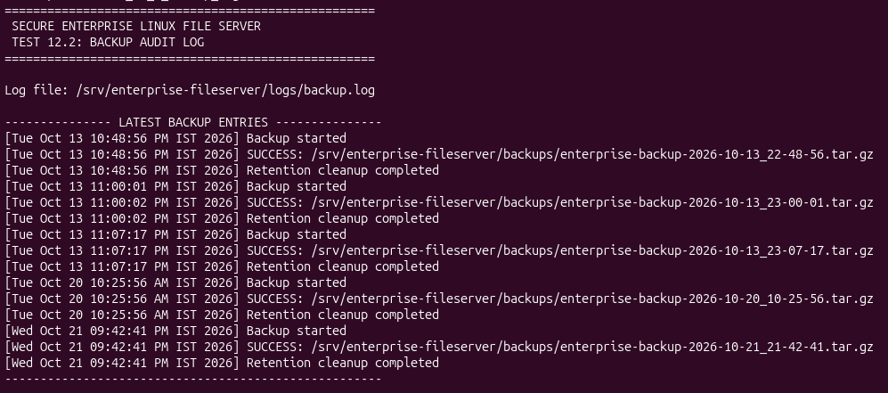
Demonstration: Manual Backup Execution & Logging
On-Demand Administrative Backup
• On-Demand Snapshots: Administrators can invoke backup.sh manually prior to scheduled maintenance, system patching, or organizational changes.
• Execution Feedback: The script outputs console confirmation upon archive creation and integrity verification.
• Timestamped File Storage: Generates compressed archives in /srv/enterprise-fileserver/backups/ with millisecond timestamp granularity.
• Comprehensive Logging: Every execution appends detailed telemetry to /srv/enterprise-fileserver/logs/backup.log, recording start time, elapsed duration, archive byte size, and success status.
PASTE YOUR REAL UBUNTU SCREENSHOT HERE
Target File: [screenshot_08_backup_execution.png]
Command: $ sudo bash /srv/enterprise-fileserver/scripts/backup.sh && sudo ls -lh /srv/enterprise-fileserver/backups/
(Replace this box with your actual terminal screenshot)
Figure 12.1: Manual execution of backup script and timestamped archive creation
PASTE YOUR REAL UBUNTU SCREENSHOT HERE
Target File: [screenshot_09_backup_log.png]
Command: $ sudo tail -n 15 /srv/enterprise-fileserver/logs/backup.log
(Replace this box with your actual terminal screenshot)
Backup Execution & Log Audit Commands:
sudo bash /srv/enterprise-fileserver/scripts/backup.sh
sudo ls -lh /srv/enterprise-fileserver/backups/
sudo tail -n 15 /srv/enterprise-fileserver/logs/backup.log
Figure 12.2: Backup audit log showing execution timestamp, size, and success status
12

Slide 13
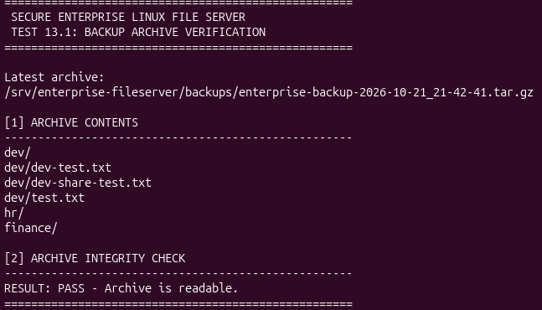
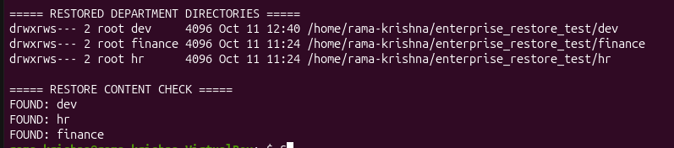
Backup Integrity Verification and Restore Testing
Disaster Recovery Testing Protocol
• Why Verification Matters: A backup is never complete until a successful restore is verified. Silent block corruption can render unverified archives useless.
• Non-Destructive Index Test: tar -tzf reads archive headers and verifies the gzip checksum without unpacking data to disk.
• Isolated Restoration Sandbox: mkdir -p /tmp/restore_test provides a safe sandbox environment to test recovery without overwriting production files.
• Controlled Extraction: tar -xzf extracts all files into the sandbox, confirming that uncompression and directory restoration succeed.
• Content & Permission Audit: Files, checksums, and directory permissions are inspected in the restore directory to guarantee complete recoverability.
PASTE YOUR REAL UBUNTU SCREENSHOT HERE
Target File: [screenshot_10_archive_verification.png]
Command: $ tar -tzf /srv/enterprise-fileserver/backups/backup_*.tar.gz | head -n 15
(Replace this box with your actual terminal screenshot)
Figure 13.1: Non-destructive archive verification via tar table of contents
PASTE YOUR REAL UBUNTU SCREENSHOT HERE
Target File: [screenshot_11_restore_test.png]
Command: $ mkdir -p /tmp/restore_test && tar -xzf /srv/enterprise-fileserver/backups/backup_*.tar.gz -C /tmp/restore_test && ls -l /tmp/restore_test/shared
(Replace this box with your actual terminal screenshot)
Figure 13.2: Successful extraction and data verification in isolated restore sandbox
13

Slide 14
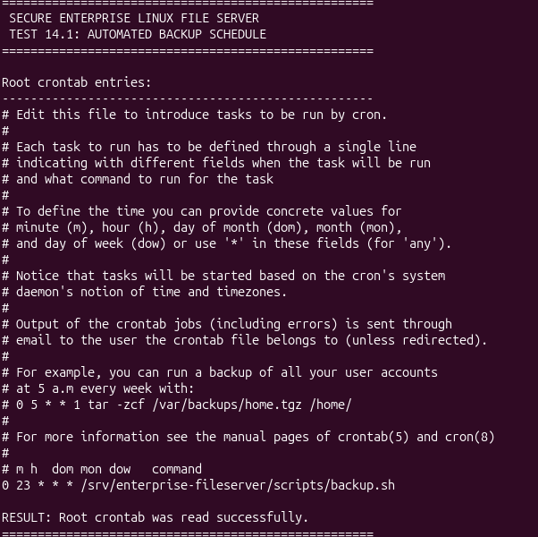
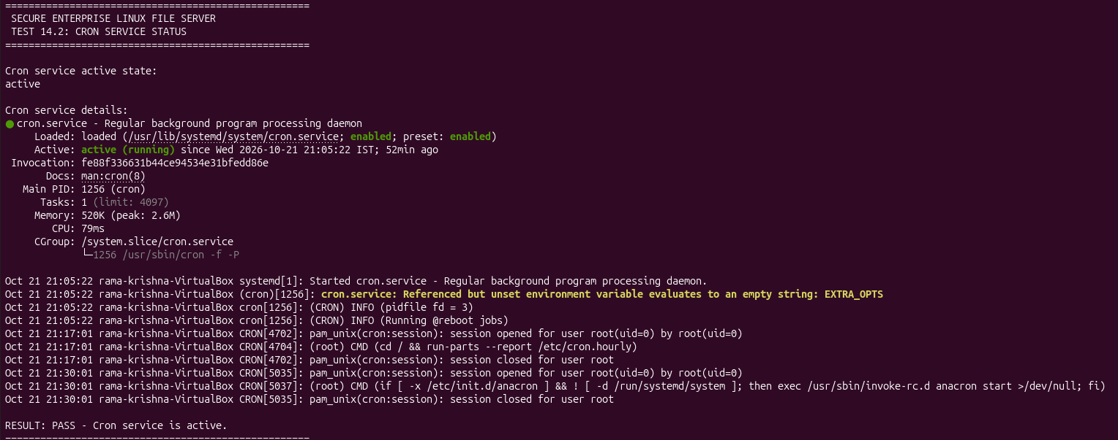
Automation: Cron Job Scheduling
Daemon Automation with Root Cron
• Root Crontab Execution: Scheduled under root crontab (sudo crontab -e) to ensure unrestricted read access across all departmental folders without permission traps.
• Daily 11:00 PM Execution: Configured at 0 23 * * * to execute unattended during off-peak hours, creating consistent daily recovery restore points.
• Eliminating Human Neglect: Background automation guarantees that backups occur reliably without requiring manual administrator intervention.
• VM Runtime Requirement: The VirtualBox Ubuntu virtual machine must be running at 11:00 PM (or run in headless mode) for the cron daemon to fire.
PASTE YOUR REAL UBUNTU SCREENSHOT HERE
Target File: [screenshot_12_crontab_list.png]
Command: $ sudo crontab -l
(Replace this box with your actual terminal screenshot)
Figure 14.1: Root crontab listing showing scheduled 11:00 PM daily backup job
PASTE YOUR REAL UBUNTU SCREENSHOT HERE
Target File: [screenshot_13_cron_service.png]
Command: $ systemctl is-active cron && systemctl status cron
(Replace this box with your actual terminal screenshot)
Field | Value | Meaning
Minute | 0 | At minute 0
Hour | 23 | At 11:00 PM (23:00 hrs)
Day | * | Every day of the month
Month | * | Every month
Weekday | * | Every day of the week
Figure 14.2: Cron daemon active status verification using systemctl
14

Slide 15
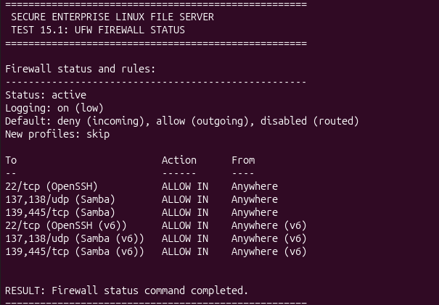
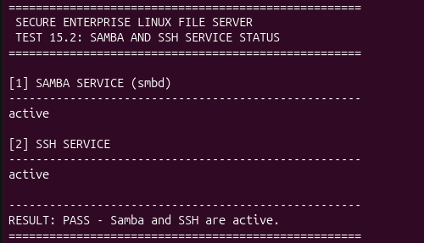
Security Architecture: Firewall & Services
Host Hardening & Service Shielding
• Default Deny Policy: UFW (Uncomplicated Firewall) drops all unsolicited inbound network packets by default (ufw default deny incoming).
• Selective Port Whitelisting: Explicitly whitelists Samba SMB ports (TCP 139, 445; UDP 137, 138) and Secure Shell SSH (TCP port 22).
• Systemd Service Supervision: systemctl ensures smbd and ssh daemons are enabled on boot and automatically restarted on crash.
• Local POSIX Hardening: Standard terminal users cannot traverse foreign department directories (chmod 2770).
• Auditability: All administrative and backup actions generate persistent log traces for forensic accounting.
PASTE YOUR REAL UBUNTU SCREENSHOT HERE
Target File: [screenshot_14_ufw_status.png]
Command: $ sudo ufw status verbose
(Replace this box with your actual terminal screenshot)
Figure 15.1: UFW firewall status showing enabled rules for Samba and SSH
PASTE YOUR REAL UBUNTU SCREENSHOT HERE
Target File: [screenshot_15_services_status.png]
Command: $ systemctl is-active smbd && systemctl is-active ssh
(Replace this box with your actual terminal screenshot)
Firewall & Service Verification Commands:
sudo ufw status verbose
systemctl is-active smbd
systemctl is-active ssh
Figure 15.2: Active status checks for Samba (smbd) and SSH system daemons
15

Slide 16
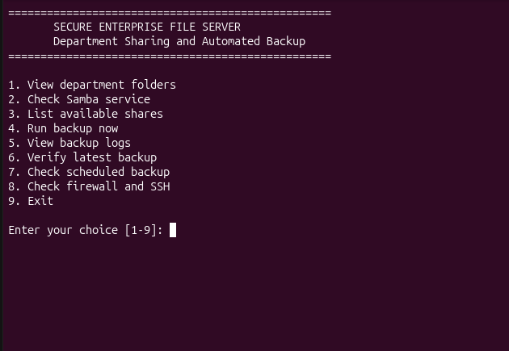
Administration: Menu-Driven Bash Interface
Workflow: User Selection → Input Validation → Modular Bash Function → Linux Command → Formatted Output
Management Menu Options (enterprise_fileserver_menu.sh)
1) View department folders & permissions
2) Check Samba service status (systemctl)
3) List active Samba shares (smbclient)
4) Run on-demand backup now (backup.sh)
5) View recent backup logs (tail -n 20)
6) Verify latest backup archive integrity (tar -tzf)
7) Check scheduled cron configuration (crontab -l)
8) Check firewall and SSH status (ufw, ssh)
9) Exit administration menu
.
PASTE YOUR REAL UBUNTU SCREENSHOT HERE
Target File: [screenshot_16_menu_interface.png]
Command: $ bash ~/enterprise_fileserver_menu.sh
(Replace this box with your actual terminal screenshot)
Figure 16.1: Menu-driven Bash management interface running in Ubuntu terminal
16

Slide 17
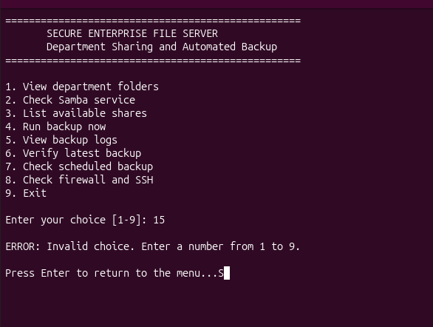
Robustness: Input Validation & Error Handling
Defensive Bash Scripting Principles
• Case Default Catch-All: The menu script implements a *) case branch to trap out-of-range numbers, alphabetical strings, and blank inputs.
• Pre-Flight Directory Checks: Backup routines verify that source department folders exist prior to attempting compression (if [ ! -d "$DIR" ]).
• Non-Zero Exit Code Traps: All critical commands evaluate $? exit status codes to intercept errors before committing state changes.
• Archive Readability Guards: tar -tzf detects corrupted gzip streams and aborts before logging false successes.
• Clean Error Communication: Displays descriptive, color-coded error prompts without terminating the administrative session loop.
PASTE YOUR REAL UBUNTU SCREENSHOT HERE
Target File: [screenshot_17_error_handling.png]
Command: $ bash ~/enterprise_fileserver_menu.sh (Entering invalid option e.g. 15 or 'xyz')
(Replace this box with your actual terminal screenshot)
Input Validation Excerpt (enterprise_fileserver_menu.sh):
case $choice in
1) view_folders ;;
2) check_samba ;;
...
*) echo -e "[ERROR] Invalid choice: $choice. Choose (1-9)"
read -p "Press Enter to return to menu..." ;;
esac
Figure 17.1: Interactive menu trapping invalid input with user error prompt
17

Slide 18
Testing Summary & Verification Matrix
Test Item | Operational Scope & Target | Verification Command / Method | Observed Result
Directory Hierarchy | Verify /srv/enterprise-fileserver/ tree | sudo tree -pug /srv/enterprise-fileserver | Verified / Passed
User & Group Isolation | Confirm devuser, hruser, financeuser memberships | id devuser && id hruser && id financeuser | Verified / Passed
Setgid Inheritance | Verify group inheritance on newly created files | touch /shared/dev/test && ls -l | Verified / Passed
Samba Share Config | Validate /etc/samba/smb.conf parameter syntax | sudo testparm -s | Verified / Passed
Authorized SMB Access | devuser authenticates to Development share | smbclient //localhost/Development -U devuser | Verified / Passed
Unauthorized SMB Denied | devuser blocked from connecting to Finance share | smbclient //localhost/Finance -U devuser | Access Denied / Passed
Manual Backup Execution | Generate timestamped .tar.gz archive in /backups/ | sudo bash backup.sh && ls -lh | Verified / Passed
Archive Readability | Integrity check & logging in backup.log | tar -tzf <archive> && tail backup.log | Verified / Passed
Cron Daemon Scheduling | Validate root crontab automated 11:00 PM trigger | sudo crontab -l && systemctl is-active cron | Verified / Passed
Menu Interface Validation | Interactive 9-option administration script | bash ~/enterprise_fileserver_menu.sh | Iterative / In Progress
18

Slide 19
Challenges Faced and Future Scope
Technical Challenge Encountered | Identified Root Cause | Engineering Solution Applied
Group Write Loss on New Files | Default umask (0022) created files without group write permission | Applied Setgid bit (2770) + Samba create mask = 0660 and directory mask = 0770
Accidental Public Share Exposure | Default Samba shares inherit global read permissions without valid users | Enforced explicit valid users = @group and removed guest ok directives
Scheduled Backup Missed | VirtualBox VM was suspended/sleeping at the scheduled 23:00 run | Documented VM power requirement and verified manual trigger fallback
FUTURE ENHANCEMENTS & EXTENSIONS
Off-Site Cloud Replication
Automate secure off-site sync of .tar.gz archives to AWS S3 or a secondary Linux server via rsync over SSH.
Archive Cryptography (GPG)
Implement automated symmetric or public-key encryption (GPG / OpenSSL AES-256) to protect data at rest.
Automated Alert Notifications
Configure email/SMS/webhook alerts to notify administrators immediately upon backup failures or disk limits.
Web Management Dashboard
Deploy Cockpit or Webmin to provide a secure web-based GUI for storage telemetry and Samba user administration.
Centralized Directory (LDAP)
Integrate Samba with FreeIPA or Microsoft Active Directory for unified enterprise identity and single sign-on.
Storage Redundancy (RAID)
Deploy mdadm RAID-1 disk mirroring or ZFS snapshot capabilities to guard against physical drive failure.
19

Slide 20
Conclusion and References
Project Summary & Key Takeaways
• Successfully designed, implemented, and hardened an enterprise departmental file server on Ubuntu Linux in Oracle VirtualBox.
• Enforced zero-trust departmental boundaries using Linux Setgid permissions (chmod 2770) and Samba access control directives (valid users).
• Automated enterprise disaster recovery via a daily 11:00 PM root cron job creating verified, timestamped, gzip-compressed tar archives with 30-day retention pruning.
Technical & Academic References
1. Canonical Ltd. Ubuntu Server Documentation: Samba File Server. https://ubuntu.com/server/docs/samba-file-server
2. Samba Core Team. smb.conf Documentation & testparm man pages. https://www.samba.org/samba/docs/
3. Free Software Foundation. GNU Bash Reference Manual & GNU Tar Documentation. https://www.gnu.org/software/bash/
4. Michael Kerrisk. The Linux Programming Interface: Users, Groups, and File Permissions. No Starch Press.
5. Canonical Ltd. UFW - Uncomplicated Firewall Documentation. https://help.ubuntu.com/community/UFW
6. Oracle Corporation. Oracle VM VirtualBox User Manual. https://www.virtualbox.org/manual/
Thank You
20

