Slide 1
Image steganography

Slide 2
Introduction to Steganography
Steganography is the practice of hiding information within other, seemingly innocuous data—like concealing a secret message in an image, audio file, video, or text—so that the very existence of the hidden information is obscured.
It involves hiding the message's existence, unlike encryption, which aims to secure the content.

Slide 3
Significance in Digital Communication
Image steganography plays a vital role in secure communication by allowing covert data transmission within visual content, preventing unauthorized access. It enhances privacy and security in digital exchanges.
Embedding copyright or ownership information into digital media to prevent piracy.
Cybersecurity researchers use steganography tools to detect how attackers may hide data.

Slide 4
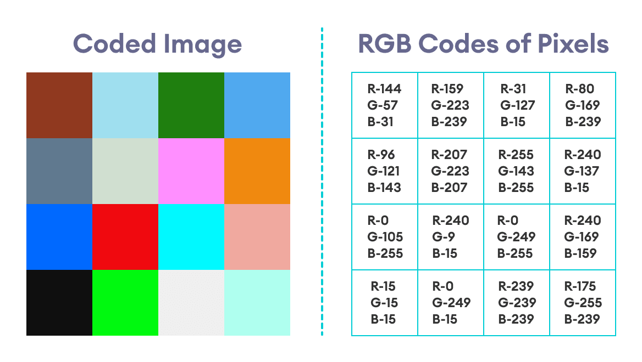
Types of Image Steganography
8-bit technique and RGB color mechanisms embed data directly into the image pixels, affecting their visual appearance. In contrast, frequency-domain techniques modify the image's frequency components, often preserving its perceptual quality.

Slide 5
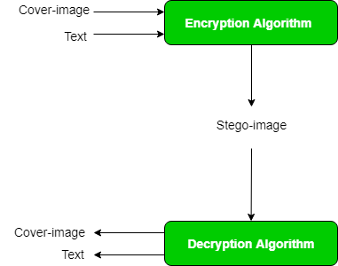
Process of Embedding Data
Data Embedding Process:-
The process of embedding data in an image involves selecting cover image, encoding the secret data, embedding it seamlessly, and ensuring that the stego image appears normal to the eye.
Stego Image Generation:-
Generating the stego image requires precise embedding techniques to hide information effectively. Careful selection of embedding locations and methods is crucial for successful steganographic encoding.

Slide 6
Tools for Image Steganography
Tool Name | Features
OpenStego | Supports various steganographic techniques
Steghide | Command-line tool for data embedding
OutGuess | Focuses on maximizing data capacity
Steganography Studio | User-friendly interface for beginners

Slide 7
Applications of Image Steganography
40%
30%
30%
Data Hiding
Watermarking
Authentication
Data hiding applications involve concealing sensitive information within images for secure communication, with a significant 40% usage rate.
Digital watermarking is utilized for copyright protection and content authentication, with a usage rate of 30% in image steganography.
Image steganography plays a role in authentication processes to verify the integrity and origin of transmitted images, comprising 30% of its applications.

Slide 8
End users
Government and Military: For secure communication and data transmission.
Law Enforcement: In investigations requiring covert data exchange.
Journalists and Whistleblowers: Protecting sensitive information.
Corporate Professionals: Ensuring confidential communication.
General Public: Privacy enthusiasts or individuals needing secure messaging.
These users benefit from steganography's ability to hide information, offering confidentiality without drawing attention.

Slide 9
GIT-HUB LINK
https://github.com/ramulavu/Steganography-project

Slide 10
Thank you

