Slide 1

BANKING WEB APPLICATION
Student : Mohana Ramakrishnan
Matriculation ID : 92129139
Date : 05.AUG.2024
GITHUB :https://github.com/Ramakrishnan- 1948/Ramakrishnan_Mohana_92129139_DLBCSPJWD01_PHASE_2_PS_2
Tutor : Christian Remfert

Slide 2
PURPOSE OF THE WEB APP
The Banking Web Application enables users to manage their finances online efficiently.
It solves the problem of needing in-person banking by offering digital customer management and transaction processing.
The app targets individuals and businesses seeking convenient and accessible financial services.
By streamlining banking processes, it reduces time and effort, enhancing the overall user experience.
The application adds value by providing an intuitive interface with secure, seamless transactions for users.

Slide 3
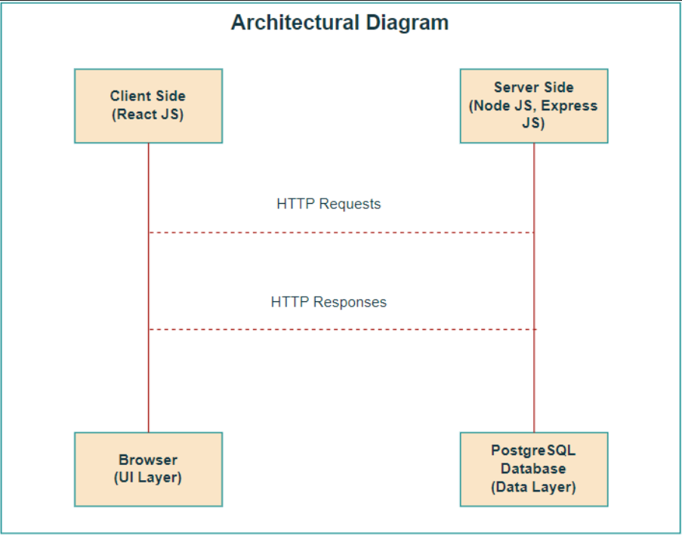
ARCHITECTURE DIAGRAM
The architecture consists of a Client Side developed with React JS for managing the user interface.
The Server Side uses Node JS and Express JS to handle business logic and API requests.
HTTP Requests from the client are processed by the server, which interacts with the PostgreSQL Database.
HTTP Responses are sent back from the server to the client, updating the browser's UI Layer.
The PostgreSQL Database serves as the data layer, storing and retrieving data as needed by the server.

Slide 4
TECHNOLOGY CHOICES
Frontend: ReactJS was chosen for its component-based architecture, enabling efficient UI development and management.
State Management: React's built-in useState and useEffect hooks manage state, with Context API or Redux for complex state needs.
Styling: CSS modules or styled-components were used for component-level styling, ensuring modular and maintainable code.
Backend: ExpressJS handles server-side logic, paired with PostgreSQL for robust, relational data management.
Authentication: JWT or Passport.js ensures secure user authentication and session management, critical for banking operations.

Slide 5
BANKING WEB APPLICATION
Home Page: The welcome screen introduces users to the banking app, offering easy navigation through a clean, intuitive interface.
Customers Page: Displays a list of all customers with their names, emails, and account balances, facilitating efficient customer management.
Make Transaction Page: Allow to make a transaction between the customers.
History Page: Displays a list of the transaction that are done by the user.
Design Decision: The color gradient and simple layout ensure clarity and focus on essential banking operations.
Navigation: The top navigation bar provides quick access to key functionalities like transactions and customer history.

Slide 6
CHANGES FROM PROPOSAL
Database Change: Switched from MongoDB to PostgreSQL for better relational data management and transaction handling.
Styling Framework: Transitioned from Bootstrap/Tailwind CSS to CSS modules and styled-components for more modular, component-specific styling.
State Management: Initially planned to rely on basic state management but considered Context API or Redux for complex state needs.
Reason for Changes: Adjustments were made due to technical constraints, improved design flexibility, and feedback from initial user testing.
Impact: These changes aimed to enhance performance, maintainability, and user experience while aligning better with project requirements.
Aspect | Original Proposal | Change Made | Reason
Database | MongoDB | PostgreSQL | Better suited for relational data and transaction handling.
Styling Framework | Bootstrap/Tailwind CSS | CSS Modules / Styled-components | Provides modular, component-specific styling.
State Management | Basic State Handling | useState, useEffect, Context API/Redux | Needed for managing more complex state scenarios.
Backend Framework | No change planned (Node.js, Express.js) | No significant change | Chosen for its robustness in handling server-side logic.
Authentication | Basic Authentication | JWT/Passport.js | Ensures more secure user authentication and session management.

Slide 7
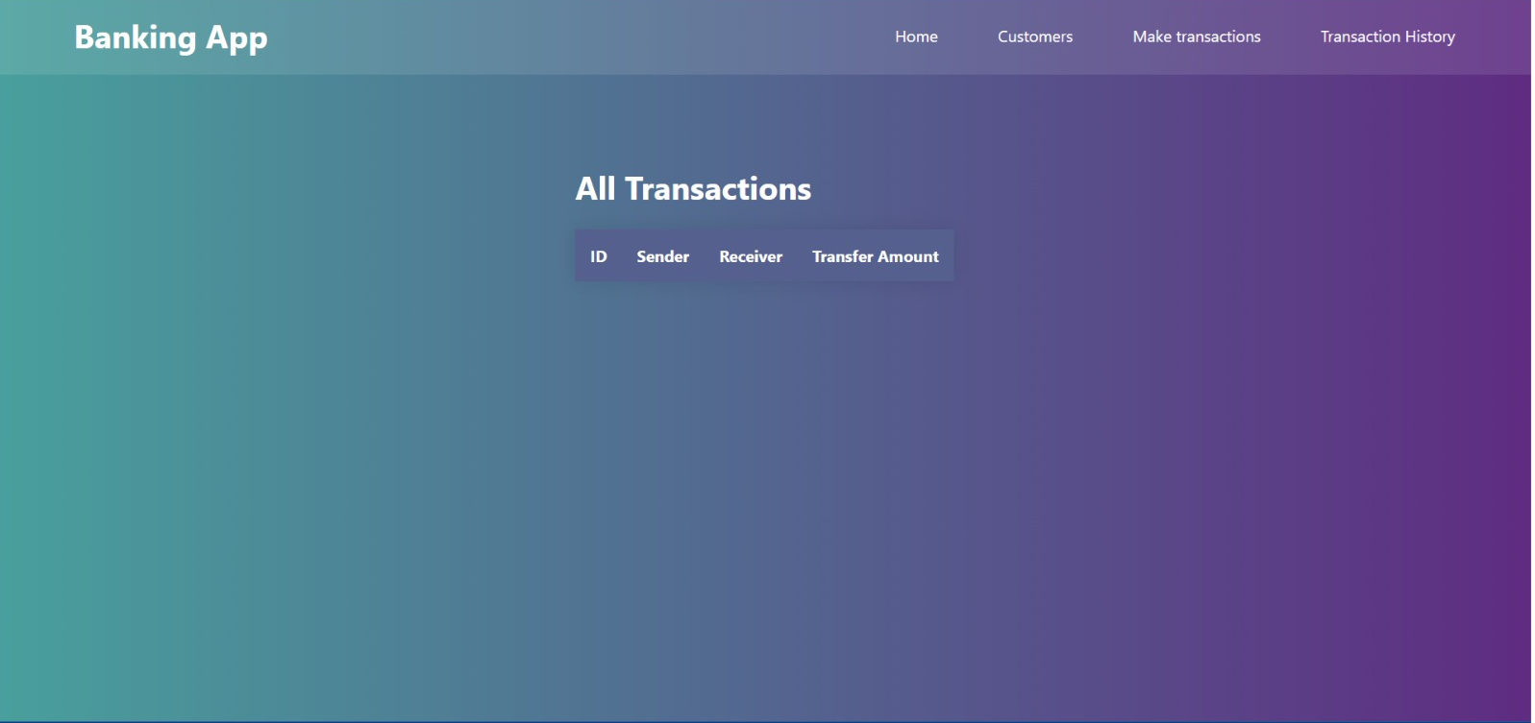
Online Banking Application – Entry Screens
The Application has menus like Home, Customers,
Make transactions, Transaction history that enables user for easy navigation through a clean, intuitive interface.
.

Slide 8
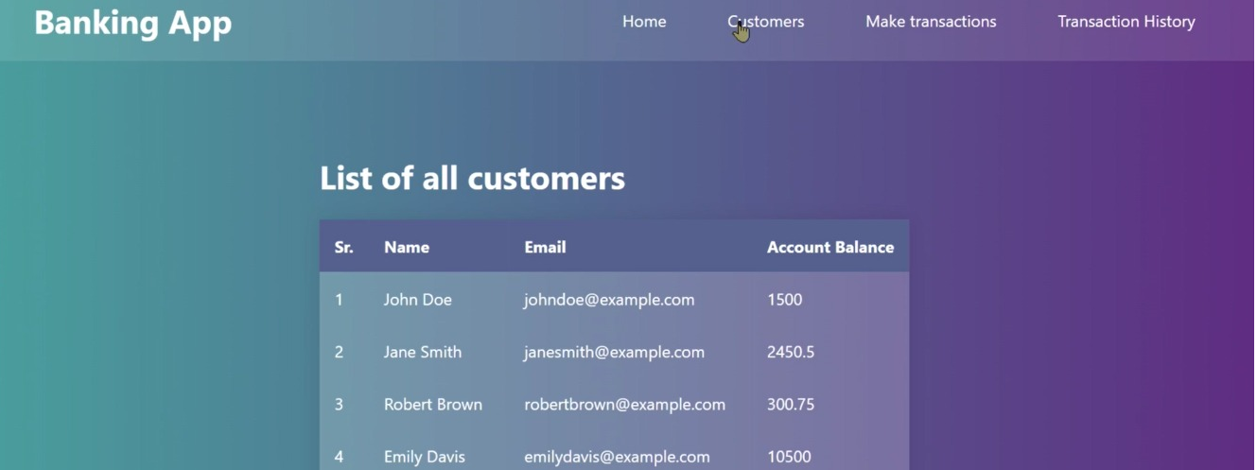
Online Banking Application – Entry Screens
The Customers menu displays list of all customers with their names, emails, and account balances, facilitating efficient customer management.

Slide 9
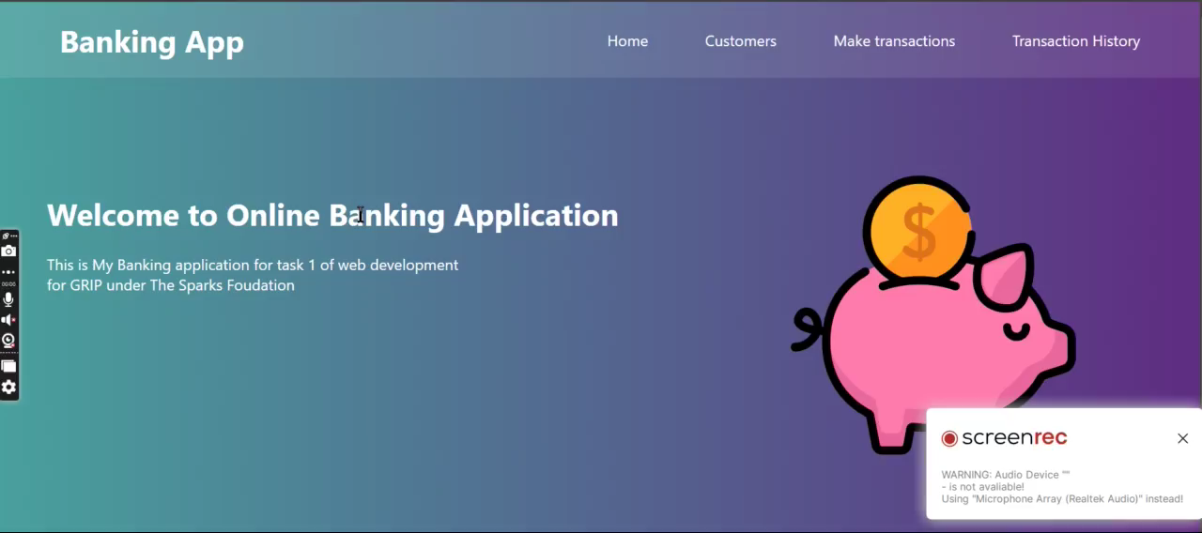
Video for Online Banking Application

Slide 10


