Slide 1
Customer Churn EDA Analysis - Univariate Ramakrishnan Natarajan

Slide 2
Exploratory Data Analysis
Business Understanding and Overview
In the telecom industry, preventing customer churn is crucial for a company's long-term success. This data analysis focuses on understanding why customers might leave a telecom company. We'll be doing Exploratory Data Analysis (EDA) using Python on the provided data. This helps us uncover patterns and insights to guide the company in making informed decisions.
Telecom churn analysis is essential because customer’s needs and technology keep evolving. EDA is the first step in understanding the data we have. In this presentation, we'll look at the challenges faced by telecom companies and use Python to explore the data, aiming to find valuable insights.
Our goal is to delve into the underlying data points contributing to this churn, leveraging exploratory data analysis (EDA) to identify patterns and insights that will inform strategic measures for reducing churn and enhancing customer retention.

Slide 3
Understanding the data

Slide 4
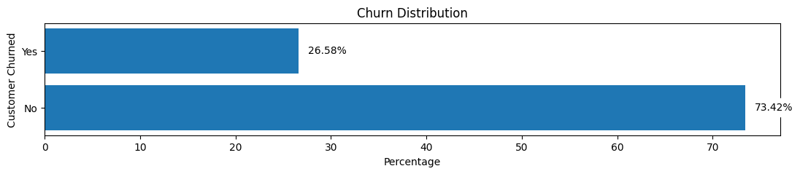
Exploratory Data Analysis
Target Variable
Initial findings show the overall churn rate is 26.58 %
The customer churn rate, determined from the given data, is 26.58%, reflecting the proportion of customers
discontinuing services.
- This will serve as our base target value to compare and evaluate the impact of categorical and numerical data.

Slide 5
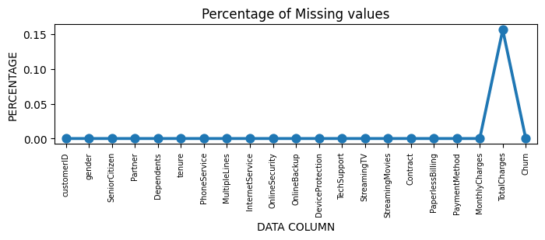
Exploratory Data Analysis
Missing Data Analysis
Data Type Correction:
Issue: The data type of the "Total Charges" column was incorrect (object instead of float64).
Resolution: The data type was changed to numerical (float64) to ensure accurate analysis.
Handling Null Values:
Issue: 11 null records were identified in the "Total Charges" column, constituting 0.15% of the dataset.
Resolution: As this percentage is very small compared to the overall data as represented on the graph below, those 11 records were dropped, resulting in a new dataset with 7032 records.

Slide 6
Exploratory Data Analysis
Data Cleaning
Tenure Grouping for Visualization:
Issue: To improve visualization, the "Tenure Months" entries (ranging from 1 to 72) were grouped into six bins: 1-12, 13-24, 25-36, 37-48, 49-60, and 61-72. The new data column, "tenure_group," was created.
Irrelevant Column Removal:
Issue: "Customer ID" and "Tenure" were identified as irrelevant for data analysis.
Resolution: Both columns were dropped, resulting in a dataset that is ready for more focused EDA.

Slide 7
Univariate Analysis

Slide 8
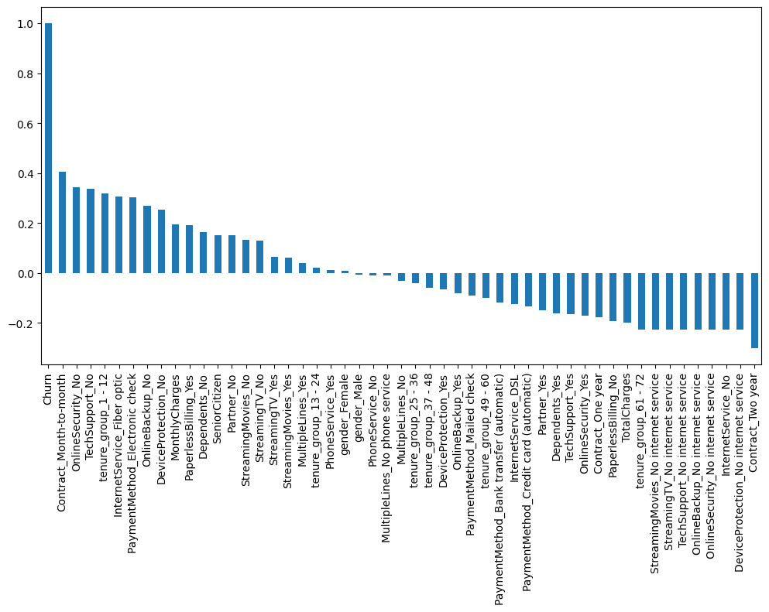
Exploratory Data Analysis
Initial Findings of Univariate Analysis
To find out the overall univariate analysis, we converted all categorical values to numerical representations using the get_dummies method. Subsequently, we conducted a correlation analysis, examining the relationship between these numerical features and the "Churn" column.
According to the analysis, customers with the following attributes tend to exhibit higher churn rates as shown in the graph:
- Month-to-month contract
- No online security or tech support
- With a tenure of less than a year
- Fiber optic internet service
- Electronic check payment
- No online backup or device protection
- High monthly charges
- Opting for paperless billing
- Having partners and dependents
- Not utilizing streaming services for TV and movies

Slide 9
Univariate Analysis (Categorical)

Slide 10
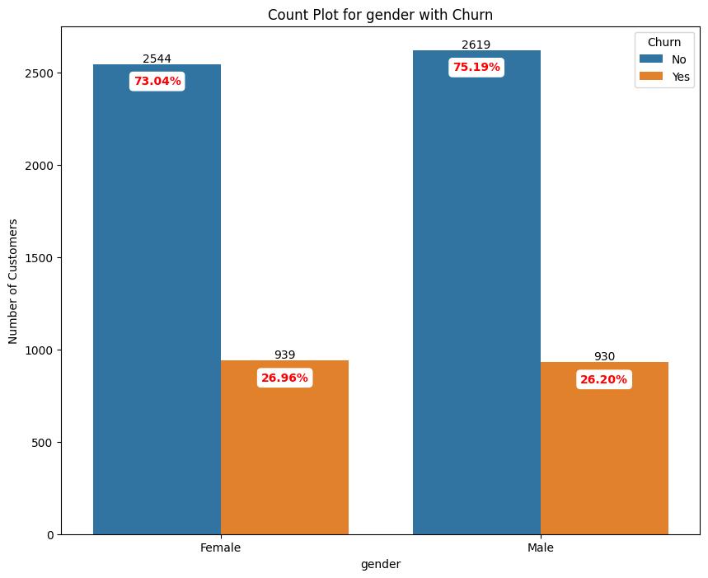
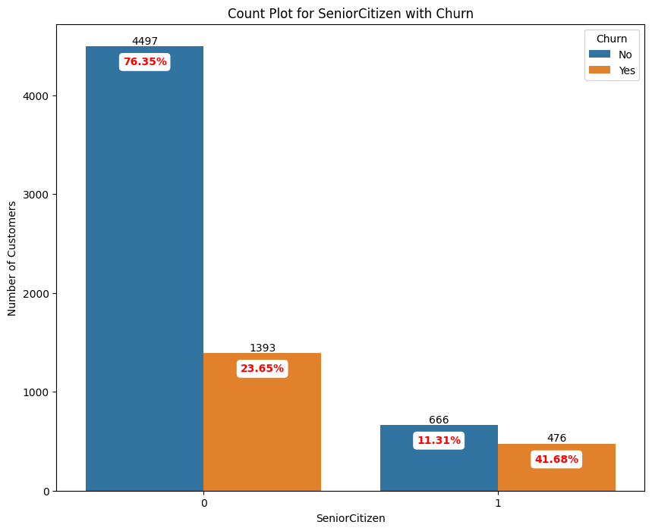
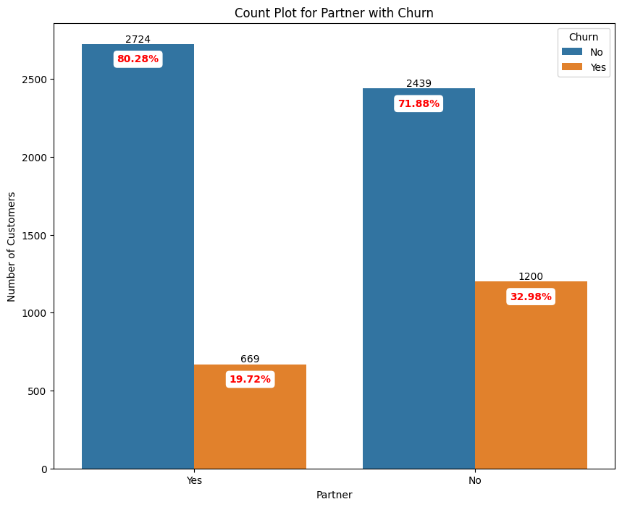
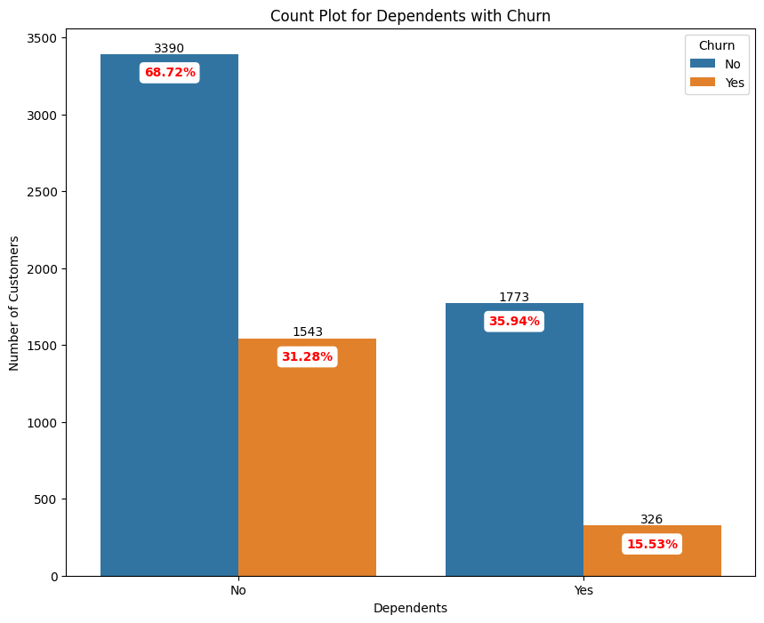
Exploratory Data Analysis
Based on Personal Attributes of Customers
Important Observations [Original Churn Rate : 26.58 %] :
Customer with following personal characteristics are bound to churn out more:
Senior citizens – 41.68% (churn rate)
Customers without partners – 32.98% (churn rate)
Customers without dependents – 31.28% (churn rate)

Slide 11
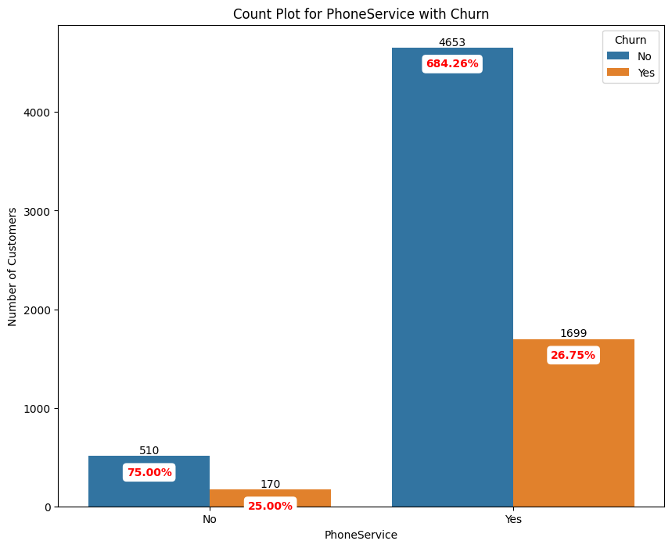
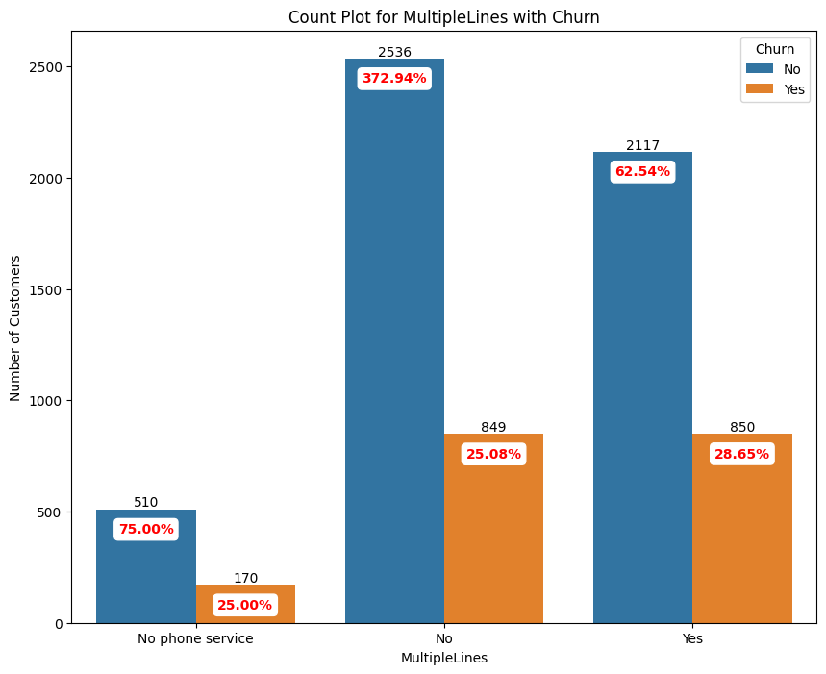
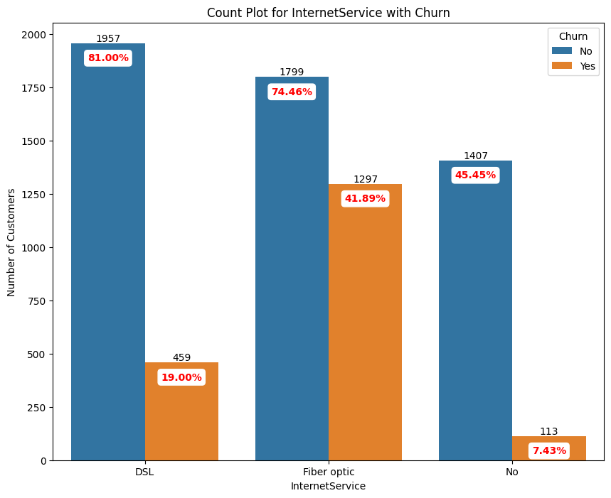
Exploratory Data Analysis
Based on Service Type
Important Observations [Original Churn Rate : 26.58 %] :
Customer with following service type are bound to churn out more:
Fiber Optic Internet Service – 41.89% (churn rate)

Slide 12
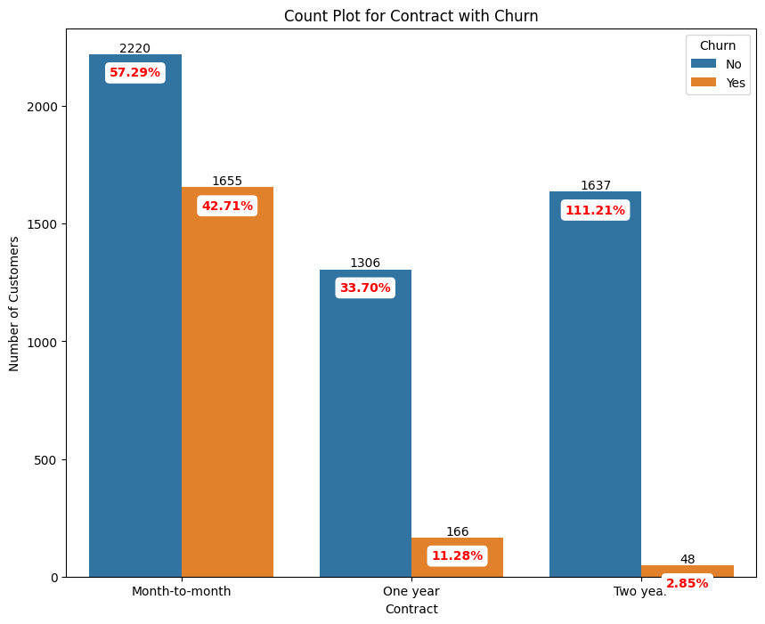
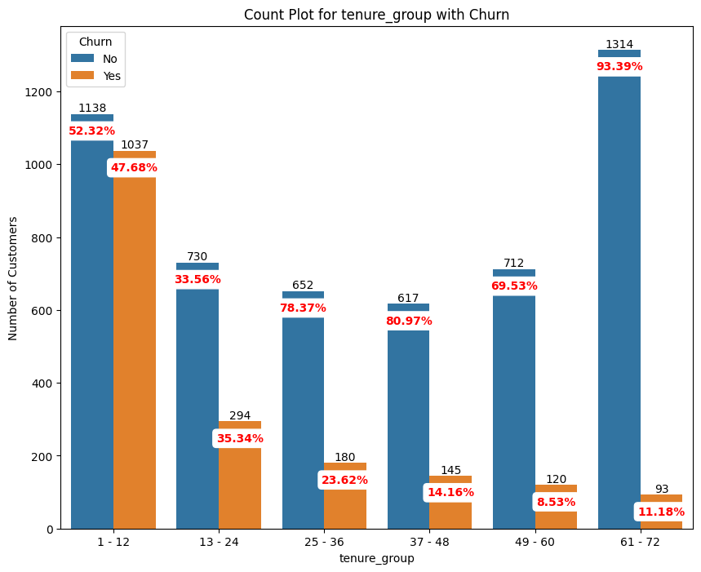
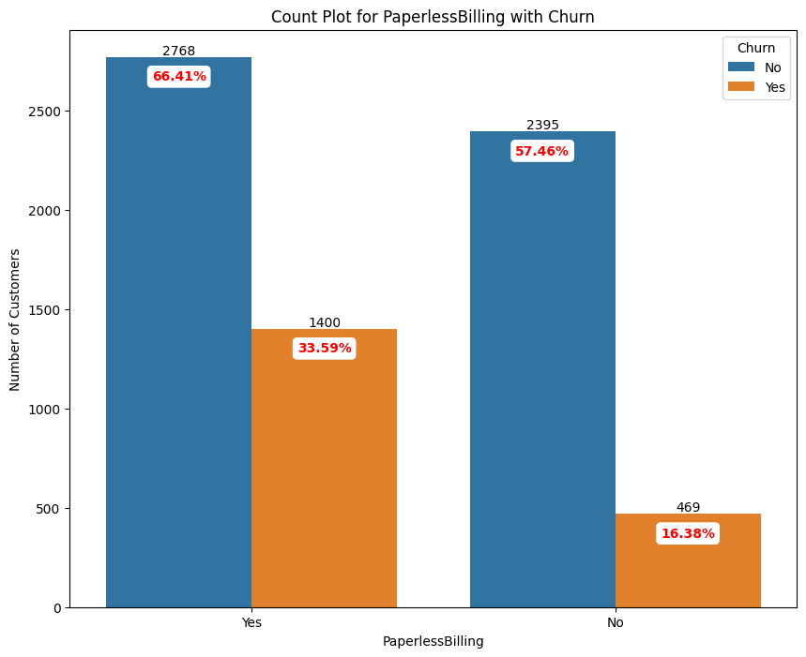
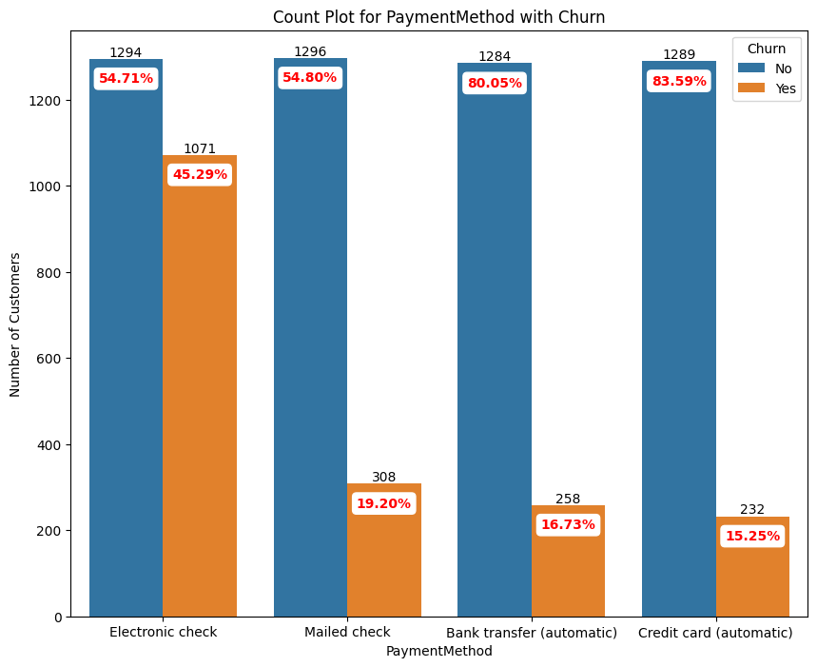
Exploratory Data Analysis
Based on Type of Contract and Payment Method
Important Observations [Original Churn Rate : 26.58 %] :
Customer with following contract type are bound to churn out more:
Month to Month – 42.71 % (churn rate)
Less than one year contract – 47.68 % (churn rate)
More than one and less than 2 years – 35.34 % (churn rate)
Important Observations [Original Churn Rate : 26.58 %] :
Customer with following payment type are bound to churn out more:
Paperless Billing – 33.59 % (churn rate)
Electronic Check – 45.29 % (churn rate)

Slide 13
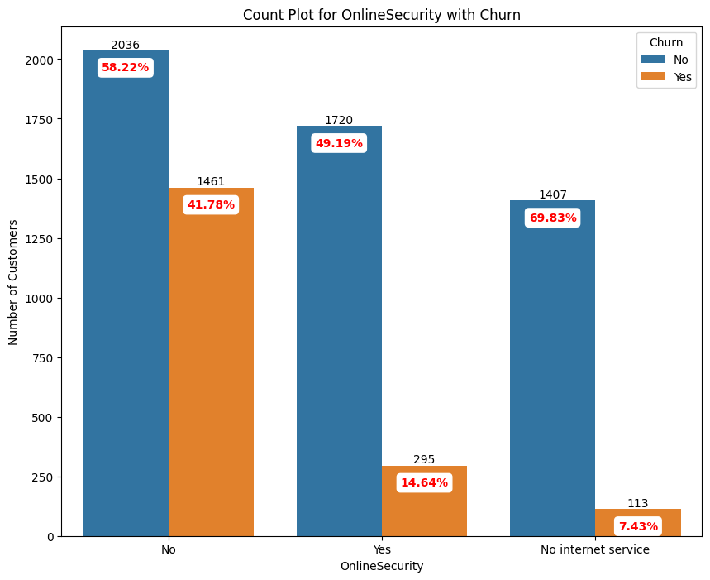
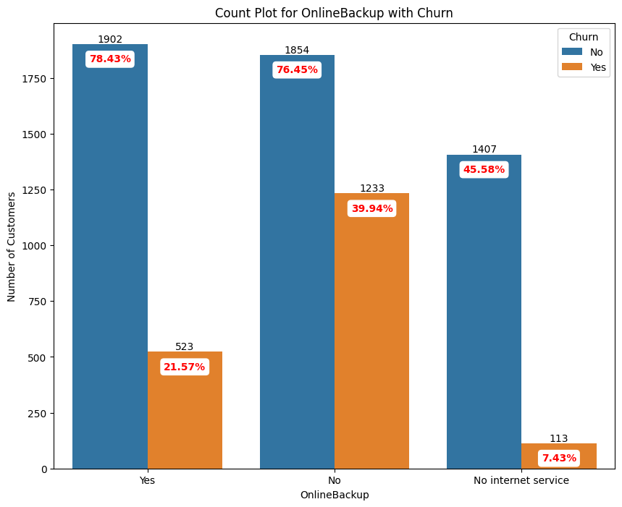
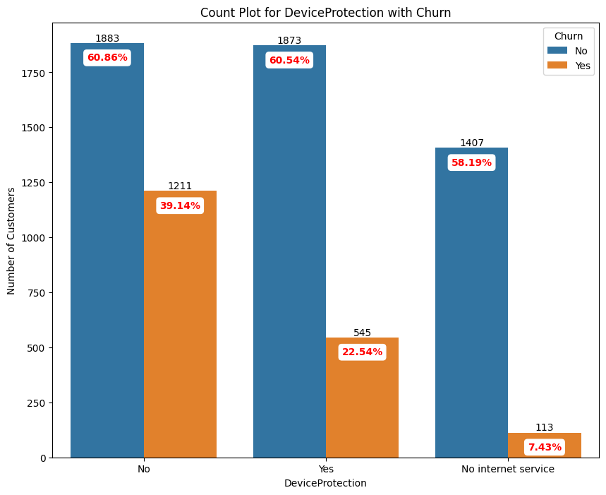

Exploratory Data Analysis
Based on Add-on Services
Important Observations [Original Churn Rate : 26.58 %] :
Customer without following add on services are bound to churn out more:
No Online Security – 41.78% (churn rate)
No Online Backup – 39.94% (churn rate)
No Device Protection – 39.14% (churn rate)
No Tech Support – 41.65% (churn rate)

Slide 14
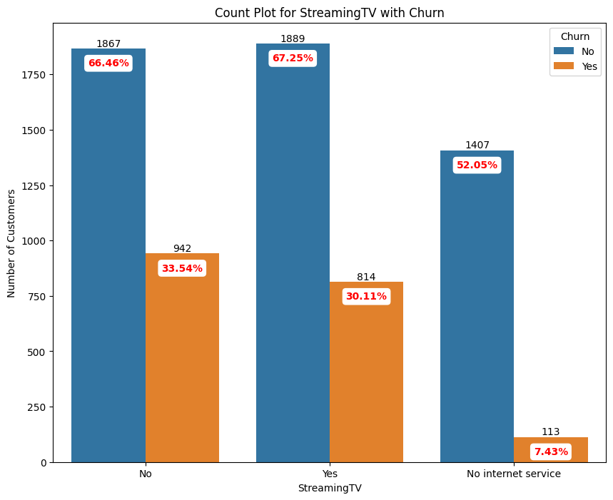
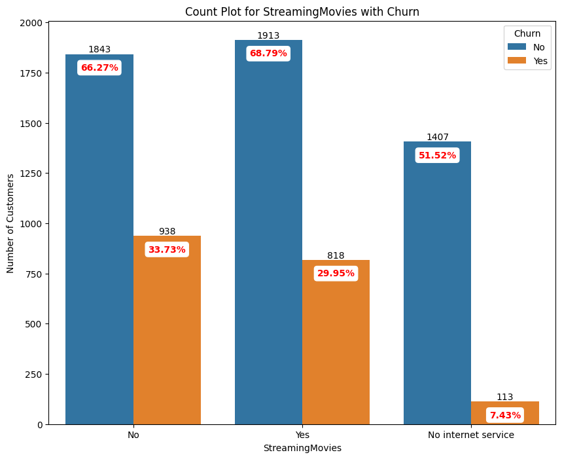
Exploratory Data Analysis
Based on Add-on Streaming Services
Important Observations [Original Churn Rate : 26.58 %] :
Customer without following streaming services are bound to churn out more:
No Streaming TV – 33.54% (churn rate)
No Streaming Movies – 33.73% (churn rate)
Another important observation, people using the following services are also likely to churn out:
Yes- Streaming TV – 30.11 % (churn rate)
Yes - Streaming Movies – 29.95 % (churn rate)

Slide 15
Univariate Analysis (Numerical)

Slide 16
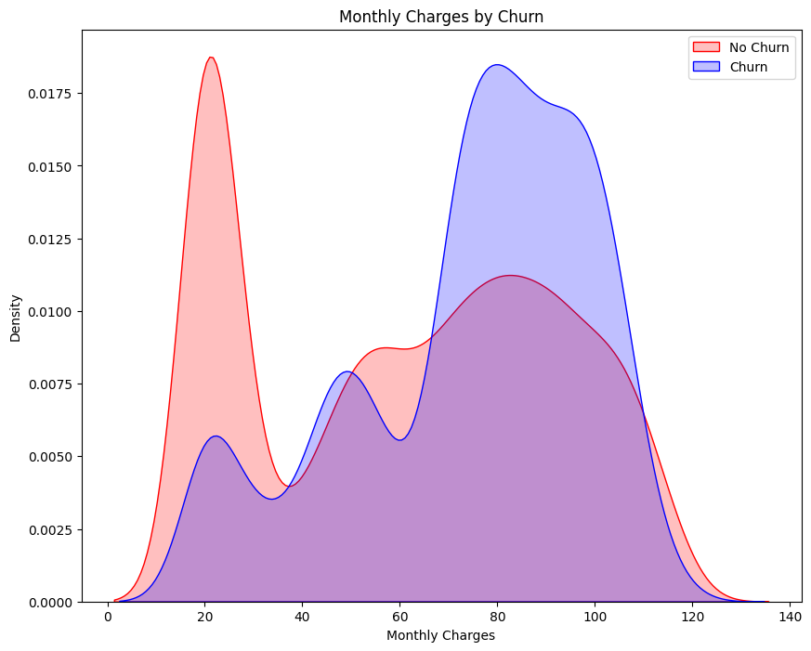
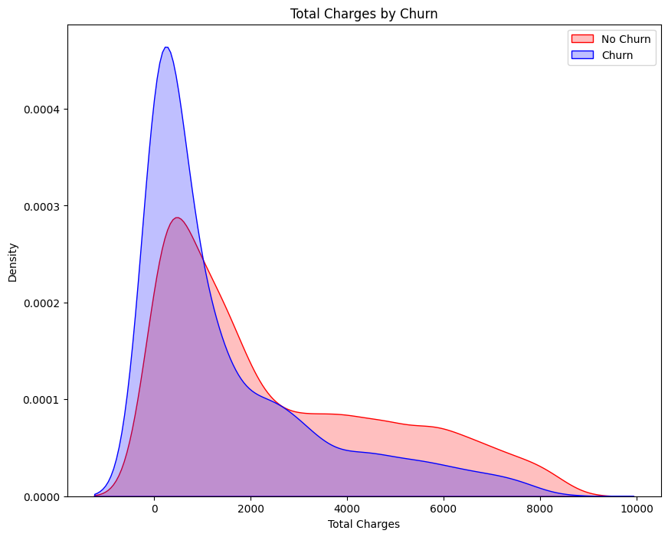
Exploratory Data Analysis
Based on Charges
Important Observations [Original Churn Rate : 26.58 %] :
The monthly charges correlation clearly proves that, the higher the charges, customers are more likely to churn.
Important Observations [Original Churn Rate : 26.58 %] :
The total charges has a correlation that shows the lower the total charges, customers are more likely to churn.
As we already know, customers are highly likely to churn out for lower tenures and lower monthly charges, this graph proves the same.

Slide 17
Next Steps

Slide 18
Project analysis slide 5
Exploratory Data Analysis
Next Steps Planned
1. Detailed Bivariate Analysis
Conduct a detailed look at how different factors relate to each other concerning customer churn through bi-variate analysis.
2. Insights Generation:
Summarize key insights from this analysis to highlight crucial patterns and relationships.
3. Machine Learning Prediction:
Utilize these insights to build a machine learning model that predicts future churners.
4. Data-Driven Decision Making:
Integrate advanced analytics and machine learning for data-driven decisions, ensuring the company stays competitive in the telecom market.

Slide 19
Thank You

