Slide 1
4.2.3 Simulation Project
Diego Santiago | Ramakrishna Senthil
Period 2
3/6/17

Slide 2
Cooperation
We chose Cooperation Simulation:
Two different breeds (Greedy & Cooperative Cows)
We decided early on that we wanted two breeds to represent the successfulness of the leader – This simulation had this infrastructure
More cooperative persons there are: more successful
Basic concept of two different breeds that changed to each other depending on certain factors

Slide 3
Rules/Characteristics Chosen
The cooperative-probability (persons)
The perceived-generosity (king)
The cruelness (king)
The defiant-attitude (persons)
The amount of tax

Slide 4
Parameters Changed
Cows to persons
"Greedy" variable to "Defiant"
"Generous" variable to "Cooperative"
Allowed for "Defiant" persons (red) to move but "Cooperative" persons stay put (blue)
"Defiant" persons get other persons from elsewhere to rebel with them

Slide 5
Summary of Observations - Viewport
The cooperative-probability (persons) - directly proportional to amount of cooperative persons
The perceived-generosity (king) - directly proportional to amount of cooperative persons
The cruelness (king) - inversely proportional to amount of cooperative persons
The defiant-attitude (persons) - inversely proportional to amount of cooperative persons
The amount of tax – inversely proportional to amount of cooperative persons

Slide 6
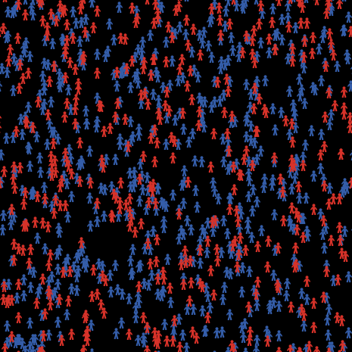
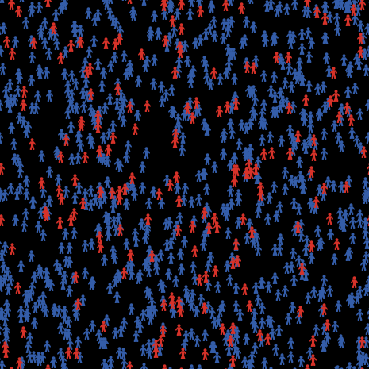
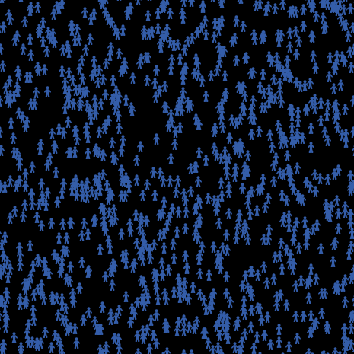
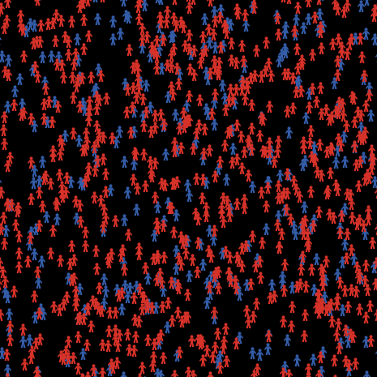
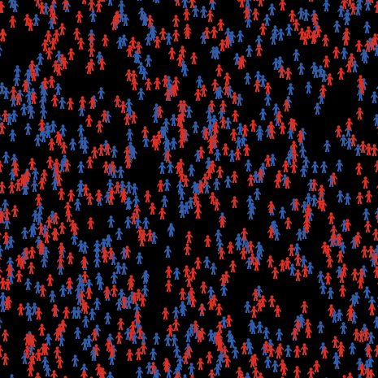
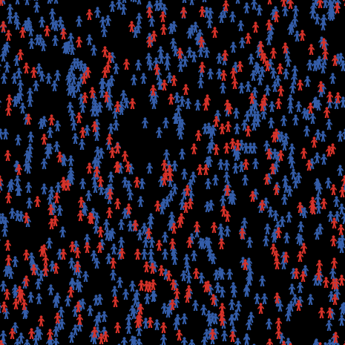
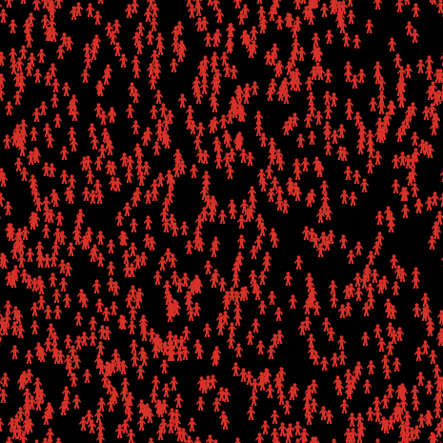
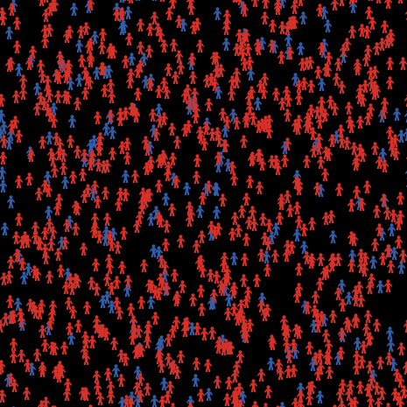
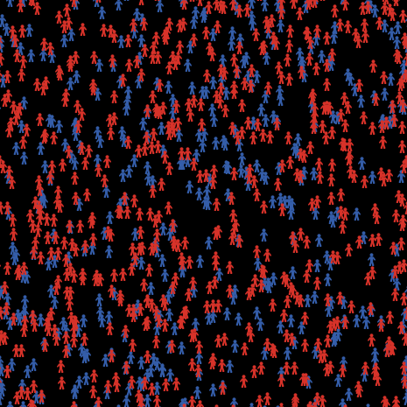
Summary of Observations – BehaviorSpace
 | LOW (Direct Factors) | MEDIUM (Direct Factors) | HIGH (Direct Factors)
LOW (Inverse)
MEDIUM (Inverse)
HIGH (Inverse)
Defiant: 40%, Cooperative: 60%
Defiant: 19%, Cooperative: 81%
Defiant: 19%, Cooperative: 81%
Defiant: 70%, Cooperative: 30%
Defiant: 50%, Cooperative: 50%
Defiant: 28%, Cooperative: 72%
Defiant: 100%, Cooperative: 0%
Defiant: 80%, Cooperative: 20%
Defiant: 60%, Cooperative: 40%

Slide 7
Predictive Power
Modifications allow for a real world situation
Depends on how accurate Machiavelli was
If Machiavelli's ideals are accurate, this model should moderately represent the general population
There will always be external variables that could change variables

