Slide 1

Towards Reliable Storage Systems:
From Local to Cloud
Haryadi S. Gunawi
UC Berkeley

Slide 2

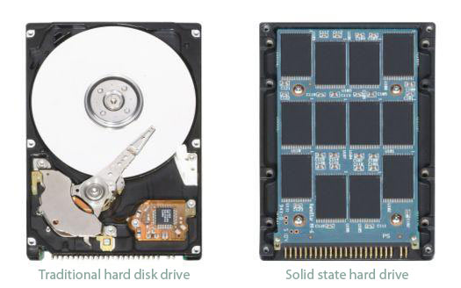
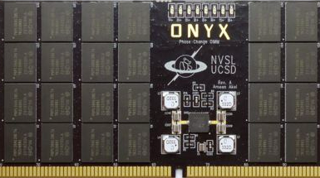
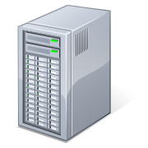

File system
OS
OS
OS
FS
FS
FS
Disk
+ Solid-state
drives (SSD)
+ Storage-class memory (e.g. PCM)
Distributed FS
“Cloud-scale” storage
OS
OS
OS
OS
FS evolution through time

Slide 3
File system innovations
Performance, functionality, ...
Reliability
Store and retrieve data anytime?
Disk FS
SSD FS
SCM FS
Distr. FS
Cloud storage
“Data is your single most important
and irreplaceable asset”
-- from the book Web Operations
FS evolution

Slide 4
Store and retrieve data anytime?
Whoops – Facebook loses 1 billion photos
Chris Keall, 10 March 2009, The National Business Review
When the Cloud Fails: T-Mobile, Microsoft Lose Sidekick Customer Data
Om Malik, 10 October 2009, gigaom.com
Web startups crumble under Amazon S3 outage
Austin Modine, 15 February 2008, www.theregister.co.uk
HSBC fined £3.2 million for data loss
Graham Cluley, 23 July 2009,
www.h-online.com
Major Amazon Outage Ripples Across Web
Rich Miller, 21 April 2011, www.datacenterknowledge.com

Slide 5
Reliable storage systems?
Challenging
Many factors: configuration errors, attacks, operational issues, complex software, hardware failures, ...
Reality
Software complexity is growing
Diverse architecture, more functionalities, optimizations, ...
Hardware fails
Economies of scale: use cheap hardware [Hamilton, Amazon]
Reliability has to come from the software [Dean, Google]
(Software has more responsibility)
Disk FS
SSD FS
SCM FS
Distr. FS
Cloud storage

Slide 6
Reliable storage systems?
Software
complexity
+
Hardware
failures

Slide 7
Research roadmap
Revisit
Measure
Advance
Build tools to measure FS reliability
Design and build
new FS reliability
frameworks
Failure modes?
Diverse failures
Today:
Buggy, complex
failure management
Tomorrow:
Robust, simple,
flexible, powerful
failure management
(xfs_vnodeops.c, line 1785)
// ignore failures ...
// there is nothing we can do
Revisit
Measure
Advance
// failures managed!
Notes:
– A comment in XFS (xfs vnodeops.c, line 1785)

Slide 8
Research contributions
Reliable local storage
- MySQL + Corruption ......... ICDE ’10
- Error-code static analysis ... PLDI ’09
- SQCK ................................... OSDI ’08
- Error-handling analysis ....... FAST ’08
- I/O Shepherding ................. SOSP ’07
- FS reliability analysis .......... SOSP ’05
FS + disk failures: buggy and complex management
New reliability frameworks (robust, simple, flexible, and powerful disk-failure management)
Multiple, diverse HW failures: rarely exercised
Advanced cloud failure testing (e.g., systematic and efficient exploration of multiple failures)
Reliable cloud storage
- Fate and Destini .................. NSDI ’11
- Programmable fail test .. OOPSLA ’11
- Scalable fail model chk .......... In Prog.
- CloudFS + mem. corrupt ...... In Prog.
- Failure as a Service ................ In Prog.
Notes:
hardware failures ...

Slide 9
Outline
Reliable local FS
Background: “new” disk failure modes
I/O Shepherding [SOSP ’07]
SQCK [OSDI ’08]
Reliable cloud storage
FATE and DESTINI [NSDI ’11]
Future work

Slide 10
Failure modes
Whole-system crash
Logging/Journaling [Hagmann87]
Atomic updates
Whole-disk failure
RAID [Patterson88]
Add mirroring or parity
More? ... partial disk failures
Notes:
add illustration with partial failures

Slide 11

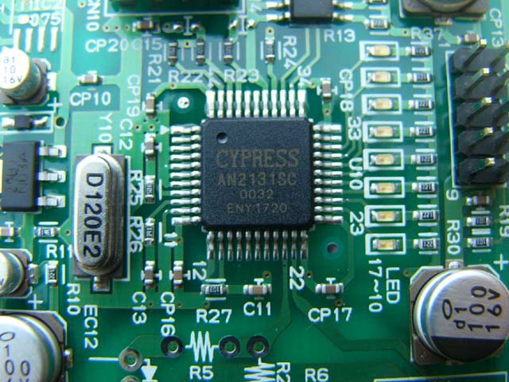
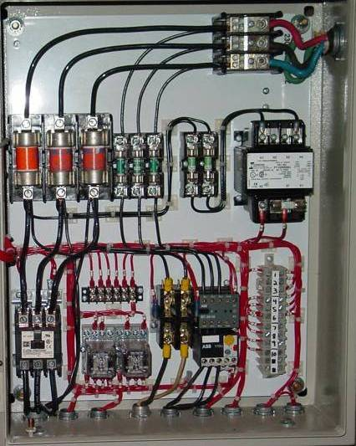
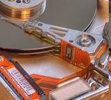
Partial disk failures
File System
Problems:
Device Driver
Buggy drivers
Device Controller
Buggy controller
Partial failures:
Single-block failures
(R/W errors)
Single-block corruptions
Transport
Interconnect
problems
Disk Subsystem
Cache
Bit errors
Firmware
Buggy firmware
Electrical
Power spike
Mechanical
Wear & tear
Media
Bit rot,
media scratch

Slide 12
Partial failures are reality
[Wehman98] | EIDE controller returns incorrect error-code
[Lewis99] | Byte shift
[Talagala99] | Interconnect problems in large disk farm
[Engler01] | Driver bugs issue bad parameters and data
[Ghemawat03] | IDE protocol yields corrupt data
[DataClinic04] | Drive memory leak
[Weinberg04] | Misdirected writes and lost writes
[Schwarz04] | Media scratch
[DataClinic04] | A power spike damages in-drive circuits
[Green05] | EIDE controller returns status bits as data
[Schindler05] | Driver bugs
[Gray05] | 30 uncorrectable bit errors over 2 PB data
[Bairavasundaram07] | Latent sector errors in 4% of 1.5 million drives
[Bairavasundaram08] | 400,000 corrupt blocks

Slide 13
Outline
Reliable local FS
Background
I/O Shepherding [SOSP ’07]
Problem:
FS + partial failures
Solution
SQCK [OSDI ’08]
Reliable cloud storage
Future work
OS
2
1
Offline FS
checker
(fsck)
File
System
Partial failures

Slide 14
FS on-disk data structures
Linux Ext3
...
Inode block
Inode entry = file/dir
Indirect block
Data block
Dir entries/users data
Partial disk failures
Single-block failures
Corruptions
Inode
Indir
blk
Data
Data
. . .
abcdef

Slide 15
FS + partial disk failures
How file systems manage disk failures?
Recovery policies?
Measuring FS reliability
Inject block-level read/write faults and read corruptions
Run various FS operations

Slide 16
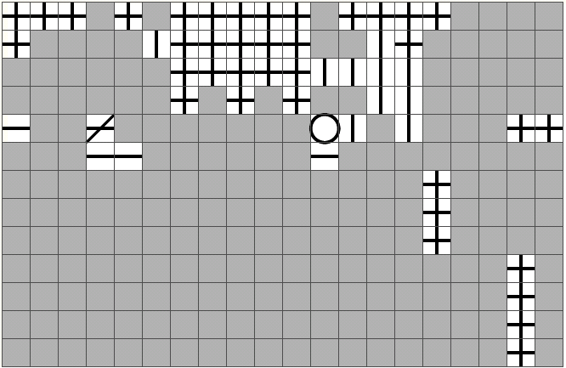
How ext3 reacts to read failures?
path
open
chmod
read
readlink
getdir
creat
link
mkdir
rename
symlink
write
trunc
rmdir
unlink
mount
fsync
umount
logwrite
recovery
Workload
Not applicable
No Recovery
Retry
Stop
inode
dir
bm
ibm
indirect
data
super
g-desc
j-super
j-rev
j-desc
j-comm
j-data
Propagate
→ Inconsistent
policies
Workload: Path traversal
cd /mnt/volume2
Failed Block: Indirect block
Policy observed:
Detect failure and
propagate failure to app
Failed block read
Propagate
Retry
Ignore
failure
Stop

Slide 17
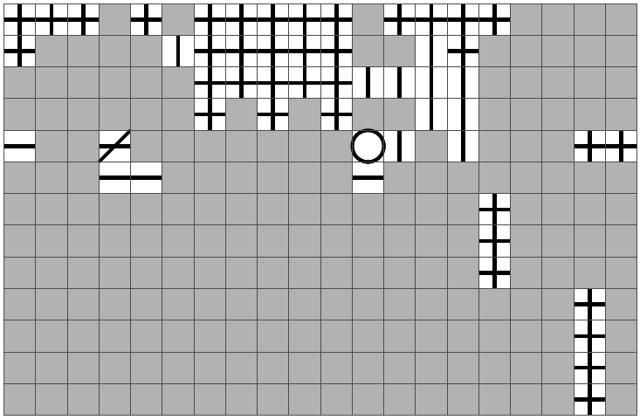
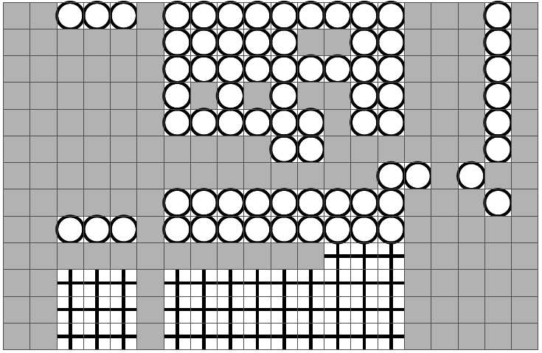
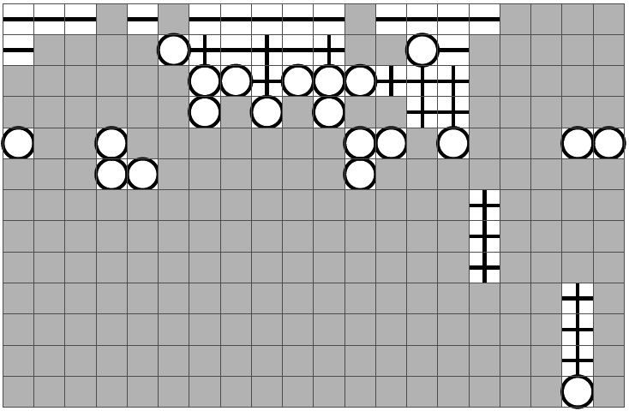
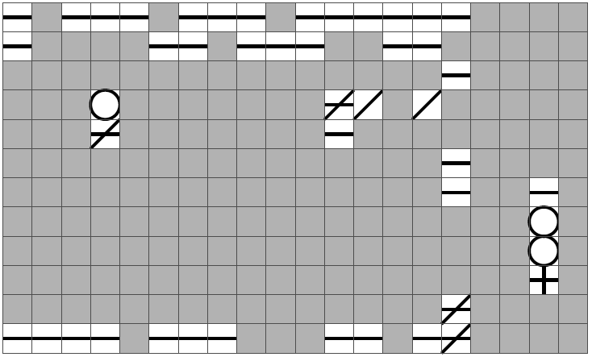
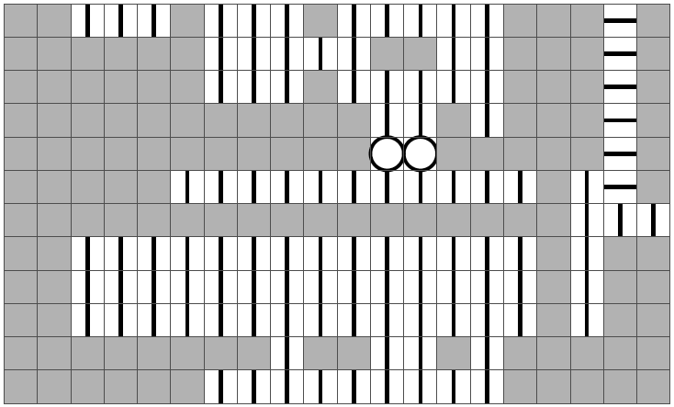
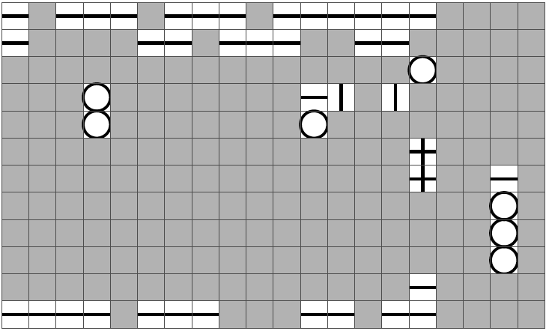
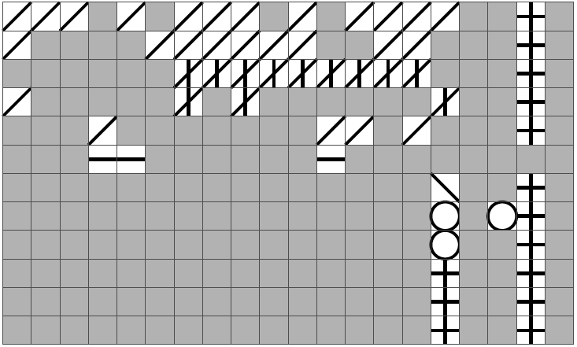
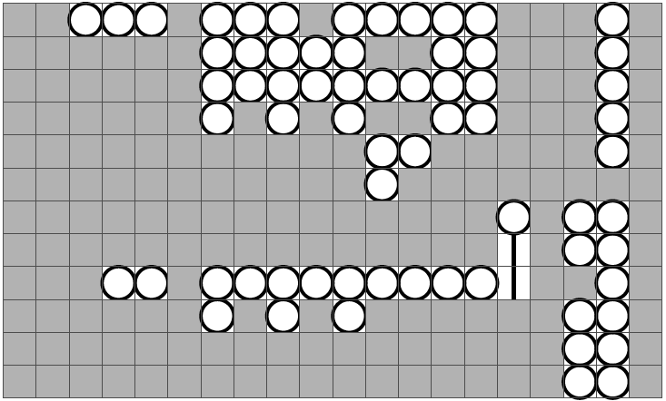
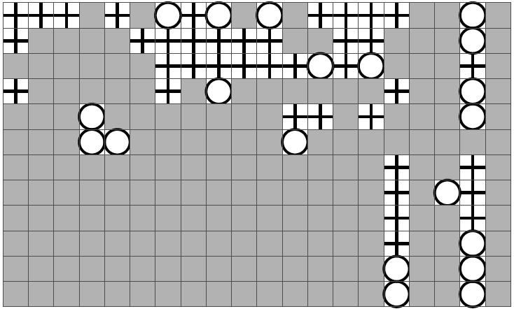
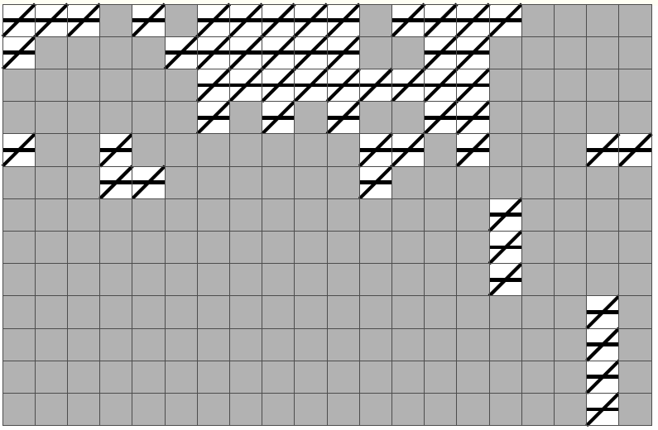
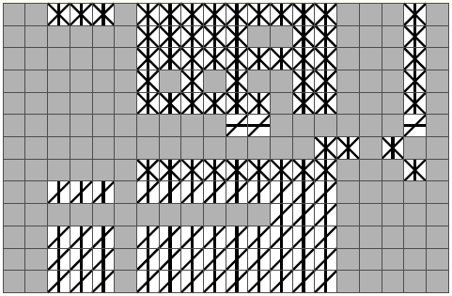
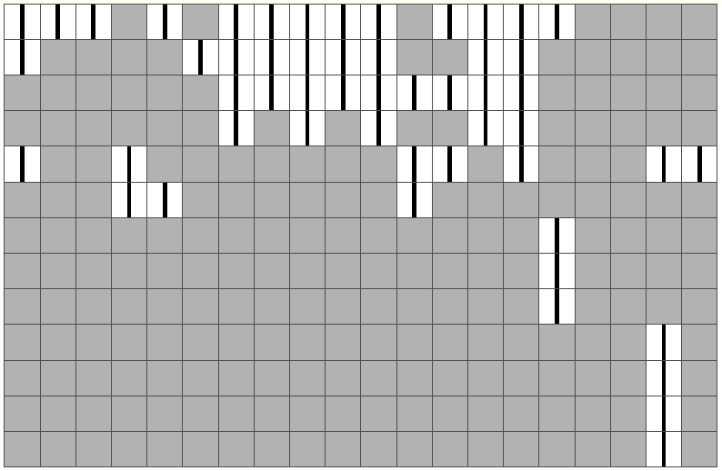
FS recovery policies
Read failure
Write failure
Read corruption
Current policies:
- Diverse
- Inconsistent
- Incomplete (failures ignored!)
Let’s do it!
Ext3
ReiserFS
In current framework?
Not so easy …
Custom policies?
+ consistent
+ per-data-structure
+ parity
+ checksums
+ remapping
+ write verify
+ version mirroring
+ …
IBM JFS
Custom
Notes:
And good …, add more policies …
What is your request?

Slide 18
Scattered policy code
acl.c
balloc.c
chkpnt.c
commit.c
dir.c
ialloc.c
inode.c
journal.c
namei.c
recover.c
resize.c
super.c
tranx.c
xtree.c
Locations of
disk-failure
handling code
ext3
source
files
3000 LOC
Findings: Broken reliability framework
Inconsistent, incomplete, scattered, inflexible policies
($$$ proprietary file systems also problematic)
Need a new reliability framework

Slide 19
Outline
Reliable local FS
Background
I/O Shepherding [SOSP ’07]
Problem: FS + partial failures
Solution: I/O Shepherding
a new, novel reliability framework for FSes
Evaluation
SQCK [OSDI ’08]
Reliable cloud storage
Future work and conclusion

Slide 20
I/O Shepherding
Layer between FS and storage
Take care of I/O reliability
Goals: policies are …
Localized
File System
(OS level)
= policy
code
Shepherd
Storage

Slide 21
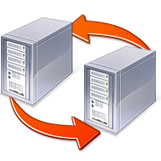
I/O Shepherding
Layer between FS and storage
Take care of I/O reliability
Goals: policies are …
Localized
Flexible
Powerful
File System
Shepherd
Add
Mirror
Check-
sum
More
Retry
More
Protec-
tion
Add
Mirror
Check-
sum
More
Retry
More
Protect-
ion
Less
Protect-
ion
M+C+
R+…
Storage
ATA
SCSI
…
Archival
Scientific
Data
Net.
Storage
Low-end
High-end

Slide 22
Core techniques
D
D
D
Mirroring
Remap
D
D
M
D
R
Challenge 1: Abstraction to specify policies
Policy specification table
Challenge 2: Ensuring atomicity and crash consistency
(Policies add more I/Os)
Chained transactions

Slide 23
Policy specification table
Abstraction to specify disk-failure handling policies?
Different block types →different reliability
Different volumes → different reliability
Need fine-grained policies
Policy specification table
Per-block-type policies
Per-volume policies
Flexible!
Can’t do this
in existing
file systems
/tmp
/boot
/lib
archive
Policy Table
Block Type | Write Policy
… | …
Superblock | TripleMirror()
Inode | ChecksumParity()
Inode Bitmap | ChecksumParity()
Data | WriteRetry1sec()
… | ...
High-level
reliability
No protection

Slide 24
File System
D
D
I/O Shepherd
Policy Code
Policy Table
Data | Remap Once()
Inode | …
Super | …
RemapOnce(Addr D)
if (Write(D) == FAIL) {
R = PickRemapLoc(D);
if (Write(R) == OK)
MapAllocate(RTbl, D, R);
}
Policy primitives
Policy metadata
Disk Subsystem
Remap-Table
D
D
R
D
R
…
…
24

Slide 25
Core techniques
Challenge 1: Abstraction to specify policies
Policy spec table, code, primitives, and metadata
Localized, flexible, simple, and powerful policies
Challenge 2: Ensuring atomicity and crash consistency

Slide 26
Shepherding + Journaling
When to run policies?
During checkpoint
Can journaling support shepherding?
Policies often add more I/Os (e.g. mirroring/remapping)
Maintain atomicity and crash consistency during checkpoint? No ...
D
I
D
I
2
1
Policies
Tx
D
I
Checkpoint to
final locations
D
I
3
Journaling area
D
I
M
R

Slide 27
Checkpoint failures (ex: Remap)
Crash
Memory
I
D
RM_{D→R}
Tx Release
Inconsistencies:
1) Pointer I→D invalid
2) No reference to R
Journal
Tx
D
I
D
I
Final Locations
RM_{D→0}
D
I
R
RM_{D→0}
Remap-Table
RM_{D→R}
Checkpoint
failure
Checkpoint completes
Remap

Slide 28
Journaling flaw
Current journaling FSes cannot deal with checkpoint failures
Ext3, IBM JFS: ignore
ReiserFS: stop the FS
Revisit
Measure
No consistency for checkpoint recovery
Journaling is for crash failures, not partial failures
Shepherding + current journal = impossible
Solution: Chained transactions
Contain state changes by the shepherd (e.g. remap table)
“Chained” with previous transaction
Advance

Slide 29
Chained transactions
Memory
All journaling FSes must deal with
checkpoint failures
Chained Txs: generic solution
Work for all policies
I
D
RM_{D→R}
RM_{D→R}
New rule: Tx release after CTx commits
Tx Release
Journal
Tx
CTx
D
I
Final Locations
D
I
R
RM_{D→0}
Checkpoint completes
Notes:
avoid deadlock: use shadow copy when updating shepherd metadata block
must make sure journaling space is sufficient
simple, nice, sophisticated ...

Slide 30
Outline
Reliable local FS
Background
I/O Shepherding [SOSP ’07]
Problem: FS + partial failures
Solution: I/O Shepherding
Evaluation
SQCK [OSDI ’08]
Reliable cloud storage
Future work

Slide 31
Evaluation
path
open
chmod
read
readlink
getdir
creat
link
mkdir
rename
symlink
write
trunc
rmdir
unlink
mount
fsync
umount
logwrite
recovery
Workload
Flexibility
Custom policies
inode
dir
bm
ibm
indirect
data
super
g-desc
j-super
j-rev
j-desc
j-comm
j-data
Failed blocks
ext3
read
Not applicable
No Recovery
Retry
Stop
Propagate
Retry + Propagate

Slide 32
Evaluation
path
open
chmod
read
readlink
getdir
creat
link
mkdir
rename
symlink
write
trunc
rmdir
unlink
mount
fsync
umount
logwrite
recovery
Workload
Flexibility
Custom policies
Fine-grained policies
inode
dir
bm
ibm
indirect
data
super
g-desc
j-super
j-rev
j-desc
j-comm
j-data
ext3
write
Failed blocks
Policy Spec
User Data | Retry + Propagate
Journal | Retry + Stop
Metadata | Retry + Remap + Stop

Slide 33
Evaluation
Policy | LOC
Propagate | 8
Sanity Check | 10
Reboot | 15
Retry | 15
Mirroring | 18
Parity | 28
Multiple Lines of Defense | 39
D-GRAID | 79
Flexibility
Simplicity
8 policies, 8-79 LOC
Composable policies
RAID variant in 79 LOC

Slide 34
Evaluation
Policy | PostMark | TPC-B | SSH
ext3 | 1.00 | 1.00 | 1.00
+ shepherd layer (no policy) | 1.00 | 1.05 | 1.01
Mirror-near | 1.59 | 1.41 | 1.04
Retry+Reboot | 1.00 | 1.05 | 1.01
Parity | 1.14 | 1.27 | 1.02
Mirror-far | 1.65 | 1.87 | 1.06
Sanity Check | 1.01 | 1.05 | 1.01
Mult. Lines of D | 1.10 | 1.28 | 1.01
Flexibility
Simplicity
Performance
0-5% bare overhead
Depends on the policies
(e.g. mirroring: 4-60%)

Slide 35
Evaluation
Flexibility
Simplicity
Performance
Robustness
Chained-transactions + 24 “unique” crash points

Slide 36
I/O Shepherding (summary)
New, novel reliability framework
Localized, simple, flexible, and powerful disk-failure management
Core features built:
Policy specification table, code, primitives, and metadata
Chained transactions
Implementation
OS and ext3 changes: ~900 LOC
Semantic information propagation, layout and allocation interface, consistency management, etc.
Shepherd infrastructure: ~3500 LOC
Shepherd primitives, thread support, maps management, etc.

Slide 37
Outline
Reliable local FS
Background
I/O Shepherding [SOSP ’07]
SQCK [OSDI ’08]
Problem:
fsck + disk corruption
Solution: declarative fsck
Reliable cloud storage
Future work
OS
2
1
Offline FS
checker
(fsck)
File
System
Partial failures

Slide 38
Fsck
File system checker
Important utility
Every file system has its own fsck
Hard task
Find all corrupt metadata
Repair FS to a consistent, usable state

Slide 39
Fsck + corruption?
Are file system checkers (fsck) reliable?
(against disk corruption)
Measure fsck reliability
Corrupt ext3 on-disk pointers
(hundreds experiments)
Problems: buggy repairs (lose/corrupt data!)
Out-of-order repair
Insecure repair
Policy-inconsistent repair
Let’s fix them!
In current framework?
Not so easy …
Notes:
fix your bad file systems

Slide 40
Complex Fsck implementation
Written in C → hard to reason about
Large and complex
Ext3 fsck: 150 checks in 16 KLOC
XFS fsck: 340 checks in 22 KLOC
Hundreds of cluttered if-checks
Difficult to fix bugs
Difficult to ensure correctness
Fsck code is “untouchable”

Slide 41
SQCK
SQCK (SQL-based FSCK)
“Complexity is the enemy of reliability”
Use a declarative query language (e.g. SQL)
A check = “find an inconsistency”
A query = “find (something) in the database”
Benefits
High-level intent is clear (write fewer lines)
Easy to cross-check and update massive information

Slide 42
Using SQCK
DB tables
Scan + load FS metadata
Declarative Checks + Repairs
Flush
File system image
Notes:
It’s the CHECKS that is complated ...
scan and loading are easy ....

Slide 43
Declarative check (ex. 1)
“Find an out-of-bound block bitmap pointer”
ext3 fsck
SQCK
first_block = sb->s_first_data_block;
last_block = first_block +
blocks_per_group;
for (i = 0, gd=fs->group_desc;
i < fs->group_desc_count;
i++, gd++) {
if (i == fs->group_desc_count - 1)
last_block = sb->s_blocks_count;
if ((gd->bg_blk_bmap < first_block) ||
(gd->bg_blk_bmap >= last_block)) {
px.blk = gd->bg_block_bitmap;
if (fix_problem(BB_NOT_GROUP, ...))
gd->bg_block_bitmap = 0;
}
...
}
SELECT *
FROM GroupDescTable G
WHERE G.blockBitmapPtr
NOT BETWEEN
G.start AND G.end

Slide 44
Declarative check (ex. 2)
“Find wrong parent directories”
ext3 fsck (buggy)
SQCK
di_t get_dir_info (ctx_t ctx, ino_t ino) {
int l = 0, h, m;
h = ctx->di_count-1;
if (!ctx->di) return 0;
if (ino == ctx->di[l].ino)
return &ctx->di[l];
if (ino == ctx->di[h].ino)
return &ctx->di[h];
while (l < h) {
di_t di = return &ctx->di[m];
m = (l+h)/2;
if (m == l || m == h) break;
if (ino == ctx->di[m].ino) return di;
if (ino < ctx->di[m].ino) h = m;
else l = m;
}
return 0;
}
SELECT F.*
FROM DirEntryTable P, C, F WHERE
P.entry_num <> “.” AND
P.entry_num <> “..” AND
P.entry_ino = C.ino AND
C.entry_num <> “..” AND
C.entry_ino = P.ino AND
F.entry_num <> “.” AND
F.entry_num <> “..” AND
F.entry_ino = C.ino AND
F.ino <> P.ino
check_dir_block(...) {
...
if ((dot_state > 1) &&
(fs_chk_inode_bitmap
(ctx->inode_dir_map,
dirent->inode))) {
subdir = get_dir_info
(ctx, dirent->inode);
...
if (subdir->parent) {
if (fix_problem(LINK_DIR)) {
dirent->inode = 0;
goto next;
}
} else {
subdir->parent = ino;
}
}

Slide 45
Outline
Reliable local FS
Background
I/O Shepherding [SOSP ’07]
SQCK [OSDI ’08]
Problem: fsck + corruption
Solution: declarative fsck
Evaluation
Reliable cloud storage
Future work

Slide 46
Evaluation
Simplicity
150 queries (1000 lines) vs. 16,000 lines of C in ext3 fsck
Reliability
Pass 300+ corruptions
Easy to fix queries
Flexibility
Easy to plug-in/out queries
Add new repairs to fsck
New checks and repairs | LOC (SQL)
Majority rule on block bm pointers | 22
Majority rule on inode bm pointers | 22
Majority rule on inode tbl pointers | 22
Finding false parents | 14
Reconstructing missing dirs | 20
Precedence cloning | 19
Secure cloning | 8

Slide 47
Evaluation
Performance
With MySQL
Within 1.5x of ext3 fsck
(includes load and check)
Optimizations:
Scanning and loading
Sort I/Os, compact tables, load only allocated metadata, overlap scanning and loading
Checking
Add extra indexing, incorporate FS domain knowledge, use bitmaps
5 min
1.5 min
38 min
8 sec
1
sqck
fsck
Total runtime
(normalized)
1G
10G
100G
800G
FS size

Slide 48
Outline
Reliable local FS
Background
I/O Shepherding [SOSP ’07]
SQCK [OSDI ’08]
Error-code propagation [PLDI ’09, FAST ’08]
Conclusion
Reliable cloud storage
Future work

Slide 49
More problems …
sync()
int x() {
return y() || z();
}
int sync() {
x(); // Bad call!
return OK;
}
x()
y()
z()
return EIO;
return EROFS;
Notes:
fun to share, have pretty pictures, no deep technical details ...

Slide 50
ext3
37 bad calls out of 188 calls

Slide 51
ReiserFS
35 bad calls out of 218 calls

Slide 52
IBM JFS
61 bad calls out of 340 calls

Slide 53
NFS Client
54 bad calls out of 446 calls

Slide 54
SGI XFS
105 bad calls out of 1455 calls

Slide 55
Developers’ comments
ext3 | // There’s no way of reporting error // to userspace, so ignore it.
XFS | // Just ignore errors at this point. // There is nothing we can do except // to try to keep going
CIFS | // Should we pass any errors back?
SCSI | // Todo: handle failure
Notes:
– A comment in XFS (xfs vnodeops.c, line 1785)

Slide 56
Reliable local FS (Conclusion)
Revisit
Disk failure modes?
Partial failures: single-block failures, corruptions
FS + partial failures?
Crucial design issues
Journaling: >10 years, but can’t handle partial failures
Fsck: >10 years, but miss some corruptions
Reliability not first class
Dev’s hints: hard to fix reliability
Build new reliability frameworks
I/O Shepherding: novel reliability layer
SQCK: declarative fsck
Robust, simple, flexible, and powerful reliability
Measure
Advance

Slide 57
Outline
Reliable local FS
Reliable cloud storage
Advancing cloud failure testing
Background
FATE and DESTINI [NSDI ’11]
Future work

Slide 58

Cloud storage
Cloud Storage

Slide 59
Cloud storage
Data-Intensive FSes:
GoogleFS, HadoopFS,
CloudStore, ...
+ Replication
+ Scale-up
+ Migration
+ ...
Structured Storage:
Cassandra, Voldemort,
BigTable, Hbase, ...
Reliable?
“This is not just data.
It’s my life.
And I would be sick
if I lost it”
[CNN ’10]
Highly-available?
Custom Storage:
Facebook Photo Store, iCloud,
DropBox, Microsoft StarTrack,
Amazon S3, EBS, ...

Slide 60
Data loss and unavailability
Cloudy
When the Cloud Fails: T-Mobile, Microsoft Lose Sidekick Customer Data
Om Malik, 10 October 2009, gigaom.com
Whoops – Facebook loses 1 billion photos
Chris Keall, 10 March 2009, The National Business Review
with a chance of
failure
Amazon Can’t Recover All Its Cloud Data From Outage
Max Eddy, 27 April 2011,
www.geekosystem.com
Cloud Storage Often Results in Data Loss
Chad Brooks, 10 October 2011, www.businessnewsdaily.com

Slide 61
Problems ...
“Fragile” operational protocols
Upgrades, maintenance, configuration changes, ...
Large-scale failure recovery hard to get right
...

Slide 62
Why recovery hard to get right?
Complex failure modes
Cloud-scale systems → multiple, diverse HW failures
Crashes, disk failures, network partitioning, memory corruption, ...
Failure testing is not advanced enough [Google]
Complex failures rarely exercised (systematically)
State-of-the-art: random
Recovery is under-specified [Hamilton, Amazon]
Lots of custom recovery
Implementation is often complex

Slide 63
Outline
Reliable local FS
Reliable cloud storage
Advancing cloud failure testing
Background
FATE and DESTINI [NSDI ’11]
FATE: Failure Testing Service
(systematic and efficient failure exploration)
DESTINI: Declarative Recovery Testing Specifications
Future work

Slide 64
HDFS (Hadoop FS)
Storage for Hadoop MapReduce Jobs
Large-scale storage
Yahoo!: 4000 nodes
Facebook: 2000 nodes
Ebay: 700 nodes
HDFS Cluster
f
write()
f
f
write()
f
f
f
Single failures
write()
f
f
f
Multiple failures

Slide 65
Multiple-failure scenarios
HDFS
write()
Let’s explore all combinations!
Crash scenarios at
failure points (I/Os):
N1
N2
N3
Client
1. A & B
A
B
2. C & D
Wait, too expensive ...
Disk I/O
3. E & F
D
C
4. ...
Network
I/O
5. ...
E
data-loss bugs
(true story)
F
time

Slide 66
Combinatorial explosion
Exercised over 40,000 failure scenarios
Combinations of 1, 2, and 3 crashes per run
80 hours of testing time
(just 3 protocols)
New challenge:
Combinatorial explosion of multiple failures
N1
N2
N3
2 crashes / run
A₁
A₂
A₃
A1 A2
A1 B2
B1 A2
B1 B2
...
B₁
B₂
B₃

Slide 67
Pruning multiple failures
Types of multiple failures
Dependent failure points
Independent failure points
Heuristic: exercise distinct recovery
Key: some failures result in similar recovery
Found same number of bugs (vs. brute-force)

Slide 68
Dependent failure points
Recovery profiling
Inject single failures first
Record new failure points
Ex: X depends on A
(X is a recovery I/O)
Brute-force (2 failures)
6 combinations: AX, BX, CX, DX, CY, DY
Recovery clustering
Two clusters: {X} and {X, Y}
Only exercise distinct recovery
Pick only one failure that triggers every recovery cluster
Results: BX, CX, CY
Crash → New failure
at points
A → X
B → X
C → X, Y
D → X, Y
A
A
B
B
X
Y
X
Y
C
C
D
D

Slide 69
Independent failure points
Independent FPs
Concurrent crashes
(e.g., A₁ and B₂)
FPN² combinations
FPN: failure points / node
Real example: 15 FPNs
Recovery clustering
Cluster A and B if:
fail(A) == fail(B)
Reduce FPN² to FPN²_{clustered}
A₁
A₂
B₁
B₂
4
FPNs
C₁
C₂
D₁
D₂
A₁
A₂
A₁
B₁
B₂
B₁
C₁
C₂
D₁
D₂

Slide 70
Evaluation
Implementation
~4200 LOC in Java
Target 3 popular cloud systems
HDFS (Hadoop file system)
ZooKeeper (distributed synchronization service)
Cassandra (distributed key-value store)
Recovery bugs
Found 22 new HDFS bugs (main target)
8 due to multiple failures
Unavailability and data loss bugs (some design bugs)
Reproduced 51 old bugs
“... not just data.
It’s our life.”

Slide 71
Pruning Efficiency
Reduce #experiments by an order of magnitude
Each experiment = 4-9 seconds
Found the same number of bugs
7720
5000
# Exps
Brute Force
Pruned
618
Write +
2 crashes
Append +
2 crashes
Write +
3 crashes
Append +
3 crashes

Slide 72
FATE and PreFail
FATE: Failure Testing Service
Efficient exploration of multiple failures (10x speedups)
PreFail: Programmable Failure Testing [OOPSLA’11]
Testers write custom pruning policies
(QA groups have “smart” testers with domain specific knowledge)
10-200x speedups
Adoption of FATE + PreFail
HDFS developers at Cloudera
Cassandra developers (exploring)

Slide 73
Outline
Reliable local FS
Reliable cloud storage
Advancing cloud failure testing
Background
FATE and DESTINI [NSDI ’11]
Conclusion
Future work

Slide 74
Reliable cloud storage (Conclusion)
Revisit
Cloud-scale HW failures?
Multiple, diverse HW failures (rarely exercised)
Cloud storage + multiple, diverse HW failures?
Data-loss and unavailability bugs
Combinatorial explosion problem ...
... of multiple failures (e.g., permanent crashes)
... of diverse failures
Measure
???

Slide 75
Reliable cloud storage (Conclusion)
ZooKeeper (synchronization service, Yahoo!)
Issue #335.
Permanent inconsistent data
1. Nodes A, B, C start (w/ latex txid: 10)
2. B becomes leader and B crashes
3. C becomes leader
4. C commits new txid-value pair (11, X)
5. A crashes, before commiting the new txid 11
6. C loses quorum and C crashes
7. A and B are back online after C crashes
8. A becomes leader
9. A's commits new txid-value pair (11, Y)
10. C is back online after A's new tx commit
11. C announce to B (11, X)
12. B replies diff starting with tx 12
13. Inconsistency: A has (11, Y), C has (11, X)
More
exponential
blow-up!
Multiple
failures
Event
re-ordering
(e.g., network delay)
Transient
failures

Slide 76
Reliable cloud storage (Conclusion)
Revisit
Cloud-scale failures?
Multiple, diverse failures (rarely exercised)
Cloud storage + multiple, diverse HW failures?
Found data-loss and unavailability bugs
Uncovered combinatorial explosion problem ...
... of multiple failures (crashes)
... of diverse failures???
Lots of remaining challenges ...
Advance cloud failure testing
Build powerful “failure model checker”
Smart efficient exploration of cloud-scale failures
WIP: scalable policy-driven failure model checking
WIP: cloud storage + memory corruption
Measure
Advance

Slide 77
Outline
Reliable local FS
SQCK [OSDI ’08]
I/O Shepherding [SOSP ’07]
Reliable cloud storage
FATE and DESTINI [NSDI ’11]
Future work

Slide 78

Future work
Cloudy with
less chance
of failure
1
Advancing cloud QA paradigms
2
Revisiting reliability principles at cloud scale
3
Exploring reliability strategies for new storage technology

Slide 79

Future work
1
Advancing cloud QA paradigms
Test and deploy
New cloud services are quickly released
Offline testing not cover all deployment scenarios
Operational protocols → fragile → outages
+ Deploy and Test (live!)
op(){...}
Example Ops:
- Recovery
- Load balancing
- Upgrades
- Config changes
- ...
op()
{...}
service2
service3
service4

Slide 80


Future work
1
Advancing cloud QA paradigms
Deploy and Test:
Live, in-production quality assurance
Operational
Drills
Build drill-capable cloud systems
Lots of intersecting challenges
Transform how we build systems
Challenges
Failure drills
Safety
Storage (HDFS, ...)
???
Upgrades
Security breach
Load spikes
Config changes
...
Performance
Coverage
System design
Monetary cost
...
OS (VM)
Computing (MapReduce)
Network
...

Slide 81
Future work
1
Advancing cloud QA paradigms
2
Revisiting reliability principles at cloud scale
No single point of failure
Current attention: hardware
Software?
“Scale Fail” (www.lwn.net, May 2011)
A: How do we load-balance connections from middleware to DB servers?
B: Through a Zeus load-balancing cluster.
A: From web servers to middleware servers?
B: The same Zeus cluster.
A: Web servers to storage? VPN between datacenters? SSH access?
B: Zeus.
A: Does everything go through Zeus?
A: Pretty much, yes.
B: Uh-huh ... what could possibly go wrong?

Slide 82
Future work
1
Advancing cloud QA paradigms
2
Revisiting reliability principles at cloud scale
No single point of software failure
Build N-Version cloud services
Google: 3 independent monitoring services
N-version cloud FS? key-value store? load balancer?
Affect data management?
“EC2-friendly” cloud storage
Statistic-guided reliability
...

Slide 83
Future work
1
Advancing cloud QA paradigms
2
Revisiting reliability principles at cloud scale
3
Exploring reliability strategies for new storage technology
Storage-class memory (PCM, Memristor)
Directly attachable to CPU
Byte-addressable
Revisit block-level (disk/flash) reliability

Slide 84
Future work
1
Advancing cloud QA paradigms
2
Revisiting reliability principles at cloud scale
3
Exploring reliability strategies for new storage technology
Beyond reliability ...
Custom OS/FS for custom cloud services
“Information and control” cloud

Slide 85
Outline
Reliable local FS
Reliable cloud storage
Future work
Conclusion

Slide 86
Conclusion
Disk FS
SSD FS
SCM FS
Distr. FS
Cloud storage
Journey of storage systems reliability
4+ decades
Architectural shifts → new reliability challenges
The need to revisit reliability
Future …
“Future is a world of failures” [Gibson]
Reliability becomes more important

Slide 87
Conclusion
My research: How to build large, powerful, reliable systems?
// ignore failures,
// nothing we can do
// TODO: handle
// failure
// failures
// managed!
Revisit
Measure
Advance

Slide 88
Research contributions:
past, present, and future
Reliable local storage
- MySQL + Corruption [ICDE ’10]
- Error-code static analysis [PLDI ’09]
- SQCK [OSDI ’08]
- Error-handling analysis [FAST ’08]
- I/O Shepherding [SOSP ’07]
- FS reliability analysis [SOSP ’05]
Reliable cloud storage
- FATE and DESTINI [NSDI ’11]
- PreFail [OOPSLA ’11]
- Scalable failure model checking [In Prog.]
- HardFS, memory corruption [In Prog.]
- Failure as a Service [In Prog.]
Other Research
- Deconstruct storage cluster [ISCA ’05]
- Information and control TCP [OSDI ’04]
- Infokernel (infoTCP) [SOSP ’03]
Future work
- Advance cloud QA paradigms
- Revisit cloud-scale reliability principles
- Explore reliability for new storage tech.

Slide 89

END
Thank you!
Questions?

