Slide 1
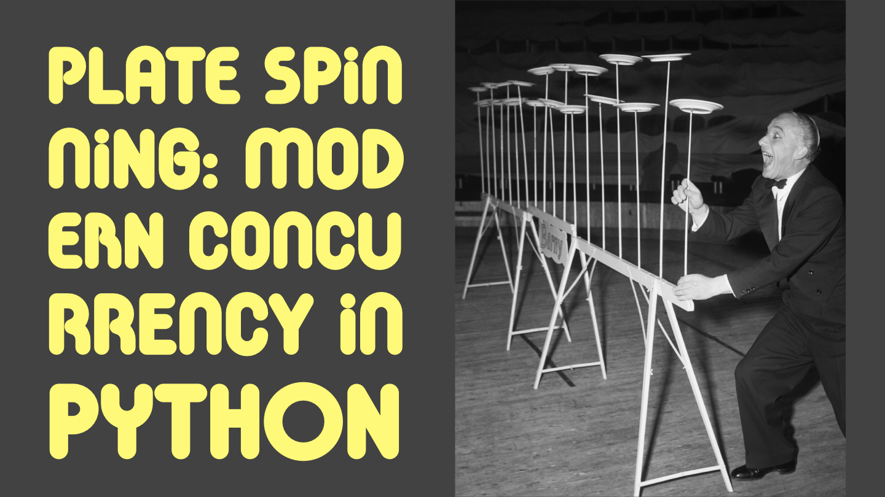


Slide 2
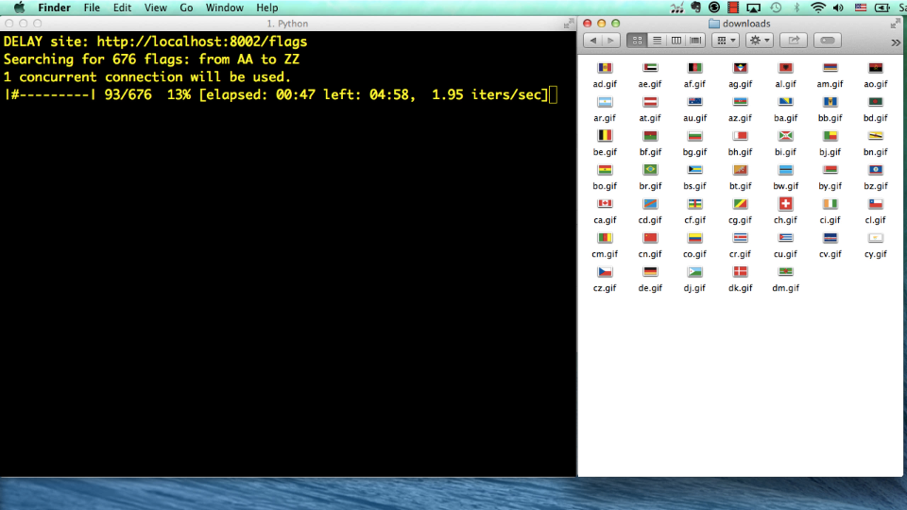
Demo: downloading images
Hitting 676 URLs, getting 194 flag pictures
Sequential:
1.92 items/s
Asynchronous:
150 items/s
http://www.youtube.com/watch?v=M8Z65tAl5l4
http://www.youtube.com/watch?v=M8Z65tAl5l4
http://www.youtube.com/watch?v=M8Z65tAl5l4
http://www.youtube.com/watch?v=M8Z65tAl5l4

Slide 3
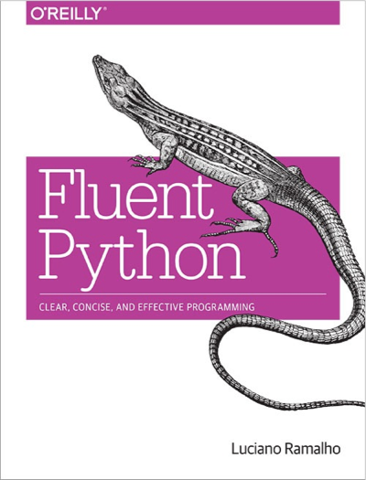
How the demo was made
Three versions of the script:
  sequential
  threaded using concurrent.futures.ThreadPoolExecutor
  asynchronous using asyncio with yield/from
Test harness:
  local nginx server + vaurien proxy
Full instructions on chapters 17 and 18 of Fluent Python

Slide 4
Pre-requisites
quick review
next...
You should know how a Python generator function works
Chapters 14 and and 16 of Fluent Python cover this in detail.
Tip: understand generators well before studying coroutines
Otherwise: just relax and enjoy the high level overview

Slide 5
Generator: quick review
Generator: any function that has the yield keyword in its body
Caller sends values or generator yields values
Most important: their progress is synchronized (e.g. loops in sync)
gen = my_generator()
gen.send(…)
yield
caller
generator

Slide 6
Spinner scripts demo
(.env35b3) $ python spinner_thread.py
spinner object: <Thread(Thread-1, initial)>
Answer: 42
(.env35b3) $ python spinner_yield.py
spinner object: <Task pending coro=<spin() running at spinner_yield.py:6>>
Answer: 42

Slide 7
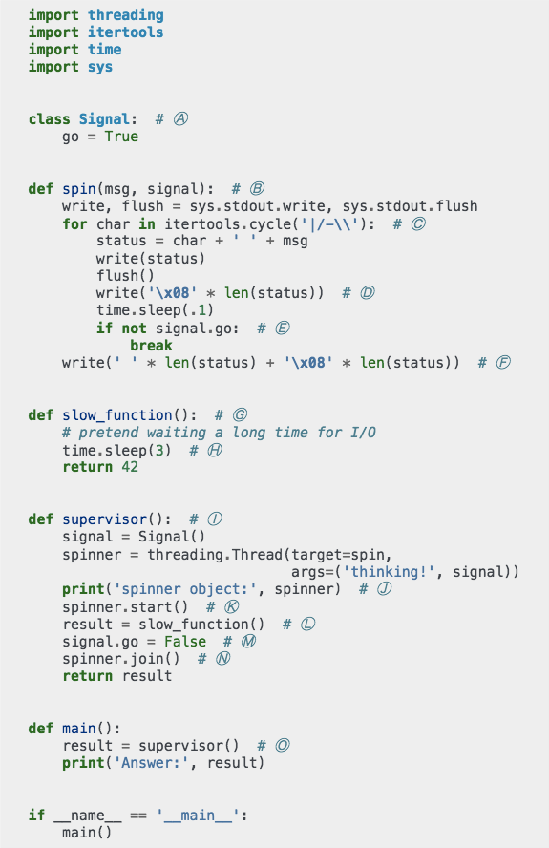
Threaded spinner script: overview
Uses threading library
Main thread blocks waiting for slow function while spinner thread runs

Slide 8
spinner_thread.py

Slide 9
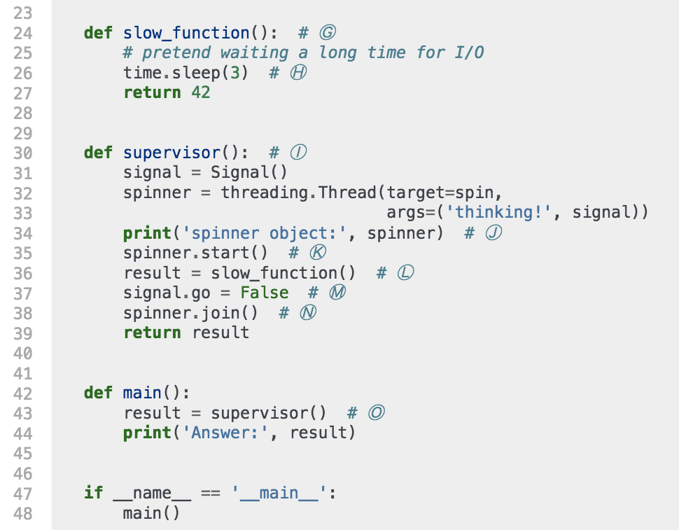
Thread... spinner bottom
Ⓚ Supervisor starts spinner thread
Ⓛ Calls slow_function, which blocks at Ⓗ
Ⓜ Uses signal object to tell spinner thread to stop

Slide 10
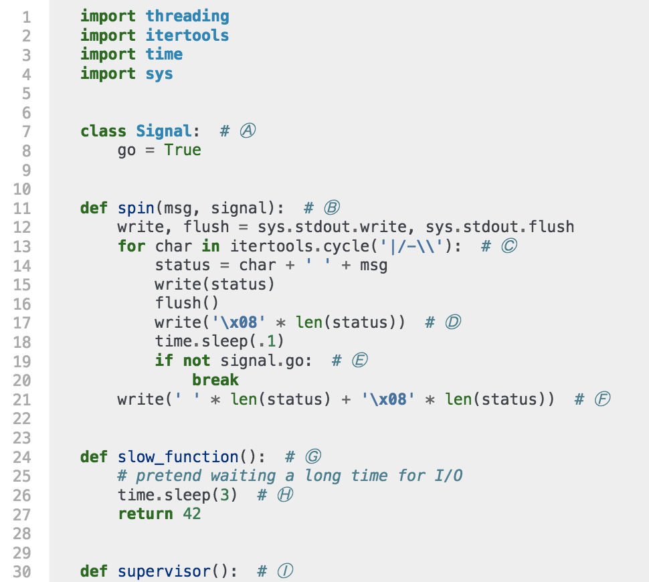
Threaded spinner: top
Ⓑ spin gets Signal instance as second argument
Ⓒ itertools.cycle() produces endless sequence of |/-\
Ⓓ write backspaces ('\x08'), then sleep for 0.1s
Ⓔ exit infinite loop if signal.go is False

Slide 11
Threaded spinner script: notes
OS thread scheduler may switch active threads at any time – that's why threads cannot be cancelled from the outside
Calling sleep() or I/O functions practically guarantees a switch
Every standard library function that does I/O releases the GIL, allowing other Python bytecode to run

Slide 12
spinner_asyncio.py

Slide 13
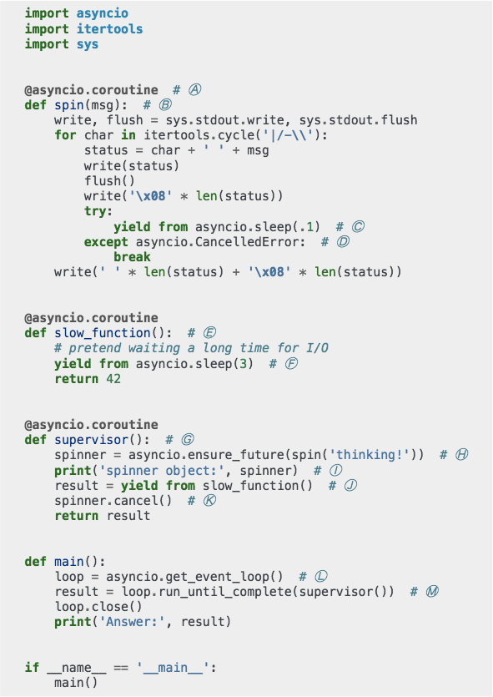
Coroutine spinner script: yield/from
Uses asyncio library
Main thread (the only thread) starts event loop to drive coroutines
supervisor, spin and slow_function are coroutines
Coroutines wait for results from other coroutines using yield from

Slide 14
yield/from concepts
PEP-380: Syntax for Delegating to a Subgenerator
dg = delegating_generator()
yield from subgenerator()
dg.send(…)
yield
caller
delegating generator
subgenerator

Slide 15
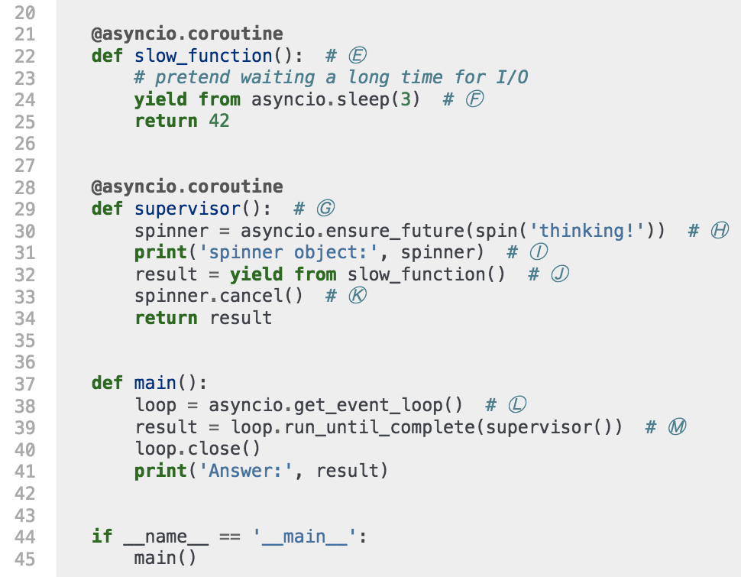
Coro... spinner: bottom
sleep() and
I/O functions
release the GIL
Ⓜ Drive supervisor coroutine with
event loop
Ⓗ Schedule Task with
spin coroutine
Ⓙ Wait for result from slow_function

Slide 16
Coro... spinner: bottom
sleep() and
I/O functions
release the GIL
≤3.4.3: asyncio.async
≥3.4.4: asyncio.ensure_future
Ⓜ Drive supervisor coroutine with
event loop
Ⓗ Schedule Task with
spin coroutine
Ⓙ Wait for result from slow_function

Slide 17
yield/from creates channel
Channel connects event loop with last subgenerator in the delegating chain
your application code
yield from
yield from
send
yield
caller is some code in BaseEventLoop (or subclass)
supervisor
slow_function
asyncio.sleep

Slide 18
Coro... spinner: bottom
sleep() and
I/O functions
release the GIL
Ⓜ Drive supervisor coroutine with
event loop
Ⓗ Schedule Task with
spin coroutine
Ⓙ Wait for result from slow_function
yield from blocks
delegating generator
(supervisor)

Slide 19
Coro... spinner: bottom
sleep() and
I/O functions
release the GIL
Ⓜ Drive supervisor coroutine with
event loop
Ⓗ Schedule Task with
spin coroutine
Ⓙ Wait for result from slow_function
slow_function is the subgenerator in this context

Slide 20
Coro... spinner: bottom
sleep() and
I/O functions
release the GIL
slow_function is the delegating generator here
Ⓕ Delegate to asyncio.sleep

Slide 21
Coro... spinner: bottom
sleep() and
I/O functions
release the GIL
asyncio.sleep is the subgenerator here
Ⓕ Delegate to asyncio.sleep

Slide 22
Coro... spinner: bottom
sleep() and
I/O functions
release the GIL
yield from blocks
slow_function
Ⓕ Delegate to asyncio.sleep

Slide 23
Coro spinner bottom
sleep() and
I/O functions
release the GIL
asyncio.sleep() sets up a timer with loop.call_later, then yields to the main loop
Ⓕ Delegate to asyncio.sleep

Slide 24
Coro spinner bottom
sleep() and
I/O functions
release the GIL
when subgenerator returns,
delegating generator resumes
at yield from
Ⓜ Drive supervisor coroutine with
event loop
Ⓗ Schedule Task with
spin coroutine
Ⓙ Attach slow_function to event loop

Slide 25
Coro... spinner bottom
sleep() and
I/O functions
release the GIL
Ⓚ After slow_function returns, cancel spinner Task
Tasks can be cancelled because cancellation happens only at yield points

Slide 26
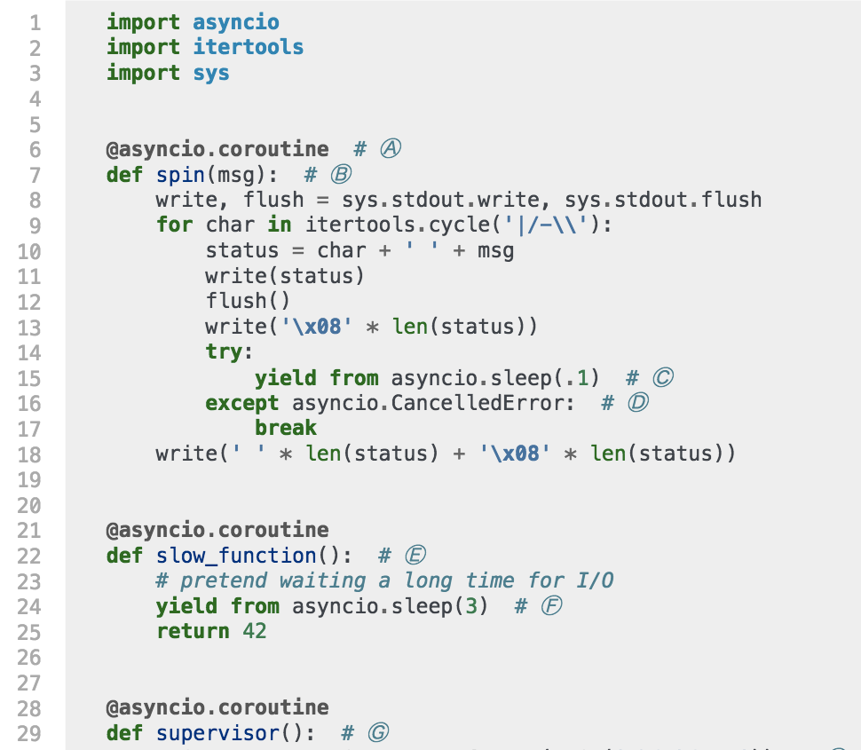
Coroutine spinner: top
sleep() and
I/O functions
release the GIL
Ⓒ Each iteration waits for asyncio.sleep(.1) to and...
Ⓓ Handles cancellation by terminating infinite loop, then clearing the status line

Slide 27
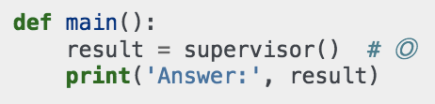
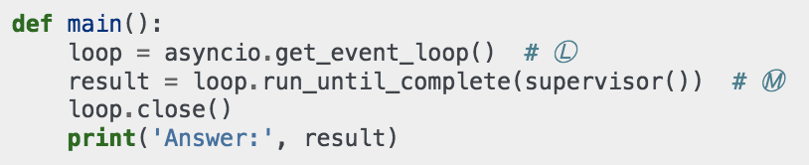
Threaded x async main
threaded
async
async main manages the event loop
note how supervisor() is called in each version

Slide 28
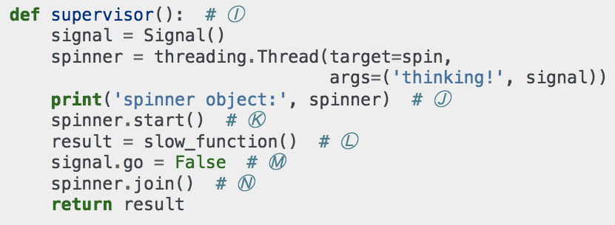
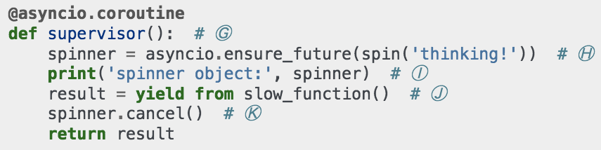
Threaded x async supervisor
threaded
async

Slide 29
Threaded x async comparison
(.env35b3) $ python spinner_thread.py
spinner object: <Thread(Thread-1, initial)>
Answer: 42
(.env35b3) $ python spinner_yield.py
spinner object: <Task pending coro=<spin() running at spinner_yield.py:6>>
Answer: 42
spinner activity implemented as Thread or Task
async Task is similar to a green thread (an application-level thread)
Task wraps a coroutine
Each coroutine uses much less memory than an OS thread (kilobytes, not megabytes)

Slide 30
flags_asyncio.py

Slide 31
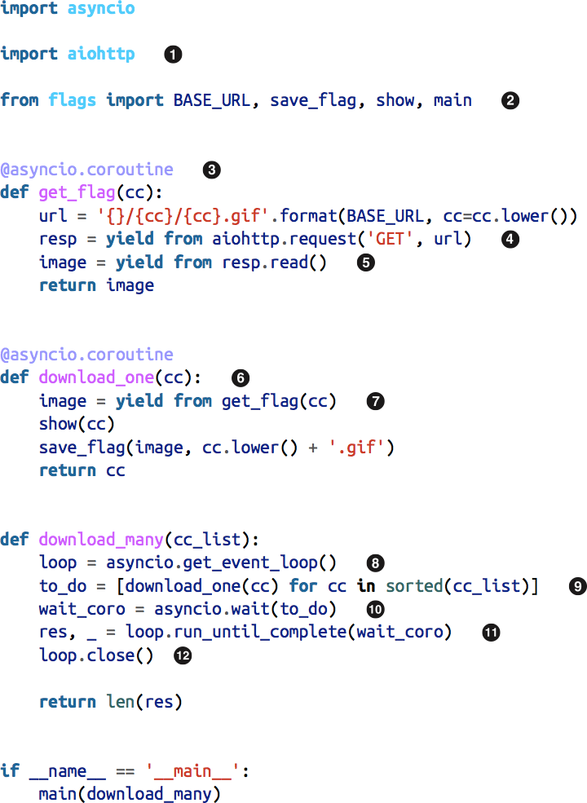
flags_asyncio.py
Simplified implementation of demo script

Slide 32
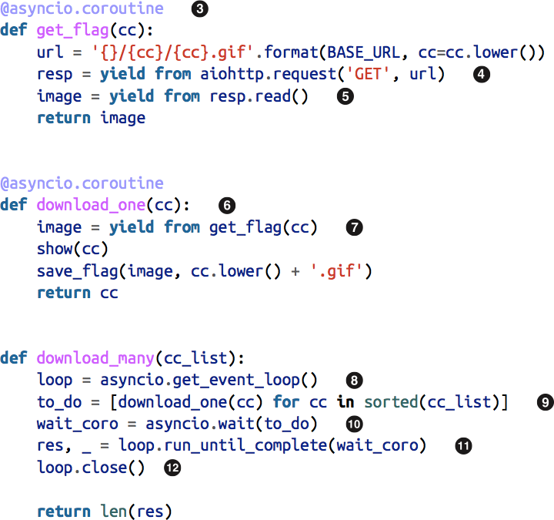
Zoom in...
download_many schedules many instances of download_one
download_one delegates to get_flag
get_flag delegates to aiottp.request() and response.read()

Slide 33
yield/from in action
User code creates chain of coroutines connecting event loop to library functions that perform asynchronous I/O
coroutines in flags_asyncio.py
yield from
yield from
send
yield
download_many calls loop .run_until_complete
download_one
get_flag
aiohttp.request

Slide 34
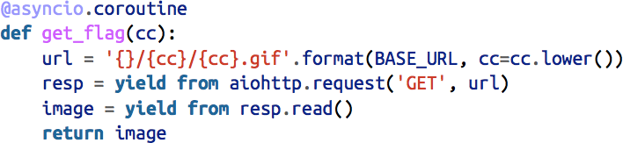
Zoom further...
Guido van Rossum's tip for reading async code:
  squint and ignore yield from for a moment...

Slide 35
Zoom further...
Guido van Rossum's tip for reading async code:
  squint and ignore yield from for a moment...

Slide 36
What is the point?
Concurrency is always hard
Python's new asyncio library and language features provide an effective alternative to:
  managing threads and locks by hand
  coping with callback hell

Slide 37
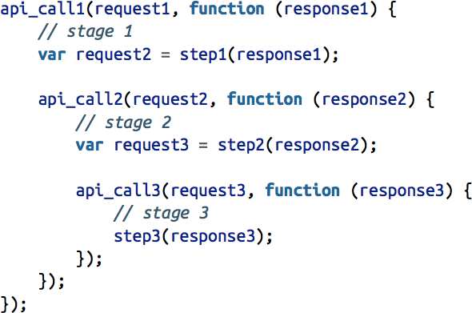
Callback hell in JavaScript
context from stage 1 is gone
context from stage 2 is gone

Slide 38
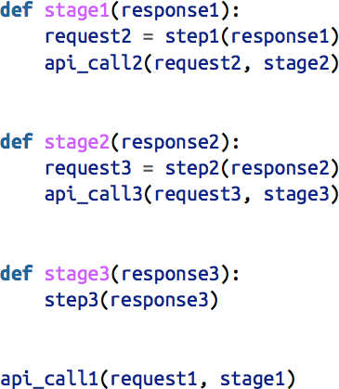
Callback hell in Python
context from stage 1 is gone
context from stage 2 is gone

Slide 39
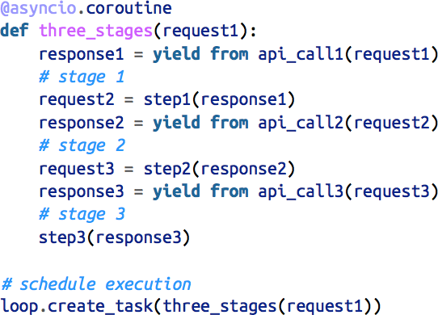
Escape from callback hell
context is preserved through all
stages: it's
all in the local scope of the delegating coroutine

Slide 40
Before considering another language for asynchronous jobs, try Python 3.4 or 3.5!

Slide 41
Python 3.5 async/await
New keywords introduced for the first time since Python 3.0 (2008)
Very briefly:
  async def is used to declare coroutines (yay!)
    asyncio.async() function is now called asyncio.ensure_future()
  await is used to delegate to subgenerators (hooray!)
  other new constructs:
    async for
    async with
Proper language support for coroutines, finally!

Slide 42
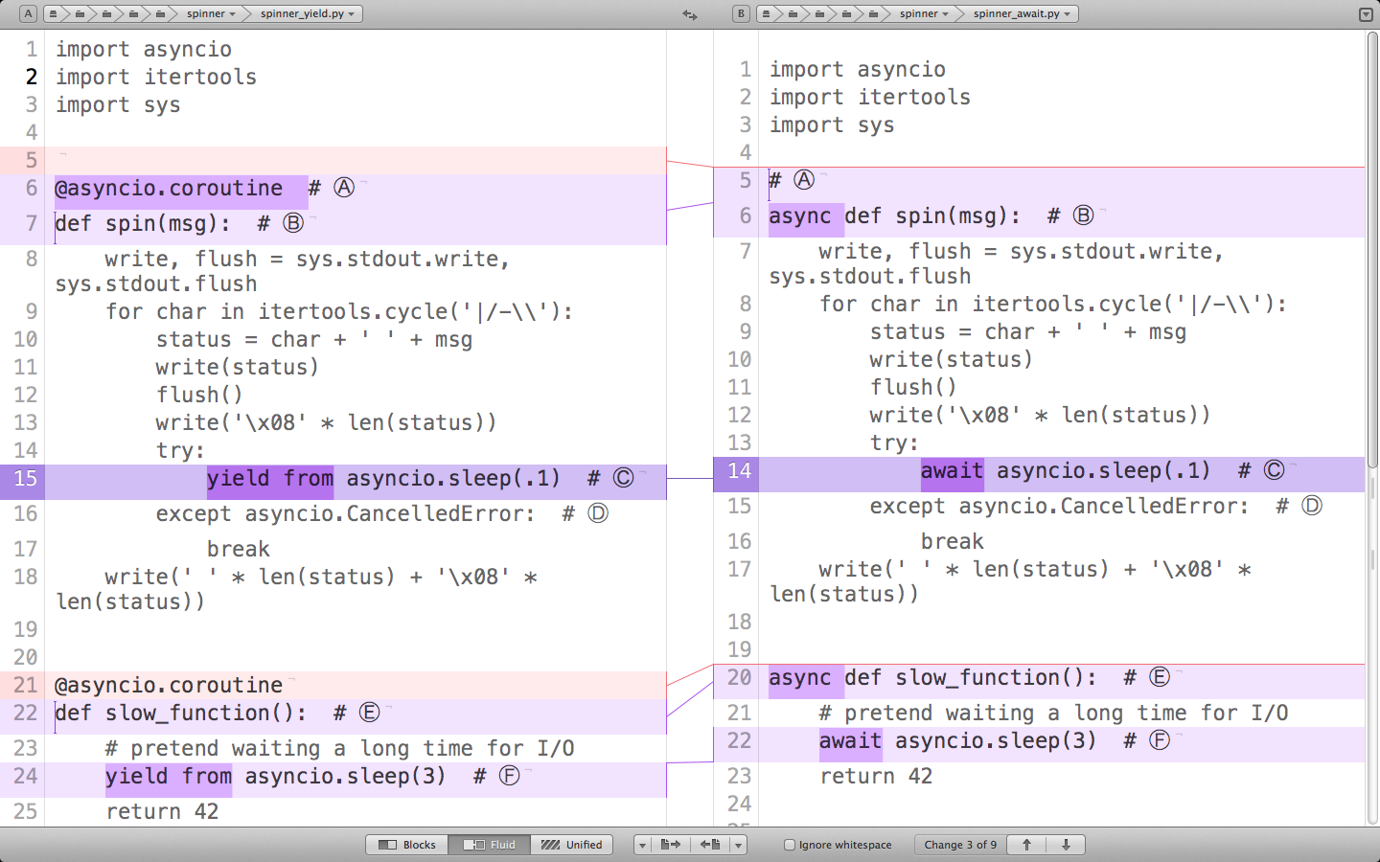

Slide 43
Summary
Concurrent I/O can be achieved without threads or callback hell
  no threads or callbacks in your code, at least
Asyncio Task instances wrap coroutines
  allow cancellation, waiting for result and status checks
Coroutines driven with yield from or await behave as cooperative lightweight threads
  explicit switching points make it easier to reason and debug
  thousands of coroutines can be scheduled at once thanks to low memory cost

Slide 44
Links
Fluent Python example code repository:
  https://github.com/fluentpython/example-code
  new async-await example in directory 17-futures/countries/
  new directory 18b-async-await with 18-asyncio examples rewritten with new syntax
Slides for this talk (and others):
  https://speakerdeck.com/ramalho/
Please rate this talk:
  http://www.oscon.com/open-source-2015/public/schedule/detail/41211
Me:
  Twitter: @ramalhoorg

