Slide 1

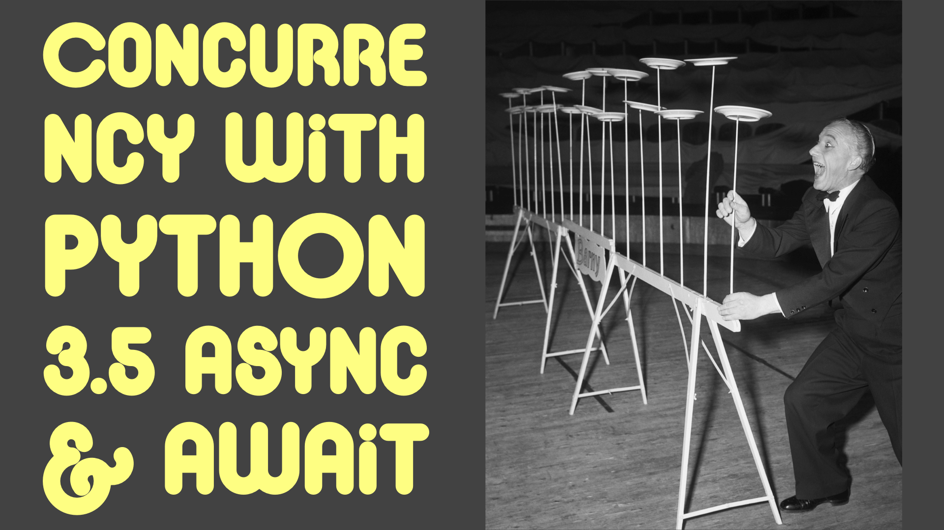

Slide 2
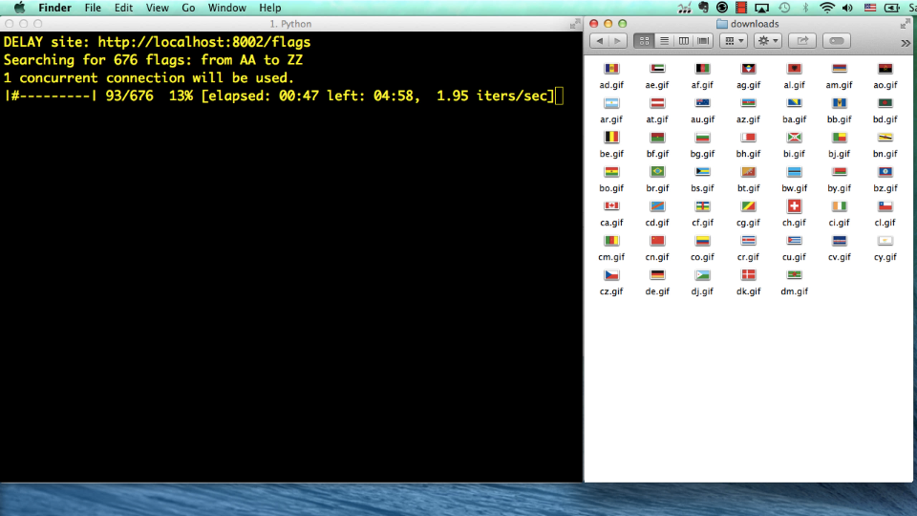
Demo: downloading images
Hitting 676 URLs, getting 194 flag pictures
Sequential:
1.92 items/s
Asynchronous:
150 items/s
http://www.youtube.com/watch?v=M8Z65tAl5l4
http://www.youtube.com/watch?v=M8Z65tAl5l4
http://www.youtube.com/watch?v=M8Z65tAl5l4
http://www.youtube.com/watch?v=M8Z65tAl5l4

Slide 3
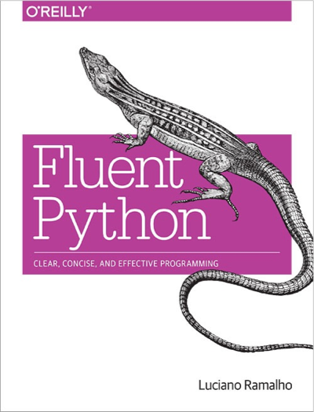
How the demo was made
Four versions of the script:
  sequential
  threaded using concurrent.futures.ThreadPoolExecutor
  asynchronous using asyncio: with yield from
  asynchronous using asyncio: with await
Test harness:
  local nginx server + vaurien proxy
Full instructions on chapters 17 and 18 of Fluent Python

Slide 4
Pre-requisites
quick review
next...
You should know how a Python generator function works
  Chapters 14 and and 16 of Fluent Python cover this in detail.
Tip: understand generators well before studying coroutines
Otherwise: just relax and enjoy the high level overview

Slide 5
Generator: quick review
Generator: any function that has the yield keyword in its body
Caller sends values and/or generator yields values
Most important: their progress is synchronized (e.g. loops in sync)
gen = my_generator()
gen.send(…)
yield
caller
generator

Slide 6
Spinner scripts demo
(.env35b3) $ python spinner_thread.py
spinner object: <Thread(Thread-1, initial)>
Answer: 42
(.env35b3) $ python spinner_yield.py
spinner object: <Task pending coro=<spin() running at spinner_yield.py:6>>
Answer: 42

Slide 7
spinner_thread.py

Slide 8
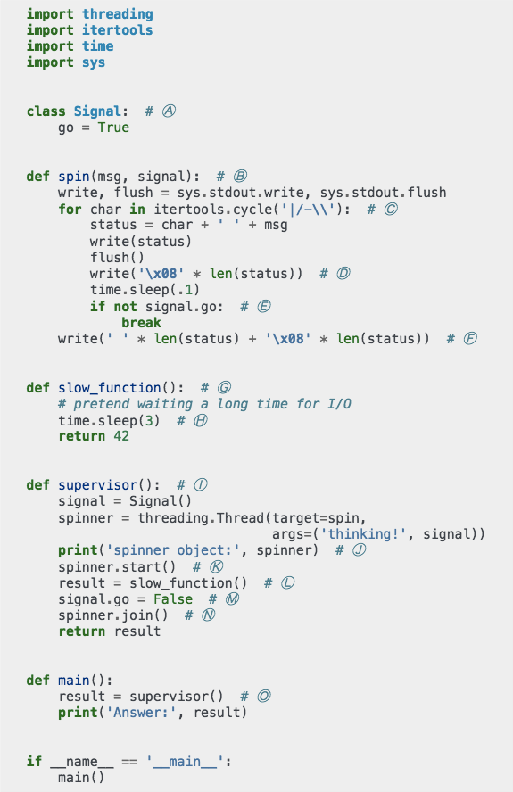
Threaded spinner script: overview
Uses threading library
Main thread starts spinner thread
Main thread blocks waiting for slow_function while spinner thread runs
When slow_function returns, main thread signals spinner thread to stop

Slide 9
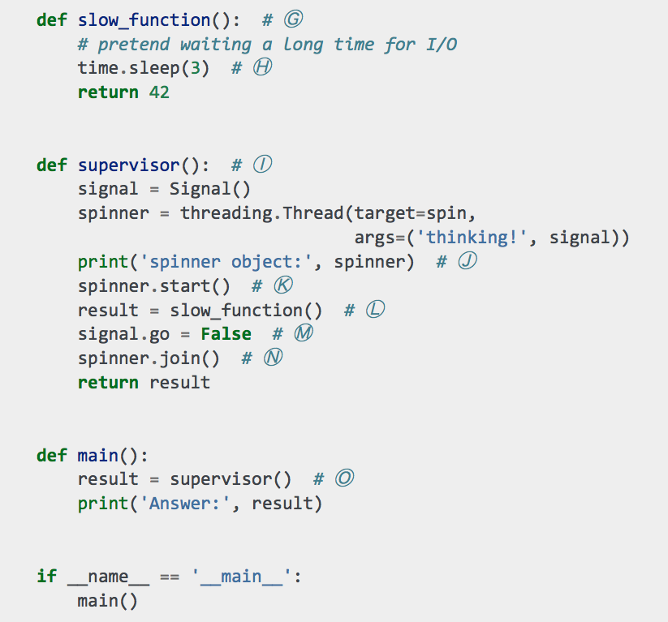
Threaded spinner: bottom
sleep() and
I/O functions
release the GIL
Ⓚ supervisor starts spinner thread
Ⓛ Calls slow_function, which blocks at Ⓗ
Ⓜ Uses signal object to tell spinner thread to stop

Slide 10
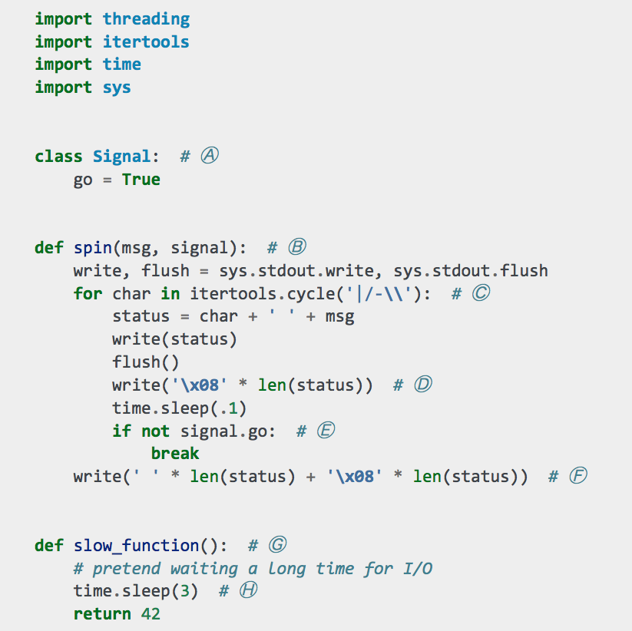
Threaded spinner: top
Ⓑ spin gets Signal instance as second argument
Ⓒ itertools.cycle() produces endless sequence of |/-\
Ⓓ write backspaces ('\x08'), then sleep for 0.1s
Ⓔ exit infinite loop if signal.go is False

Slide 11
Threaded spinner script: notes
OS thread scheduler may switch active threads at any time – that's why threads cannot be cancelled from the outside
Calling sleep() or I/O functions practically guarantees a switch to another thread
Every standard library function that does I/O releases the GIL, allowing other Python bytecode to run

Slide 12
spinner_await.py

Slide 13
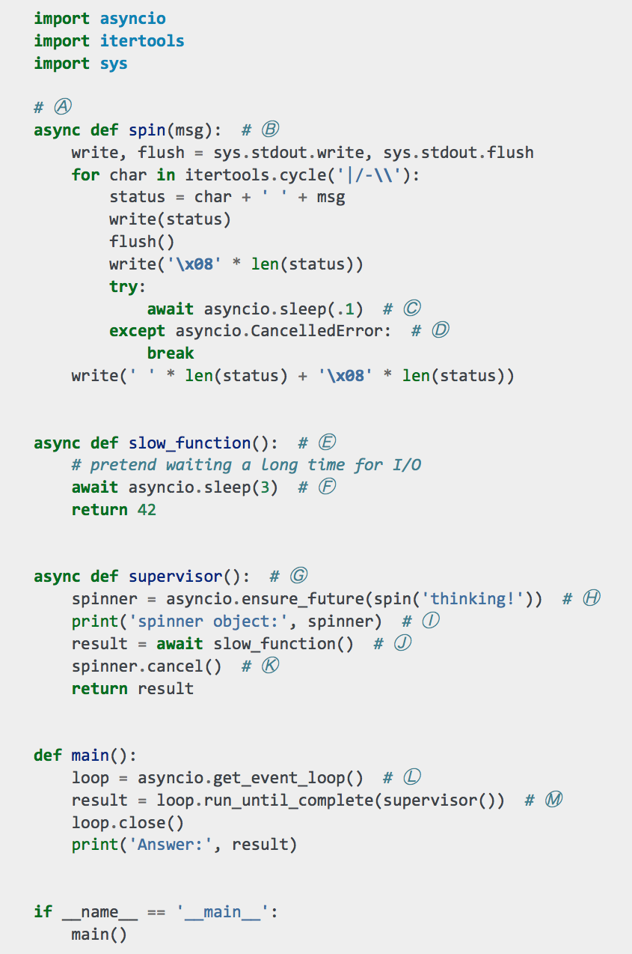
Coroutine spinner script: async/await
Uses asyncio library
Main thread (the only thread) starts event loop to drive coroutines
supervisor, spin and slow_function are coroutines
Coroutines wait for results from other coroutines using await

Slide 14
yield-from concepts
PEP-380: Syntax for Delegating to a Subgenerator
dg = delegating_generator()
yield from subgenerator()
dg.send(…)
yield
caller
delegating generator
subgenerator

Slide 15
async/await concepts
PEP-492: Coroutines with async and await syntax
  introduces native coroutines (≠ generator coroutines)
nc = native_coro()
async def native_coro():
...
await an_awaitable()
nc.send(…)
yield
caller
native coroutine function
an awaitable
object

Slide 16
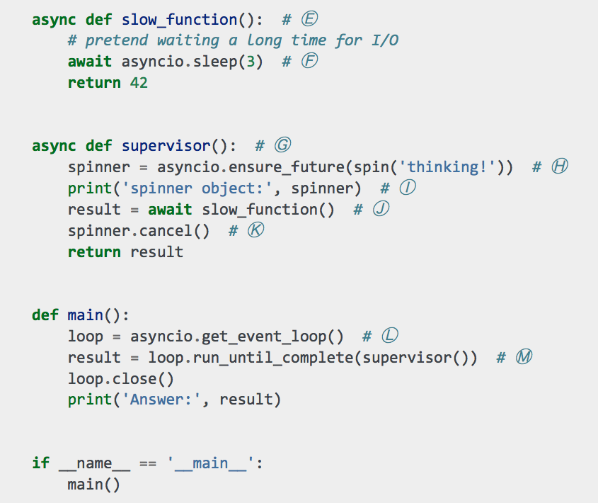
Coro... spinner: bottom
Ⓜ Drive supervisor coroutine with
event loop
Ⓗ Schedule Task with
spin coroutine
Ⓙ Wait for result from slow_function

Slide 17
await creates channel
Channel connects event loop with last awaitable object in the delegating chain
your application code
await
await
send
yield
caller is some code in BaseEventLoop (or subclass)
supervisor
slow_function
asyncio.sleep

Slide 18
Coro... spinner: bottom
await blocks
delegating coroutine
(supervisor)
Ⓜ Drive supervisor coroutine with
event loop
Ⓗ Schedule Task with
spin coroutine
Ⓙ Wait for result from slow_function

Slide 19
Coro... spinner: bottom
slow_function is driven directly by the event loop
Ⓜ Drive supervisor coroutine with
event loop
Ⓗ Schedule Task with
spin coroutine
Ⓙ Wait for result from slow_function

Slide 20
Coro... spinner: bottom
slow_function
blocks here
Ⓕ Delegate to asyncio.sleep

Slide 21
Coro... spinner: bottom
asyncio.sleep() sets up a timer with loop.call_later, then yields to the event loop
Ⓕ Delegate to asyncio.sleep

Slide 22
Coro... spinner: bottom
Ⓚ After slow_function returns, cancel spinner task
Tasks can be cancelled because cancellation happens only at yield points

Slide 23
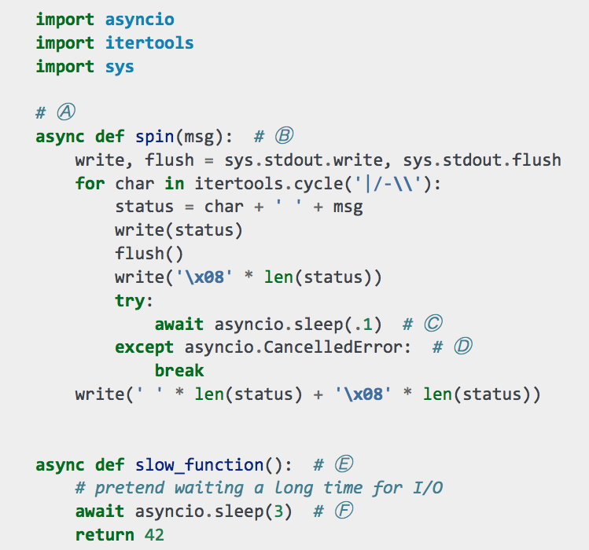
Coroutine spinner: top
Ⓒ Each iteration waits for asyncio.sleep(.1) and...
Ⓓ Handles cancellation by terminating infinite loop, then clearing the status line

Slide 24
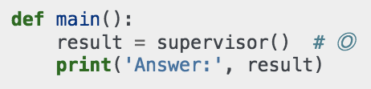
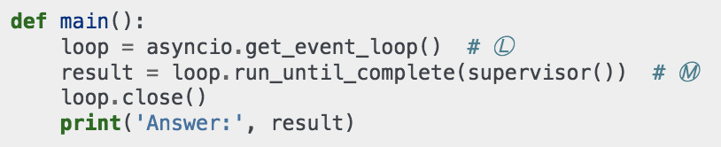
Threaded x async main
threaded
asynchronous
asynchronous main manages the event loop
note how supervisor() is called in each version

Slide 25
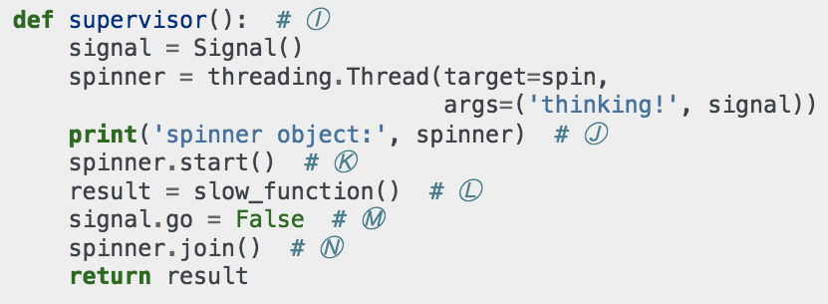
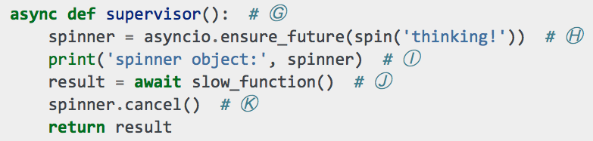
Threaded x async supervisor
threaded
asynchronous

Slide 26
Threaded x async comparison
(.env35b3) $ python spinner_thread.py
spinner object: <Thread(Thread-1, initial)>
Answer: 42
(.env35b3) $ python spinner_yield.py
spinner object: <Task pending coro=<spin() running at spinner_yield.py:6>>
Answer: 42
spinner action implemented as Thread or Task
asynchronous Task is similar to a green thread
  an application-level, cooperative thread)
Task wraps a coroutine
Each coroutine uses much less memory than an OS thread (kilobytes, not megabytes)

Slide 27
flags_await.py

Slide 28
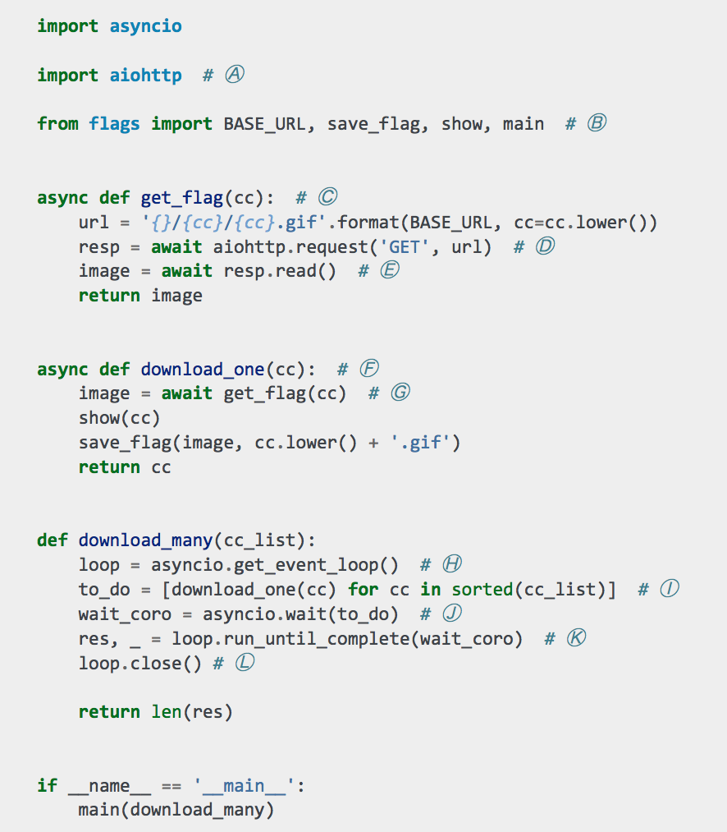
flags_await.py
Simplified implementation of demo script

Slide 29
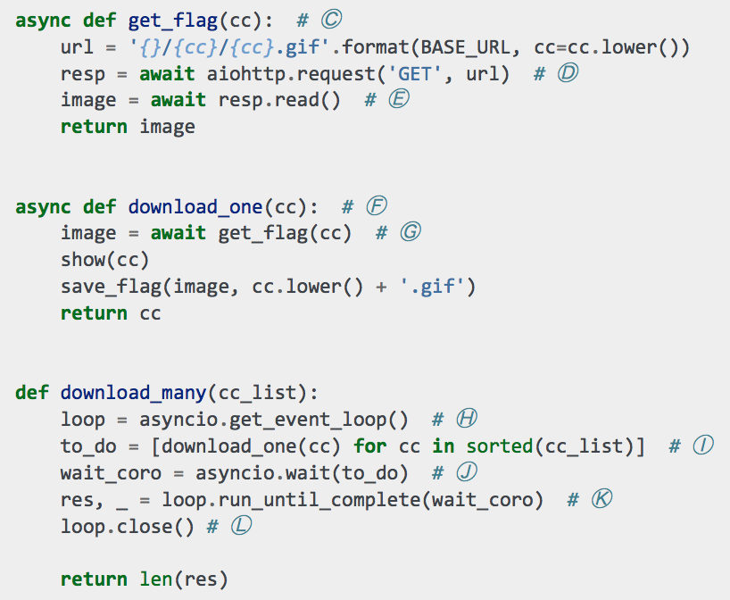
Zoom in...
Ⓘ...Ⓚ
download_many schedules many instances of download_one
Ⓖ
download_one delegates to get_flag
Ⓓ, Ⓔ
get_flag delegates to aiottp.request() and response.read()

Slide 30
await in action
User code creates chain of coroutines connecting event loop to library coroutines that perform asynchronous I/O
coroutines in flags_await.py
await
await
send
yield
download_many calls loop .run_until_complete
download_one
get_flag
aiohttp.request

Slide 31
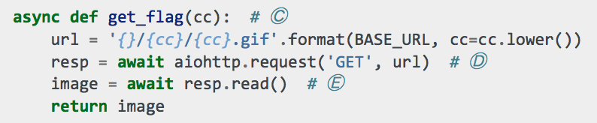
Zoom further... and squint
Guido van Rossum's tip for reading async code:
  squint and ignore await for a moment...

Slide 32
Zoom further... and squint
Guido van Rossum's tip for reading async code:
  squint and ignore await for a moment...

Slide 33
What is the point?
Concurrency is always hard
Python's new asyncio library and language features provide an effective alternative to:
  managing threads and locks by hand
  coping with callback hell

Slide 34
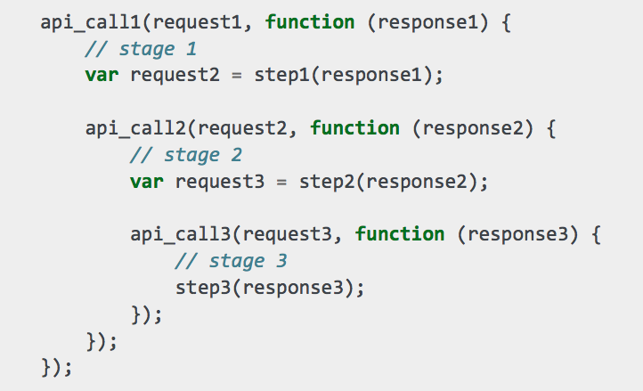
Callback hell in JavaScript
context from stage 1 is gone
context from stage 2 is gone

Slide 35
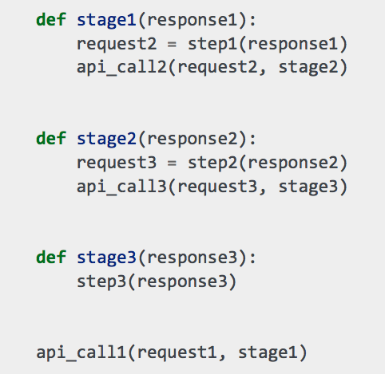
Callback hell in Python
context from stage 1 is gone
context from stage 2 is gone

Slide 36
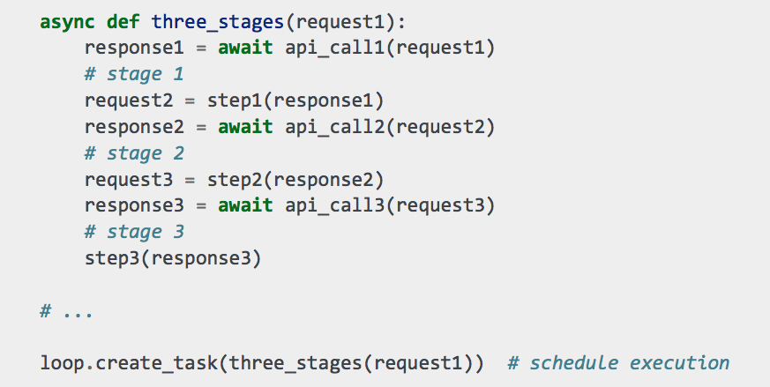
Escape from callback hell
context is preserved through all
stages: it's
all in the local scope of the native coroutine

Slide 37
Escape (squinting)
context is preserved through all
stages: it's
all in the local scope of the native coroutine

Slide 38
Before considering another language for asynchronous jobs, try Python 3.3 or later!
supports yield from!

Slide 39
Python 3.5 async/await
New keywords introduced for the first time since Python 3.0 (2008)
PEP-492 very briefly:
  async def is used to build native coroutines
  await is used to delegate to awaitable objects
    native coroutines; decorated generator-based coroutines; implementers of __await__ protocol
  new constructs available only inside native coroutines:
    async for: suports asynchronous __aiter__ and __anext__
    async with: suports asynchronous __aenter__ and __aexit__
Proper language support for coroutines, finally!

Slide 40
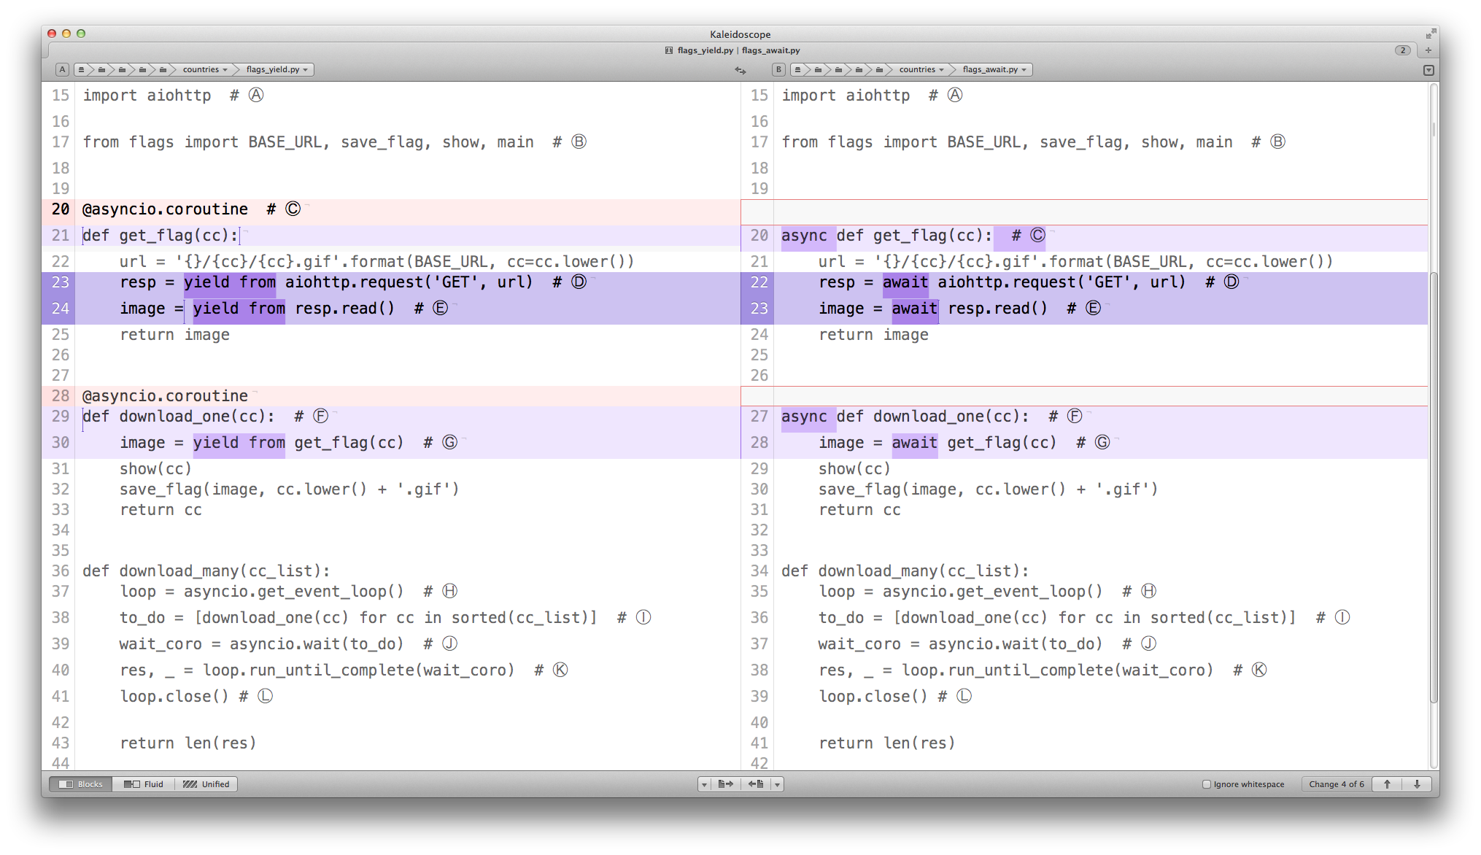
yield-from syntax
async/await syntax

Slide 41
Summary
Concurrent I/O can be achieved without threads or callback hell
  no threads or callbacks in your code, at least
Asyncio Task instances wrap coroutines
  allow cancellation, waiting for result and status checks
Coroutines driven with await (or yield from) behave as cooperative lightweight threads
  explicit switching points make it easier to reason and debug
  thousands of coroutines can be scheduled at once thanks to low memory cost

Slide 42
Links + Q & A
Fluent Python example code repository:
  https://github.com/fluentpython/example-code
  new async-await example in directory 17-futures/countries/
  new directory 18b-async-await with 18-asyncio examples rewritten with new syntax
Slides for this talk (and others):
  https://speakerdeck.com/ramalho/
Please rate this talk:
  http://bit.ly/oscon-spin
Me:
  Twitter: @ramalhoorg
Q & a

