Slide 1
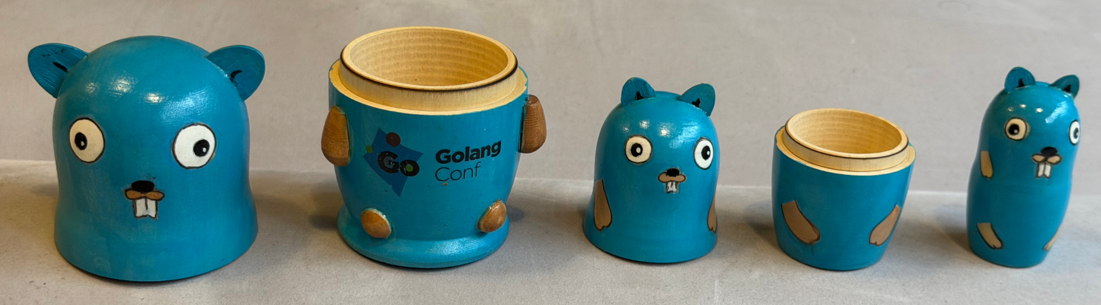
Sets in Go: past, present and future
Luciano Ramalho
luciano@ramalho.org
github/codeberg:
@ramalho

Slide 2
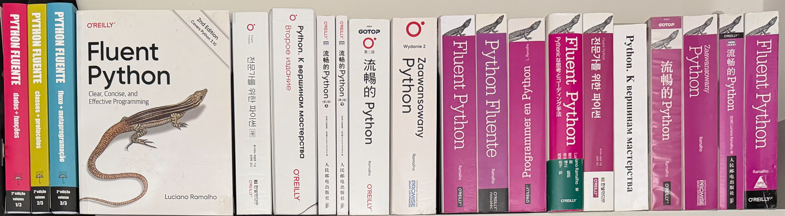
My best work (so far): Fluent Python
Published in 9 languages, 2 editions (2015, 2022)
A deep dive into idiomatic Python, exploring the design of the language and its standard library

Slide 3
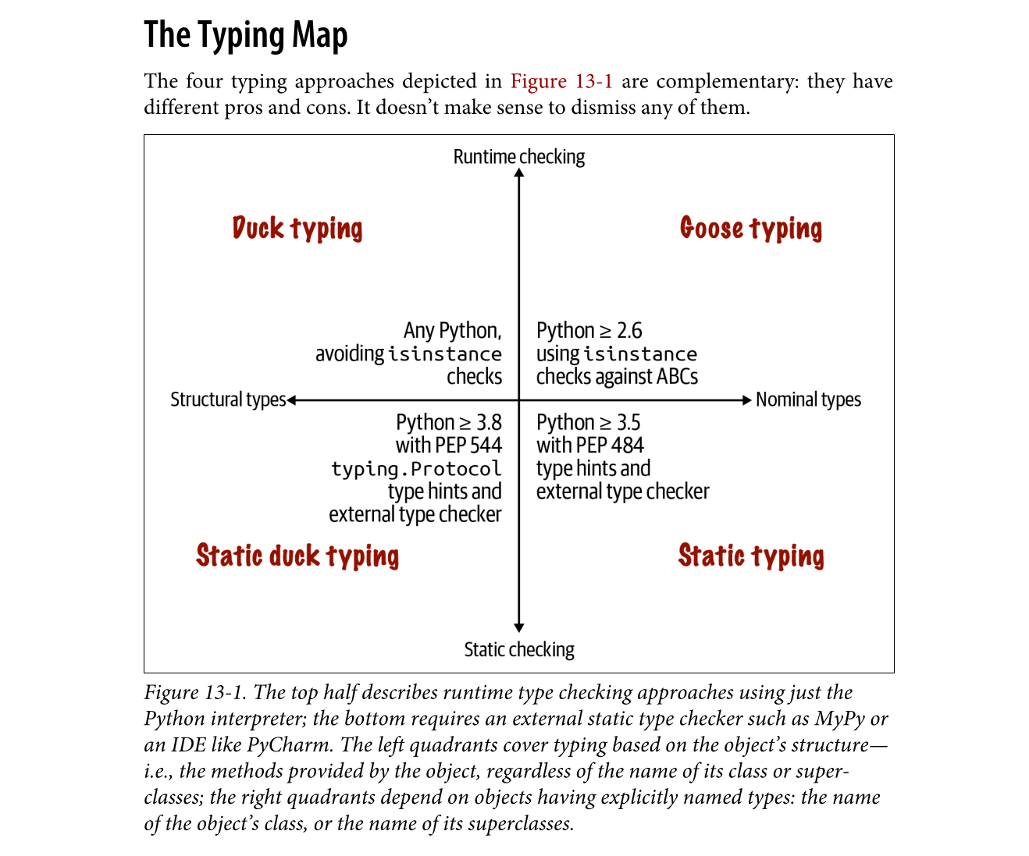

Slide 4
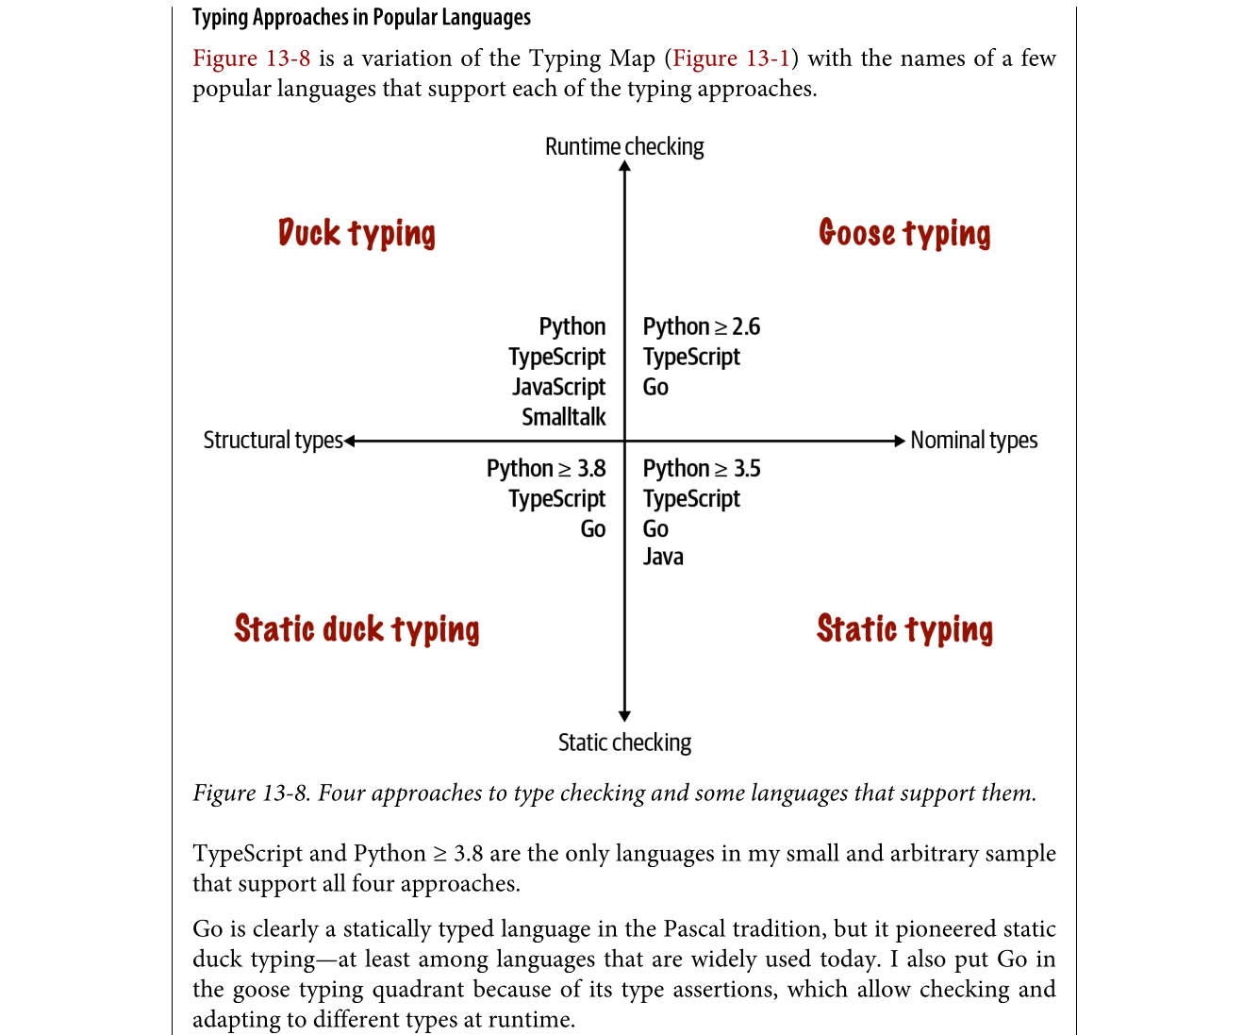

Slide 8
About me
Member of the Bartz v. Anthropic class action
Principal consultant at Thoughtworks (2015-2023)
Instructional designer at Oficina Turing
Co-founder of Garoa Hacker Clube,
a hackerspace in São Paulo, Brasil (since 2010)

Slide 9
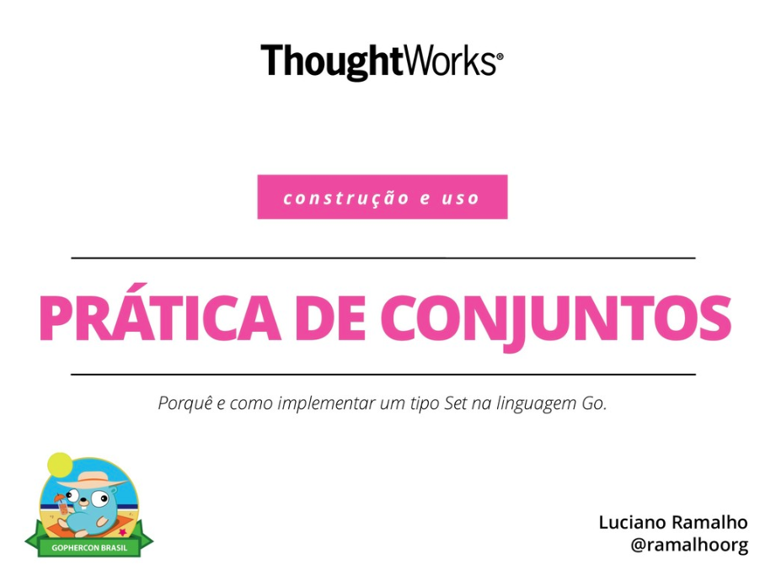
A tale of two talks
vintage
2018
In 2018 I presented
"Set Practice" at
GopherCon Brasil:
  Pitch: "Why and how to implement sets in Go"
This is a radical update, covering the set types
in the collections package
for Go 1.28

Slide 10
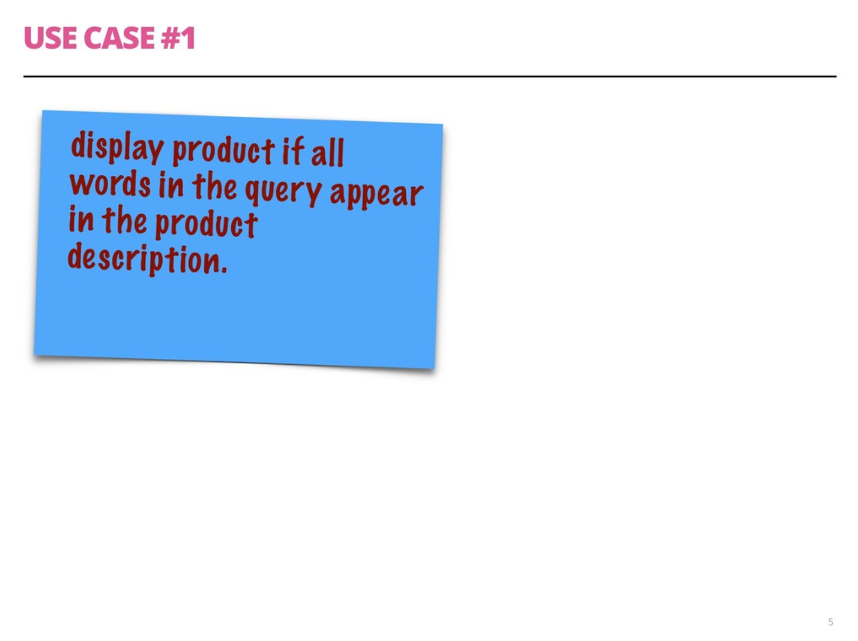

Slide 11
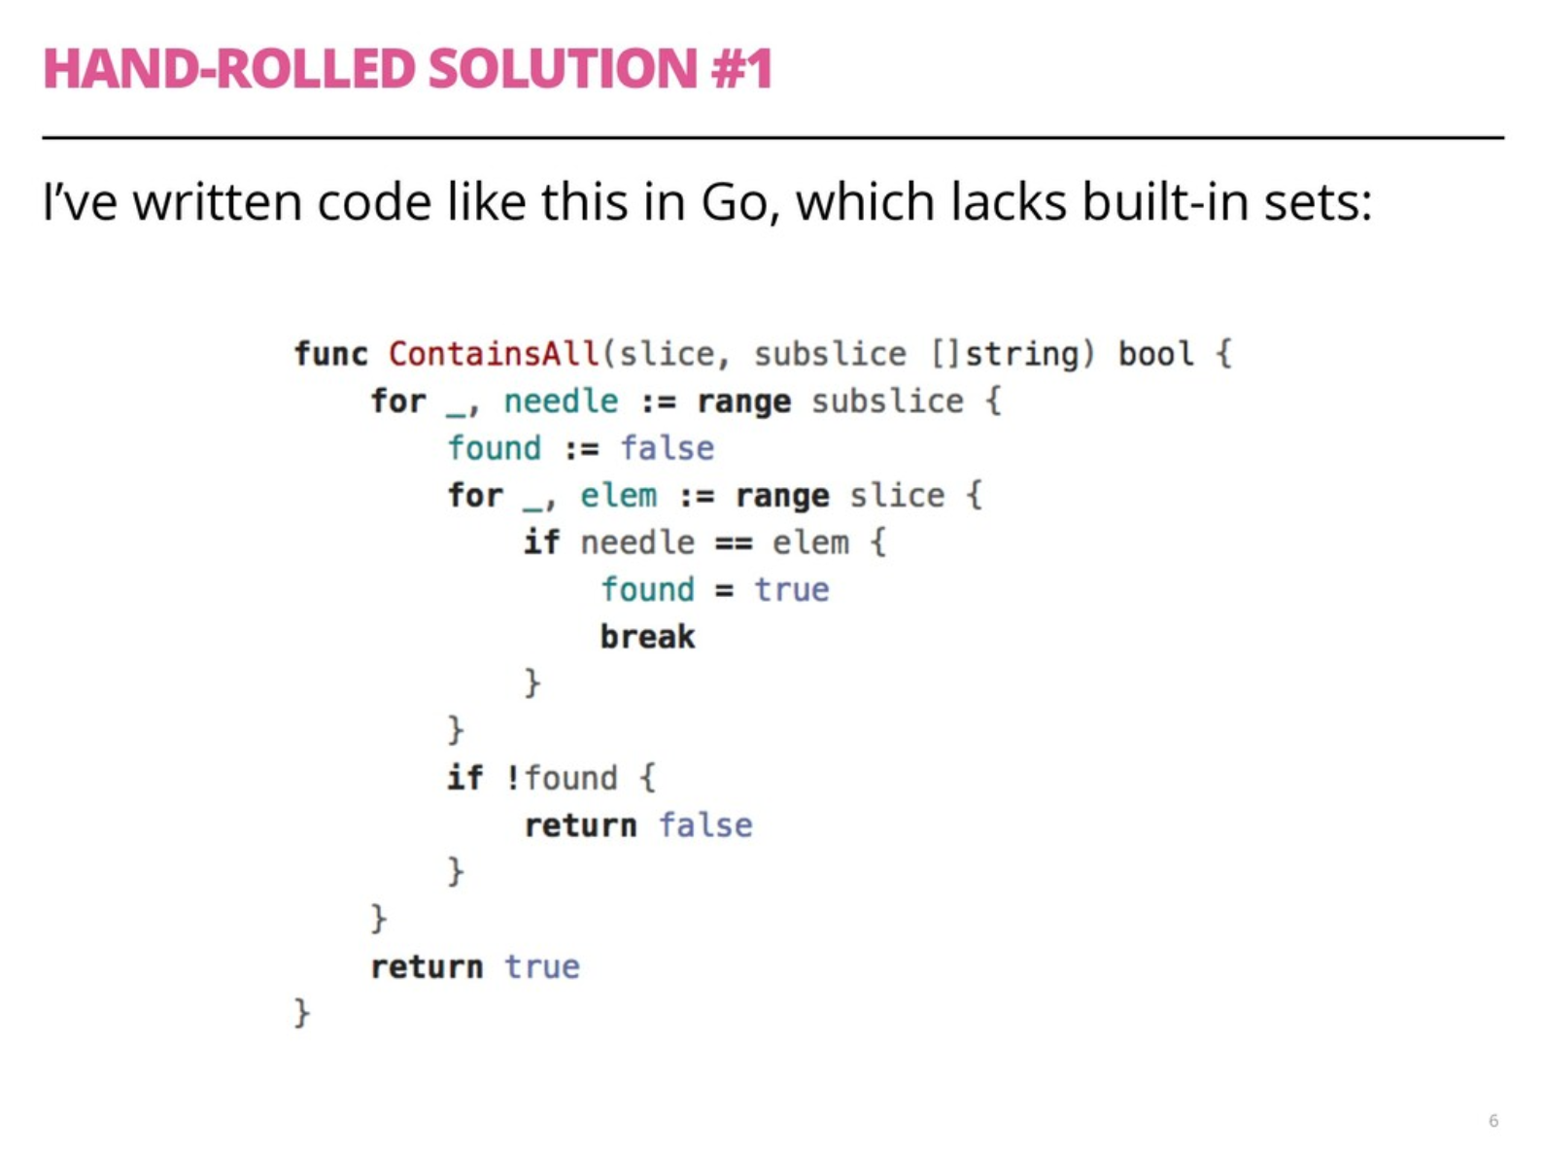
vintage
2018

Slide 12
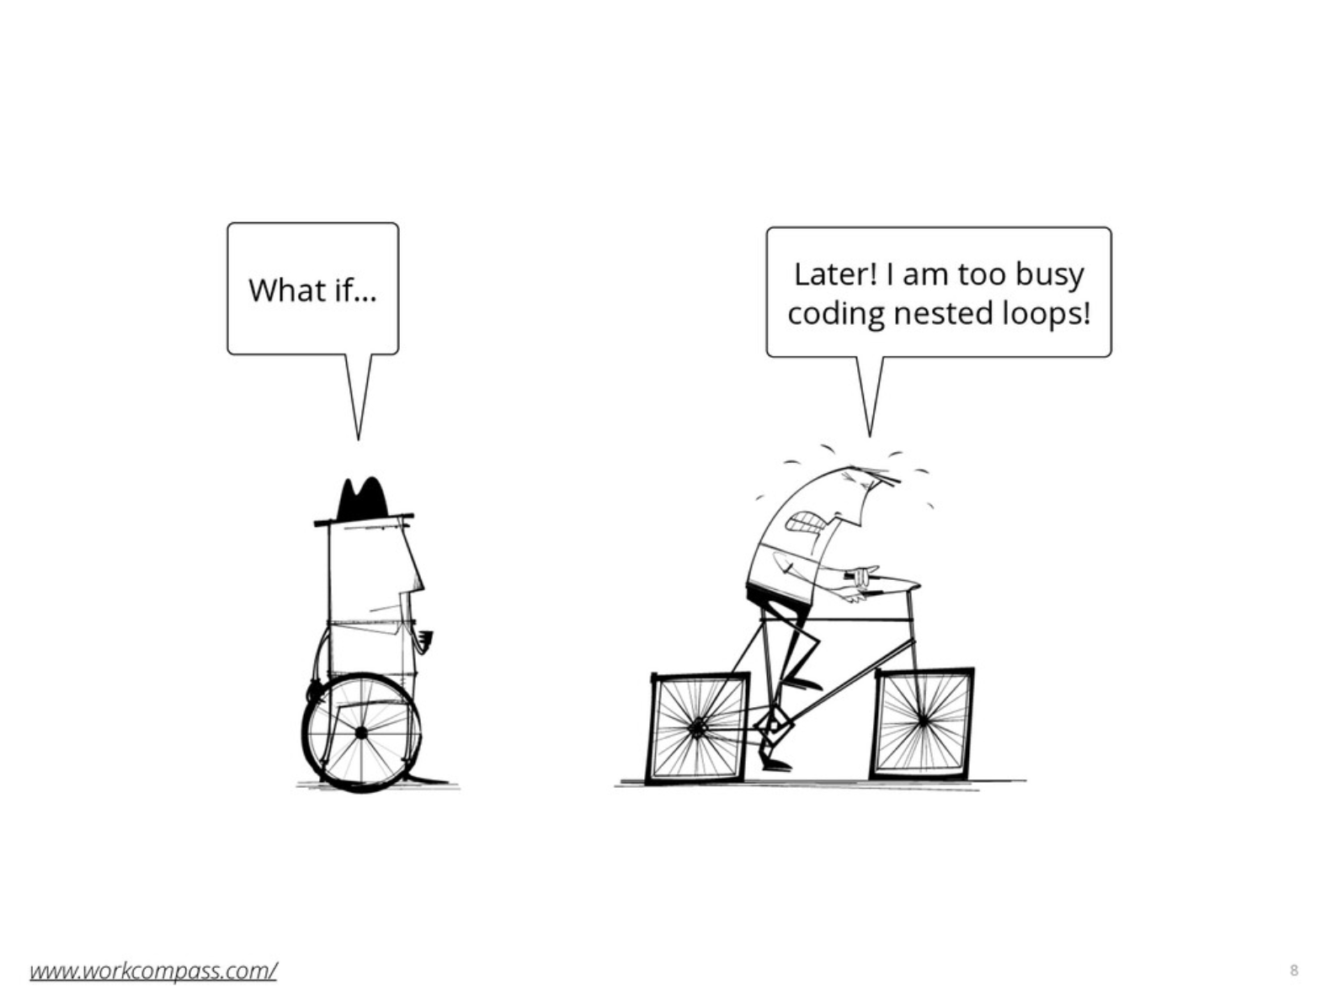

Slide 13
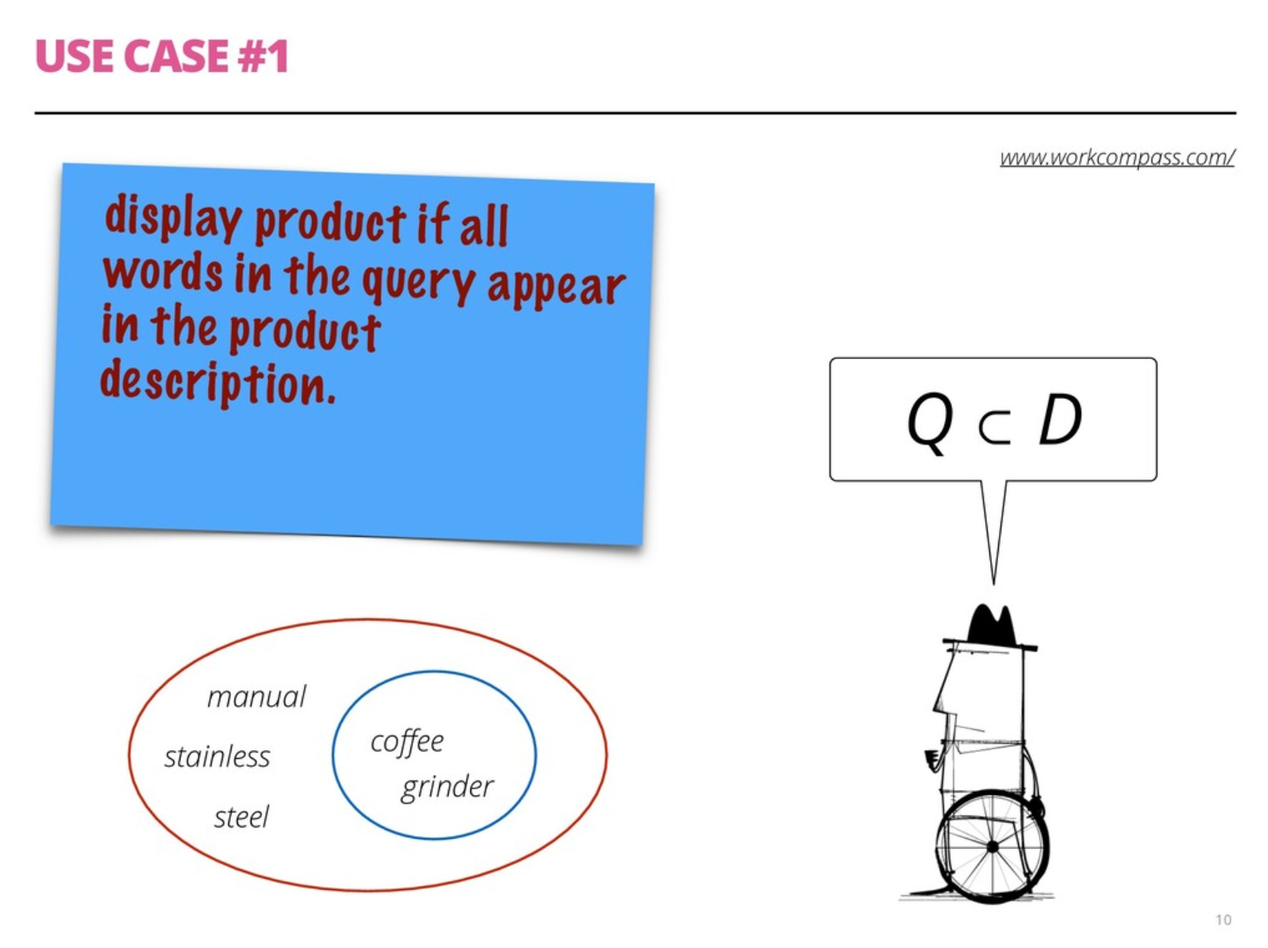

Slide 14
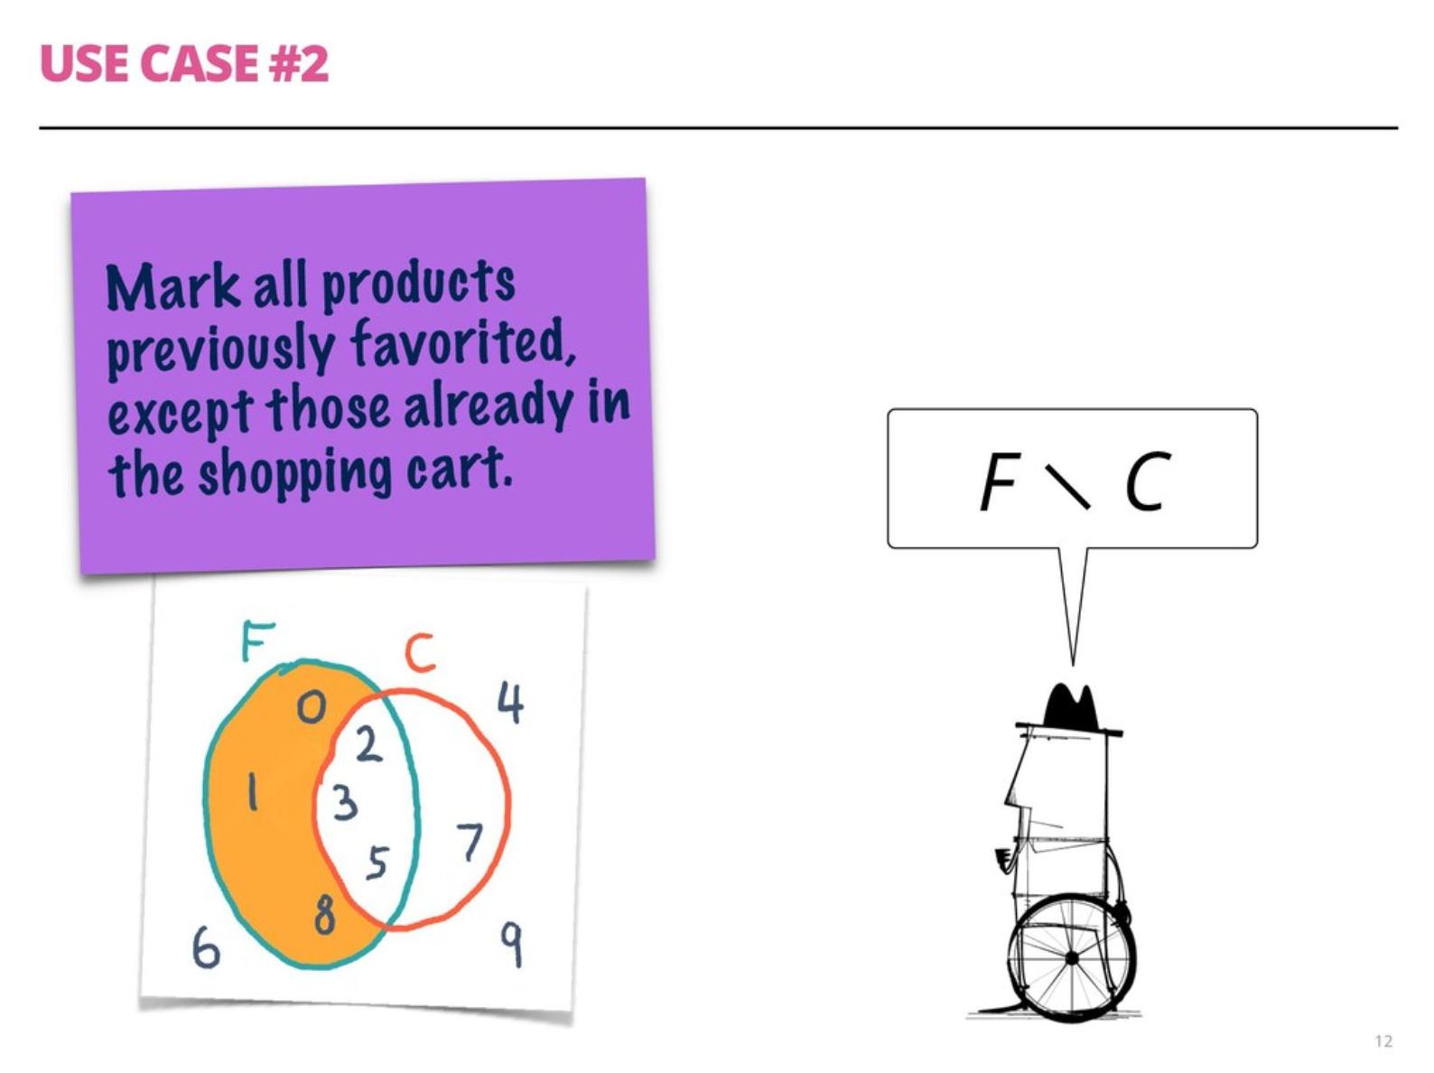

Slide 15
Sets and Logic

Slide 16
Nobody has yet discovered a branch of mathematics that has successfully resisted formalization into set theory.
Thomas Forster
Logic Induction and Sets
p. 167

Slide 17
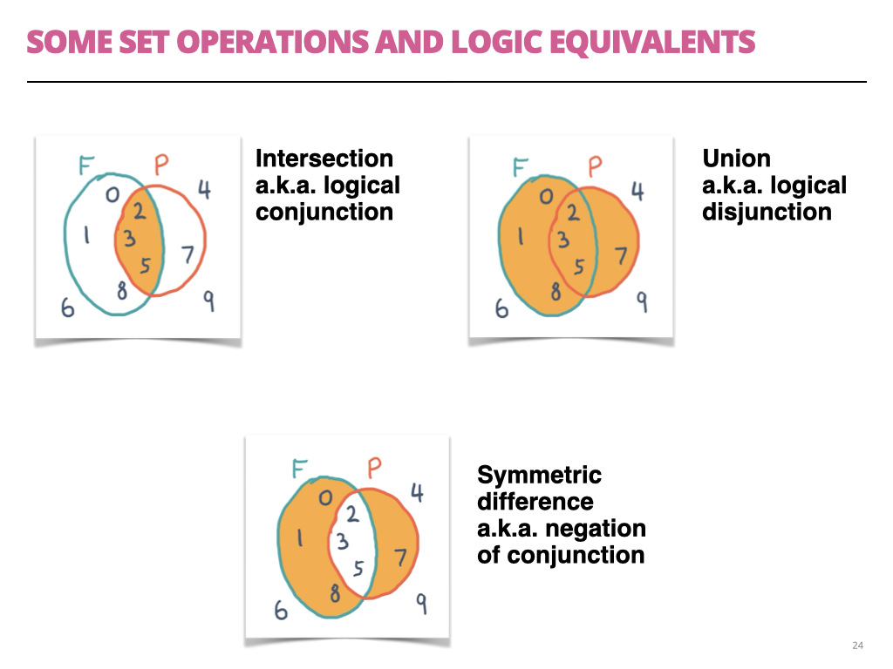

Slide 18
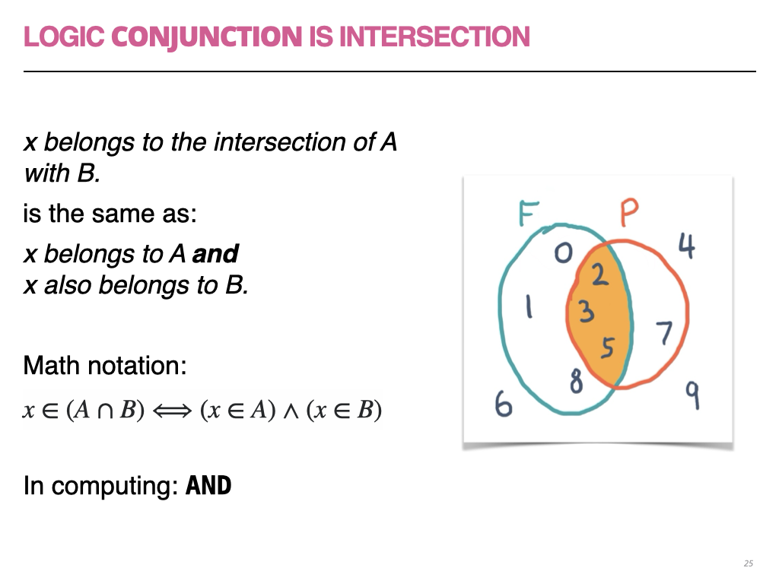

Slide 19
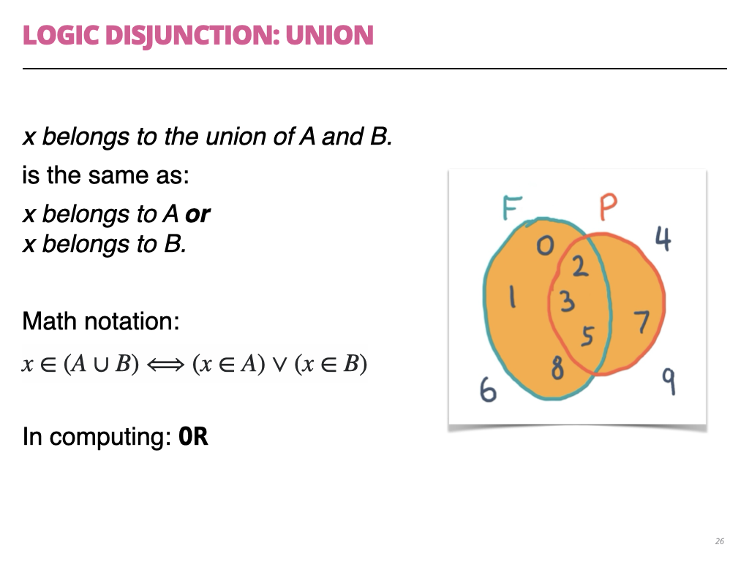

Slide 20
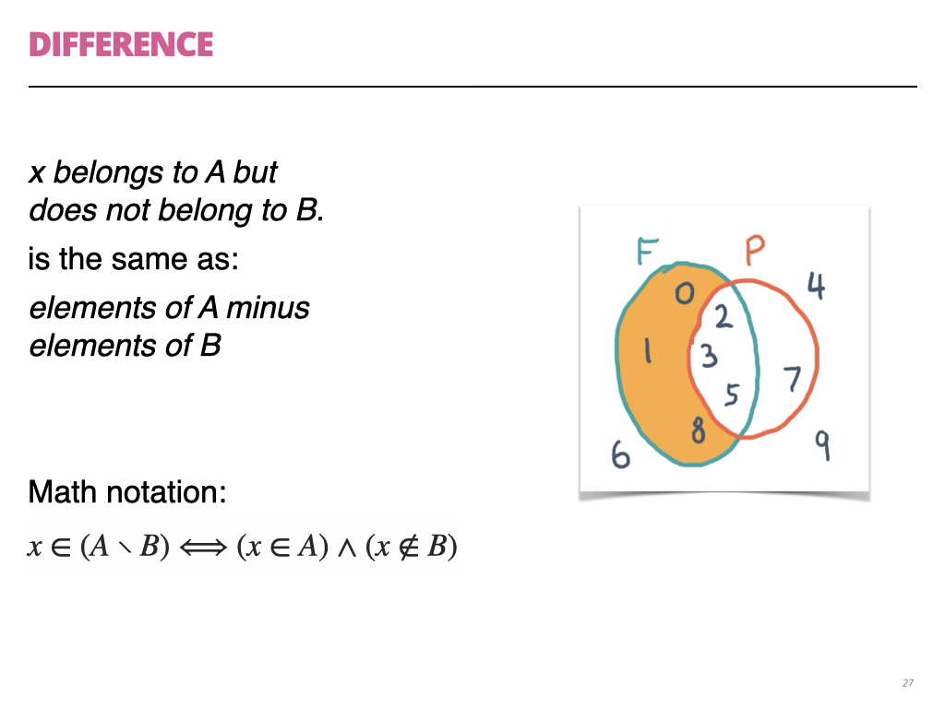

Slide 21
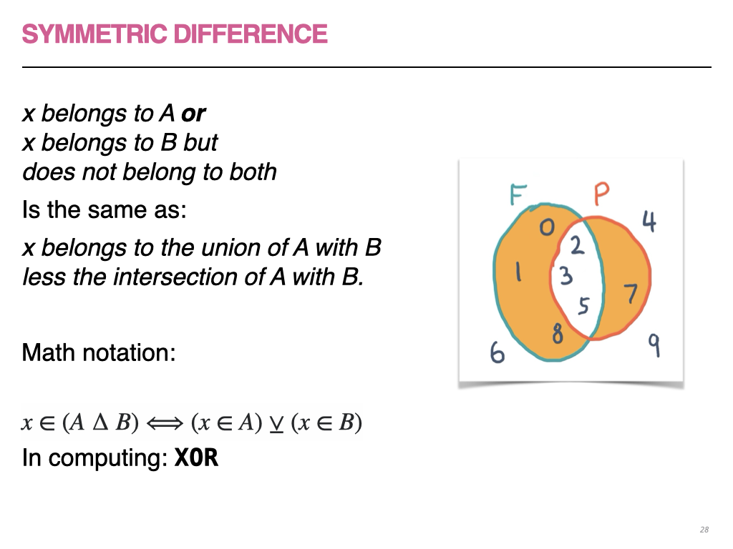

Slide 22
Set algebra in the wild

Slide 23
Set algebra
Essential: e ∈ S
Highly desirable in practice:
  S ⊇ Z (superset: S contains all elements of Z)
  S ∩ Z (intersection)
  S ∪ Z (union)
  S ∖ Z (difference)

Slide 24
Implementing sets
Invariant: set elements are unique
  Elements must be hashable and comparable
e ∈ S (membership test):
  Expected to be O(1) in a reasonable implementation
Membership test at constant time provides significant performance gains with the remaining operations

Slide 25
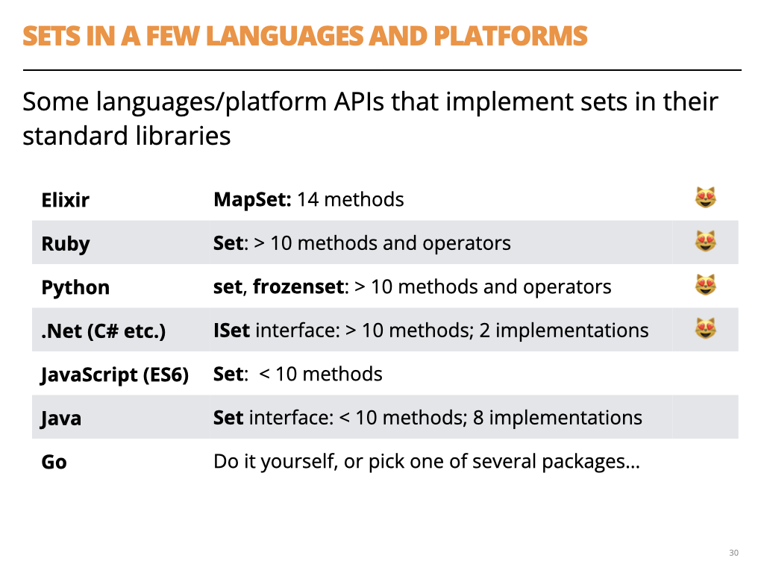
vintage
2018

Slide 26
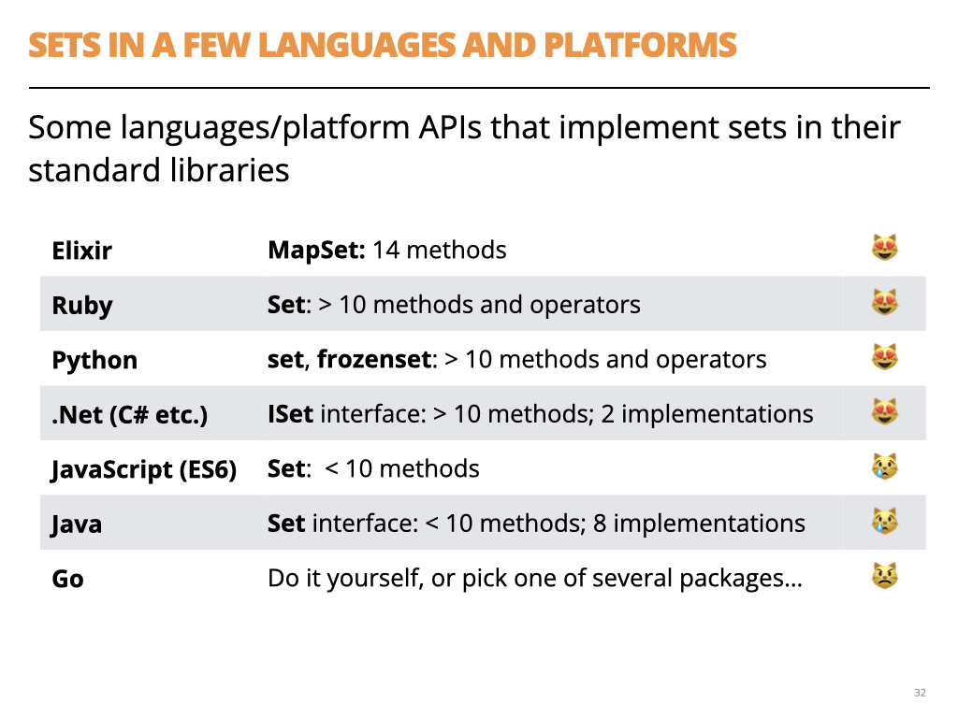
vintage
2018

Slide 27
rich
APIs
lean
APIs
vintage
2018

Slide 28
Evolution of set APIs
Most methods in lean APIs handle single elements
  e.g.: adding/removing an element, iteration
“The von Neumann bottleneck”

Slide 29
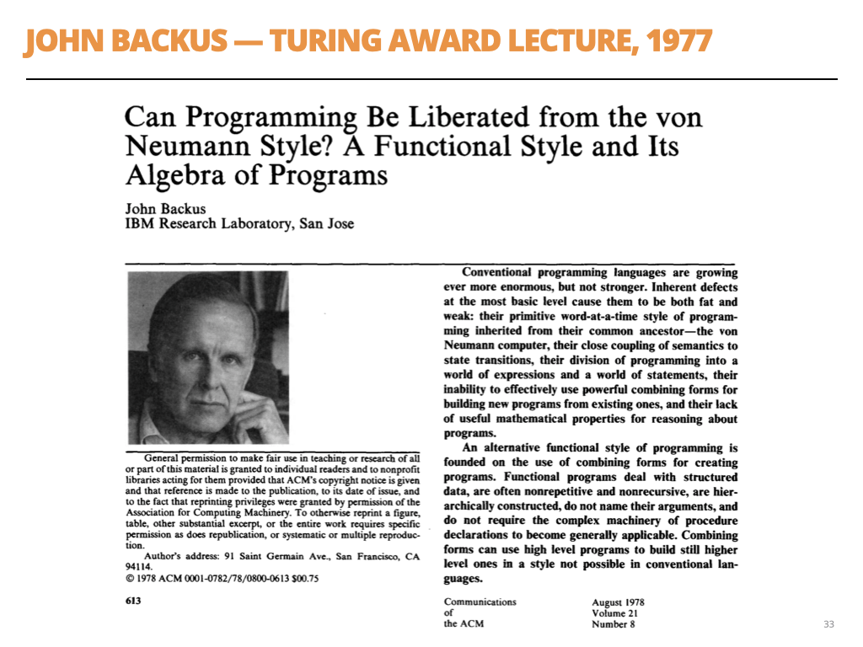

Slide 30
Evolution of set APIs
Languages are providing more set algebra operations
ECMAScript 2025 added:
    Set.intersection, Set.union,
    Set.difference, Set.symmetricDifference,
    Set.isSubsetOf, Set.isSupersetOf, Set.isDisjointFrom
Go 1.28 will have a rich set API!

Slide 31
The collections proposal for Go 1.28

Slide 32
The Go Collections working group was formed in late 2025 with the purpose of bringing common collection data structures to the standard library, guided by the familiar Go principles of pragmatism and simplicity.
…
This work seeks to add several of the more important data types to the standard library, and to establish conventions for their APIs and those of future additions.
Alan Donovan
Go issue #80590

Slide 33
The 7 proposed additions
hash/maphash.Hasher
standard interface supporting custom hash functions and equivalence relations for arbitrary data types (released in Go 1.27)
container/hash.Map[K,V]
a hash-based Map that uses custom hash functions.
container/hash.Set[T]
a hash-based Set along the same lines.
container/heap/v2.Heap
a generic binary heap API to replace the standard library's existing heap (hard to use).

Slide 34
The 7 proposed additions
container/set.Set[T]
transparently represented as map[T]struct{}, supporting usual set operations such as Union and Intersection. We expect it to become the standard set in most new Go APIs.
container/mapset
helper functions (Union, Intersection, and so on) for manipulating legacy sets as sets in existing code whose API cannot be changed. set.Set wraps this API.
container/ordered.Map[K,V]
a map that preserves insertion order

Slide 35
proposal: container/...: generic collection types
Umbrella issue:
https://github.com/golang/go/issues/80590
6 new concrete collection types
1 new interface Hasher (included in Go 1.27)
3 new abstract interfaces for collections, sets and maps

Slide 36
Source tree
(WIP)
go/src/
├── hash/
│ └── maphash/
│ └── hasher.go = Hasher interface, in Go 1.27 (#70471)
├── maps/
│ └── maps.go ★ added Identical (#78456), used by mapset
├── container/
│ ├── container_test.go ★✚ abstract interfaces (unexported)
│ ├── set/
│ │ └── set.go ★✚ the new canonical set (#69230)
│ ├── mapset/
│ │ └── mapset.go ★✚ helpers for map-based sets (#77052)
│ ├── hash/
│ │ ├── map.go ★✚ hash.Map, uses maphash.Hasher (#69559)
│ │ └── set.go ★✚ hash.Set, same approach (#80584)
│ ├── heap/
│ │ ├── heap.go = existing, pre-generics
│ │ └── v2/
│ │ └── heap.go ? generic, more ergonomic Heap (#77397)
│ ├── list/
│ │ └── list.go = existing
│ ├── ordered/
│ │ └── ordered.go ? tree-based ordered.Map/Set (#60630)
│ └── ring/
│ └── ring.go = existing
│
│
Open Cls
(unmerged)
identified
by #issue

Slide 37
Abstract interfaces
go/src/
├── hash/
│ └── maphash/
│ └── hasher.go
├── maps/
│ └── maps.go
├── container/
├── container/
│ ├── container_test.go
│ ├── set/
│ │ └── set.go
│ ├── mapset/
│ │ └── mapset.go
│ ├── hash/
│ │ ├── map.go
│ │ └── set.go
│ │
Unexported but
intended as models
for new collection types

Slide 38
Comment in container/container_test.go
// The following interfaces define the abstract data types for
// collections in Go. They are expressed using F-bounded polymorphic
// interfaces to achieve covariant parameter/result specialization,
// and may be used as constraint types in generic functions.
//
// These interfaces are not yet published, but may be included in a
// future Go release once we have experience of whether these methods
// are necessary and sufficient.

Slide 39
_AbstractSet
1 // _AbstractSet models a set S of elements E,
2 // such as *hash.Set, or set.Set.
3 type _AbstractSet[E any, S _AbstractSet[E, S]] interface {
4 _AbstractCollection[E, S]
5
6 Insert(E) bool
7 InsertAll(iter.Seq[E]) bool
8 Equal(S) bool
9 All() iter.Seq[E]
10 Delete(E) bool
11 DeleteAll(iter.Seq[E]) bool
12 DeleteFunc(func(E) bool) bool
13 Intersection(S) S
14 IntersectionWith(S)
15 Intersects(S) bool
16 Union(S) S
17 UnionWith(S)
18 Difference(S) S
19 DifferenceWith(S)
20 SymmetricDifference(S) S
21 SymmetricDifferenceWith(S)
22 }

Slide 40
1 // _AbstractSet models a set S of elements E,
2 // such as *hash.Set, or set.Set.
3 type _AbstractSet[E any, S _AbstractSet[E, S]] interface {
4 _AbstractCollection[E, S]
5
6 Insert(E) bool 👈
7 InsertAll(iter.Seq[E]) bool 👈
8 Equal(S) bool
9 All() iter.Seq[E]
10 Delete(E) bool 👈
11 DeleteAll(iter.Seq[E]) bool 👈
12 DeleteFunc(func(E) bool) bool 👈
13 Intersection(S) S
14 IntersectionWith(S)
15 Intersects(S) bool
16 Union(S) S
17 UnionWith(S)
18 Difference(S) S
19 DifferenceWith(S)
20 SymmetricDifference(S) S
21 SymmetricDifferenceWith(S)
22 }
return bool
to report
change

Slide 41
1 // _AbstractSet models a set S of elements E,
2 // such as *hash.Set, or set.Set.
3 type _AbstractSet[E any, S _AbstractSet[E, S]] interface {
4 _AbstractCollection[E, S]
5
6 Insert(E) bool
7 InsertAll(iter.Seq[E]) bool
8 Equal(S) bool
9 All() iter.Seq[E]
10 Delete(E) bool
11 DeleteAll(iter.Seq[E]) bool
12 DeleteFunc(func(E) bool) bool
13 Intersection(S) S 👈
14 IntersectionWith(S)
15 Intersects(S) bool
16 Union(S) S 👈
17 UnionWith(S)
18 Difference(S) S 👈
19 DifferenceWith(S)
20 SymmetricDifference(S) S 👈
21 SymmetricDifferenceWith(S)
22 }
set algebra
operations
return new set

Slide 42
1 // _AbstractSet models a set S of elements E,
2 // such as *hash.Set, or set.Set.
3 type _AbstractSet[E any, S _AbstractSet[E, S]] interface {
4 _AbstractCollection[E, S]
5
6 Insert(E) bool
7 InsertAll(iter.Seq[E]) bool
8 Equal(S) bool
9 All() iter.Seq[E]
10 Delete(E) bool
11 DeleteAll(iter.Seq[E]) bool
12 DeleteFunc(func(E) bool) bool
13 Intersection(S) S
14 IntersectionWith(S) 👈
15 Intersects(S) bool
16 Union(S) S
17 UnionWith(S)
18 Difference(S) S
19 DifferenceWith(S) 👈
20 SymmetricDifference(S) S
21 SymmetricDifferenceWith(S) 👈
22 }
update
receiver
in-place

Slide 43
_AbstractSet: a self-referential declaration!
// _AbstractSet models a set S of elements E,
// such as *hash.Set, or set.Set.
type _AbstractSet[E any, S _AbstractSet[E, S]] interface {
🙀

Slide 44
Enum is actually a generic class defined as Enum<T extends Enum<T>>. This circular definition is probably the most confounding generic type definition you are likely to encounter. We're assured by the type theorists that this is quite valid and significant, and that we should simply not think about it too much, for which we are grateful.
Ken Arnold, James Gosling, David Holmes
The Java Programming Language, 4th Edition
Cited in Generics Considered Harmful
by Ken Arnold (https://fpy.li/15-51)

Slide 45
A good, informal explanation
F-Bounded Polymorphism: Type-Safe Builders in Java
  How a self-referential type bound solves a real inheritance problem, why Java's own Enum uses the same trick, and what it all means in practice.
  By Pradeep Samuel
  Published March 9, 2026
https://www.fbounded.com/blog/f-bounded-polymorphism/

Slide 46
_AbstractSet is F-bounded
// _AbstractSet models a set S of elements E,
// such as *hash.Set, or set.Set.
type _AbstractSet[E any, S _AbstractSet[E, S]] interface {
That’s Go notation for an
“F-bounded polymorphic interface”
Provides de S type variable,
useful in return types for the set algebra
Constrains the concrete type of S to
a subtype of _AbstractSet

Slide 47
1 // _AbstractSet models a set S of elements E,
2 // such as *hash.Set, or set.Set.
3 type _AbstractSet[E any, S _AbstractSet[E, S]] interface {
4 _AbstractCollection[E, S]
5
6 Insert(E) bool
7 InsertAll(iter.Seq[E]) bool
8 Equal(S) bool
9 All() iter.Seq[E]
10 Delete(E) bool
11 DeleteAll(iter.Seq[E]) bool
12 DeleteFunc(func(E) bool) bool
13 Intersection(S) S 👈
14 IntersectionWith(S)
15 Intersects(S) bool
16 Union(S) S 👈
17 UnionWith(S)
18 Difference(S) S 👈
19 DifferenceWith(S) 👈
20 SymmetricDifference(S) S 👈
21 SymmetricDifferenceWith(S) 👈
22 }

Slide 48
_AbstractMap is also F-bounded
1 // _AbstractMap models a mapping M from keys K to values V,
2 // such as *hash.Map or *ordered.Map.
3 type _AbstractMap[K, V any, M _AbstractMap[K, V, M]] interface {
4 _AbstractCollection[K, M]
5
6 Set(K, V) (V, bool)
7 SetAll(iter.Seq2[K, V]) bool
8 Get(K) (V, bool)
9 At(K) V
10 All() iter.Seq2[K, V]
11 Keys() iter.Seq[K]
12 Values() iter.Seq[V]
13 Delete(K) (V, bool)
14 DeleteAll(iter.Seq[K]) bool
15 DeleteFunc(func(K, V) bool) bool
16 }

Slide 49
F-bounded _AbstractCollection
1 // _AbstractCollection models a collection C of elements E,
2 // such as *hash.Map, *hash.Set, *ordered.Map, or set.Set.
3 type _AbstractCollection[E any, C _AbstractCollection[E, C]] interface {
4 Clear()
5 Clone() C
6 Contains(E) bool
7 ContainsAll(iter.Seq[E]) bool
8 Len() int
9 String() string
10 }
Both _AbstractSet and _AbstractMap
embed _AbstractCollection

Slide 50
After the interfaces in container_test.go
// These types define the fundamental operations that need to be
// implemented by all set and map types. Their naming, signature, and
// semantic conventions should be followed wherever possible when
// defining new collection types.
// ...
//
// Map.Set should replace an existing entry with an equivalent key.
// This follows the built-in map: https://go.dev/play/p/pkH8kkFTuEg.
//
// The "plural" functions {Contains,Delete,Insert,Set}All are
// sufficiently important that they belong as methods; they
// also compute a convenient bool result.

Slide 51
Static tests in container_test.go
1 // -- conformance --
2
3 // This is a static compilation test of various symmetries,
4 // expressed using F-bounded polymorphic interfaces to
5 // achieve covariant parameter/result specialization.
6
7 var _ _AbstractSet[int, set.Set[int]] = make(set.Set[int])
8
9 var _ _AbstractSet[int, *hash.Set[int]] = new(hash.Set[int])
The compiler allows assigning set.Set and hash.Set
to a variable _ of type _AbstractSet

Slide 52
Generic function in container_test.go
1 // ContainsAny reports whether set x contains any element of sequence y
2 func ContainsAny[E any, S _AbstractSet[E, S]](x S, y iter.Seq[E]) bool {
3 for elem := range y {
4 if x.Contains(elem) {
5 return true
6 }
7 }
8 return false
9 }
ContainsAny works with any _AbstractSet

Slide 53
Another generic function in container_test.go
1 // Take removes and returns an arbitrary element from a set.
2 // It returns zero if the set was empty.
3 func Take[S _AbstractSet[E, S], E any](set S) (e E, found bool) {
4 for e = range set.All() {
5 found = true
6 set.Delete(e) // may fail for NaN
7 break
8 }
9 return
10 }
Take returns an element of type E
(from _AbstractSet[E, S]) and a bool

Slide 54
More set algebra, also in container_test.go
1 // Subset reports whether set x is a subset of set y.
2 func Subset[S _AbstractSet[E, S], E any](x, y S) bool {
3 // We cannot shortcut if x == y here because
4 // it may panic for some types (e.g. maps) or give
5 // the wrong answer for others (e.g. strings
6 // considered as unordered sets of bytes).
7 // Secondarily, pointer identity also doesn't
8 // repect NaN != NaN.
9
10 return x.Len() <= y.Len() && y.ContainsAll(x.All())
11 }
12
13 // Superset reports whether x is a superset of y.
14 func Superset[S _AbstractSet[E, S], E any](x, y S) bool {
15 return Subset(y, x)
16 }
x ⊆ y
x ⊇ y

Slide 55
Implementation of set.Set[T]

Slide 56
set.Set[T]
go/src/
├── hash/
│ └── maphash/
│ └── hasher.go
├── maps/
│ └── maps.go
├── container/
├── container/
│ ├── container_test.go
│ ├── set/
│ │ └── set.go
│ ├── mapset/
│ │ └── mapset.go
│ ├── hash/
│ │ ├── map.go
│ │ └── set.go
│ │

Slide 57
set.Set delegates all work to mapset functions
1 package set
2
3 import (
4 "mapset" // proposed mapset in Go 1.28
5 "iter"
6 "maps"
7 )
8
9 // A Set[E] is a set of elements of type E.
10 type Set[E comparable] map[E]struct{}
11
12 // Collect creates a new set containing the elements of the sequence.
13 func Collect[E comparable](seq iter.Seq[E]) Set[E] {
14 return Set[E](mapset.Collect(seq))
15 }
All but one method are one-liners calling functions in mapset

Slide 58
Functions for using legacy maps as sets
go/src/
├── hash/
│ └── maphash/
│ └── hasher.go
├── maps/
│ └── maps.go
├── container/
├── container/
│ ├── container_test.go
│ ├── set/
│ │ └── set.go
│ ├── mapset/
│ │ └── mapset.go
│ ├── hash/
│ │ ├── map.go
│ │ └── set.go
│ │

Slide 59
The proposed mapset uses no named types
1 package mapset
2
3 import (
4 "iter"
5 )
6
7 // Collect returns a new set containing the elements of the sequence.
8 func Collect[K comparable](seq iter.Seq[K]) map[K]struct{} {
9 return collect[K, struct{}](seq)
10 }
11
12 /// ...
13
14 func collect[K comparable, V bool | struct{}](seq iter.Seq[K]) map[K]V {
15 x := make(map[K]V)
16 InsertAll(x, seq)
17 return x
18 }

Slide 60
set.Collect versus set.Of
1 // Collect creates a new set containing the elements of the sequence.
2 func Collect[E comparable](seq iter.Seq[E]) Set[E] {
3 return Set[E](mapset.Collect(seq))
4 }
5
6 // Of creates a new set containing the elements of the sequence.
7 func Of[E comparable](elems ...E) map[E]struct{} {
8 return Set[E](mapset.Of(elems...))
9 }
set.Collect takes iter.Set[E]; set.Of takes ...E
set.Collect builds Set[E]; set.Of builds map[E]struct{}
  Design choice or work in progress?

Slide 61
Implementation of mapset.Collect
1 // Collect returns a new set containing the elements of the sequence.
2 func Collect[K comparable](seq iter.Seq[K]) map[K]struct{} {
3 return collect[K, struct{}](seq)
4 }
5
6 // CollectBool returns a new set containing the elements of the sequence.
7 // The map values are all "true".
8 func CollectBool[K comparable](seq iter.Seq[K]) map[K]bool {
9 return collect[K, bool](seq)
10 }
11
12 func collect[K comparable, V bool | struct{}](seq iter.Seq[K]) map[K]V {
13 x := make(map[K]V)
14 InsertAll(x, seq)
15 return x
16 }

Slide 62
Implementation of mapset.Of
1 // Of creates a new set containing the elements of the sequence.
2 func Of[K comparable](elems ...K) map[K]struct{} {
3 return of[K, struct{}](elems...)
4 }
5
6 // OfBool creates a new set containing the elements of the sequence.
7 // The map values are all "true".
8 func OfBool[K comparable](elems ...K) map[K]bool {
9 return of[K, bool](elems...)
10 }
11
12 func of[K comparable, V bool | struct{}](elems ...K) map[K]V {
13 x := make(map[K]V, len(elems))
14 for _, elem := range elems {
15 insert(x, elem)
16 }
17 return x
18 }

Slide 63
Implementation of mapset.Insert{All}
1 // Insert adds elem element to the set.
2 // If the set values are boolean, the value 'true' is used.
3 // It reports whether len(x) changed.
4 func Insert[M ~map[K]V, K comparable, V bool | struct{}](x M, elem K) bool {
5 pre := len(x)
6 insert(x, elem)
7 return len(x) != pre
8 }
9
10 // InsertAll adds each element of the addenda sequence to the set.
11 // If the set values are boolean, the value 'true' is used.
12 // It reports whether len(x) changed.
13 func InsertAll[M ~map[K]V, K comparable, V bool | struct{}](x M, addenda iter.Seq[K])
bool {
14 pre := len(x)
15 for k := range addenda {
16 insert(x, k)
17 }
18 return len(x) != pre
19 }

Slide 64
Implementation of mapset.insert
1 func insert[M ~map[K]V, K comparable, V bool | struct{}](m M, k K) {
2 // Choose the distinguished "present" value (true or struct{}{}).
3 // This compiles to a load from .rodata.
4 var present V
5 if _, ok := any(present).(bool); ok {
6 present = any(true).(V)
7 }
8
9 // This is the canonical insertion operation.
10 // All maps created by this API use only the
11 // distinguished 'present' value for the result type.
12 m[k] = present
13 }

Slide 65
Implementation of set.Intersection{With}
1 // Intersection returns new map containing the intersection of x and y.
2 func (x Set[E]) Intersection(y Set[E]) Set[E] {
3 return mapset.Intersection(x, y)
4 }
5
6 /// ...
7 // -- in-place binary updates --
8
9 // IntersectionWith updates x to the [Intersection] of x and y.
10 func (x Set[E]) IntersectionWith(y Set[E]) {
11 mapset.IntersectionWith(x, y)
12 }

Slide 66
Implementation of mapset.Intersection (1)
1 // Intersection returns new map containing the intersection of x and y.
2 func Intersection[MX ~map[K]VX, MY ~map[K]VY,
K comparable, VX, VY bool | struct{}](x MX, y MY) MX {
3 z := make(MX)
4
5 if maps.Same(x, y) {
6 copy(z, x)
7 return z
8 }
9
10 // Iterate over the smaller of the two maps...
continues...

Slide 67
Implementation of mapset.Intersection (2)
10 // Iterate over the smaller of the two maps.
11 if len(x) < len(y) {
12 for k := range x {
13 if Contains(y, k) {
14 insert(z, k)
15 }
16 }
17 } else {
18 for k := range y {
19 if Contains(x, k) {
20 insert(z, k)
21 }
22 }
23 }
24 return z
25 }

Slide 68
mapset.Contains and mapset.copy
1 // Contains reports whether set x contains key k.
2 func Contains[M ~map[K]V, K comparable, V bool|struct{}](x M, k K) bool {
3 _, ok := x[k]
4 return ok
5 }
6
7 func copy[MD ~map[K]VD, MS ~map[K]VS, K comparable, VD, VS bool|struct{}]
(dst MD, src MS) {
8 // Avoid maps.Clone, which may return nil,
9 // and may propagate 'false' values.
10 for k := range src {
11 insert(dst, k)
12 }
13 }

Slide 69
mapset.IntersectionWith
1 // IntersectionWith updates x to the [Intersection] of x and y.
2 func IntersectionWith[M ~map[K]V, K comparable, V bool|struct{}](x, y M) {
3 if maps.Same(x, y) {
4 return // x ∩ x = x
5 }
6 for k := range x {
7 if !Contains(y, k) {
8 delete(x, k)
9 }
10 }
11 }

Slide 70
maps.Same
1 // Same reports whether two maps refer to the same data structure.
2 //
3 // Beware that some shortcuts based on Same(x, y) may have surprising
4 // behavior for maps containing floating-point NaNs, since NaN != NaN.
5 func Same[MX ~map[K]VX, MY ~map[K]VY, K comparable, VX, VY any]
(x MX, y MY) bool {
6 // Maps in Go are references yet the core language
7 // provides no safe way to ask whether they alias.
8 type pointer = unsafe.Pointer
9 return *(*pointer)(pointer(&x)) == *(*pointer)(pointer(&y))
10 }
Under active discussion: https://github.com/golang/go/issues/78456

Slide 71
About hash.Set[T]

Slide 72
Why hash.Map[K,V] and hash.Set[V]
Native maps require keys to support == and a built-in hash function.
  This also limits the values in set.Set[V]
The upcoming container/hash.Map[K,V] and container/hash.Set[V] support custom equality tests and hash functions
  Examples: a set of big.Int,
  or a map with case-insentitive string keys

Slide 73
Map and Set types with support for custom hashers
go/src/
├── hash/
│ └── maphash/
│ └── hasher.go
├── maps/
│ └── maps.go
├── container/
├── container/
│ ├── container_test.go
│ ├── set/
│ │ └── set.go
│ ├── mapset/
│ │ └── mapset.go
│ ├── hash/
│ │ ├── map.go
│ │ └── set.go
│ │

Slide 74
How to provide custom Hash and Equal
Invariant: the hash of equal objects must be equal
Create a struct that implements the maphash.Hasher interface provided in Go 1.27: hash/maphash/maphash.go
Pass the struct to the constructor (proposed for Go 1.28):
  hash/map.NewMap or
  hash/set.NewSet
func NewSet[E any](hasher maphash.Hasher[E]) *Set[E] {

Slide 75
Hasher interface
go/src/
├── hash/
│ └── maphash/
│ └── hasher.go
├── maps/
│ └── maps.go
├── container/
├── container/
│ ├── container_test.go
│ ├── set/
│ │ └── set.go
│ ├── mapset/
│ │ └── mapset.go
│ ├── hash/
│ │ ├── map.go
│ │ └── set.go
│ │

Slide 76
The maphash.Hasher interface in Go 1.27
1 package maphash
2
3 // A Hasher defines the interface between a hash-based container
4 // and its elements. It provides a hash function and an equivalence
5 // relation over values of type T, enabling those values to be
6 // inserted in hash tables and similar data structures.
7 //
8 // ...more than 100 lines of comments...
9
10 type Hasher[T any] interface {
11 Hash(*Hash, T)
12 Equal(x, y T) bool
13 }

Slide 77
Example: a case-insentive Hasher implementation
1 // CaseInsensitive is a Hasher[string] whose
2 // equivalence relation ignores letter case.
3 type CaseInsensitive struct{}
4
5 func (CaseInsensitive) Hash(h *Hash, s string) {
6 h.WriteString(strings.ToLower(s))
7 }
8
9 func (CaseInsensitive) Equal(x, y string) bool {
10 // (We avoid strings.EqualFold as it is not
11 // consistent with ToLower for all values.)
12 return strings.ToLower(x) == strings.ToLower(y)
13 }

Slide 78
Wrapping up

Slide 79
Mandatory AI tips
For developers using agents:
The precise vocabulary of set algebra is useful to prompt coding agents, regardless of the programming language.
For citizen programmers:
Learning set algebra and the relational model may be the best foundation for agentic coding.
For everyone:
Demand your time back. Time is not money, it is your time to live!

Slide 80

Remember Aaron Schwartz
Co-creator of RSS and Markdown
Co-founder of Reddit
Aaron was arrested for downloading scientific articles from JSTOR in bulk
His life was destroyed by the Obama DOJ
He never shared the articles with anyone.
What would he would do with them? Perhaps train a model?

Slide 81

The Knowledge Smoothie
SAM ALTMAN: Let’s make a smoothie!
Who can contribute with fruits?
EVERYONE: OK, here’s the fruit I have!
SAM ALTMAN: The smoothie is ready.
It’s $20 a glass!
EVERYONE: But you took our fruits to make it!
SAM ALTMAN: No I didn’t! Where’s your fruit? Show me!

Slide 82
The Solution
Any LLM vendor who refuses to disclose every external source used in training must open source the model and its weights.
Too radical?
It’s only fair and common sense.

Slide 83
Key takeaways
Set algebra provides simpler, faster solutions to common data processing tasks.
Sets and other collections in the upcoming Go 1.28 provide a foundation for the design of generic collections.
New maps and sets based on Hasher are more flexible
The Go source code shown here is unmerged and may change!

