Slide 1
Elevate Labs Data Analyst Internship
Task 4: Interactive Dashboard Design for business stakeholders.
Rama Lokesh Reddy Penumallu
rlpreddy565@gmail.com

Slide 2
Task Objective & Approach
Objective: Design an interactive dashboard for business stakeholders to inform data-driven decisions.
Dataset Used: Superstore Sales Data(superstore_cleaned.csv).
Tools used: Power BI Desktop.
Outcome: Learn how to create dashboards that inform business decisions by synthesizing data into actionable insights.

Slide 3
Key Performance Indicators (KPIs)
KPIs Chosen for This Dashboard:
Total Sales: Overall revenue generated.
Total Profit: Overall profitability.
Sales Growth %: Year-over-year (or period-over-period) growth in sales, indicating market expansion or decline.
Profit Growth %: Year-over-year (or period-over-period) growth in profit, indicating efficiency and financial health.

Slide 4
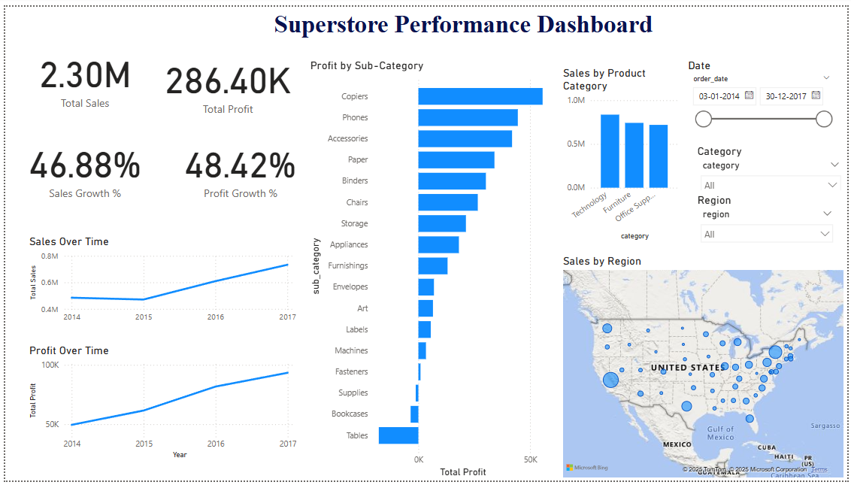
Superstore Sales & Profit Performance Dashboard
Provides an "at-a-glance" view of key business performance.
Designed for interactive exploration.
Focuses on sales, profit, and their trends over time and across different business dimensions.

Slide 5
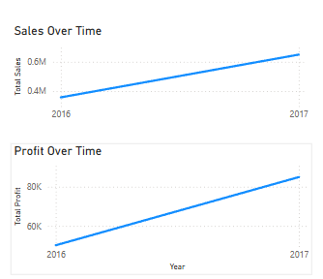
Sales & Profit Trend Analysis
Steady Growth in Sales and Profit (2016–2017) : "Overall Sales have shown a consistent upward trend from 2016 to 2017.“
Notable Surge in Sales and Profit in 2017: "A significant surge in sales and profit was observed in 2017, likely driven by strong demand.“
Sales Growth Outpaces Profit Growth: "While sales generally grew, profitability did not grow at the same rate, indicating potential increases in costs or other factors affecting margins.“
Positive Momentum in Key Performance Indicators: "The Sales Growth % and Profit Growth % KPIs indicate positive momentum compared to the previous period."

Slide 6
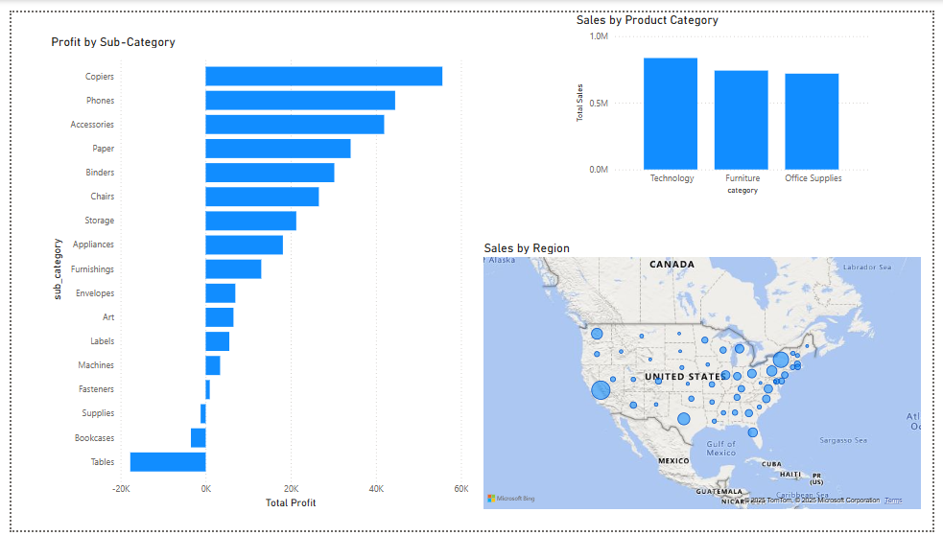
Performance by Category, Region, and Sub-Category
Technology Category Leads in Sales Volume: "The Technology category consistently leads in Total Sales, while Office Supplies contributes the least volume among the three categories."
High Sales Concentration in Eastern and Coastal U.S.: "The eastern and coastal regions of the U.S. generate the highest Total Sales, highlighting their market dominance compared to central and western areas.“
Profit Concentration in a Few Key Sub-Categories: "While Copiers is highly profitable, certain sub-categories like Tables and Bookcases are consistently running at a loss or with very low profit margins."

Slide 7
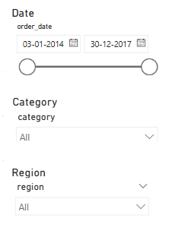
Interactive Exploration for Stakeholders
"The dashboard is fully interactive, allowing users to dynamically filter data by Order Date (Year, Quarter, Month), Product Category, for Stakeholders and Region."
"This enables stakeholders to drill down into specific periods or segments to gain tailored insights."
"All visuals update in real-time based on selected filters, enhancing the user experience."

