Slide 1

Conversation Channels
by Rama Menda

Slide 2
Agenda Conversational Channels
Overview
Technology Options
Amazon Alexa
Google Assistant

Slide 3

Google Assistant Conversational Channels
Google Voice Kit
Micro Phone
Speaker
Raspberry Pi
Google Voice Kit
Voice recognition HAT
How it works ?
Google Cloud Platform
Demo Link (Download & Play)
Voice Kit SD Image
Python
Google Assistant Libraries
Google Cloud Platform’s
Google Assistant API’s
Credentials
Google Assistant API
Voice to Text Conversion | Process Request | Text to Voice

Slide 4
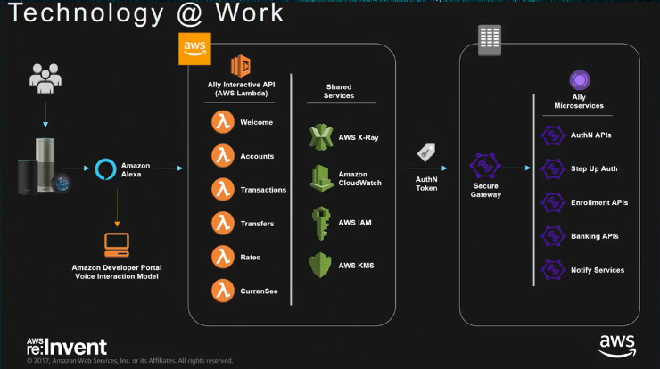
Amazon Alexa Conversational Channels
Ally Bank’s Conversational Channel architecture
Note : Complete recording : https://www.youtube.com/watch?v=9Q4u7qQBSgA
Draft

Slide 5
Reference Documents Conversation Channels
# | Document | Link
1 | Google Voice Kit Overview | https://aiyprojects.withgoogle.com/voice/#project-overview
2 | AWS re:Invent 2017: Ally Bank & Cognizant: Transforming Customer Experience Using Amazon Alexa | https://www.youtube.com/watch?v=9Q4u7qQBSgA
3
4

