Slide 1
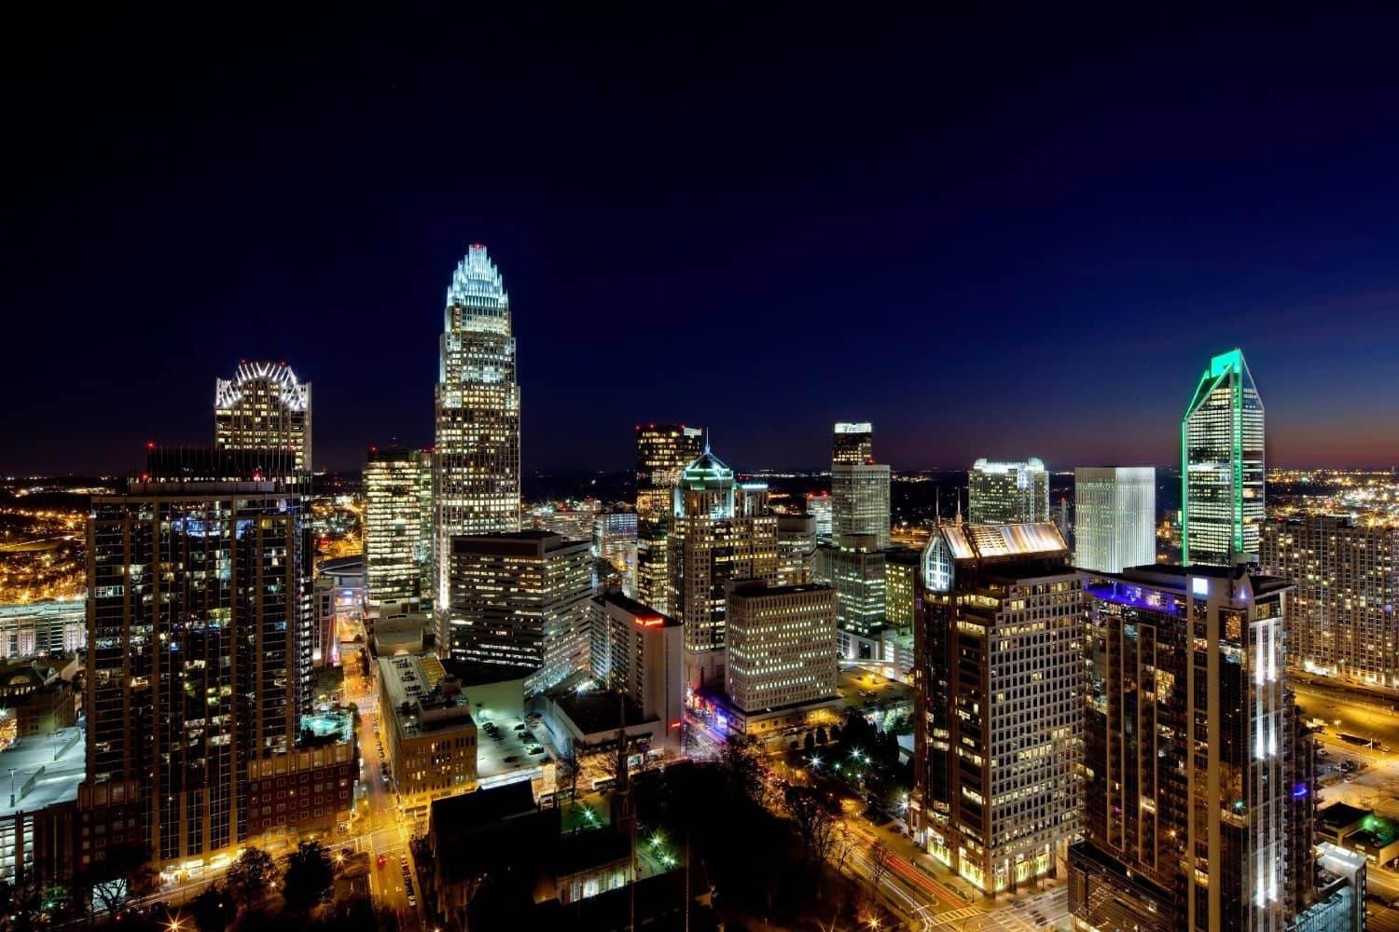
Virtualization Microservices – Part 2/4
By Rama Menda

Slide 2
Topics
Changing Server technology
Virtual Machines
Containers (History)
Building Containers
Questions ?
Docker Container ecosystem

Slide 3
Changing Server Technology…
Application 1
Application 2
Application 1
Application 2
Bins/Libs
Bins/Libs
App 1
App 2
App 3
Job
Job Queue
Application 3
Application 4
Guest OS
Guest OS
Job 1
Job Scheduler
J5
J4
J3
J2
J1
Bins/Libs
Bins/Libs
Bins/Libs
Job
Application 5
Application 6
CPU| RAM |HD |N/W
CPU| RAM |HD |N/W
Bins/Libs
Bins/Libs
Bins/Libs
Bins/Libs
Uses shared resources
Host Operating System
Bins/Libs
Bins/Libs
Hypervisor
Container Engine
Host Operating System
Physical Server
CPU
RAM
HD
N/W
Host Operating System
Host Operating System
Host Operating System
Host Operating System
Physical Server
CPU
RAM
HD
N/W
Physical Server
Physical Server
Physical Server
Physical Server
CPU
RAM
HD
N/W
CPU
RAM
HD
N/W
CPU
RAM
HD
N/W
CPU
RAM
HD
N/W
Mainframe Systems
Standalone Servers
Virtual Machines
Containers
????
~1960
~1998
~2013
Virtual Machine is a tightly isolated software container with an operating system and applications inside. Each VM’s guest OS may be different then the Host OS.
Container is a lightweight, stand-alone, executable package of a software that includes everything needed to run it, runtime, system tools , system libraries , settings.
Characteristics
Jobs are scheduled and executed as a batch
Characteristics
Reduced Server Costs compared to Mainframe.
Compatible application deployment on one Physical server
Characteristics
Hardware level virtualization
Improved provisioning
Scalable
Fully Isolated
Higher resource utilization
Characteristics
OS level virtualization
Lightweight
Real-time provisioning
Scalable
Bare-metal performance
Process level isolation

Slide 4
Why Containers ?
Readiness to support Business as a Service
Cost effective
Business
Highly Available System
Agility
Containers
Package Once
Deploy Anywhere
Development
Operations
Dynamic Scaling
Reduced deployment time
Dynamic Scaling
Operational Efficiency
Dynamic Scaling

Slide 5
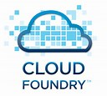
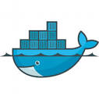









Containers are not new …!
Warden is re-implemented in GO and named as Garden to support multiple back ends. e.g. Linux, runC, Windows
Process isolation using kernel cgroups and namespaces, combined with tools to build and retrieve named images (runC)
It is an OS level virtualization technology for Linux. Allows a physical server to run multiple isolated OS instances, called containers.
Industry standard Open Container Initiative by 20+ organizations Docker , CoreOS , Google, Linux, redhat etc..
It is a CoreOS reference implementation of app container (appc) specification.
Partition system resources (file systems, network addresses, memory)
chroot system call
provides Process Isolation.
Google renamed Process Containers to Control Groups and merged to
Linux kernel 2.6.24
OCI Release 1.0
Unix V7
Warden
Docker
Rocket
1979
2000
2001
2004
2005
2006
2007
2008
2011
2013
2014
2015
2016
2017
Free BSD Jails
Solaris Containers
Process Containers
(AKA Control Groups)
Linux Containers
LMCTFY
Windows
Containers
Let Me Contain That For You, is the open source container stack, aims to provide guaranteed performance, high resource utilization, shared resources, over-commitment, and near zero overhead. In 2015 it was merged into libcontainer, which is now part of OCI
It is an OS level virtualization technology for x86 and SPARC systems. It combines system resource controls and boundary separation provided by Zones.
LXC supports kernel's cgroups and namespaces to provide an isolated environment for applications.
To run Docker images natively
on windows servers
It allows admins to partition a FreeBSD computer system into several independent, smaller systems
- called “jails”
It limits, accounts and isolates resource usage (CPU, memory, disk I/O, network, etc.) of processes

Slide 6
Containers – Market Analysis
Container Adaption
Gartner Quadrant Positioning

Slide 7
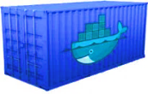




Docker - Components
Docker Client
Docker Engine
Docker Hub
(Public Registry)
Developer IDE
Containers
Downloaded
Images
Images
Application Code
Dependent
Libraries
Images
Repository
Dockerfile/ Docker-compose.yml
Docker REST API
Build Plug-ins
Maven-Spotify
Gradle
Docker CLI
Images
Repository
Docker Commands
docker build | pull | run | …
Docker daemon
Docker Compose
Orchestration Platform
Docker Swarm
Kubernetes
(or)

Slide 8
Docker - Image Vs Container
Docker Host
Container Registry
Writable Layer
Writable Layer
Writable Layer
Writable Layer
Writable Layer
Writable Layer
Image
Image Layer 2
Image Layer 1
Container
Container
Image Layer 4
Image Layer 5
Image
Image Layer 4
Image Layer 2
Image Layer 3
Image Layer 2
Image Layer 1
Image Layer 1
Image Layer 1
Image
Image Layer
Local Repository
Image Layer 4
Image Layer 2
Image Layer 1
Image Layer3
Image Layer 2
Image Layer 4
Image Layer 5
Image Layer 6
Image Layer 1
Image Layer 7
Image Layer 8
Image Layer 9

Slide 9
Docker – Application data management
Writable Container Layer
By default all files created inside a container are stored on a writable container layer.
The data doesn’t persist when that container is no longer running, and it can be difficult to get the data out of the container if another process needs it.
Writing into a container’s writable layer requires a storage driver to manage the filesystem. The storage driver provides a union filesystem, using the Linux kernel.
This extra abstraction reduces performance as compared to using data volumes, which write directly to the host filesystem.
2. Data Volume
Volumes are stored in a part of the host filesystem which is managed by Docker (/var/lib/docker/volumes/ on Linux). Non-Docker processes should not modify this part of the filesystem. Volumes are the best way to persist data in Docker.
3. Bind Mounts
Bind mounts may be stored anywhere on the host system.
Non-Docker processes on the Docker host or a Docker container can modify them at any time.
Container
Writable Layer
1
Docker
Host Operating System
4. tmpfs mount
tmpfs mounts: A tmpfs mount is not persisted on disk, either on the Docker host or within a container. It can be used by a container during the lifetime of the container, to store non-persistent state or sensitive information. For instance, internally, swarm services use tmpfs mounts to mount secrets into a service’s containers.
Host Resources
Memory
Host Filesystem
Docker Area
4
3
2
CPU
N/W

Slide 10
Docker - Communication
How one container communicates to another ?
How Host communicates to one container ?
How containers are connected to outside HOSTs ?
How are the IP addresses are generated ?
Risks ?

Slide 11
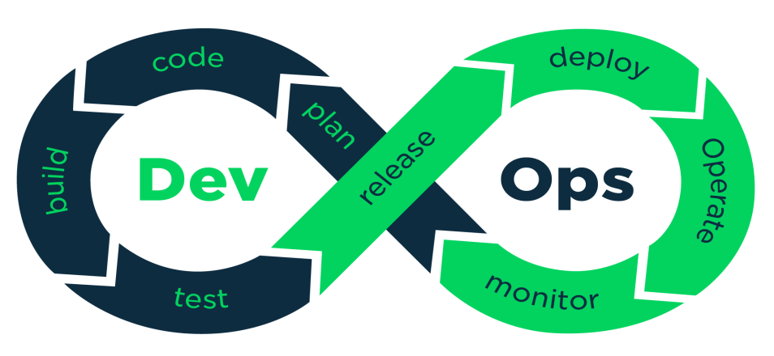
Docker Containers – DevOps tools
Docker Client +
IDE (e.g eclipse)
Docker Plug-ins
Maven Spotify
Gradle Plug-in
Container Repository
Artifactory
Container Orchestrator
Kubernetes
Docker Swarm

Slide 12
Virtual Machines VS Containers
This is to cover
How they share Memory
How they differ deployment units
How they share Underlying resources

Slide 13

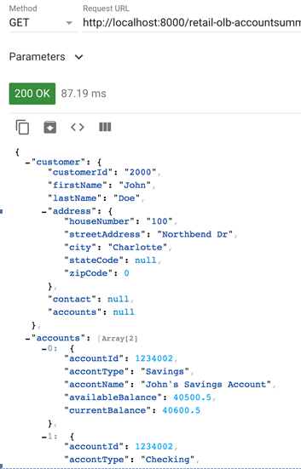

Use Case – Customer’s Accounts Summary
Use case : Banking customer can have more than one account. After successful authentication, system should load the accounts summary page containing Customer information and list of accounts and their balances. Note : Ignored Authentication/Authorization for simplicity.
AccountsSummary microservice (endpoint : AccountsSummary?custId=2000 method: GET)
Customer microservice(endpoint : customers/2000 method: GET )
CustomerAccount microservice (endpoint : customers/2000/accounts/ method : GET)
AccountsSummary : 7000
CustomerAccount : 9020
Service instances & other common platform services
Customer : 9010
AccountsSummary : 7002
CustomerAccount : 9022
Spring Hystrix
Sleuth
Sleuth
Customer : 9012
Sleuth
Spring Hystrix
Sleuth
Sleuth
Sleuth
Zuul (Port : 8000) .
Hystrix Dashboard
(Port: 8030)
Turbine
(Port : 8040)
Zipkin Dashboard
(Port : 9411)
Ribbon
Client
Eureka Server (Port:8761)
Spring Config
(Port : 8020)
AccountsSummary service response:

Slide 14
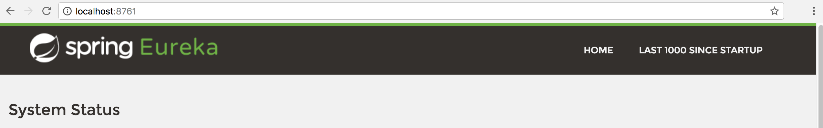
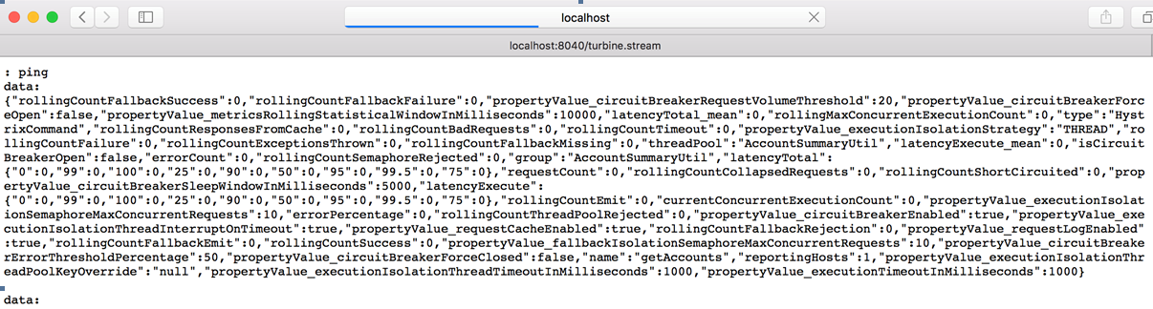
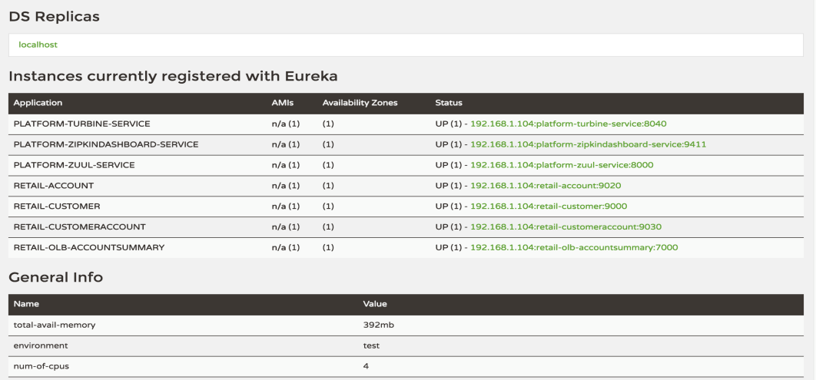
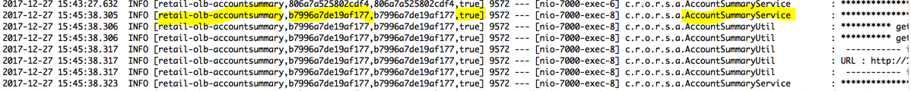
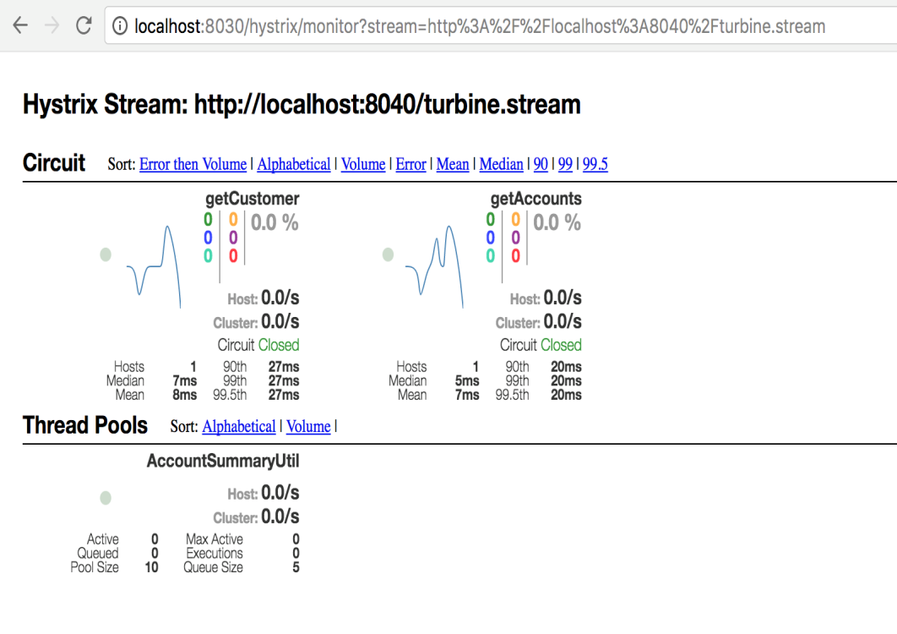
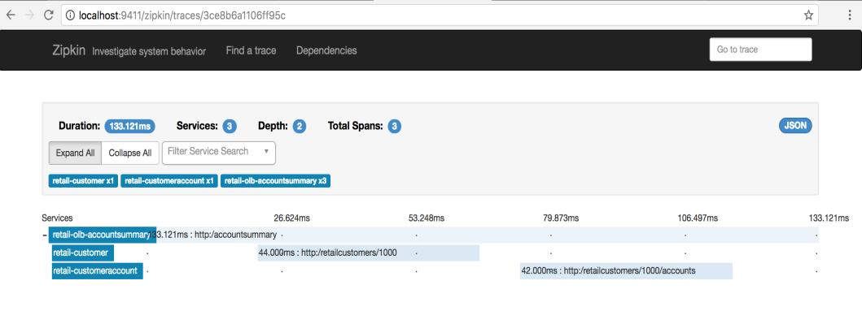
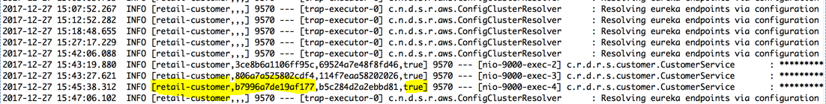
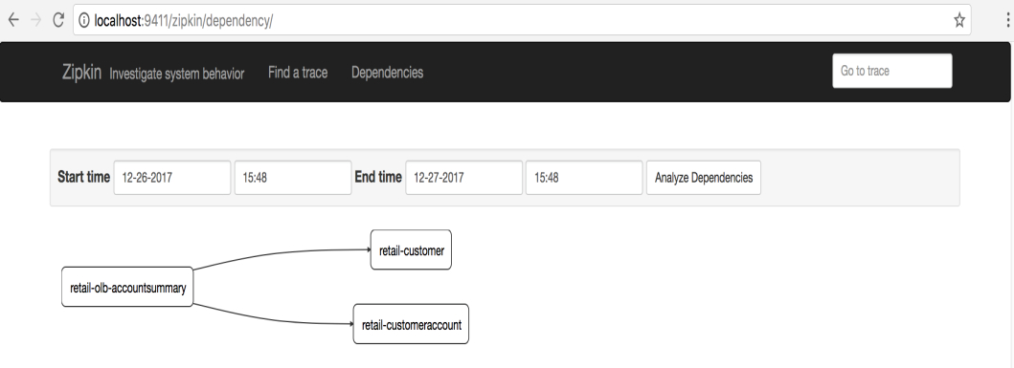
Usecase – Customer’s Accounts Summary … continued
Service Request Trace (Spring Cloud Sleuth)
Propagated Trace Id to the called service
4/28/2018
14
4/28/2018

Slide 15
Questions and Next steps
# | Question | By | Clarification
1
2
3
Next Steps Container Orchestration Tools ( Docker Swarm / Kubernetes / Mesos) DevOps CI/CD pipeline for Containers and Virtual Machines
?

Slide 16
Appendix

Slide 17
Docker Containers – Create | Publish | Use | Remove

Slide 18
Virtual Machine
Virtualization is the technology that helps in creating virtual resources such as a server , desktop, operating system, file storage or network.
Virtual Machine ??
Benefits
Virtual Machine 1
Virtual Machine 2
Virtual Machines
App1
APP2
App3
APP4
Bins/Libs
Bins/Libs
Bins/Libs
Bins/Libs
Guest Operating System
Guest Operating System
CPU
RAM
HD
N/W
CPU
RAM
HD
N/W
Hypervisor
Host Operating System
Physical Server
CPU
RAM
HD
N/W

Slide 19
Reference Documents Virtualization
# | Document | Notes
1
2
3
4
5
6
7
4/28/2018
By Rama Menda

Slide 20
Backup

Slide 21
Changing Server technology…
Job Queue
Application 1
Application 2
Job
Job Scheduler
Bins/Libs
Bins/Libs
Job 1
J5
J4
J3
J2
J1
Job
Guest OS
Guest OS
Uses shared resources
CPU| RAM |HD |N/W
CPU| RAM |HD |N/W
Host Operating System
Hypervisor
Physical Server
Host Operating System
CPU
RAM
HD
N/W
Physical Server
CPU
RAM
HD
N/W
????
~1960
~1966
~2013
Mainframe System
Standalone Servers
Virtual Machines
Containers
Application 1
Application 2
App2
App3
App4
Application 3
Application 4
Bins/Libs
Bins/Libs
Bins/Libs
Bins/Libs
Bins/Libs
Application 5
Application 6
Bins/Libs
Bins/Libs
Host Operating System
Bins/Libs
Bins/Libs
Container Engine
Host Operating System
Physical Server
CPU
RAM
HD
N/W
Host Operating System
Host Operating System
Physical Server
CPU
RAM
HD
N/W
Physical Server
Physical Server
CPU
RAM
HD
N/W
CPU
RAM
HD
N/W

Slide 22
Changing Server technology…
Virtual Machines
Mainframe System
Virtual Machine 1
Virtual Machine 2
Job Definitions
Job Queue
App1
APP2
App3
APP4
Job Definitions
J5
J4
J3
J2
J1
Bins/Libs
Bins/Libs
Bins/Libs
Bins/Libs
Job Definitions
Job Scheduler
Job Definitions
Guest Operating System
Guest Operating System
Uses shared resources
CPU
RAM
HD
N/W
CPU
RAM
HD
N/W
Operating System
Hypervisor
Physical Server
Host Operating System
CPU
RAM
HD
N/W
Physical Server
CPU
RAM
HD
N/W
Standalone Servers
Containers
App 5
Application 6
Images
Application 3
Application 4
App1
App2
App3
App4
Bins/Libs
Bins/Libs
Application 1
Application 2
Bins/Libs
Bins/Libs
Bins/Libs
Bins/Libs
Bins/Libs
Bins/Libs
Operating System
Bins/Libs
Bins/Libs
Operating System
Container Engine
Physical Server
CPU
RAM
HD
N/W
Operating System
Physical Server
Host Operating System
CPU
RAM
HD
N/W
Physical Server
CPU
RAM
HD
N/W
Physical Server
CPU
RAM
HD
N/W

Slide 23
Virtualization
Virtualization is the technology that helps in creating virtual resources such as a server , desktop, operating system, file storage or network.
Mainframe System
Virtual Machines
App1
APP2
App3
APP4
Job Definitions
Bins/Libs
Bins/Libs
Bins/Libs
Bins/Libs
Job Definitions
Job Scheduler
J5
J4
J3
J2
J1
Job Definitions
Guest Operating System
Guest Operating System
Job Definitions
Jobs in Queue uses
Shared the resources
CPU
RAM
HD
N/W
CPU
RAM
HD
N/W
Operating System
Hypervisor
Host Operating System
Physical Server
Physical Server
CPU
RAM
HD
N/W
CPU
RAM
HD
N/W
Desktop Systems
Containers
App 5
Application 6
Application 3
Application 4
App1
App2
App3
App4
Bins/Libs
Bins/Libs
Bins/Libs
Application 1
Bins/Libs
Application 2
Bins/Libs
Bins/Libs
Bins/Libs
Bins/Libs
Operating System
Bins/Libs
Bins/Libs
Container Engine
Operating System
Physical Server
CPU
RAM
HD
N/W
Operating System
Host Operating System
Physical Server
CPU
RAM
HD
N/W
Physical Server
Physical Server
CPU
RAM
HD
N/W
CPU
RAM
HD
N/W

Slide 24
Virtualization
Virtualization is the technology that helps in creating virtual resources such as a server , desktop, operating system, file storage or network.
Mainframe
Application 5
Application 6
Desktop Systems
Job Definitions
Application 3
Application 4
Job Definitions
J5
J4
J3
J2
J1
Bins/Libs
Bins/Libs
Job Definitions
Job Scheduler
Bins/Libs
Application 1
Bins/Libs
Application 2
Job Definitions
Operating System
Jobs in Queue uses
Shared the resources
Bins/Libs
Bins/Libs
Operating System
Physical Server
CPU
RAM
HD
N/W
Operating System
Operating System
Physical Server
CPU
RAM
HD
N/W
Physical Server
Physical Server
CPU
RAM
HD
N/W
CPU
RAM
HD
N/W
Virtual Machines
Containers
App1
APP2
App3
APP4
App1
App2
App3
App4
Bins/Libs
Bins/Libs
Bins/Libs
Bins/Libs
Bins/Libs
Bins/Libs
Bins/Libs
Bins/Libs
Guest Operating System
Guest Operating System
CPU
RAM
HD
N/W
CPU
RAM
HD
N/W
Container Engine
Hypervisor
Host Operating System
Host Operating System
Physical Server
Physical Server
CPU
RAM
HD
N/W
CPU
RAM
HD
N/W

Slide 25


Containerization – Development Lifecycle Impacts

Slide 26
Why Containers
Containers

Slide 27
Docker - Components
Docker Client
Docker Host
Docker Hub
(Public Registry)
Developer IDE
Containers
Images
Application Code
Dependent
Libraries
Images
Repository
Dockerfile/ Docker-compose.yml
Build Plug-ins
Docker REST API
Maven-Spotify
Gradle
Docker daemon
Images
Repository
Docker CLI
Docker Commands
docker build
docker pull
docker run
Docker
Compose
Docker
Swarm
Docker Image :
Docker Container :
Docker Compose
Docker Hub:
Dockerfile :
Other Supported Platforms
Kubernetes
Other Supported registries
Artifactory

Slide 28
Docker - Components
Docker Client
Docker Host
Docker Hub
(Public Registry)
Developer IDE
Containers
Images
Application Code
Dependent
Libraries
Images
Repository
Dockerfile/ Docker-compose.yml
Build Plug-ins
Docker REST API
Maven-Spotify
Gradle
Docker daemon
Images
Repository
Docker CLI
Docker Commands
docker build
docker pull
docker run
Docker
Compose
Docker
Swarm
Docker Image :
Docker Container :
Docker Compose
Docker Hub:
Dockerfile :
Other Supported Platforms
Kubernetes
Other Supported registries
Artifactory

