Slide 1

Evolution of Conversational Banking
By Rama Menda
Version : 1.0

Slide 2
Topics
Artificial Intelligence and Key subject areas
Use cases
Questions ?
Evolving banking customer experience
Image/Video Services
Natural Language Processing

Slide 3
Artificial Intelligence and Key subject areas
Artificial Intelligence An area of computer science that emphasizes the creation of intelligent machines that work and react like humans. Activities include Speech recognition , Learning, Planning, Problem solving etc.
Machine learning Field of study that gives computers the ability to learn without being explicitly programmed. – By Arthur Samuel
A computer program is said to learn from experience E with respect to some class of tasks T and performance measure P, if its performance at tasks in T, as measured by P, improves with experience E.
--By Tom Mitchell
Deep learning Deep learning is a specific approach used for building and training neural networks, which are considered highly promising decision-making nodes. An algorithm is considered to be deep if the input data is passed through a series of nonlinearities or nonlinear transformations before it becomes output.
Natural Language Processing An area of computer science and Artificial Intelligence that helps computers understand interpret and manipulate human language.
AI
Machine Learning
Deep Learning
Key Subject Areas
Image / Video Analysis
Deep learning based image analysis
Deep learning based video analysis
Natural Language Processing
Discover insights and relationships in text
Text Translation , Text <> Speech conversion
Automatic speech recognition

Slide 4
Natural Language Processing
Natural Language Processing Is a branch of Artificial Intelligence that helps computers understand interpret and manipulate human language. NLP draws from many disciplines, including computer science and computations linguistics, in its pursuit to fill the gap between human communication and computer understanding.
Key capabilities
Speech to Text
Automatic speech recognition service(ASR) uses Deep learning to convert speech into accurate, grammatically correct text.
Text to Speech
Uses advanced Deep learning technologies to synthesize speech that sounds like a human voice.
Text to Text
Translate text in one language to another language.
Text Analysis
Uses Natural Language Processing(NLP) to find insights and relationships in text such as Entities (People , places, dates, brands, quantities) , Key Phrases , Language and Sentiments(Positive/Negative feelings)
Amazon Transcribe
Microsoft Cognitive Services–Bing Speech
IBM Watson – Speech to Text
Google – Cloud Speech API
Amazon Polly
Microsoft Cognitive Services–Bing Speech
IBM Watson –Text to Speech
Amazon Translate
Google – Cloud Translation API
IBM Watson –Language Translator Service
Microsoft Cognitive Services - Translator Text Speech
Amazon Comprehend
Microsoft Cognitive Services–Text Analytics
IBM Watson – Discovery Service

Slide 5
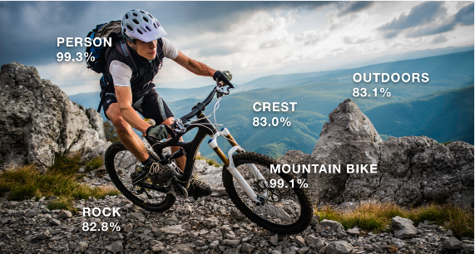
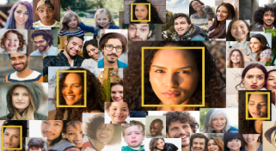


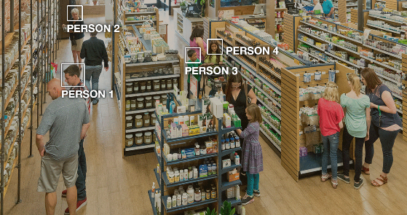
Image / Video Services
Image/Video Analysis
Capability to analyze image (or) video to identify the objects, people, text, scenes and activities, as well as detect any unsafe content. Analyze the face attributes such as happiness, age range, eyes open, glasses, facial hair, etc.
Key capabilities
Identification
Identify objects (e.g. bike, telephone, building etc.)
Facial Recognition &
Facial Analysis
Identify a person in a photo or video
Unsafe content
detection
Identify potentially unsafe or inappropriate content
Person tracking
Ability to track people when they go in and out of the scene and their movements in the frame to tell things like whether someone was entering or exiting a building.
Analyze the face attributes such as happiness, age range, eyes open, glasses, facial hair, etc.
Available tools
Amazon Rekognition API
IBM Watson Visual Recognition API
Google – Cloud Vision API
Microsoft Cognitive Services - Face API

Slide 6
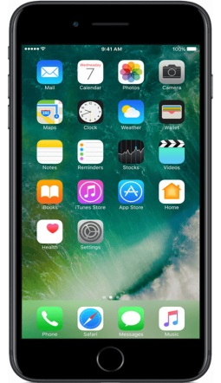


Evolving Banking Customer experience
Banking Center
~1400
ATM
1967
Online Banking
1999
Conversational Banking
2017
1980
Telephone Banking
2012
Mobile Banking
Conversational Banking ?
Chatbot
Fulfillment Services
(via Gateway)
@ I would like to know my account balance
@ Please let me know my account balance
@List my recent transactions
@ Show my recent transactions
@ Transfer money
@ Transfer Cash
SORs
Utterances
Text/Speech
BPMS
Intents
Balance Inquiry
Recent transactions
Money Movement
Account#
Account#
From Acct#
To Acct#
Amount
Services
Slots & Prompts
Intents : An action user wants to perform
Utterances : How a user might convey the intent.
Slots : Input parameters to fulfill the intent
Prompts : Questions to be asked to the uses for each of the required Slots
Response Cards : List of options for each prompt to be shared with the user

Slide 7
Use Case – Conversational Channel (Using Amazon Lex)
Use case : Customer can have more than one bank account. After successful authentication, conversation channel should be able to support the following.
Getting Account Balance
Listing recent transactions
Money Movement
Note : Ignored Authentication/Authorization for simplicity and assume existing services to perform the above business functions.
Amazon Lex
AWS Lambda
API Gateway
Domain
Services
Speech > Text
(or) Text
F What is my Balance
F Please let me know my Balance
F List my recent transactions
F Show my recent transactions
F Transfer money
F Transfer Cash
Get Accounts
Utterances
Get Recent Transactions
Intents
Balance Inquiry
Recent transactions
Money Movement
Speech < Text
(or) Text
C Account#
C Account#
C From Acct#
C To Acct#
C Amount
Money Movement
Slots & Prompts
Amazon Lex: An AWS service for building conversational interfaces for applications using voice and text
AWS Lambda: It is an event-driven, server-less computing platform which runs the code in response to events and automatically manages the computer resources required by the code
API Gateway: A facade to consume domain services to orchestrate and abstract the underlying complexity
Domain Services: Grouped Business Services into various domains and sub-domains.
How to develop Amazon Lex Bot ?
Amazon Lex console (or)
AWS Model Building API
(Through CLI or Custom Programs)
Where to develop ?
Amazon AWS
How to test ?
Amazon Test Chatbot utility
Channels ( Facebook Messenger , Kik, Slack and Twilio SMS)
Amazon CLI

Slide 8
Use Case – Conversational Channel (Using Amazon Lex) … continued
Domain Services
Customer Account microservice (endpoint : customers/2000/accounts method=GET)
Transactions microservice (endpoint : transactions?accounted=1234001 method=GET)
Money Movement microservice (endpoint : moneymovement/ method POST , message format=JSON)
Note : Ignored Authentication/Authorization for simplicity and assume existing services to perform the above business functions.
TODO : Add Screen Shots
5/21/2018

Slide 9
Appendix

Slide 10
Key Players / Product Spectrum
 |  | Image/Video Services | Language Services
Amazon |  | Amazon Rekongnition | Amazon Polly Amazon Comprehend Amazon Translate Amazon Transcribe
Microsoft |  | Cognitive services - Face API
Google |  | Cloud Vision API Cloud Video Intelligence | Cloud Speech API Cloud Translation API
IBM |  | IBM Watson Visual Recognition API | Watson Conversation Service
Apple |  |  | Apple Siri
Facebook |  | Facebook Messenger platform
Others | Machine Box https://machinebox.io/ | Facebox Videobox, Tagbox etc. | Textbox, Fakebox etc

Slide 11
Use cases
Use Case | Description | By Whom
Conversational Channels (Chatbots) | Reduces the response time to customers and increases the accuracy to 100 percent thereby sharply improving the bank’s productivity and efficiency. | Capital One Ally Bank - Alexa Bank of America – Erika
Customer Satisfaction Dashboard | Scans cameras installed in the branch and captures the facial expressions of the customers to determine if the customer is happy or not and consolidated data in dashboard gauges the effectiveness of representatives or tellers | State Bank Of India
AML Pattern Detection | Most of the major banks across the globe are shifting from rule based software systems to artificial intelligence based systems which are more robust and intelligent to the anti-money laundering patterns
Algorithmic trading | artificial intelligence models which learn by taking input from several sources of variation in financial markets and sentiments about the entity to make investment decisions on the fly. | Winton Capital Management Ketchum Trading

Slide 12
Reference Documents
# | Document
1 | Banks are embracing the power of conversational banking | By Accenture
2 | FinTech Tends Report 2017 | By Pwc
3 | AI applications in Banking
4

