Slide 1

Microservices Spring Cloud Netflix ecosystem
By Rama Menda
Version : 1.0

Slide 2
Topics
Software Architecture Evolution
Current Limitations/Challenges
Micro services adaption
Example Use case
Questions ?
Spring Cloud Netflix ecosystem

Slide 3
Software Architecture Evolution ( Middleware/Services)
Standalone
Applications
Client-Server
Applications
N-tier
Applications
SOAP SOA
Applications
REST / API
Applications
(AKA Monolith)
Micro services
App Type
Before 1990
Since ~ 1990
Since ~ 1995
Since ~2005
Since ~ 2010
Since ~ 2015
Timeline
Avoids manual effort
Allows concurrent users
Reduce deployment costs
Re-usability
Friction less Integration
Agile delivery
Economical scaling
Benefits
Only one user can access the application
Inconsistent client versions
High deployment cost
Siloed Systems
Lack of re-use across systems
Complex Integration
Expensive Service changes as they bundled together
Expensive Service changes
Handling un-predictable load (Optimally)
Handling un-predictable load
(By making as a Cloud-Native)
Challenges

Slide 4

Monolith Application Limitations/Challenges
Monolith web application architecture
Application Server
Application Server
Web Server (Apache)
Application Server
Application Server
Databases
Online-Banking UI WAR
Customer Management UI
Account Management UI
Transactions UI
Transfers UI
Bill Pay UI
Rewards UI
Services WAR
Customer Services
Account Services
Transactions Services
Transfers Services
Bill Pay Services
Rewards Services
Challenges
Agility
Ability to re-factor to leverage modern methodologies/languages
Resiliency
Fault Isolation
Next Generation
Readiness
Ability to support un-expected volume (e.g. Banking as a Service partners)
Developer’s on-boarding, delivery efficiency and deployment time

Slide 5
Microservices adaption – Benefits / Challenges
Microservices web application architecture
Web Server (Apache)
Application Server
Application Server
Application Server
Databases
App Server
Application Server
Application Server
Cust DB
Cust UI services war
Customer Services war
Acct UI services war
Account Services war
Acct DB
Online -bank UI WAR
Customer & Account UI
Transactions & Transfers UI
Bill Pay & Rewards UI
Trans UI services
Transaction Services war
TXN DB
SPA
XFER DB
Transfers UI services war
Transfer Services war
Bill Pay UI services war
Bill Pay Services war
Bill Pay DB
Rewards UI services
Rewards Services war
Rewards DB
Benefits
Agility
Resiliency
Fault Isolation and the ability to re-factor to leverage modern methodologies/languages
Next Generation
Readiness
Ability to support un-expected volume by scaling only required services
Developer’s on-boarding, delivery efficiency and deployment time
Challenges
DevOps
Performance /
Consistency
Inter service communication impacts the overall request performance
Management of more number of services and their run-time instances.
Service’s health monitoring
Transactions span across multiple services

Slide 6


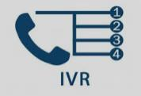


Microservices ecosystem
What is needed to address the challenges ?
Challenge |  | Solution
DevOps | Provision to register and discover the service instances | Service Registry
 | Centralized service configuration management across all environments | Service Configuration
 | Consolidated dashboard for service metrics | Service health Dashboard
 | Single entry point for service requests | API Gateway
 | Consolidated dashboard for service requests trace | Distributed Trace Dashboard
 | Mechanism to prevent cascading failure | Circuit Breaker
Performance/Consistency |  | Through Service Design Patterns
Anatomy of a microservice platform
UI Microservices
Domain Microservices
Databases
Databases
Databases
Circuit Breaker
Trace
Circuit Breaker
Trace
API Gateway
Service Health
Dashboard
Service Health
Aggregator
Request Trace
Dashboard
BPMS
Load
Balancer
Service Registry
Service
Configuration
Services

Slide 7
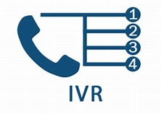

Spring Cloud Netflix ecosystem
UI Microservices
Domain Microservices
Databases
Databases
Databases
Spring Hystrix
Sleuth
Spring Hystrix
Sleuth
Zuul (API Gateway) .
Hystrix Dashboard
(Service Health
Dashboard)
Turbine
(Service Status
Aggregator)
Zipkin
(Request Trace Aggregator)
BPMS
Ribbon
Client
Eureka Server (Service Registry)
Spring Config
(Service Configuration)
Services
Spring Could Core Services
Zuul
Provides dynamic routing, monitoring , resiliency, security etc.
Balances the load with the help of Ribbon Client module
Eureka
Service registry
Config
support for externalized configuration in a distributed system
Hystrix
Stops cascading failures in a complex distributed system
Turbine
Aggregates multiple Hystrix metrics streams to provide the aggregated view
Hystrix
Dashboard
The Hystrix Dashboard displays the health of each circuit breaker.
Sleuth/Zipkin
Distributed service request tracing system
Fail fast and rapid recovery
Ribbon Client
It is a client side load balancer

Slide 8
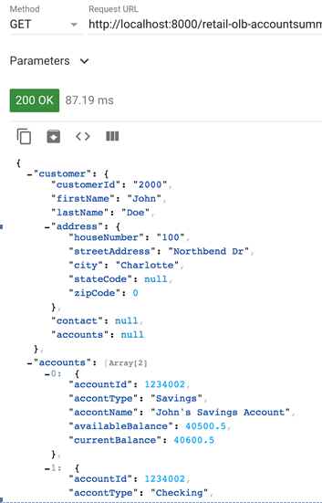
Use Case – Customer’s Accounts Summary
Use case : Banking customer can have more than one account. After successful authentication, system should load the accounts summary page containing Customer information and list of accounts and their balances. Note : Ignored Authentication/Authorization for simplicity.
AccountsSummary microservice (endpoint : AccountsSummary?custId=2000 method: GET)
Customer microservice(endpoint : customers/2000 method: GET )
CustomerAccount microservice (endpoint : customers/2000/accounts/ method : GET)
AccountsSummary : 7000
CustomerAccount : 9020
Service instances & other common platform services
Customer : 9010
AccountsSummary : 7002
CustomerAccount : 9022
Spring Hystrix
Sleuth
Sleuth
Customer : 9012
Sleuth
Spring Hystrix
Sleuth
Sleuth
Sleuth
Zuul (Port : 8000) .
Hystrix Dashboard
(Port: 8030)
Turbine
(Port : 8040)
Zipkin Dashboard
(Port : 9411)
Ribbon
Client
Eureka Server (Port:8761)
Spring Config
(Port : 8020)
AccountsSummary service response:

Slide 9
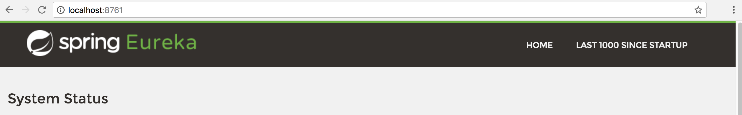
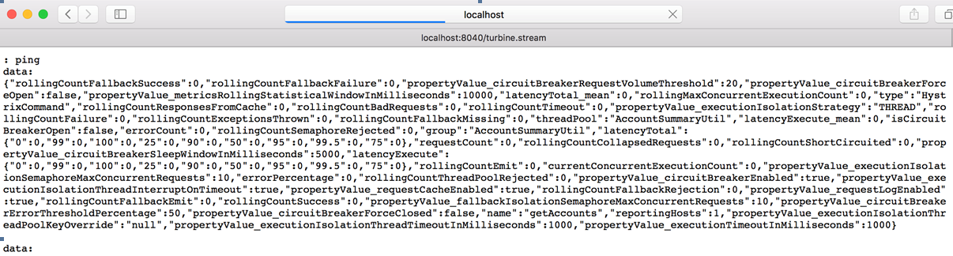
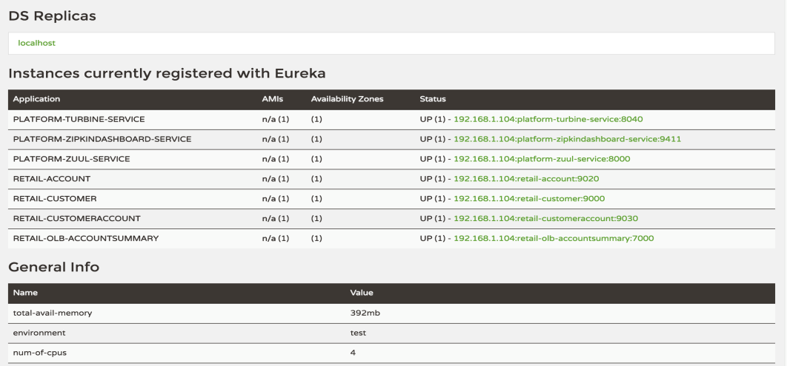
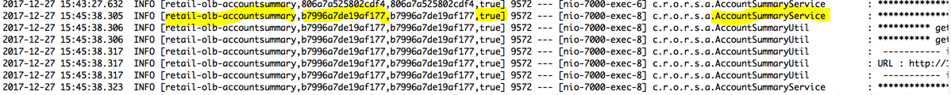
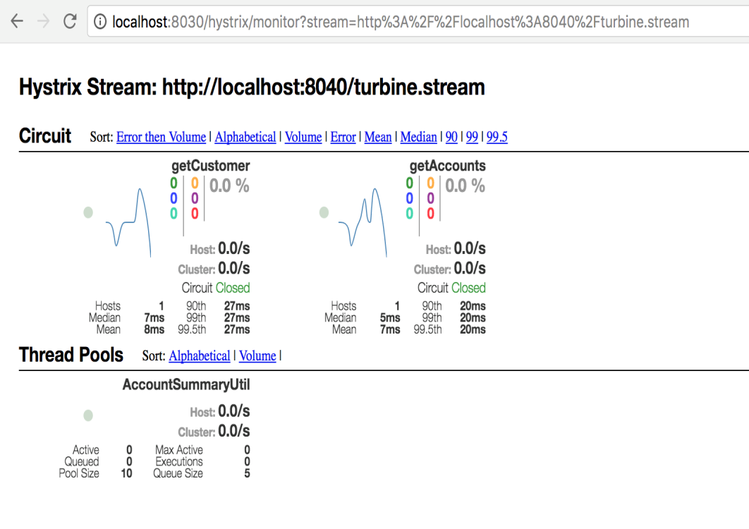
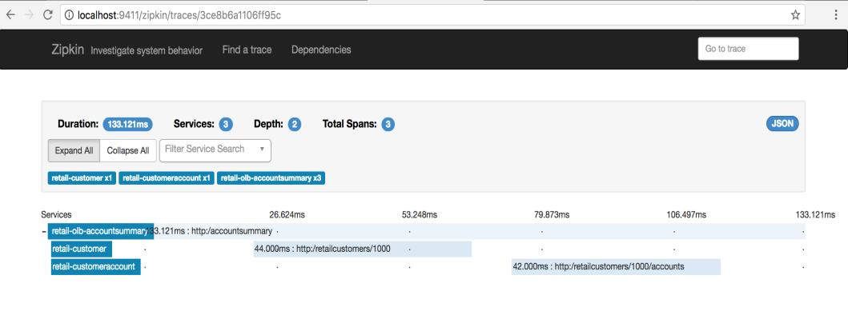
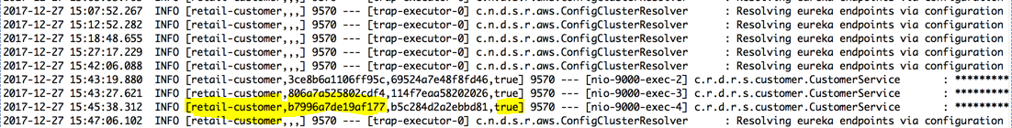
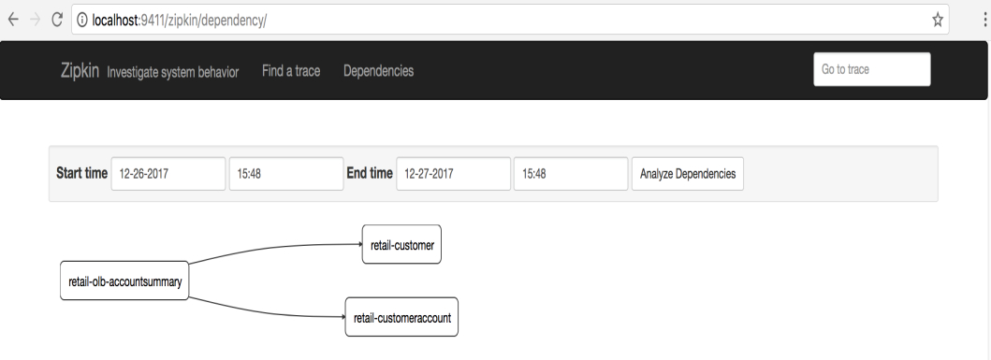
Usecase – Customer’s Accounts Summary … continued
Service Request Trace (Spring Cloud Sleuth)
Propagated Trace Id to the called service
5/21/2018
9
5/21/2018

Slide 10
Questions and Next steps
# | Question | By | Clarification
1
2
3
Next Steps Containers (Docker / rkt) & Virtual Machines Container Orchestration Tools ( Docker Swarm / Kubernetes / Mesos) DevOps CI/CD Pipeline for Containers and Virtual Machines
?

Slide 11
Appendix

Slide 12
Microservices - Options
Capability | Spring Cloud | Other Tools | Comment
API Gateway | Zuul
Service Registry | Eureka Server
Load Balancer | Ribbon Client
Circuit Breaker | Hystrix
Service Configuration Management | Config
Distributed trace dashboard | Sleuth / Zipkin
Service health dashboard | Hystrix Dashbaord / Turbine
Service instance as a Container |  | Docker
Container Management |  | Kubernetes

