Slide 1
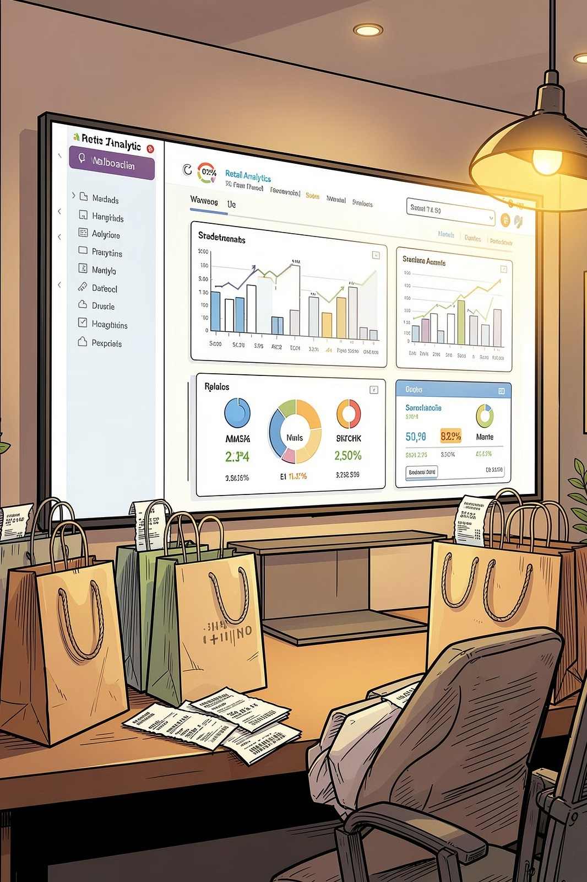


Customer Shopping Behavior Analysis
3,900 purchases across product categories — uncovering spending patterns, segments, and subscription behavior.

Slide 2
Inside the Data
DATASET OVERVIEW
3,900
Transactions
$59.76
Avg Purchase
Key Features
Customer demographics: Age, Gender, Location Purchase details: Category, Amount, Season, Size Shopping behavior: Discounts, Reviews, Shipping 37 missing values in Review Rating
18
Columns
3.75
Avg Rating

Slide 3
Python EDA Pipeline
METHODOLOGY
Load Data
Clean & Impute
Feature Engineer
Load to PostgreSQL
Imported with pandas, imputed missing Review Ratings by category median, standardized columns to snake case, engineered age groups, and dropped redundant promo_code_used.

Slide 4

Revenue by Gender
SQL INSIGHTS
Gender
Key Finding
Male customers generate 2.1x more revenue than female customers.
Female
75.2k
839 high-spending discount users identified — customers who applied discounts yet spent above the average purchase amount.
Male
158k
0
20k
40k
60k
80k 100k
Revenue (USD)
120k
140k
160k

Slide 5
Top-Rated & Discount-Dependent Products
SQL INSIGHTS
Top 5 by Rating |  |  | Highest Discount Rates
Product | Rating |  | Product | Discount %
Gloves | 3.86 |  | Hat | 50.00%
Sandals | 3.84 |  | Sneakers | 49.66%
Boots | 3.82 |  | Coat | 49.07%
Hat | 3.80 |  | Sweater | 48.17%
Skirt | 3.78 |  | Pants | 47.37%

Slide 6
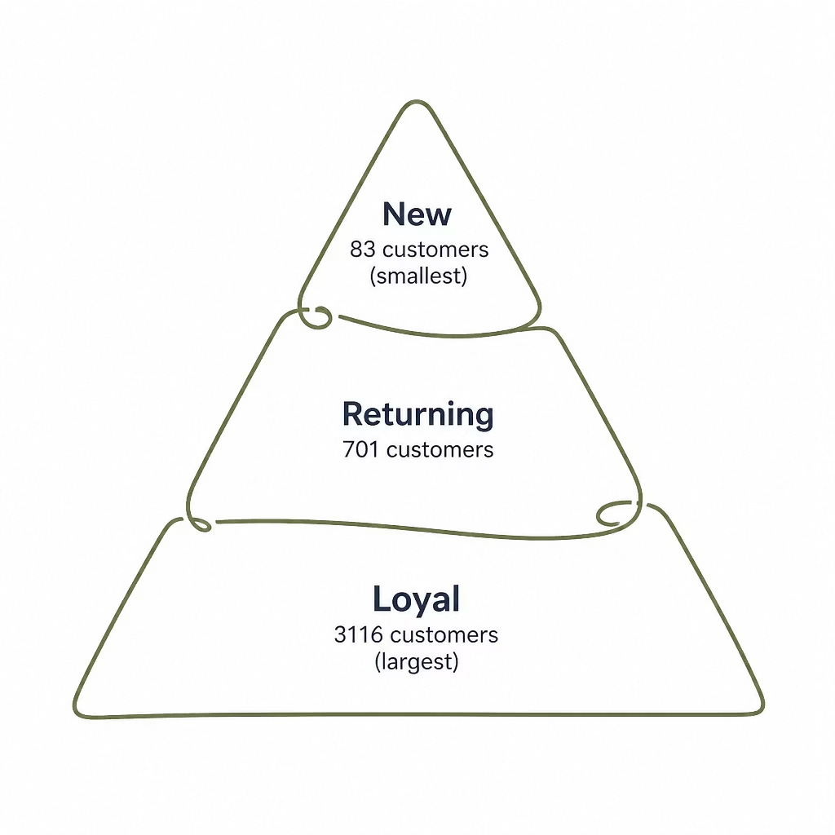
Customer Segmentation
SQL INSIGHTS
Segment Breakdown
Loyal: 3,116 customers
Returning: 701 customers
New: 83 customers
Repeat buyers with >5 purchases: 2,518 non-subscribers vs. 958 subscribers.

Slide 7

Revenue by Age Group
SQL INSIGHTS
Age Group
Shipping Comparison
Standard: $58.46 avg
Express: $60.48 avg
Young Adult
62.1k
59.2k
Express shipping users spend $2 more per purchase on average.
Middle-aged
Adult
56k
Senior
55.8k
0
10k
20k
30k 40k Revenue (USD)
50k
60k

Slide 8
Top Products per Category
SQL INSIGHTS
Accessories Jewelry · Sunglasses · Belt
Clothing
Blouse · Pants · Shirt
Footwear Sandals · Shoes · Sneakers
Outerwear
Jacket · Coat

Slide 9
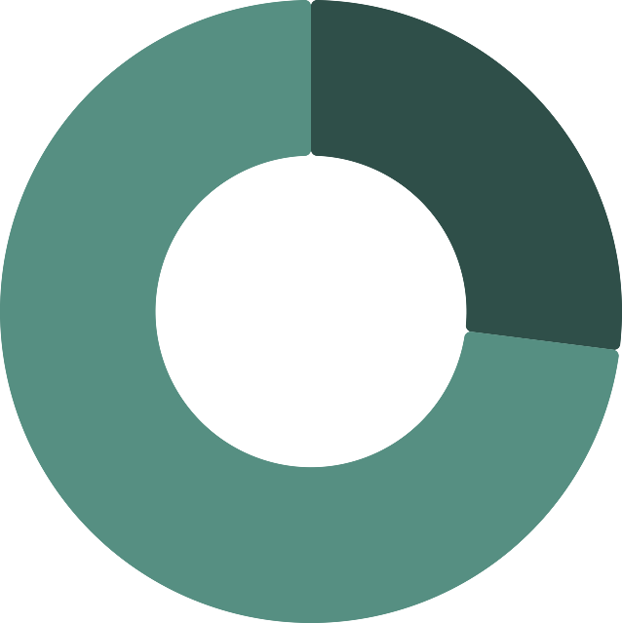
Subscription Status
POWER BI DASHBOARD
Subscriber Spend
Subscribers: 1,053 customers, $59.49 avg spend
Non-subscribers: 2,847 customers, $59.87 avg spend
27%
Subscription drives loyalty, not higher per-purchase spend.
Subscribed · 27%
Not Subscribed · 73%
73%

Slide 10
Strategic Actions
RECOMMENDATIONS
Boost Subscriptions Promote exclusive subscriber benefits.
Loyalty Programs
Reward repeat buyers to grow Loyal segment.
Review Discounts
Balance sales boosts with margin control.
Product Positioning Highlight top-rated and best-selling products.
Targeted Marketing
Focus on high-revenue age groups and express users.

