Slide 1

Banking analytics
Meet the team - (GROUP 6)
Ms. Dikshita Patil
Mr. Piyush Kumar
Mr. Raman Rar
Mr. Mujahid Rajahmed
Mr. Abhilash Thomas
Under the guidance of Mrs. Dipti Sinha

Slide 2

About:
Banking Analytics is one of the world's leading financial institutions, serving individuals, small- and middle-market businesses, large corporations, and governments with a full range of banking, investment management, and other financial and risk management products and services.
Department: Finance
Target Data: 2007-2011
Purpose: Funding
Objective:
The primary goal of this project is to analyze the seasonality of Financial data from 2007-2011 and create adequate plans to know the total loan amount recovered and give insights to company on how to increase their customer base and profit by pointing out problems encountered during our analysis.

Slide 3
Data Information
We have two datasets that are Finance 1 & Finance 2.
In Finance 1, there are 39,717 Rows and 24 Columns.
In Finance 2, there are 39,717 Rows and 25 Columns.

Slide 4
Data Processing:
1. Data Understanding: The key to success on any data project is a thorough understanding of the data. As a result, we took the time to learn about your company's data model and domain.
2. Data Cleaning: After learning about your company, we cleaned up the accessible datasets and considered what an ideal dataset for this topic would look like.
3. Data Modelling: After confirming that the data was clean for analysis, we needed to process and model it into a dataset capable of precisely answering the business questions and producing the required outcomes.
4. Data Analysis : We used our analytical capabilities to identify insights from our new dataset and to create visualizations to describe the insights
5. Uncover Insights:. Finally, we applied these insights to create business decisions and recommendations for next steps.

Slide 5
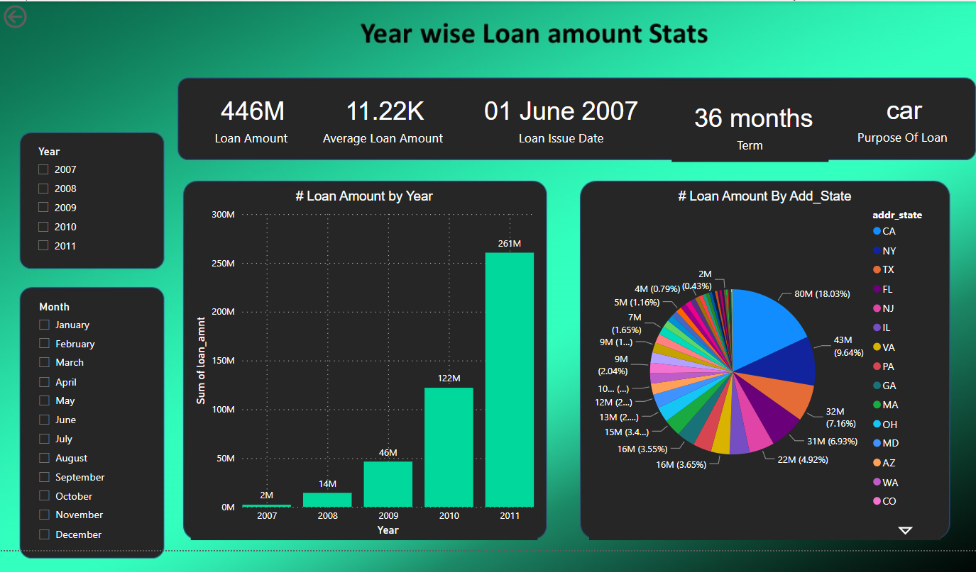
KPI-1 year wise loan amount stats.
Insights -
The total loan amount was increased by every year.
The state CA has occupied the majority of the loan amount 80M.
The state OK is occupied the least loan amount of 3M.

Slide 6
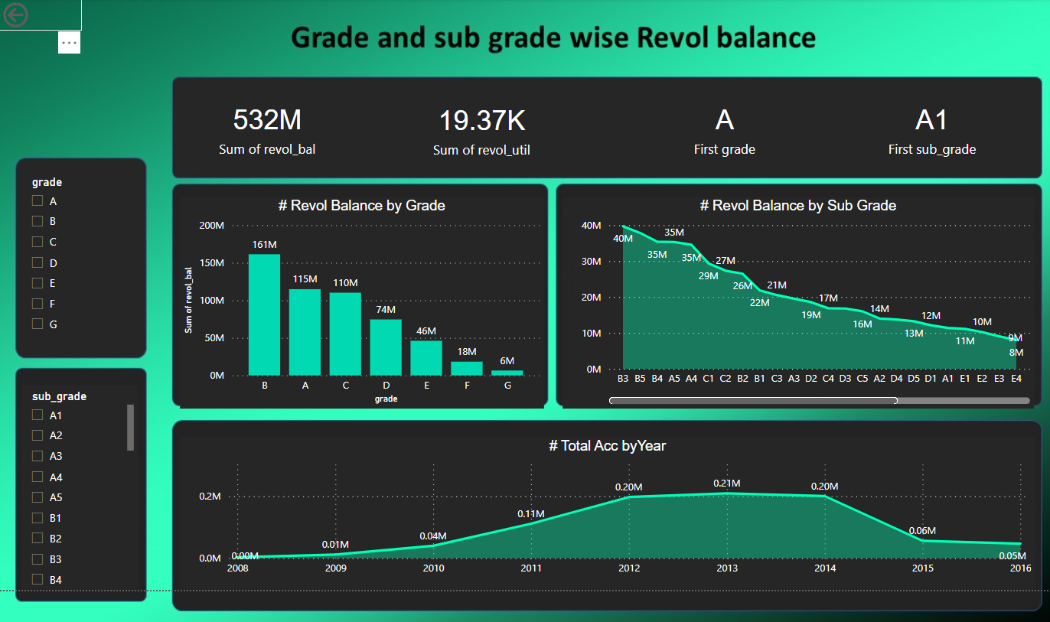
KPI-2 grade and sub grade wise revol balance.
Insights -
Grade B has more Revolving balance and Grade G has least Revolving balance.
Also annual income is high in B3 subcategory and less in G5 subcategory.

Slide 7
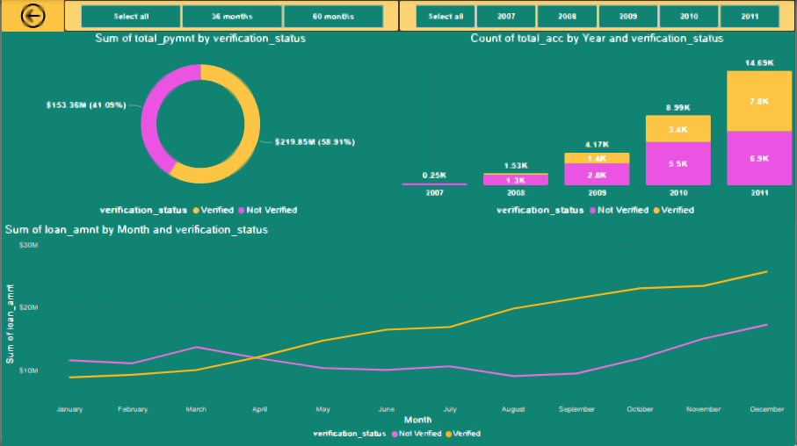
KPI-3 total payment for verified status vs non-verified status.
Insights -
Verified status open account count overtakes Non- Verified in year 2011.
Percentage of total payment for verified status is about 58.91% and in the case of non-verified status it is about 41.05%.
April is the month in which loan amt taken by verified customers overtakes Non Verified customers.

Slide 8
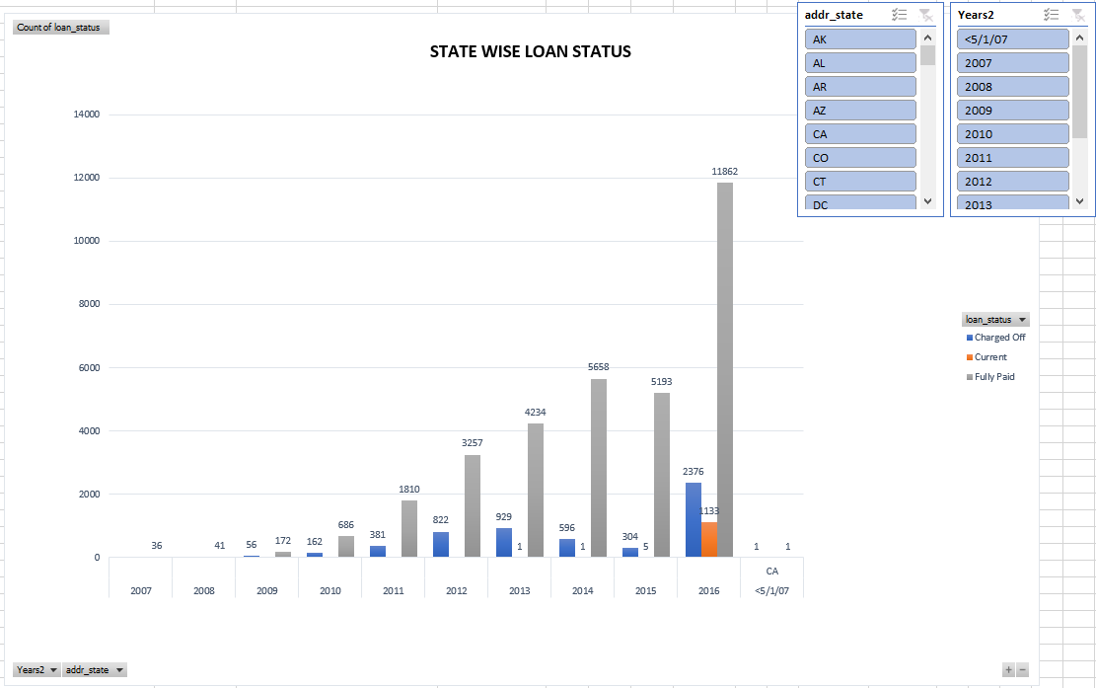
KPI-4 State wise and last credit pull d wise loan status.
Insights -
IN ,ME and IA states have mostly fully-paid status.
AK have more Average funded amount in the last Credit_pull_d. following with DC and NU

Slide 9
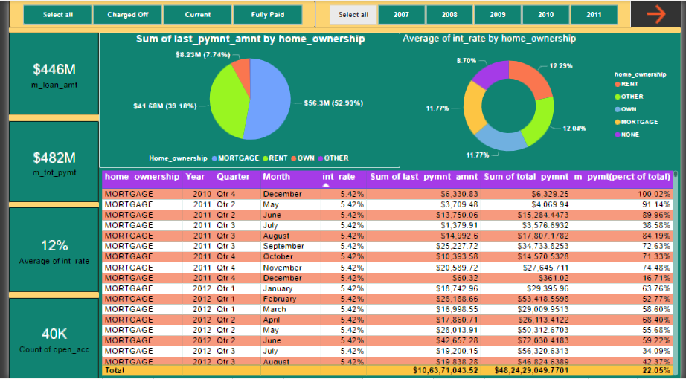
KPI-5 home ownership vs last payment date stats.
Insights -
In 2009 & 2011 others pays highest interest rate i.e. 12.5% &16.5%.
Till 2009 people living on rent used to have highest percentage proportion in last payment amount & total payment amt.

Slide 10
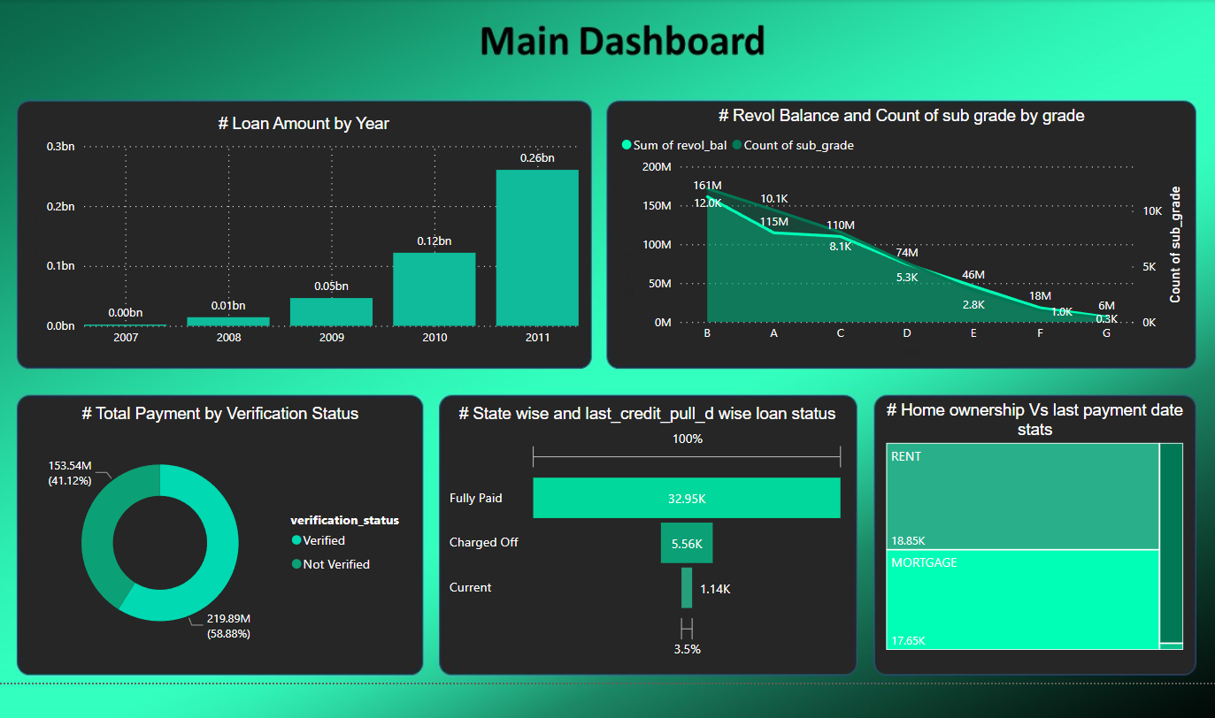
Main dashboard of finance analytics.

Slide 11
Recommendations:
In our findings we discovered that every year the loan amount was doubled compared to the previous year. Hence the company needs to increase its liquidity in reason to increase in loan amount so as not to lose potential customers.
In our findings OK state has the least Loan occupancy, so focusing on increasing the number of clients will help the Business. It could be done by implementing model of successful states.
Most of the loan amount is taken for the purpose of debt consolidation(profit % - 10%) which is most in year and less for purpose of renewable energy (profit % - 10.8%), moving (profit % - 10.2%), vacation (profit % - 15.6%) which are the immerging markets in the world. So company could shift its focus to these markets as profit earned from these markets are more.
Non verified customers account for approx. 41 % of total loan amount which decreases the credibility of the company. So company needs to take appropriate measures such as rigorous verification by sales representatives.
The verification could be increased by giving incentives to verified customers in comparison to non verified customers, it would result in more customers seeking to get verified.
If we see in the case of education, reason behind the taking loan for education is student loan which is approx. 1 million and installment is also high as average interest rate is 11.78%. So we can increase loan amount on education by decreasing interest rate.

Slide 12


