Slide 1
Queue

Slide 2
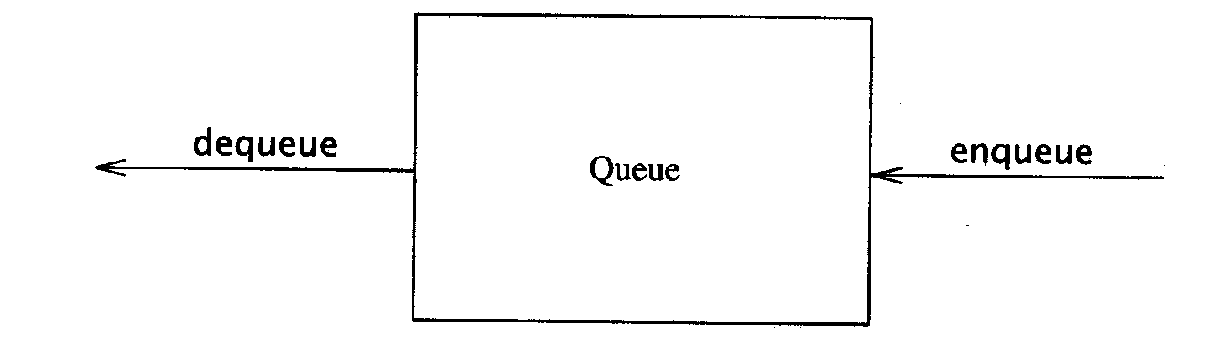
Queue
Like a stack, a queue is also a list. However, with a queue, insertion is done at one end, while deletion is performed at the other end.
Accessing the elements of queues follows a First In, First Out (FIFO) order.
  Like customers standing in a check-out line in a store, the first customer in is the first customer served.
Basic operations:
  enqueue: insert an element at the rear of the list
  dequeue: delete the element at the front of the list

Slide 3
The Queue Operations
New people must enter the queue at the rear. The C++ queue class calls this a push, although it is usually called an enqueue operation.
$ $
Front
Rear
Notes:
Don’t ask me why the C++ STL used the name push. It only confuses matters with a stack. In any case, when a new item enters a queue, it does so at the rear.

Slide 4
Enqueue and Dequeue
Primary queue operations: Enqueue and Dequeue
Like check-out lines in a store, a queue has a front and a rear.
Enqueue
  Insert an element at the rear of the queue
Dequeue
  Remove an element from the front of the queue
Implementation of Queue: Just as stacks can be implemented as arrays or linked lists, so with queues.
Remove
(Dequeue)
Insert
(Enqueue)
front
rear

Slide 5
The Queue Operations
A queue is like a line of people waiting for a bank teller. The queue has a front and a rear.
$ $
Front
Rear
Notes:
When you think of a computer science queue, you can imagine a line of people waiting for a teller in a bank. The line has a front (the next person to be served) and a rear (the last person to arrive.

Slide 6
Qinsert- Enqueue operation
  This procedure Inserts an element ITEM into a queue.
  [Queue Already Filled?]
  If FRONT=1 and REAR=N or if FRONT = REAR +1 then write overflow.
  2) [Find New Value of Rear]
  If FRONT=NULL then [QUEUE Initially Empty]
  SET FRONT=1 and REAR=1
  ELSE if REAR=N then
  Set REAR=1
  ELSE Set REAR=REAR+1
  [End of if]
  3) Set Queue[REAR]=Item.
  4) Return.

Slide 7
Qdelete – Dequeue operation
  [QUEUE Already empty?]
  If FRONT=NULL then [WRITE Underflow]
  2) SET Item= Queue[FRONT]
  3) If FRONT=REAR [QUEUE has already one element to Start]
  Set FRONT=NULL and REAR=NULL.
  Else If FRONT=N
  SET FRONT=1.
  ELSE
  SET Front=Front+1.
  4) EXIT

Slide 8
Queue Implementation of Array
There are several different algorithms to implement Enqueue and Dequeue
Naïve way
  When enqueuing, the front index is always fixed and the rear index moves forward in the array.
rear
rear
rear
3
3
6
3
6
9
front
front
front
Enqueue(3)
Enqueue(6)
Enqueue(9)

Slide 9
Queue Implementation of Array
Naïve way
  When dequeuing, the element at the front the queue is removed. Move all the elements after it by one position. (Inefficient!!!)
rear
rear
rear = -1
6
9
9
front
front
front
Dequeue()
Dequeue()
Dequeue()

Slide 10
DEQUES
A deque is a linear list in which elements can be added or removed at either end but not in middle( Left ,Right pointer).
There are two variation of a Deque- namely an Input Restricted and an output-Restricted deque.
An input restricted deque is a deque which allows insertions at only one end of a list but allows deletions on both the ends of the list
An output restricted Deque is a deque which allows deletions at only one end of the list but allows insertions at both the ends of the list.

Slide 11
Priority Queue
A priority queue is a collection of elements such that each element has been assigned priority and such that the order in which elements are deleted and processed comes from the following rules:
1) An element of higher priority is processed before any element of lower priority.
2) Two elements with the same priority are processed according to the order in which they were added to the queue.
Priority queue can be implemented with one –way list and arrays:
Each node in the list contains three items of information: an information field info, priority number PRN and a link number link.
A node X precedes a node a node Y in the list 1) when X has higher priority than Y or 2) When both have the same priority but X was added to the list before Y.
A
1
2
B
2
3
C
2
Null

Slide 12
Array Representation of Queue
Another way to maintain a priority queue in memory is to use a separate queue for each level of priority( or for each priority number).
Each Such queue will appear in its own circular array and must have its own pair of pointers FRONT and REAR.
A two Dimensional array queue can be used instead of the linear arrays.
FRONT | REAR
1 | 2
2 | 3
0 | 0
5 | 1
4 | 4
 | 1 | 2 | 3 | 4 | 5 | 6
1 | A | B
2 |  | C | X
3
4 | F |  |  |  | D | E
5 |  |  |  | G
1
2
3
4
5

Slide 13
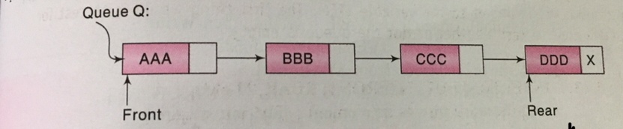
Linked Representation f Queue

Slide 14
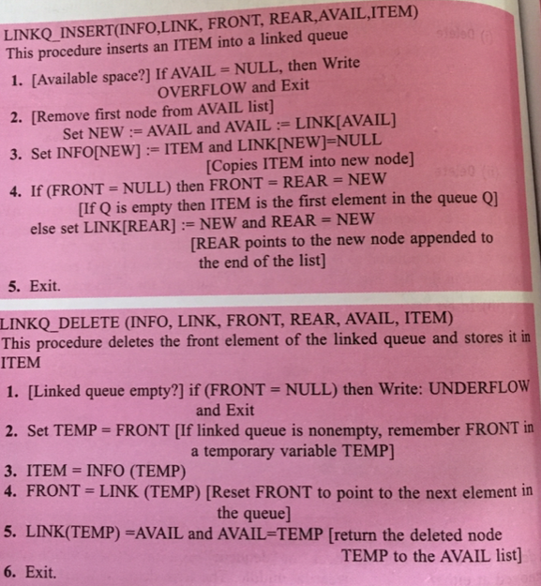


Slide 15
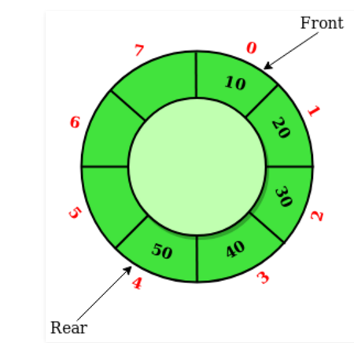
Circular Queue
Circular Queue is a linear data structure in which the operations are performed based on FIFO (First In First Out) principle and the last position is connected back to the first position to make a circle. It is also called ‘Ring Buffer’

Slide 16

Summary
Like stacks, queues have many applications.
Items enter a queue at the rear and leave a queue at the front.
Queues can be implemented using an array or using a linked list.
Notes:
A quick summary . . .

