Slide 1

Application of Data Science Algorithms on ‘3D Imagery Data’
Day 2, 14th August 2020 @11:00 AM

Slide 2
Agenda
Introduction to 3D data
Data Collection, Data Formats
Applications – Case Studies
3D data - Alignment (Open 3D)
3D data – Object Detection (Point Net++)
Generic Case Studies
Industrial Metrology for Quality Assurance
3D Object Detection & its Volumetric Analysis

Slide 3
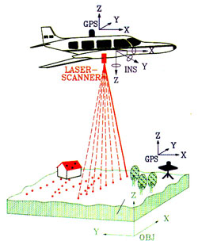
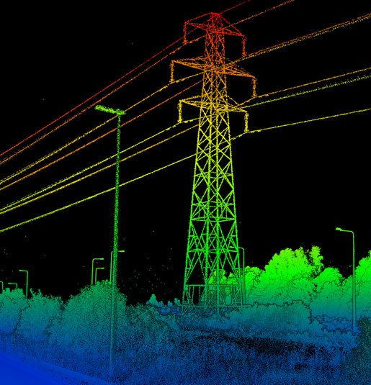
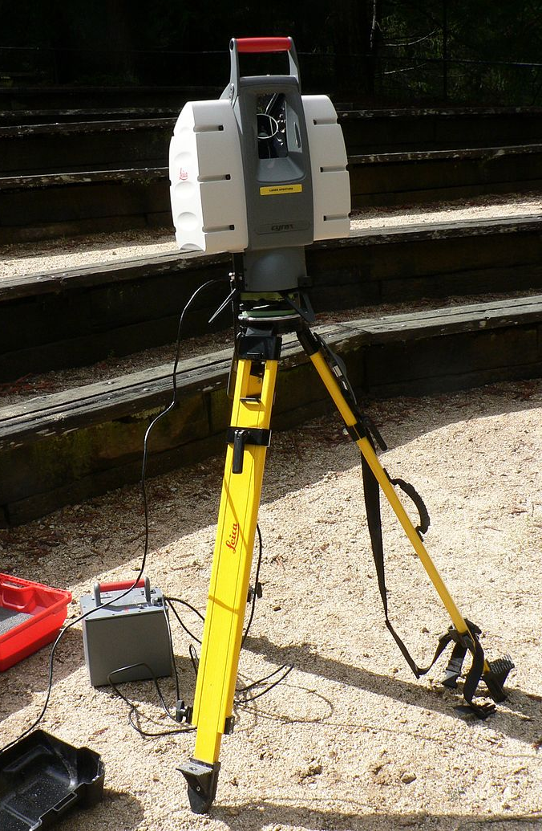
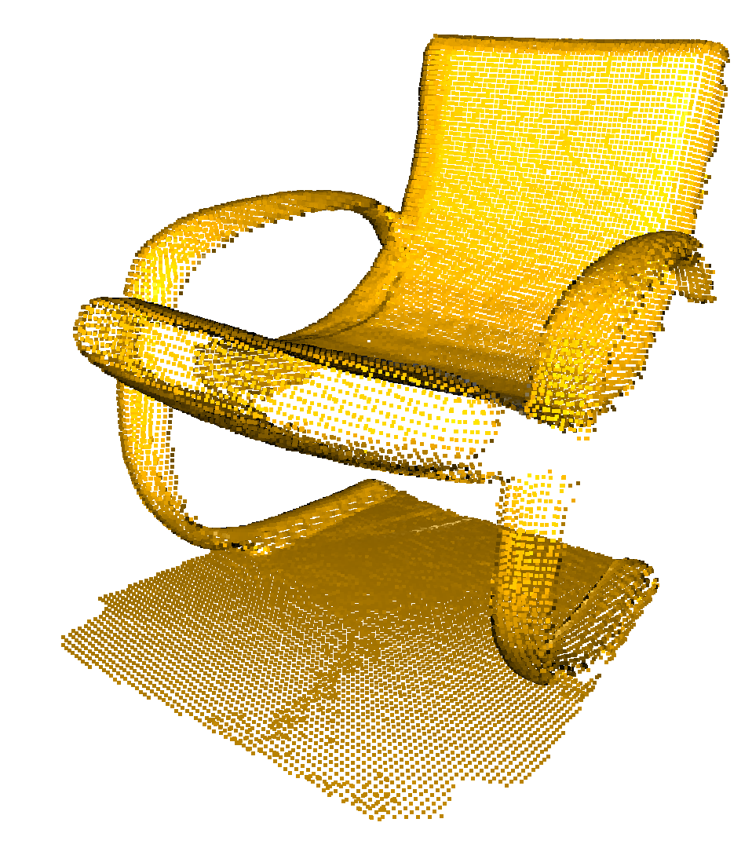
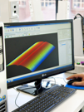
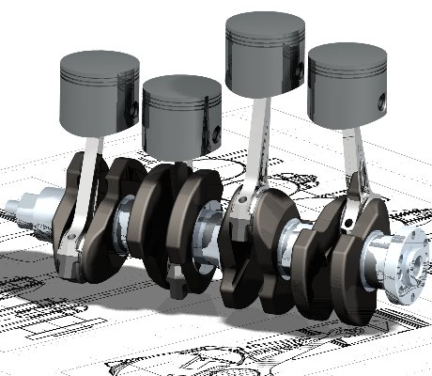
3D Data
Data Generation
Data Format
Use Cases
Point Cloud Data
x, y, z - 3D coordinates
nx, ny, nz - Normals
r,g,b- color
Agriculture
Crop Categorization
Crop Mapping
Autonomous vehicles
Navigation
Collision avoidance
Autonomous cruise control
Obstacle detection in autonomous vehicles
Forestry
Bio Conservation
Medical Imaging
Ref: https://levelfivesupplies.com/100-real-world-applications-of-lidar-technology/
UAV data
Mesh Data
Triangles to define the 3D surface.
ply- Polygon File Format
stl- StereoLithography
obj - Object Files
off- Object File Forma
gltf -GL Transmission Format
Camera
CAD

Slide 4
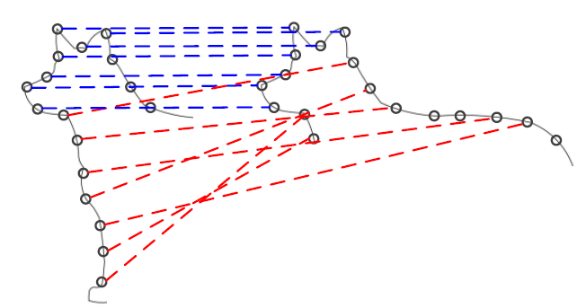
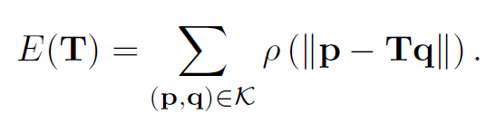
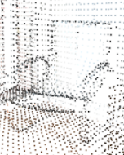

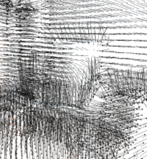

Alignment of 3D Objects
Basic Operations
Global Registration
Scaling
Transformation- translate, rotations
RANSAC (Random Sample Consensus)
Random Down Sampling
Nearest Neighborhood <threshold
Faster Global Registration
Point-to-point
Outlier Removal
ICP (Iterative Closest Point) registration
Radius outlier removal
Statistical outlier removal
Point-to-Plane
Q.-Y. Zhou, J. Park, and V. Koltun, Fast Global Registration, ECCV, 2016.
http://www.open3d.org/docs/release/introduction.html

Slide 5
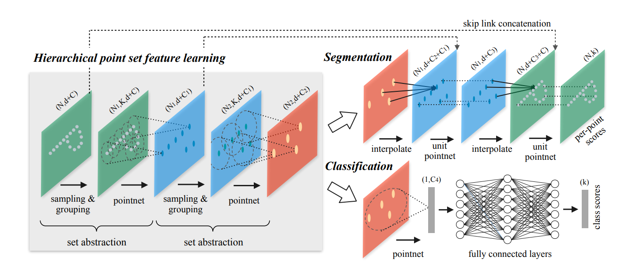
Object Detection of 3d Objects
http://stanford.edu/~rqi/pointnet2/
Main Goal
Partitioning of Point sets
Abstracting Local Features
Farthest Point Sampling

Slide 6
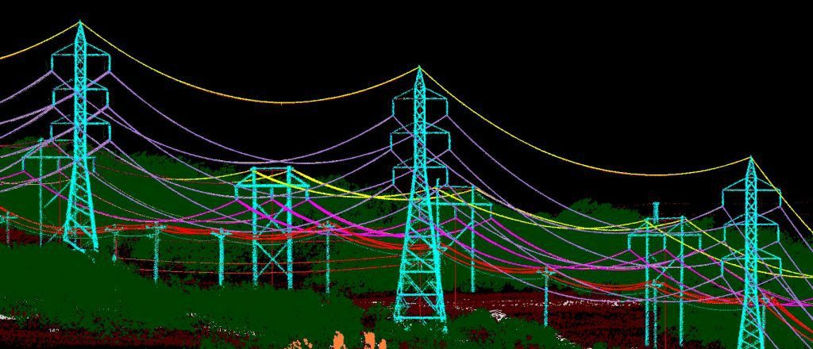

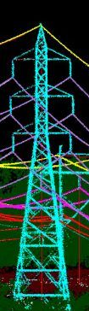
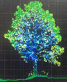
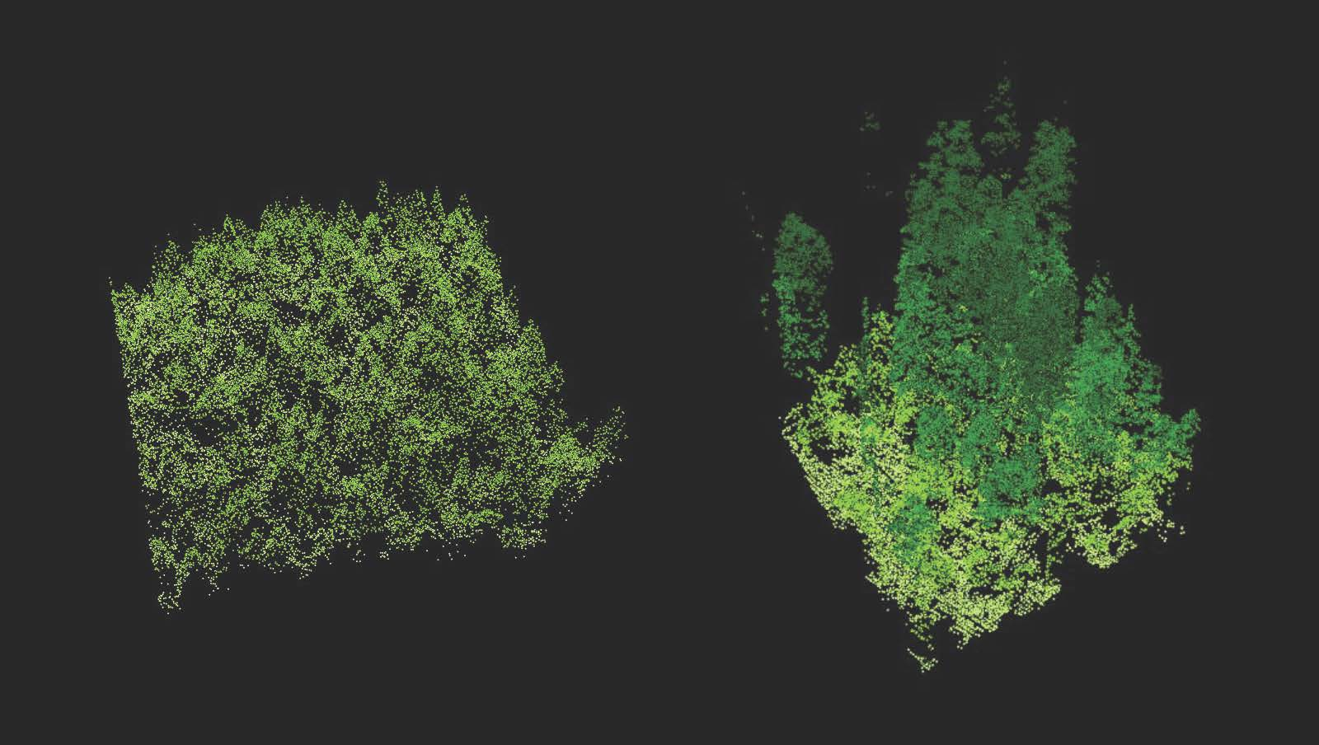
Case Study -1 3D Object Detection & its Volumetric Analysis
Scope
Extract features – e.g. Vegetation, terrain, and buildings
Assess the growth or Changes in objects over time;
Assess & Predict the Risk
Clustering Method
(to identify object which contain the group of point cloud data
Classification Model
LiDAR Data
Unknown
Object Types
Conductors
Tree
Volumetric Analysis Before & After
Tower
Identified
Object Types

Slide 7
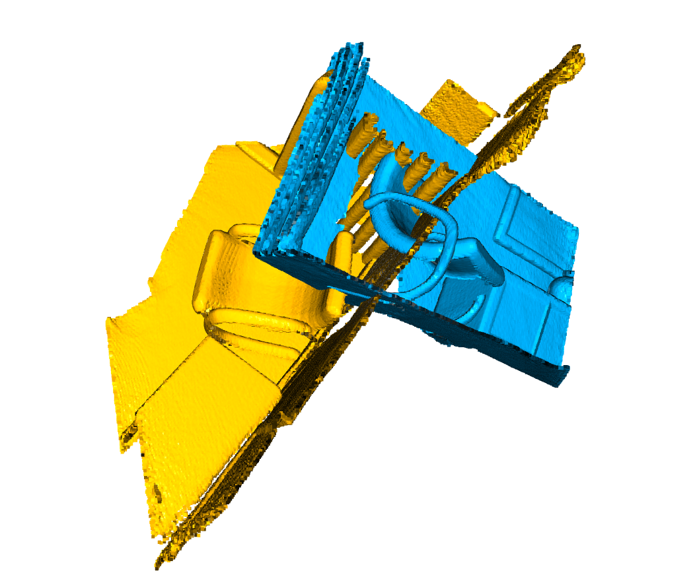
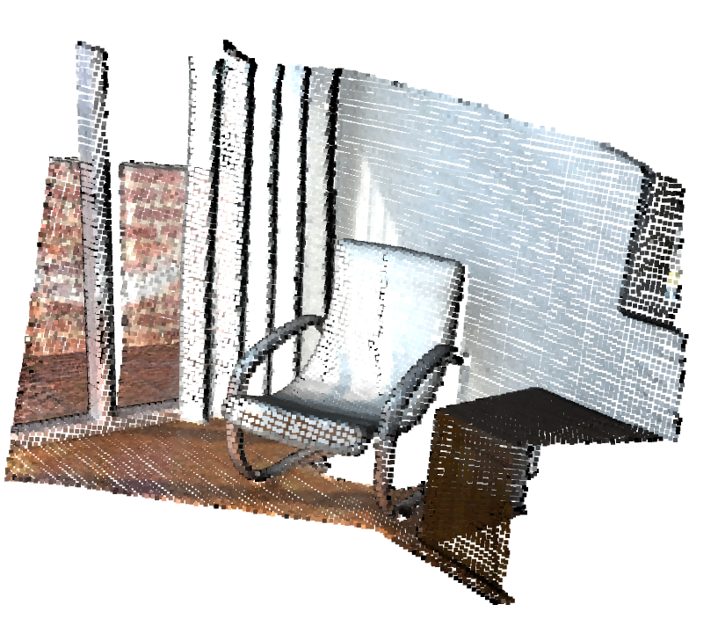
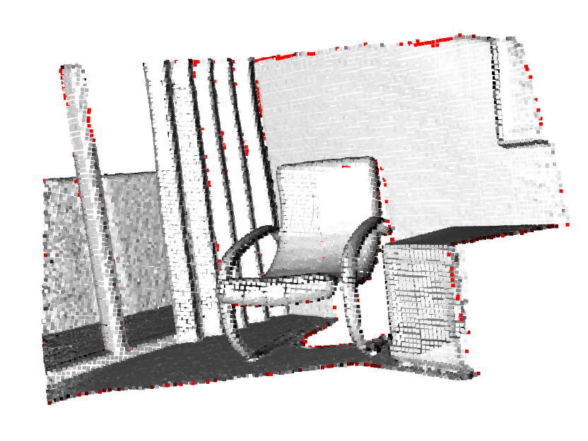
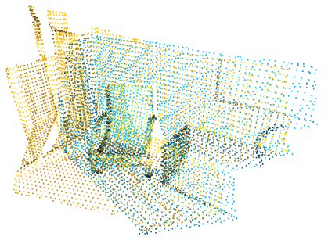
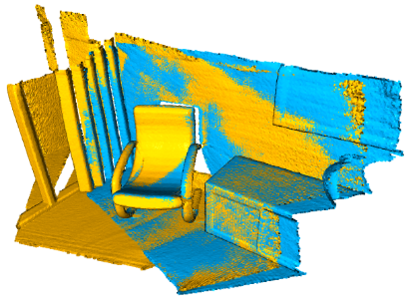
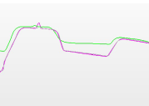
Case Study: Industrial Metrology for Quality Assurance
Comparing Two Scans
Down sampling
Outlier Removal
scan1
scan2
Wear
Measuring Dimensions
Local Registration
Global Registration

Slide 8

THANK YOU

Slide 9
References
http://www.asu.edu/courses/art345/pike_b/terrainmapping/lidar.htm
https://en.wikipedia.org/wiki/Lidar
https://levelfivesupplies.com/100-real-world-applications-of-lidar-technology/
http://www.open3d.org/
https://github.com/intel-isl/Open3D-PointNet2-Semantic3D

