Slide 1
AICTE | IBM SkillsBuild
HABIT LOOP
MIRROR
“Screen Time tells you how much. We tell you why.”
Understand the patterns behind your digital habits.
Machine Learning and Applied AI Internship 2026
Student: Ramanarajarajan T
Internship ID: IBMUEML007043
College: KPR Institute of Engineering and Technology (KPRIET), Coimbatore
Project theme: AI-Powered Digital Habit Awareness & Behavioral Self-Regulation

Slide 2
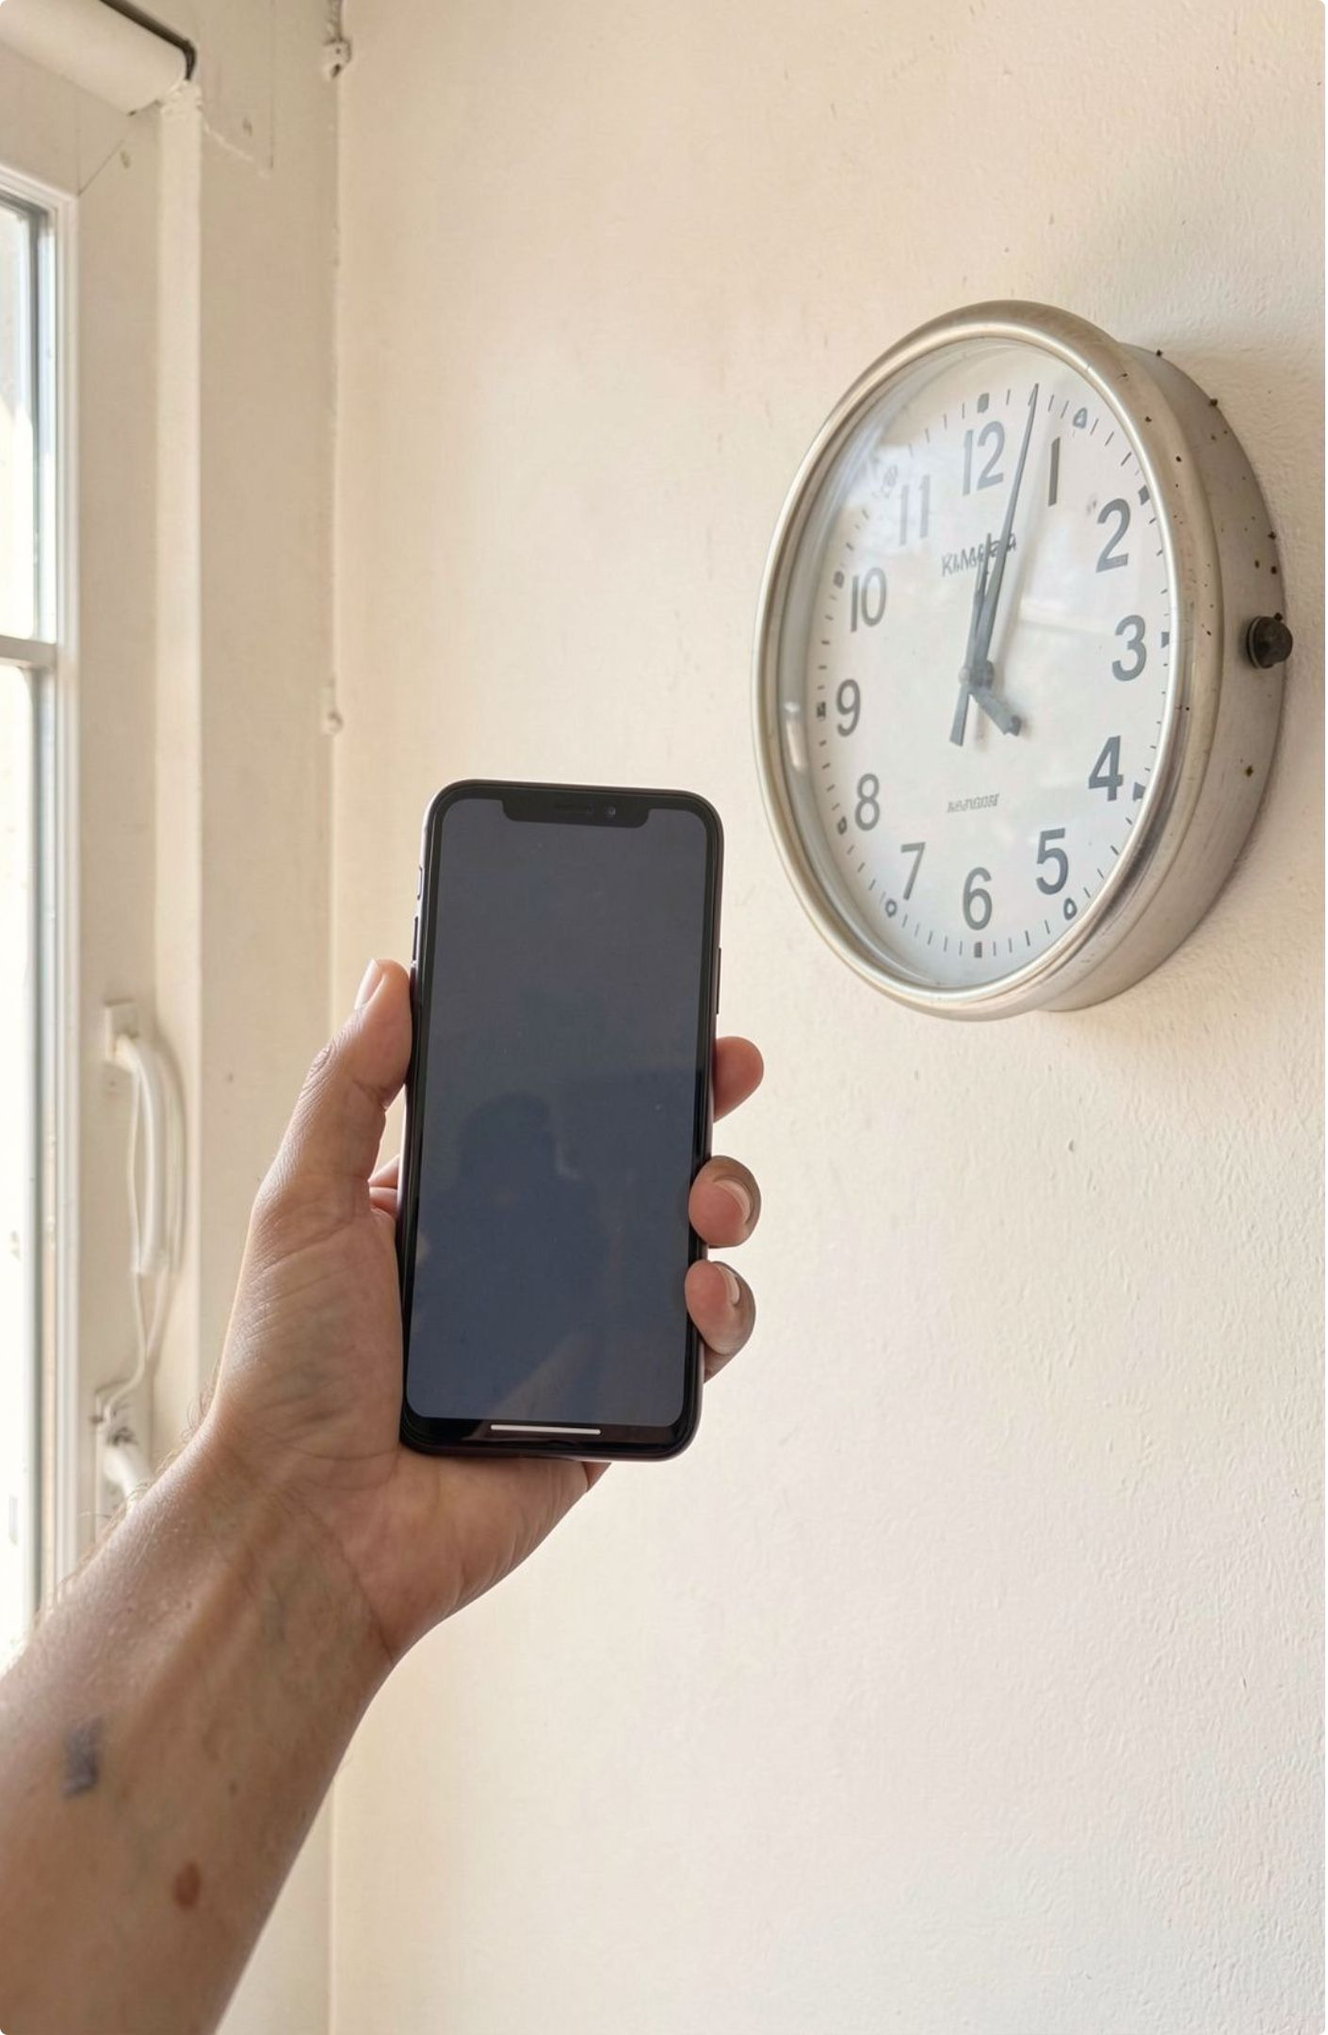
THE GAP
The Problem: screen time tells us how much, but not why
Key insight: Measuring screen time alone does not explain the behavior behind it.
What tools show: Traditional tools show total screen time, app duration, and session counts.
What they miss: They rarely explain recurring patterns, preceding context, or intentionality.
What remains absent: They do not suggest meaningful alternatives for unplanned usage.
Traditional tracker: Duration → Habit Loop Mirror: Pattern → Context → Reflection → Action
02

Slide 3

THE SHIFT
From screen-time metrics to behavioral awareness
Habit Loop Mirror transforms raw usage data into understandable patterns, evidence-based insights, reflection, and meaningful alternatives.
Understand → Reflect → Substitute → Improve
Understand | Reflect | Substitute | Improve
Detect recurring usage patterns. | Explain patterns using analytics and encourage non-judgmental reflection. | Suggest personalized alternatives. | Track multi-week habit evolution.
03

Slide 4









CORE MECHANISM
Explain
The 5-stage Behavioral Mirror Loop
Detect
Trigger → Action → Latency → Duration.
Correlate notifications with session starts across multiple days.
Reflect
Planned, Necessary, Relaxation, or Unplanned.
Use evidence and non-judgmental behavioral language throughout.
Improve
Track multi-week evolution and verified reclaimed time.
Substitute
Personal Swap Engine recommends 2-, 10-, or 20-minute activities.
04

Slide 5

Layer | Technology
Frontend | React 18, TypeScript, Vite, Tailwind CSS, React Router, Lucide React, Framer Motion
Authentication | Supabase Auth + JWT
Backend | Python 3.12+, FastAPI, Uvicorn, SQLAlchemy, Pydantic, Alembic
Analytics | pandas, NumPy, scikit-learn
Intelligence | Deterministic Personal Swap Engine + Kimi K3 / Moonshot AI Adapter
Data | Supabase PostgreSQL; SQLite for local development
Deployment | Vercel → frontend; Render → backend
SYSTEM DESIGN
System Architecture
05

Slide 6
INTELLIGENCE LAYER
AI & Machine Learning intelligence
Python analytics generate the ground-truth evidence; AI explains that evidence.
ANALYTICS / ML
AI LAYER
FALLBACK
Evidence first
Meaning second
Continuity always
Processes telemetry, detects multi-day clusters, calculates latency and duration, and generates evidence-based signals.
Converts evidence into understandable insights, contextual explanations, reflection, and personalized guidance.
Deterministic evidence templates keep the system functional when Kimi access is unavailable.
Key features: Habit Loop Detection · Explainable Insights · Session Reflection · Personal Swap Engine
· Digital Day Timeline · Habit Evolution
06

Slide 7
How Habit Loop Mirror works
Start Habit Mirror
Sign up or enter Demo Mode
01
02
Complete personalization onboarding
Import usage CSV
03
04
Analyze usage data
Detect a recurring habit loop
05
06
View the explainable AI insight
Reflect on session intentionality
07
08
Select a personalized alternative
Track habit improvement
09
10
Example flow: Raw Usage Data → Recurring Evening Pattern → Evidence-Based Detection → AI Explanation → Reflection → Personal Swap → Long-Term Improvement
07

Slide 8

RESPONSIBLE AI
Responsible AI: awareness, not judgment
Awareness, not diagnosis
Non-judgmental language
Evidence-based AI
Not a medical treatment or clinical diagnostic platform.
Avoid “addicted” labels and unsupported causal claims.
Python analytics precede AI interpretation.
User control
Deterministic fallback
Self-regulation
Support awareness, reflection, and user-controlled improvement.
Users choose categories and preferred alternatives.
Core functionality remains available without external AI.
Avoid: “Notification caused the user to open the app.” Use: “Session followed notification.”
08

Slide 9

Increased digital self-awareness
Better understanding of recurring patterns
Healthier digital routines
Meaningful alternatives
Long-term self-regulation
Enhanced digital self-awareness
Improved behavioral understanding
Healthier and more intentional digital habits
SDG 3 · GOOD HEALTH AND WELL-BEING
SDG 3: digital well-being is part of well-being
Habit Loop Mirror promotes digital well-being by helping users understand screen-time patterns and recurring digital habits, encouraging self-awareness, self-regulation, healthier routines, and meaningful alternatives to unplanned usage.
09

Slide 10
READINESS & NEXT HORIZON
Testing | Pytest backend tests · frontend production build and type checking · API health checks · deterministic demo dataset
Deployment | Vercel frontend · Render backend · Supabase PostgreSQL · Supabase Auth · Moonshot AI / Kimi
Future scope | real-time mobile telemetry · advanced pattern models · learned recommendations · real-time detection · privacy-preserving on-device analytics · expanded cross-platform support
Validation, deployment & future scope
From measuring screen time to understanding digital behavior.
THANK YOU
AICTE | IBM SkillsBuild · Machine Learning and Applied AI Internship 2026
10

