Slide 1
Capstone Project
Anwar Shahid

Slide 2

Pakistani Restaurant in New York City

Slide 3
Business Problem
It would be very beneficial for Pakistani Americans, immigrants and visitors to provide them some ready made information about good Pakistani restaurant in New York. This report helps such Pakistani and other communities to find good Pakistani restaurant in New York city. This report also discusses the best location if someone wants to start a new business as restaurant. Addionally, we will try to deliver best location to stay on based on good Pakistani restaurants. We have used numerous datasets to explore the restaurants, neighborhood and user ratings to explore good Pakistani restaurants in New York. This project will definitely help travellers and locals to save much more time in finding the good Pakistani cuisine in New York area.

Slide 4
Problem Statement
Finding the best available Pakistani restaurant in New York which can ultimately help the residents and visitors. It will drastically save the time for such audience in finding the Pakistani restaurant in the neighborhood of New York city.

Slide 5
Data Sources
Dataset 1
New York City data containing the neighborhoods and boroughs, latitudes, and longitudes will be obtained from the data source: https://cocl.us/new_york_dataset
Dataset 2
New York City data containing neighborhood boundaries will be obtained from the data source: https://data.cityofnewyork.us/City-Government/Borough-Boundaries/tqmj-j8zm
Dataset 3
All data related to locations and quality of Italian restaurants will be obtained via the FourSquare API utilized via the Request library in Python.

Slide 6
Methodology
Collection of data will be done from above mentioned link and then it will be cleaned and processed using different libraries in Python. It is understood that cleaned and processed data can only generate useful and valid results.
Neighborhood boundaries are very important as per the given problem statement. So to get the neighborhood boundaries of New York city, we will use the above listed link.
Next we will use FourSquare API by using request library in Python to get locations of Pakistani restaurants including its user ratings, likes and tips. We will put it all together into a data frame.
After this we will use K-Mean clustering to find locations of Pakistani Restaurants in New York City.

Slide 7
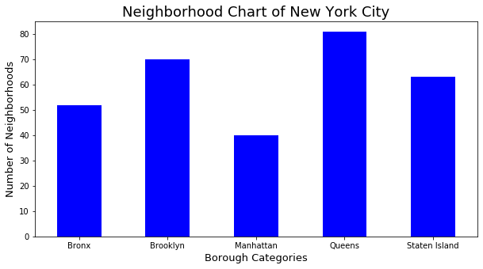
Results

Slide 8
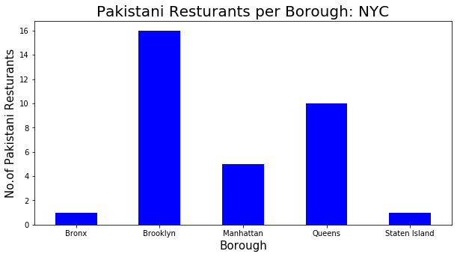
Results cont…

Slide 9
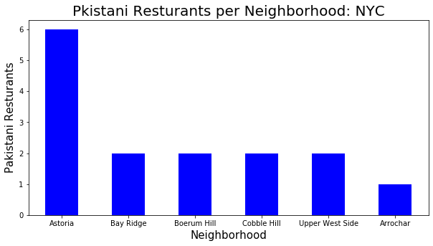
Results cont…

Slide 10
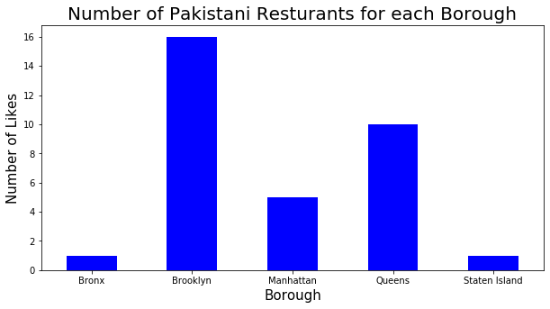
Results cont…

Slide 11
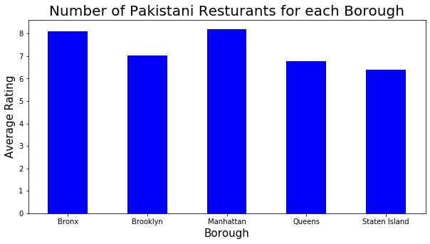
Results cont…

Slide 12
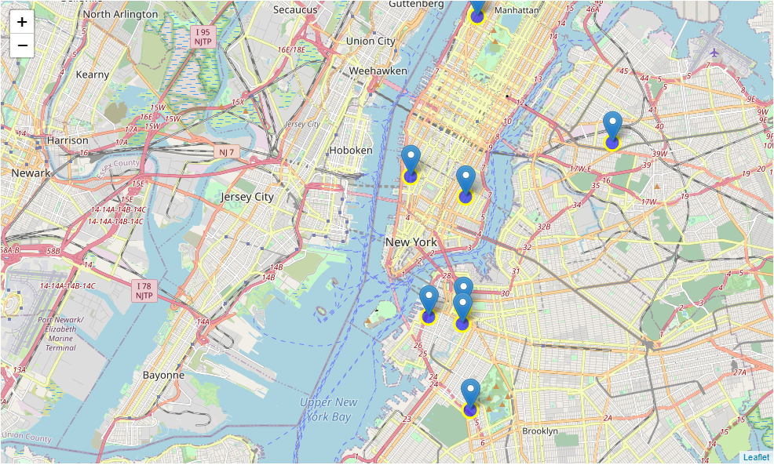
Map Clusters

Slide 13
Results and Discussion
We have devised a mechanism to find the Pakistani restaurant in New York city and surrounding area. The methodology and result obtained are the reflection of true claim of this statement. Our procedure is basically dependent on valid data from USA data portal and FouSquareAPI data.
This project is very comprehensive in terms of data and its outcomes. The same can be extended to find other Pakistani shops in the related area for example Fashion and Jewellery shops.

