Slide 1

Community Project
Branch: CSE-CYBERSECURITY & INTERNET OF THINGS(ICB)
Department: Data Engineering
Semester: V Section: A Regulation: R24 Course Code: R24MSCSP001
Community Project
Branch: CSE-CYBERSECURITY & INTERNET OF THINGS(ICB)
Department: Data Engineering
Semester: V Section: A Regulation: R24 Course Code: R24MSCSP001
Project Title: VIDYA Uday – DIGITAL EMPOWERMENT AND AI AWARENESS
Batch Number:3
SS. No | Register Number | Student Name
1 | 24331A4726 | KALISETTY CHARAN TEJA
2 | 24331A4745 | PANDI ABHINASH
3 | 24331A4720 | GUMMIDI PUSPHA
4 | 24331A4752 | S SYED MOHAIDEEN
Guide Name : Mrs. G .LALITHA
Designation : ASSISTANT PROFESSOR
Project Coordinator :Dr .T .GOVINDH RAO
Designation: ASSISTANT PROFESSOR
Head of the Department: Dr. V. JYOTHI
Designation: Associate Professor

Slide 2
Abstract
A concise overview of VidyaUday and its core purpose
Background
🌾 Rural Student Guidance Gap: Lakhs of rural 10th and Intermediate students complete board exams without proper career guidance, unaware of free AI learning tools and government financial aid.
💸 Commercial Coaching Traps: Private apps charge ₹20,000–₹50,000 for guidance, while 100% free government resources, scholarships, and digitized textbooks remain undiscovered.
Our Solution (VidyaUday)
🌐 All-in-One Free Web Platform: A mobile-friendly portal requiring zero login, no app installation, and zero personal data collection.
🤖 Seven Comprehensive Modules: Brings together 10+ free AI tools with copyable prompts, career roadmaps, a 30-sec scholarship checker, SCERT textbooks, coding guides, cyber scam defense, and Uday the Owl AI chatbot.
Expected Outcome
🎓 Direct Student Empowerment: Saves cyber café application fees, helps rural students claim statutory scholarships, and builds foundational AI and digital literacy.
VidyaUday | 2
03-07-2026

Slide 3
Introduction
The challenge rural students face and what VidyaUday does about it
The Rural Student Challenge
👥 Blind Decision Making: Lakhs of rural students pass 10th and Intermediate every year, choosing groups and colleges purely based on peer pressure or limited family knowledge.
💸 Exploitation by Intermediaries: Students pay ₹200–₹500 to private cyber cafés just to fill basic forms, often missing critical scholarship deadlines due to procedural complexity.
The Information & Language Barrier
🔍 Scattered Official Portals: Genuine welfare schemes and study materials exist, but they are buried across multiple English-only government websites without vernacular guidance.
Our Platform: VidyaUday (Seven Essential Modules)
🦉 Unified Educational Portal: Combines 🤖 AI Tools, 🗺️ Career Roadmaps, 🏆 Scholarships, 📚 SCERT Books, 💻 Coding Practice, 🛡️ Cyber Scam Buster, and 🦉 Uday AI Chatbot under one roof.
VidyaUday | 3
03-07-2026

Slide 4
Problem Statement
Rural students are not short on ability — they are short on access
Core Problem Statement
Lakhs of rural 10th and Intermediate students face a severe guidance gap, making life-defining educational choices without awareness of emerging AI study tools, diverse career streams, or statutory government scholarships. Fragmented government portals, English-dominant websites, and aggressive commercial coaching fees systematically leave first-generation learners behind.
Real Findings from Our Rural Student Survey
❓ 74.2% Lack Career Awareness: Unaware of viable diploma, vocational, or technical career options beyond traditional MPC/BiPC streams.
💸 ₹50,000+ Aid Missed Annually: Deserving students miss out on government fee reimbursements simply due to lack of deadline visibility and application support.
🤖 81.5% Never Used AI Tools: Have never utilized free AI tools like ChatGPT or Gemini to help with homework, maths problem-solving, or language learning.
VidyaUday | 4
03-07-2026

Slide 5
Project Objectives
Five clear goals that define what VidyaUday sets out to achieve
Strategic Project Objectives
🤖 Democratize Educational AI: Introduce rural students to 10+ free AI tools (ChatGPT, Gemini, Canva, Gamma) with 1-click copyable prompts for homework, maths, and essays.
🗺️ Provide Clear Career Roadmaps: Deliver year-by-year paths after 10th & Intermediate (MPC, BiPC, CEC, MEC, Polytechnic, ITI) with verified salary growth timelines.
🏆 Automate Scholarship Discovery: Build a 30-second eligibility checker matching students to Central and State financial schemes with direct application links.
🛡️ Teach Cyber Scam Defense: Equip students with practical digital safety skills, a 30-second readiness quiz, and guidance to detect fake scholarship traps.
🦉 Deliver Bilingual AI Support: Provide Uday the Owl—a bilingual AI assistant powered by Google Gemini and Web Speech voice technology for instant student queries.
VidyaUday | 5
03-07-2026

Slide 6
Project Scope
What VidyaUday includes — and what it deliberately does not cover
In-Scope (Platform Capabilities)
🎓 Target Audience: Comprehensive coverage tailored specifically for rural 10th (SSC), Intermediate (+2), Polytechnic, and ITI students.
🤖 Core Platform Features: 10+ AI Tools Directory, Google Gemini AI Chatbot, Career Stream Explorer, 30-Sec Scholarship Checker, SCERT Books Hub, and Cyber Scam Buster.
📱 Universal Accessibility: 100% mobile-responsive design, offline printable PDF packs, and English-Telugu synthesized voice assistance.
Out-of-Scope (Deliberate Boundaries)
🏫 Not a Classroom Replacement: Designed strictly as an informational and career guidance bridge, not as a substitute for classroom teachers or school syllabi.
💳 No Financial Processing: Does not collect banking details or disburse funds; safely redirects students to official government portals (NSP, ePASS).
🔒 Zero Backend Data Tracking: Operates client-side without storing user phone numbers, passwords, or personal records, ensuring complete student privacy.
VidyaUday | 6
03-07-2026

Slide 7
Literature Review / Background Study
Existing platforms and why they fall short for rural students
Key Research Findings & Literature Analysis
📜 NEP 2020 Recommendations: Highlights the critical importance of early career counselling, mother-tongue educational resources, and foundational AI literacy for school students.
📊 ASER Rural Technology Survey: Reports show that while smartphone penetration among rural families exceeds 75%, educational use is crippled by English-only interfaces and complex navigation.
🏛️ Government Portals (NSP & ePASS): Provide essential financial welfare but suffer from multi-layered portals that force rural students to depend on paid cyber café agents.
💸 Commercial EdTech Paywalls: Private guidance and career platforms lock access behind paywalls of ₹20,000–₹50,000/year, catering only to affluent urban learners.
💡 The VidyaUday Bridge: Fills this critical societal gap with a 100% free, lightweight, bilingual portal uniting career guidance, scholarships, AI tools, and digital safety.
VidyaUday | 7
03-07-2026

Slide 8
VidyaUday vs Competitors
Feature-by-feature comparison — what makes VidyaUday unique
Feature / Capability | VidyaUday | Govt Portals (NSP) | Private EdTech | Static PDFs
Access Cost & Ads | 100% Free / No Ads | Free (Complex UI) | ₹20,000–₹50,000 | Free
Curated AI Tools & Prompts | Yes (10+ Free Tools) | No AI Tools | Paid AI Tutors | No
Gemini AI Voice Chatbot | Yes (Uday the Owl) | No Chatbot | Text-Only Paid Bot | No
Interactive Career Roadmaps | Yes (Year-by-Year Paths) | No (Raw Notices) | Yes (Paid Paywall) | Static Lists
Dual-State Scholarship Checker | Yes (30-Sec Quiz & Matrix) | Separate State Logins | No | No
Digital Literacy & Scam Buster | Yes (Quiz + Scam Guide) | No | No | No
VidyaUday | 8
03-07-2026

Slide 9
Data Gathered / Data Used
Every module is powered by real, verified field and educational data
Primary Field Research (Rural Student Outreach Survey)
📋 Field Survey of 120+ Students: Conducted direct interactive surveys with high school and junior college students in rural mandals.
❓ Lack of Alternatives: 74.2% of students did not know about polytechnic, ITI, or vocational careers beyond traditional MPC/BiPC.
🤖 Zero AI Exposure: 81.5% had never used AI study assistants, believing AI is only for software engineers.
💸 Scholarship Information Gap: 68.4% of eligible students missed government financial aid deadlines due to procedural confusion.
Secondary Data & Official Sources Curated
🤖 AI Tools & Prompt Library: Curated 10+ free tools (ChatGPT, Gemini, Canva, Gamma, GitHub) with tested student prompt templates.
🗺️ Career Progression Data: Mapped 11 complete academic streams after 10th and 12th with real-world entry-to-senior salary trends.
🏆 Statutory Welfare Gazettes: Codified official scholarship rules from AP Social Welfare (JVD/JVD), Telangana ePASS, and NSP Central Schemes.
📚 Official Curriculum Data: Mapped authentic digitized textbook repositories from official state SCERT and SWAYAM portals.
VidyaUday | 9
03-07-2026

Slide 10
Methodology / System Design — Flow Chart
A guided five-step journey from confusion to a confident, informed decision
1. Student Visits VidyaUday
Opens lightweight web platform on any mobile browser with zero login, no app installation, and zero ads.
2. Module Selection
Chooses from 🤖 AI Tools, 🗺️ Career Roadmaps, 🏆 Scholarships, 📚 SCERT Books, 💻 Coding, or 🛡️ Scam Buster.
3. Student Interacts or Asks Uday
Inputs class stream or asks questions directly to Uday the Owl AI assistant via voice or text in Telugu or English.
4. Instant Client-Side Processing
JavaScript rule engine evaluates eligibility matrix, filters curated schemes, and renders personalized results.
5. Empowered Student Action
Student accesses official apply links, copies AI prompts for homework, or downloads offline study packs.
VidyaUday | 10
03-07-2026

Slide 11
Methodology / System Design — Block Diagram
Four-layer architecture that powers the VidyaUday platform
Layer 1: Presentation & User Interface Layer
Responsive Mobile-First UI (HTML5/CSS3) • Bilingual Switcher (English/Telugu) • Web Speech Voice Engine • Clean Accessibility
Layer 2: Core Feature Modules
🤖 AI Tools Hub • 🦉 Uday Owl Chatbot • 🗺️ Career Roadmaps • 🏆 Scholarship Finder • 📚 SCERT Textbooks • 🛡️ Scam Buster
Layer 3: AI & Client-Side Logic Engine
Google Gemini 1.5 Flash API • Web Speech Voice Synthesis • JavaScript Decision Tree Matrix • LocalStorage Offline Cache
Layer 4: Data & Verification Layer
Curated Student AI Prompts • Official Welfare Gazettes (JVD & ePASS) • National Scholarship Portal • SCERT Curriculum Data
VidyaUday | 11
03-07-2026

Slide 12
Implementation / Core Modules
Comprehensive features built and verified on the live VidyaUday platform
Platform Implementation Modules
🤖 AI Tools & Prompt Templates: Curated 10+ free AI tools (ChatGPT, Gemini, Canva, Gamma) with 1-click copyable prompts for maths problem-solving, essay outlines, and Telugu translation.
🦉 Uday the Owl AI Assistant: Trilingual chatbot powered by Google Gemini 1.5 Flash API with Web Speech voice input and voice reading in English, Telugu, and Hindi.
🗺️ Interactive Career Roadmaps: Step-by-step career path mapping after 10th and 12th covering MPC, BiPC, CEC, MEC, Polytechnic, and ITI with degree outcomes and real salary growth timelines.
🏆 Scholarship Checker & Matrix: 30-second eligibility checker evaluating caste, income, and class against Central and State schemes, complete with a side-by-side comparison matrix.
📚 Learning Hub & SCERT Books: 1-click access to digitized state SCERT textbooks, DIKSHA, SWAYAM, and NPTEL free certification platforms.
🛡️ Digital Literacy & Scam Buster: 3-mode hub featuring student digital safety checklists, a 30-second readiness self-assessment quiz, and guides to detect fake scholarship scams.
VidyaUday | 12
03-07-2026

Slide 13
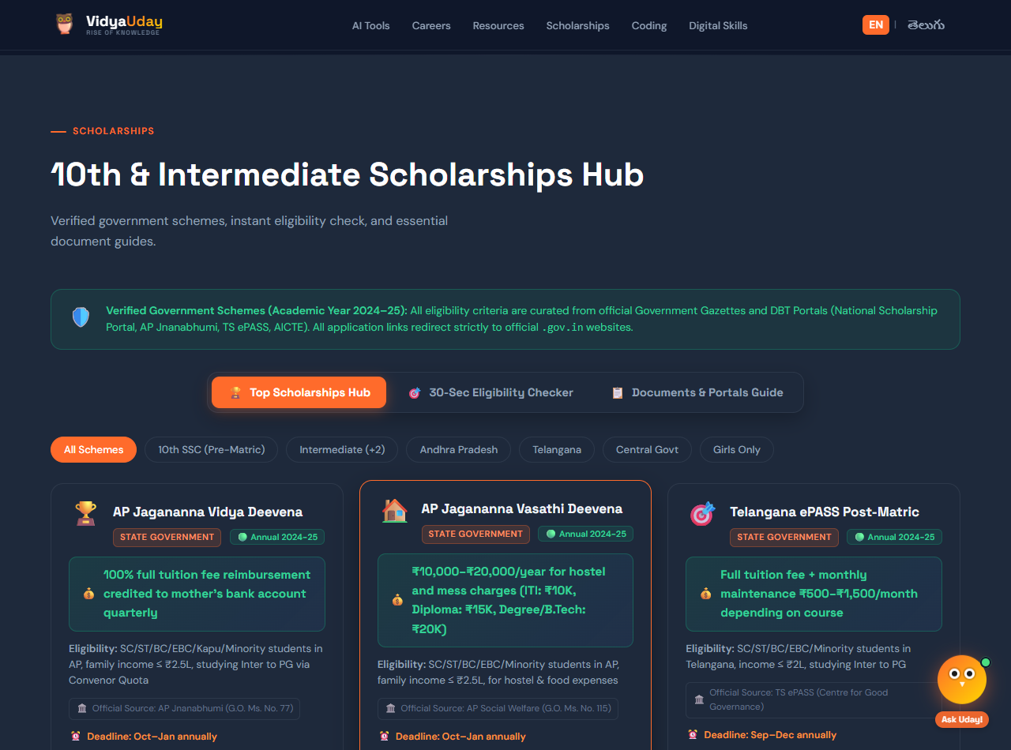
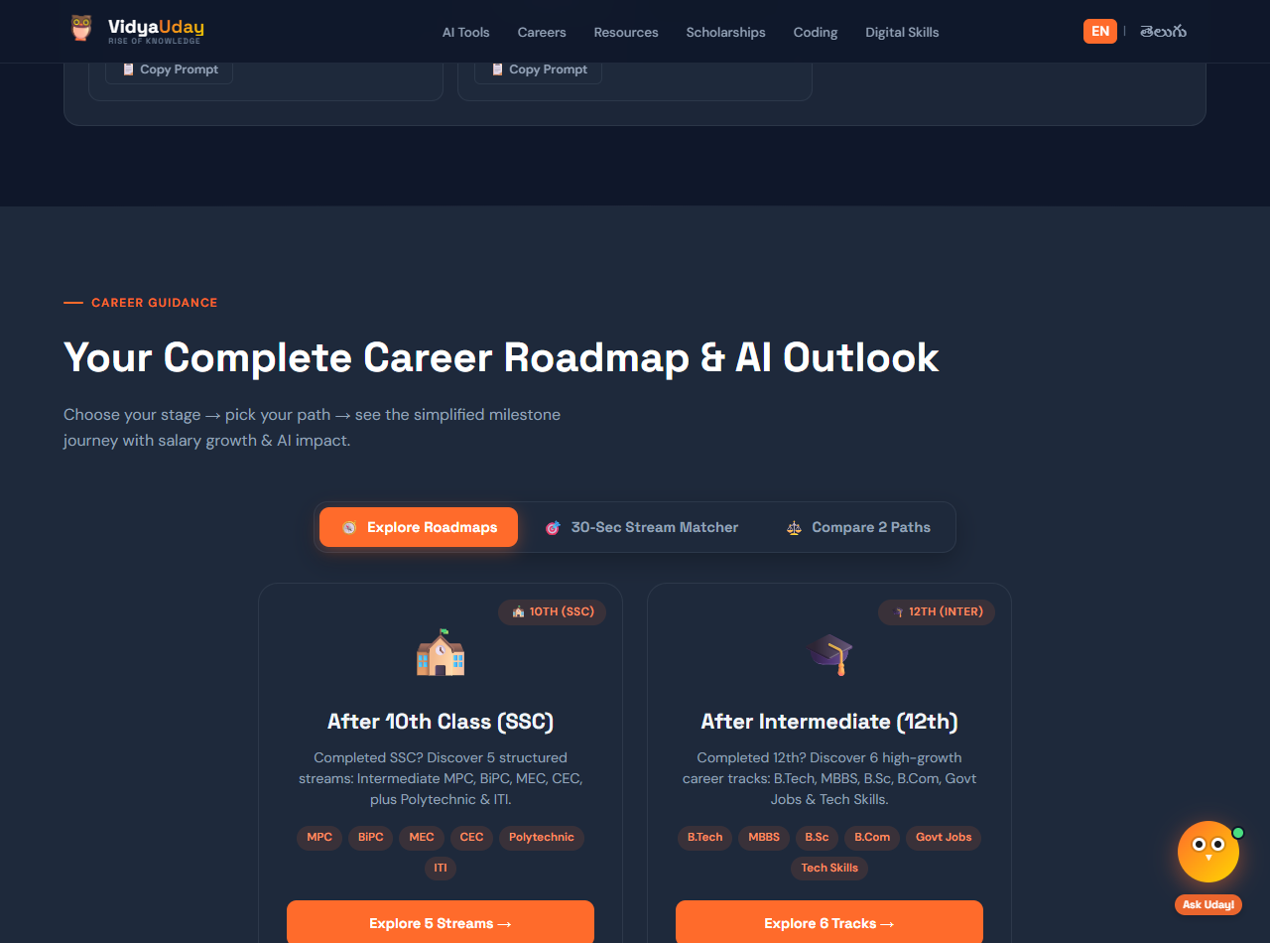
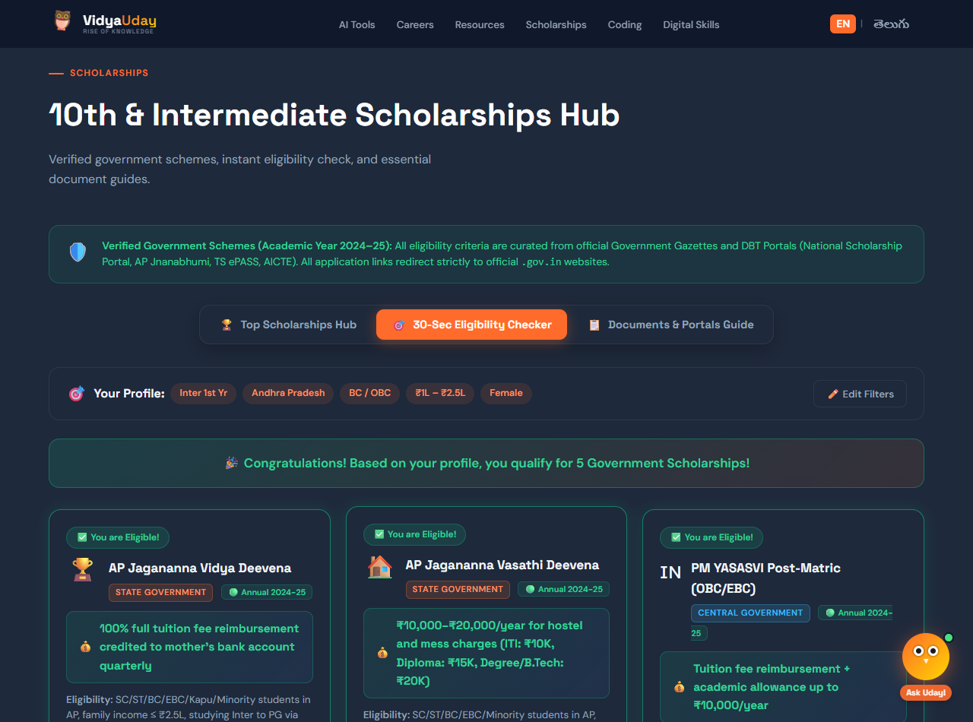
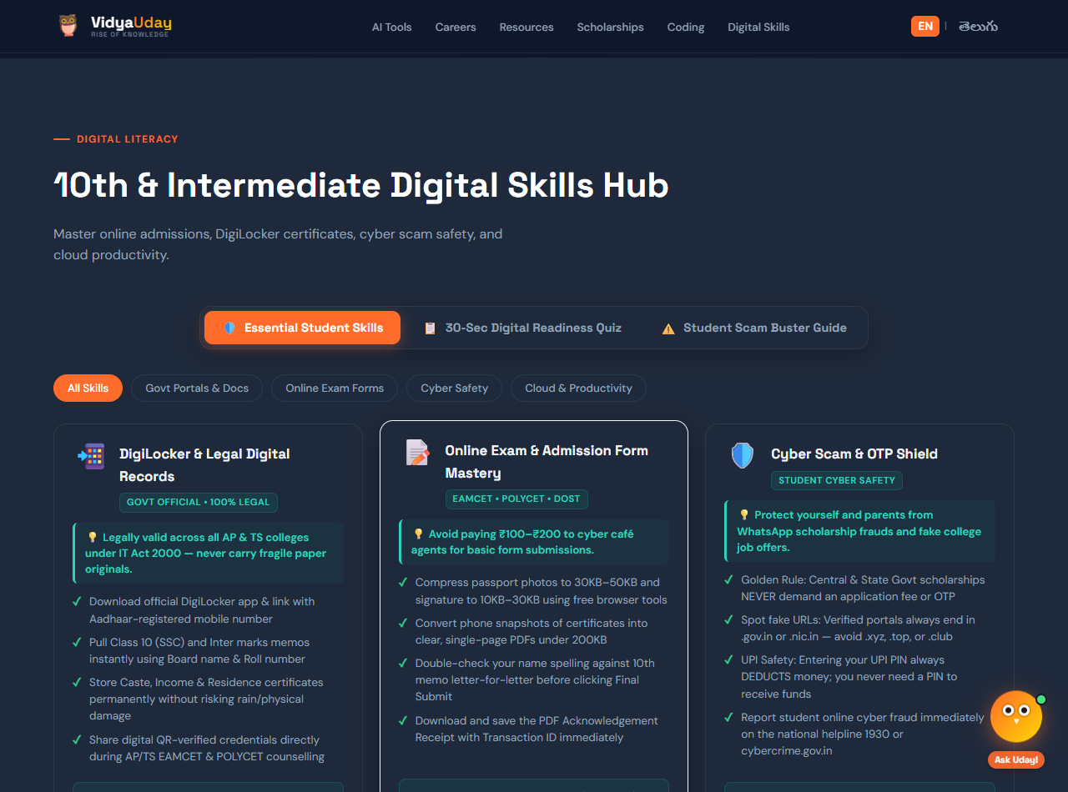
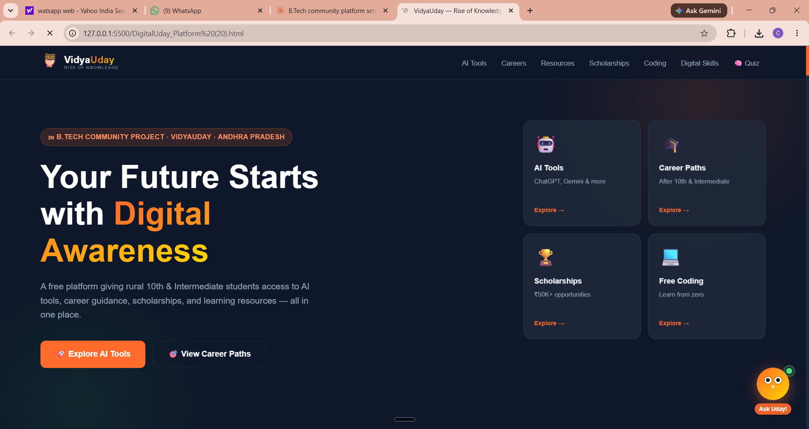
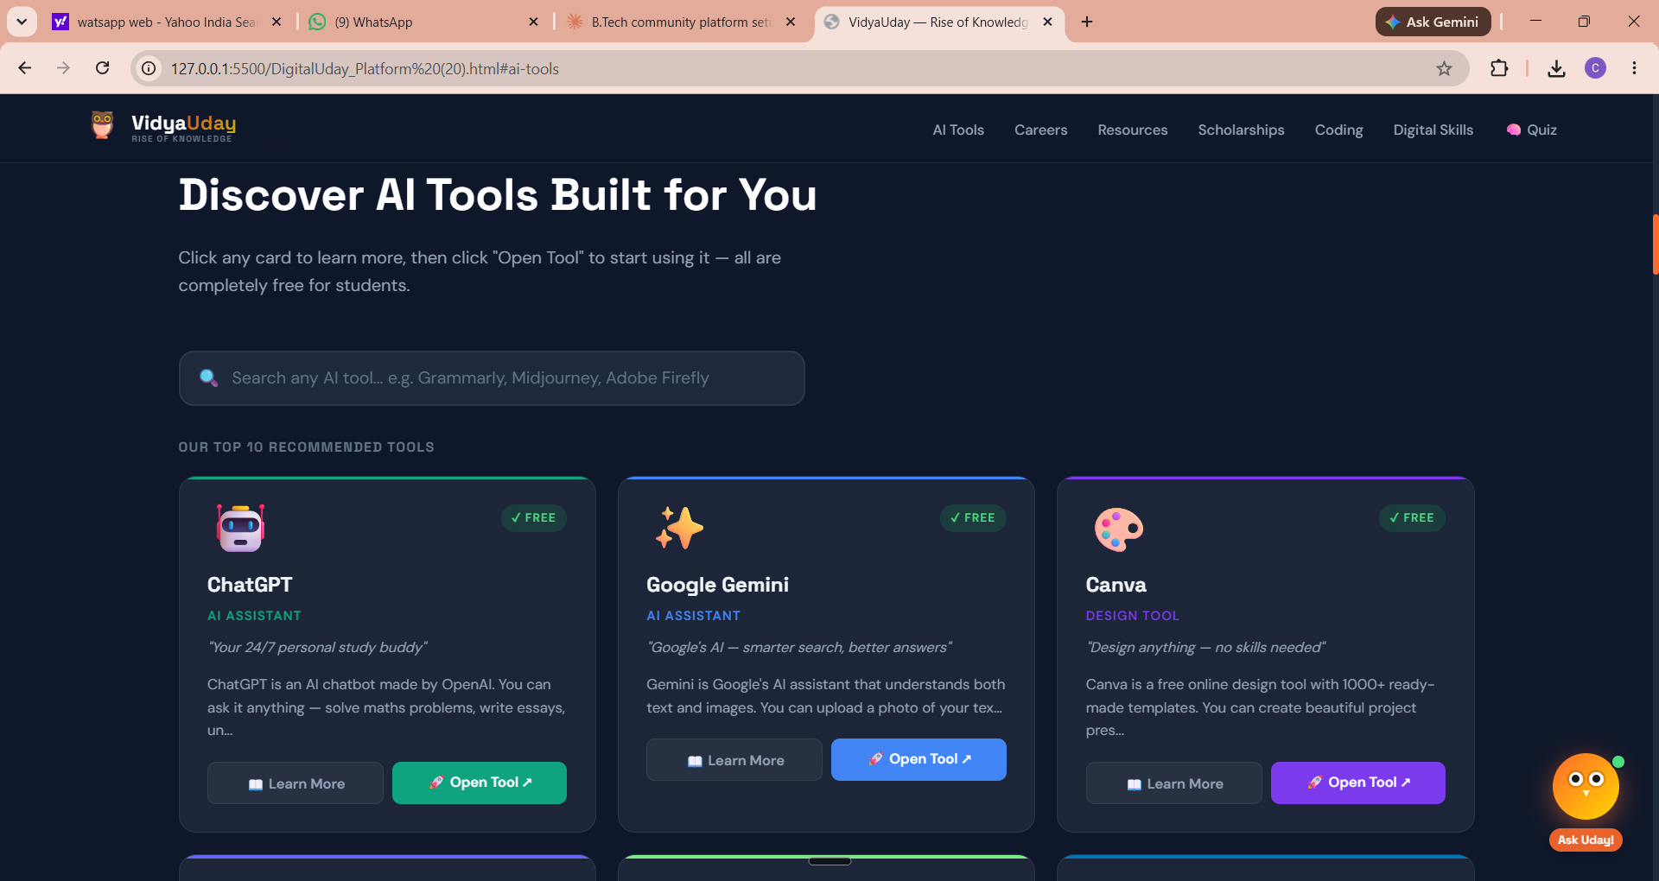
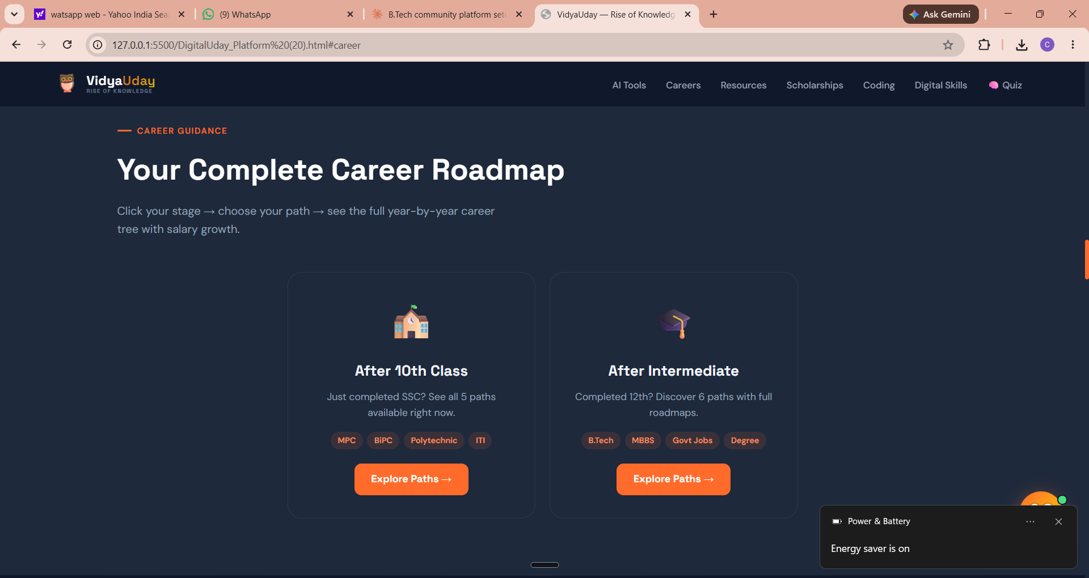
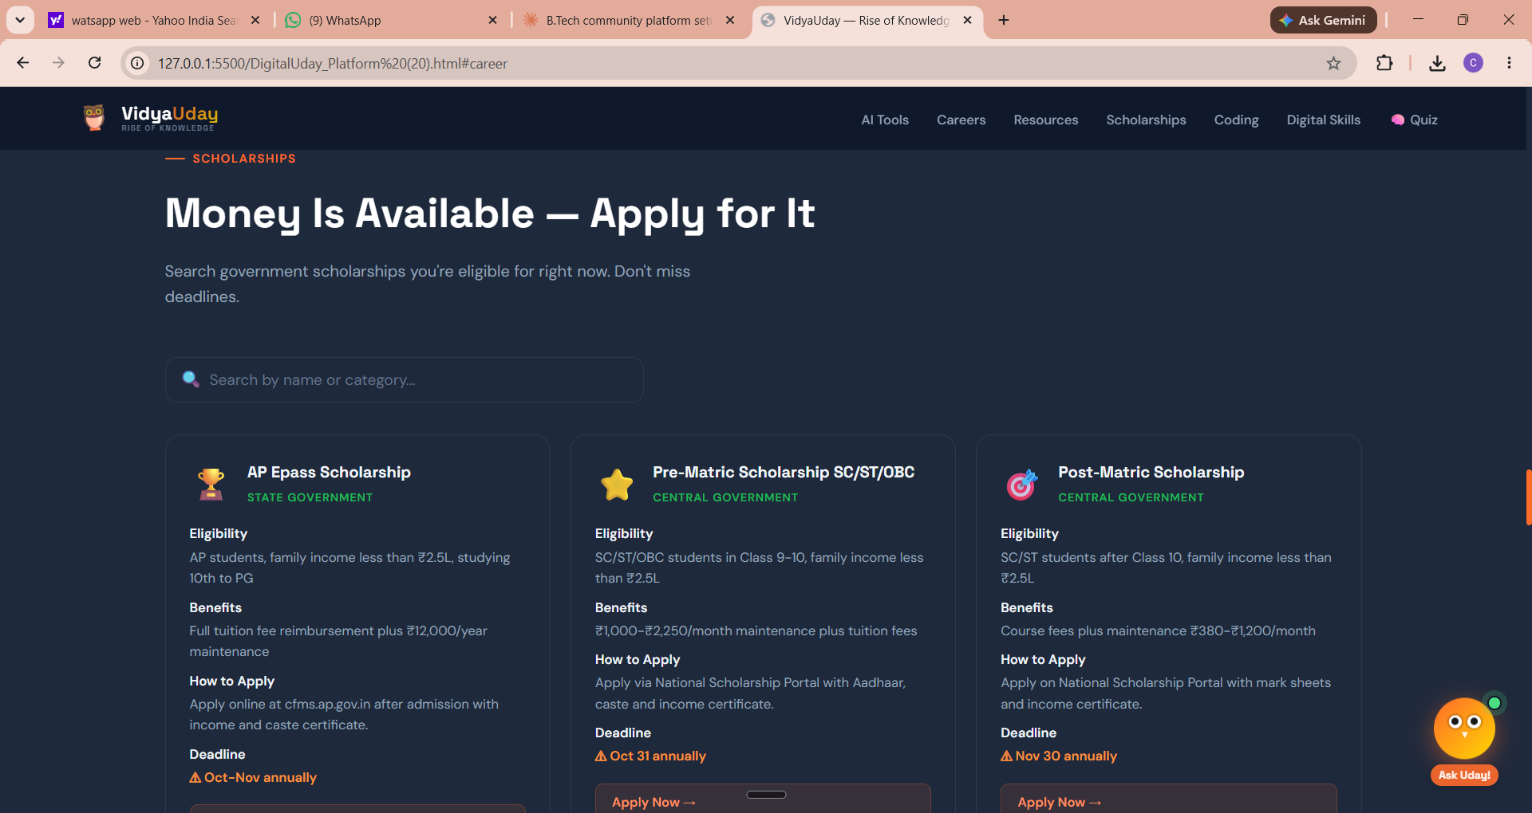
VidyaUday Live Platform Screenshots
Real production screens demonstrating interactive student capabilities
Screen 1: Scholarship Discovery Hub
Screen 2: Interactive Career Roadmaps
Screen 3: AP/TS Eligibility Matcher
Screen 4: Digital Literacy & Scam Buster
VidyaUday | 13
03-07-2026

Slide 14
Impact Assessment
Technical, social, and economic impact of the VidyaUday platform
Social & Educational Impact on Rural Students
🎓 Informed Career Choices: Breaks peer pressure by helping rural students explore diploma, vocational, and non-traditional careers with clear degree outcomes.
💸 Eliminates Cyber Café Charges: Empowers students to discover schemes and apply directly without paying ₹200–₹500 in service charges for each form.
🛡️ Builds Cyber Hygiene & Safety: Trains first-generation internet users to avoid online scam traps, protect OTPs, and report cyber fraud to helpline 1930.
Technological Impact & Innovation
⚡ Sub-1.5s Load Time on 3G: High-speed, responsive single-page architecture optimized for low-cost smartphones and rural mobile networks.
🤖 Real AI & Voice Integration: Integrates Google Gemini 1.5 Flash API and Web Speech API into a zero-login, privacy-first web application.
VidyaUday | 14
03-07-2026

Slide 15
Challenges Faced
Key obstacles encountered during development and how each one was resolved
Key Challenges & Engineering Solutions
🤖 Making AI Accessible to School Students: Challenge: Rural students do not know how to prompt AI tools like ChatGPT or Gemini effectively. Solution: Created 1-click copyable prompt cards tailored specifically for homework help, maths problem-solving, and vernacular translation.
⚖️ Handling Diverse Government Scholarship Rules: Challenge: Central and State scholarship schemes maintain divergent eligibility rules, income caps, and portal structures. Solution: Engineered a unified, state-aware JSON decision rule engine that dynamically evaluates student profiles in seconds.
📶 Rural Internet & Low-Spec Device Constraints: Challenge: Rural students predominantly browse on basic smartphones with intermittent mobile connectivity. Solution: Replaced resource-heavy frameworks with pure lightweight JavaScript, clean CSS, SVG icons, and printable offline download packs.
VidyaUday | 15
03-07-2026

Slide 16
Conclusion
What VidyaUday proves — and what it means for every rural student
Summary of Project Achievements
🏆 Built a Production-Ready Platform: Successfully deployed VidyaUday as a 100% free, all-in-one educational guidance platform for rural students.
🤖 United AI Tools, Roadmaps & Scholarships: Centralized curated AI tools, interactive career streams, government scholarships, and SCERT textbooks into one clean web portal.
🦉 Integrated Conversational AI & Speech: Integrated Google Gemini 1.5 Flash API and Web Speech voice technology so language is never a barrier.
Final Project Takeaway
🌟 VidyaUday demonstrates that accessible, thoughtful technology can bridge the rural education divide. By placing high-quality guidance, scholarship access, and digital literacy directly into students' hands at zero cost, we empower rural youth to make confident, informed choices for their future.
VidyaUday | 16
03-07-2026

Slide 17
Future Work
Planned enhancements that will take VidyaUday to the next level
Roadmap for Future Platform Enhancements
📲 Progressive Web App (PWA) Offline Engine: Implement service-worker caching to allow students to access career roadmaps, guides, and prompts with zero internet connectivity.
🤖 Automated WhatsApp & Telegram Alert Bot: Develop an automated vernacular bot sending scholarship deadline reminders, entrance exam alerts, and career FAQs directly to family phones.
🤝 College Student Mentorship Network: Establish a digital volunteer bridge connecting senior engineering students from MVGR College with rural school students for 1-on-1 career guidance.
📦 Native Ultra-Lightweight Android APK: Package the platform into a standalone 2MB Android application distributed freely through village schools, Grama Sachivalayams, and local libraries.
VidyaUday | 17
03-07-2026

Slide 18
References
Sources consulted and official platforms referenced in building VidyaUday
Academic & Statutory References
🏛️ [1] National Education Policy (NEP 2020), Ministry of Education, Government of India, New Delhi.
🌐 [2] National Scholarship Portal (NSP), Ministry of Electronics & IT, Govt of India: https://scholarships.gov.in
📑 [3] State Social Welfare Department Gazettes & ePASS Electronic Scholarship System: https://telanganaepass.cgg.gov.in
🤖 [4] Google Gemini API Documentation, Google AI for Developers, Generative Language API, 2024.
📊 [5] Pratham Education Foundation, "Annual Status of Education Report (ASER): Beyond Basics," New Delhi.
🚨 [6] National Cyber Crime Reporting Portal (Helpline 1930), Indian Cyber Crime Coordination Centre (I4C), MHA: https://cybercrime.gov.in
VidyaUday | 18
03-07-2026

