Slide 1
Data Structures And Algorithms

Slide 2
Arrays
An array is an indexed sequence of components
Typically, the array occupies sequential storage locations
The length of the array is determined when the array is created, and cannot be changed
Each component of the array has a fixed, unique index
Indices range from a lower bound to an upper bound
Any component of the array can be inspected or updated by using its index

Slide 3
Array Limitations
Size of the array remains fixed, so expansion is not possible. Size is specified at the time of array creation
Insertion of an element in the array is very complex
Deletion of array element is not possible. We can delete the value at a given location, but the array does not shrink

Slide 4
Inserting an element into an array
Suppose we want to insert the value 8 into this sorted array (while keeping the array sorted)
1
3
3
7
12
14
17
19
22
30
We can do this by shifting all the elements after the mark right by one location
Of course, we have to discard the 30 when we do this
1
3
3
7
8
12
14
17
19
22
30
• Moving all those elements makes this a slow operation (linear in the size of the array)

Slide 5
Deleting an element from an array
Deleting an element is similar--again, we have to move all the elements after it
1
3
3
7
8
12
14
17
19
22
1
3
3
7
12
14
17
19
22
?
Deletion is a slow operation; we don’t want to do it very often
Deletion leaves a “vacant” location at the end
How do we mark it vacant?
Every bit pattern represents a valid integer
We must keep a count of how many valid elements are in the array

Slide 6
Linked Lists
A linked list is a sequence of dynamically allocated storage elements, each containing a pointer to its successor
As storage is allocated dynamically, there is no size limitation as in arrays
The list can expand or shrink based on the requirement
Head and Tail pointers hold the refence of first and last node in the list
Types of lists - linear lists, circular lists, doubly linked lists

Slide 7
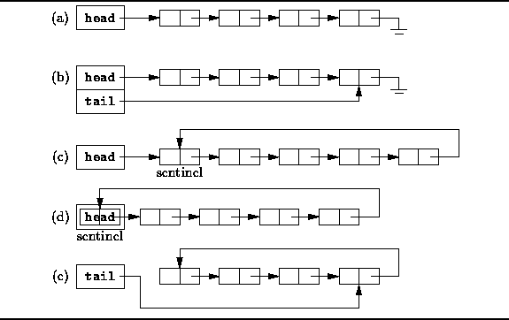
Linked Lists

Slide 8
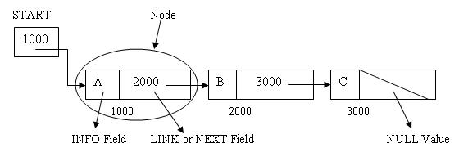
Linked Lists - variations
Linear List :
Each node points to next node. Head pointer points to first node and pointer in the last node will be NULL
Also known as One Way List or Singly Linked List

Slide 9
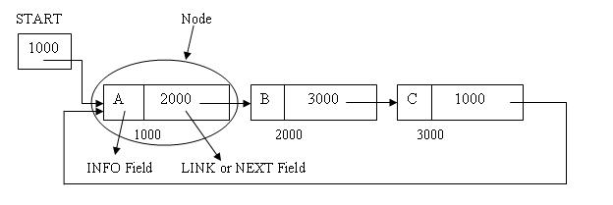
Linked Lists - variations
Circular lists :
Same as Linear lists but the last node points to the first node

Slide 10
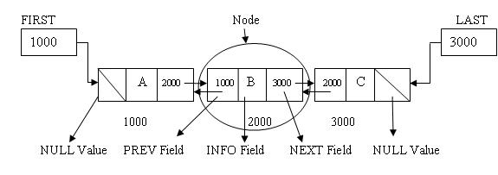
Linked Lists - variations
Doubly linked lists :
Each node will have 2 pointers to point to next node and previous node
Suitable to traverse forward as well as backward

Slide 11
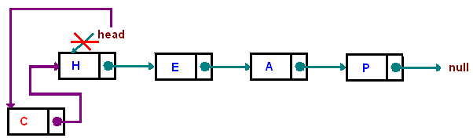
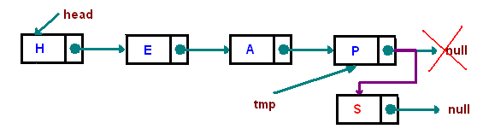
Linked List - Operations
Adding node at the beginning ( HEAD) of the list (AddFirst )
Adding node at the end ( TAIL) of the list (AddLast )

Slide 12
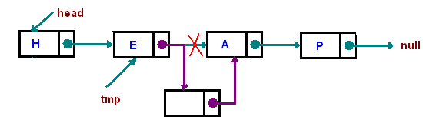
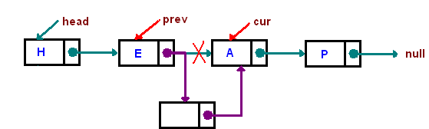
Linked List - Operations
Adding new node after a particular node ( AddAfter )
Adding new node before a particular node (AddBefore)

Slide 13
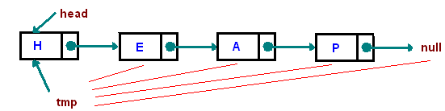

Linked List - Operations
Traversing the List ( Search, ShowAll etc )
Deleting the first node ( DeleteFirst )

Slide 14
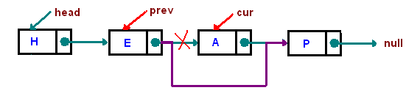
Linked List - Operations
Deleting a particular node ( Delete )

Slide 15
Stacks
A stack is a container which provides function, Push, for putting objects into the stack; and one function, Pop, for taking objects out of the stack
A stack is a last-in, first-out or LIFO data structure
The last item put into the stack is a the top. When an item is pushed into a stack, it is placed at the top of the pile
When an item popped, it is always the top item which is removed
A typical stack implementation also provides an accessor called Top which returns the item at the top of the stack without removing it from the stack

Slide 16
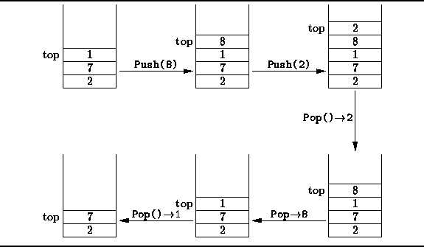
Stacks

Slide 17
Queues
A Queue is a container which provides function, Enqueue, for adding objects into the queue; and one function, Dequeue, for taking objects out of the queue
A queue is a first-in, first-out or FIFO data structure
Items are added at the end of the quese and removed from the beginning of the queue

Slide 18
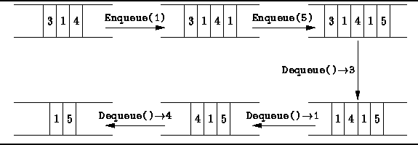
Queues

Slide 19
Recursion

Slide 20
Recursion
The function calling itself is called recursion
There has to be terminating condition in recursion
Recursion is alternative to repeated actions where loops are not possible

Slide 21
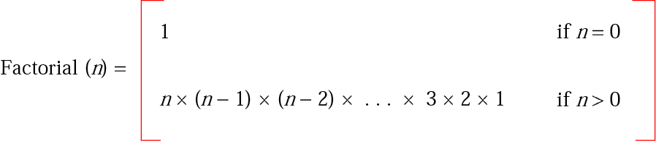
Iterative definition of factorial

Slide 22
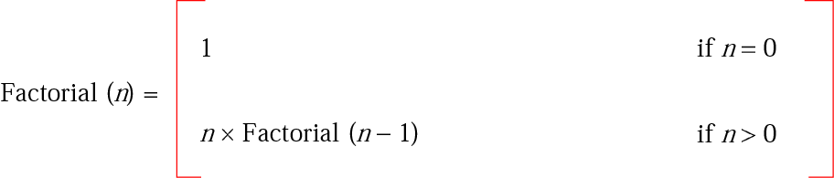
Recursive definition of factorial

Slide 23
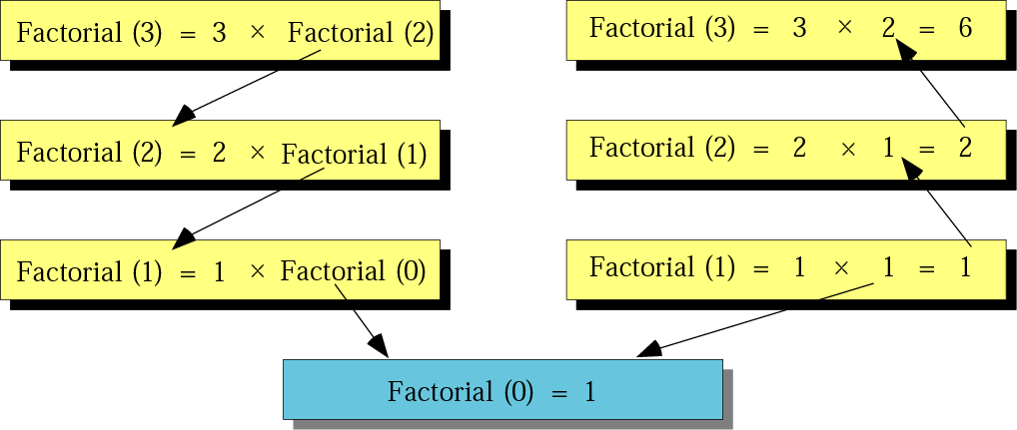
Tracing recursive solution to factorial problem

Slide 24
Recursive factorial
Factorial
Input: A positive integer num
if (num is equal to 0) then 1.1 return 1 else 1.2 return num x Factorial (num – 1) End if
End

Slide 25
Sorting

Slide 26
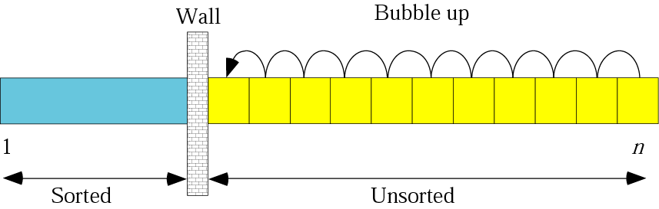
Bubble sort

Slide 27
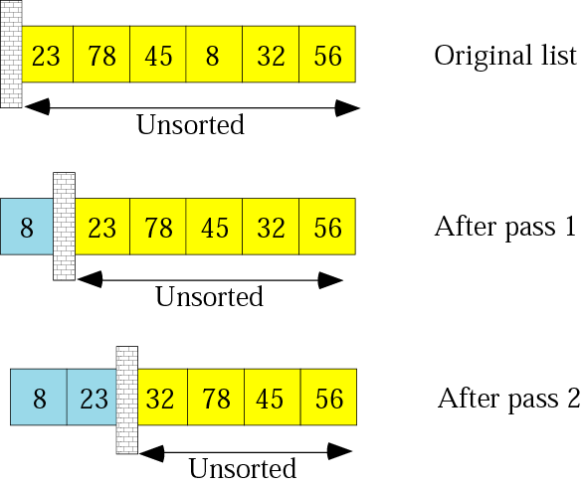
Example of bubble sort

Slide 28
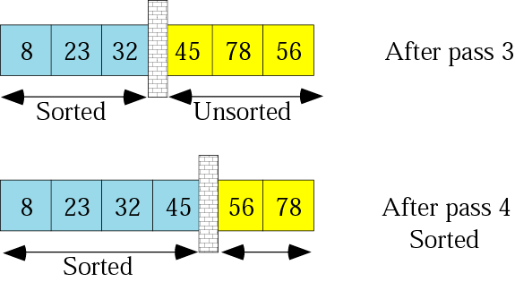
Example of bubble sort

Slide 29
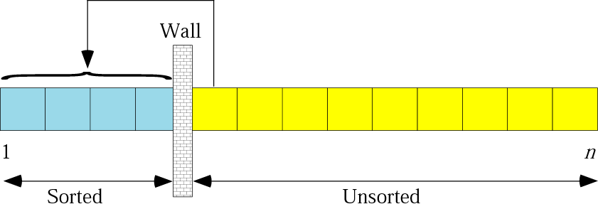
Insertion sort

Slide 30
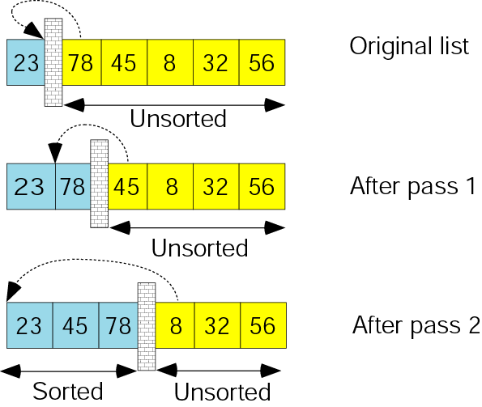
Example of insertion sort

Slide 31
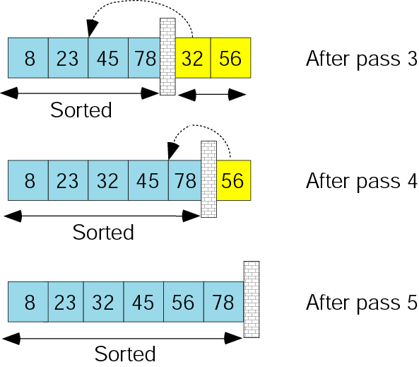
Example of insertion sort

Slide 32
Merge sort
Merge sort includes two operations
Keep dividing the array into and two arrays and sort them separately
Merge these two arrays into one using merge algorithm

Slide 33
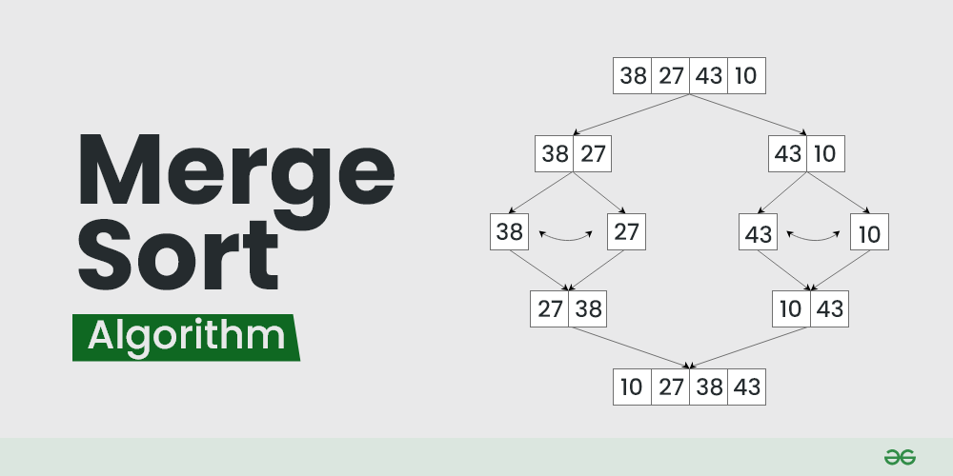
Merge sort

Slide 34
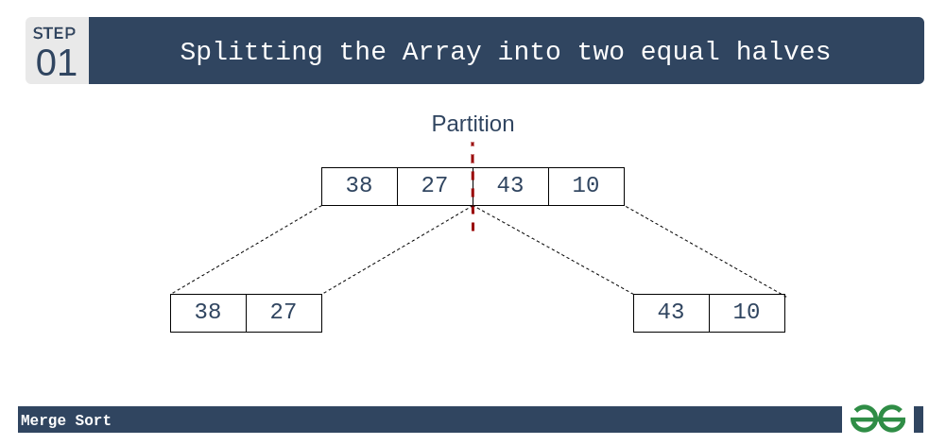
Merge sort

Slide 35
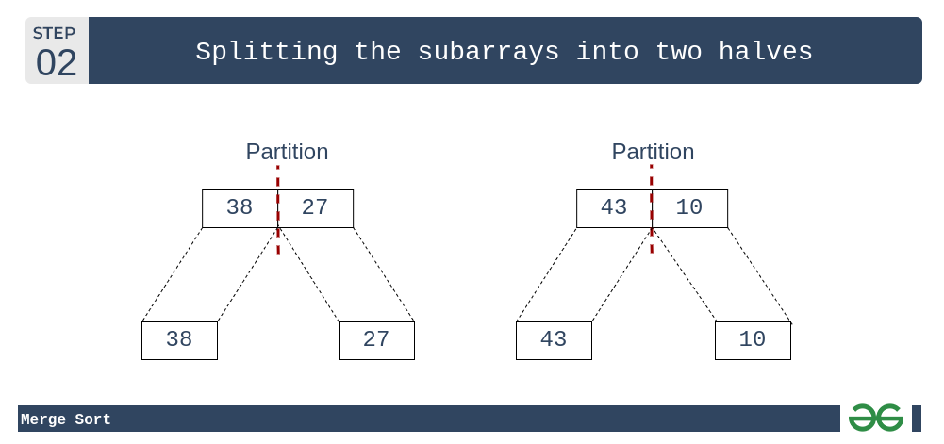
Merge sort

Slide 36

Merge sort

Slide 37
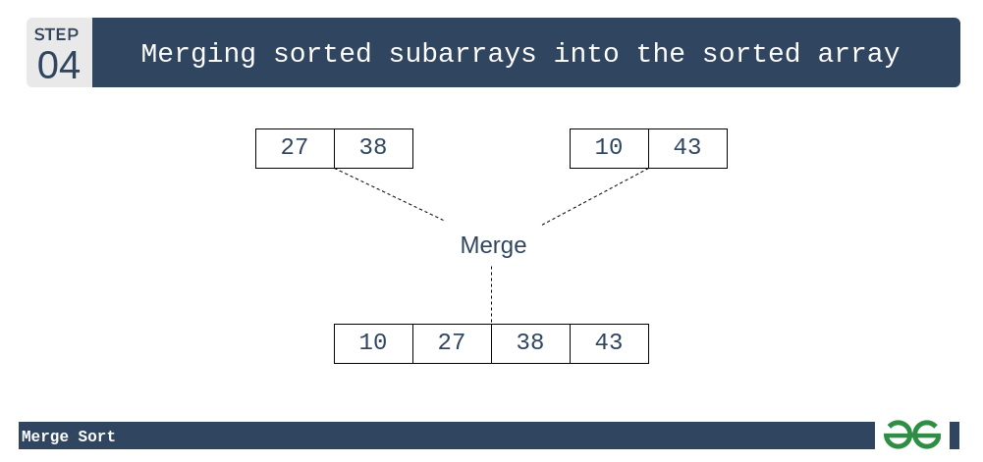
Merge sort

Slide 38
Searching

Slide 39
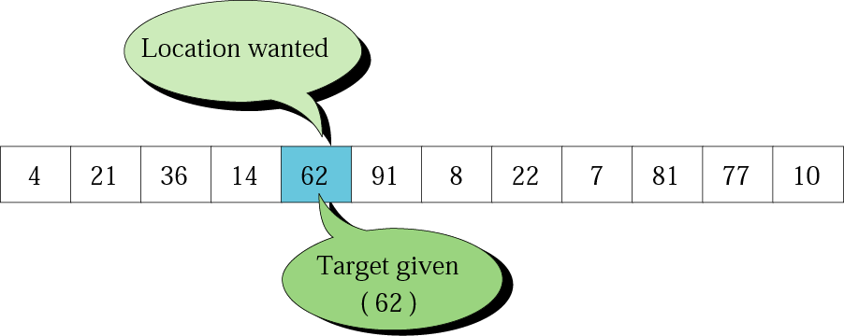
Search concept

Slide 40
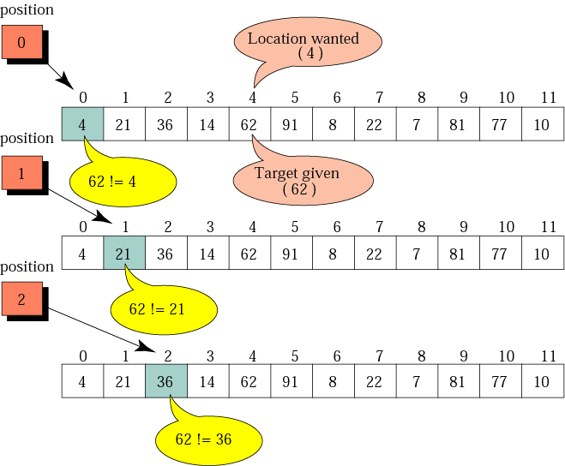
Example of a sequential search

Slide 41
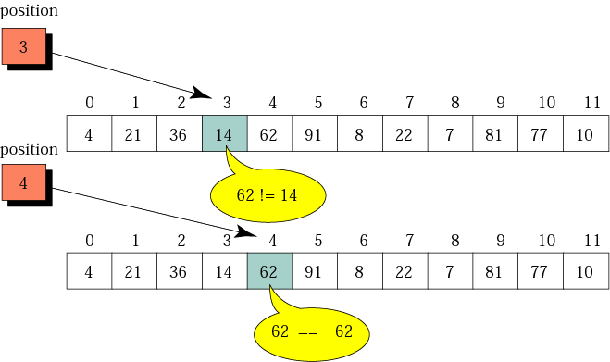
Example of a sequential search

Slide 42
Binary search
Binary search can be performed only on sorted data
Divide the array into two parts and search only the part where the element may possibly present
Repeat this until left with single element or the element found

Slide 43
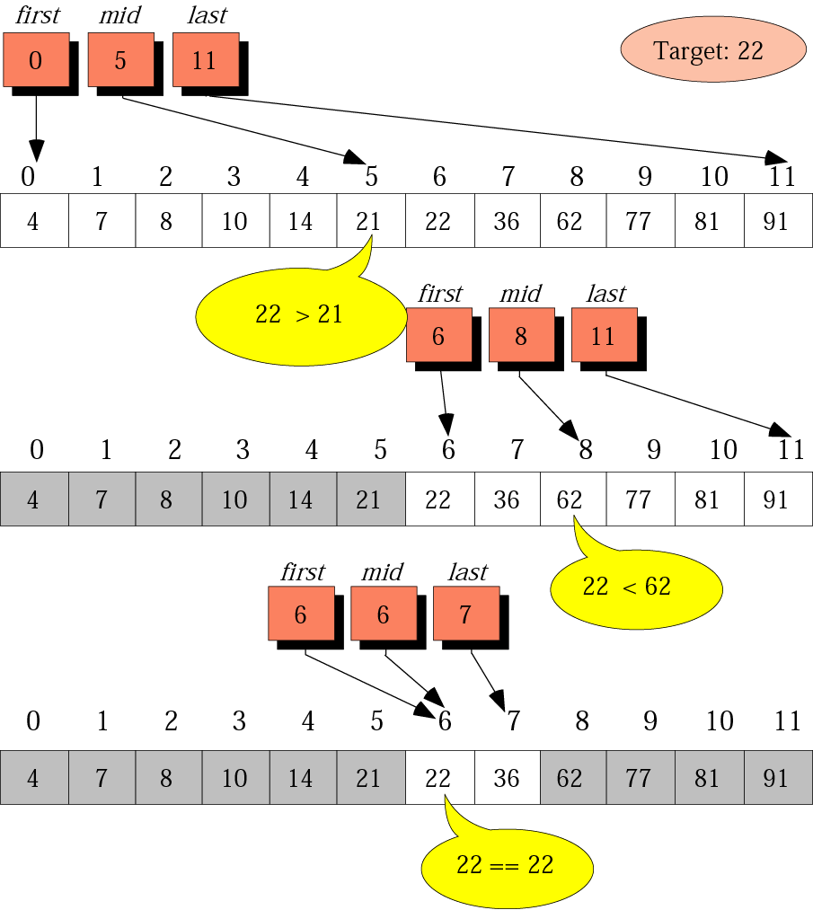
Example of a binary search

Slide 44
End

