Slide 1


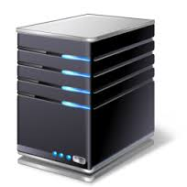

Clients
Phones
$$$/
Free
Capability
Token
Register using
Capability Token
Calls over
external carriers
App Server
Account SID,
AuthToken
$$$
Twilio Server

