Slide 1
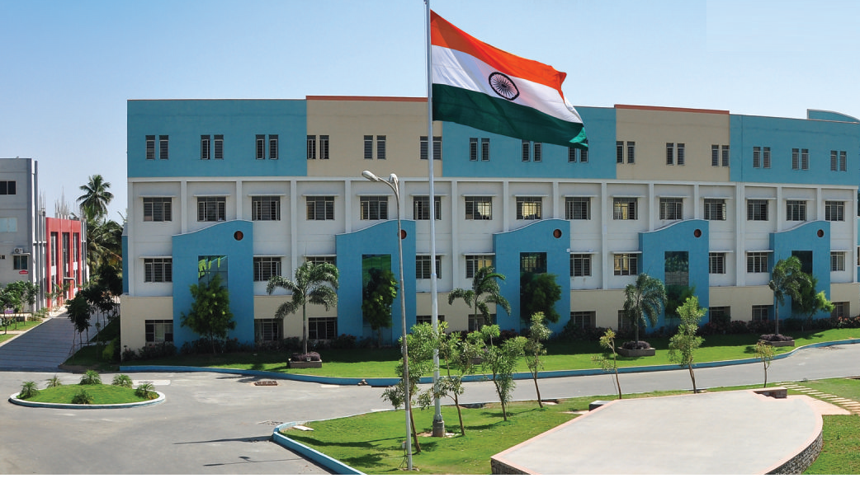
SRI ESHWAR COLLEGE OF ENGINEERING
academic year : 2017-18 department : civil section : 4 -year
FINAL YEAR PROJECT REVIEW – 1st
Date of review: 02.08.2017

Slide 2
PLANNING,ANALYSIS AND DESIGN OF STATE BANK OF INDIA
By,
K.JANANI S.SRINIVASAN
M.DIVYA DHARSINI
GUIDED BY,
Mr S.RAAJ KUMAR
ASSISTANT PROFESSOR
SRI ESHWAR COLLEGE OF ENGINEERING

Slide 3
CONTENTS
Introduction
Study area
Literature review
Objectives
Methodology
Work plan

Slide 4
ABSTRACT
The total area of the parking is 5000 sq.ft
Total height of the buliding 29,180 mm is feet consisting one floor
Code books referred: IS 456-2007, IS 875, IS 800-2000

Slide 5
INTRODUCTION
A system of trading money which: provides a safe place to save excess cash known as deposits.
Supplies liquidity to the economy by loaning this money out to help businesses grow and to allow consumers to purchase consumers products, homes, cars etc

Slide 6
Objective
Securitization of loans
Bank lockers
Earning savings through demand and term deposit accountss
Safe and secure transactions can be achieved
Dealing in Foreign exchange

Slide 7
STUDY AREA
Our project will be implement on “KONDAMPATTI”
REASON:
No other bank present in that area.
No atm present in that area.
people have to travel 9-10 km to withdraw or deposit money.

Slide 8
WORK PLAN
1 | 7/7/17 | Explain the out line of the project
2 | 21/7/17 | To visit the existing bank to gain more information
3 | 2/8/17 | Planning, designing process to be completed
4 | 16/8/17 | 1st step of analysis process is to be started
5 | 11/9/17 | Analysis process is to be completed
6 | 27/9/17 | To explain the entire project
7 | 20/10/17 | To submit the project book
8 | 28/10/17 | Final review

Slide 9
LITERATURE REVIEW
S.No | Title | Journal /Author/Year | Description
1 | Competition in Banking Industry | International Journal of Commerce Business and Management IJCBM, ISSN:2319-2828 Vol. 1, No3, December 2012. | These paper tries to look at the assessed completion and market power.
2 | LITERATURE REVIEW OF SERVICE QUALITYIMPROVEMENT IN THE RETAIL BANKING INDUSTRY | Dr.Chaisomphol Chaoprasert | The paper analyzes past studies regarding service quality improvement in the banking industry
3 | A literature review of Bank Profitable and risk adjustments decisions | International conference on business economics, financial science and management TORONTO, CANADA,17-jun-2014 | In this paper describe risk about finance and banking.

Slide 10
S.no | Title | Journal /Author/Year | Description
4 | Literature Review On The Profitability Of Banks | International journal of probability of bank vol 13 pg-385-399/ Mohan, Don/2011 | These paper describes about profitability of bank.
5. | Literature Review of Banking sector | International journal of Banking vol 17 issues1/C.Patel,M.Swami,P.Saikia,S.Shah/2015 | About development of Banking sectors in India.
6 | Literature Review of Banking and risk | International journal of Banking and risk vol 19 issues2/Figg J W /2011 | About risk developed in banking sectors.

Slide 11
S.No | Title | Journal/Author/Year | Description
8 | Literature Review of Banking services | International journal on Banking services Atlas.Randall I/2010 | It gives us about development of advance Banking services.
9 | Literature Review of profitability analysis | International journal of profitability analysis Anyangu Harris Amunga/2009 | It describes about full data’s of profitability analysis
10 | Literature review on financial performance analysis of banks | International journal of emerging financial performance analysis of Bank O.Omar,M.Latif, /2013 | It tells us about financial performance analysis of bank

Slide 12
METHODOLOGY
By using “Auto CAD” software planning and designing of bank.
By using “STAAD Pro.” software analyzing of bank.
By using “Revit Architecture” software. It shows section & elevation of the bank structure.
By using “Primavera” software to estimate the total cost of the bank.

Slide 13
QUERIES??...

