Slide 1

AI Academy: Future-Ready Skills for Grades 6-9

Slide 2


Why AI now?
For grades 6–9
SKILLS SHIFT 2026 → 2030
2026 • NOW
42% need
85%
2027 • L1
58%
2028 • L2
71%
of jobs in 2030 will need AI literacy — World Economic Forum. Not college. Now.
2029 • L3
83%
AI literacy is not coding alone. It's pattern detection, data thinking, and ethical decisions.
2030 • L4
85%
What this means: Starting in middle school builds judgment before habits form. By G9, your child has built, not just watched, AI.
Grades 6–9 is the brain window for abstract thinking + real-world curiosity
Spiral learning — same concept, deeper each year — sticks where cramming fails
Pattern
Data
Ethics
Future-ready means your child can question AI, not just use it
Detects regularity
Cleans messy data
Chooses rightly

Slide 3
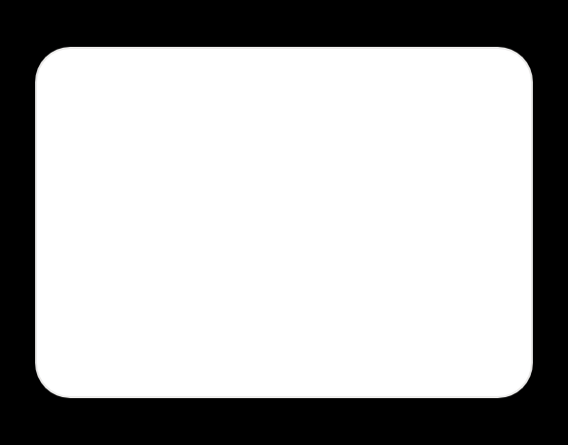

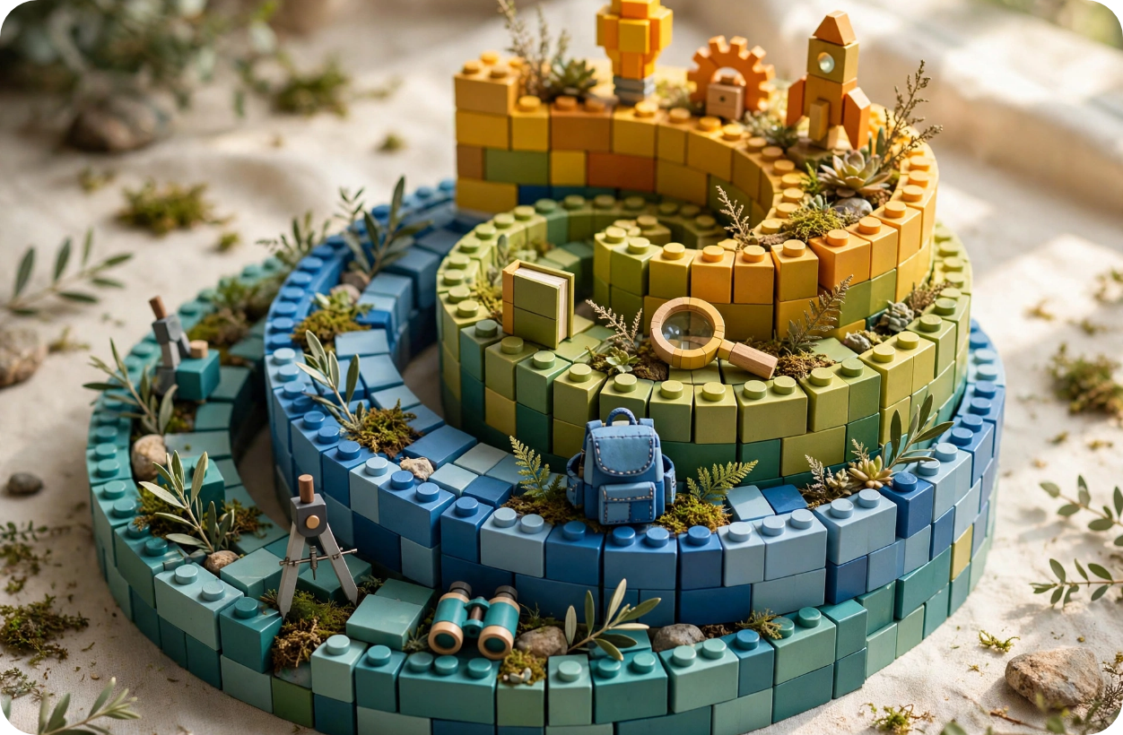






Our model at a glance — 4 levels, 144 weeks, spiral learning
Same core ideas revisit deeper each year. No jumps. No gaps.
L1 G6 Explorer
36 WEEKS
L2 G7 Builder
36 WEEKS
Foundation • Play + patterns
Tools • Real data
•
Pattern Detector – Sock Sorting
•
Data cleaning & classification
•
Bouncer at Club – Classification
•
Regression – Auto-rickshaw fares
•
Messy Room 80% – Data cleaning
•
Evaluation + Real-world ML
GRADE 6 • CURIOSITY FIRST
GRADE 7 • HANDS-ON RIGOR
L3 G8 Creator
36 WEEKS
L4 G9 Innovator
36 WEEKS
Depth • Neural ideas
Systems • Launch
•
LEGO Neurons – Assembly Line
•
Robot Senses – Distance 0-400cm
•
Cookie Cutter Convolution 1989
•
Spotlight Theater – Attention
•
Blindfolded Map – SLAM tiffin route
Spiral staircase: Concepts return higher each orbit — pattern thinking in G6 becomes neural skill in G8, becomes agents in G9.
•
Startup + Moonshot JFK 1962
GRADE 8 • BUILD BRAINS
GRADE 9 • REAL AUDIENCE
↻
Why spiral works: L1 sorts socks by pattern. L3 sorts pixels by same logic (convolution). L4 sorts sensor readings to map a tiffin delivery. Your child doesn't relearn — they level up.

Slide 4













How a single week works — 90 minutes, 9 sections
HOOK 10m
MENTAL 15m
LAB 20m
POOL 10m
ETHICS 15m
PROJECT 20m
?
Hook 10m + Mental Model 15m
◍
Physical Lab 20m
◍◍
Community Pool 10m
"Can a computer be a bouncer?" Real question → Teacher analogy + Where it breaks + Draw-Along 60-sec sketch.
No-Tech default cards → Simulator sliders live → High-Tech bonus micro:bit. Failure Museum: 3 fails ❌→✅ fix.
Anonymized pooling 60 → 180 students. Privacy: counts only, no names. Diversity: Hyderabad + Delhi + Chennai = 72% → 88%.
SAY EXACTLY → KID DRAWS → CHECK
Success = LED AND gate works, explains weight + bias
WHY POOLING = LAW OF LARGE NUMBERS
⚑
Ethics 15m
★
Project Studio 20m
✓
Workbook + Eval
Traffic light Red/Yellow/Green + case study Gender Shades 2018. Pledge textarea: "I will check bias before training."
Choice Board A Science Fair B Game C Art — same core skill. Real audience + 60-sec pitch: My model... Works when... Fails when...
Sentence starters: "My model worked when... but failed when..." Self-dot Red/Yellow/Blue/Green. Formative check every 10m.
ACTION NOT JUST TALK
PORTFOLIO AUTO-ADDS
REFLECTION 5 MINS AT HOME

Slide 5
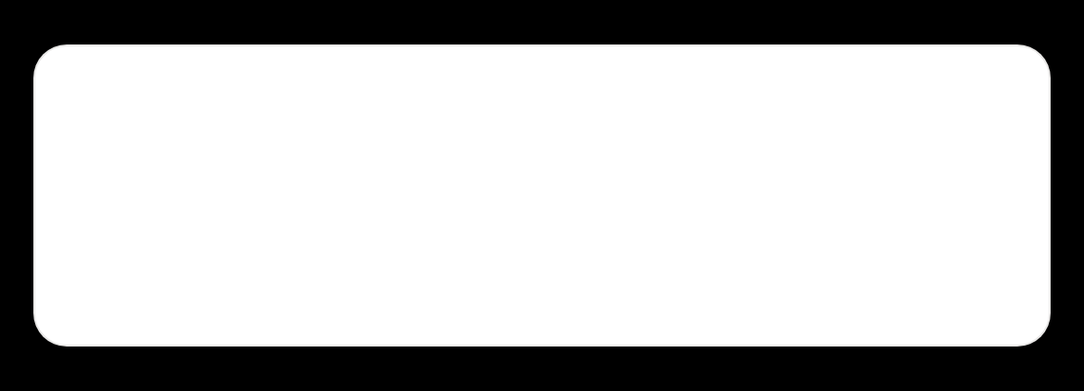












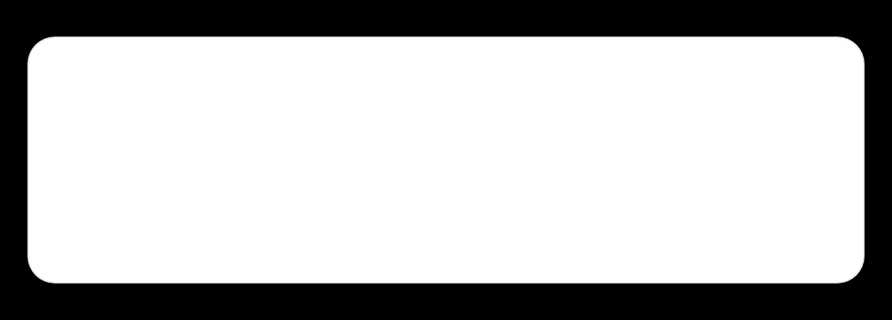
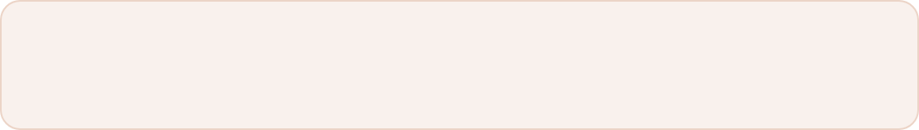


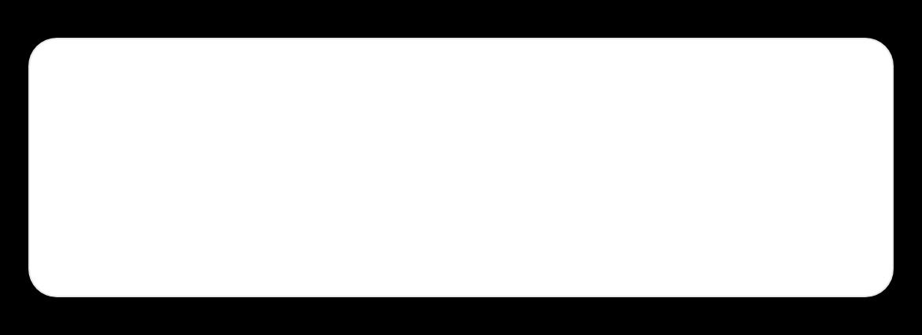


No hardware needed — how learning actually happens
Every school can run this — cards and paper first, phone simulators second, kits only as bonus.
No-Tech default
🃏
DEFAULT
NO-TECH CARDS • PRINT 1 PAGE
LIVE SIMULATOR • PHONE WORKS
Cut cards for weights, bias, inputs. Students are the computer — human simulation. No projector, no internet needed. Works on floor.
w1=2
💡
w1
2.0
w2
-1
bias
-1
input
1/0
bias=-1
AND gate
Sum: 1.0 → LED ON ✓
Students add: w·x + b → decision
🏛️
Failure Museum — 3 fails per lab
Live simulators — on phone
Example: LED always ON — bias was -2 → try -1 • Builds growth mindset: "Watch me fail first, then fix" • No fear of mistakes
🎛️
Sliders for weights / bias / distance 0–400cm / servo 0–180°. LED turns ON/OFF instantly. 30+ simulators built-in, offline PWA.
📄
📱
♿
Printable cards
Offline PWA
Accessible
1-page PDF
After 1st load
Font toggle + high contrast
High-Tech optional
🔧
BONUS
Optional micro:bit + distance sensor + servo kit. Same lesson, real hardware reward. Not required for grade.

Slide 6








Where analogies break — preventing misconceptions
We teach the limit of every story. That’s how your child learns to think, not just memorize. Every week has Where it breaks, Common Wrong, and What if? to test immediately.
EXAMPLE • WEEK 2 • CLASSIFICATION
EXAMPLE • L3 W1 • NEURAL NETS
?
LIVE SIMULATOR CHECK • L3 U1 W2
Bouncer at Club
LEGO Neurons
“Many think weight = 0 ignores input”
WORKS
Sorting people by rules — like a neuron sorting inputs (allow / deny). Easy to picture.
WORKS
Bricks stack to build a decision. Add more bricks, more complex idea — like layers.
Correct, but bias still matters — LED may still be ON. Kids miss this.
BREAKS
Bouncer doesn't learn. Real neuron does — via backprop adjusting weights. We say that out loud.
BREAKS
Bricks are not continuous. Real weights are 0.73, -0.12, not just 0 or 1. LEGO steps, nature slides.
TRY NOW IN CLASS
w1=0, w2=1, bias = +0.2
Input 0,0 → 0*0+1*0+0.2 = 0.2 → ON
→ Weight zero didn't block bias
Common Wrong: “If it says no once, it always says no.” → Actually, new data retrains it.
Common Wrong: “More bricks = smarter.” → Actually, too many bricks = overfitting — memorizes, doesn't generalize.
WHAT IF TEST
WHAT IF TEST
WHAT IF BIAS +5?
What if music changes? Does bouncer rule still work? → Leads to bias discussion.
What if we use tiny bricks? → Introduces weight precision concept.
→ Always ON, regardless of inputs. Kids slide it live and see.

Slide 7
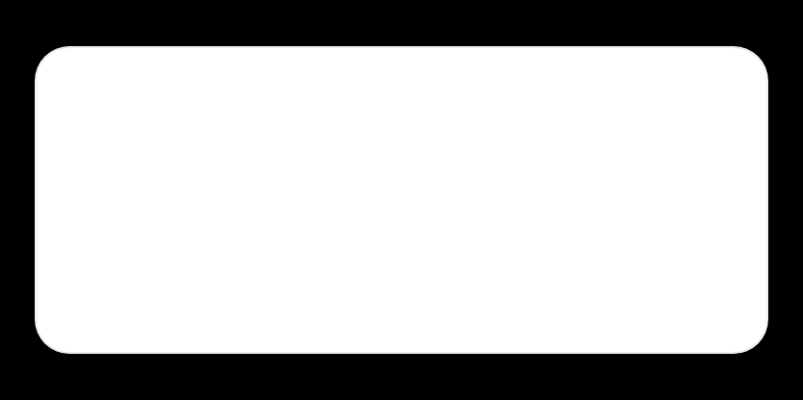
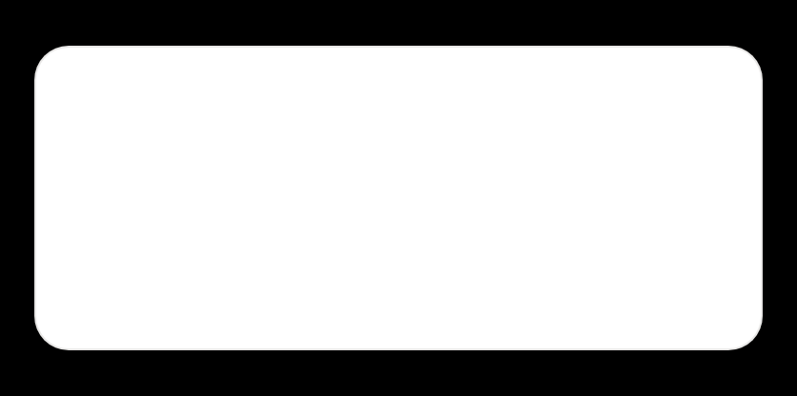










Choice Board + Real Audience — Every child finds their way
Same core skill, three doors in. Real people watching — not just teacher marks.
OPTION A • SCIENCE FAIR
🔬
OPTION B • GAME LAB
🎮
OPTION C • ART STUDIO
🎨
AND gate science board
Bouncer decides who enters
Light Switch controls LED art
Build weighted voting with cards. Show w·x+b → LED.
Game character filters players by 2 rules. Fail? Fix bias.
Diwali lights pattern reacts to inputs — art that thinks.
Skill: Weights + bias logic
Same skill, play context
Same skill, creative voice
Real Audience → 60-sec pitch
Differentiation baked in
Portfolio builds live. Demo Day at L4 end — parents, other class, website.
S
Struggling: Fill blanks, cards pre-cut, sentence starters
“My model… Works when… Fails when… Ethical risk… Next…” — structure they keep.
O
On-level: Build from scratch, simulator sliders live
A
Advanced: Add XOR 2nd layer — when one neuron isn't enough
✓ Photo of model
✓ 60-sec video
✓ My AI Portfolio
Parents tell us: “My child finally felt capable, not compared.”

Slide 8
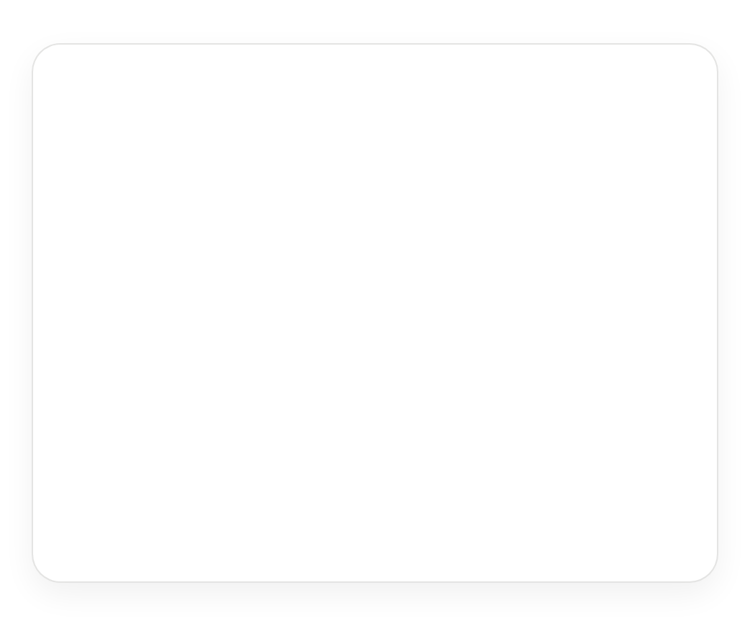


















Global standards,
local stories.
COMMUNITY POOL — DIVERSITY MATTERS
ANONYMIZED
Two of every six examples are Indian — so your child sees themselves in the learning, not an imported worksheet.
Made for your child
Hyderabad • Delhi • Chennai pooling
Telugu / Hindi vocab optional
Hyderabad
Delhi
Chennai
REGRESSION
CLASSIFICATION
Auto-rickshaw fare
Monsoon crop
Distance vs time vs traffic → predictable fare
Leaf image → healthy / stressed
One city only
Three cities diverse
72%
→
88%
VISION
SLAM • L4
biased accuracy
fair + robust
Cricket ball line
Tiffin delivery route
Camera detects out or in — same as VAR
Blindfolded map — tiffin wallah's memory
Vocab that sticks: weight = “bharuvu” (how much it pulls) — Telugu/Hindi gesture + pronunciation. Kids remember when language is theirs. Bias is taught with Diwali lights: “If we only train on white lights, we miss colorful diyas.”

Slide 9
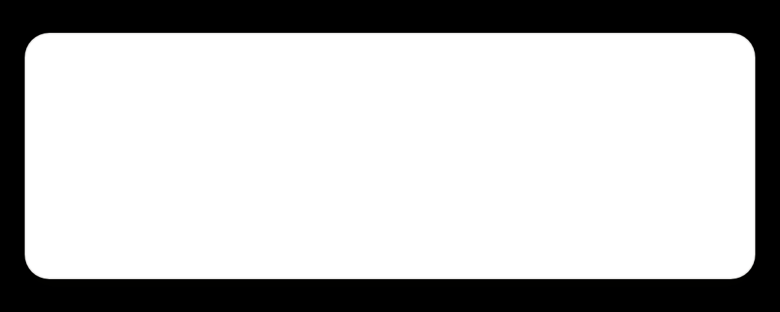
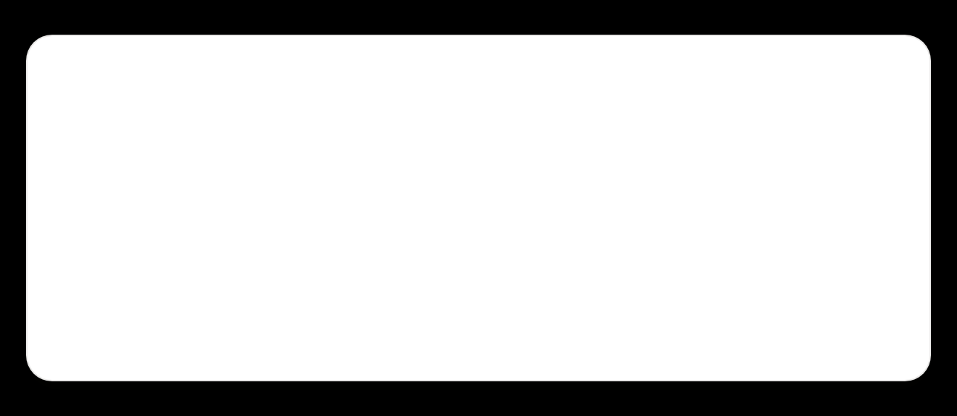






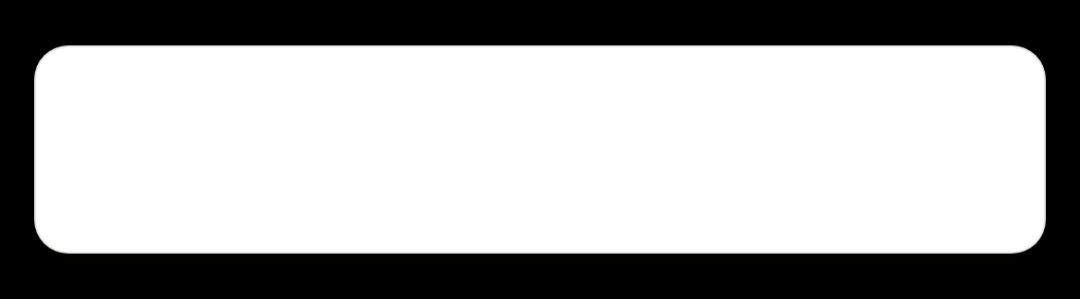


Safety, privacy & ethics — action, not just talk
We teach consent before code, consequences before convenience. Privacy is practiced in class, not promised in a policy doc.
PRIVACY • COMMUNITY POOL
ANONYMIZED ONLY
TRAFFIC LIGHT • ASK BEFORE YOU ACT
RED 2018 • GENDER SHADES
✓
We pool counts only — no names, no photos, no IDs. “Hyderabad class: 12/20 sorted correctly” — not who did it. Opt-out anytime.
STOP
Facial recognition bias — 34% error on darker women
Joy Buolamwini MIT study. We show our own pooling bias demo.
?
YELLOW 2023 • GETTY VS STABILITY AI
Kids practice consent: every pooling has a checkbox they read aloud: “I understand this is anonymous and I can opt-out.” Taught as digital citizenship.
Who owns training data? Permission Slip — Copyright
Artists sue AI trained on their work. Kids debate: cake ownership.
GO
GREEN 2024 • DEEPFAKE CHECK
Taylor Swift deepfake — consent + harm discussion
ENVIRONMENTAL ETHICS
REAL COST
When is generation harmful? Green only with consent + labeling.
🛺🛺
1 model training = 5 auto-rickshaw rides Energy infographic kids calculate in L4 — when to train vs. when to reuse
I will
What would YOU do?
check dataset bias before training — show my counts by city/gender.
Pledge + 1 action before project starts. Written, not clicked.
Student signs: ___________ Date: _______

Slide 10
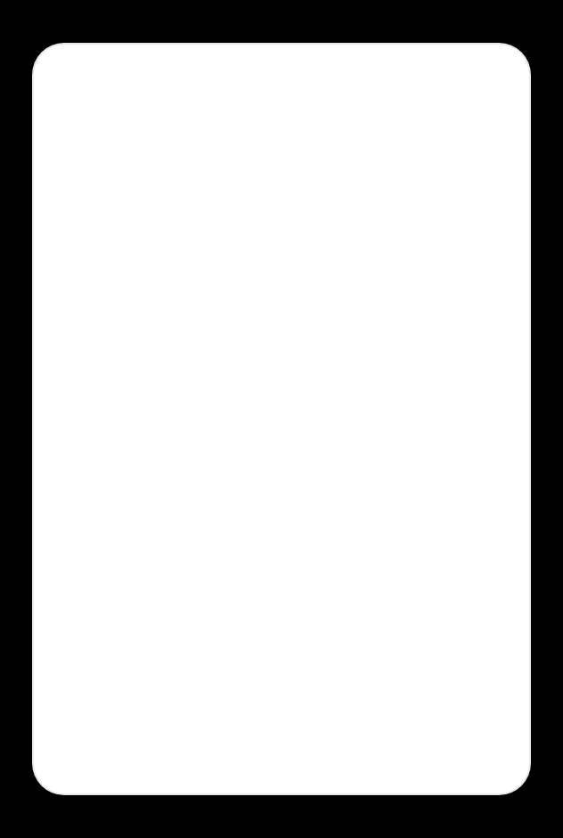
















Teacher training — zero-to-hero in 15 minutes
No AI background needed. Every week comes with exact scripts, misconceptions, and management tips — so any teacher can run it with confidence.
1
2
3
4
One-sentence core idea
Exact script + checks
Misconceptions mapped
Tips + credential
Week core locked: “Neuron = weighted vote + bias + decision.” Teacher starts from clarity, not jargon.
Each phase: Say: + student action + ✅ Green check + 🟠 If stuck.
3 Common Wrong + 2 What Kids Get Confused + fix + what to say. Socratic stems, not lectures.
Management: music during Project 20m, 30 dots ready. Growth ladder for teachers.
CHECK EVERY 10M:
✅ LED glows? ✅ Kids explain w+b?
🟠 If stuck: “What if bias +5? Try slider.”
MICRO-CREDENTIAL:
L1 Explorer Guide →
L2 Builder → L3 Creator →
L4 Innovator badge
SAY EXACTLY:
“This neuron votes. Weight says how loud. Bias says how stubborn. Then it decides.”
SOCRATIC 342 STEMS:
• “What do you notice?”
• “What do you wonder?”
• “How is X like Y?”
Timer visible
Cards pre-cut
Don't tell, ask
Peer checklist 5m
LinkedIn share
💬
Socratic, not telling: If early finisher → XOR ladder. If stuck → 30-sec action. Teacher models failing first: “Watch me fail, then fix.”
✓
Result: Zero prep panic — any teacher runs Day 1. Parent trust because teacher confidence is visible.

Slide 11

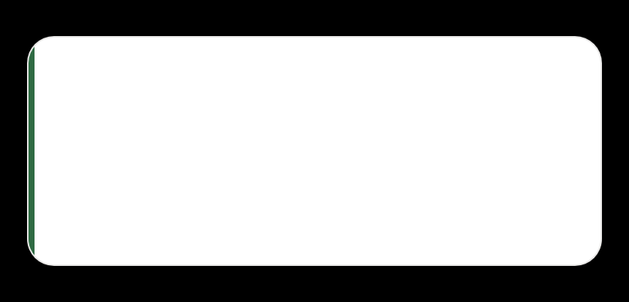
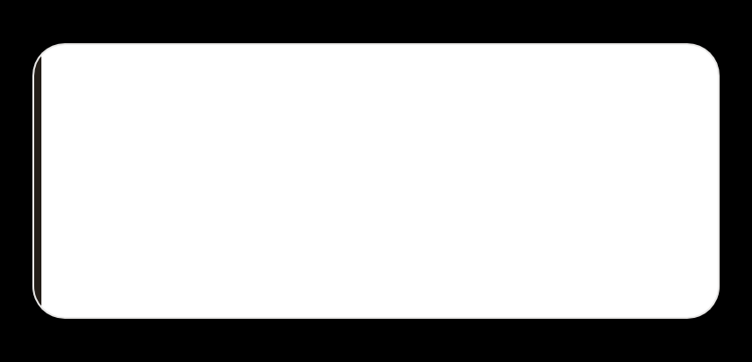
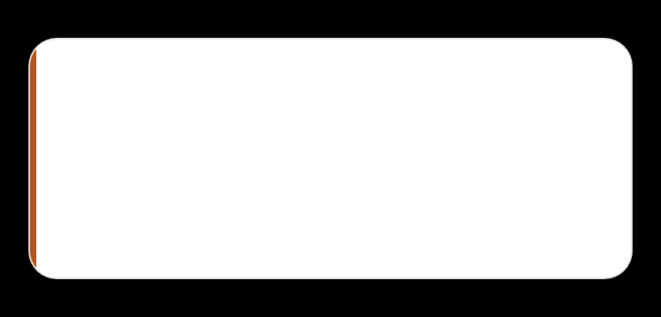









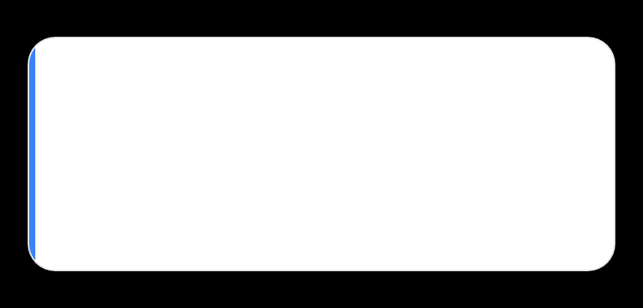
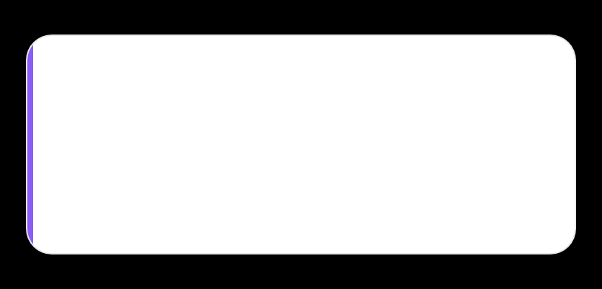
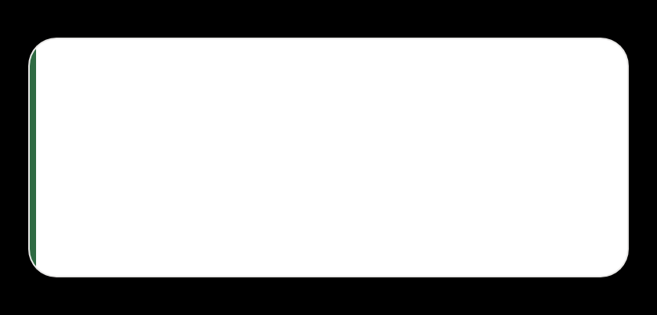










How it benefits your child —
skills that last beyond AI
We don't teach tricks for today's tools. We build judgment for tomorrow's problems — the same six skills parents value, tied to how the model actually runs.
VERIFIED 144 WEEKS • 114 SKILLS
◧
Data Thinking
?
Critical Thinking
✦
Creativity
80% of real AI work is cleaning. Messy Room analogy — sort, filter, keep what matters.
Where analogy breaks + Common Wrong + What If testing. Asks “when does this fail?”
Choice Board A/B/C — Science Fair, Game, Art. Dream Machine GANs to diffusion.
Messy data cards
Auto-rickshaw fare
Bouncer ≠ learning
weight=0, bias?
LED Diwali art
Dream Machine
◍◍
Collaboration
⚑
Ethics & Responsibility
↻
Resilience
Community Pooling 60→180, team agents AutoGen 2023, multi-modal building together.
Permission Slip Copyright, Who Owns Cake, Fair Referee — action pledge, not lecture.
Failure Museum 3 fails per lab + troubleshooting. “Watch me fail first, then fix.”
Hyd/Del/Che
72% → 88%
Traffic light R/Y/G
Gender Shades
LED always ON → bias -2 to -1
Growth mindset
✓
What parents see: Not screen time — thinking time. Your child explains “My model worked when… but failed when… Ethical risk…” in 60 seconds. That's transferable, not temporary.

Slide 12



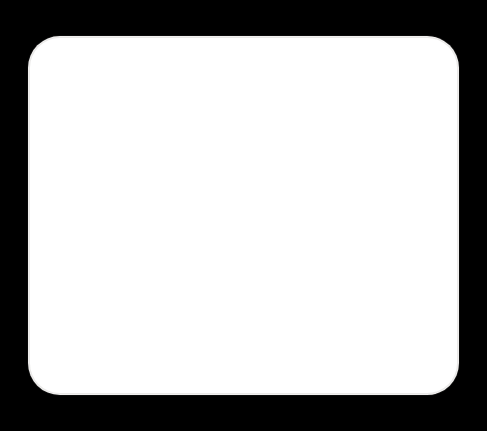
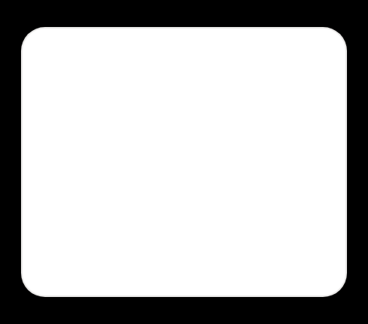
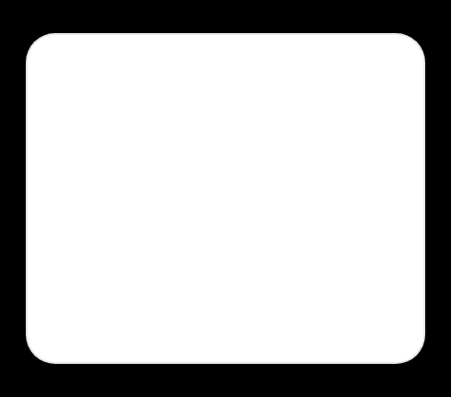









Results you can see — not just grades
My AI Portfolio — auto-builds in browser
DEMO DAY WEBSITE →
🃏
🚕
🗺️
W2 AND gate card model
Auto-rickshaw fare predictor
Tiffin SLAM map
Photo + 60-sec pitch + reflection
Regression chart + ethics check
Distance scan • servo • map built
L2 U3 W14 • STRONG: DATA CLEANING
G6 Explorer
G7 Builder
G9 Innovator
Skill breakdown that means something
78
Mastery Map 114 skills
Unlimited practice, offline
Strong: Data cleaning • Needs: Bias / Variance • Next: Goldilocks overfit zone
Adaptive practice: unlimited variants, not same worksheet.
Red = start • Yellow = trying
Blue = getting it • Green = mastered • See gaps at a glance
localStorage, no login tracking
Parent weekly email: “Ask them: What if bias = +5?”
📧
/100

Slide 13


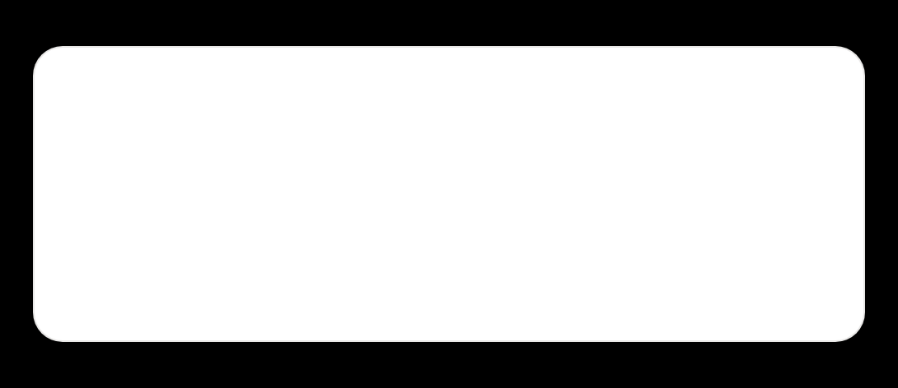






What to ask at home — parent dashboard
CONVERSATION STARTERS THAT WORK
1
“Explain to a 5-year-old what a neuron does?”
Checks real understanding vs memorized words. If they can simplify, they truly get it.
No homework pressure. 90 minutes happens in class. At home: 5 minutes of reflection, no screens needed — cards and conversation.
“My model worked when… but failed when… I fixed by…”
2
Sentence starters from workbook. Normalizes failure — our Failure Museum.
3
“Where does this analogy break?”
WEEKLY EMAIL — COPYABLE
COPY
Bouncer at Club doesn't learn — neuron does. Critical thinking over blind trust.
This week: Neural Skill — Weighted Sum
Your child built AND gate with cards.
Skill Score +3 → 78/100 • Strong: Data Cleaning
Ask them: “What if bias = +5? Would LED stay ON?”
Tip from teachers: Keep cards on dining table. When they teach you the AND gate with w=2, bias=-1 — let them be the expert. Portfolio grows from that pride.
💬
90-min in class, 5-min at home
Metacognition prompt
No worksheets. Just talk. Research shows reflection outlasts repetition.
“One thing I learned, one question I have, one thing I want to try tomorrow.”

Slide 14
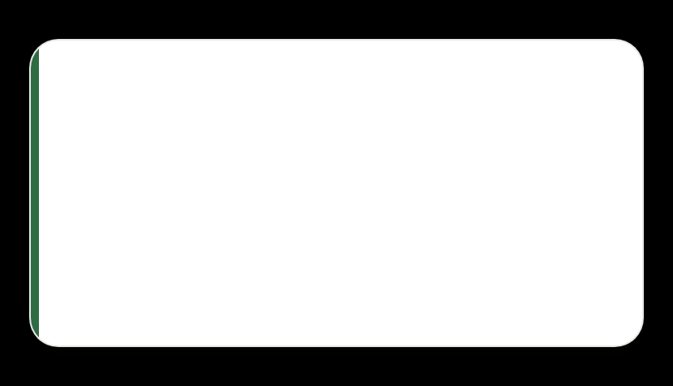
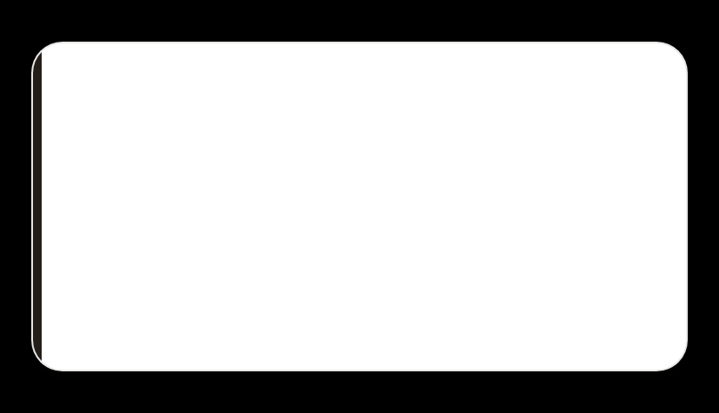
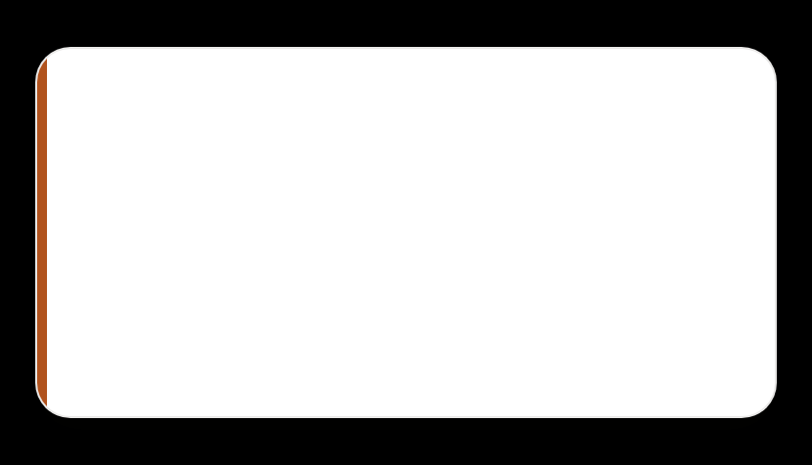










Safety & access — no hardware, no trademarks, offline ready
Built so every school can run it — and every child can learn safely. No purchases, no brand names, no internet required after first load.
🃏
DEFAULT • EVERY CLASS
©️
SAFE FOR SCHOOLS
📴
PWA • OFFLINE
No hardware
No trademarks
Offline ready
CARDS / PAPER / PHONE
GENERIC TERMS ONLY
SERVICE WORKER CACHED
No-tech cards are the default. Works on floor, no projector. Optional kit is bonus, not required for grade.
We say “controller board” not brand names. No AOPS/IXL-style terms. Safe to deploy anywhere.
After first load, it runs offline. Schools with no internet can still run all 144 weeks. File ~212KB.
🖨️
Printable 1-page cards
Aa
Dyslexia-friendly + accessible
🔒
Private by design
Weights / bias / inputs pre-cut. 1 page per week. No color printing needed. Timer visible, music during Project 20m.
Font toggle Nunito ↔ OpenDyslexic, high contrast toggle, size slider. Design for inclusion, not afterthought.
Passwords hashed SHA-256, no hint in UI. Session only. Cloudflare Pages $0 hosting • 25MB limit • localStorage portfolio.
For parents: No data leaves device. No photos collected. Anonymized counts only. Opt-out taught as consent skill.

Slide 15
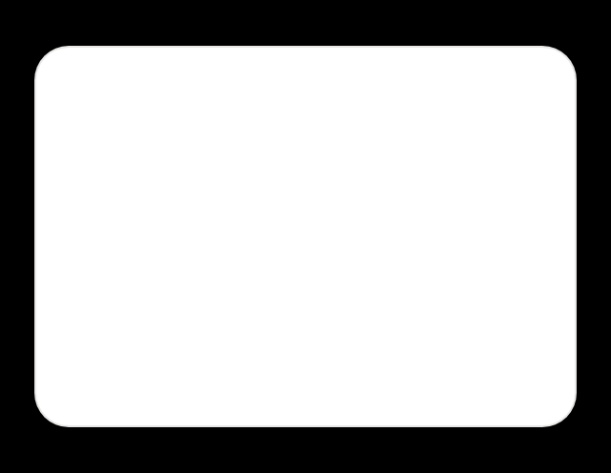
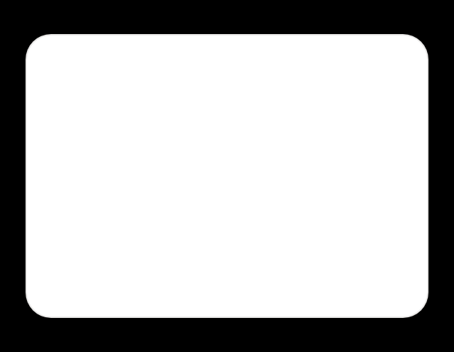








Next steps — try it today
01 • LIVE SITE
02 • START HERE
03 • REAL ENDING
Open the academy
90 minutes, no hardware
Demo Day at end of L4
Works on phone, offline after first load
Begin with L1 W1 Pattern Detector — Sock Sorting
or L3 U1 W2 Neural Skill — Weighted Sum
Real audience — parents, other classes, community website. Portfolio auto-builds to show high school.
ai-academy.pages.dev
Student: student1234
Teacher: teacher1234
Print cards → slider simulator → Demo
Ask teacher: “Choice Board + My AI Portfolio link?”
Ask your teacher for Choice Board + Portfolio →
GitHub: github.com/ramanaraokamma/ai-academy
No hardware • No trademarks • Classroom PWA $0 hosting • 212KB verified • 144 weeks • Dyslexia-friendly font toggle • This is for your child — global standards, local stories like auto-rickshaw fares, tiffin SLAM, Diwali lights.

