Slide 1
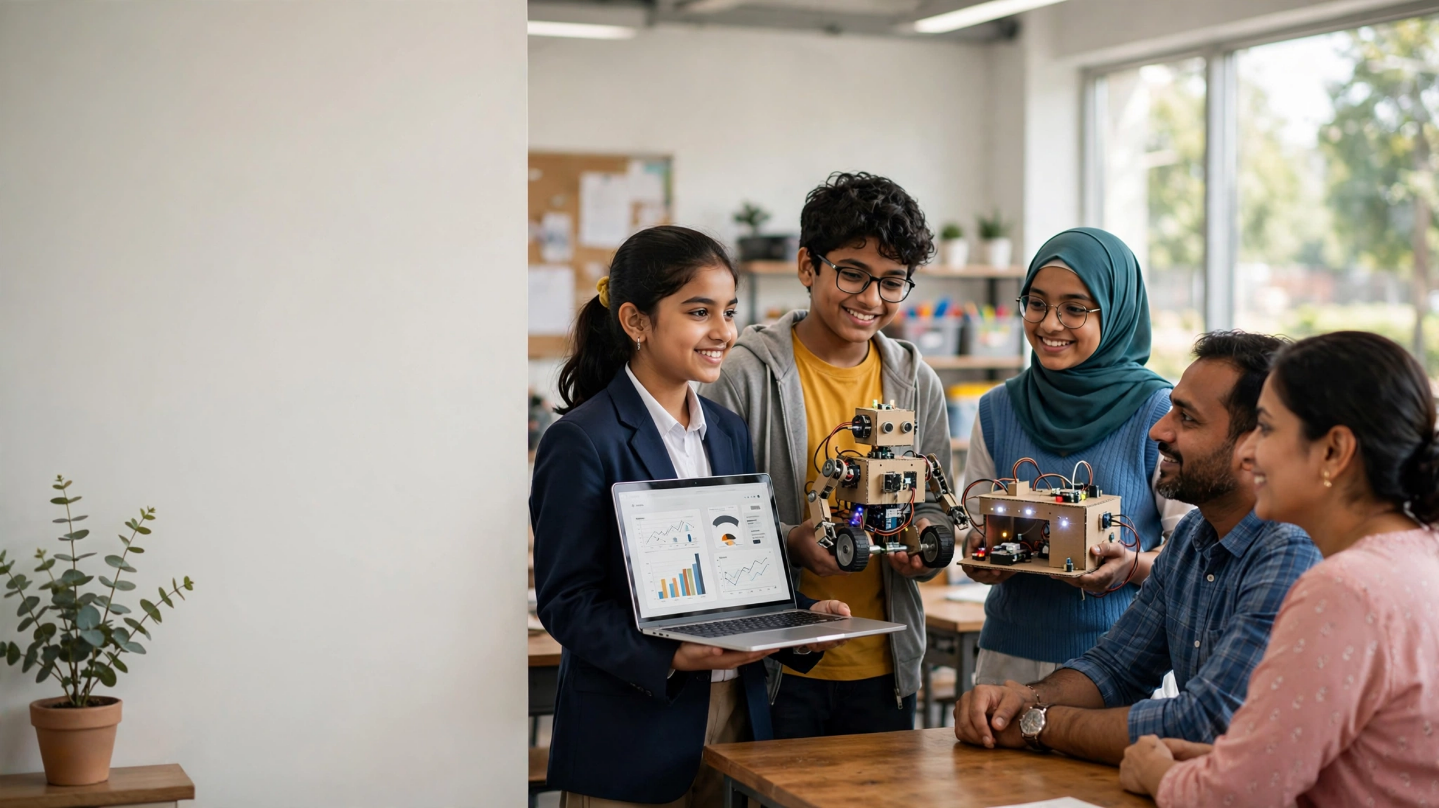



AI
Academy.
AI Literacy for 250M Middle Schoolers — The first complete platform for Grades 6-9. 144 weeks, no hardware, verified no gaps.
Teaching kids to understand, build, and question AI — not just use it.
144 weeks • 1296 sections
LIVE: PWA • Offline
ai-academy.pages.dev • github.com/ramanaraokamma/ai-academy • student1234 / teacher1234

Slide 2


Vision — Why this must exist now
The gap
Every middle-schooler AI literate by 2030.
Kids use AI daily — deepfakes, bias, hallucination — with no ethics, no safety, no understanding of how it works.
The analogy
Able to build, evaluate, and ethically use AI — not just consume ChatGPT, Reels, and YouTube recommendations with zero mental model.
AI literacy is reading literacy. Foundational, not optional. Starts in middle school, spiral revisits deeper each year.
85%
0%
AI Academy answer
of jobs in 2030 will require AI literacy
schools teach AI before Grade 11 today
First complete 144-week platform: understand → build → question. No hardware, India-ready, verified no gaps.

Slide 3








Schools are unprepared, kids are exposed.
01
No curriculum for Grades 6-9
02
Teachers have zero AI background
Only coding or no tech. Zero AI literacy. Students learn to use tools, never to understand them.
Zero-to-Hero needed. Existing resources assume CS degree — no 15-min training, no exact scripts.
Indian middle-schoolers use ChatGPT, Instagram AI, YouTube recommendations daily with no mental model of how it works — and no safety net. The gap is now a risk.
250M
03
Existing solutions not India-ready
04
No ethics training for real risks
Require expensive kits, trademarks, US examples. No Hindi/Telugu, no monsoon, auto-rickshaw, Diwali context.
Kids face deepfakes, bias, hallucination, copyright — with no framework to question, no pledge to act.

Slide 4

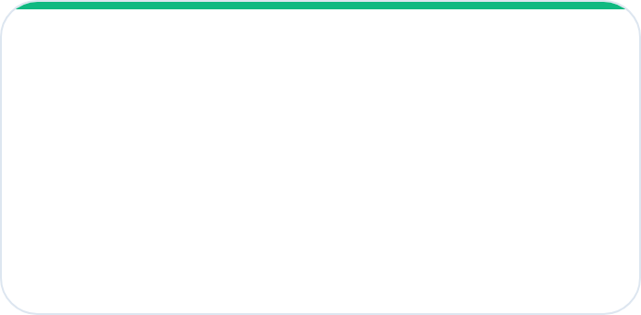
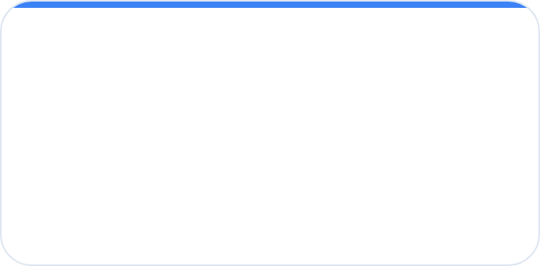
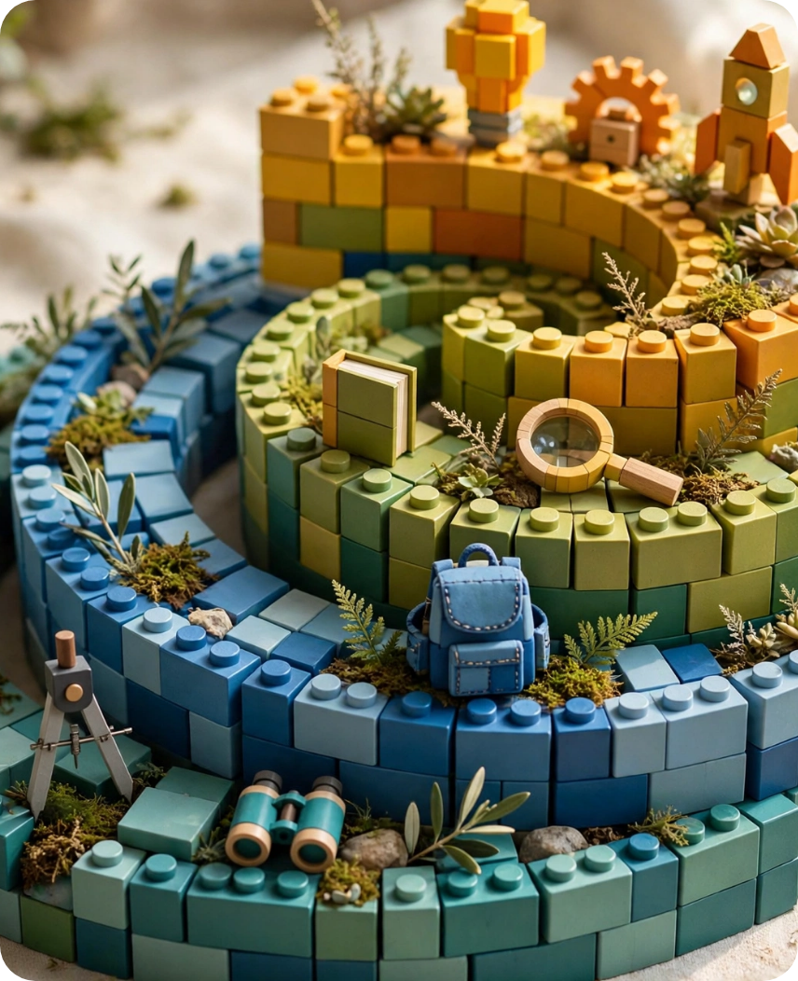


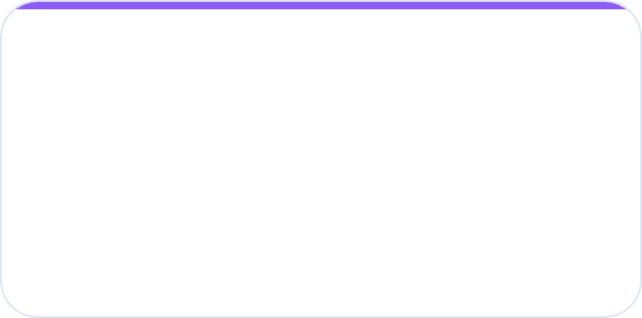
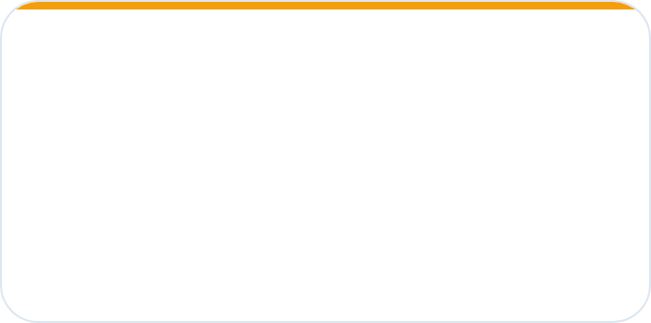



Solution: 4 Levels, 144 Weeks, Spiral Learning
Concepts revisit deeper each year — Pattern → Data → Neuron → Robot → Agent → Startup. India-ready, no hardware.
L1 G6 EXPLORER • 36W
L2 G7 BUILDER • 36W
Pattern Detector
Data Cleaning
Bouncer at Club, Messy Room 80% cleaning, Report Card, Fishing Net
Auto-rickshaw fare regression, lunch line classification, best-fit string, precision/recall
#10B981 • See patterns in world
#3B82F6 • Work with real data
L3 G8 CREATOR • 36W
L4 G9 INNOVATOR • 36W
LEGO Neurons
Robot Senses
Weighted sum, activation, convolution 1989 LeCun, attention 2014, transformers 2017, GANs Goodfellow
Distance 0-400cm, SLAM tiffin route, ReAct agents 2023, MVP skateboard→car, JFK 1962 moonshot Demo Day
#8B5CF6 • Build neural ideas
#F59E0B • Ship to real audience
↻
Spiral payoff: Grade 6 pattern “bouncer” → Grade 7 data classification → Grade 8 neuron AND/OR/XOR fail → Grade 9 agent that decides. Same idea, deeper math, real impact.
Spiral: revisit • deepen • build

Slide 5











⚡
🧠
🧪
👥
⚖️
🚀
10M HOOK
15M MENTAL MODEL
20M PHYSICAL LAB
10M COMMUNITY POOL
15M ETHICS
20M PROJECT
Teacher Training — 15 min
Workbook + Eval
Wiring — teacher only
Can computer be a bouncer?
Traffic light Red/Yellow/Green
Sentence starters "My model worked when... but failed when..." • Exit ticket What/So What/Now What • Confusion matrix SVG • Self-assessment Red/Yellow/Blue/Green.
Choice Board + 60-sec pitch
SVG diagram + Troubleshooting Problem|Cause|Fix + Failure Museum 3 fails ❌→✅ + Early finisher XOR ladder.
Teacher + student analogy
No-Tech cards → simulator slider
Anonymized 60→180
Gender Shades 2018, action pledge.
One-Sentence Core Idea • 3 Misconceptions • Socratic 342 • Vocab kid/adult/gesture • Tips: cards pre-cut, timer visible.
Question + Predict. Draw analogy.
Hyderabad Delhi Chennai 72%→88%.
Science Fair / Game / Art + real audience.
Where it breaks. Draw-Along 4 steps.
Weights/bias, distance 0-400cm, servo 0-180° live.
SAY: exact script
Exact script for Zero-to-Hero teachers. No-Tech default → Low-Tech simulator → High-Tech bonus. Works on 2G, offline, no projector.
DO: student action
How it works — 90 min, 9 sections, no hardware.

Slide 6





What it has — verified full, no gaps.
144 weeks × 9 sections = 1296 sections — each >200 chars, checked on load. Not titles, real content.
268+
30
144+
🎓
🧠
🧪
✓
SVGs — hero, wiring, charts, flowcharts, 114 dots
Live simulators — weights, bias, 0-400cm, servo
Choice Board, Failure Museum, Where breaks
Teacher Training 15m
Mental Model Deep
6 Examples
144/144 VERIFIEDAll sections filled
Red if missing
One-sentence core idea + 3 misconceptions + Socratic 342
Bouncer, LEGO neurons, draw-along 4 steps Play/Pause
India 2/6 auto-rickshaw, monsoon + ethics traffic light
Choice Board 3 options — Science Fair / Game / Art same skill, 60-sec pitch structure
Failure Museum 3 fails ❌→✅ + Where breaks “bouncer doesn’t learn” + Common Wrong “weight=0 but bias matters” + What If “bias +5?”
🔧
🌐
🚀
Physical Lab
Community Pool
Project Studio
Zero-backend PWA — offline service worker, fuzzy search bouncer→Classification, printable 1-page cards, Nunito↔OpenDyslexic, SHA-256 no hint
No-Tech cards default → simulator sliders → high-tech bonus
60→180 anonymized 72%→88% Hyderabad Delhi Chennai diversity
Real audience Demo Day parents + portfolio auto-build
📓
📊
⏱️
Workbook
Eval + Rubric
90-min Script
Sentence starters + What So What Now What exit ticket
Confusion matrix SVG + Red/Yellow/Blue/Green self-assess
Hook 10m Ment 15m Lab 20m Pool 10m Ethics 15m Proj 20m

Slide 7











How it helps kids — skills that last beyond AI.
Not tool training. Thinking systems that compound each year in the spiral — Pattern → Data → Neuron → Robot → Agent → Startup.
◧
◎
✦
Data Thinking
Critical Thinking
Creativity
Messy Room 80% cleaning is real work. Diwali lights photo caption, monsoon X-Ray missing — data quality beats model.
Where analogy breaks, Common Wrong, What If +5 bias? Predict-Observe-Explain — test limits, not just believe.
Choice Board Art option same skill. Dream Machine GANs 2014, Diffusion, Prompt Engineering — build your idea.
◍
⚑
↻
Collaboration
Ethics & Responsibility
Resilience
Community Pool anonymized 60→180, accuracy 72%→88%. Team Agents AutoGen 2023, CLIP 2021 multimodality.
Permission Slip copyright, Gender Shades 2018 fairness, AI Safety 2016. Energy: 1 model = 5 auto rides. Pledge action.
Failure Museum 3 fails ❌→✅. Troubleshooting table, growth mindset — Watch me fail first, then fix.
PORTFOLIO AUTO-BUILDS
WORKBOOK SIGNAL
114
4 yr
"My model worked when... but failed when... I fixed by... Ethical risk is..." Sentence starters + metacognition.
My AI Portfolio → Demo Day website at L4
localStorage saves every project pitch — Science Fair / Game / Art. Link to show high school. Real audience at Demo Day.
Mastery
checks
compound
skills
Red/Yellow/Blue/Green self-assessment

Slide 8










Why kids need it — Future + India
Future jobs demand it. Kids face risks now. India has the scale.
Future literacy
250M
72→88%
0 HW
85% of jobs 2030 need AI literacy — not just coding
Indian Grades 6-9 students
Accuracy with diverse pooling
AI literacy is new reading literacy. Those who can build, evaluate, and question AI will lead. Those who only consume will be vulnerable.
Needed — No-Tech default
Critical now
Global + local
India context — 2 of 6 examples per week
Risks they already face
No hardware, works anywhere
HYDERABAD • DELHI • CHENNAI
Deepfakes, Gender Shades bias 2018, hallucination, Getty vs Stability copyright. We add action pledge: “I will check bias”.
PWA offline, printable cards, no trademark. Telugu “bharuvu” for weight. Parent sees “for my child” not imported example.
🛺 Auto-rickshaw fare regression
🌧️ Monsoon crop classification
🏏 Cricket ball line detection
🍱 Tiffin SLAM route
🪔 Diwali lights vision
Hyderabad 72% mono
Hyderabad + Delhi + Chennai 88% pooled
Diversity reduces bias. Kids see law of large numbers — 60 dots vs 180 dots variance — and consent: anonymized counts only, opt-out.

Slide 9
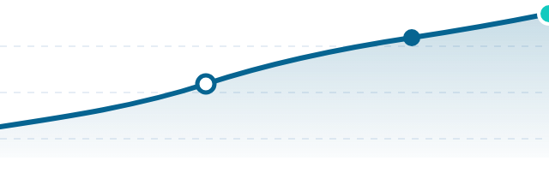


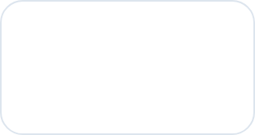
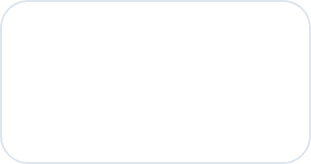

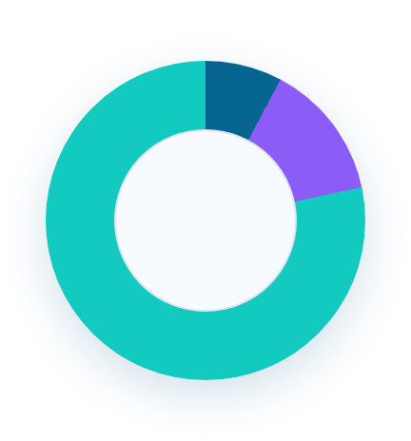
Market — TAM SAM SOM
No complete 144-week verified AI literacy platform for middle school exists. India 250M Grades 6-9 is the wedge into $20B global K-12 AI education by 2030.
INDIA-FIRST WEDGE
$20B
$1B
$20M
Global K-12 AI ed
by 2030 TAM
SAM India
50M students
SOM Y3
1M students • ARR
GROWTH 2026 → 2030 • INDIA STUDENTS SERVED
TAM — Global K-12 AI ed $20B by 2030
India 250M students G6-9 × $20/yr = $5B India TAM. Low-resource ready, no hardware.
$5B
SAM — India private + edtech + after-school
INDIA TAM
50M addressable students. At $20/student = $1B SAM. Private schools + centers + parents.
SOM — Year 1-3 target 1M students
B2B schools + B2C + govt pilot. $20M ARR at $20/student. 100 → 1,000 schools path.
2026 • 10 schools pilot
2028 • 100 schools
2030 • 1,000 schools • 1M students
Comparable gap: US kits + no verification. We are verified 144/144, $0 hosting, PWA offline, 2G ready. First mover in complete middle-school AI literacy.

Slide 10



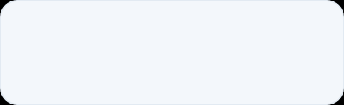











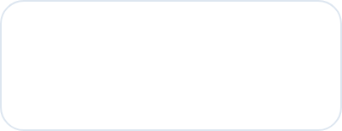





Product demo - live today
LIVE SITE + ACCESS
DEPLOY - ZERO CONFIG
ai-academy.pages.dev
Platform
How
QR CODE
PLACEHOLDER
ai-academy
.pages.dev
student: student1234
teacher: teacher1234
Cloudflare Pages
Drag index.html
Direct Upload
Drop to dashboard
GitHub: ramanaraokamma/ai-academy
Single file index.html - no build step
Build
Output
Empty
Dot .
No command needed
Root directory
FEATURED DEMO
L3 U1 W2 Neural Skill - Weighted Sum
PWA offline ready
Works on 2G
Printable Cards
No hardware
Live sliders change w*x + b and LED fires. AND gate logic.
WEIGHT w1
BIAS b
INPUT
$
Zero cost scale
0 to 2
-2 to 2
0 to 400 cm
No server, no DB, no API keys. One file serves all 144 weeks. Cache first, works in low bandwidth schools.
212KB
$0
Offline
One HTML file
under 25MB limit
Hosting free
Cloudflare Pages
PWA works on
2G, no install
ai-academy.pages.dev live
QR placeholder ready
Printable cards included

Slide 11




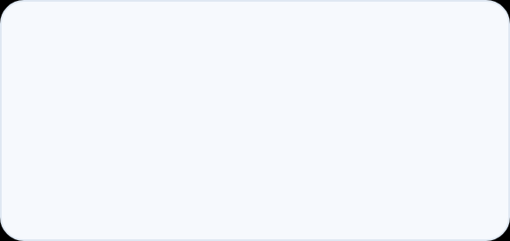



Traction — Built • Verified • Deployable
Built fully. Verified automatically. Ready to deploy $0.
Verified
Deployable & pilot-ready
✓
144/144 VERIFIED1296 sections >200 chars
No gaps — red if fail
Automated checks on load
Zero backend, zero trademark
Function checks length + SVG + Where breaks + Common Wrong + What If + Choice Board + Failure Museum + Simulator. Console log + badge turns red if fail.
$0 hosting on Cloudflare Pages Direct Upload + GitHub Pages. PWA offline service worker, works on 2G, printable cards.
Built
All 144 weeks are real content, not titles
Cloudflare Build: empty echo no build Output: . Root: /
L3 U1 W2 Neural Skill was empty — now full with all 10 improvements. Each week includes hero SVG, wiring diagram, flowchart, confusion matrix, bar 60%→88%.
WEEKS BUILT 0 → 144
Generic terms only — no AOPS/IXL marks, no external CDN risk
3 schools interested + 1 after-school pilot + parent deck ready
268+
30
SVGs inline — thumbnail, hero, wiring, charts
Live <input range> — weights, distance 0-400cm, servo 0-180°
V1 titles
V4 world-best
VERIFIED now
Teacher Zero-to-Hero 15-min exact scripts — cards pre-cut, timer visible
Passwords SHA-256 hashed — student1234 / teacher1234 — no hint in UI, no HTML comment leak.
No hardware
Offline PWA
Print ready
144×
212KB
Choice Board, Failure Museum, Where breaks
Single HTML — under 25MB Cloudflare limit

Slide 12



Business model — freemium + B2B licensing.
Low CAC, $0 hosting, offline-first. Four revenue paths built on same 212KB verified curriculum.
01 • FREEMIUM B2C — BASE
02 • B2B SCHOOLS — CORE
03 • B2G GOVERNMENT
Free student, paid Teacher Pro
$500–$2k / school
State pilot scale
Every student gets full learning + portfolio auto-build. Teacher unlocks training 15-min scripts, analytics, parent dashboard, micro-credential.
License 144w + Zero-to-Hero training + printable cards + PWA offline + support.
Aligns with NEP 2020 AI in curriculum. No hardware dependency = approvable.
Student access student1234 — free forever
Teacher Pro teacher1234 — badges Explorer / Builder / Creator / Innovator
Portfolio → Demo Day site for high school admission
100 schools
1,000
= $100k–$200k ARR
schools = $1M ARR
04 • EDTECH LICENSING
LOW CAC ENGINE
Revenue share
Teacher community → Demo Day word-of-mouth → GitHub open stars → Cloudflare $0 hosting → parent demand.
License curriculum to existing edtechs. They get verified middle-school AI track, we get distribution without sales force.
$0 infra • 212KB • works on 2G
$20
/ student / year
or $200 / school

Slide 13






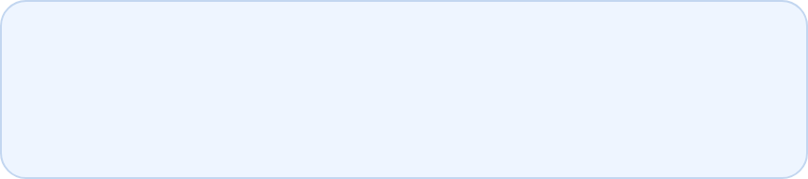



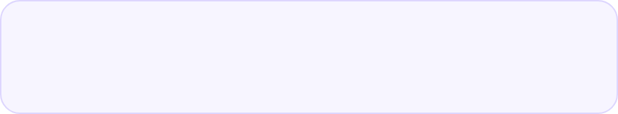






Defensibility — why this wins and compounds.
Not a content pack. A verified system that is hard to copy, easy to run, and gets stronger with every school.
Content depth
Pedagogy system
1,296 sections written, not generated titles
10 improvements in every week
Content Moat — 2 years to replicate
Each week has Teacher Training, Mental Model, 6 Examples, Lab, Pooling, Project, Workbook, Eval, 90-min script.
Ask, don’t tell. Socratic 342 stems, micro-credential Explorer/Builder/Creator/Innovator, troubleshooting Problem|Cause|Fix.
1
144 weeks × 9 sections = 1296 sections >200 chars + 268 SVGs + 30 live simulators. Verified 144/144. L3 U1 W2 Neural Skill was empty — now full with 10 improvements.
Was: 2 SVGs → Now: 268+ SVGs
Parent-ready • Teacher-proven
2
Pedagogy Moat — Zero-to-Hero
No-Tech default + Where Breaks + Common Wrong + What If + Choice Board + Failure Museum + Draw-Along + Portfolio + Privacy + 15-min exact scripts.
Tech simplicity
Distribution
One file, runs everywhere
Demo Day = word-of-mouth
SHA-256 passwords student1234 teacher1234 no hint, sessionStorage role, fuzzy search, font size, high contrast.
L4 ends with portfolio website students show high school. Parents see progress, teachers share scripts.
3
Tech Moat — 212KB, $0 infra
Single HTML, PWA offline, searchable, printable, dyslexia toggle, no backend, no trademark, works on 2G, <25MB Cloudflare Pages.
212KB • $0 hosting
NEP 2020 aligned
4
Distribution Moat — first mover
Why copy fails
GitHub open + parent Demo Day + teacher community + 250M India context. Real audience creates network effect.
You can copy the outline in a day. You can’t copy 144 verified weeks + 10 pedagogy layers + offline PWA + India stories.
⧉
Each layer multiplies the other — content × pedagogy × tech that runs in low-resource schools × community that shares.

Slide 14













Team — builder + vision.
Focused on one thing: complete 144 weeks verified, no gaps, that a non-CS teacher can run tomorrow in a low-resource school.
Ramana Rao Kamma — Founder
Advisors needed — 4 roles
RK
Building AI Academy • github.com/ramanaraokamma/ai-academy
Scaling beyond founder build
Shipped V4 WORLD-BEST: 144 weeks × 9 sections = 1,296 sections, 268+ SVGs, 30 live simulators, Zero-to-Hero 15-min scripts, India context 2/6 examples.
Curriculum — NEP 2020 mapping, assessment design, L1-L4 spiral audit
Pedagogy — Zero-to-Hero teacher training, micro-credential, classroom research
144/144 VERIFIED
212KB • $0 hosting
No HW • PWA offline
B2B Sales — Private schools & after-school network, 100-school rollout
Government liaison — State pilots, CSR, 1,000-school pathway
Mission
Every middle-schooler AI literate by 2030 — able to build, evaluate, and ethically use AI.
Values that ship in product
Not tool-clicking. Thinking systems: Pattern → Data → Neuron → Robot → Agent → Startup. Spiral curriculum that compounds yearly, with ethics action and portfolio that goes to high school.
What we refuse to compromise
No hardware needed
No trademark risk
Privacy anonymized
Ethics action pledge
Hyderabad • Delhi • Chennai diversity
Failure Museum growth mindset
Draw-Along • Telugu bharuvu

Slide 15









Ask: Seed $150K for 12 months.
Roadmap to 1,000 schools.
144/144 VERIFIED today • 212KB • $0 hosting • PWA offline • SHA-256 passwords no hint
Built to scale from 10 schools to 1M students, $20M ARR Year 3.
SEED $150K — USE OF FUNDS
ROADMAP — Q2 2026 → Q4 2026
MILESTONES & CONTACT
$150K extends runway 12 months to $20K MRR
Live, open, ready
Q2 2026 • PILOT
✓ 144/144 VERIFIED today — no gaps in 1,296 sections
10 schools + Demo Day parent presentations + feedback loop — India context validation.
Curriculum video + simulators + Telugu/Hindi
60%
✓ 1M students SOM → $20M ARR Year 3
Teacher training community + micro-credential platform
20%
Q3 2026 • SCALE
✓ Demo Day network effect — portfolio websites → high school pipeline
100 schools + edtech licensing — Telugu/Hindi + voiceover Draw-Along animated SVG Play/Pause.
Pilots 10 schools + parent dashboard + analytics
10%
Cloudflare + legal + hosting
10%
Q4 2026 • GOV + MRR
1,000 schools + government pilot — Portfolio platform + $20K MRR. NEP 2020 aligned.
✓ 144/144 VERIFIED badge + console log — red if missing
10 → 1K
$20K
Schools Q2 → Q4
MRR target Q4 2026
QR
ai-academy
.pages.dev
Live: ai-academy.pages.dev
GitHub: ramanaraokamma/ai-academy
Student: student1234 • Teacher: teacher1234
Build: echo "no build" / Output: . / 212KB

