Slide 1


Ansible Hands-on Introduction
Jon Jozwiak, Sr. Cloud Solutions Architect
Minneapolis RHUG - April 13, 2017

Slide 2
What is Ansible?
It's a simple automation language that can perfectly describe an IT application infrastructure in Ansible Playbooks.
It's an automation engine that runs Ansible Playbooks.
Ansible Tower is an enterprise framework for controlling, securing and managing your Ansible automation with a UI and RESTful API.

Slide 3






















Slide 4

Community
THE MOST POPULAR OPEN-SOURCE AUTOMATION COMMUNITY ON GITHUB
13,000+ stars & 4,000+ forks on GitHub 2000+ GitHub Contributors
Over 900 modules shipped with Ansible New contributors added every day 1200+ users on IRC channel
Top 10 open source projects in 2014
World-wide meetups taking place every week Ansible Galaxy: over 18,000 subscribers
250,000+ downloads a month AnsibleFests in NYC, SF, London
http://ansible.com/community

Slide 5
Installing Ansible
# Install with yum (Example RHEL 7)
$ wget http://dl.fedoraproject.org/pub/epel/7/x86_64/e/epel-release-7-9.noarch.rpm
$ yum localinstall epel-release-7-9.noarch.rpm
$ yum --enablerepo=epel install ansible
# Install using pip
$ pip install ansible
Or
sudo rpm -Uvh https://dl.fedoraproject.org/pub/epel/epel-release-latest-7.noarch.rpm
sudo yum -y install ansible

Slide 6
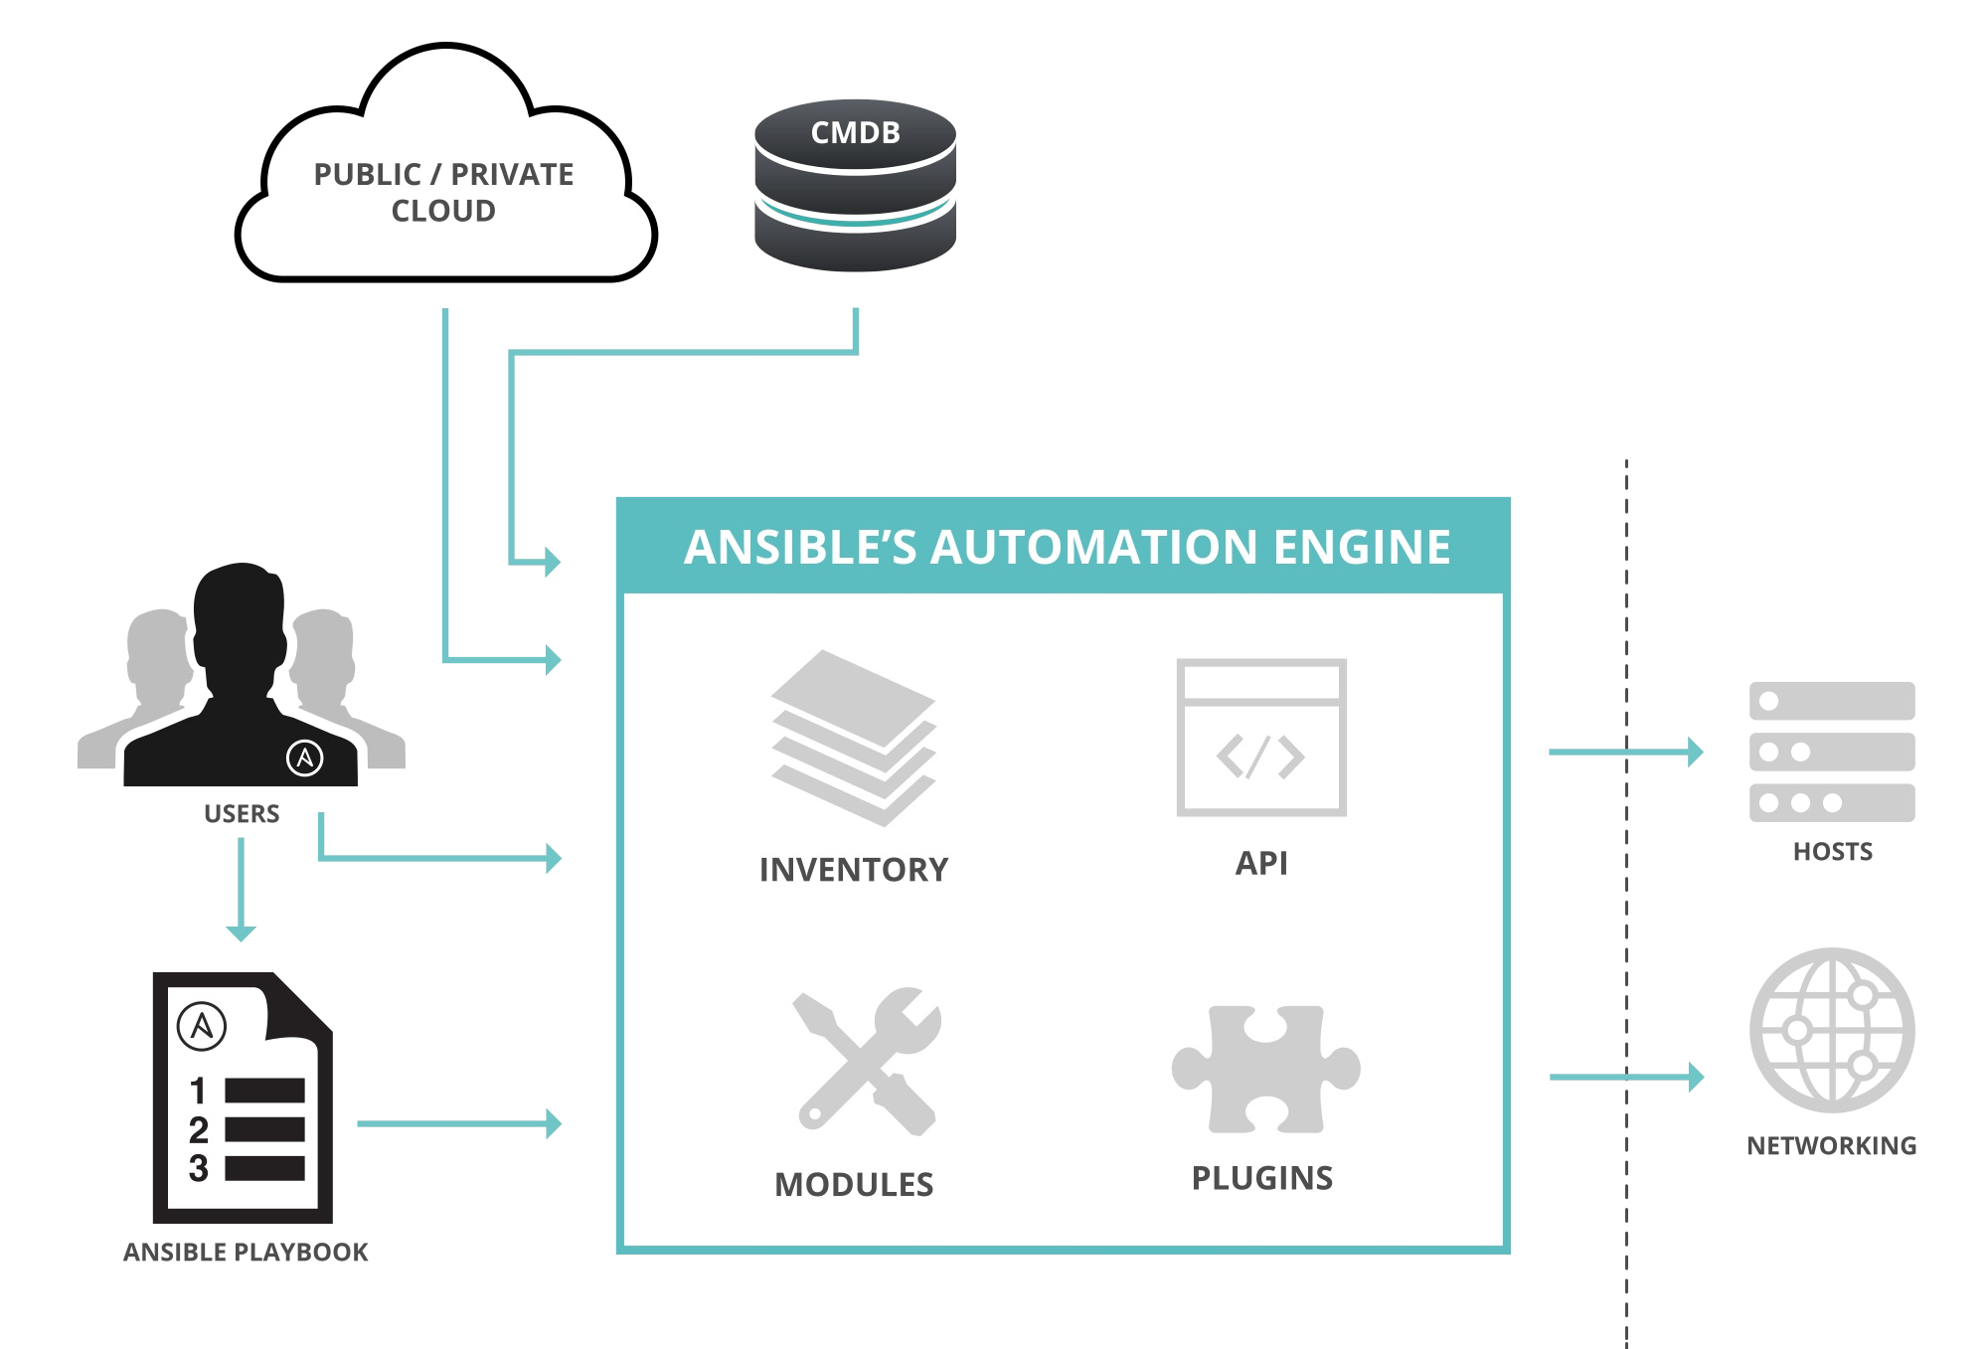
How Ansible Works

Slide 7


Modules
Modules are bits of code transferred to the target system and executed to satisfy the task declaration. Ansible ships with several hundred today!
apt/yum copy
file
get_url git ping debug service
synchronize template

Slide 8
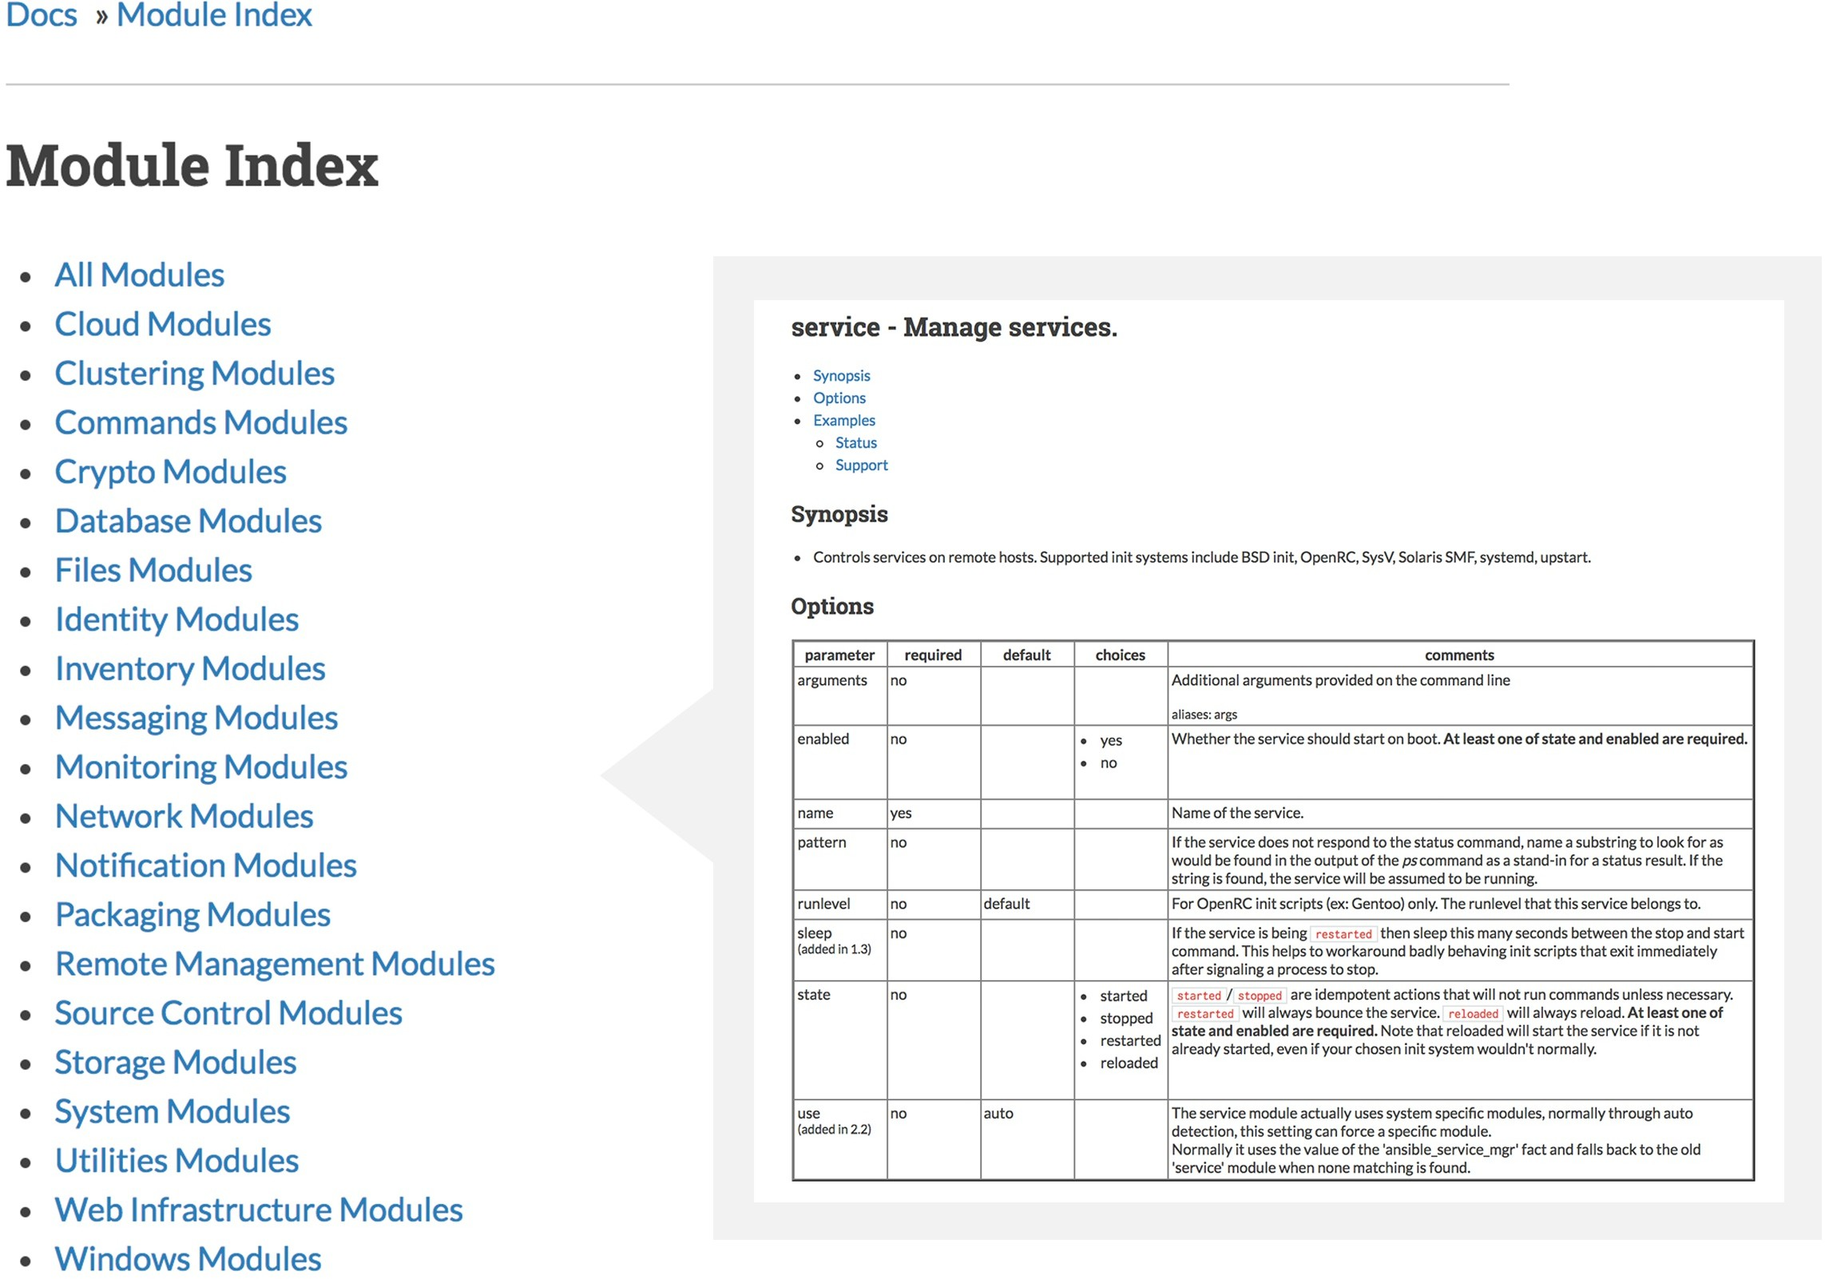
Modules Documentation
http://docs.ansible.com/

Slide 9

Modules Documentation
# List out all modules installed
$ ansible-doc -l
...
copy cron
...
# Read documentation for installed module
$ ansible-doc copy
> COPY
The [copy] module copies a file on the local box to remote locations. Use the [fetch] module to copy files from remote locations to the local box. If you need variable interpolation in copied files, use the [template] module.
* note: This module has a corresponding action plugin. Options (= is mandatory):

Slide 10
Modules: Run Commands
If Ansible doesn’t have a module that suits your needs there are the “run command” modules:
command: Takes the command and executes it on the host. The most secure and predictable.
shell: Executes through a shell like /bin/sh so you can use pipes etc. Be careful.
script: Runs a local script on a remote node after transferring it.
raw: Executes a command without going through the Ansible module subsystem.
NOTE: Unlike standard modules, run commands have no concept of desired state and should only be used as a last resort.

Slide 11
Inventory
Inventory is a collection of hosts (nodes) with associated data and groupings that Ansible can connect and manage.
Hosts (nodes) Groups
Inventory-specific data (variables) Static or dynamic sources

Slide 12
Static Inventory Example
10.42.0.2
10.42.0.6
10.42.0.7
10.42.0.8
10.42.0.100
host.example.com

Slide 13
Static Inventory Example
[control]
control ansible_host=10.42.0.2
[web]
node-[1:3] ansible_host=10.42.0.[6:8]
[all:vars] ansible_user=vagrant
ansible_ssh_private_key_file=~/.vagrant.d/insecure_private_key

Slide 14
Ad-Hoc Commands
An ad-hoc command is a single Ansible task to perform quickly, but don’t want to save for later.
# check all my inventory hosts are ready to be # managed by Ansible
$ ansible all -m ping
# collect and display the discovered facts # for the localhost
$ ansible localhost -m setup
# run the uptime command on all hosts in the # web group
$ ansible web -m command -a "uptime"

Slide 15
Sidebar: Discovered Facts
Facts are bits of information derived from examining a host systems that are stored as variables for later use in a play.
$ ansible localhost -m setup localhost | success >> { "ansible_facts": {
"ansible_default_ipv4": { "address": "192.168.1.37",
"alias": "wlan0", "gateway": "192.168.1.1",
"interface": "wlan0",
"macaddress": "c4:85:08:3b:a9:16", "mtu": 1500,
"netmask": "255.255.255.0",
"network": "192.168.1.0",
"type": "ether"
},

Slide 16
Lab # 1:
Ad-Hoc Commands

Slide 17
Variables
Ansible can work with metadata from various sources and manage their context in the form of variables.
Command line parameters Plays and tasks
Files Inventory
Discovered facts Roles

Slide 18
Tasks
Tasks are the application of a module to perform a specific unit of work.
file: A directory should exist
yum: A package should be installed
service: A service should be running
template: Render a configuration file from a template
get_url: Fetch an archive file from a URL
git: Clone a source code repository

Slide 19
Example Tasks in a Play
tasks:
name: httpd package is present yum:
name: httpd state: latest
name: latest index.html file is present copy:
src: files/index.html dest: /var/www/html/
name: restart httpd service:
name: httpd state: restarted

Slide 20
Handler Tasks
Handlers are special tasks that run at the end of a play if notified by another task when a change occurs.
If a configuration file gets changed notify a service restart task that it needs to run.

Slide 21

Example Handler Task in a Play
tasks:
- name: httpd package is present yum:
name: httpd state: latest
notify: restart httpd
- name: latest index.html file is present copy:
src: files/index.html dest: /var/www/html/
handlers:
- name: restart httpd service:
name: httpd state: restarted

Slide 22
Plays & Playbooks
Plays are ordered sets of tasks to execute against host selections from your inventory.
A playbook is a file containing one or more plays.

Slide 23

Playbook Example
---
- name: install and start apache hosts: web
become: yes vars:
http_port: 80
tasks:
name: httpd package is present yum:
name: httpd state: latest
name: latest index.html file is present copy:
src: files/index.html dest: /var/www/html/

Slide 24
Human-Meaningful Naming
---
- name: install and start apache hosts: web
become: yes vars:
http_port: 80
tasks:
- name: httpd package is present yum:
name: httpd state: latest
-
name: latest index.html file is present
copy:
src: files/index.html dest: /var/www/html/

Slide 25
Host Selector
---
- name: install and start apache
hosts: web
become: yes vars:
http_port: 80
tasks:
name: httpd package is present yum:
name: httpd state: latest
name: latest index.html file is present copy:
src: files/index.html dest: /var/www/html/

Slide 26
Privilege Escalation
---
- name: install and start apache hosts: web
become: yes
vars:
http_port: 80
tasks:
name: httpd package is present yum:
name: httpd state: latest
name: latest index.html file is present copy:
src: files/index.html dest: /var/www/html/

Slide 27
Play Variables
---
- name: install and start apache hosts: web
become: yes vars:
http_port: 80
tasks:
name: httpd package is present yum:
name: httpd state: latest
name: latest index.html file is present copy:
src: files/index.html dest: /var/www/html/

Slide 28
Tasks
---
- name: install and start apache hosts: web
become: yes vars:
http_port: 80
tasks:
- name: latest httpd package is present yum:
name: httpd
state: latest
- name: latest index.html file is present
copy:
src: files/index.html
dest: /var/www/html/

Slide 29
Lab # 2:
A Simple Playbook

Slide 30
Doing More with Playbooks
Here are some more essential playbook features that you can apply: Templates
Loops Conditionals
Tags Blocks

Slide 31
Templates
Ansible embeds the Jinja2 templating engine that can be used to dynamically: Set and modify play variables
Conditional logic
Generate files such as configurations from variables

Slide 32
Loops
Loops can do one task on multiple things, such as create a lot of users, install a lot of packages, or repeat a polling step until a certain result is reached.
- yum:
name: state: latest
"{{ item }}"
with_items:
- httpd
- mod_wsgi

Slide 33
Conditionals
Ansible supports the conditional execution of a task based on the run-time evaluation of variable, fact, or previous task result.
- yum:
name: httpd state: latest
when: ansible_os_family == "RedHat"

Slide 34
Tags
Tags are useful to be able to run a subset of a playbook on-demand.
yum:
name: "{{ item }}" state: latest with_items:
httpd
mod_wsgi
tags:
- packages
- template:
src: templates/httpd.conf.j2 dest: /etc/httpd/conf/httpd.conf
tags:
- configuration

Slide 35
Blocks
Blocks cut down on repetitive task directives, allow for logical grouping of tasks and even in play error handling.
-
block:
yum:
name: "{{ item }}" state: latest with_items:
httpd
mod_wsgi
template:
src: templates/httpd.conf.j2 dest: /etc/httpd/conf/httpd.conf
when: ansible_os_family == "RedHat"

Slide 36
Roles
Roles are a packages of closely related Ansible content that can be shared more easily than plays alone.
Improves readability and maintainability of complex plays
Eases sharing, reuse and standardization of automation processes
Enables Ansible content to exist independently of playbooks, projects -- even organizations
Provides functional conveniences such as file path resolution and default values

Slide 37
Project with Embedded Roles Example
site.yml roles/
common/ files/ templates/ tasks/ handlers/ vars/ defaults/ meta/ apache/ files/ templates/ tasks/ handlers/ vars/ defaults/

Slide 38
Project with Embedded Roles Example
# site.yml
---
hosts: web roles:
common
apache

Slide 39
Ansible Galaxy
http://galaxy.ansible.com
Ansible Galaxy is a hub for finding, reusing and sharing Ansible content.
Jump-start your automation project with content contributed and reviewed by the Ansible community.

Slide 40
Lab #3:
A Playbook Using Roles
Lab #4:
Using an Ansible Galaxy Role

Slide 41
Next Steps
It's easy to get started
ansible.com/get-started
Join the Ansible community
ansible.com/community
Would you like to learn a lot more?
redhat.com/en/services/training/do407-automation-ansible

