Slide 1


Apache Tomcat as a container for Servlets and JSP

Slide 2
What is Tomcat?
Tomcat is a Servlet container (Web server that interacts with Servlets) developed under the Jakarta Project of Apache Software Foundation
Tomcat implements the Servlet and the Java Server Pages (JSP) specifications of Sun Microsystems
Tomcat is an open-source, non commercial project
  Licensed under the Apache Software License
Tomcat is written in Java (OS independent)

Slide 3
Reminder: A JSP Example
<html>
<head>
<title>Hello World</title>
</head>
<body>
<h2><%= new java.util.Date() %></h2>
<h1>Hello World</h1>
</body>
</html>
hello.jsp
http://localhost/dbi/hello.jsp
Pay attention to the fact a cookie is placed in the client…
We’ll discuss it next lessons

Slide 4
Tomcat Directory Structure
Tomcat-Base
conf
logs
webapps
server
work
shared
server.xml
ROOT
myApp1
myApp2
lib
classes
WEB-INF
web.xml
Tomcat-Home
lib
classes
bin
common
lib
classes

Slide 5
Base and Home Directories
The directory TOMCAT-HOME contains executables and libraries required for the server launching, running and stopping
  This directory is placed under /usr/local/…
The directory TOMCAT-BASE contains the Web-site content, Web applications and configuration data
  This directory is placed under your home directory

Slide 6
Installing Tomcat in the CSE Net
Create a directory for tomcat base
  For example: mkdir ~/tomcat-base
Set the environment variable CATALINA_BASE to your tomcat-base directory
  For example: setenv CATALINA_BASE ~/tomcat-base
  Insert this line into your .cshrc file
Run ~dbi/tomcat/bin/setup
$CATALINA_BASE is now a regular Tomcat base directory, and Tomcat is ready to run

Slide 7
Running Tomcat in the CSE Net
To start tomcat use ~dbi/tomcat/bin/catalina run
Or, in background, ~dbi/tomcat/bin/catalina start
To stop tomcat use ~dbi/tomcat/bin/catalina stop
To see the default page of Tomcat from your browser use the URL http://<machine-name>:<port>/
  machine-name is the name of the machine on which Tomcat runs and port is the port you chose for Tomcat
You can also use http://localhost:<port>/ if your browser runs on the same machine as Tomcat
Don’t forget to stop the server before you logout…
Open http://localhost:<port>
In class port number is 80, you can check /conf/server.xml

Slide 8
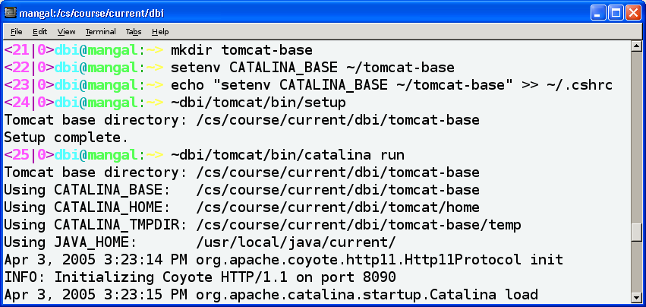
From Scratch to Server in the CSE Net

Slide 9
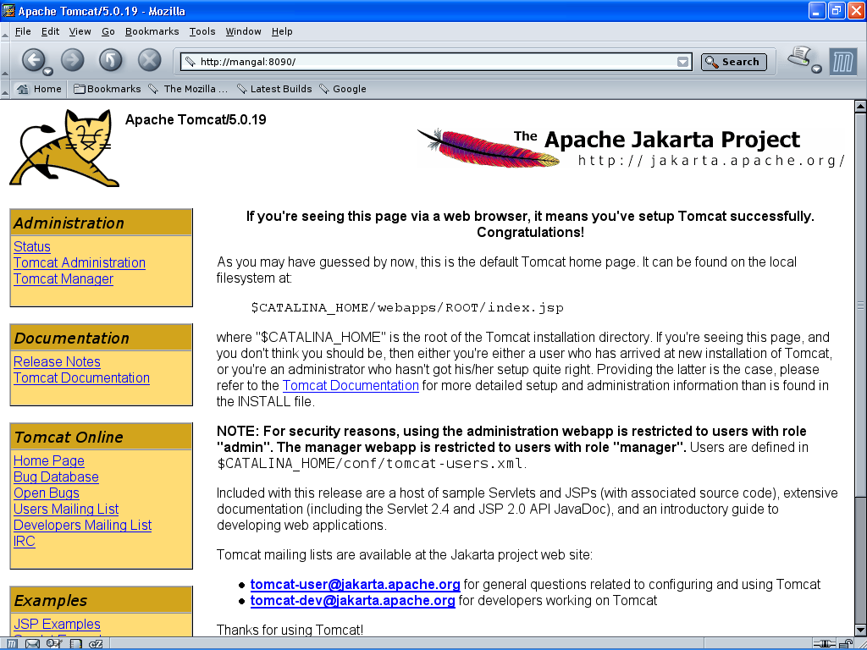

Slide 10
Choosing a port for Tomcat
In the file $CATALINA_BASE/conf/server.xml you will find the element Connector of Service “Catalina”
Choose a port (greater than 1024 – why?) and change the value of the port attribute to your chosen one:
<Server>
…
<Service name="Catalina”>
<Connector port="8090"/>
…
</Service>
…
</Server>

Slide 11
Creating Web Applications

Slide 12
Creating Web Applications
A Web application is a self-contained subtree of the Web site
A Web application usually contains
several different types of Web resources like HTML files, Servlets, JSP files, and other resources like Database tables
Each Web application has its own subdirectory under the directory
$CATALINA_BASE/webapps/

Slide 13
The Directory Structure of a Web Application
Tomcat automatically identifies a directory $CATALINA_BASE/webapps/myApp/ with the relative URL /myApp/
For example, a file named index.html in myApp is mapped to by the following URLs:
  http://machine:port/myApp/index.html
  http://machine:port/myApp/

Slide 14
The Directory Structure of a Web Application
You can also use subdirectories under myApp
For example: the file myApp/myImages/im.gif is mapped to by the URL
http://machine:port/myApp/myImages/im.gif
By default, Tomcat maps the root directory (http://localhost:8090/) to the directory webapps/ROOT/
  You can change this default

Slide 15
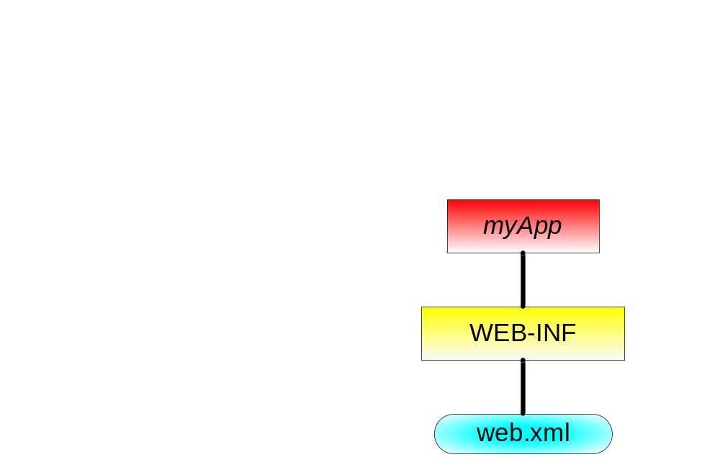
The Directory Structure of a Web Application
An application's directory must contain the following:
  The directory WEB-INF/
  A legal web.xml file under WEB-INF/
Minimal content of web.xml
<web-app>
</web-app>

Slide 16
Configuring a Web Application
Application-specific configuration and declarations are written in the file myApp/WEB-INF/web.xml
This file contains:
  Servlet declarations, mappings and parameters
  Default files for directory requests (e.g index.html)
  Error pages (sent in cases of HTTP errors)
  Security constraints
  Session time-out specification
  Context (application) parameters
  And more…

Slide 17
Error Pages
Use the error-page element to define the page sent in case of an HTTP error that occurs within the application context
An error page element has two sub elements:
  error-code - the HTTP error status code
  location - the page that should be sent

Slide 18
Error Page Example
<html>
<head><title>Not Found</title></head>
<body>
<h1 style="text-align:center; color:green">
Sorry, no such file...
</h1>
</body>
</html>
my404.html
<web-app>
<error-page>
<error-code>404</error-code>
<location>/my404.html</location>
</error-page>
</web-app>
web.xml

Slide 19
Welcome Pages
The (optional) welcome-file-list element contains a list of file names
When the URL request is a directory name, Tomcat automatically brings the first file on the list
If that file is not found, the server then tries the next file in the list, and so on
This file can be of any type, e.g., HTML, JSP, image, etc.
The default welcome list for all applications is set in $CATALINA_BASE/conf/web.xml

Slide 20
Welcome Page Example
<html>
<head><title>Welcome</title></head>
<body>
<h1 style="text-align:center; color:red">
Welcome Dear Visitor!
</h1>
</body>
</html>
welcome.html
<web-app>
<welcome-file-list>
<welcome-file>welcome.html</welcome-file>
<welcome-file>index.html</welcome-file>
<welcome-file>index.jsp</welcome-file>
</welcome-file-list>
</web-app>
web.xml

Slide 21
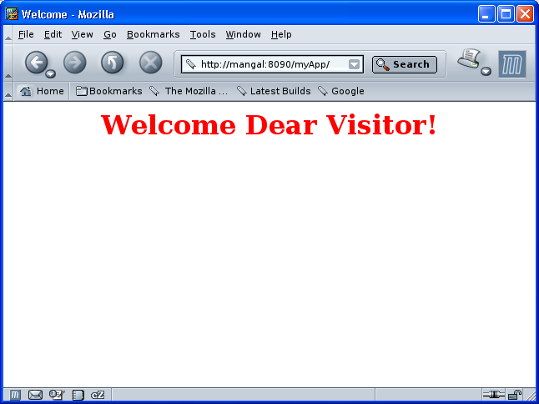

Slide 22
Tomcat and Java Classes
Tomcat uses Java classes you provide in order to run Servlets and JSP files
  For example, the Servlets themselves!
Tomcat 5.x initialization scripts ignore your environment CLASSPATH variable
Classes are expected to be placed (or linked) at some predefined places in its directories
There are actually 5 or 6 more and less restrictive classpaths used by tomcat – can you think why?
Hint: how would a malicious web application gain control of another, innocent, web application?

Slide 23
Java Class Locations
Tomcat expects to find Java classes in class files (in a directory named classes) and JAR files (in a directory named lib) in the following places:
TOMCAT-HOME/common/
  Basic runtime classes. No need to touch this directory
$CATALINA_BASE/webapps/myApp/WEB-INF/
  Application-specific classes (Servlets are typically here)
$CATALINA_BASE/shared/
  Classes that are used by all the Web applications

Slide 24
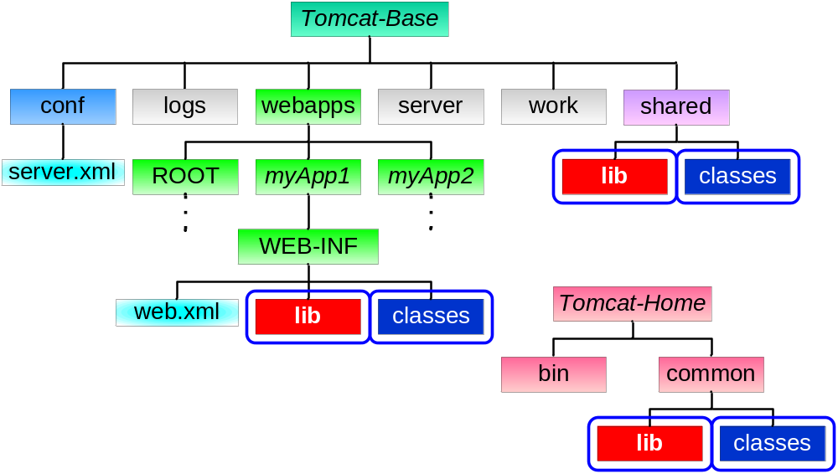
Java Class Locations

Slide 25
web.xml DTD
Your web.xml file must conform to the web-app DTD:
<!ELEMENT web-app (icon?, display-name?, description?, distributable?, context-param*, filter*, filter-mapping*, listener*, servlet*, servlet-mapping*, session-config?, mime-mapping*, welcome-file-list?, error-page*, taglib*, resource-env-ref*, resource-ref*, security-constraint*, login-config?, security-role*, env-entry*, ejb-ref*, ejb-local-ref*)>

Slide 26
Our Entire web.xml so far
<web-app>
<servlet>
<servlet-name>hello</servlet-name>
<servlet-class>HelloWorld</servlet-class>
</servlet>
<servlet-mapping>
<servlet-name>hello</servlet-name>
<url-pattern>/hi</url-pattern>
</servlet-mapping>
web.xml

Slide 27
Our Entire web.xml so far
<welcome-file-list>
<welcome-file>welcome.html</welcome-file>
<welcome-file>index.html</welcome-file>
<welcome-file>index.jsp</welcome-file>
</welcome-file-list>
<error-page>
<error-code>404</error-code>
<location>/my404.html</location>
</error-page>
</web-app>
web.xml

Slide 28
Web Application Development

Slide 29
Web Archives
A WAR (Web ARchive) file is a JAR file that contains a whole Web-application directory
For example, to create a WAR file of myApp do:
cd webapps/myApp
  jar cvf myApp.war * (don’t forget the filename! What would happen otherwise?)
Tomcat unpacks all WAR files found in $CATALINE_BASE/webapps/ at statup
  The unpacked directory and context will be named as the WAR file name (without the .war extension)
  The WAR will not be unpacked if webapps/ already contains the directory and the WAR is not newer...
  Why not keep the applications packed?
  If we must unpack them, why pack them to begin with?

Slide 30

Tomcat 5.5 Manager
Tomcat 5.5 comes with a Web application called “manager”, which supports functions for managing Web applications
You can either use the HTML interface at http://<machine>:<port>/manager/html/ or send direct HTTP requests to it
You will need to authenticate as a privileged user
  Use the username “admin” with no password

Slide 31
Tomcat 5.5 Manager
Using the manager, you can
  Deploy a Web application by posting a WAR file
  Undeploy a deployed Web application
  Start/stop a Web application (make it available/unavailable)
  Reload an existing Web application (unpack new WARs)
Warning: while “stop” makes an application unavailable, “undeploy” deletes the application directory and WAR file from webapps/
Find these options in the tomcat manager GUI

