Slide 1
Deploying Web Applications to Tomcat Server

Slide 2
agenda
Tomcat Basics
Tomcat Administration
Deploy web applications to Tomcat server
WAR file
Deployment folder

Slide 3

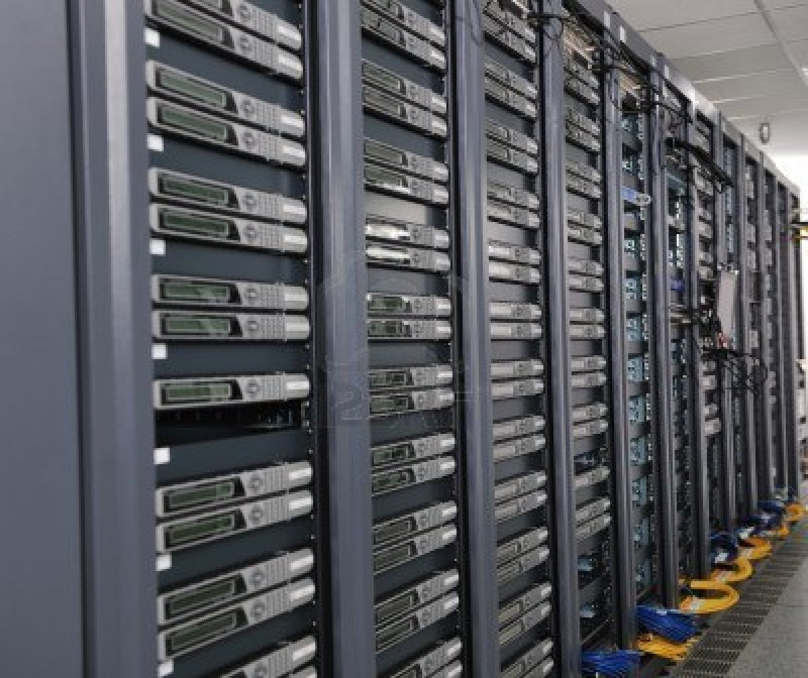


Server
Hardware
Software
Web Server
Database Server

Slide 4
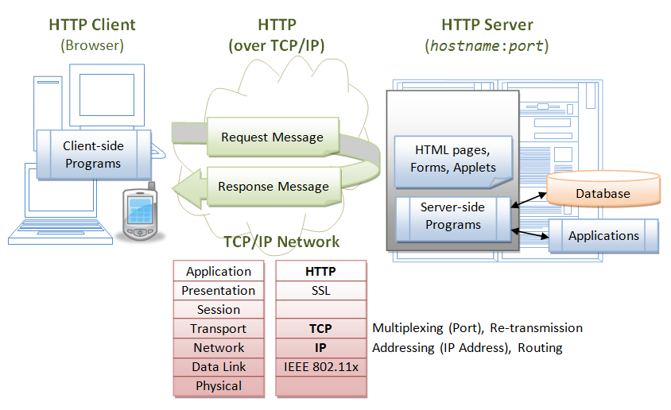
The Large Picture

Slide 6
Tomcat Basics
What is Tomcat?
Web container
Manage Java Servlets
HTTP Web server
Deliver web pages on the request to clients.
Receive content from clients.
Create HTML documents dynamically ("on-the-fly")

Slide 7
Install Tomcat
Windows
Installer (apache-tomcat-6.0.36.exe)
Mac
Unzip

Slide 8
Outline
Tomcat Basics
Tomcat Administration
Deploy web applications to Tomcat server
WAR file
Deployment folder

Slide 9
Look inside the Tomcat directory
/tomcat
/conf
/lib
/logs
/webapps
/work
server.xml
/ROOT
/deployedApp1
/deployedApp2
/bin
/WEB-INF
/META-INF
web.xml
/lib
/classes
startup.sh
shutdown.sh

Slide 10
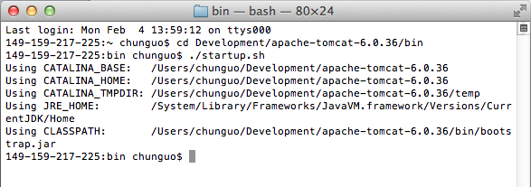
Start Tomcat Server
Windows
> startup.bat
Mac
$ cd “TOMCAT_HOME”/bin
$ ./startup.sh
Test
http://localhost:8080

Slide 11
Shut Down Tomcat Server
Windows
> shutdown.bat
Mac
$ cd “TOMCAT_HOME”/bin
$ ./shutdown.sh
Test
http://localhost:8080

Slide 12
Look inside the Tomcat directory
/tomcat
/conf
/lib
/logs
/webapps
/work
server.xml
/ROOT
/deployedApp1
/deployedApp2
/bin
/WEB-INF
/META-INF
web.xml
/lib
/classes
startup.sh
shutdown.sh

Slide 13
Tomcat Architecture
HTTP
Request
HTTP Response
AJP
Request
AJP
Response
TOMCAT
Connector
HTTP 1.1
Connector
AJP 1.3
Engine
Host
Context
Host
Context
Web application A
Web application C
Context
Context
Web application B
Web application D
More about server.xml: http://www.mulesoft.com/tomcat-configuration#.URM9VlqWkSg

Slide 14
Host, Context
Host
http://chausie.slis.indiana.edu/
http://localhost:8080/
Context
http://chausie.slis.indiana.edu/ROOT
http://localhost:8080/myApp

Slide 15
Tomcat configuration file (server.xml)
<?xml version='1.0' encoding='utf-8'?>
<Server port="8005" shutdown="SHUTDOWN”>
<Service name="Catalina”>
<Connector port="8080" protocol="HTTP/1.1” connectionTimeout="20000” redirectPort="8443" />
<Connector port="8009" protocol="AJP/1.3" redirectPort="8443”/>
<Engine name="Catalina" defaultHost="localhost">
<Realm className="org.apache.catalina.realm.UserDatabaseRealm"
resourceName="UserDatabase"/>
<Host name="localhost" appBase="webapps” unpackWARs="true" autoDeploy="true"
xmlValidation="false" xmlNamespaceAware="false">
</Host>
</Engine>
</Service>
</Server>

Slide 16
Change Default Port
In “server.xml”
… …
<Connector port="8080" protocol="HTTP/1.1"
connectionTimeout="20000"
redirectPort="8443" />
… …

Slide 17
Change Default Port
In “server.xml”
… …
<Connector port="8080" protocol="HTTP/1.1"
connectionTimeout="20000"
redirectPort="8443" />
… …

Slide 18
Outline
Tomcat Basics
Tomcat Administration
Deploy web applications to Tomcat server
WAR file
Deployment folder

Slide 19
Package your web application
Export your project to as a WAR file.
A WAR file (or Web application ARchive) is a JAR file used to distribute a collection of JavaServer Pages, Java Servlets, Java classes, XML files, tag libraries, static web pages (HTML and related files) and other resources that together constitute a web application.

Slide 20
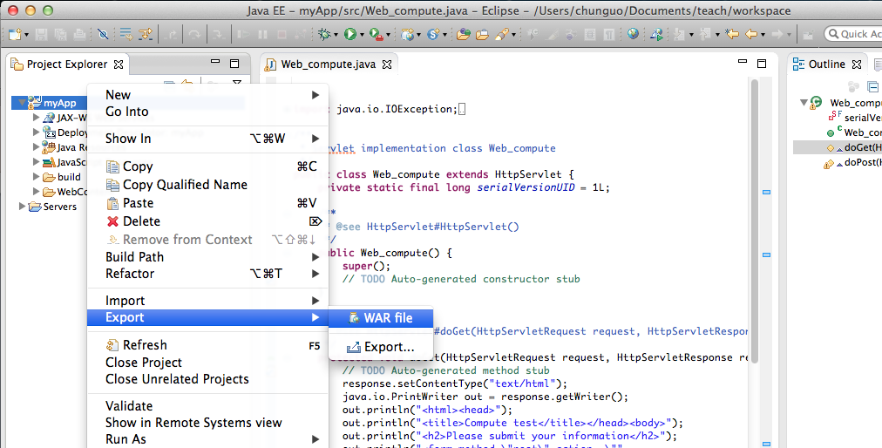
Package your web application
In Eclipse, right click on your project name; go to “Export”, and click “WAR file ”.

Slide 21
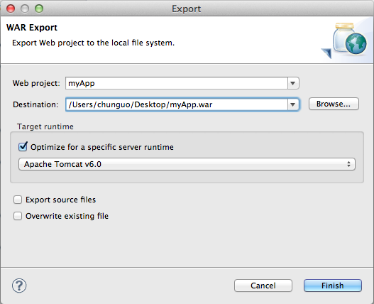
Package your web application
Click “Browse” to select a location to store your WAR file, and click “Finish”.

Slide 22
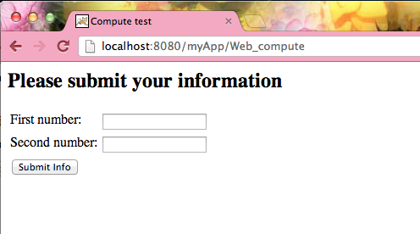
Deploy your web application
Copy your WAR file to the TOMCAT_HOME/webapps directory.
Restart Tomcat.
./shutdown.sh
./startup.sh
Test
http://localhost:8080/myApp/Web_compute
Check the TOMCAT_HOME/webapps directory. A new directory named “myApp” is created.

Slide 23
Look inside your application directory
/myApp
/WEB-INF
Index.html
/img
/classes
/lib
web.xml

Slide 24
Look inside your application directory
/myApp
/WEB-INF
Index.html
/img
/classes
/lib
web.xml
This is the root directory of the web application. All static content (e.g. HTML files, images) are stored here.

Slide 25
Look inside your application directory
/myApp
/WEB-INF
Index.html
/img
/classes
/lib
web.xml
WEB-INF directory is not part of the public document.

Slide 26
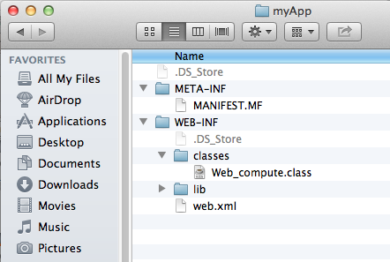
Look inside your application directory
/myApp
/WEB-INF
Index.html
/img
/classes
/lib
web.xml
This directory is where servlet and utility classes are located.

Slide 27
Look inside your application directory
/myApp
/WEB-INF
Index.html
/img
/classes
/lib
web.xml
This directory contains Java Archive files that the web application depends upon. For example, this is where you would place a JAR file that contained a JDBC driver.

Slide 28
Look inside your application directory
/myApp
/WEB-INF
Index.html
/img
/classes
/lib
web.xml
web application deployment descriptor

Slide 29
Web Application Deployment Descriptor: web.xml
<display-name>myApp</display-name>
<welcome-file-list>
<welcome-file>index.html</welcome-file>
<welcome-file>index.htm</welcome-file>
<welcome-file>index.jsp</welcome-file>
<welcome-file>default.html</welcome-file>
<welcome-file>default.htm</welcome-file>
<welcome-file>default.jsp</welcome-file>
</welcome-file-list>
<servlet>
<description></description>
<display-name>Web_compute</display-name>
<servlet-name>Web_compute</servlet-name>
<servlet-class>Web_compute</servlet-class>
</servlet>
<servlet-mapping>
<servlet-name>Web_compute</servlet-name>
<url-pattern>/Web_compute</url-pattern>
</servlet-mapping>
</web-app>

Slide 30
Welcome page
The welcome-file-list element contains a list of file names
When the URL request is a directory name, Tomcat automatically brings the first file on the list
If that file is not found, the server then tries the next file in the list, and so on
This file can be of any type, e.g., HTML, JSP, image, etc.
<welcome-file-list>
<welcome-file>index.html</welcome-file>
<welcome-file>index.htm</welcome-file>
<welcome-file>index.jsp</welcome-file>
<welcome-file>default.html</welcome-file>
<welcome-file>default.htm</welcome-file>
<welcome-file>default.jsp</welcome-file>
</welcome-file-list>

Slide 31
Welcome page
The welcome-file-list element contains a list of file names
When the URL request is a directory name, Tomcat automatically brings the first file on the list
If that file is not found, the server then tries the next file in the list, and so on
This file can be of any type, e.g., HTML, JSP, image, etc.
<welcome-file-list>
<welcome-file>Web_compute</welcome-file>
<welcome-file>index.htm</welcome-file>
<welcome-file>index.jsp</welcome-file>
<welcome-file>default.html</welcome-file>
<welcome-file>default.htm</welcome-file>
<welcome-file>default.jsp</welcome-file>
</welcome-file-list>

Slide 32
Servlet Declaration and Mapping
<servlet>
<description></description>
<display-name>Web_compute</display-name>
<servlet-name>Web_compute</servlet-name>
<servlet-class>Web_compute</servlet-class>
</servlet>
<servlet-mapping>
<servlet-name>Web_compute</servlet-name>
<url-pattern>/Web_compute</url-pattern>
</servlet-mapping>
The element <servlet> declares a Servlet
The element <servlet-mapping> maps a URL to a specific Servlet
The URL is relative to the application’s base URL (http://localhost:8080/myApp/)

Slide 33
Servlet Declaration and Mapping
<servlet>
<description></description>
<display-name>Web_compute</display-name>
<servlet-name>Web_compute</servlet-name>
<servlet-class>Web_compute</servlet-class>
</servlet>
<servlet-mapping>
<servlet-name>Web_compute</servlet-name>
<url-pattern>/Web_compute</url-pattern>
</servlet-mapping>
The element <servlet> declares a Servlet
The element <servlet-mapping> maps a URL to a specific Servlet
The URL is relative to the application’s base URL (http://localhost:8080/myApp/)

Slide 34
Work Flow
The user submits an HTTP request
Tomcat finds the servlet based on the URL and the deployment descriptor (web.xml) and passes the request to the servlet
The servlet writes an HTML page containing the response
Tomcat returns the HTML page to the user

