Slide 1
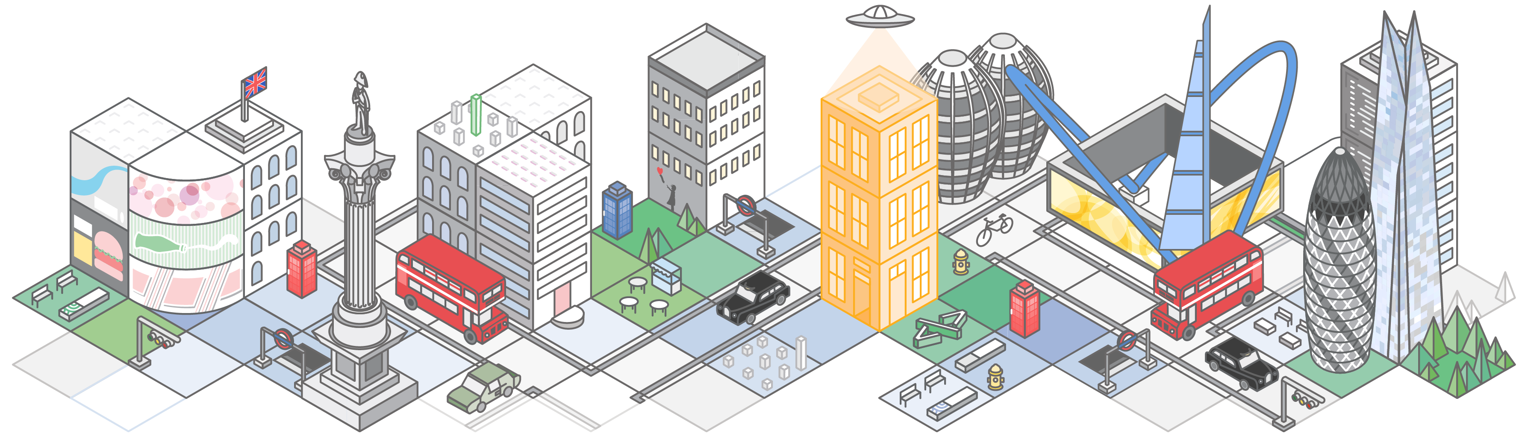

Amazon Virtual Private Cloud

Slide 2
What To Expect From This Session
Fundamentals
VPC Overview
Picking you IP Space
Subnet Design
Routing and NATing
VPC Security
Advanced Topics
VPC Peering
VPC Flow Logging
VPC Endpoints
DC Connectivity
IPsec VPN Tunnel
AWS Direct Connect

Slide 3

Amazon VPC Overview

Slide 4
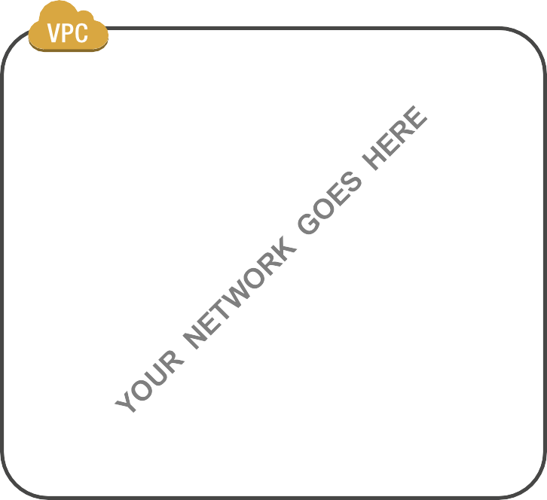
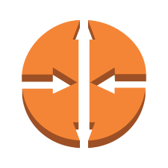
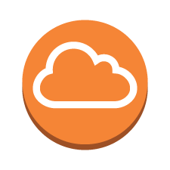



What is a Virtual Private Cloud?
Your own logically isolated section of the Amazon Web Services (AWS) Cloud
By default, your VPC has no access to the internet nor are instances addressable from the internet
You have complete control over your virtual networking environment
Proven and well-­understood networking concepts:
User defined IP address range
Subnets
Route Tables
Access Control Lists
Network Gateways
A way to gain agility as well as additional security

Slide 5
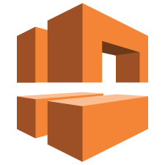
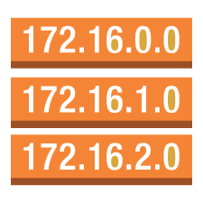

What’s in the VPC tool box?
VPC -­ User-­defined address space up to /16 (65,536 addresses)
Subnets -­ 200 user-­defined subnets up to /16
Route Tables – Define how traffic should be routed from/to each subnet
Access Control Lists – Stateless network filtering between subnets
Internet Gateway – A logical device enabling traffic to be routed to/from the public internet Managed NAT – Provide Network Address Translation to private instances for 10Gbps traffic Virtual Private Gateway -­ The Amazon end of a VPN connection
Customer Gateway -­ The router at the customer end of a VPN connection

Slide 6
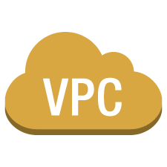
VPCs span an entire region
VPC CIDR: 10.1.0.0 /16
Availability Zone A
Availability Zone B

Slide 7


Subnets sit in a single VPC in a single AZ
VPC CIDR: 10.1.0.0 /16
Subnet (10.1.1.0/24)
Subnet (10.1.2.0/24)
Availability Zone A
Availability Zone B

Slide 8
Picking Your IP Space

Slide 9

Plan your VPC IP space before creating it
Consider future AWS region expansion
Consider future connectivity to your internal networks
Consider subnet design
VPC can be /16 down to /28
CIDR cannot be modified after creation

Slide 10


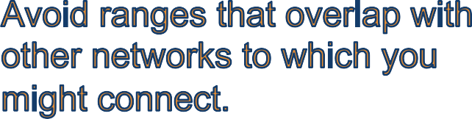
Choosing IP address ranges for your VPC
172.31.0.0/16
Recommended:
/16
(64K addresses)
Recommended: RFC1918 range

Slide 11
Subnet Design

Slide 12


Public / Private Subnets
VPC CIDR: 10.1.0.0 /16
PUBLIC
PUBLIC
Subnet (10.1.1.0/24)
Subnet (10.1.2.0/24)
PRIVATE
PRIVATE
Subnet (10.1.3.0/24)
Subnet (10.1.4.0/24)
Availability Zone A
Availability Zone B

Slide 13

Public / Private Subnets
VPC CIDR: 10.1.0.0 /16
Web (public)
Web (public)
Subnet (10.1.1.0/24)
Subnet (10.1.2.0/24)
Database (private)
Database (private)
Subnet (10.1.3.0/24)
Subnet (10.1.4.0/24)
Availability Zone A
Availability Zone B

Slide 14
Public / Private Subnets
VPC CIDR: 10.1.0.0 /16
Web (public)
Web (public)
Subnet (10.1.1.0/24)
Subnet (10.1.2.0/24)
Database (private)
Database (private)
Subnet (10.1.3.0/24)
Subnet (10.1.4.0/24)
Availability Zone A
Availability Zone B

Slide 15
Routing and NATing

Slide 16
Public Subnet Routing
VPC CIDR: 10.1.0.0 /16
Subnet (10.1.1.0/24)
Subnet (10.1.2.0/24)
Availability Zone A
Availability Zone B

Slide 17
Public Subnet Routing
VPC CIDR: 10.1.0.0 /16
Web (public)
Subnet (10.1.1.0/24)
Subnet (10.1.2.0/24)
Availability Zone A
Availability Zone B

Slide 18
Public Subnet Routing
VPC CIDR: 10.1.0.0 /16
Web (public)
Subnet (10.1.1.0/24)
Subnet (10.1.2.0/24)
Availability Zone A
Availability Zone B

Slide 19
Public Subnet Routing – Internet Gateway
VPC CIDR: 10.1.0.0 /16
Web (public)
Subnet (10.1.1.0/24)
Subnet (10.1.2.0/24)
Availability Zone A
Availability Zone B

Slide 20
Public Subnet Routing – Internet Gateway
VPC CIDR: 10.1.0.0 /16
Web (public)
Subnet (10.1.1.0/24) Subnet (10.1.2.0/24)
Availability Zone A Availability Zone B
Route Table
Destination Target
10.1.0.0/16 Local
0.0.0.0/0 Internet Gateway

Slide 21
Private Subnet Routing
VPC CIDR: 10.1.0.0 /16
Web (public)
Web (public)
Subnet (10.1.1.0/24)
Subnet (10.1.2.0/24)
Database (private)
Database (private)
Subnet (10.1.3.0/24)
Subnet (10.1.4.0/24)
Availability Zone A
Availability Zone B

Slide 22
Private Subnet Routing
VPC CIDR: 10.1.0.0 /16
Web Web
Subnet (10.1.1.0/24) _{(public)} Subnet (10.1.2.0/24) _{(public)}
Database Database
Subnet (10.1.3.0/24) _{(private)} Subnet (10.1.4.0/24) _{(private)}
Availability Zone A Availability Zone B
Route Table
Destination Target
10.1.0.0/16 Local
0.0.0.0/0 Internet Gateway
Route Table
Destination Target
10.1.0.0/16 Local

Slide 23
Private Subnet Routing – NAT Gateway
VPC CIDR: 10.1.0.0 /16
N
Web (public)
Web (public)
Subnet (10.1.1.0/24)
Subnet (10.1.2.0/24)
Database (private)
Database (private)
Subnet (10.1.3.0/24)
Subnet (10.1.4.0/24)
Availability Zone A
Availability Zone B

Slide 24
Private Subnet Routing -­ NATGateway
VPC CIDR: 10.1.0.0 /16
N
Web Web
Subnet (10.1.1.0/24) _{(public)} Subnet (10.1.2.0/24) _{(public)}
Database Database
Subnet (10.1.3.0/24) _{(private)} Subnet (10.1.4.0/24) _{(private)}
Availability Zone A Availability Zone B
Route Table
Destination Target
10.1.0.0/16 Local
0.0.0.0/0 NAT Endpoint

Slide 25
Private Subnet Routing
VPC CIDR: 10.1.0.0 /16
N
Web (public)
Web (public)
Subnet (10.1.1.0/24)
Subnet (10.1.2.0/24)
Database (private)
Database (private)
Subnet (10.1.3.0/24)
Subnet (10.1.4.0/24)
Availability Zone A
Availability Zone B

Slide 26
Authorizing Traffic: Network ACLs and Security Groups

Slide 27
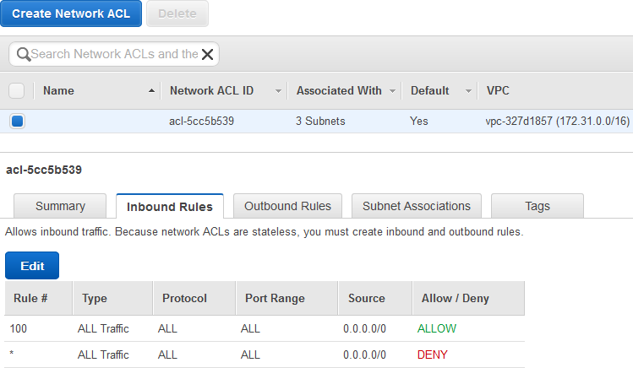
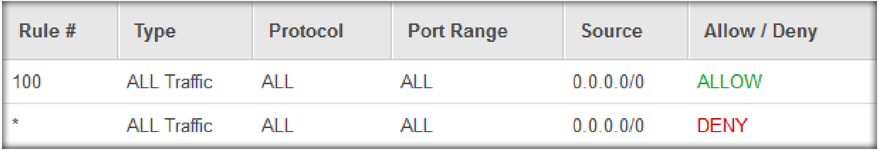
Network ACLs = Stateless Firewall Rules
Can be applied on a subnet basis
English translation: Allow all traffic in

Slide 28
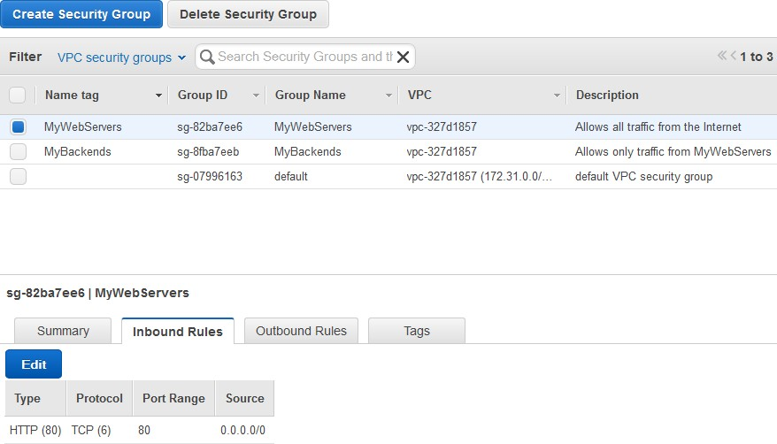


Security Groups = Stateful Firewall Rules
In English: Hosts in this group are reachable from the Internet on port 80 (HTTP)

Slide 29
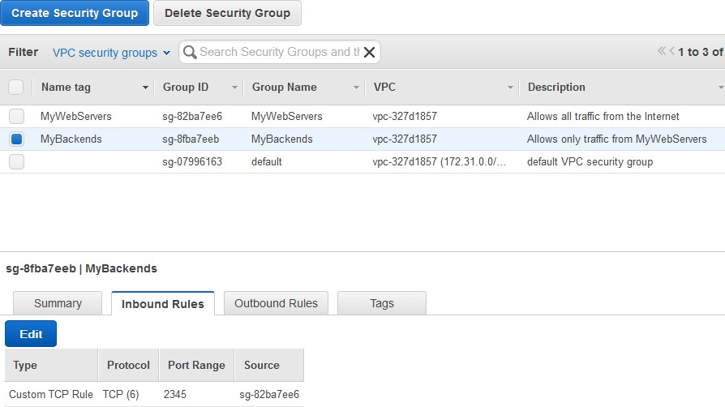


Security Group Mutual Trust
In English: Only instances in the MyWebServers Security Group can reach instances in this Security Group

Slide 30
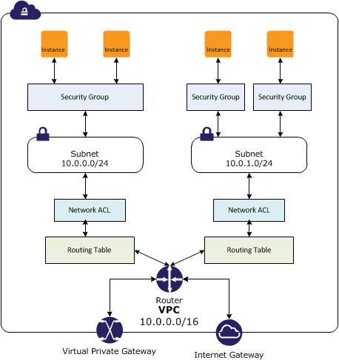
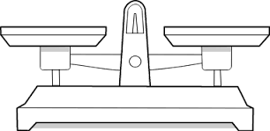
Security Balancing Act
Comparison between Security Groups and Network ACLs
Area of Security | Security Group | Network ACL
Operational Level | Instance level | Subnet level
Supports ALLOW rules… | …only | …and DENY rules
State Type | Stateful | Stateless
Evaluation method | All rules evaluated | Stop on first match
Applicability to Instances | Only if SG explicitly added to instance | Automatically to all instances in subnet
Source / Destination | IP CIDR and other Security Groups | IP CIDR only

Slide 31
VPC Peering

Slide 32



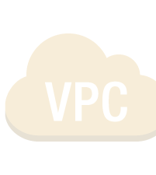



Connecting your VPCs (VPC Peering)
Creates a private network connection between any two VPCs in a region
You can connect VPCs together within a Region without having to
Maintain all the VPN overhead between multiple VPCs
Expose the destination VPC to the Internet and all that entails
Including cross-­account VPC Peering
Often used for Common/Core services
Authentication / Directory Services
Monitoring / Logging
Security Scanning
Remote Administration

Slide 33
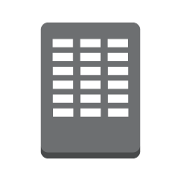
Common Design – Shared Services VPC
Move shared services such as Active Directory, Logging, Monitoring and Service Buses to a shared services VPC (A)
VPC B 10.2.0.0/16
VPC C 10.3.0.0/16
VPC D 10.4.0.0/16
None of the other VPCs can send traffic directly to each other – they must go through VPC A (= app isolation)
pcx-­aaaacccc
pcx-­aaaabbbb
pcx-­aaaadddd
Only VPC A has direct network access to your data center via Direct Connect
VPC A 10.1.0.0/16
Routing Tables define which subnets are allowed to route over a peer connection
Security Groups and NACLs still apply, and Security Groups in VPC A can be defined to mutually trust the Security Groups in the other VPCs
10.0.0.0/16

Slide 34
VPC Flow Logs

Slide 35


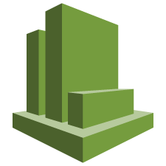




See all of the traffic at your instances
Ability to analyze traffic
Troubleshooting network connectivity
Visibility into effects of security group rules

Slide 36
VPC Flow Logs
Enabled at the ENI, subnet, or VPC level
Traffic data surfaced as “flow log records” per ENI
Data accumulated and published to CloudWatch Logs at ~10 minute intervals
Exposed as CloudWatch log groups and streams
Normal CloudWatch Logs groups/streams with all related features
Create custom CloudWatch metrics based upon log filtering
Create CloudWatch alarms based upon the new metrics
CloudWatch Logs -­> Amazon Kinesis stream integration

Slide 37
Flow Log record (text, space-­delimited)
Field | Description
version | The VPC Flow Logs version.
account-id | The AWS account ID for the Flow Log.
interface-id | The ID of the network interface for which the log stream applies.
srcaddr | The source IP address. The IP address of the network interface is always its private IP address.
dstaddr | The destination IP address. The IP address of the network interface is always its private IP address.
srcport | The source port of the traffic.
dstport | The destination port of the traffic.
protocol | The IANA protocol number of the traffic. For more information, go to Assigned Internet Protocol Numbers.
packets | The number of packets transferred during the capture window.
bytes | The number of bytes transferred during the capture window.
start | The time, in Unix seconds, of the start of the capture window.
end | The time, in Unix seconds, of the end of the capture window.
action | The action associated with the traffic: ACCEPT: The recorded traffic was permitted by the security group or network ACLs. REJECT: The recorded traffic was not permitted by the security groups or network ACLs.
log-status | The logging status of the flow log: OK: Data is logging normally to CloudWatch Logs. NODATA: There was no network traffic to or from the network interface during the capture window. SKIPDATA: Some flow log records were skipped during the capture window.

Slide 38
VPC Endpoints

Slide 39
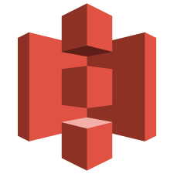







Service Endpoints need Internet Connectivity
Traffic to the VPC’s range stays in the VPC
aws ec2 describe-route-tables --route-table-ids rtb-c9d737ad
|+----------------------------------------------------+|
||| Routes |||
||+-----------------------+------------+-------------+||
||| DestinationCidrBlock | GatewayId | State ||
||+-----------------------+------------+--------------||
||| 10.10.0.0/16 | local | active
||| 0.0.0.0/0 | igw-5a1ae13f | active
||
||
+----------------------------------------------------+||
Everything not destined for the VPC goes to the Internet

Slide 40

VPC Endpoints Allow Direct Access from VPC
aws ec2 describe-route-tables --route-table-ids rtb-ef36e58a
|+-------------------------------------------------------------------+|
||| Routes |||
||+-----------------------+-----------------------------------------+||
||| DestinationCidrBlock | DestinationPrefixListId | GatewayId ||
||+-----------------------+-------------------------+----------------||
||| 10.10.0.0/16
|||
| | local ||
| pl-68a54001 | vpce-a610f4cf ||
+-------------------------+-------------------------+---------------+||

Slide 41



The Amazon S3 Prefix list
aws ec2 describe-prefix-lists
--prefix-list-ids
pl-68a54001
--------------------------------------------------
| DescribePrefixLists |
+------------------------------------------------+
|| PrefixLists ||
|+---------------+------------------------------+|
|| PrefixListId | PrefixListName ||
|+---------------+------------------------------+|
|| pl-68a54001 | com.amazonaws.us-west-2.s3 ||
|+---------------+------------------------------+|
||| Cidrs
IP||ra|nge for Amazon S3
||+--------------------------------------_{C}-_{h}-_{a}-_{n}-_{g}-_{e}-+_{s}|_{o}|_{ver time and is managed by}
||| 54.231.160.0/19 |||
AWS
||+--------------------------------------------+||

Slide 42
Rich security controls
New route entry
As many endpoints per VPC as you like, but maximum one assigned route per subnet
Policies on VPC endpoints
Constrain principals, actions, destination buckets, paths within buckets
S3 bucket policies
Constrain source VPCs and/or VPC endpoints
All policies ANDed together
IAM, VPC endpoints and S3

Slide 43



VPC endpoint policy example
{ "Statement": [
{
"Sid": "Access-to-specific-bucket-only", "Principal": "*",
"Action": [ "s3:GetObject", "s3:PutObject"
],
"Effect": "Allow",
"Resource": ["arn:aws:s3:::my_secure_bucket", "arn:aws:s3:::my_secure_bucket/*"]
}
]
In English: Calls via this VPC endpoint are allowed Get/Put to my_secure_bucket
}

Slide 44



S3 bucket policy example #1
{ "Version": "2012-10-17",
"Statement": [
{
"Sid": "Access-to-specific-VPCE-only", "Principal": "*",
"Action": "s3:*",
"Effect": "Deny",
"Resource": ["arn:aws:s3:::my_secure_bucket", "arn:aws:s3:::my_secure_bucket/*"],
"Condition": {
"StringNotEquals": { "aws:sourceVpce": "vpce-a610f4cf” }
}
}
In English: Deny access to this bucket to all calls except those coming via this VPC endpoint
]
}

Slide 45



S3 bucket policy example #2
{ "Version": "2012-10-17”,
"Statement": [
{
"Sid": "Access-to-specific-VPC-only", "Principal": "*",
"Action": "s3:*",
"Effect": "Deny",
"Resource": ["arn:aws:s3:::my_secure_bucket", "arn:aws:s3:::my_secure_bucket/*"],
"Condition": {
"StringNotEquals": { "aws:sourceVpc": "vpc-c15180a4” }
}
}
In English: Deny access to this bucket to all calls except those coming from this VPC
]
}

Slide 46
Connecting to Your Network

Slide 47


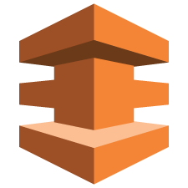
Connect to your data center
Subnet (10.1.1.0/24)
Subnet (10.1.2.0/24)
Subnet (10.1.3.0/24)
Subnet (10.1.4.0/24)
192.168.0.0/16
Availability Zone A
Availability Zone B
10.1.0.0/16
or

Slide 48

Connect to your data center
Subnet (10.1.1.0/24)
Subnet (10.1.2.0/24)
Internal Server
Subnet (10.1.3.0/24)
Subnet (10.1.4.0/24)
192.168.0.0/16
Availability Zone A
Availability Zone B
10.1.0.0/16
or

Slide 49
Connect to your data center
Route Table
Destination Target
10.1.0.0/16 Local
0.0.0.0/16 IGW
Subnet (10.1.1.0/24) Subnet (10.1.2.0/24)
Internal Server
Subnet (10.1.3.0/24) Subnet (10.1.4.0/24)
^{192.168.0.0/16} Availability Zone A Availability Zone B
10.1.0.0/16
or
Route Table
Destination | Target
10.1.0.0/16 | Local
192.168.0.0/16 | VGW
0.0.0.0/0 | NAT Endpoint

Slide 50
AWS Direct Connect

Slide 51
What is AWS Direct Connect…
Dedicated, private pipes into AWS
Create private (VPC) or public virtual interfaces to AWS Reduced data-­out rates (data-­in still free)
Consistent network performance
At least 1 location to each AWS region Option for redundant connections
Multiple AWS accounts can share a connection
Uses BGP to exchange routing information over a VLAN

Slide 52




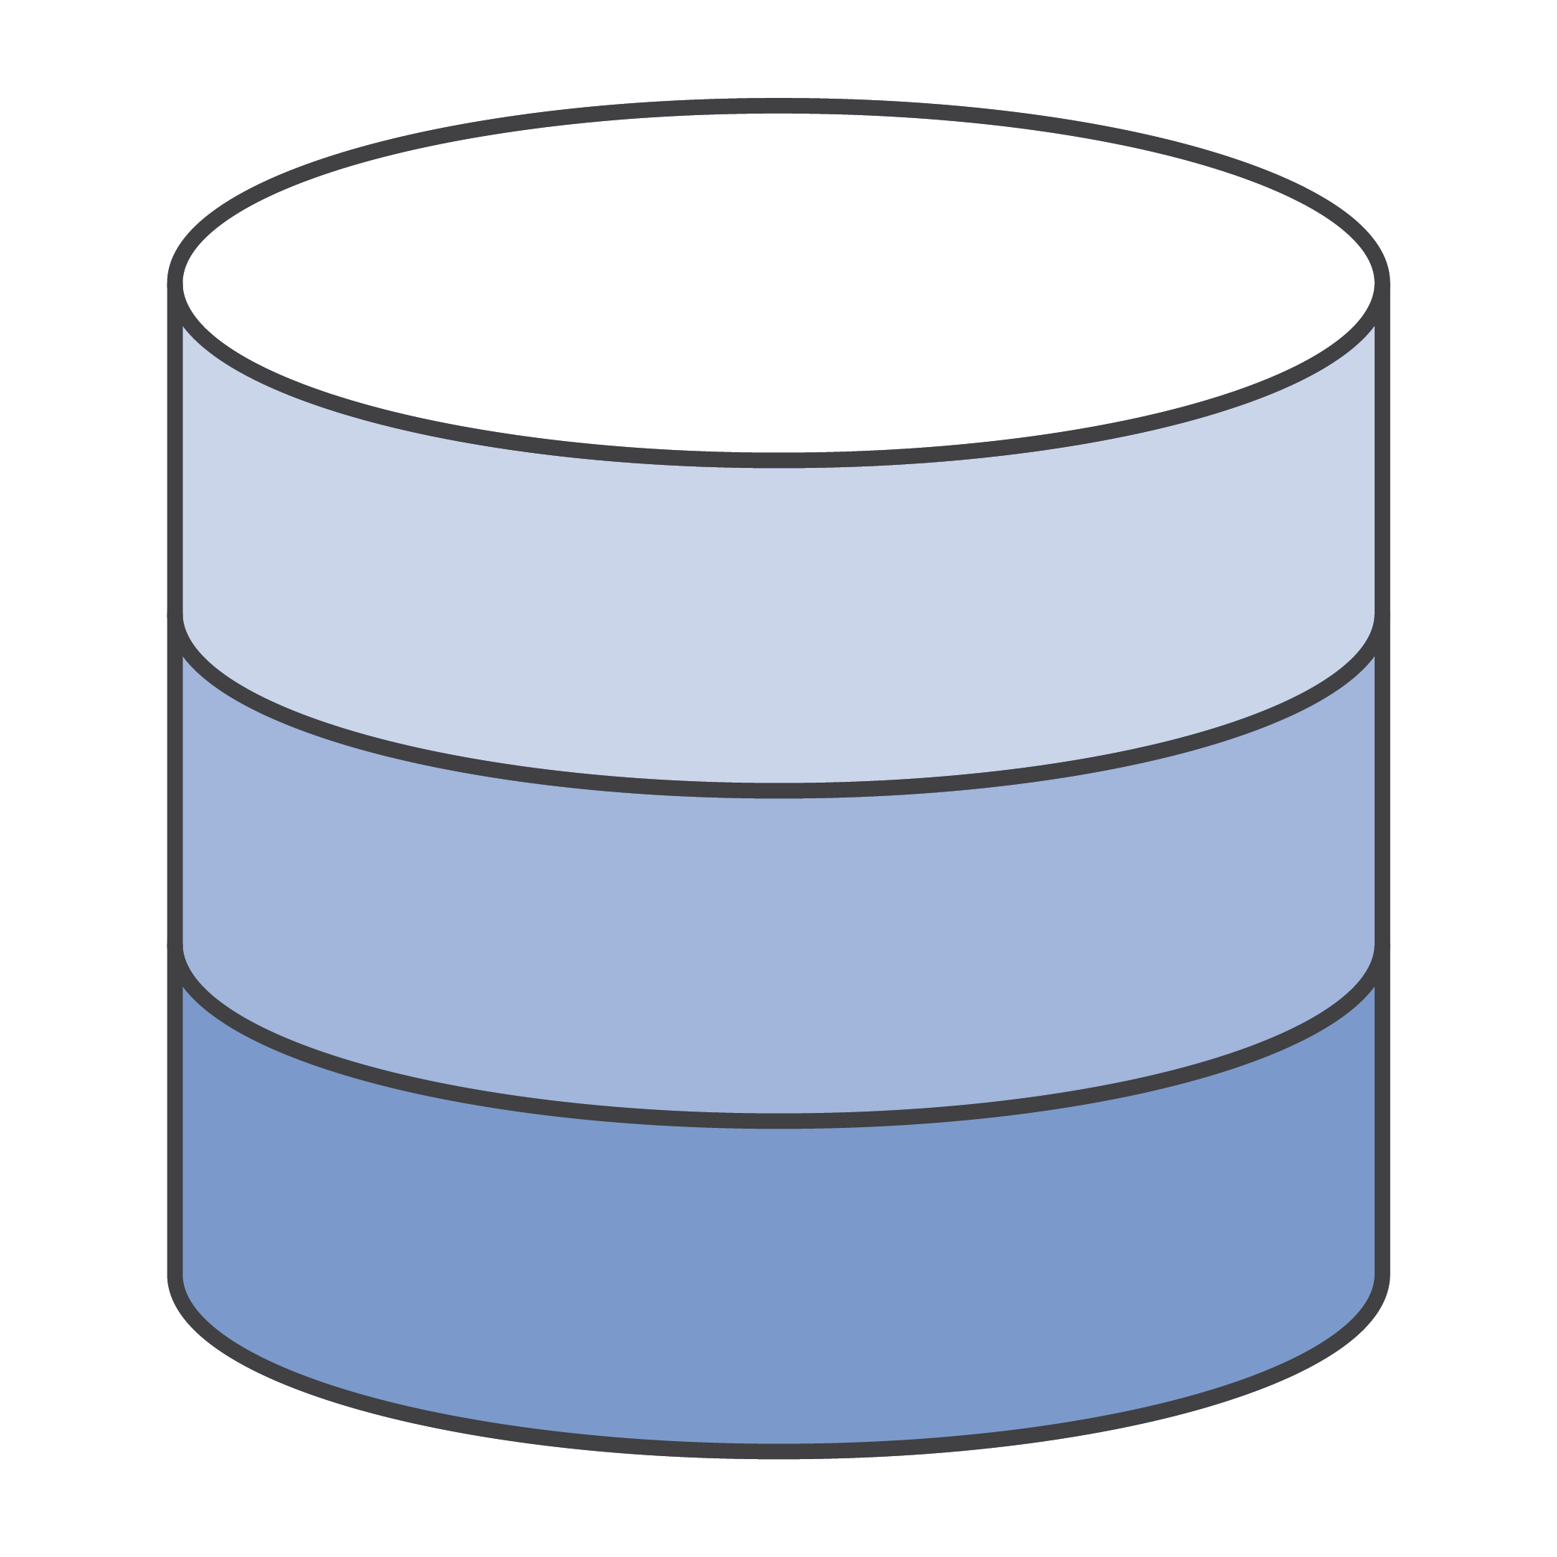


At the Direct Connect Location
Demarcation
AWS Backbone Network
Cross Connect | Customer Router | Access Circuit | Customers Network Backbone
Access Circuit
DX Location
Colocation
Customer Network
AWS Direct Connect Routers
Customer Router
CORP

Slide 53
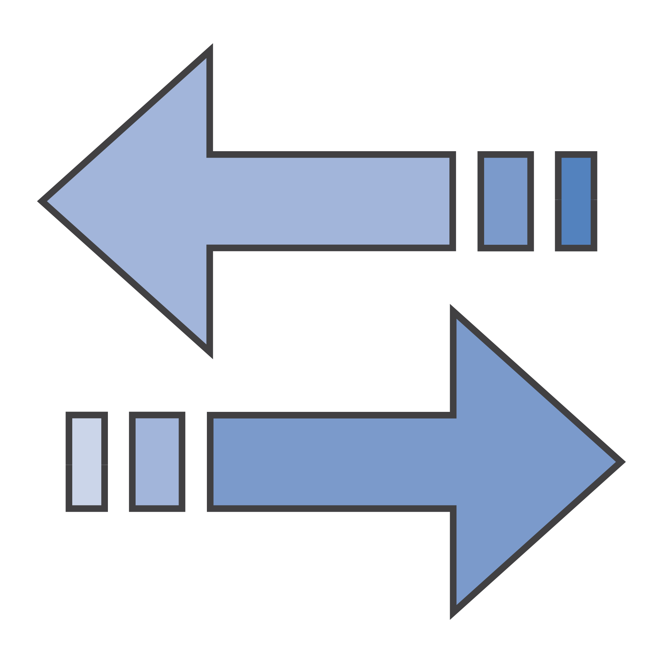







Dedicated Port via Direct Connect Partner
Demarcation
AWS Backbone Network
Cross Connect
Partner Equipment
Partner Network
Access Circuit
Customer Router
DX Location
Colocation
Partner Network
AWS Direct Connect Routers
CORP
For a full Direct Connect Partner list see here: https://aws.amazon.com/directconnect/partners/

Slide 54
At the Direct Connect Location – via MPLS
Demarcation
AWS Backbone Network
Cross Connect
Provider Edge
Partner MPLS Core
Access Circuit to CE
DX Location
Colocation
MPLS Core
CE Router
AWS Direct Connect Routers
Partner PE Router
CE Router
CORP

Slide 55
Dual DX – Single Location
DX Location
Service Provider Network
Customer Router
AWS Direct Connect Routers
CORP

Slide 56
Dual DX – Single Location / Dual Routers
DX Location
Colocation
Service Provider Network
AWS Direct Connect Routers
Customer Routers
CORP

Slide 57
Single DX – Dual Location / Dual Routers
DX Location 1
Colocation
AWS Direct Connect Routers
Customer Routers
Service Provider
DX Location 2
Network
Colocation
AWS Direct Connect Routers
Customer Routers
CORP

Slide 58
Dual DX – Dual Location / Dual Routers
DX Location 1
Colocation
AWS Direct Connect Routers
Customer Routers
Service Provider
DX Location 2
Network
Colocation
AWS Direct Connect Routers
Customer Routers
CORP

Slide 59
Things to remember
All Direct Connect locations are at 3rd party data centers
You will have to work with at least one other organisation
Could be just the Data Center
Could be a Network Provider / Direct Connect Partner
Could be multiple Network Providers AND the Data Center
There are a number of possible connection speeds
1G and 10G links can connect to multiple VIFs (=> multiple VPCs)
Sub-­1G Hosted Connections from Partners support just a single VIF (=> single VPC)
VIFs could be attached to other accounts in the same AWS Region
Public VIF’s include the Hardware VPN Endpoints
Use Direct Connect to transport an IPsec VPN connection

Slide 60
Thank You. Questions ?

