Slide 1
Apache Web Server
Quick and Dirty
Steve Gibbard for SANOG 16
(Originally by Joel Jaeggli for AfNOG 2007)‏

Slide 2
About Apache
Apache http server project
http://httpd.apache.org
Apache foundation started to support the web server project, but now extends to a multitude of other projects.

Slide 3
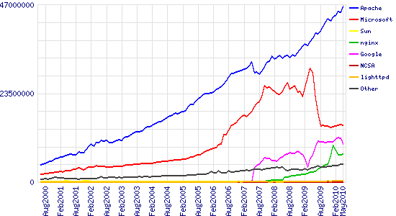
Stats of Web Server types

Slide 4
What the Busiest 1M Websites use

Slide 5
Apache Installation on FreeBSD
Apache can be installed from Ports
  /usr/ports/www/apache22
Can be installed from pkg_add
Or from source if one requires a more recent version what's on FreeBSD source ports tree

Slide 6
File System Layout
config files are in /usr/local/etc/apache22/
files the webserver will serve are in /usr/local/www/apache22/data/
Startup script is
/usr/local/etc/rc.d/apache22
Take a look in
/usr/local/etc/rc.d/apache22
Add apache22_enable="YES" to /etc/rc.conf
Run
/usr/local/etc/rc.d/apache22 start
Restart
  $ apachectl restart

Slide 7
Apache SSL
Secure Socket Layer (SSL) port is 443
SSL is important to protect communication between browser and web-server
Requires the creation of SSL certificates and Certificate Signing Requests (CSR)
For integrity SSL certificates are signed by a Certificate Authority’s (CA) such as Verisign
Self signed Certificates will also work but your browser will not trust it and will give a warning to users (which most don’t read)
Refer to the Creating SSL Certificate Exercise Section

Slide 8
How SSL Works
Each SSL certificate has a Public and Private key
The Public Key is used to encrypt the information
The Public Key is accessible to everyone
The private Key is used to decipher the information
The private should be not be disclosed

Slide 9
Role of Certificate Authority
There are a number of CA that certify certificates
Most browsers have pre-included public Keys from the CA’s
A CA certified certificate will have validation information signed by the CA’s private key
The browser will decrypt the validation information using the public key and verify that the certificate is certified by the CA
If this fails a warning is given

Slide 10
Virtual Hosting
Apache Provides multiple options of virtual hosting and scales
  Name Based virtual hosts
  IP Based Virtual Hosts
  Aliases
Its recommended to use an IP address over hostnames in virtual hosting configuration
Refer to virtual hosting Exercise section

Slide 11
Installing PHP & Mysql
PhP and Mysql implementations have increased driven mainly by development requests
LAMP and WAMP are the most common implementations
FreeBSD = “FAMP” ? http://geekybits.blogspot.com/2007/09/creating-famp-server.html
Installation via ports and relatively straight forward
See PHP & Mysql installation exercise section

Slide 12
Apache and IPv6
Apache supports IPv4 and IPv6 by default
Set the listen option to port 80 will listen for both IPv4 and IPv6
listen option with IPv4 and IPv6 specific addresses will invoke different sockets for each protocol
  Listen 196.200.219.xx:80
  Listen [2001:4348:0:219:196.200.219:xx]:80

Slide 13
Start Apache!
/usr/local/etc/rc.d/apache22 start
Check that you can access http://localhost in your browser
Check that you can access https://localhost in your browser, and that you get a certificate warning
Click on the padlock icon in your browser and check that the certificate details are correct
Profit!

Slide 14
Apache implementations
Apache is widely used to serve many content applications
Webmail, Blogs, Wiki’s, CMS etc
Attempt to install wordpress and configure it

Slide 15
Start Exercises

