Slide 1







Presentation
on
cloud computing

Slide 2


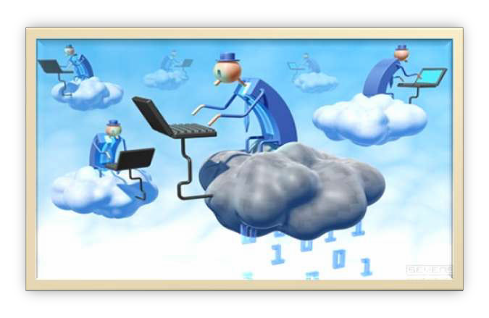
Cloud computing

Slide 3


Introduction:-
Cloud computing is a technology that uses the internet and central remote servers to maintain data and applications.
Cloud
computing
allows
consumers and
businesses to use applications without installation and access their personal files at any computer with internet access.

Slide 4

Contd..
User do not have or need knowledge, control, ownership in the computer infrastructure.
A simple example of cloud computing is Yahoo
email or Gmail etc.
All a consumer would need is just an internet connection and can start sending emails.

Slide 5












History of cloud computing:-
Yesterday, Today, and Tomorrow:-
In 1960s the American computer scientist named John McCarthy stated that computing will become a publicly available service in the future. This is what has happened today and cloud computing has made it all possible.
He claimed that computing might be sold in future in
the same way as utilities are (electricity, water etc.).
The first successful Amazon.
company to develop commercially
cloud computing technology was

Slide 6

The Past:-
In the past, computing was done through utility of
supercomputers and mainframes.
The problem with this set-up arises from the cost
needed to create a supercomputer or mainframe.
The cost of past computing methods was very high.

Slide 7

The Present:-
Today, computing can be done with utility of the service offered by a provider that specializes on this industry.
This makes the cost of computing lower compared with the utility of supercomputers in the past and this is the concept of cloud computing.
Intelligent cloud computing is able to manage all of the resources efficiently.

Slide 8


Tomorrow:-
As computer technology continue to progress so does the capability of cloud computing.
As faster computers and larger virtual storage areas become available, cloud computing will also continuously improve with it.
It can be possible in the future that data processed in an hour today can be done in just a minute. Faster processors and connections will be the main proponents of this improvement.

Slide 9

Life before cloud Computing:
Traditional business applications have always been very complicated and expensive. The amount and variety of hardware and software required to run them are daunting. You need a whole team of experts to install, configure, test, run, secure, and update them.
When you multiply this
effort across
dozens or
hundreds of apps, it’s easy to see why the biggest companies with the best IT departments aren’t getting the apps they need. Small and mid-sized businesses don’t stand a chance.

Slide 10

Life after Cloud Computing:
With cloud | computing, | you | eliminate those
headaches | because | you’re | not managing
hardware and software—that’s the responsibility of an experienced vendor like salesforce.com. The shared infrastructure means it works like a utility: You only pay for what you need, upgrades are automatic, and scaling up or down is easy.
Cloud-based apps can be up and running in days or weeks, and they cost less. With a cloud app, you just open a browser, log in, customize the app, and start using it.

Slide 11



Cloud Services:

Slide 12

Software as a Service:-
SaaS is the most widely known and widely used form of cloud computing.
SaaS
eliminates
customer
worries about
application servers, storage, application development and related, common concerns of IT.
Highest-profile examples are Google's Gmail and
Apps, Yahoo , Google and Skype.

Slide 13

Platform as a Service:-
It delivers virtualized servers on which customers can run existing applications or develop new ones without having to worry about maintaining the operating systems, server hardware.
It provides development platforms to create and run applications in the cloud.

Slide 14

Infrastructure as a Service:-
IaaS is designed to replace the functions of an
entire data center.
Here Cloud Computing provides grids or virtualized servers, networks, storage and systems software.
This saves cost (time and equipment deployment .
expense)
of capital

Slide 15

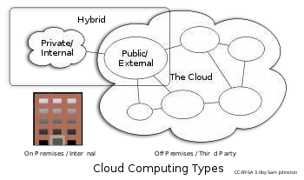
Types of Cloud Computing:
Public cloud
Private cloud
Hybrid cloud

Slide 16






Public Cloud: Computing
infrastructure is
hosted at the
the
vendor’s premises. The customer has no visibility over location of the cloud computing infrastructure. The computing infrastructure is shared between organizations.
Private Cloud: Computing
architecture is dedicated to the
customer and is not shared with other organizations. They are expensive and are considered more secure than Public Clouds. Private clouds may be externally hosted ones as well as in premise hosted clouds.
Hybrid Cloud: Organizations
host some critical, secure
applications in private clouds. The not so critical applications are hosted in the public cloud. The combination is known as Hybrid Cloud.

Slide 17

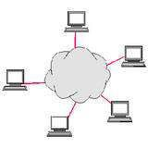
Advantages of Cloud Computing:-
Online form of computing
Reduced cost
More storage
Automatically updated
Computing flexibility
Mobility
Shared Resources
No downloads

Slide 18

1.Online form of computing:-
Cloud computing is a online form of computing where users can access applications via a browser, while the application is installed and stored on a server.
An example of this would be Google Docs.

Slide 19

2. Reduced cost:-
It helps keep the cost down for both the users and website owners. Also for the users, they can access it from any computer and still have the file they need.
The main advantage of using cloud computing facility is that customers do not have to pay for infrastructure installation and maintenance cost.
As a user of cloud computing you have to pay the service charges according to your usage of computing power and other networking resources

Slide 20

3.More storage:-
It can hold more storage than a personal computer can. It takes away the need for the upgrading computer memory, which also helps keep the cost down for the companies and users alike.
User do not have to worry about installation, email servers, anti-viruses, backups, web servers and both physical and logical security of your data.

Slide 21

4.Automatically updated:-
Owners no longer need to hire people to update more than one server, and it also helps the users who do not like to download updates for the software.
The server gets the updates and everyone who uses the service gets the updates without updating anything on their end.

Slide 22

5.Mobility:-
It allows users to connect even without their own computers, meaning you can do your work from anywhere in the world as long as you have a internet connection and a computer access.
So you can take your wedding and vacations.
work
with
you on your

Slide 23

6. Shared Resources:
A key
component of
cloud
computing
is that
companies share resources. With cloud computing, this allows them all to have access to the resources via cloud computing.
This again saves businesses time and money by placing their resources all in one location that is easy for their workers to look up and access.

Slide 24


7.Computing flexibility & No downloads:-
Computing Flexibility- It has more flexibility
than
other network computing systems and saves time plus money for people who are in a time crunch.
No Downloads-The users do not need to download anything, so that saves time and hard drive space for users. They can just log onto the network.

Slide 25


Disadvantages of Cloud
Computing:
Security and Privacy
Dependency(loss of control)
Cost
Decreased Flexibility
Migration Problems:

Slide 26

1.Security and Privacy:
The biggest concerns about cloud computing are security. Users might not be comfortable handing over their data to a third party.
Privacy is another issue with cloud servers. Ensuring that a client’s data is not accessed by any unauthorized users is of great importance for any cloud service.
To make their servers more secure, cloud service vendors have developed password protected accounts.

Slide 27

2.Cost:
Data centers have to buy or develop the software that’ll run the cloud, rewire the machines and fix problems. This makes their initial cloud offers more expensive.
The first customer pay a higher price and have to deal with more issues than those who switch later.

Slide 28

3.Decreased Flexibility:
This is only a temporary problem.
Some of the current users might have to deal with the facts that their cloud server is difficult or impossible to upgrade without losing some data.

Slide 29

4.Migration problems:
In case the user has to switch to some other provider, there are migration issues.
It’s not easy
to transfer
huge
data
from one
provider to the other.

Slide 30


Examples of Cloud Computing:
e
E-Mail
Social Networking
Working in a virtual offic

Slide 31


1.E-mail:
Some of the biggest cloud computing services are Web-based e-mail. As of January 2010, over 500 million people used Microsoft's Web-based e- mail, Hotmail or Windows Live Mail.
Online email has been offered by all the big names (such as Microsoft, Yahoo and of course Google) for a number of years.

Slide 32

2.Social Networking:
The most famous use of cloud computing, which does not strike people as "cloud computing" at first glance is social networking Websites, including Facebook, MySpace, Twitter, and many, many others.
By creating a Facebook fan page, a business can connect with its customers, and at the same time, those customers will be promoting your business.

Slide 33

3.Working in a Virtual Office:
Google’s online suite of office
probably the best example.
applications is
Rather than having a system and space hogging
suite of applications
like a word processor, a
and a presentation or
spreadsheet creator
publishing platform sitting on your computer, you could opt to work online instead.

