Slide 1
Jenkins : Getting Started
By
Ramana Reddy

Slide 2
Agenda
What is Jenkins - an Introduction.
What is Continuous Integration.
Installing and Configuring Jenkins.
Managing Security.
Creating a job with Jenkins.
Hands on CI with Jenkins.
References.

Slide 3
What is Jenkins - an Introduction
Jenkins is the leading open source continuous integration tool.
Jenkins was originally developed as the Hudson project. Hudson's creation started in summer of 2004 at Sun Microsystems.
In November 2010, an issue arose in the Hudson community with respect to the infrastructure used. Negotiations were held between the principal project contributors and Oracle; a key sticking point was the control of the name "Hudson" itself, which Oracle claimed, and on January 11, 2011, a proposal was made to change the project name from "Hudson" to "Jenkins".
●
●
●

Slide 4
What is Jenkins...
●
On February 1, 2011, Oracle said that they intended to continue development of Hudson, and considered Jenkins a fork rather than a rename. As of December 2016, the Jenkins organization on Git Hub had 638 project members and around 1,800 public repositories, compared with Hudson's 32 project members and 17 public repositories.
Hudson is not maintained anymore, Jenkins is the replacement for it.
Jenkins builds and tests our software continuously and monitors the execution and status of remote jobs, making it easier for team members and users to regularly obtain the latest stable code.
●
●

Slide 5
What is Continuous Integration
Continuous Integration is a development practice in which developers are required to commit changes to source code in a shared repository several times a day. Every commit is then build and this allows the teams to detect problems early.
It then bring following benefits to software development:
●
Catch issues fast and nip them in the bud.
Everyone can see what’s happening.
Automate the build.
Continuous Integration leads to Continuous Deployment allowing us to deliver software more rapidly.

Slide 6
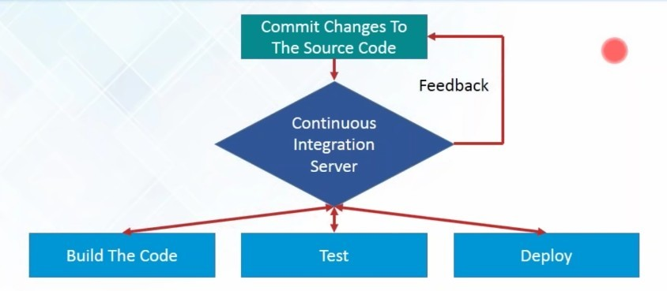
What is Continuous Integration...

Slide 7
What is Continuous Integration...
●
“Continuous Integration doesn’t get rid of bugs, but it does make them dramatically easier to find and remove.” - Martin Fowler, chief scientist,ThoughtWorks.
Jenkins is just a framework, it achieves Continuous Integration by the help of Plugins. It provides support for over 1000 Plugins .
●

Slide 8
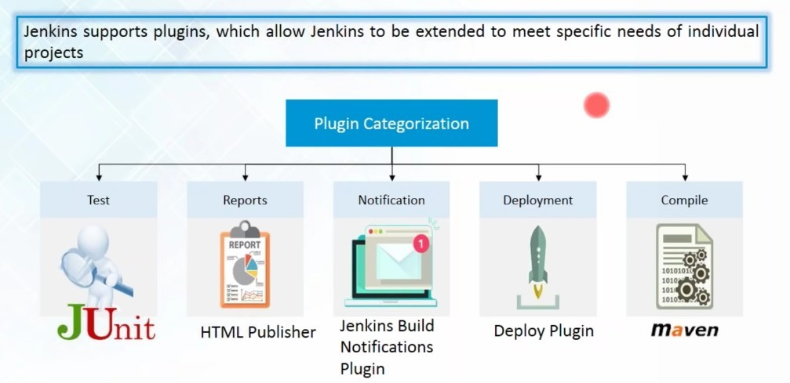
What is Continuous Integration...

Slide 9
Installing and Configuring Jenkins
JDK
JDK 1.7 or above
Memory
2 GB RAM (recommended)
Disk Space
No minimum requirement. However, all builds will be stored on the Jenkins machines, it has to be ensured that sufficient disk space is available for build storage.
Operating System Version
Jenkins can be installed on Windows, Ubuntu/Debian, Red Hat/Fedora/CentOS, Mac OS X, openSUSE, FReeBSD, OpenBSD, Gentoo.
Java Container
The WAR file can be run in any container that supports Servlet 2.4/JSP 2.0 or later.(An example is Tomcat 5).

Slide 10
Installing and Configuring Jenkins...
●
Download Jenkins: Open the official website of Jenkins : https://jenkins.io/index.html
Click on Download Jenkins and download the LTS Release.
From the command prompt, browse to the directory where the jenkins.war file is present. Run the following command:
java -jar jenkins.war
Extraction of the war file is done by an embedded webserver called winstone.
Jenkins by default runs on port 8080, but we can run it on different port by issuing following command:
java -jar jenkins.war --httpPort=8181
●
●
●

Slide 11
Installing and Configuring Jenkins...
●
Open http://localhost:8080/jenkins to check the Jenkins Dashboard.
We can now get the Jenkins-git setup enabled by clicking the Manage Jenkins option and then click the Available tab and enter the search keyword ie; git.
Install the git plugin and restart Jenkins by issuing this command in the browser:
http://localhost:8080/jenkins/restart
●
●

Slide 12
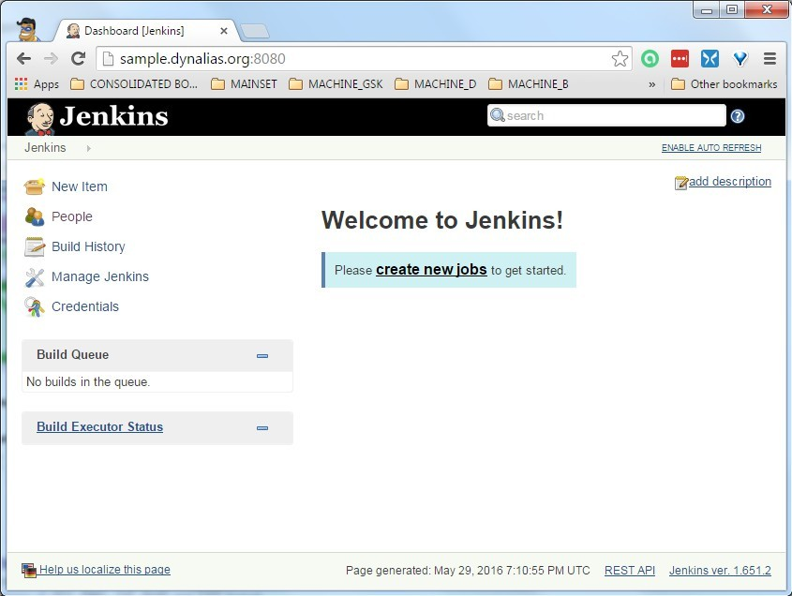
A new Jenkins

Slide 13
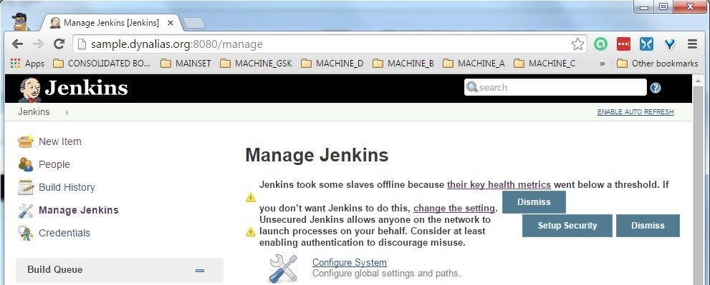
Manage Jenkins

Slide 14
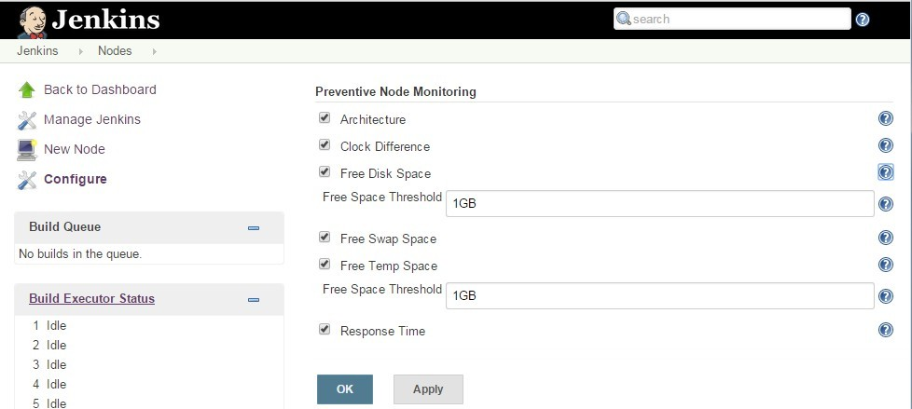
Configure Node
●
If you are on a small server Nerf these or provide more resources

Slide 15
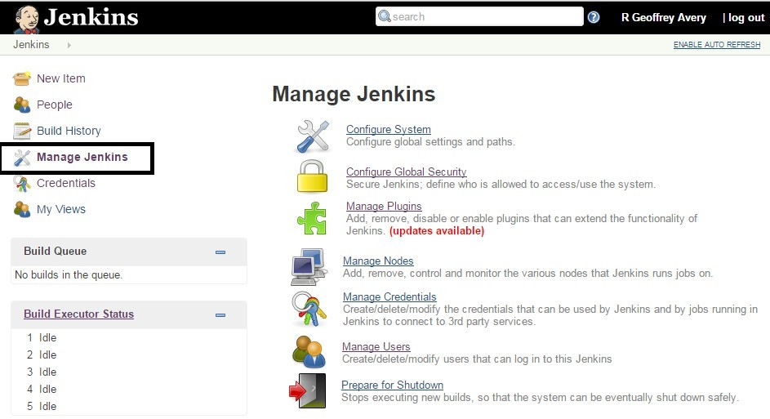
Manage Jenkins

Slide 16
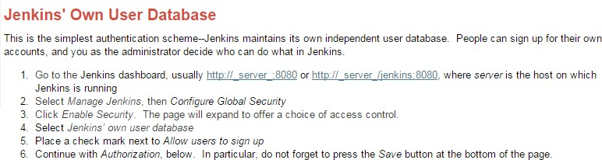
How to add users
●
https://wiki.jenkins-ci.org/display/JENKINS/Standard+Security+Setup
Make sure your user has powers before you deny everyone full power
●

Slide 17
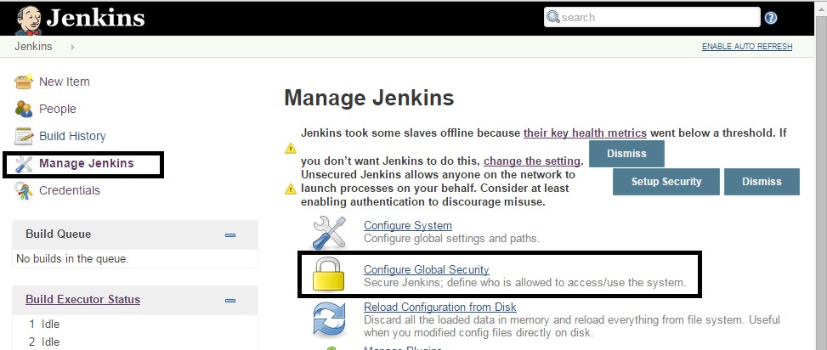
Get to adding users
●
Manage Jenkins → Configure Global Security

Slide 18
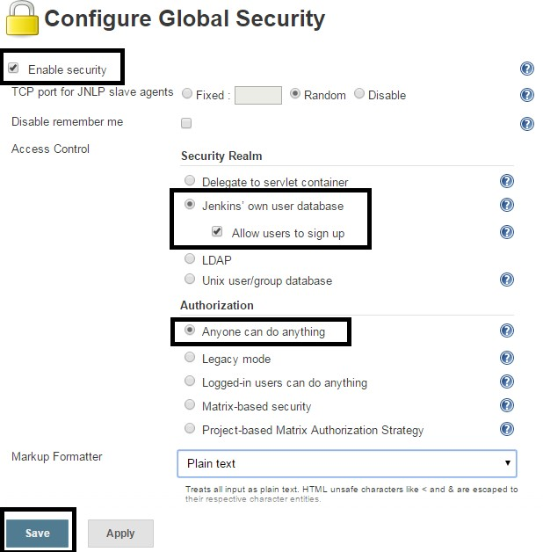
Enable Security
Turn on security
Let Jenkins manage
Anyone can still get in (don't lock yourself out)
●
●
●

Slide 19
Become a User
●
Go create yourself a user

Slide 20
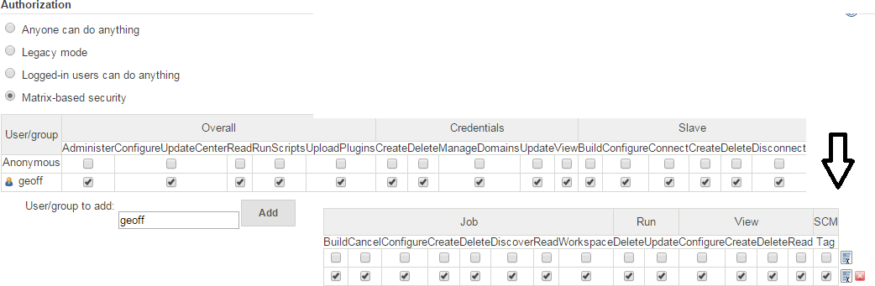
Enable Matrix Security
Pick matrix Add yourself
Give yourself full power
●
●
●

Slide 21
Plugins
Jenkins supports many plugins to add features
Can generally install new plugin without a restart
To upgrade or remove a restart usually needed
●
●
●

Slide 22
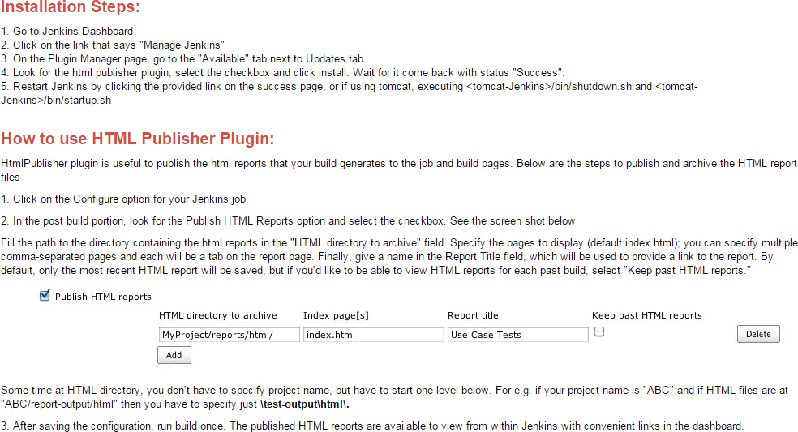
HTML Publisher Plugin
●
https://wiki.jenkins-ci.org/display/JENKINS/HTML+Publisher+Plugin

Slide 23
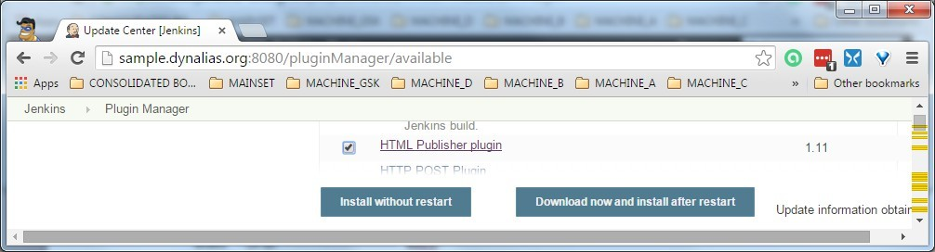
Add Plugin

Slide 24
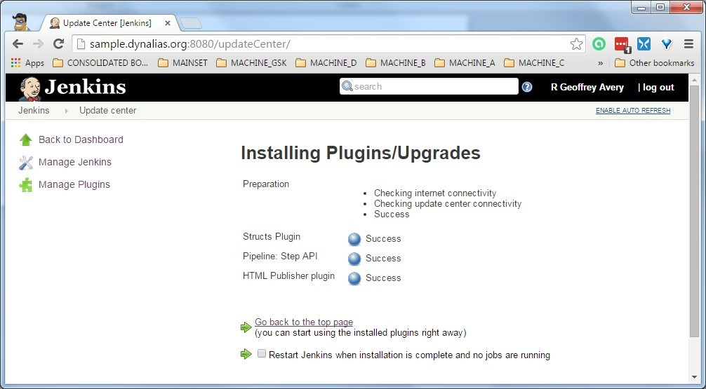
Approve the plugin

Slide 25
More good plugins
https://wiki.jenkins-ci.org/display/JENKINS/
NodeLabel+Parameter+Plugin Validating+String+Parameter+Plugin Git+Plugin (need git 1.7.9+)
●
●

Slide 26
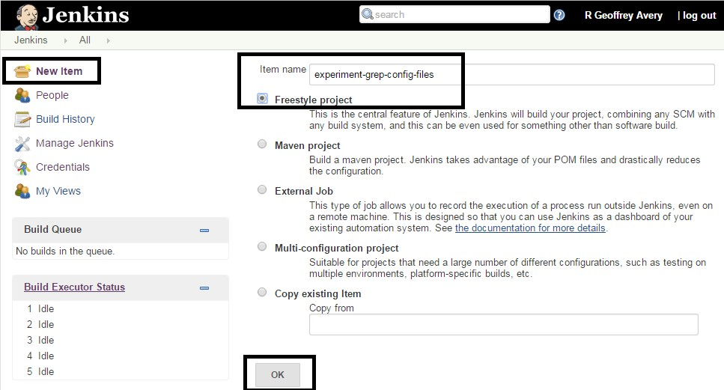
Create a Job

Slide 27
Job to grep configurations
●
Jenkins stores job as
…/jobs/jobname/config.xml
Pain to search across many jobs
This sample job will grep just config.xml files Will make html report of what is found
●
●
●

Slide 28
Live Demo Now

Slide 29
Schedule for Periodic Builds
This field follows the syntax of cron (with minor differences). Specifically, each line consists of 5 fields separated by TAB or whitespace:
MINUTE HOUR DOM MONTH DOW
MINUTE HOUR DOM MONTH DOW
Minutes within the hour (0–59) The hour of the day (0–23) The day of the month (1–31) The month (1–12)
The day of the week (0–7) where 0 and 7 are Sunday.
To specify multiple values for one field, the following operators are available. In the order of precedence,
* specifies all valid values
M-N specifies a range of values
M-N/X or */X steps by intervals of X through the specified range or whole valid range A,B,...,Z enumerates multiple values
To allow periodically scheduled tasks to produce even load on the system, the symbol H (for “hash”) should be used wherever possible. For example, using 0 0 * * * for a dozen daily jobs will cause a large spike at midnight. In contrast, using H H * * * would still execute each job once a day, but not all at the same time, better using limited resources.
The H symbol can be used with a range. For example, H H(0-7) * * * means some time between 12:00 AM (midnight) to 7:59 AM. You can also use step intervals with H, with or without ranges.
The H symbol can be thought of as a random value over a range, but it actually is a hash of the job name, not a random function, so that the value remains stable for any given project.

Slide 30
Schedule for School Night
H H(6-11) * * 1-5
#Once each school night between 10pm-4am San Francisco / 1am-7am Wilmington / 6am-noon London (an hour later in summer)
#If someone does something foolish on Friday or Saturday the site won't be broken over the weekend because of the update
Schedule jobs with a very cron like syntax Use 'H' to let jenkins pick for better distribution
●
●

Slide 31
Return to live demo

Slide 32
Add a slave node
Not all work needs to or should run on master Slaves can be on same server or many
Make a user (groupadd, useradd) Install Java (apt-get, yum, or ?) Setup ssh for connections...
●
●
●
●
●

Slide 33
Create ssh key for slave
jenkins@localhost:~$ mkdir .ssh jenkins@localhost:~$ cd .ssh
jenkins@localhost:~/.ssh$ | chmod 0700 .
jenkins@localhost:~/.ssh$ -f jenkins_to_mrprod | ssh-keygen -C | "jenkins to slave | mrprod"
jenkins@localhost:~/.ssh$ | ls -aFl
total 16
drwx------ | 2 | jenkins | jenkins | 4096 | Jun | 1 | 12:53 | ./
drwxr-xr-x | 14 | jenkins | jenkins | 4096 | Jun | 1 | 12:51 | ../
-rw------- | 1 | jenkins | jenkins | 1679 | Jun | 1 | 12:53 | jenkins_to_mrprod
-rw-r--r--
1 jenkins jenkins
399 Jun
1 jenkins_to_mrprod.pub

Slide 34
.ssh/config
host sample-mrprod
hostname user
sample.dynalias.org mrprod
identityfile ~/.ssh/jenkins_to_mrprod
Let the master call slave from command line
Will need ForwardAgent and Proxy Command if you need to tunnel through a middle box
●
●

Slide 35
Give ssh key to slave
root@localhost:/home/mrprod# sudo su mrprod localhost:~> pwd
/home/mrprod localhost:~> mkdir .ssh
localhost:~> chmod 0700 .ssh localhost:~> cd .ssh
localhost:~/.ssh> touch authorized_keys localhost:~/.ssh> chmod 0600 authorized_keys #then put the public key in authorized_keys
ssh will not work if you forget the chmod step

Slide 36
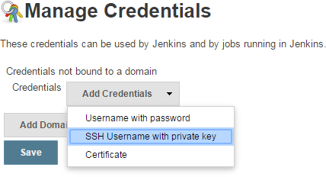
Add ssh key to jenkins

Slide 37
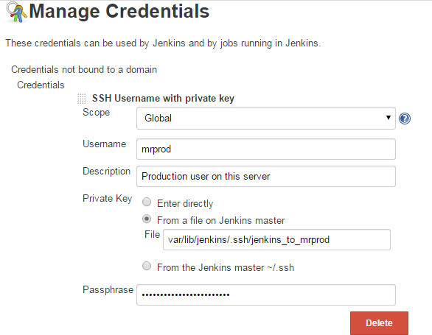
Add ssh key to jenkins (2)

Slide 38
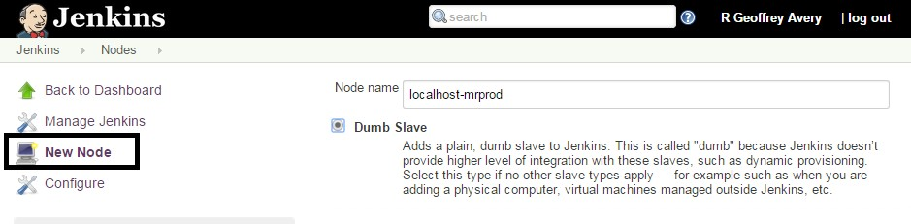
Create a slave node

Slide 39
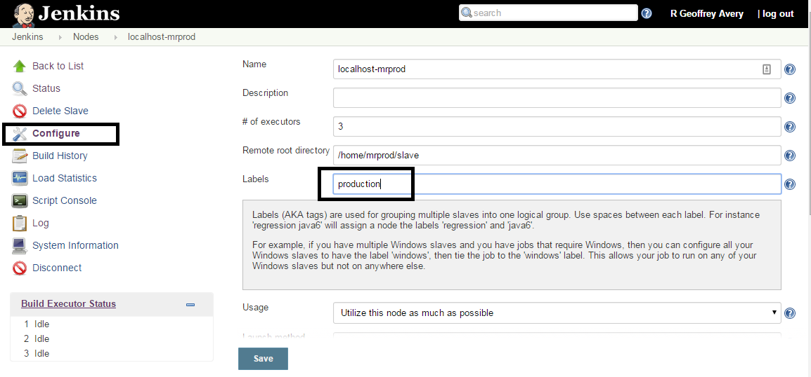
Make a label for nodes

Slide 40
Live Demo Now

Slide 41
Starting and Stopping
http://sample.dynalias.org:8080/quietDown http://sample.dynalias.org:8080/cancelQuietDown
${JENKINSURL}/${ACTION} #------
$ sudo /etc/init.d/jenkins restart
●
Other valid choices for the ACTION: start|stop|status|restart| force-reload
●
A good idea to quietDown first so you don't stop jobs in progress

Slide 42
Thank You
Slides will be found at http://platypiventures.com/perl/present
And the conference website

Slide 43
Slides of the Rigged Demo
These were replaced by the live demo

Slide 44
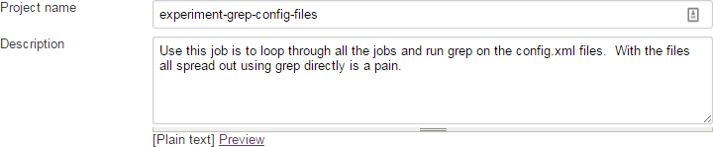
Job Name

Slide 45
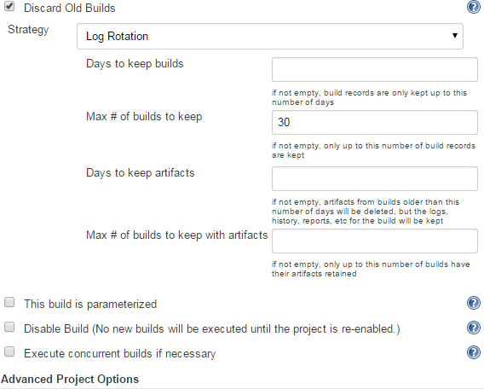
Basic Job Settings

Slide 46
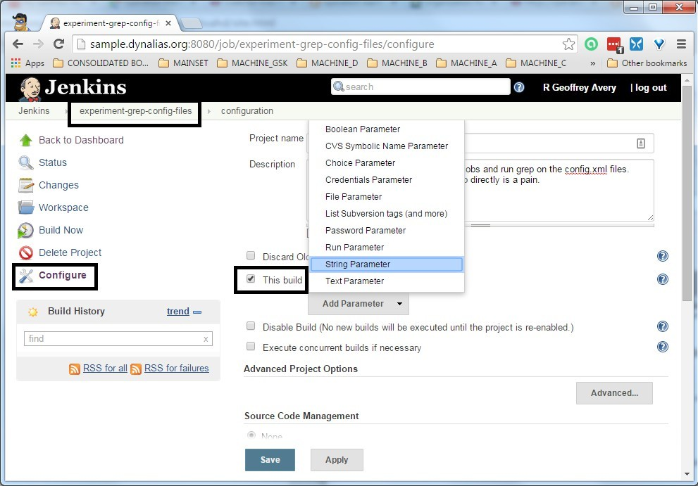
Add a Variable

Slide 47
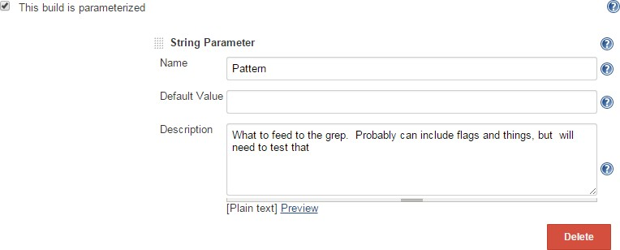
What do you want to look for?

Slide 48
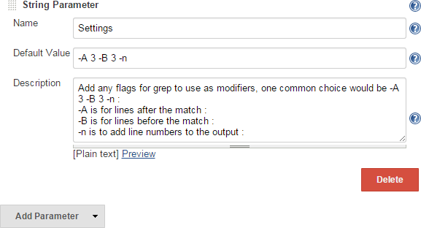
Pass through to grep

Slide 49
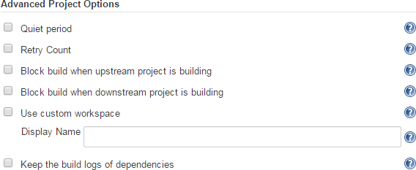
Advanced Job Settings

Slide 50
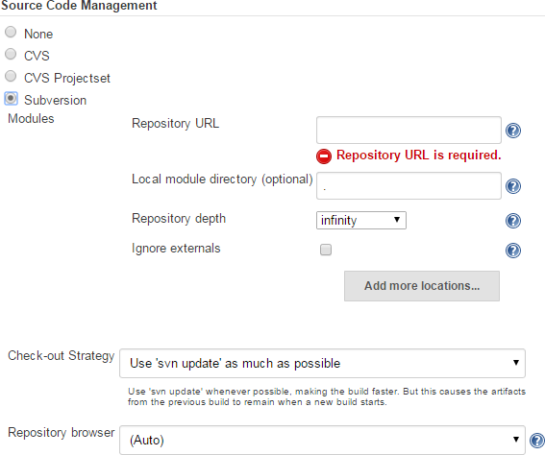
Source Code Settings
●
Git needs a plugin

Slide 51
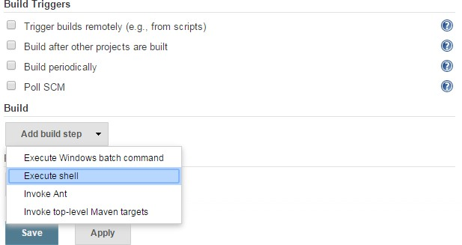
Add Code to Do Something
●
Add a shell to do the real work. Today with bash, but also supports Groovy and anything you can call

Slide 52
Script Part 1
#!/bin/bash
# make sure we have place to write the output
# if no directory build one, blow away a file it it is in the way if [[ ! -d $WORKSPACE/output ]] ; then
if [[ -e $WORKSPACE/output ]] ; then rm $WORKSPACE/output
fi
mkdir $WORKSPACE/output
fi
ls -aFlR $WORKSPACE
report="$WORKSPACE/output/found.html"
hostname
whoami pwd
cd ../../jobs pwd
echo "<h1>$Pattern</h1> ( $Settings )<hr>" > $report

Slide 53
Script Part 2
jenkinsgrep () {
for dir in * ; do
echo "\n\n--------------- $dir"
local results=$(grep $Settings $Pattern $dir/config.xml) if [[ -n $results ]]; then
echo $results
#
echo "<h2>$dir</h2>" >> $report
echo "<h2><a href='${JENKINS_URL}job/$dir/configure'>$dir</a></h2>" >> $report
echo "<pre>$results</pre>" >> $report
fi done
}
jenkinsgrep

Slide 54
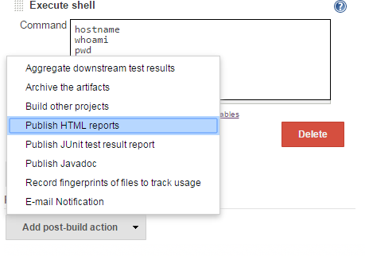
Add an HTML report

Slide 55
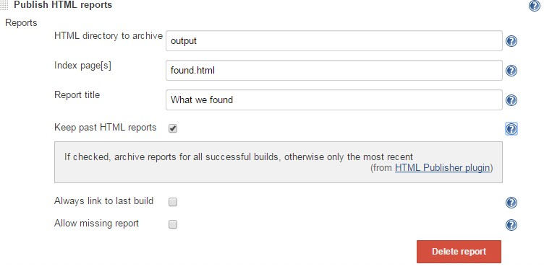
Configure the Report

Slide 56
The End (Again)
Check github for slides and the config.xml files for the jobs discussed

