Slide 1

Maven
Automated build management.
Copyright © 2014 HashedIn Technologies Pvt Ltd. All rights reserved. CONFIDENTIAL

Slide 2
Manual build management (life before maven)
Download the dependencies to compile the source code.
Run the javac command to compile the source code.
Run the java commands to test the source code.
Run the jar command to package the source code.
Run the javadoc command to create the documentation.

Slide 3

Hey, but..
Anything, which is not the part of business logic, must be automated!
That’s correct! Maven is at our rescue.

Slide 4
What is Maven?
At its simplest, build automation tool
Produces deployable artifact (jar, war etc) from source code.
Helps us manage the dependencies.
Has built in build lifecycle.
Can also be used as a project management tool
Can produce the project documentation
Supports plugins to provide various report.
Supports versioning and releasing the project.

Slide 5
Maven in action!
Lets create a simple maven based project.
Copyright © 2014 HashedIn Technologies Pvt Ltd. All rights reserved. CONFIDENTIAL

Slide 6
Creating a simple java application
mvn archetype:generate
Creates an application in interactive mode; will prompt for
archetype - default 414 (maven-archetype-quickstart)
archetype version - default 1.1
groupId - com.hashedin.hu
artifactId - HelloWorldMaven
version - default 1.0-SNAPSHOT
package - default groupId
mvn archetype:generate -DgroupId=com.hashedin.hu - DartifactId=HelloWorldMaven -DinteractiveMode=false - DarchetypeArtifactId=maven-archetype-quickstart

Slide 7
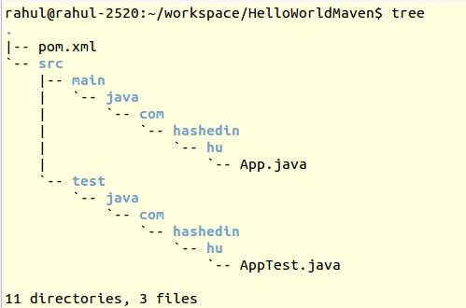
Directory Structure
src/main/java
The source code directory.
com.hashedin.hu package created automatically by archetype.
src/test/java
The test directory.
The test cases are also placed inside the same default package.
pom.xml

Slide 8
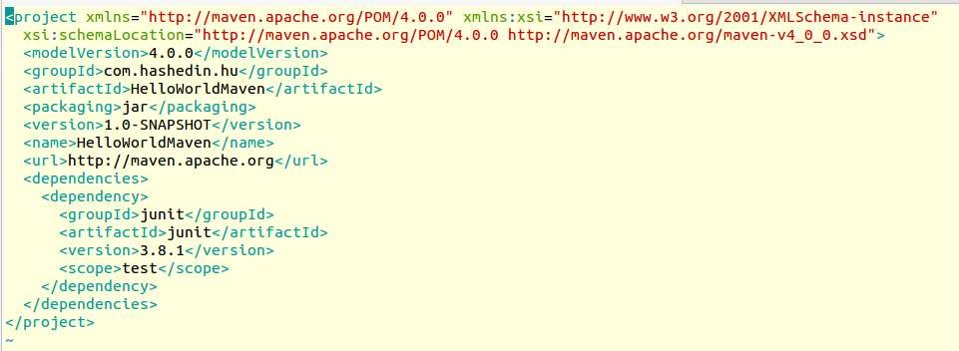
Contents of pom.xml

Slide 9
Goals - Automated build commands
mvn compile
Compiles the source code, generates any files, copies resources to our
target directory.
mvn clean
Deletes the target directory and any generated resources.
mvn package
Runs the compile command first, run test cases and packages the app based on its packaging type.
mvn install
Runs the package command then installs it in local repo.

Slide 10
The ‘target’ directory
Automatically created by maven.
This is where everything gets compiled to.
This is also the place where test cases run from.
Contents in this directory gets packaged into jar, war etc.

Slide 11
The pom.xml
Holds the meta information about the project.
Project Information
groupId
artifactId
version
packaging
Dependencies - Direct dependencies used in our application.
Build
Repositories
Plugins, Directory Structure etc.
Holds all the dependencies and artifacts.

Slide 12
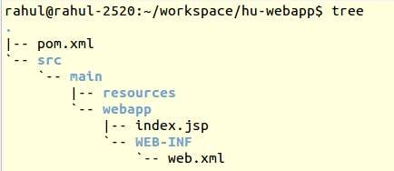
Creating a web application
mvn archetype:generate -DgroupId=com.hashedin
-DartifactId=hu-webapp
-DarchetypeArtifactId=maven-archetype-webapp
src/main/webapp
The base directory containing all the assets like JSP, Images etc.
src/webapp/WEB-INF
web.xml - Deployment Desc.
src/main/java
Standard java classes: Servlets, POJOs etc.
Copyright © 2014 HashedIn Technologies Pvt Ltd●. All righpts reosermved. C.OxNFmIDENlTIAL

Slide 13
Dependencies

Slide 14
Dependencies
Resources that our project relies upon to function.
To include, just list the dependency in pom.xml
Transitive dependencies will be pulled in by maven.
Dependencies are identified by their coordinates
groupId
artifactId
version
Example:
<dependency>
<groupId>org.hibernate</groupId>
<artifactId>hibernate-core</artifactId>
<version>4.3.5.Final</version>
</dependency>

Slide 15
Transitive Dependencies
Our project dependencies’s dependencies.
Eg: Hibernate has dependency on 8 other resources:
hibernate-core
hibernate-commons-annotations
jboss-logging etc
All the transitive dependencies are automatically downloaded and added by maven.
The main reason people start off with maven.

Slide 16
Dependencies Scope
Not all resources are needed at all times!
There are 6 available scopes:
compile - default scope, artifacts available everywhere.
provided - like compile, but not packaged into an artifact. It will be
available where artifact is deployed. (servlets-api)
runtime - needed only for execution not for compiling.
test - available for test-compilation and execution phase.
system - provided, you specify the path to the jar on file system.
import - deals with dependencyManagement and multi modules.
Lets add few dependencies to our simple application.

Slide 17
Repositories

Slide 18
Local Repository
Where maven caches everything it downloads
/home/<username>/.m2/repository.
When maven needs to resolve a dependency, it first looks into the local repository and then goes about downloading it.
Stores the artifacts using the information we provide for artifactId, groupId
and version.
~/.m2/repository/com.hashedin/HelloWorldMaven/1.0-SNAPHOST/HelloWorldMaven-1.0- SNAPSHOT.jar
No need to copy the artifact into every project and store it in the SCM (git etc)

Slide 19
Remote Repository
Just a network accessible location that maven downloads
dependencies from.
Default location: http://repo.maven.apache.org/maven2/
We can add multiple repositories.
All the artifacts that remote repository contains are open
source. Dont add any private artifact of the organization.

Slide 20
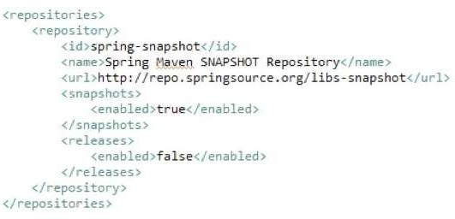
Adding a new remote repository
We can add a remote repository to search for dependencies if
these dependencies aren’t available on default location.

Slide 21
Build lifecycle and plugins

Slide 22
Build Lifecycle
Software projects undertake various steps before they are actually
distributed. (eg. compile, test, package etc).
Build lifecycle defines the process of building and distributing the artifacts.
There are three built‐in build lifecycles:
Default/Build - Handles project building and deployment.
Clean - Handles project cleaning
Site - Handles project’s site generation.
Each build lifecycle is made up of phases.

Slide 23
Build / Default lifecycle
Validate
Compile
Test
Package
Install
verify
Deploy
You can invoke a specific phase on the lifecycle
Example: mvn test
When you invoke a specific phase, every previous phase run, including the one you specified. If we run, mvn test
Validate
Compile
Tes t
Refer: All lifecycle phases

Slide 24
Clean and Site lifecycle phases
Clean
Pre - Clean Clean Post - Clean
Handles project cleaning.
Deletes target directory and any generated files.
Site
Pre - Site Site Post - Site
Site - Deploy
Generates project documentation.
Used to generate various kind of reports.

Slide 25
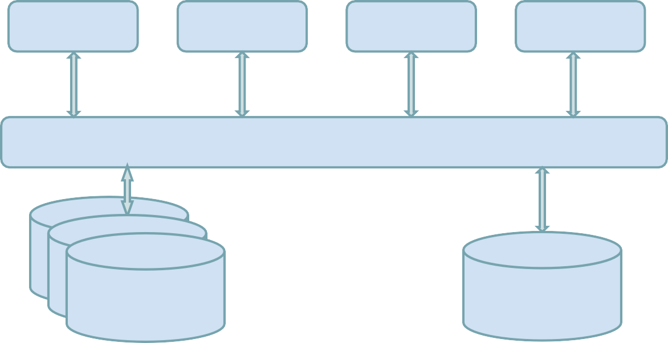
Maven Architecture
Plugin 1
Plugin 2
Plugin 3
Plugin N
Maven - Core Engine
Repositories
Local
Repository
Fig: Maven’s plugin based architecture.

Slide 26
Maven Architecture - Core Engine
Project processing
Read the project configuration file and configure the
project accordingly.
Build lifecycle management
Run a series of phases (as seen before).
Framework for plug‐ins

Slide 27
Maven Architecture - Plugins
Provides the core operations to build your project.
For example, to create a jar the maven jar plugin will do the job, not
maven itself.
Plug‐ins provides one or more “Goals”
A Goal perform some operation on the project.
Ex: compile, create a Jar, deploy to Jboss, etc.
Goals can be bound to build lifecycle phases

Slide 28
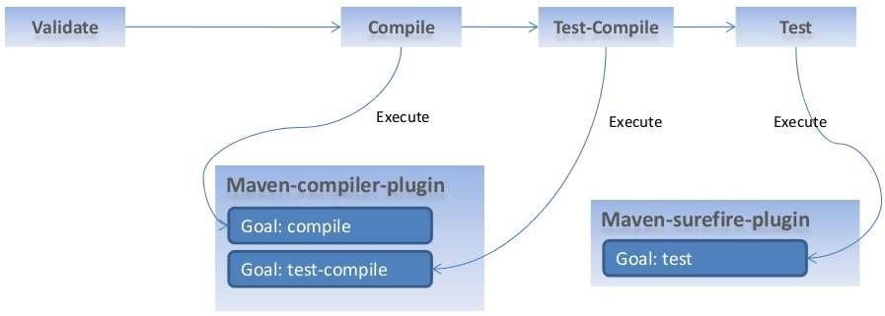
Maven lifecycle, plugins, and goals
Goals can be bound to build‐lifecycle phases
Eg: $ mvn test

Slide 29
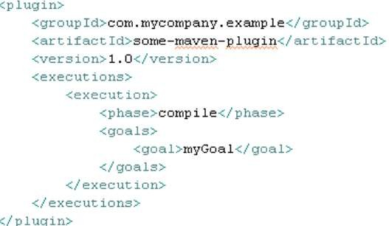
Maven lifecycle, plugins, and goals
We can bind a plugin’s goal to a lifecycle phase

Slide 30
Maven lifecycle, plugins, and goals
Putting lifecycle phases plug‐ins and goals together
A lifecycle is a series of phases
A phase is made of goals
Goals are provided by plug ins
Each phase have default bindings

Slide 31
Jetty
The web interface for Maven.
Copyright © 2014 HashedIn Technologies Pvt Ltd. All rights reserved. CONFIDENTIAL

Slide 32
Jetty - The Web Container
We can use the jetty plugin to run our web application
Plugin configuration:
<plugin>
<groupId>org.mortbay.jetty</groupId>
<artifactId>jetty-maven- plugin</artifactId></plugin>
Usage:
Start: $mvn jetty:run
Stop: <ctrl-c>, $mvn jetty:stop
For jetty to function without any configuration, keep:
resources in ${basedir}/src/main/webapp
classes in ${project.build.outputDirectory}
web.xml in ${basedir}/src/main/webapp/WEB-INF/

Slide 33
Summary - Benefits of maven
Declarative way of defining the dependency.
Transitive dependency management.
Keeps the code organized.
Various plugins available for almost any task we would need to undertake.
Reduces build size by eliminating the need to check in jar files into source code repository.

Slide 34
References
Apache Maven Guides
Maven by example Apache Maven tutorial

Slide 35
That’s It!
Questions, Suggestions Or Feedback?
Copyright © 2014 HashedIn Technologies Pvt Ltd. All rights reserved. CONFIDENTIAL

