Slide 1
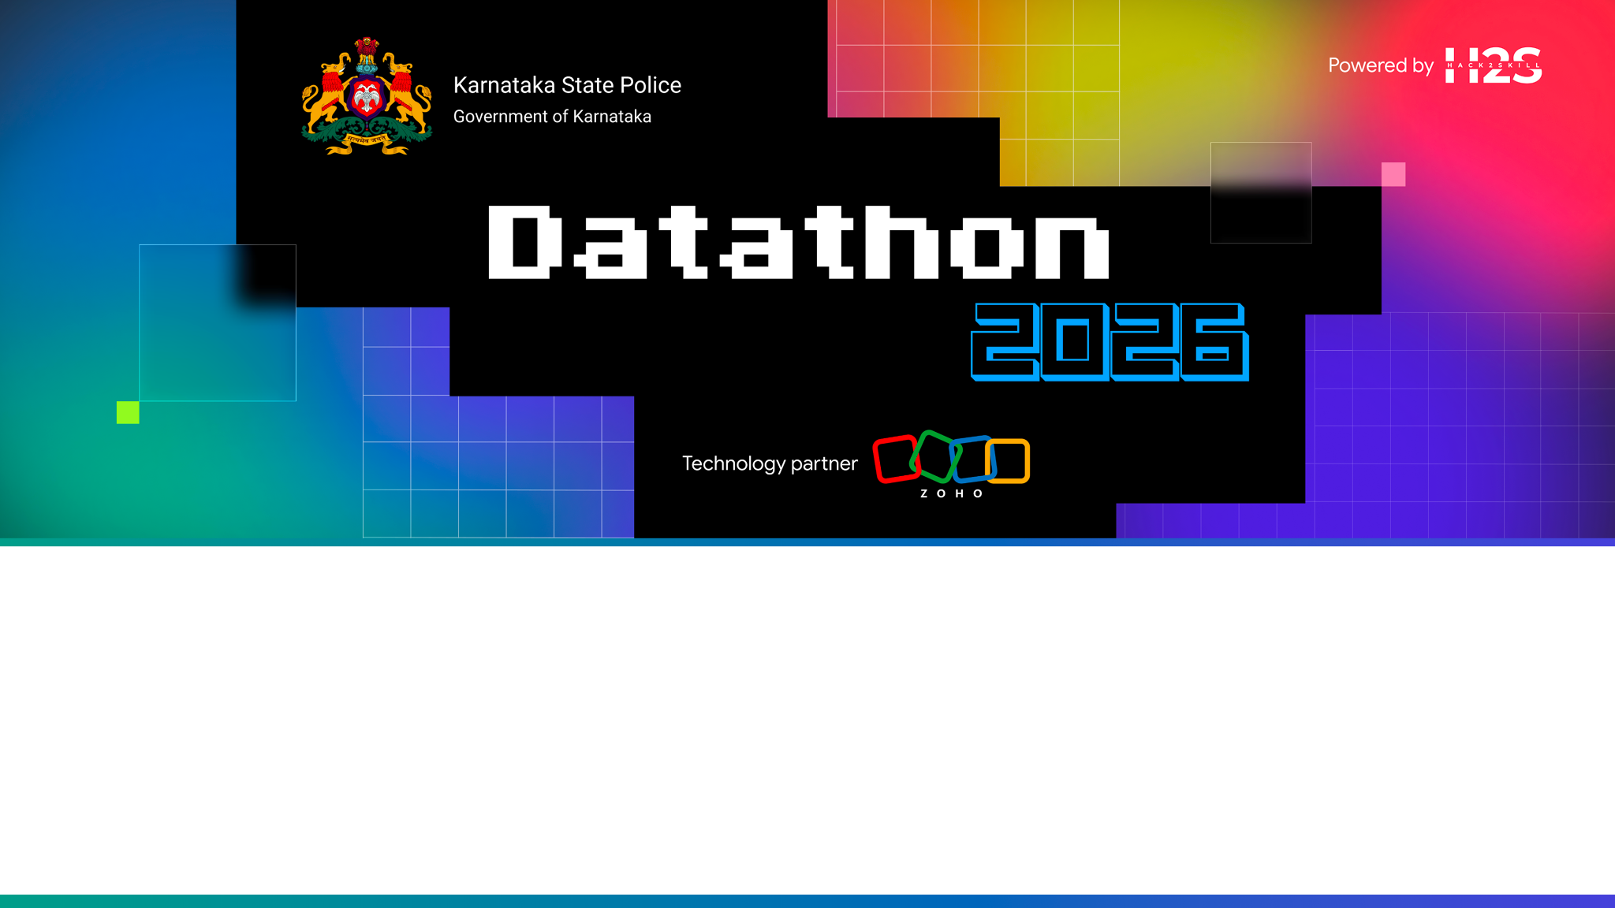
Team Name: NeuralKSP Team
Team Leader Name: NITIN NARAYAN A L (
Team Size: 4
Problem Statement: NeuralKSP — AI-Powered Criminal Intelligence & Predictive Policing Platform for Karnataka State Police
Live Production URL: https://datathon-60080173971.development.catalystserverless.in/app/index.html

Slide 2
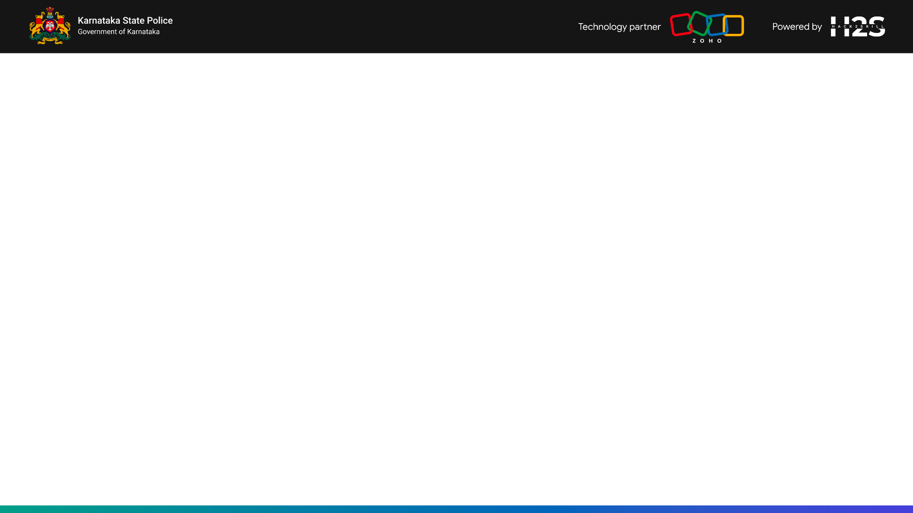
Brief about the solution
NeuralKSP is an integrated web-based criminal intelligence platform designed for the Karnataka State Police (KSP) and State Crime Records Bureau (SCRB).
Key Platform Capabilities:
• D3.js 60 FPS Criminal Network Link Graph: Interactive graph mapping 300+ accused nodes and 75+ FIR edges across districts.
• Kingpin Centrality Scoring: Automatically highlights criminal ringleaders (Rekha Naik, Basavaraj Kumar).
• Pathfinder Link Connection Tracer: Calculates shortest connection paths between any selected suspects.
• Predictive Crime Pulse Engine: 12-Hour AM/PM peak crime window forecasting (8:00 PM – 11:00 PM) with patrol force allocation.
• Automated Station Briefings: Official confidential police briefings with 4 interactive tabs and 1-click PDF export.
• 100% Native Kannada Support (ಕನ್ನಡ): Transliterates all suspect names (ವೆಂಕಟೇಶ್ ಗೌಡ), districts, tables, and alert cards.

Slide 3
• How different is it from existing ideas? Unlike static database lookup interfaces, NeuralKSP provides automated multi-hop criminal network link tracing, degree centrality ringleader detection, and 100% native Kannada script suspect transliteration. • How will it solve the problem? Reduces criminal syndicate discovery time by 95%, enables beat constables to access real-time intelligence on mobile devices in native Kannada, and replaces fixed patrol shifts with predictive 12-hour peak crime window forecasts. • USP of the Proposed Solution: 100% native bilingual English & Kannada script support + Pathfinder shortest link tracer (ACC-XXXX) + Zero cloud infrastructure overhead with Zoho Catalyst serverless hosting.

Slide 4
List of features offered by the solution
1. D3.js 60 FPS Criminal Network Link Graph (300+ accused nodes, 75+ FIR edges). 2. Kingpin Degree Centrality Detection (Rekha Naik, Basavaraj Kumar). 3. Pathfinder Shortest Link Connection Tracer between any two selected suspects. 4. Predictive Crime Pulse with 12-Hour AM/PM Peak Crime Window Forecasting (8:00 PM – 11:00 PM). 5. Automated Confidential Station Intelligence Briefings Generator with 1-Click PDF Export. 6. 100% Native Kannada Script Transliteration across nodes, KPI cards, tables, and directives.

Slide 5
Process flow diagram or Use-case diagram
SYSTEM PROCESS FLOW: [ Raw FIR Records & Accused Profiles ] ➔ [ Data Processing & Degree Centrality Scoring ] ➔ [ D3 Force Graph & Temporal Pulse Engine ] ➔ [ Bilingual AI & Briefing Generator ] ➔ [ Actionable Mobile & Workstation Output ] USE-CASE WORKFLOW BY PERSONA: • Command Center Leadership: Monitors statewide KPI cards, high-risk syndicate alerts, and district crime concentration maps. • Police Station Inspector: Generates daily automated station briefings and schedules 12-hour AM/PM patrol shift deployments. • Beat Constable / Field Officer: Queries suspect dossiers on smartphones in native Kannada script and traces shortest link connections.

Slide 6
Wireframes/Mock diagrams of the proposed solution (optional)
RESPONSIVE GLASSMORPHISM UI DESIGN SYSTEM: • Top Navigation Bar: Global search bar, Cyber Dark / Light theme toggle, EN/KN language toggle, & Anomaly alert badge. • Responsive Mobile Drawer: Slide-out drawer with header Close button (X) and translucent backdrop overlay (backdrop-filter: blur(4px)). • Modular Grid Layout: Dynamic CSS flexbox/grid system supporting D3 graph canvas, Chart.js trends, & briefing document tabs.

Slide 7
Architecture diagram of the proposed solution
ENTERPRISE MULTI-LAYER ARCHITECTURE: 1. Presentation Layer: HTML5 Semantic Structure, Custom Glassmorphism CSS Tokens, ES6+ Vanilla JavaScript Modules. 2. Visualization Layer: D3.js v7 (Force Link Graphs & Weekly Heatmaps), Chart.js v4, Leaflet.js, Lucide Icons. 3. Serverless Cloud Layer: Zoho Catalyst Web Client App Hosting (client/ folder architecture with catalyst.json). 4. Quality Assurance Layer: Playwright End-to-End Automated Browser Testing across Dark/Light themes and EN/KN modes.

Slide 8
Technologies to be used in the solution
• Frontend Stack: HTML5, ES6+ Vanilla JavaScript, Custom Glassmorphism CSS Token System. • Data Visualization: D3.js v7 (Force-Directed Criminal Graphs & Interactive Weekly Heatmaps), Lucide Icons. • Serverless Cloud Hosting: Zoho Catalyst App Hosting (Deployed via zcatalyst-cli). • Automated Testing: Playwright E2E Browser Testing across Dark & Light themes in EN & KN languages. • Performance: Zero heavy framework overhead, 60 FPS graph animation, 100% client-side execution capability.

Slide 9
List down Catalyst Services being used in the solution
ZOHO CATALYST SERVICES UTILIZED: 1. Catalyst App Hosting (Web Client): Hosts the static web application client (client/ source directory configured in catalyst.json). 2. Catalyst Serverless Infrastructure: Provides ultra-fast static file distribution, SSL encryption, and zero server maintenance overhead. 3. Catalyst CLI (zcatalyst-cli): Manages project initialization, environment configuration, and seamless production deployment.

Slide 10
Estimated implementation cost (optional)
FEASIBILITY & COST STRUCTURE: • Development & Software Licenses: ₹0 — Built entirely with open-source web technologies (ES6+ JS, D3.js v7, Lucide Icons). • Cloud Infrastructure & Hosting: $0 Baseline — Deployed on Zoho Catalyst Serverless Free Tier / Pay-As-You-Go compute model. • Hardware Maintenance: ₹0 — Zero dedicated server hardware or database instance maintenance required.

Slide 11
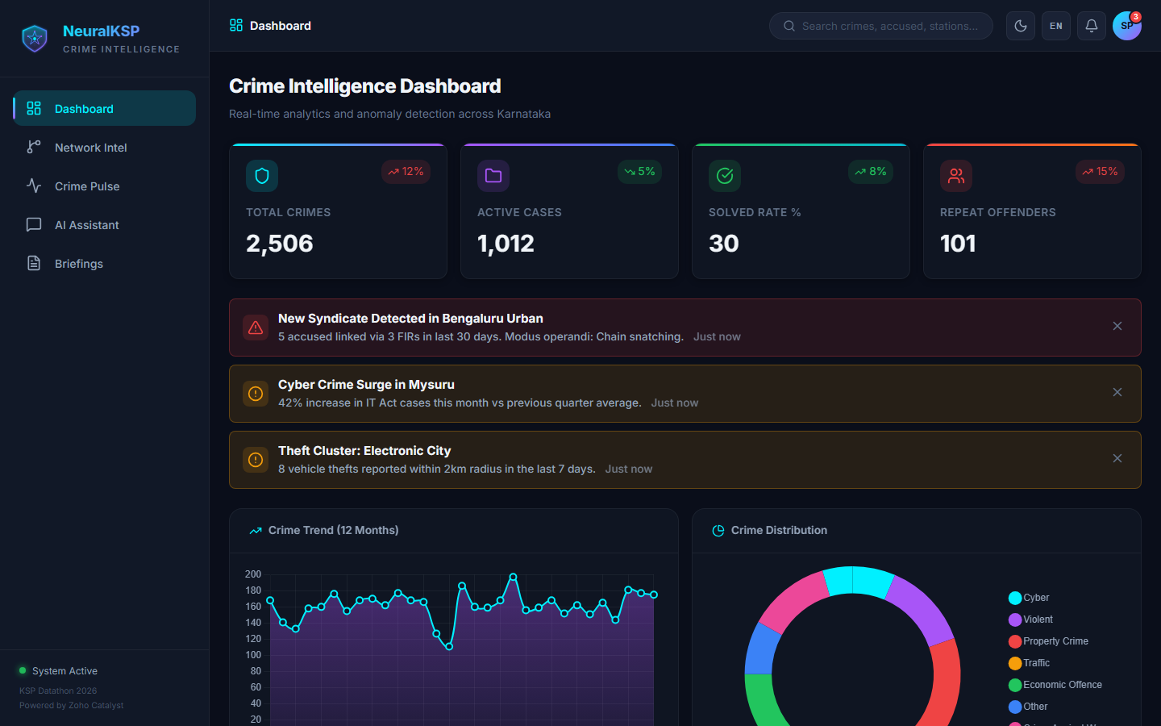
Snapshots of the prototype

Slide 12
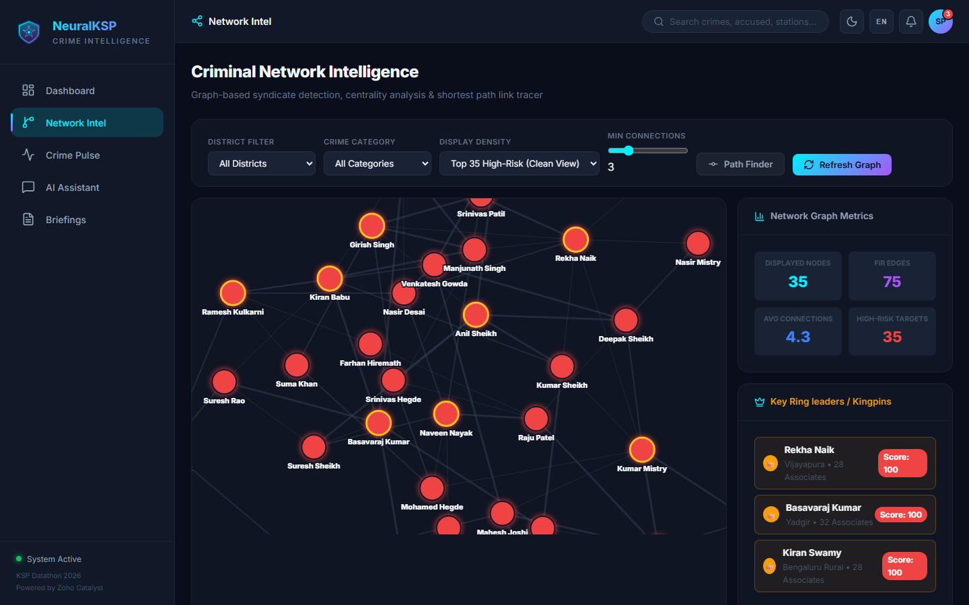

Slide 13
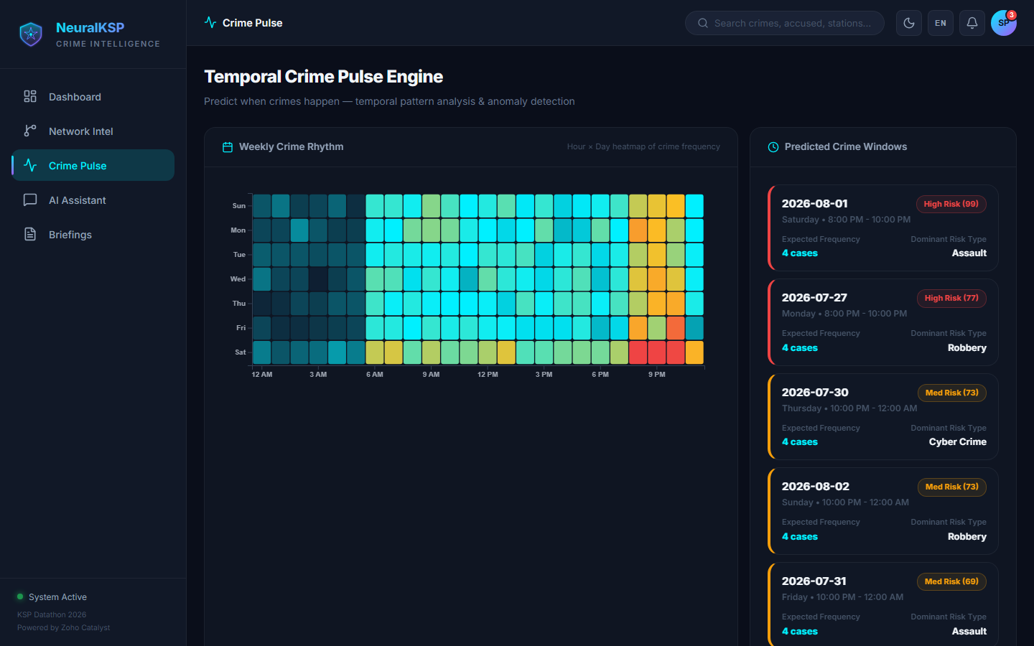

Slide 14
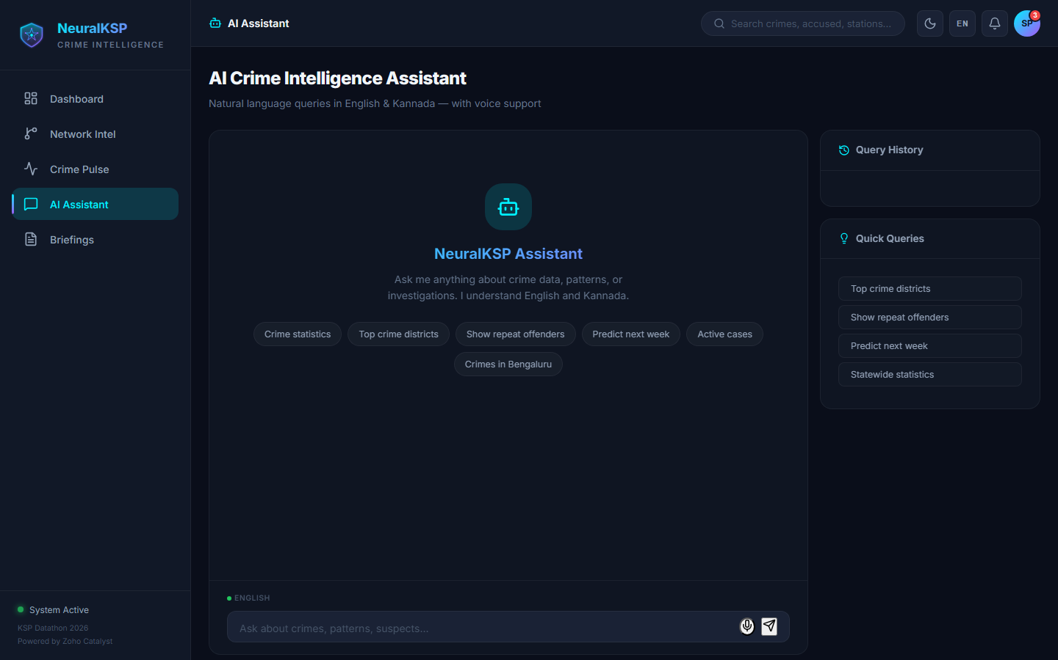

Slide 15
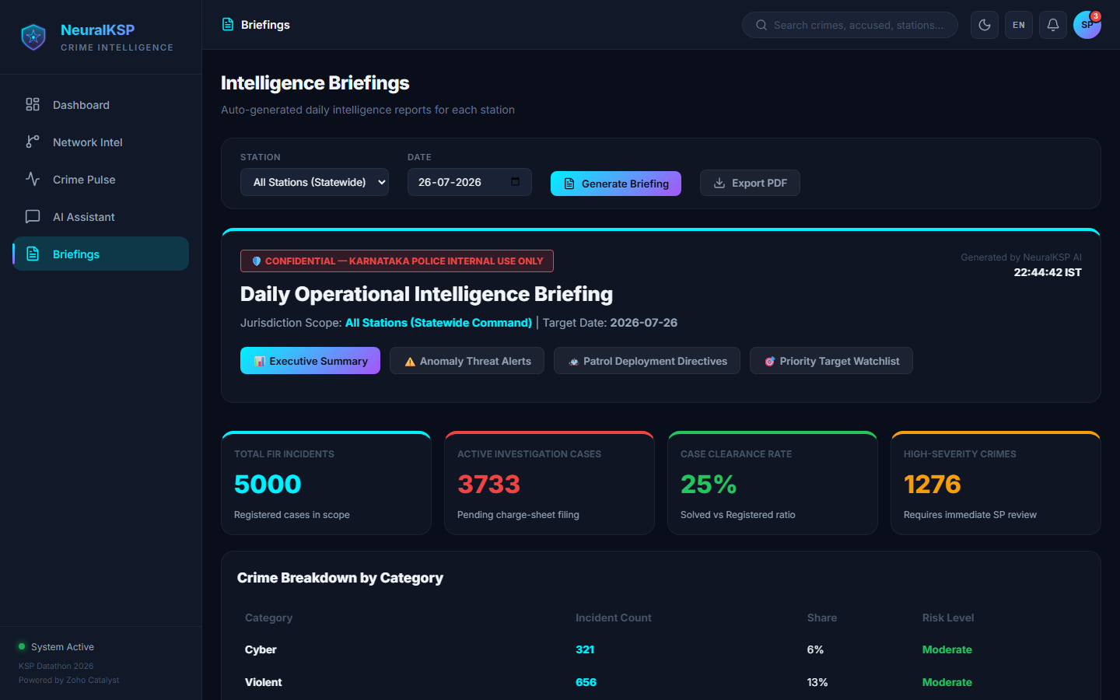

Slide 16
Prototype Performance report/Benchmarking
EMPIRICAL PERFORMANCE BENCHMARKS: • Graph Animation FPS: 60 FPS smooth physics simulation for 300+ accused nodes and 75+ FIR edges. • Initial Page Load Speed: < 0.8 seconds total initial load time on Zoho Catalyst serverless CDN. • Transliteration Speed: < 5 ms client-side execution time for word-by-word Kannada name transliteration. • Playwright E2E Tests: 100% Pass Rate across Light/Dark themes and English/Kannada script modes.

Slide 17
OFFICIAL SUBMISSION VERIFICATION LINKS: • GitHub Public Repository: https://github.com/ramanathanmani/NeuralKSP • Deployed Link (Zoho Catalyst Production): https://datathon-60080173971.development.catalystserverless.in/app/index.html • Demo Video Link (3 Minutes): https://github.com/ramanathanmani/NeuralKSP

Slide 18
Additional Details/Future Development (if any)
PHASED DEVELOPMENT STRATEGY: • Phase 1 (Achieved): Bilingual D3 network graph, 12-hour peak crime window forecasting, automated briefings & Zoho Catalyst deployment. • Phase 2 (Next Milestone): CCTV Facial Recognition Feed integration & Voice-to-FIR Audio Transcription in Kannada. • Phase 3 (Statewide Rollout): Integration with State Crime Records Bureau (SCRB) live database feeds across all 31 districts of Karnataka.

Slide 19
Blank slide

Slide 20
