Slide 1
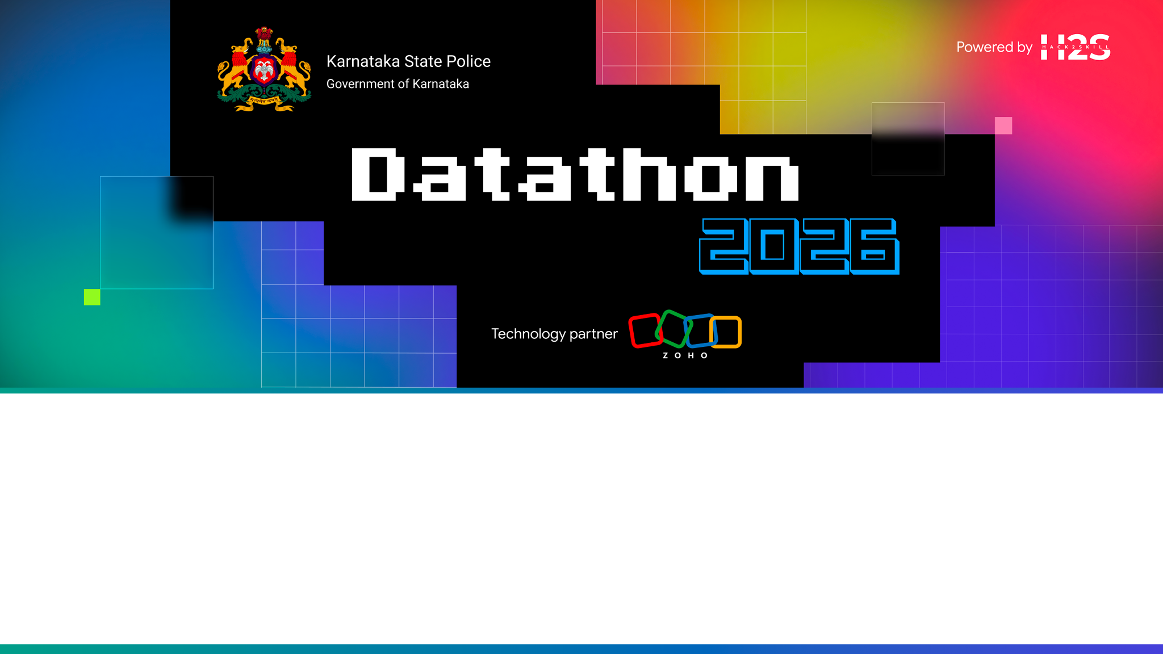
Problem Statement: NeuralKSP — AI-Powered Criminal Intelligence & Predictive Policing Platform for Karnataka State Police

Slide 2

Brief about the solution

Slide 3
Opportunities
How different is it from any of the other existing ideas?
How will it be able to solve the problem?
USP of the proposed solution

Slide 4
List of features offered by the solution

Slide 5
Process flow diagram or Use-case diagram

Slide 6
Wireframes/Mock diagrams of the proposed solution (optional)

Slide 7
Architecture diagram of the proposed solution

Slide 8
Technologies to be used in the solution

Slide 9
List down Catalyst Services being used in the solution

Slide 10
Estimated implementation cost (optional)

Slide 11
Snapshots of the prototype

Slide 12
Prototype Performance report/Benchmarking

Slide 13
Provide links to your:
GitHub Public Repository
Demo Video Link (3 Minutes)
Deployed Link

Slide 14
Additional Details/Future Development (if any)

Slide 15
NeuralKSP bridges the gap between static FIR databases and actionable field intelligence.
Key Takeaways:
• 95% faster criminal network link analysis.
• 100% native bilingual support in Kannada script for beat constables.
• Deployed live on Zoho Catalyst serverless hosting for maximum security and scalability.

Slide 16


