Slide 1
GENAI APPLICATION
StockSage
10
Nodes
AI
4
APIs
5
AI-Powered Stock Analysis Chatbot · Group Project Final Presentation
LLMs
Raman Barnwal

Slide 2
PROJECT OBJECTIVE
01
What & Why
⚡ THE PROBLEM
🚀 OUR SOLUTION
Retail investors & finance students lack access to professional-grade stock analysis without expensive tools or deep financial expertise.
StockSage AI — a Dify-powered chatbot delivering real-time prices, RSI analysis, news sentiment, and a Buy/Hold/Sell recommendation. Free. Instant. No expertise needed.
TARGET USERS
📈 Retail Investors
🎓 Finance Students
📊 Beginner Traders
Making institutional-grade stock intelligence accessible to everyone — powered by GenAI.

Slide 3
DEVELOPMENT
02
How It Was Built
◈
◈
◈
◈
Dify.ai
Alpha Vantage
Finnhub
GPT-4.1-mini
No-code visual
workflow builder &
chatbot platform
30-day price history,
RSI & technical
indicators API
Real-time quotes &
financial news for
sentiment analysis
LLM powering all
analysis, prediction
& report generation
Key Design Choices
// Multi-node pipeline — 10 specialized nodes, not one giant prompt
// Parallel API execution — quotes, history & news fetched simultaneously
// Structured LLM output — fixed format labels ensure parseable, reliable data
// 5 dedicated LLM nodes — each with a single focused responsibility

Slide 4
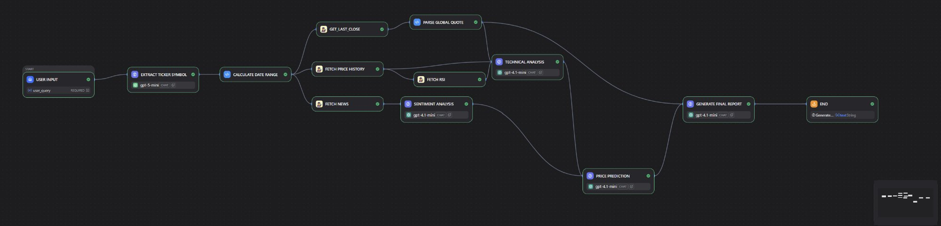
ARCHITECTURE
03
Workflow Pipeline
01
02
03
04
05
06
Input → Ticker
Calc Dates
3× Parallel APIs
Sentiment + Tech
Price Prediction
Final Report

Slide 5
GENAI TECHNIQUES
04
Prompt Design & AI Methods
// SAMPLE PROMPT — Sentiment Node
01
Structured Output Prompting
Every LLM node uses a fixed labeled format (TREND:, RSI_SIGNAL:) ensuring parseable, reliable outputs that chain into downstream nodes.
SYSTEM:
You are a financial sentiment analyst.
Always respond in this exact format:
02
Chained LLM Pipeline
5 LLM nodes feed sequentially: Ticker → Sentiment → Technical → Prediction → Report. Each specializes in exactly one task.
SENTIMENT: [Bullish/Bearish/Neutral]
CONFIDENCE: [0-100%]
KEY_THEMES: [3 themes]
03
Tool-Augmented Generation
SUMMARY: [2-3 sentences]
4 custom API tools inject real-time market data into LLM context, grounding every claim in actual live data — not hallucinations.
USER:
Context Injection via Variables
04
Analyze news for {{ticker}}:
{{news_data}}
Dify passes structured API outputs directly into downstream prompts using {{node/output}} variable syntax — zero manual parsing.

Slide 6
LIVE DEMO
05
Executing StockSage AI — "Analyze AAPL"
01
02
03
04
05
→
→
→
→
User Query
Extract Ticker
Parallel APIs
AI Analysis
Report Output
"Analyze Apple stock"
GPT-5-mini
returns: AAPL
Price · RSI
News fetched
Sentiment +
Technical nodes
Full institutional
report generated
ACTUAL OUTPUT · AAPL Stock Analysis Report · February 28, 2026
PRICE
RSI
SENTIMENT
SUPPORT
TARGET (1M)
RATING
$102.45
52
Bullish
$98.00
$106–109
BUY
+0.29%
Neutral
80% confidence
Key floor
Base case
Strong signal

Slide 7
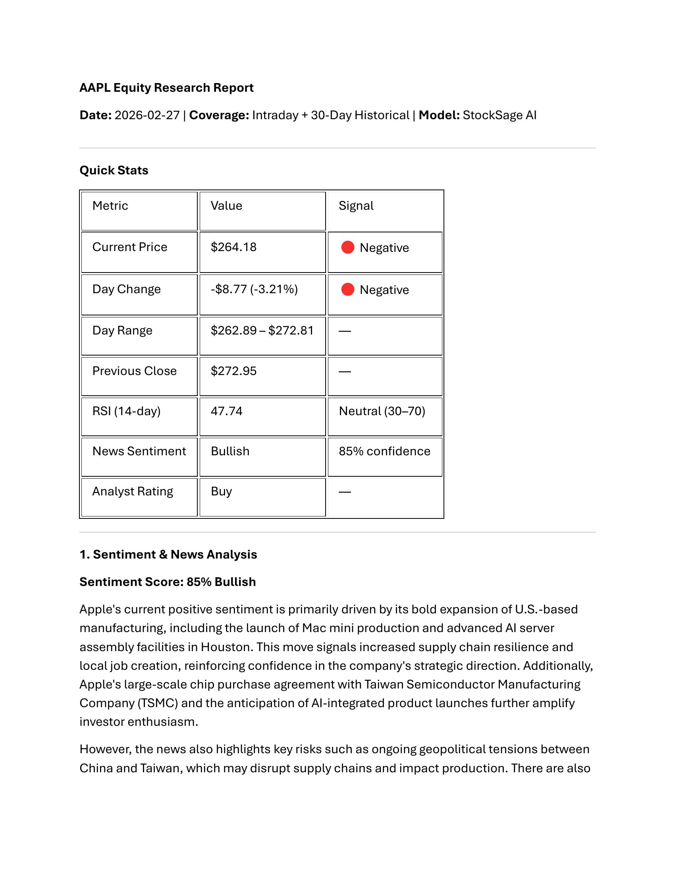
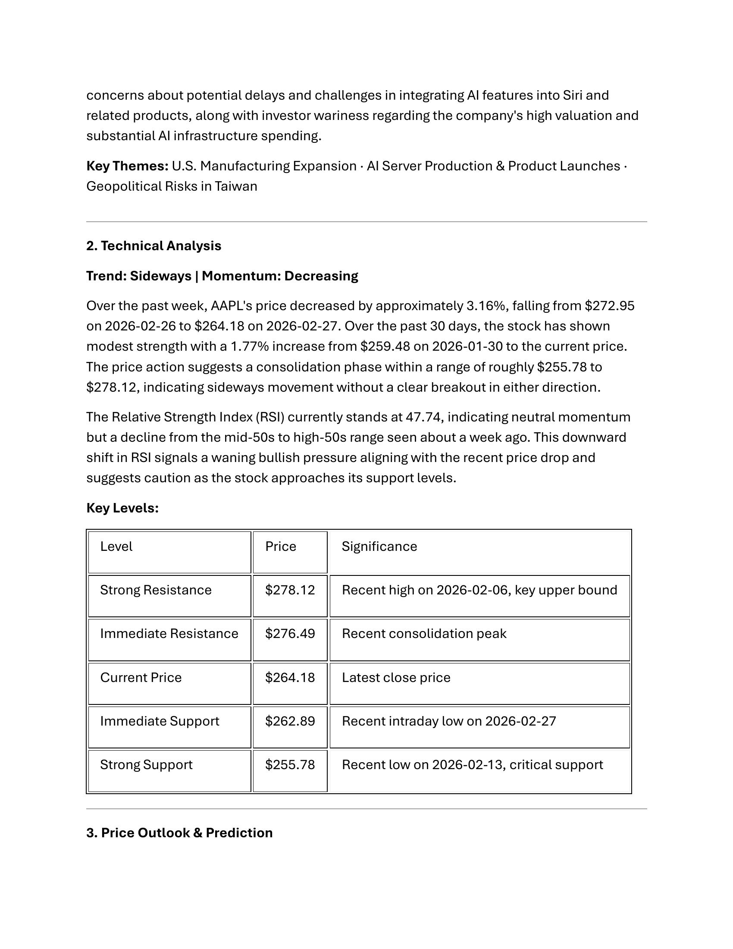
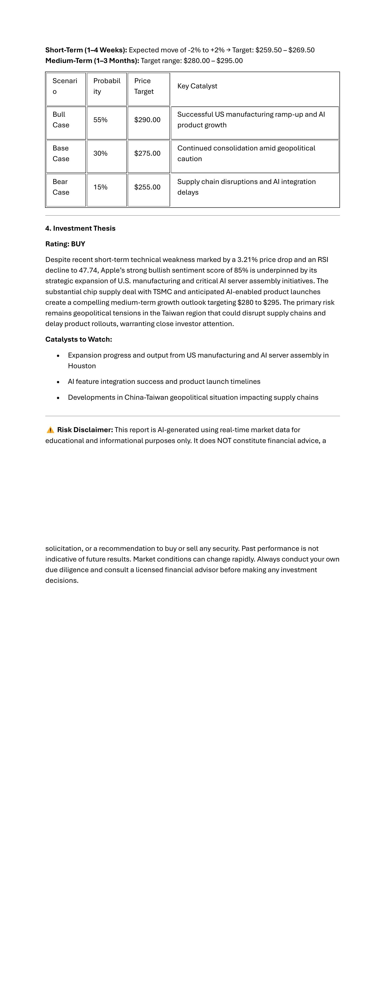
SAMPLE OUTPUT
06
AAPL Equity Research Report — Feb 27, 2026
Quick Stats & Sentiment Analysis
Technical Analysis & RSI
Investment Thesis & Recommendation

Slide 8
REFLECTIONS
07
Observations & Lessons Learned
✅ What Worked
⚠️ Challenges
🚀 Future Work
// Dify's visual workflow made complex multi-step logic intuitive
// Alpha Vantage 25 req/day limit hit during rapid testing
// Error-handling guards to prevent LLM data hallucination
// Parallel API execution cut response time from ~6s to ~2s
// LLMs fabricated data when API calls returned empty responses
// Portfolio mode — analyze multiple tickers in one query
// Structured output prompts produced reliable, parseable LLM data
// Dify variable reference syntax is error-prone to configure
// RAG layer integrating SEC filings for fundamental analysis
// Free API tiers fully sufficient for functional prototype
// Input validation gap — APPL vs AAPL caused silent failures
// Price alert notifications via Dify webhook integrations

Slide 9
Thank
You.
StockSage AI — institutional-grade analysis for everyone.
10
4
5
Free
Workflow Nodes
API Tools
LLM Nodes
APIs Used
Raman Barnwal

